Slide 1
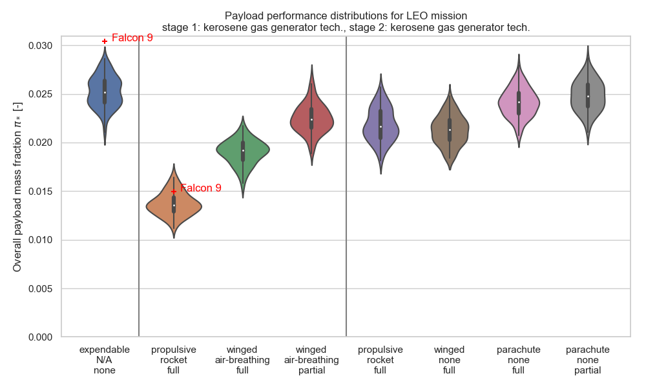
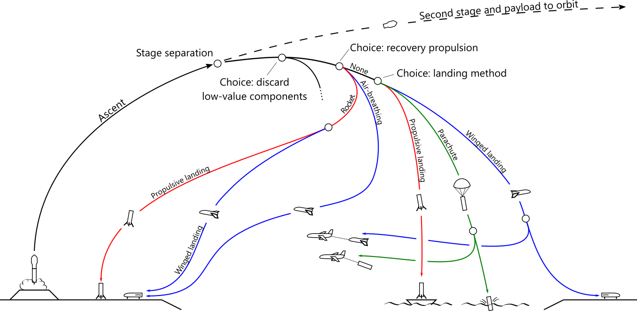


Expendable
Launch site recovery
Downrange recovery:
Ship Land Ocean Mid-air
Landing method:
Recov. prop. method:
Portion recov’d:

Slide 2
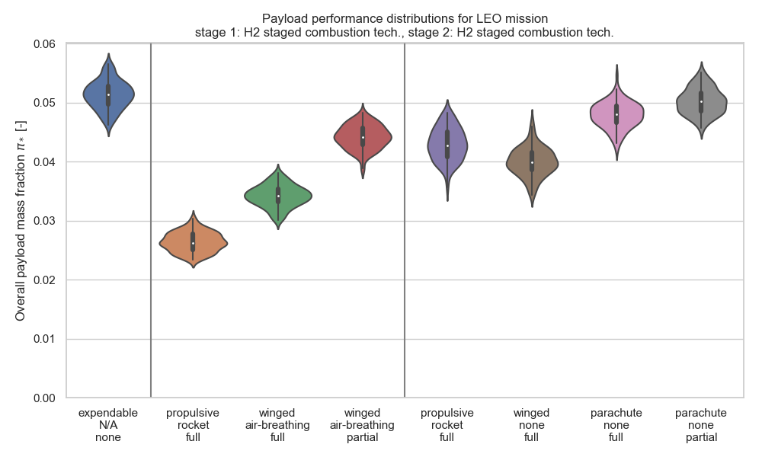
Expendable
Launch site recovery
Downrange recovery:
Ship Land Ocean Mid-air
Landing method:
Recov. prop. method:
Portion recov’d:

Slide 3
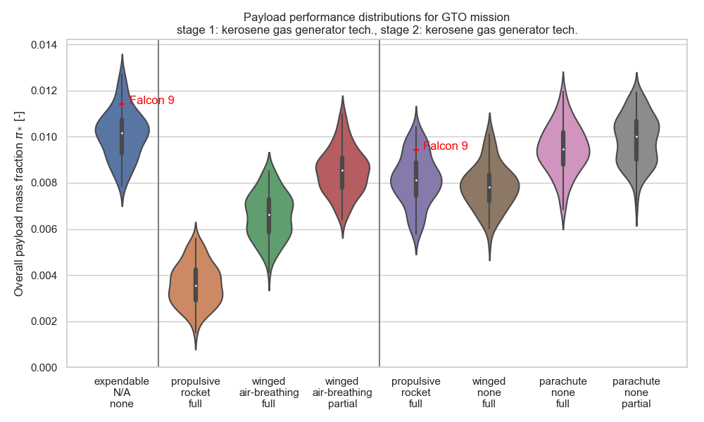
Expendable
Launch site recovery
Downrange recovery:
Ship Land Ocean Mid-air
Landing method:
Recov. prop. method:
Portion recov’d:

Slide 4
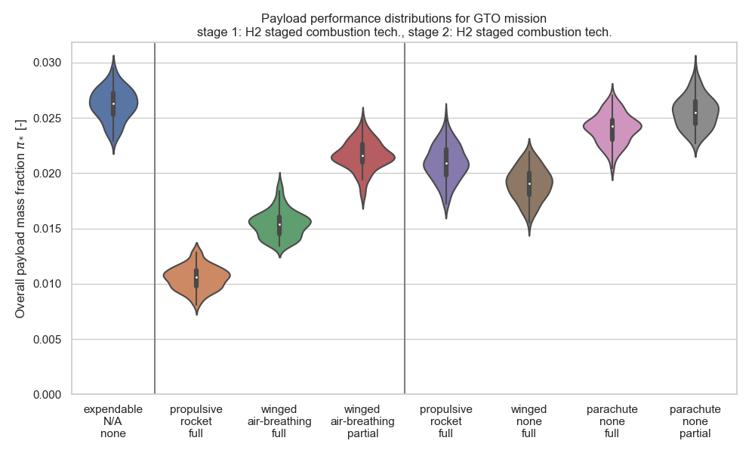
Expendable
Launch site recovery
Downrange recovery:
Ship Land Ocean Mid-air
Landing method:
Recov. prop. method:
Portion recov’d:

