Slide 1
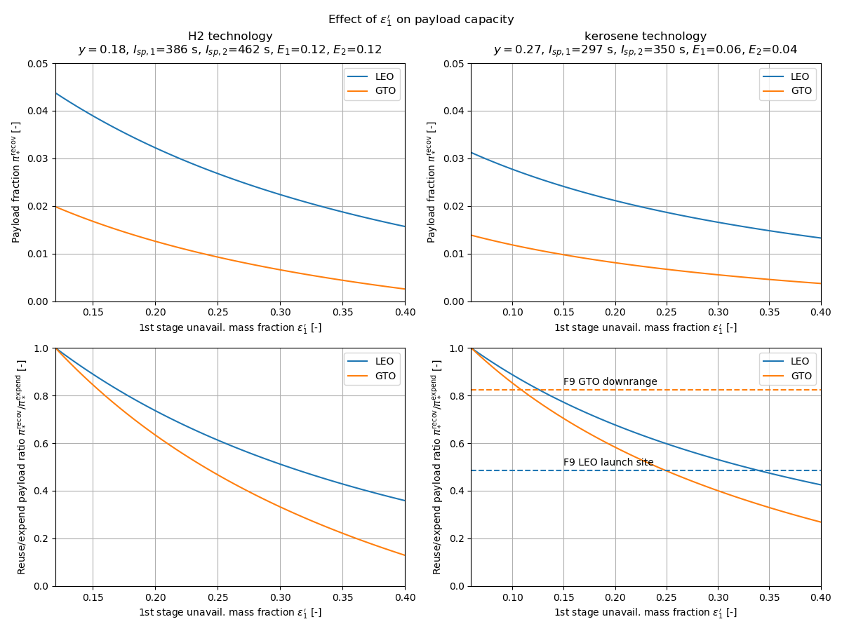

Higher $Δv$ missions are more sensitive to $ε_{1}′$
Higher $Δv$ missions are more sensitive to $ε_{1}′$

