Slide 1
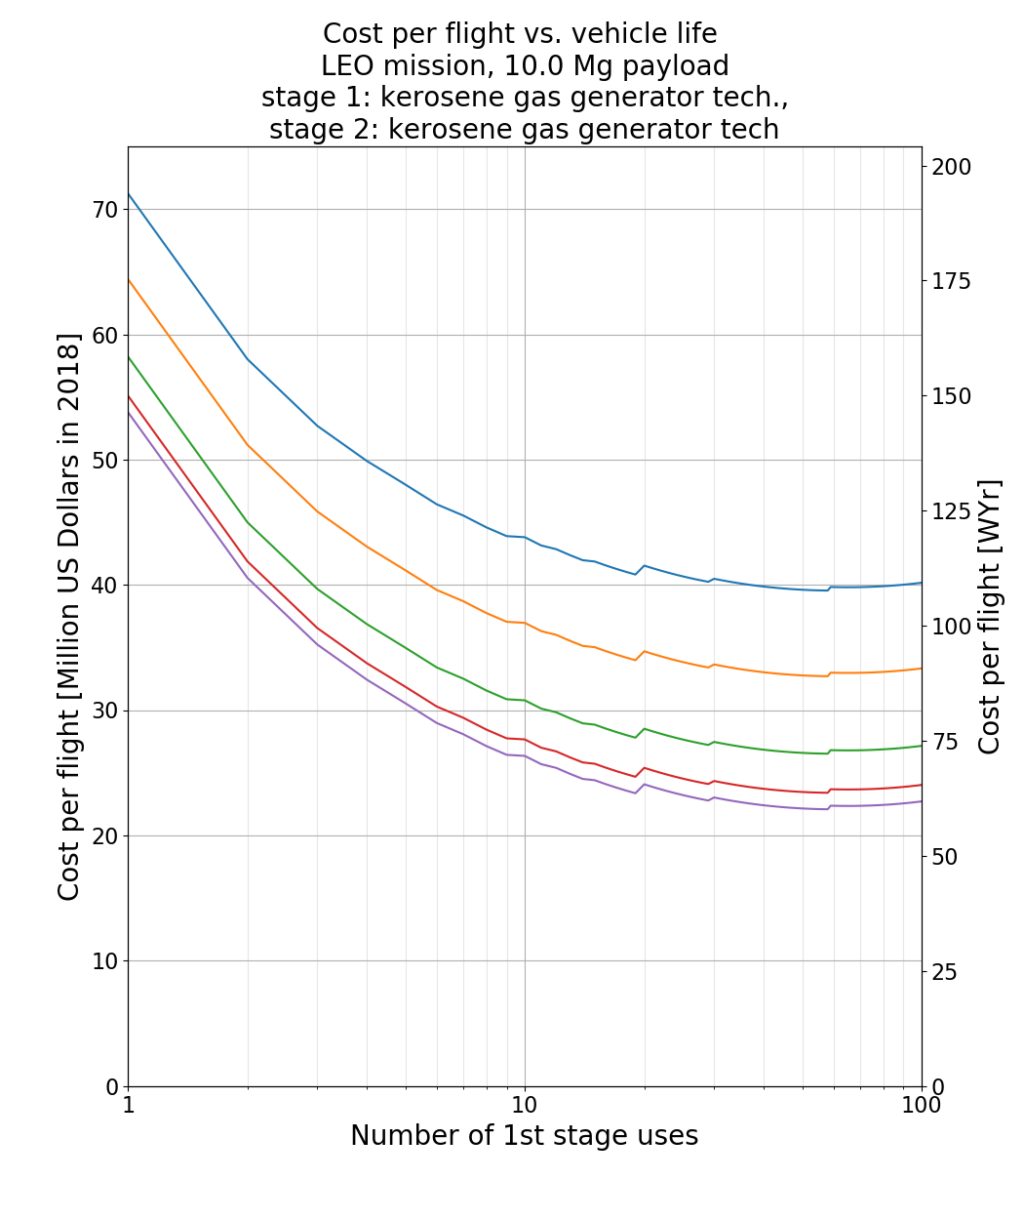
Launch rate:
3
5
10
20
40
Cost decreases with increasing launch rate

