Slide 2
Scope and Motivation
Recovery Strategies
Performance Model
Cost Model
Tradeoffs & Comparisons

Slide 3
Scope and Motivation
Recovery Strategies
Performance Model
Cost Model
Tradeoffs & Comparisons

Slide 4
Motivation for 1st stage reuse: Cost savings with reasonable technical challenge
Launch vehicle reuse is often touted as a key step to reduce costs and increase launch rate.
However, whole-vehicle reuse architectures face major technical challenges, and none have survived development.
e.g. early STS architectures, X-33, Delta Clipper
Reusing only the 1st stage (or part of the 1st stage) is an easier, incremental step
Expendable launch vehicles
now
Partially reusable launch vehicles
future?
Fully reusable launch vehicles
High cost/flight
Potential cost savings
Demonstrated technology
Incremental development from existing vehicles
High development cost

Slide 5
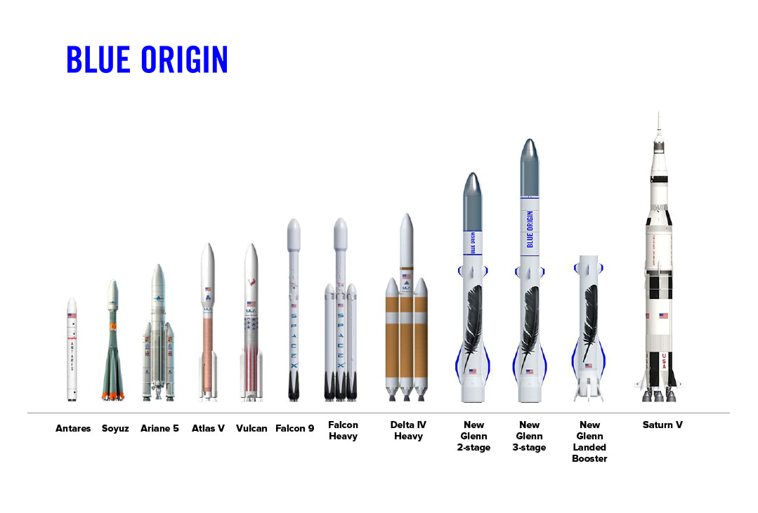
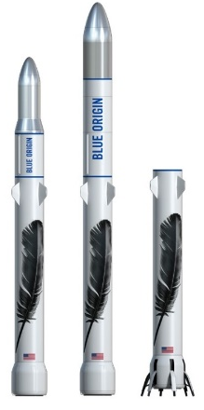
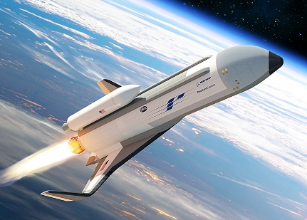
Why focus on 1st stage reusability? Best reward/effort ratio
The first stage is easier to recover …
… and embodies the majority of the production cost
1st stage reuse is therefore of considerable commercial interest
1st stage
~2 MJ kg⁻¹
2nd stage
~60 MJ kg⁻¹
Reentry specific energy
1st stage
TODO
2nd stage
Production cost
SpaceX
Falcon 9
Operational
Blue Origin
New Glenn
In development
ULA
Vulcan SMART reuse
In development
Boeing
XS-1 Phantom Express
In development

Slide 6
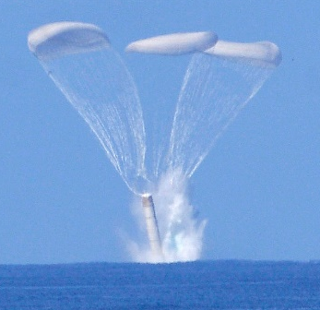
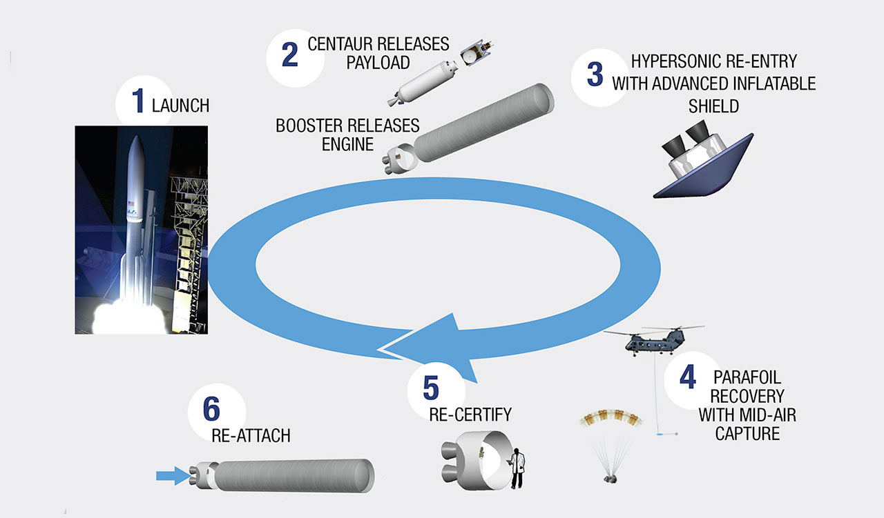
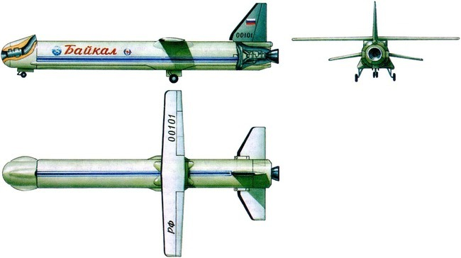
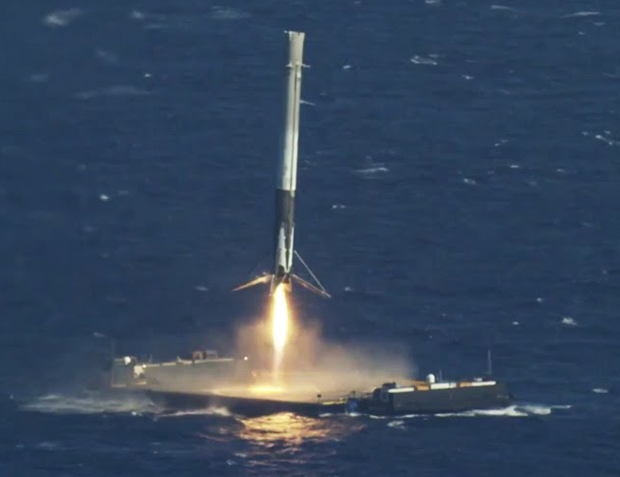
Wide variety of 1st stage reuse proposals & implementations
Image: NASA
Parachute recovery
(e.g. Shuttle*, Ares I)
Image: ULA
Engine-pod recovery
(e.g. Vulcan SMART, Ariane Adeline)
Image: Khrunichev
Image: SpaceX
Air-breathing flyback
(e.g. Baikal, LFBB)
Propulsive landing
(e.g. Falcon 9*, New Glenn)
*reused successfully

Slide 7
There is considerable debate in industry over the value of 1st stage reuse
“… SpaceX will therefore not break even on the reusability portion of the equation.”
- Jim Cantrell, CEO Vector Space Systems, 2017
“ [the launch industry] is going to be dominated by reusability”
- Bob Smith, CEO Blue Origin, 2018
“I am a skeptic with regard to many of the claims that have been made for cost reductions.”
- David Thompson, CEO Orbital ATK, 2016
“the potential cost reduction over the long term is probably in excess of a factor of 100.”
- Elon Musk, CEO SpaceX, 2015
“We tried to make [the SSME] reusable […] Look how long and how much money it took for us to do that”
- Dan Dumbacher, NASA, 2014

Slide 8
Fundamental questions
Tradeoff between payload capacity and production cost savings:
Recovery requires extra hardware (& maybe propellant) on the first stage
→ A reusable vehicle will have lower payload capacity than an “equivalent” expendable vehicle
Uncertain refurbishment costs
Uncertain market demand
Which reuse architecture, if any, can provide sufficient cost savings to justify its associated payload reduction?
How do expected cost savings vary with refurbishment costs and launch rate?

Slide 9
Scope
We consider orbital launch vehicles using
2 sequential stages
Proven, high-TRL propulsion and structural technologies
For such launch vehicles, we
Identify and categorize strategies for recovering & reusing (portions of) the first stage
Estimate the effect of each strategy on payload capacity
Estimate the effect of each strategy on operations, production and development costs
Identify tradeoffs and compare strategies

Slide 10
Approach
Use statistical techniques to represent the uncertainty inherent in high-level performance and cost models
Performance/payload model: derived from physical first principles
Cost model: TRANSCOST 8.2
Wherever possible, these models are calibrated against data from
Operational launch vehicles
Detailed conceptual studies
Replicability
Open code TODO github link
Open data
Compare reusable boosters against the baseline of an “equivalent” expendable vehicle

Slide 11
Scope and Motivation
Recovery Strategies
Performance Model
Cost Model
Tradeoffs & Comparisons

Slide 12
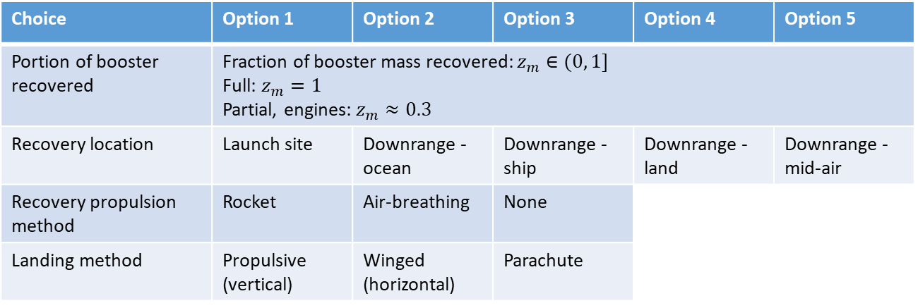
Classifying recovery strategies
Choice | Option 1 | Option 2 | Option 3 | Option 4 | Option 5
Portion of booster recovered | Fraction of booster mass recovered: $z_{m}∈(0, 1]$ Full: $z_{m}=1$ Partial, engines: $z_{m}≈0.3$
Recovery location | Launch site | Downrange - ocean | Downrange - ship | Downrange - land | Downrange - mid-air
Recovery propulsion method | Rocket | Air-breathing | None
Landing method | Propulsive (vertical) | Winged (horizontal) | Parachute
90 possible choice combinations, of which 36 pass “laugh test”
Classification captures all 10 operated or proposed recovery strategies known to the authors

Slide 13
Identifying recovery strategies
Portion of Booster Recovered
Recovery Location
Recovery Propulsion Method
Landing Method
Full Recovery Partial Recovery
Rocket
Propulsive (vertical)
e.g. Falcon 9
Plausible
Winged (horizontal)
e.g. USAF RBS
Plausible
Launch site
Parachute
e.g. Kistler K-1
High landing loads
Propulsive (vertical)
Winged landing preferable
Air-breathing
Winged (horizontal)
e.g. Baikal, LFBB
e.g. Adeline
Parachute
High landing loads
None
Insufficient energy for return if staging velocity > ~1 km/s
Rocket
Propulsion not needed
Air-breathing
Propulsive (vertical)
Plausible
Downrange - ocean
Winged (horizontal)
Plausible
None
Parachute
e.g. Shuttle, Ares I
Plausible
Propulsive (vertical)
e.g. Falcon 9
Plausible
Rocket
Winged (horizontal)
Propul. not needed for winged vehicles
Parachute
Targeting difficult
Downrange - ship
Air-breathing
Propulsion not needed for winged vehicles
Propulsive (vertical)
e.g. New Glenn
Plausible
None
Winged (horizontal)
Only small boosters
Plausible
Parachute
Only small boosters
Targeting difficult
Targeting difficult
Color code:
Operated
Plausible
Major challenges
Not desirable

Slide 14
Identifying recovery strategies (2)
Portion of Booster Recovered
Recovery Location
Recovery Propulsion Method
Landing Method
Full Recovery Partial Recovery
Rocket
Propulsion not needed
Air-breathing
Downrange - land
Propulsive (vertical)
Plausible
None
Winged (horizontal)
e.g. XS-1 Phantom Express
Plausible
Parachute
High landing loads
Rocket
Propulsion not needed
Downrange – mid-air
Air-breathing
Propulsive (vertical)
Capture difficult
None
Winged (horizontal)
e.g. Sippel et al 2017
Plausible
Parachute
Only small boosters
e.g. ULA SMART
Color code:
Operated
Plausible
Major challenges
Not desirable

Slide 15
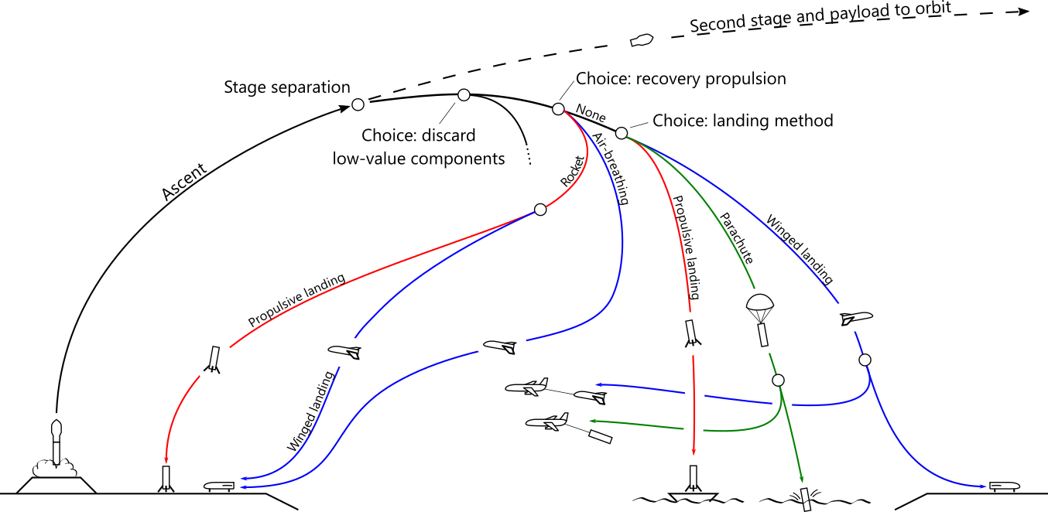
Identifying recovery strategies (3)
Examples:
Falcon 9
USAF RBS
Baikal
Vulcan SMART
Falcon 9
New Glenn
Ares I
XS-1 Phantom Express
Launch site recovery
Downrange recovery

Slide 16
Scope and Motivation
Recovery Strategies
Performance Model
Cost Model
Tradeoffs & Comparisons

Slide 17








Key performance metric is (overall) payload mass fraction
We care about payload mass fraction because:
It determines how large of a rocket we need to launch a payload to orbit
Larger rockets are (general) more expensive
Payload, $m_{∗}$
2nd stage propellant $m_{p,2}$
2nd stage inert $m_{inert,2}$
Overall payload mass fraction:
$π_{∗}=\frac{m_{∗}}{m_{0}}$ =
1st stage propellant $m_{p,1}$
1st stage inert $m_{inert,1}$
+
Typically, $π_{∗}≈$ 1% to 6%
Gross liftoff mass $m_{0}$

Slide 18

Payload mass fraction depends on:
Mission
$Δv_{∗}$ : delta-v required to reach the target orbit (includes grav. & drag losses)
Vehicle design
$I_{sp,1}, I_{sp,2}$ : each stage’s (average) specific impulse
$ε_{1}, ε_{2}$ : each stage’s inert mass fraction
$y=\frac{m_{2}}{m_{1}}$ : stage 2 / stage 1 mass ratio

Slide 19
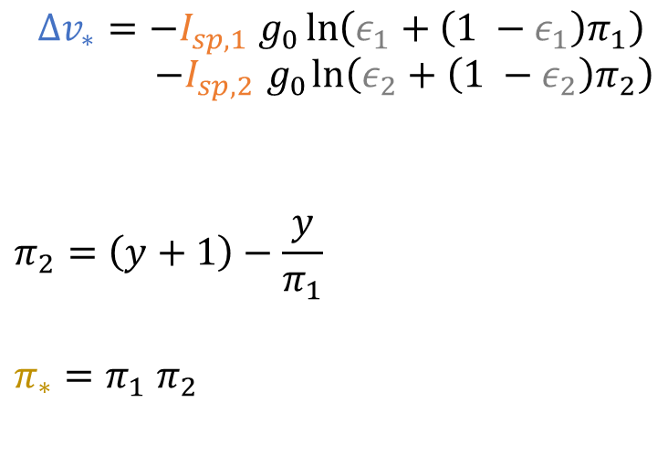



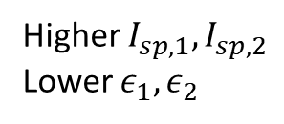
Tsiolkovsky’s rocket equation relates $π_{∗}$ to mission and vehicle design parameters
delta-v to target orbit
Stage payload mass fractions
TODO real numbers
specific impulse
$$π_{∗}$$
$$Δv_{∗}=−I_{sp,1} g_{0}\ln\left(ε_{1}+\left(1 −ε_{1}\right)π_{1}\right)$$
$$−I_{sp,2}{ g}_{0}\ln\left(ε_{2}+\left(1 −ε_{2}\right)π_{2}\right)$$
$$π_{2}=\left(y+1\right)−\frac{y}{π_{1}}$$
$$π_{∗}=π_{1} π_{2}$$
Higher $I_{sp,1},I_{sp,2}$
Lower $ε_{1}, ε_{2}$
Inert mass fractions
Stage mass ratio
Overall payload mass fraction
LEO
GTO
Delta-v to reach target orbit
$$Δv_{∗}$$
Overall payload mass fraction

Slide 20
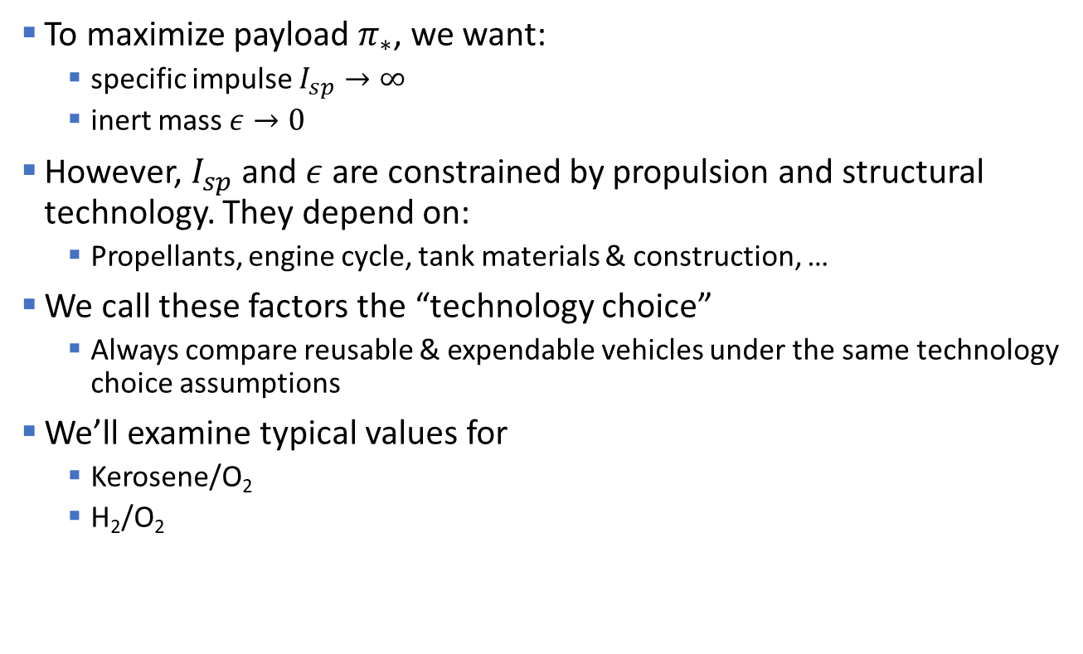
“Technology choice” sets $I_{sp}$ and $ε$
To maximize payload $π_{∗}$, we want:
specific impulse $I_{sp}→∞$
inert mass $ε→0$
However, $I_{sp}$ and $ε$ are constrained by propulsion and structural technology. They depend on:
Propellants, engine cycle, tank materials & construction, …
We call these factors the “technology choice”
Always compare reusable & expendable vehicles under the same technology choice assumptions
We’ll examine typical values for
Kerosene/O₂
H₂/O₂

Slide 21
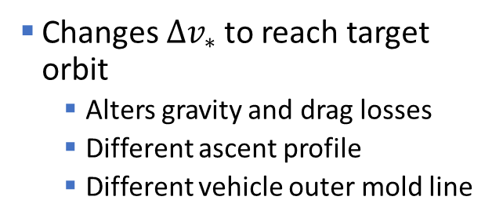
How does reuse change the equation?
Increases 1st stage “inert” mass
Extra hardware for recovery
Propellant held in reserve for recovery
Changes $Δv_{∗}$ to reach target orbit
Alters gravity and drag losses
Different ascent profile
Different vehicle outer mold line
Main effect
“The impact of the different [reusable launch vehicle] types on the ascent flight profile is found small and, similar to the [expendable launch vehicle] ascent flight performance losses, these are more dependent on the particular configuration […] than on the landing and return modes”
-Sippel, Stapert, Bussler & Dumont, DRL, 2017

Slide 22




Additional mass on a reusable first stage
1st stage baseline hardware $m_{hb,1}$
1st stage propellant $m_{p,1}$
Recovery propellant $m_{pr,1}$
Recovery hardware $m_{hr,1}$

Slide 23
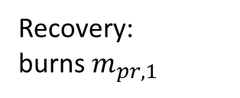
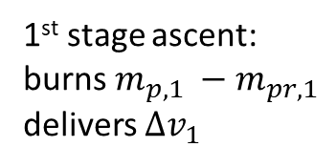
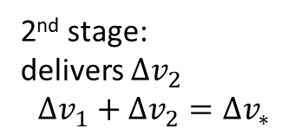
With recovery, a larger fraction of the 1st stage mass is unavailable for the ascent burn
2nd stage:
delivers $Δv_{2}$
$$Δv_{1}+Δv_{2}=Δv_{∗}$$
Stage separation
1st stage ascent:
burns$m_{p,1} −m_{pr,1}$
delivers $Δv_{1}$
Recovery:
burns $m_{pr,1}$
Launch
Landing

Slide 24


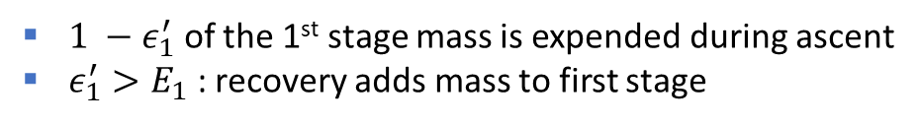






First stage “unavailable mass” captures performance impacts of recovery
1st stage baseline hardware $m_{hb,1}$
Recovery propellant $m_{pr,1}$
1st stage propellant $m_{p,1}$
Recovery hardware $m_{hr,1}$
Baseline inert mass fraction $E_{1}$:
Unavailable mass fraction $ε_{1}^{′}$:
$$E_{1}=$$
$$ε_{1}^{′}=$$
Depends on technology choice
and recovery strategy
Limited by technology choice
$1 −ε_{1}^{′}$ of the 1st stage mass is expended during ascent
$ε_{1}^{′}>E_{1}$ : recovery adds mass to first stage

Slide 25
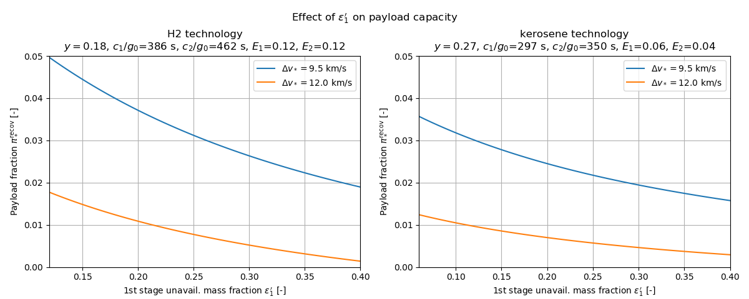
Payload capacity declines as unavailable mass increases

Slide 26
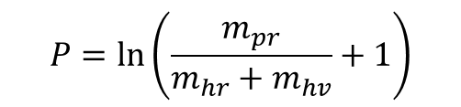



Unavailable mass depends on:
How much of the first stage we recover:
How much recovery hardware is added:
How much propellant is burned during recovery:
or
$a=\frac{m_{hr,1}}{m_{hr,1}+m_{hv,1}}$ =
$$P=\frac{Δv_{r}}{c_{1}}$$
Rocket propulsion
$$P=ln\left(\frac{m_{pr}}{m_{hr}+m_{hv}}+1\right)$$
$$P=\frac{R_{cruise}}{v_{cruise}\frac{L}{D} I_{sp}^{ab}}$$
Air-breathing
propulsion

Slide 27
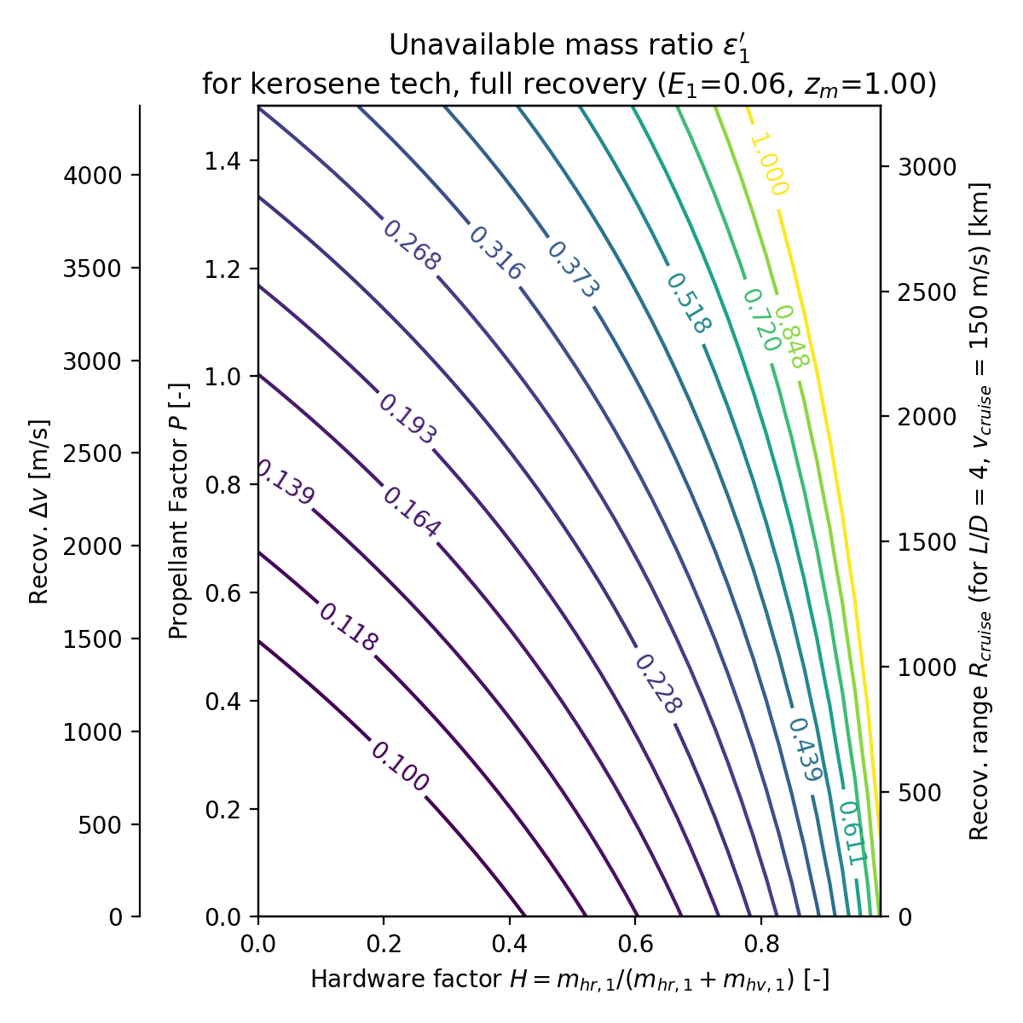
Propulsive
Launch site
Propulsive
Downrange
Winged
Launch site
Parachute
Downrange
Winged
Downrange

Slide 28
Launch site
Rocket-propelled
Propulsive landing
Downrange
Propulsive landing
Launch site
Air-breathing
Winged
Downrange
Glider
Winged
Downrange
Parachute

Slide 29

Monte Carlo simulation
Distributions on $E_{1}, ε_{2} c_{1},c_{2}$ from recent launch vehicles
Distributions on recovery hardware $a$ from detailed design studies and analogies to aircraft
Distributions on recovery propellant from estimates of recovery $Δv$ or recovery cruise range

Slide 30
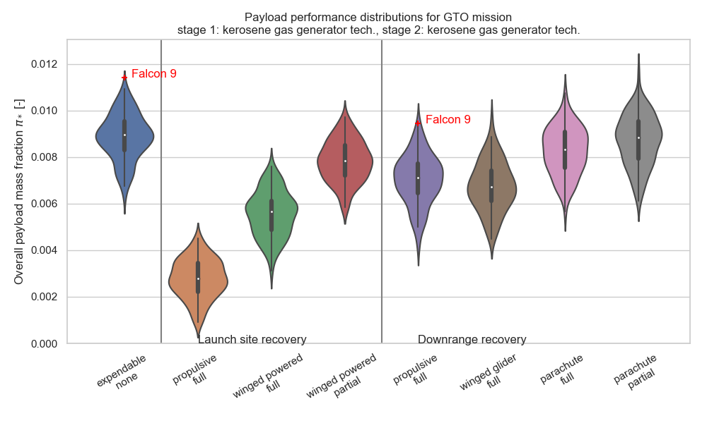
TODO shouldn’t extend above max. expendable

Slide 31
Scope and Motivation
Recovery Strategies
Performance Model
Cost Model
Tradeoffs & Comparisons

Slide 32
Cost model: Transcost 8.2
Goal: Implement the Transcost 8.2 model to estimate production, development, and operations costs, as well as the total cost-per-flight for various launch vehicles
Validate using operational launch vehicles
Considerations:
Account for uncertainties in CER coefficients and exponents
Account for uncertainties in cost factors
Choose reasonable production numbers (impacts learning effect)

Slide 33
Production cost estimates for current launch vehicles

Slide 34
Production cost analysis
Relative cost trends of the vehicles is reasonable (i.e. Falcon 9 costs less than the others)
Production cost estimate values seem to be too high given current listed prices per launch
Possible explanations:
Launches are underpriced
Work-Year dollar values are less than industry standard
Learning factor is better than anticipated
Scope and profit of subcontractors is less than expected
Mass of shrouds, fairings, or other components are accounted for improperly

Slide 35
Scope and Motivation
Recovery Strategies
Performance Model
Cost Model
Tradeoffs & Comparisons

Slide 36
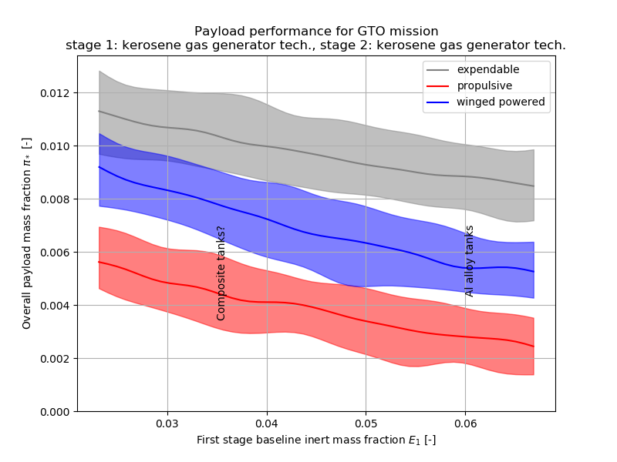
Performance sensitivity/sweeps
TODO: methane?

Slide 37
Schedule and launch rate considerations
TODO
Schedule and ops are a key point: reuse may enable higher launch rate with same workforce
Effect of downrange vs. launch site recovery on schedule & fleet size
Effect of partial recovery re-integration on schedule

Slide 38
Mission/market sensitivities
TODO
Market may soon support high launch rates to LEO due to proposed constellations, eg starlink, oneweb, DARPA blackjack
Reuse from LEO mission easier than from GTO
Constellation customers may be more tolerant of launch risk than expensive monolithic satellite customers
Small sat launchers
Hardware smaller fraction of total cost

