Slide 1
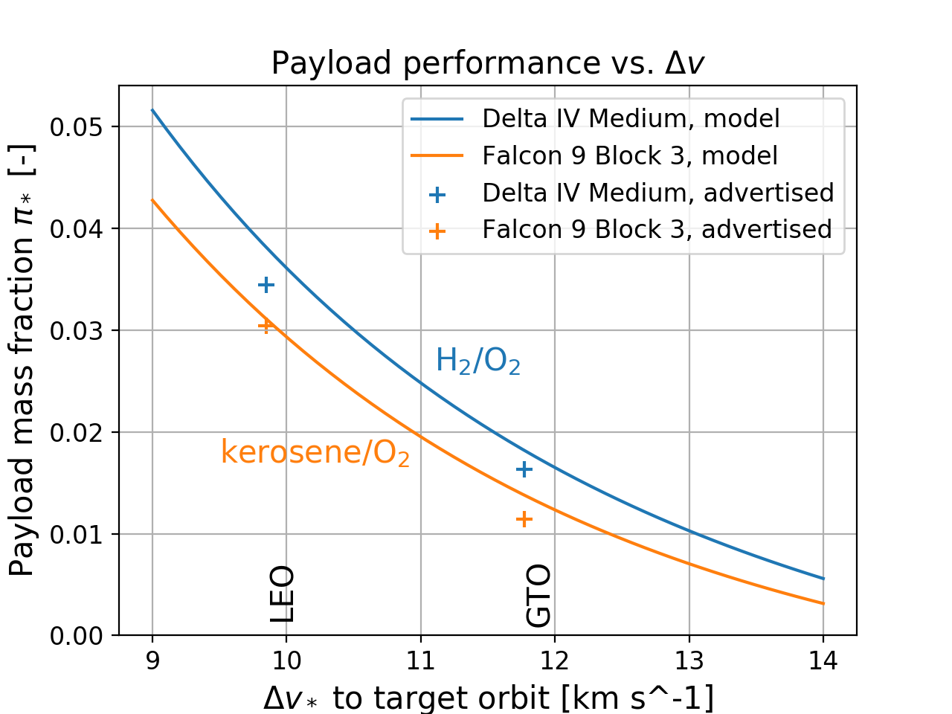
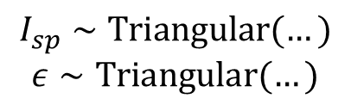



Payload capacity is set by $I_{sp}$ and inert mass
Specific impulse
$$I_{sp,1 } , I_{sp,2}$$
$$π_{∗}=$$
Tsiolkovsky
$$ε_{1 } , ε_{2}$$
Inert mass fraction
Payload mass fraction
Technology limits achievable specific impulse and inert mass fraction
$$I_{sp}∼Triangular(…)$$
$$ε∼Triangular(…)$$
Based on modern
kerosene/O₂ stages

Slide 2

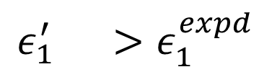
Reuse adds mass to the first stage, decreasing payload capacity
Recovery hardware
$$ε_{1}^{′} >ε_{1}^{expd}$$
$$π_{∗}$$
Recovery propellant
“unavailable” mass fraction
expendable inert mass fraction
Payload mass fraction
For each reuse strategy:
Recovery hardware distribution fit to detailed studies
Recovery propellant calculated fro maneuvers with dispersed parameters
Model output: element masses to cost model

