Slide 1
Visiting old friends
A Gameplay Programming bot by
Nikos Vanden Broek 2DAE5

Slide 2
Things to keep in mind
Find and pick up items
Maintain balanced inventory
Avoid / shoot enemies
Bonus points from checkpoints
Items always in buildings
Items stack up in buildings least visited

Slide 3
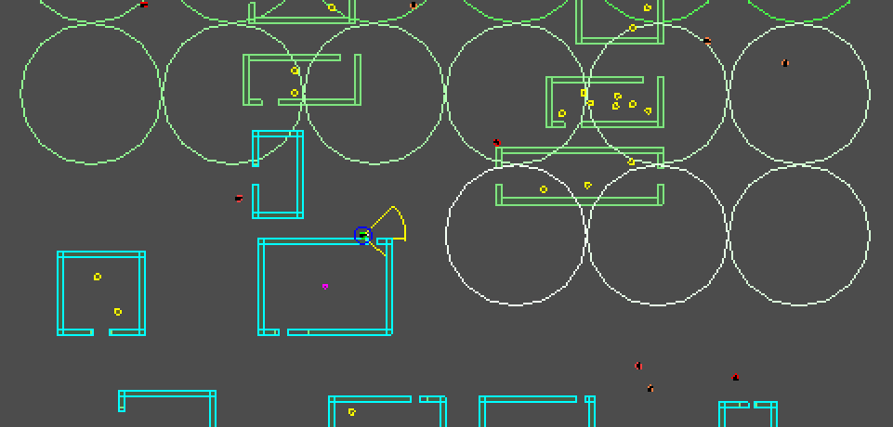
Learned world data
Scan the entire map once
Remember buildings, their doors, and last visit
Remember items seen but passed by for different reasons
Temporary images of enemies to avoid

Slide 4
Obstacle avoidance
Uses temporary enemy images to avoid actual enemies
Uses building walls to avoid steering into walls
Steering into a wall
Mirror target away from wall

Slide 5
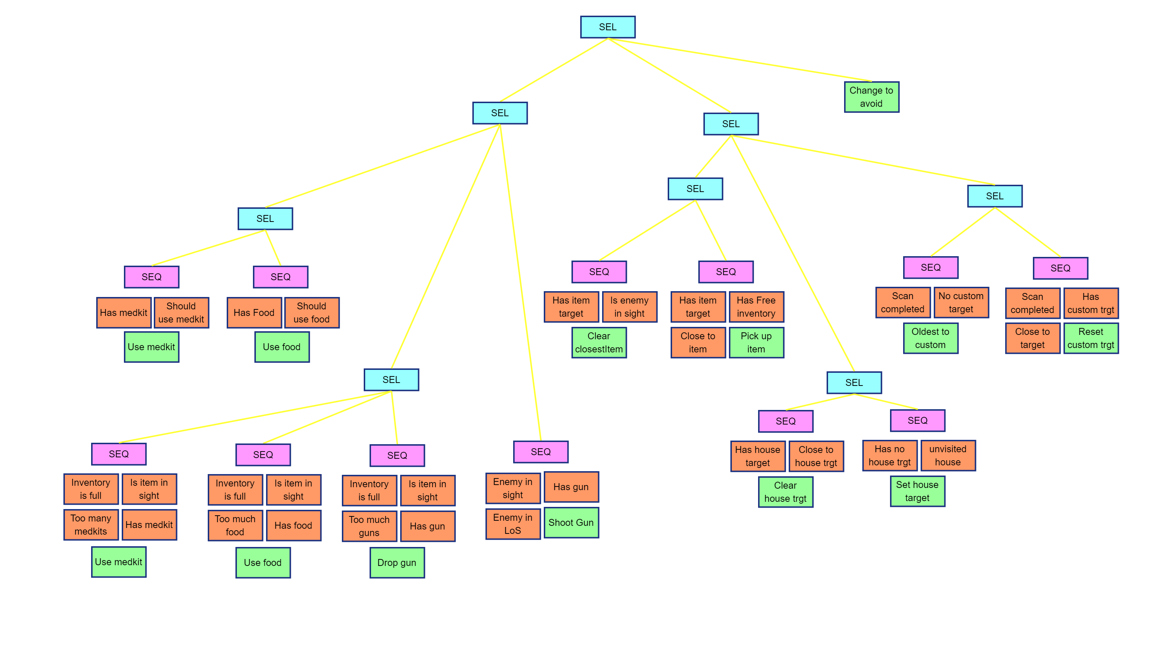

Slide 6
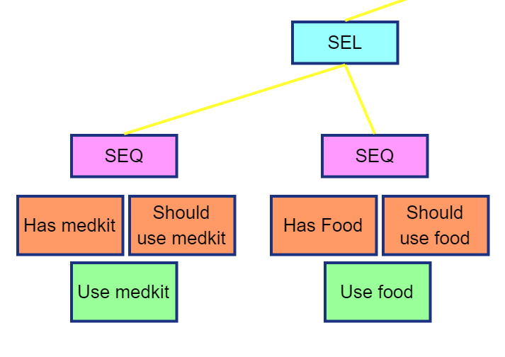
Staying alive
Use the weakest item first
Is missing health > weakest heal
Is missing stamina > weakest food

Slide 7
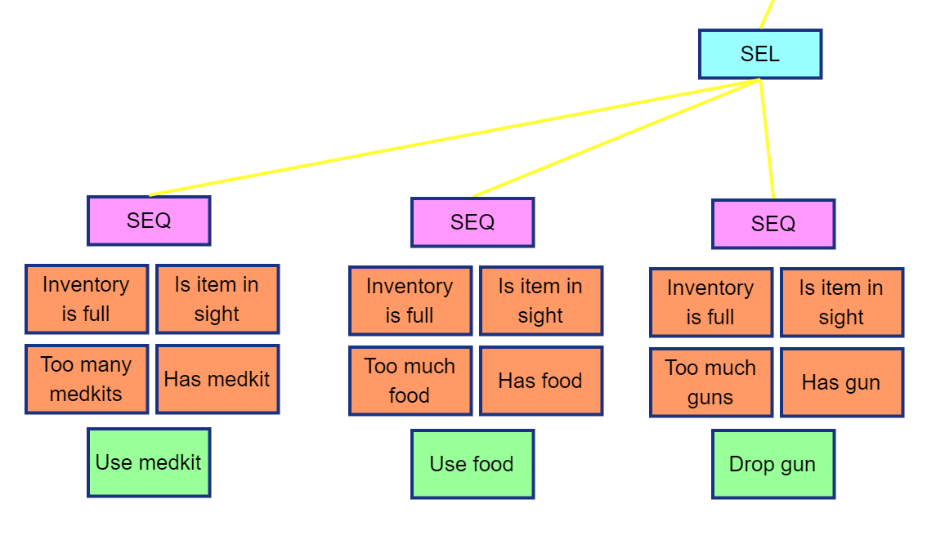
Inventory management
Plugin provides data about number of each type, and weakest of each type
Don’t care about inventory unless it’s full and we see an item
Find the item type we have the most of
Use weakest med kit or food
Drop weakest gun
If same amount take order : Med kit - Food - Gun

Slide 8
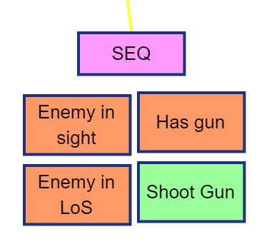
Enemies
Check if enemy in our LoS using Circle-Line intersection
If in sight but not LoS, determine shortest rotation target
Tree provides data when enemy in sights and if bot should rotate
Plugin handles the rotation

Slide 9
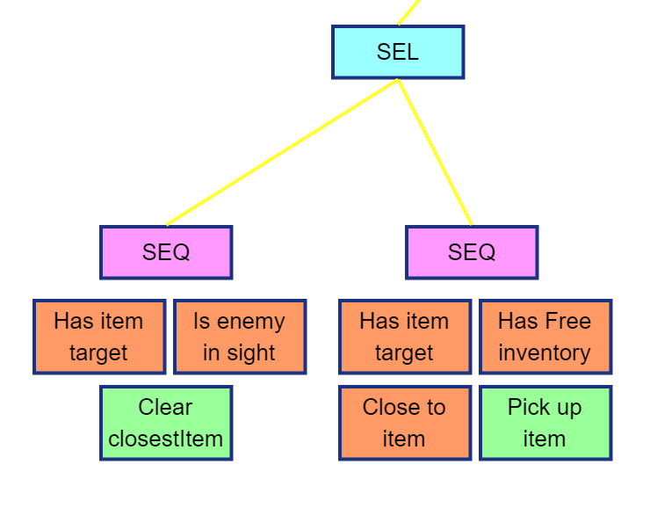
Picking up items
Plugin provides closest item in FoV
In none in FoV, provide missed one through learned world data
Pick up item once in range, instantly drop if it’s trash

Slide 10
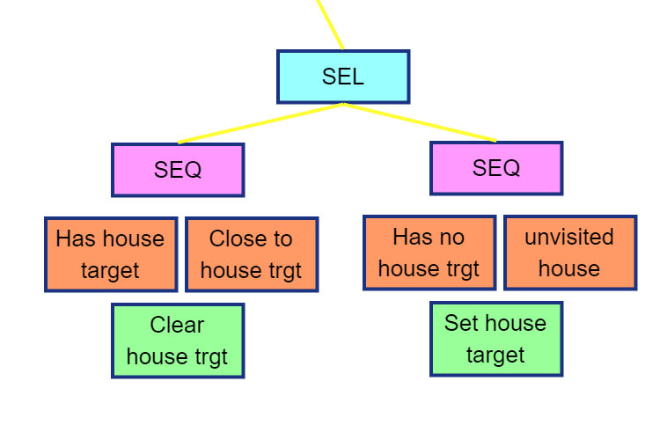
Visiting houses along the way
Visit houses we run into along the way once
Remember which houses have been visited and update their ‘last visited’ time using alive time
Reset list when scan finishes, reaching custom target, or picking up checkpoint

Slide 11
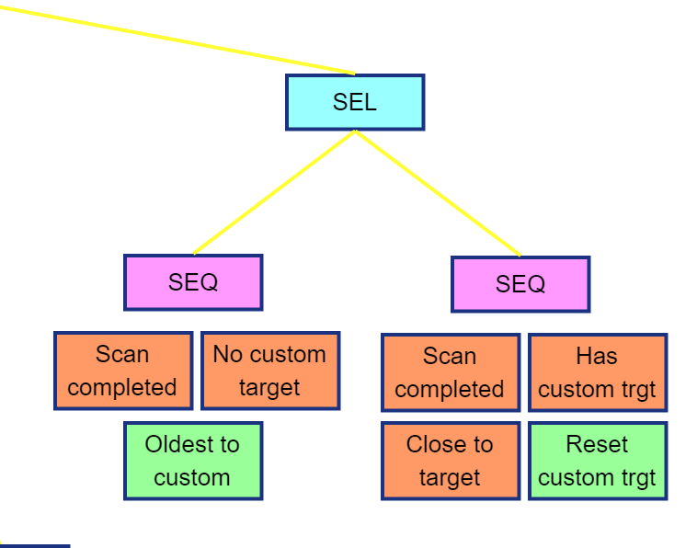
Visit old friends
Learned world data remembers which hasn’t been visited in the longest time
Once visited, oldest becomes most recent, go to new ‘oldest’ visited house
Guarantee all houses get visited regularly

Slide 12
Recap
Scan the world once to get every house
Once scan is done, keep going to the longest unvisited house
Check other houses we run in to along the way
Pick up any item we find along the way and keep a balanced inventory
Pick up the checkpoint if it’s in the same house
Avoid/shoot enemies we run in to
Live forever

