Slide 1
Concurrent Programming 15-213: Introduction to Computer Systems 23rd Lecture, Nov. 17, 2015
Instructors:
Randal E. Bryant and David R. O’Hallaron
Notes:
<number>

Slide 2
Concurrent Programming is Hard!
The human mind tends to be sequential
The notion of time is often misleading
Thinking about all possible sequences of events in a computer system is at least error prone and frequently impossible

Slide 3
Concurrent Programming is Hard!
Classical problem classes of concurrent programs:
Races: outcome depends on arbitrary scheduling decisions elsewhere in the system
Example: who gets the last seat on the airplane?
Deadlock: improper resource allocation prevents forward progress
Example: traffic gridlock
Livelock / Starvation / Fairness: external events and/or system scheduling decisions can prevent sub-task progress
Example: people always jump in front of you in line
Many aspects of concurrent programming are beyond the scope of our course..
but, not all ☺
We’ll cover some of these aspects in the next few lectures.

Slide 4
Iterative Servers
Iterative servers process one request at a time
Client 1
Server
Client 2
connect
accept
connect
write
read
write
call read
call read
ret read
write
read
close
close
Wait for server to finish with Client 1
accept
read
write
ret read

Slide 5
Where Does Second Client Block?
Second client attempts to connect to iterative server
Call to connect returns
Even though connection not yet accepted
Server side TCP manager queues request
Feature known as “TCP listen backlog”
Call to rio_writen returns
Server side TCP manager buffers input data
Call to rio_readlineb blocks
Server hasn’t written anything for it to read yet.
Client
socket
open_clientfd
Connection
request
connect
rio_writen
rio_readlineb

Slide 6
Fundamental Flaw of Iterative Servers
Client 1
Server
Client 2
connect
accept
connect
write
call read
write
call read
call read
ret read
write
call read
Client 2 blocks
waiting to read
from server
User goes
out to lunch
Client 1 blocks
waiting for user
to type in data
Server blocks
waiting for
data from
Client 1
Solution: use concurrent servers instead
Concurrent servers use multiple concurrent flows to serve multiple clients at the same time

Slide 7
Approaches for Writing Concurrent Servers
Allow server to handle multiple clients concurrently
1. Process-based
Kernel automatically interleaves multiple logical flows
Each flow has its own private address space
2. Event-based
Programmer manually interleaves multiple logical flows
All flows share the same address space
Uses technique called I/O multiplexing.
3. Thread-based
Kernel automatically interleaves multiple logical flows
Each flow shares the same address space
Hybrid of of process-based and event-based.

Slide 8
Approach #1: Process-based Servers
Spawn separate process for each client
client 1
server
client 2
call accept
call connect
ret accept
call connect
call fgets
child 1
fork
User goes out to lunch
Client 1 blocks
waiting for user to type in data
call read
call accept
ret accept
Child blocks waiting for data from Client 1
call fgets
fork
child 2
write
call
read
call read
...
write
close
ret read
close

Slide 9
Process-Based Concurrent Echo Server
int main(int argc, char **argv)
{
int listenfd, connfd;
socklen_t clientlen;
struct sockaddr_storage clientaddr;
Signal(SIGCHLD, sigchld_handler);
listenfd = Open_listenfd(argv[1]);
while (1) {
clientlen = sizeof(struct sockaddr_storage);
connfd = Accept(listenfd, (SA *) &clientaddr, &clientlen);
if (Fork() == 0) {
Close(listenfd); /* Child closes its listening socket */
echo(connfd); /* Child services client */
Close(connfd); /* Child closes connection with client */
exit(0); /* Child exits */
}
Close(connfd); /* Parent closes connected socket (important!) */
}
}
echoserverp.c

Slide 10
Process-Based Concurrent Echo Server (cont)
void sigchld_handler(int sig)
{
while (waitpid(-1, 0, WNOHANG) > 0)
;
return;
}
echoserverp.c
Reap all zombie children

Slide 11
Concurrent Server: accept Illustrated
listenfd(3)
1. Server blocks in accept, waiting for connection request on listening descriptor listenfd
Client
Server
clientfd
Connection
request
listenfd(3)
2. Client makes connection request by calling connect
Client
Server
clientfd
listenfd(3)
3. Server returns connfd from accept. Forks child to handle client. Connection is now established between clientfd and connfd
Server
Client
Server
Child
clientfd
connfd(4)

Slide 12
Process-based Server Execution Model
Connection requests
Listening
server
process
Client 1
server
process
Client 2
server
process
Client 1 data
Client 2 data
Each client handled by independent child process
No shared state between them
Both parent & child have copies of listenfd and connfd
Parent must close connfd
Child should close listenfd

Slide 13
Issues with Process-based Servers
Listening server process must reap zombie children
to avoid fatal memory leak
Parent process must close its copy of connfd
Kernel keeps reference count for each socket/open file
After fork, refcnt(connfd) = 2
Connection will not be closed until refcnt(connfd) = 0

Slide 14
Pros and Cons of Process-based Servers
+ Handle multiple connections concurrently
+ Clean sharing model
descriptors (no)
file tables (yes)
global variables (no)
+ Simple and straightforward
– Additional overhead for process control
– Nontrivial to share data between processes
Requires IPC (interprocess communication) mechanisms
FIFO’s (named pipes), System V shared memory and semaphores

Slide 15
Approach #2: Event-based Servers
Server maintains set of active connections
Array of connfd’s
Repeat:
Determine which descriptors (connfd’s or listenfd) have pending inputs
e.g., using select or epoll functions
arrival of pending input is an event
If listenfd has input, then accept connection
and add new connfd to array
Service all connfd’s with pending inputs
Details for select-based server in book

Slide 16
I/O Multiplexed Event Processing
Read and service
Active Descriptors
Pending Inputs
listenfd = 3
listenfd = 3
connfd’s
connfd’s
0
10
10
1
7
Active
7
2
4
4
3
-1
-1
Inactive
4
-1
-1
5
12
12
6
Active
5
5
7
-1
-1
8
-1
-1
9
-1
Never Used
-1

Slide 17
Pros and Cons of Event-based Servers
+ One logical control flow and address space.
+ Can single-step with a debugger.
+ No process or thread control overhead.
Design of choice for high-performance Web servers and search engines. e.g., Node.js, nginx, Tornado
– Significantly more complex to code than process- or thread-based designs.
– Hard to provide fine-grained concurrency
E.g., how to deal with partial HTTP request headers
– Cannot take advantage of multi-core
Single thread of control

Slide 18
Approach #3: Thread-based Servers
Very similar to approach #1 (process-based)
…but using threads instead of processes

Slide 19
Traditional View of a Process
Process = process context + code, data, and stack
Process context
Code, data, and stack
Program context:
Data registers
Condition codes
Stack pointer (SP)
Program counter (PC)
Stack
SP
Shared libraries
brk
Run-time heap
Kernel context:
VM structures
Descriptor table
brk pointer
Read/write data
PC
Read-only code/data
0

Slide 20
Alternate View of a Process
Process = thread + code, data, and kernel context
Thread (main thread)
Code, data, and kernel context
Shared libraries
SP
Stack
brk
Run-time heap
Thread context:
Data registers
Condition codes
Stack pointer (SP)
Program counter (PC)
Read/write data
PC
Read-only code/data
0
Kernel context:
VM structures
Descriptor table
brk pointer

Slide 21
A Process With Multiple Threads
Multiple threads can be associated with a process
Each thread has its own logical control flow
Each thread shares the same code, data, and kernel context
Each thread has its own stack for local variables
but not protected from other threads
Each thread has its own thread id (TID)
Thread 1 (main thread)
Thread 2 (peer thread)
Shared code and data
shared libraries
stack 1
stack 2
run-time heap
Thread 1 context:
Data registers
Condition codes
SP1
PC1
Thread 2 context:
Data registers
Condition codes
SP2
PC2
read/write data
read-only code/data
0
Kernel context:
VM structures
Descriptor table
brk pointer

Slide 22
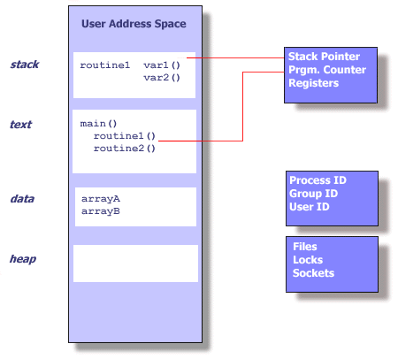
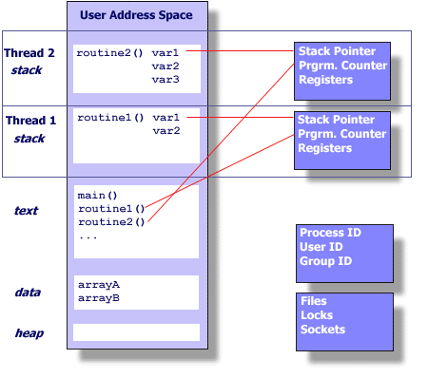
Threads vs Processes

Slide 23
Logical View of Threads
Threads associated with process form a pool of peers
Unlike processes which form a tree hierarchy
Threads associated with process foo
Process hierarchy
T2
P0
T4
T1
P1
shared code, data
and kernel context
sh
sh
sh
T5
T3
foo
bar

Slide 24
Concurrent Threads
Two threads are concurrent if their flows overlap in time
Otherwise, they are sequential
Always consider them to be concurrent!!
Examples:
Concurrent: A & B, A&C
Sequential: B & C
Thread A
Thread B
Thread C
Time

Slide 25
Concurrent Thread Execution
Single Core Processor
Simulate parallelism by time slicing
Multi-Core Processor
Can have true parallelism
Thread A
Thread B
Thread C
Thread A
Thread B
Thread C
Time
Run 3 threads on 2 cores

Slide 26
Threads vs. Processes
How threads and processes are similar
Each has its own logical control flow
Each can run concurrently with others (possibly on different cores)
Each is context switched
How threads and processes are different
Threads share all code and data (except local stacks)
Processes (typically) do not
Threads are somewhat less expensive than processes
Process control (creating and reaping) twice as expensive as thread control
Linux numbers:
~20K cycles to create and reap a process
~10K cycles (or less) to create and reap a thread

Slide 27
POSIX Threads
Thread API available on many OS’s
#include <pthread.h>
cc myprog.c –o myprog -lpthread
Thread creation
int pthread_create(pthread_t * thread, pthread_attr_t * attr, void * (*start_routine)(void *), void * arg);
Thread termination
void pthread_exit(void *retval);
Waiting for Threads
int pthread_join(pthread_t th, void **thread_return);

Slide 28
The Pthreads "hello, world" Program
/*
* hello.c - Pthreads "hello, world" program
*/
#include "csapp.h"
void *thread(void *vargp);
int main()
{
pthread_t tid;
Pthread_create(&tid, NULL, thread, NULL);
Pthread_join(tid, NULL);
exit(0);
}
Thread attributes
(usually NULL)
Thread ID
Thread routine
Thread arguments
(void *p)
hello.c
Return value
(void **p)
void *thread(void *vargp) /* thread routine */
{
printf("Hello, world!\n");
return NULL;
}
hello.c

Slide 29
Execution of Threaded “hello, world”
Main thread
call Pthread_create()
Pthread_create() returns
Peer thread
call Pthread_join()
printf()
Main thread waits for
peer thread to terminate
return NULL;
Peer thread
terminates
Pthread_join() returns
exit()
Terminates
main thread and
any peer threads

Slide 30
Thread-Based Concurrent Echo Server
int main(int argc, char **argv)
{
int listenfd, *connfdp;
socklen_t clientlen;
struct sockaddr_storage clientaddr;
pthread_t tid;
listenfd = Open_listenfd(argv[1]);
while (1) {
clientlen=sizeof(struct sockaddr_storage);
connfdp = Malloc(sizeof(int));
*connfdp = Accept(listenfd,
(SA *) &clientaddr, &clientlen);
Pthread_create(&tid, NULL, thread, connfdp);
}
}
echoservert.c
malloc of connected descriptor necessary to avoid deadly race (later)

Slide 31
Thread-Based Concurrent Server (cont)
/* Thread routine */
void *thread(void *vargp)
{
int connfd = *((int *)vargp);
Pthread_detach(pthread_self());
Free(vargp);
echo(connfd);
Close(connfd);
return NULL;
}
echoservert.c
Run thread in “detached” mode.
Runs independently of other threads
Reaped automatically (by kernel) when it terminates
Free storage allocated to hold connfd.
Close connfd (important!)

Slide 32
Thread-based Server Execution Model
Connection requests
Listening
server
main thread
Client 1
server
peer
thread
Client 2
server
peer
thread
Client 1 data
Client 2 data
Each client handled by individual peer thread
Threads share all process state except TID
Each thread has a separate stack for local variables

Slide 33
Issues With Thread-Based Servers
Must run “detached” to avoid memory leak
At any point in time, a thread is either joinable or detached
Joinable thread can be reaped and killed by other threads
must be reaped (with pthread_join) to free memory resources
Detached thread cannot be reaped or killed by other threads
resources are automatically reaped on termination
Default state is joinable
use pthread_detach(pthread_self()) to make detached
Must be careful to avoid unintended sharing
For example, passing pointer to main thread’s stack
Pthread_create(&tid, NULL, thread, (void *)&connfd);
All functions called by a thread must be thread-safe
(next lecture)

Slide 34
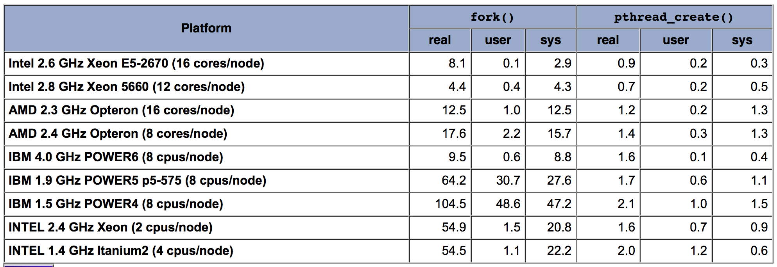
Pros and Cons of Thread-Based Designs
+ Easy to share data structures between threads
e.g., logging information, file cache
+ Threads are more efficient than processes

Slide 35
Pros and Cons of Thread-Based Designs
- Unintentional sharing can introduce subtle and hard-to-reproduce errors!
The ease with which data can be shared is both the greatest strength and the greatest weakness of threads
Hard to know which data shared & which private
Hard to detect by testing
Probability of bad race outcome very low
But nonzero!

Slide 36
Example: Sum an array
Sum is distributive and commutative
Split up the array
Sum the parts
Sum up the returned answers

Slide 37
#include <stdio.h>
#include <stdlib.h>
#include <pthread.h>
#include <sys/time.h>
typedef struct
{
int begin, end;
}
ThreadArgs;
int *elems;
static inline double microtime()
{
struct timeval tv;
gettimeofday(&tv, NULL);
return 1e6 * tv.tv_sec + tv.tv_usec;
}
int sumup(int *a, int begin, int end)
{
int sum = 0;
for (int i = begin; i < end; i++)
sum += a[i];
return sum;
}
void *summer( void *args )
{
// Extract the args
int begin = ((ThreadArgs *)args)->begin;
int end = ((ThreadArgs *)args)->end;
int *sum = (int *)malloc(sizeof(int));
*sum = sumup(elems, begin, end);
pthread_exit((void *)sum);
}
int main(int argc, char *argv[])
{
if (argc != 3)
{
printf("Usage: %s <nelems> <nthreads>\n", argv[0]);
exit(1);
}
int nelems = atoi(argv[1]);
int nthreads = atoi(argv[2]);
int elemsperthread = nelems / nthreads;
pthread_t *tid;
// allocate the array and initialize elems
elems = (int *)malloc(nelems * sizeof(int));
for (int i = 0; i < nelems; i++)
elems[i] = 1;
// allocate room for storing thread ids
tid = (pthread_t *)malloc(nthreads * sizeof(pthread_t));
double tstart = microtime();
for (int i = 0; i < nthreads; i++)
{
ThreadArgs *args = (ThreadArgs *)malloc(sizeof(ThreadArgs));
args->begin = i * elemsperthread;
args->end = args->begin + elemsperthread;
pthread_create(&tid[i], NULL, summer, args);
}
int sum = 0;
for (int i = 0; i < nthreads; i++)
{
int *ans;
pthread_join(tid[i], (void **)&ans);
sum += *ans;
}
double tend = microtime();
double rstart = microtime();
int realsum = sumup(elems, 0, nelems);
double rend = microtime();
printf("Answer from threads is %d in %.0lfms\n", sum, tend - tstart);
printf("Real answer is %d in %.0lfms\n", realsum, rend - rstart);
}

Slide 38
Thread Timing
Scenario 1:
Thread T1 creates thread T2
T2 requires data from T1 that will be placed in global memory
T1 places the data in global memory after it creates T2
Assumes T1 will be able to place the data before T2 starts or before T2 needs the data
Scenario 2:
T1 creates T2 and needs to pass data to T2
T1 gives T2 a pointer to a variable on its stack
What happens if / when T1 finishes?

Slide 39
Thread Timing
Set up all requirements before creating the thread
It is possible that the created thread will start and run to completion before the creating thread gets scheduled again
Producer – Consumer relationships
make sure the data is placed before it is needed (Don’t rely on timing)
make sure the data is there before consuming (Don’t rely on timing)
make sure the data lasts until all potential consumers have consumed the data (Don’t rely on timing)
Use synchronization primitives to enforce order

Slide 40
Data Races
A race occurs when correctness of the program depends on one thread reaching point x before another thread reaches point y
/* A threaded program with a race */
int main()
{
pthread_t tid[N];
int i;
for (i = 0; i < N; i++)
Pthread_create(&tid[i], NULL, thread, &i);
for (i = 0; i < N; i++)
Pthread_join(tid[i], NULL);
exit(0);
}
/* Thread routine */
void *thread(void *vargp)
{
int myid = *((int *)vargp);
printf("Hello from thread %d\n", myid);
return NULL;
}
N threads are sharing i
race.c

Slide 41
Data Race Illustration
for (i = 0; i < N; i++)
Pthread_create(&tid[i], NULL, thread, &i);
Main thread
i = 0
Peer thread 0
i = 1
myid = *((int *)vargp)
Race!
Race between increment of i in main thread and deref of vargp in peer thread:
If deref happens while i = 0, then OK
Otherwise, peer thread gets wrong id value

Slide 42
Could this race really occur?
Main thread
Peer thread
int i;
for (i = 0; i < 100; i++) {
Pthread_create(&tid, NULL,
thread,&i);
}
void *thread(void *vargp) {
Pthread_detach(pthread_self());
int i = *((int *)vargp);
save_value(i);
return NULL;
}
race.c
Race Test
If no race, then each thread would get different value of i
Set of saved values would consist of one copy each of 0 through 99

Slide 43
Experimental Results
No Race
Single core laptop
Multicore server
The race can really happen!

Slide 44
False Sharing
Variables are not shared but are so close together,
they are within the same cache line.
P1
P2
Read A
Write A
(invalidate cache line)
Read B
Write B
(invalidate cache line)
Cache
Cache
Location A
Location B
Location A
Location B
Location A
Location B
Cache Line
Memory

Slide 45
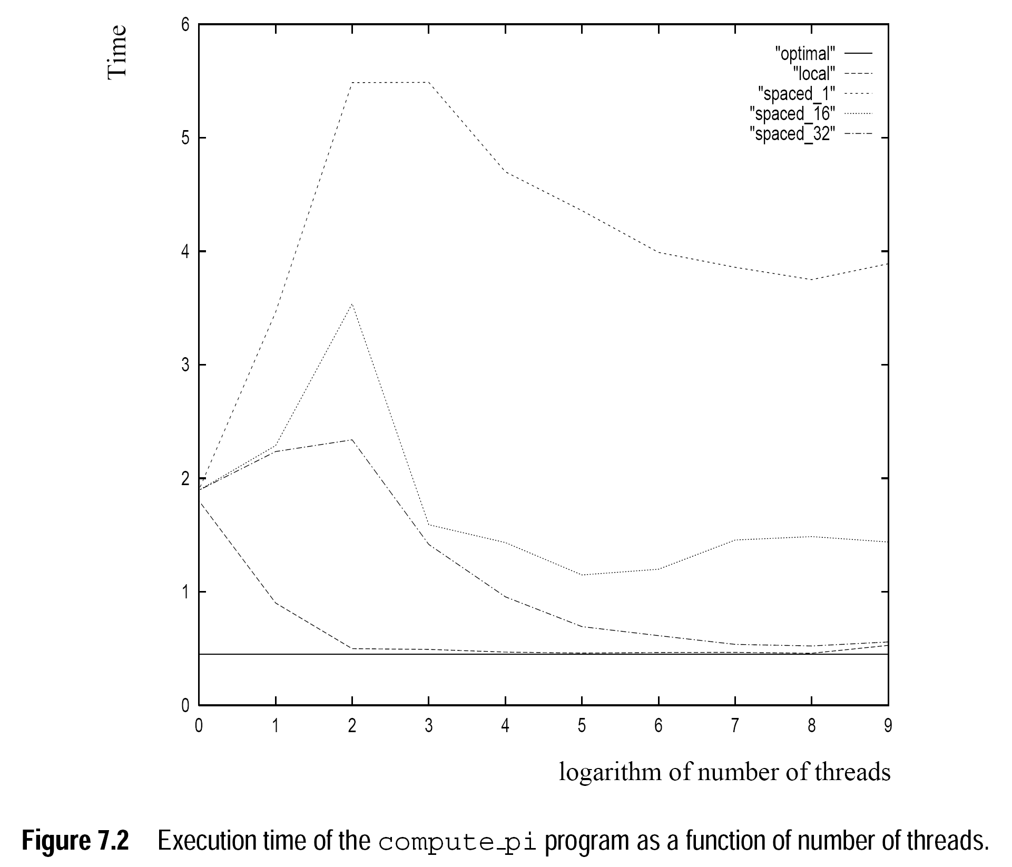
Effects of False Sharing

Slide 46
Summary: Approaches to Concurrency
Process-based
Hard to share resources: Easy to avoid unintended sharing
High overhead in adding/removing clients
Event-based
Tedious and low level
Total control over scheduling
Very low overhead
Cannot create as fine grained a level of concurrency
Does not make use of multi-core
Thread-based
Easy to share resources: Perhaps too easy
Medium overhead
Not much control over scheduling policies
Difficult to debug
Event orderings not repeatable

