Slide 1
Fast Non-dominated Sorting Genetic Algorithm

Slide 2
Properties
Based on some amount of objective functions
Commonly known as NSGA-II
Multi-dimensional optimization algorithm
Limited to some problem bounds
Uses objective functions to create Pareto-fronts, of which it decides next population candidates
Time complexity of O(n²) (realistically generations*objectives*population ²)
Preserves population diversity explicitly (crowding distance)
Emphasizes non-dominated solutions

Slide 3
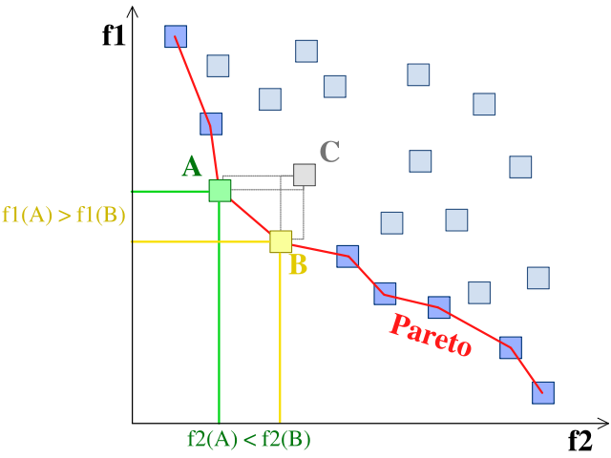
Pareto Fronts (img: wikipedia)
Pareto fronts, or frontiers, partially evaluate some multi-dimensional set of actions, useful for defining what isn’t good

Slide 4
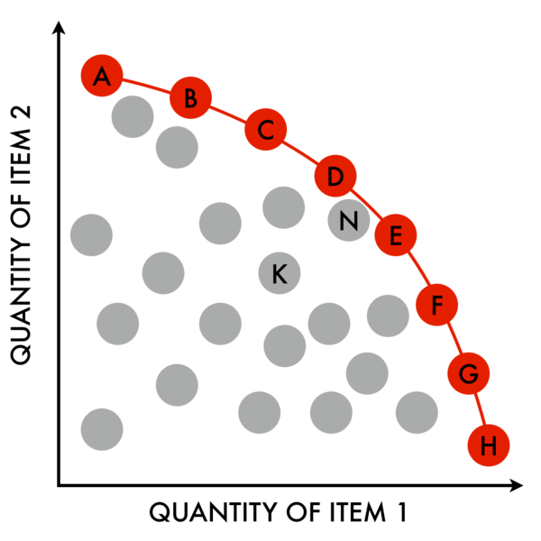
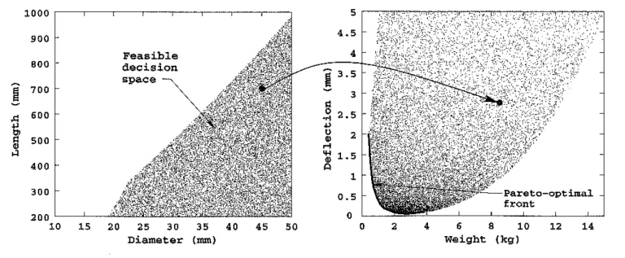
Pareto Fronts, cont.d
When a “best” choice may not exactly exist, gives a set of “good” possible solutions.

Slide 5
Pareto Fronts, cont.d
Given some N variables, we can
define a “dominant” variable if
V_{cost, i} ≤ W_{cost, i} for all i.
Any solution S can have any
actions discarded provided some
other element is more dominant -
this defines S’ , the Pareto front

Slide 6
Basic Genetic Sorting
Each iteration takes the “best” from previous solutions, in same fashion as Genetic Algorithm:
Consider some population P with single-var fitness F :
x ϵ P_{N}: f(x) x ϵ P_{N+1}:
1 -0.5 1
2 1 5
3 2 … (hybrids of 1, 5)
4 5
5 0

Slide 7
NSGA-II
Maintains Genetic sorting “elitism”, while also preserving diverse elements of some N fitness fns:
Unionize parent and child populations (created via basic mutation), perform non-dominated sorting (ranking) to find set of Pareto fronts
Populations dominated by other populations will have a worse “ranking” and therefore be less considered in generating next iteration population

Slide 8
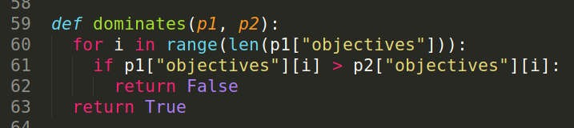
Non-dominated Sorting
From some solution set P , the non-dominated set P’ are those not dominated by anything in P ; in the search space, this is the globally Pareto-optimal set
Find all solutions x_{N} not dominated by any other solution x _{M} :
For all objectives, x _{N} is no worse than x_{M}
In at least one objective, x_{N} is strictly better than x_{M}
Sort the populations and classify them by fronts – this identifies sets with a higher Pareto efficiency, and can be used to form the next population

Slide 9
NSGA-II
Fill the new population according to the best fronts seen after sorting:
Repeatedly unionize P_{t+1} ∪ F_{i} while |P_{t+1}| < N
Increase counter i

Slide 10
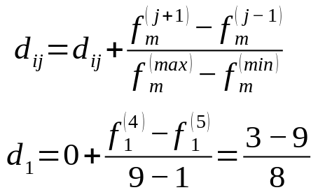
Crowding Distance Calculation
Perform crowding sort:
For all populations, calculate crowding distance for all intermediate values (non first/last values), for each fitness objective m
e.g.

Slide 11
NSGA-II
Generate a new offspring population:
Use crowded tournament selection, i.e compare by front ranking then by crowding distance
Then use crossover and mutation methods seen in previous genetic algorithms
Restart process using new population and offspring

Slide 12
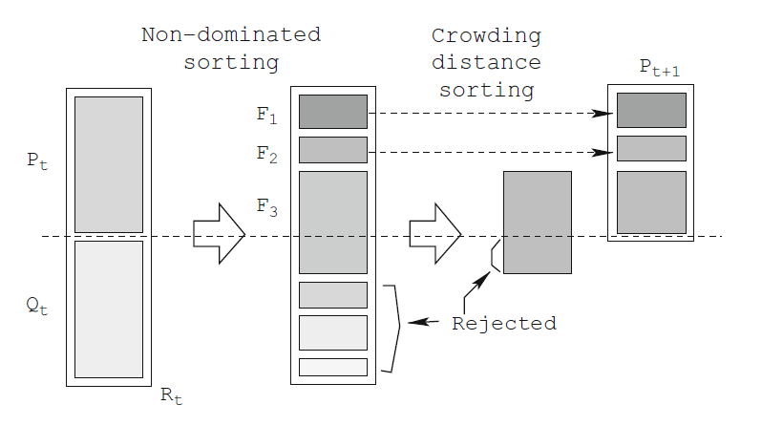
NSGA-II, visualized

Slide 13
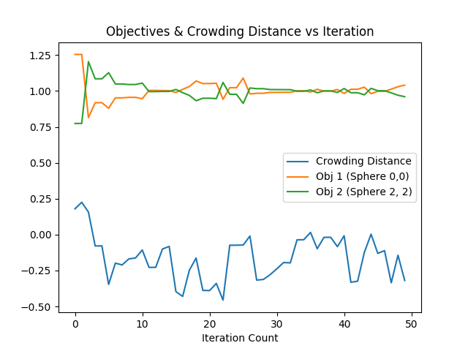
NSGA-II, visualized

Slide 14
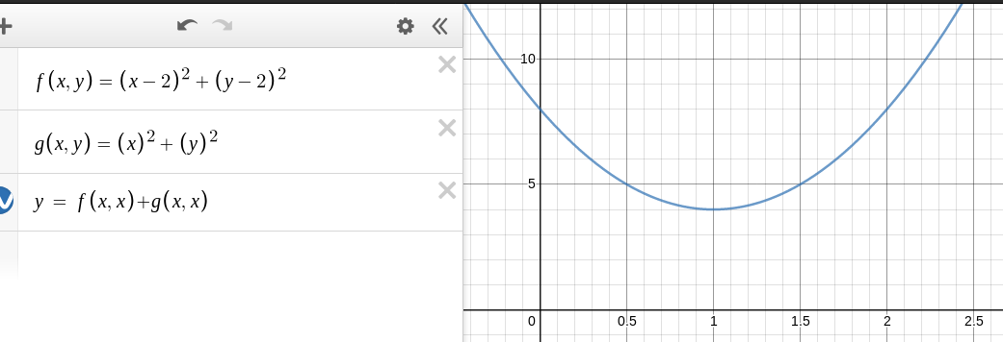
NSGA-II, visualized

Slide 15
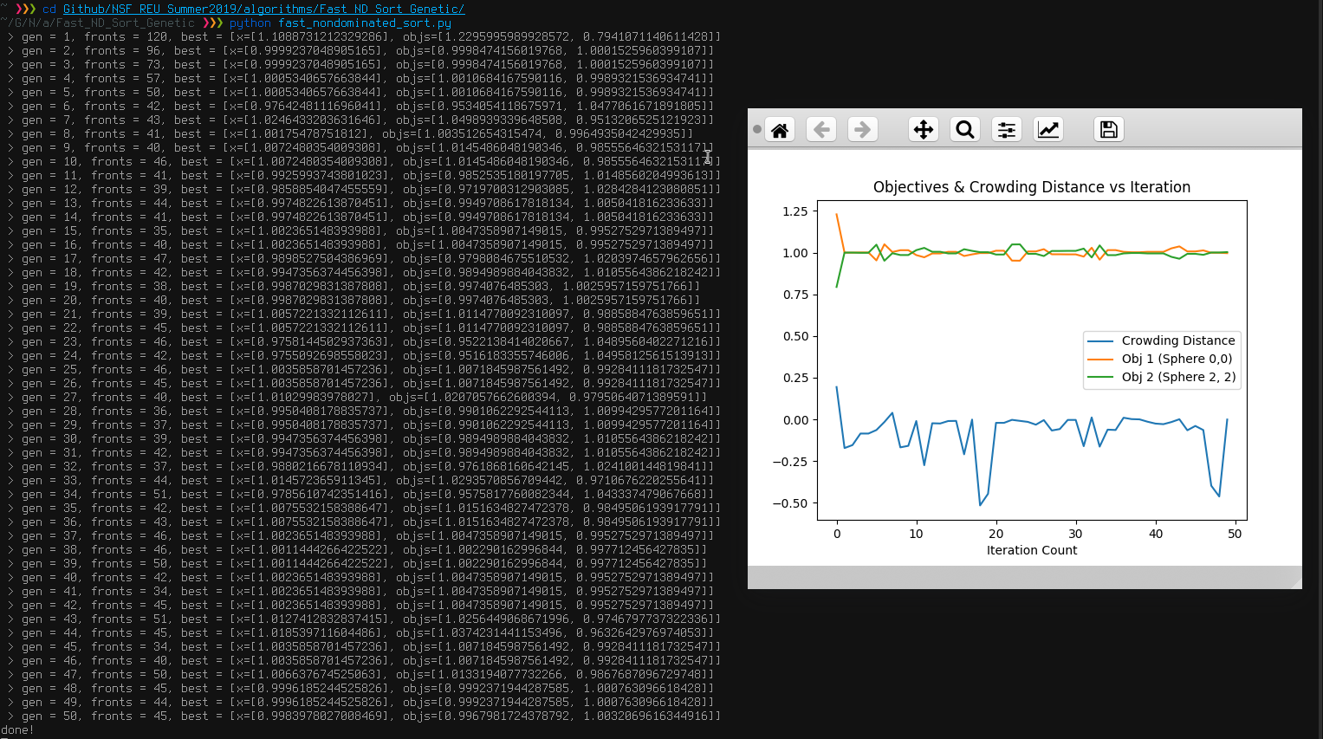

Slide 16
Algorithm Walkthrough
Generate populations of bitstrings, random
Length depends on user params & dimensions
Calculate objectives for population
First convert bitstrings into floats within space
Objective 1: Sphere @ [0, …]
Objective 2: Sphere @ [2, …]
pop = { “bitstring”: “1011100101101010”,
“bitstring”: “0101100101110101”, … }
“1011100101101010”|₂ → 47466
[-10, 10] & 47466 → (-10 + 20(47466/65536)) → 4.4854
Obj. 1→ 4.4854² = 20.11 Obj. 2→ (4.4854-2)² = 6.177

Slide 17
Algorithm Walkthrough
Run non-dominated sort:
Compare objectives of all pop members to others
Pop member A is more dominant than B if C(A) > C(B) for no objectives; e.g. [5.49, 2.11] dominates [7.12, 3]
Begin adding population members to fronts based on rank, i.e. “dominance count”; some population member dominated by 0 others will have rank 0, the best
Each “front” will have the same rank for each element
Return fronts so that a new population may be generated based on the best ranking fronts

Slide 18
Algorithm Walkthrough
Run non-dominated sort:
Compare objectives of all pop members to others
Pop member A is more dominant than B if C(A) > C(B) for no objectives; e.g. [5.49, 2.11] dominates [7.12, 3]
Begin adding population members to fronts based on rank, i.e. “dominance count”; some population member dominated by 0 others will have rank 0, the best
Each “front” will have the same rank for each element
Return fronts so that a new population may be generated based on the best ranking fronts

Slide 19
Algorithm Walkthrough
Select child population based on a “pick two, keep the best” subset of parents
Mutate via generic genetic algorithm methods
Calculate new objectives for children

Slide 20
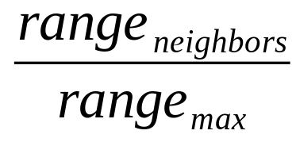
Algorithm Walkthrough
Start main iteration (user defined):
Unify parent set and children set
Run nondominated sorting
Select new parents:
Sort by rank then crowding distance
Crowding distance →
Keeps a diverse set of candidates
Select random set of “best” parents, generate new child candidates and mutate
Repeat some amount of times until convergence

Slide 21
http://oklahomaanalytics.com/data-science-techniques/nsga-ii-explained/
Basic explanation of NSGA-II
https://www.youtube.com/watch?v=DN-O5-ptQmo
Process-explaining video of NSGA-II
https://www.youtube.com/watch?v=Z8vMa_ohRNY
Calculating Crowding Distance
https://en.wikipedia.org/wiki/Multi-objective_optimization
Resources regarding NSGA-II and Pareto fronts/efficiency

