Slide 1
Firefly Swarm Algorithm

Slide 2
FIREFLY SWARM ALGORITHM
Properties
Population-based optimization algorithm
Time complexity of O(n²)
Based on “flashing lights” in firefly communication
Can be considered “greedy”:
Fireflies move to closest as they’re seen instead of best

Slide 3
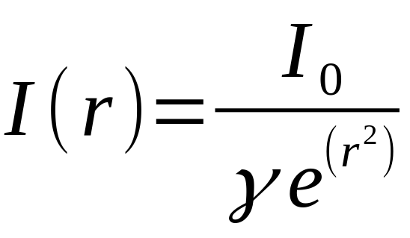
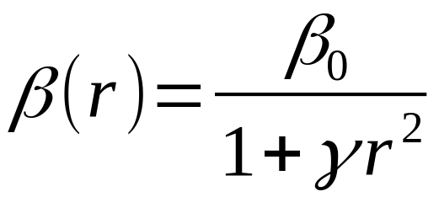
FIREFLY SWARM ALGORITHM
Parameters
Light absorption γ:
Constant ~ [0.001, 1000]
Light Intensity:
Property to optimize / maximize
Attractiveness:
Dependent on distance between two fireflies
Randomness scalar:
Constant ~ [0.95, 0.99]
Decreases randomness in movement over time

Slide 4
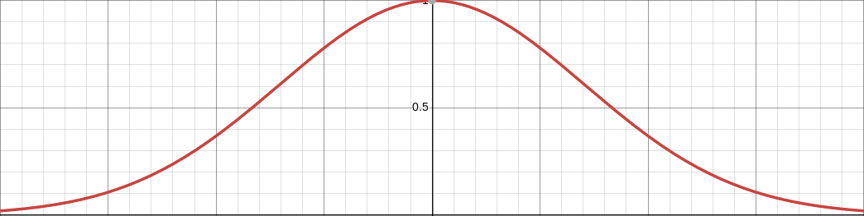
FIREFLY SWARM ALGORITHM
Algorithm Walkthrough
Initialize population:
pop = {“vector”: random_vector(search_space), …}
Calculate light intensity for each member:
for p in pop:
p[“intensity”] = intensity(p[“vector”], absorption)

Slide 5

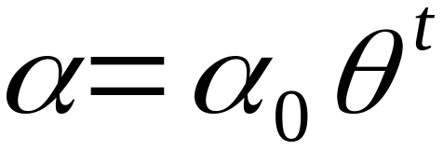
FIREFLY SWARM ALGORITHM
Algorithm Walkthrough
Compare each firefly’s intensity with each other:
for p in pop:
for n in pop:
if n[“intensity”] > p[“intensity”]:
# update position and calculate new intensity
In cases of greater intensity, update firefly according to attractiveness and random factor:

Slide 6
FIREFLY SWARM ALGORITHM
Algorithm Walkthrough
Rank fireflies in order to find the best
best = max(pop, key = lambda x: x[“intensity”])

Slide 7
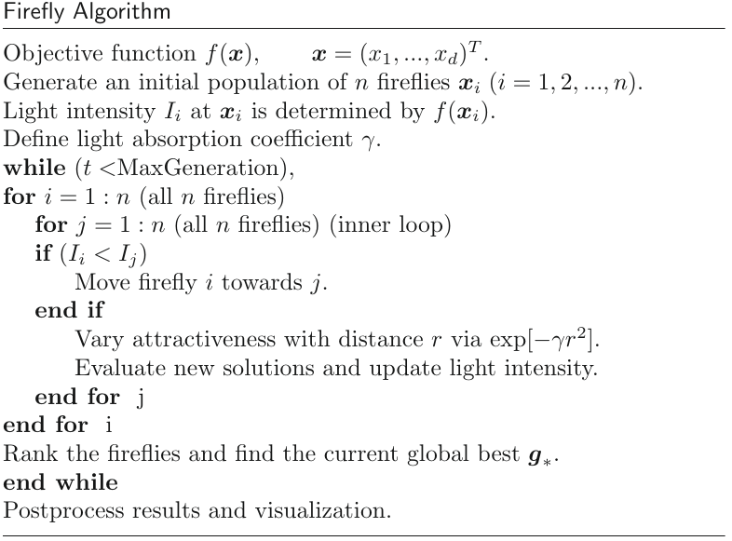
FIREFLY SWARM ALGORITHM

Slide 8
FIREFLY SWARM ALGORITHM
Ackley Demo

Slide 9
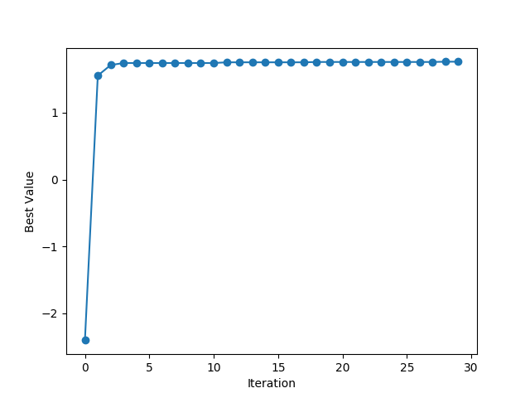
FIREFLY SWARM ALGORITHM
Ackley Demo

Slide 10
FIREFLY SWARM ALGORITHM
YANG, XIN-SHE. NATURE-INSPIRED OPTIMIZATION ALGORITHMS. ELSEVIER, 2016.
(Chapter 8)

