Slide 1
Tabu Search & Reactive Tabu Search

Slide 2
Tabu Search Characteristics
Iteratively optimizes some function
Based on local search methods
Checks immediate neighbors for improvements
However, uses a “relaxed” local search rule:
“Non-optimal” moves can be made if no immediate improvements are available (e.g. local max)
Stores a “local memory” in order to avoid cycling
Like many, applicable to TSP

Slide 3
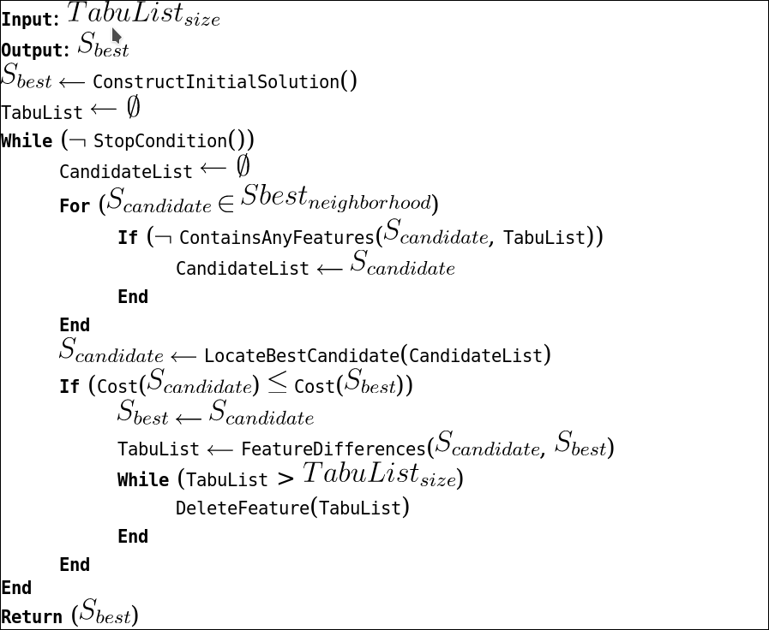
Implementation (Pseudocode)
Credit: Jason Brownlee, Clever Algorithms

Slide 4
Tabu Search Implementation
Random Sequence Permutation
for i in range(len(cities)):
permutation[i] = i
for i in permutation:
r = randrange(len(permutation) – i) + i
# generates a random number between i and size
perm[r], perm[i] = perm[i], perm[r]
# swap two values in permutation, randomizing it

Slide 5
Tabu Search Implementation
First Sequence – Dictionary Implementation
current[“vector”] = random_permutation()
current[“cost”] = cost(current[“vector”], cities)
# cost fn takes the total sum of distances for all nodes
best = current

Slide 6
Tabu Search Implementation
Iteration
Iterate some N times, generally user-defined
Create new candidate sequence
Find “best” candidate, by sorting via cost
Update local and global “best” candidates
Make new “tabu” nodes, based on consecutive values
Delete past “tabu” nodes dependent on space

Slide 7
Tabu Search Implementation
New Sequences
Generating new candidates:
Reverse random section of initial sequence
Compare with “tabu” values, repeat if found
Sequence is “tabu” if two consecutive values are “tabu”
New tabu values will be value preceding and after reversed segment, if sequence is picked

Slide 8
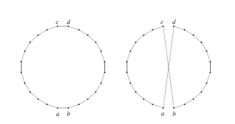
Tabu Search Implementation
New Sequences
Stochastic 2-opt move to provide a “new” candidate

Slide 9
Tabu Search Implementation
Sorting Candidates& Picking New Best
candidates = [generate(original_seq, tabu_list, nodes)
for x in range(max_candidates) ]
candidates.sort( key = candidate[“cost”] )
if (best_candidate[“cost”] < current[“cost”]):
current = best_candidate
if (best_candidate[“cost”] < best[“cost”]):
best = best_candidate

Slide 10
Tabu Search Implementation
New “Tabu” Nodes
# edges found from generating new candidate
for edge in best_candidate_edges:
tabu_list.append(edge)
# delete some nodes to make space
while len(tabu_list) > tabu_list_size:
tabu_list.pop()

Slide 11
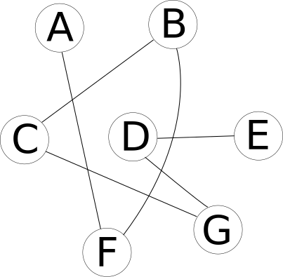
Example “Initial” Permutation

Slide 12
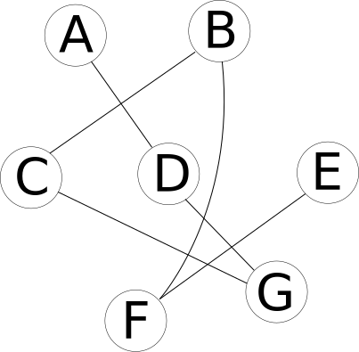
“New” Random Permutation (swap F→D), store (A, D), (F, E)
A-F-B-C-G-D-E → A-D-G-C-B-F-E

Slide 13
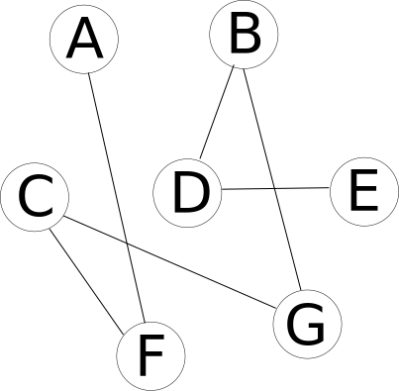
To-be “Tabu” Permutation, later down the line stored: (A,F), (D,E)
A-F-C-G-B-D-E

Slide 14
To-be “Tabu” Permutation, later down the line
D-F will not be picked as a permutation, as the first iteration added A-D and F-E to the tabu list
A-F-B-C-G-D-E → A-D-G-C-B-F-E

Slide 15
Visualization (matplotlib), Berlin52 dataset

Slide 16
Tabu Search Implementation
Heuristics
Picking Iteration Count
Algorithm only approaches solvedness but generally won’t reach it, meaning some defined number of iterations must be picked
Tabu List Size
To preserve space and time, max Tabu node count can be decreased or increased
Candidate Amount
Increasing candidate amount increases the likelihood for a good new “best” candidate, but takes more runtime/space

Slide 17
Reactive Tabu Search

Slide 18
Reactive Tabu Search Characteristics
Uses the same method as Tabu Search
Uses a modified strategy to avoid cycling:
“Reacts” to the occurrence by adapting the Tabu list size
e.g. more occurrences of tabu paths found will lessen the likelihood of blocking tabu candidates
Generally, Reactive Search Optimization is based on monitoring existing search behaviors and implementing machine learning techniques to adapt search methods

Slide 19
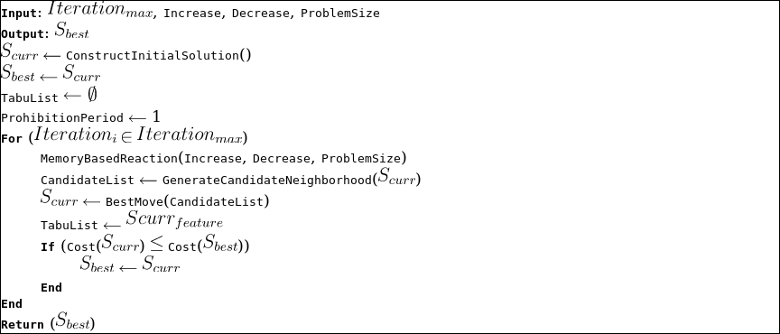
Implementation (Pseudocode)
Credit: Jason Brownlee, Clever Algorithms

Slide 20
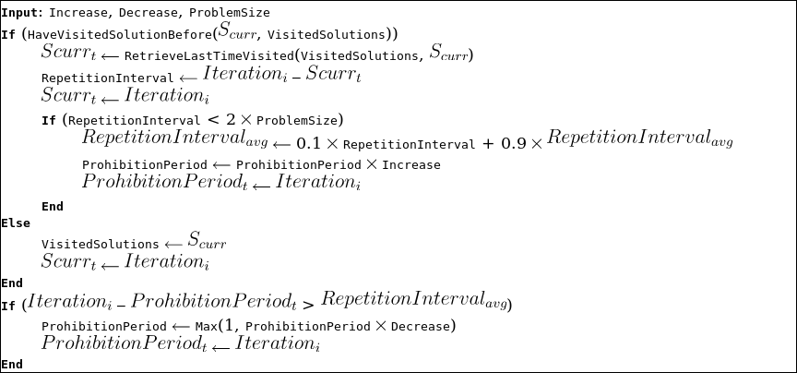
Reactive Implementation (Pseudocode)
Credit: Jason Brownlee, Clever Algorithms

Slide 21
Reactive Tabu Search Implementation
Create First Sequence Permutation (Random)
Iterate some max_iter times:
Create or recall candidate entry from stored list
If it existed:
Update its “recall” iteration, increase “visit” counter
If it’s been (2*cities – 1) iterations since last checking:
Increase prohibition time slightly exponentially
If iterations since increase/decrease is more than updated factor, decrease it towards 1

Slide 22
Reactive Tabu Search Implementation, cont’d
Generate list of candidates randomly (same as reg. tabu)
Find best candidate via sorting by cost
Check if best candidate is tabu (i.e. see if its edges were made tabu in last [prohibited period] turns
If there’s 0 or 1 non-tabu candidates, increase prohibition period and reset increase/decrease counter
Update the current candidate and best edges to be the best non-tabu candidate available, or tabu if need-be (cost)
Make the current candidate tabu (i.e. add its edges to tabu list)

Slide 23
Reactive Tabu Search Implementation
Results & Heuristics
Increase / Decrease Coefficient:
Modifies minimum iterations to wait before re-using existing permutations
Otherwise, same as Tabu search vars minus list size
Performance
Overall more efficient than Tabu search
Faster time per iteration, similar end cost
Possibly more storage-intensive

Slide 24
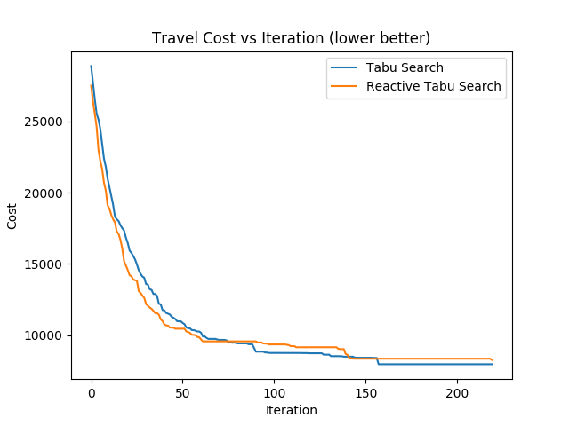
Visualization (matplotlib), Berlin52 dataset

Slide 25
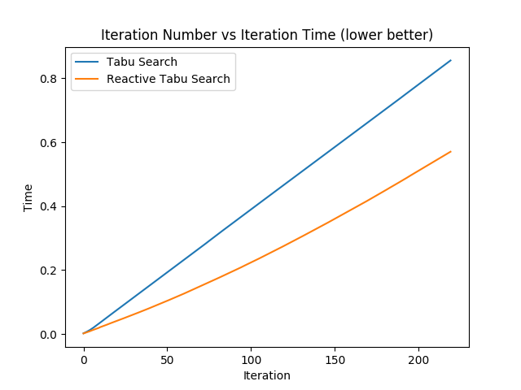
Visualization, cont’d (matplotlib), Berlin52 dataset

Slide 26
Resources
Battiti, Roberto, and Giampietro Tecchiolli. “Training Neural
Nets with the Reactive Tabu Search ” IEEE Journals &
Magazine,
ieeexplore.ieee.org/stamp/stamp.jsp?tp=&arnumber=410361.
https://www.saipanyam.net/2011/06/stochastic-algorithms-2.html

