Slide 1

Incremental Evolutionary Algorithm for the Eight-Queens Problem
Project 1
Team: Lance Heinrich, Matias Avila, Chester Lee, Alex Cortez

Slide 2
Introduction
- The Eight-Queens problem requires placing 8 queens on an 8×8 chessboard so that no two attack each other.
- Traditional approaches generate entire board configurations at once.
- Our incremental evolutionary algorithm places queens one at a time to guide the search more effectively.

Slide 3
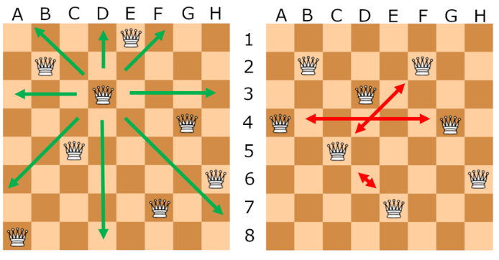
Examples
Correct Board
Incorrect Board

Slide 4
Motivation
- The Eight-Queens problem is a classic constraint satisfaction challenge used to benchmark search and optimization algorithms.
- Solving it effectively demonstrates the ability to handle large combinatorial search spaces.
- Real-world relevance: Similar principles apply to scheduling, resource allocation, and layout design problems.
Provides an accessible yet rigorous platform for exploring evolutionary algorithm techniques.

Slide 5
Why Use an Incremental Approach?
- Instead of random full-board configurations, we place queens sequentially while minimizing conflicts.
- Helps avoid infeasible solutions early, reducing wasted computations.
- Ensures a more structured search instead of purely random exploration.

Slide 6
Search Space Analysis
- Without pruning: 8^8 = 16,777,216 possible configurations.
- Evolutionary pruning removes infeasible placements, reducing the search space significantly.
- The search space size depends on how effectively conflicts are avoided in early placements.

Slide 7
Evolutionary Strategy
1. Selection: Tournament selection picks promising placements.
2. Crossover: Combines board states to generate new candidates.
3. Mutation: Randomly adjusts a queen’s position to maintain diversity.
4. Fitness Evaluation: Prioritizes solutions with fewer conflicts.

Slide 8
Mutation and Diversity
- Mutation prevents stagnation and local optima traps.
- A small mutation rate introduces variety while keeping the search efficient.
- Ensures alternative configurations are explored.

Slide 9
Implications of the Search Space Size
- Structured placement reduces unnecessary computations.
- Guided search leads to faster convergence.
- Scalable: Can be extended to N-Queens problems beyond 8×8 boards.

Slide 10
Results and Observations
- Algorithm finds optimal solutions in most runs.
- Local optima (fitness of 27) appears in some cases.
- Performance improves with better selection mechanisms and refined fitness evaluation.

Slide 11
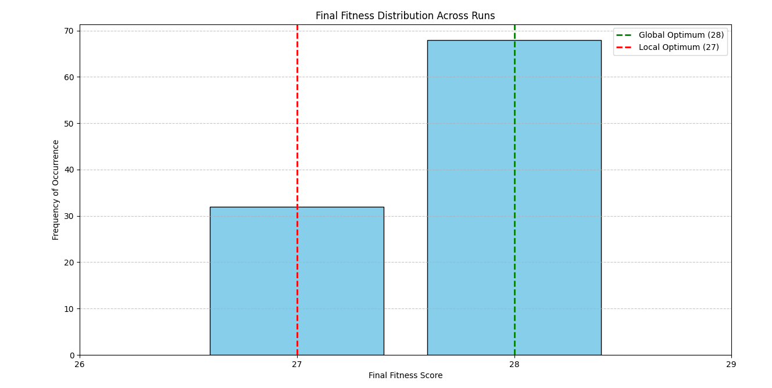
Fitness Distribution
How often does the algorithm reach its global optimum?
100 Runs, 1000 Generations Per Run

Slide 12
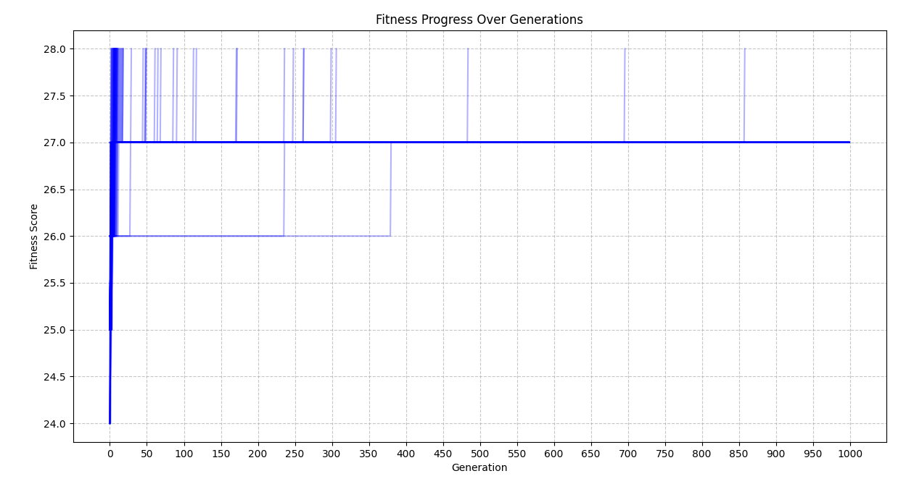
Fitness Progress
Would the algorithm be more efficient with less generations?
Most of the runs that reach the global optimum do so within the first 50 generations.

Slide 13
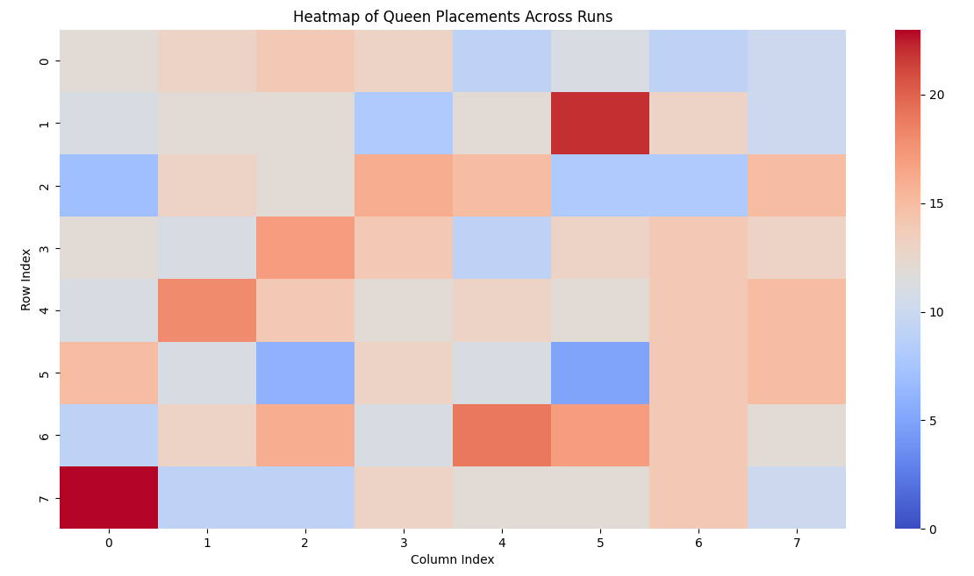
Queen Placement Heatmap
No observed pattern, ensured that the algorithm used random placement.

Slide 14
Weaknesses of Incremental Evolutionary Algorithm
- Slow Convergence: Small improvements can take many generations.
- Local Optima Traps: Risk of getting stuck in suboptimal solutions.
- Limited Diversity: Small mutations might not introduce enough variety.
- High Computational Cost: Many iterations are needed for progress.

Slide 15
Future Works / Improving the Algorithm
- Adaptive Mutation Rates: Dynamically adjust mutation intensity.
- Hybrid Approaches: Combine with global search techniques.
- Diversity Preservation: Use speciation or novelty search.
- Parallel Processing: Run multiple evolutionary paths in parallel.

Slide 16
Conclusion
- The incremental evolutionary approach significantly improves efficiency over random full-board solutions.
- Balances structured placement with evolutionary flexibility (mutation & crossover).
- Applicable to other constraint satisfaction and optimization problems.

Slide 17
Questions?
- Thank you for your attention!
- Any questions?

