Slide 1
The Gold of Athletes
By: Lance Hinds

Slide 2
Objectives
Analyze a dataset with data from multiple years of Olympics
Determine correlations between items in the dataset using Python and Pandas coding methods
Observe graphing visualizations to note trends within the dataset
Determine generalizations that can be made from the dataset analysis
Obtain further understanding of manipulating a dataset

Slide 3
Introduction
Gold Medals are an indication of high merit in the Olympics
What group or category is likely to receive a gold medal?
Is it related to certain measurements (age, height, weight)?
Is it related to time?
Visualizations will center around this thinking
The factors that determine when a gold medal will be given will be found

Slide 4
Methodology
Handling Missing Values:
Missing values were seen in the height, weight, age, and medal status of some athletes
Missing values were replaced by the mean of the values in that category
The missing values for medals were replaced by ‘No Medal’
When using some categories that included missing values, the missing values weren’t included in the implementation
Some implementations required for rows of the dataset to be deleted
Data Wrangling
A new dataset was created after handling the missing values
The new dataset was altered further to allow for the creation of certain visualizations
Helpful elements of the dataset were observed such as the size and the data types present
Operations of mean, median, max, and min were used for further study
The categories that represented the dataset strongly were determined

Slide 5
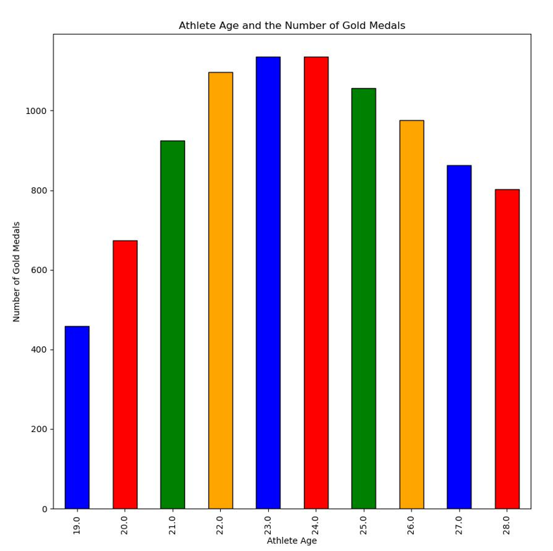
Visualization 1: Athlete Age and Gold Medals
The age of an athlete was tested first
Does the age have a correlation to the gold medals earned?
Takeaways:
The most gold medals were given to participants of around age 23
Participants a lot younger or older than 23 received less gold models
Being of young age is a strong factor in earnings of gold medals

Slide 6
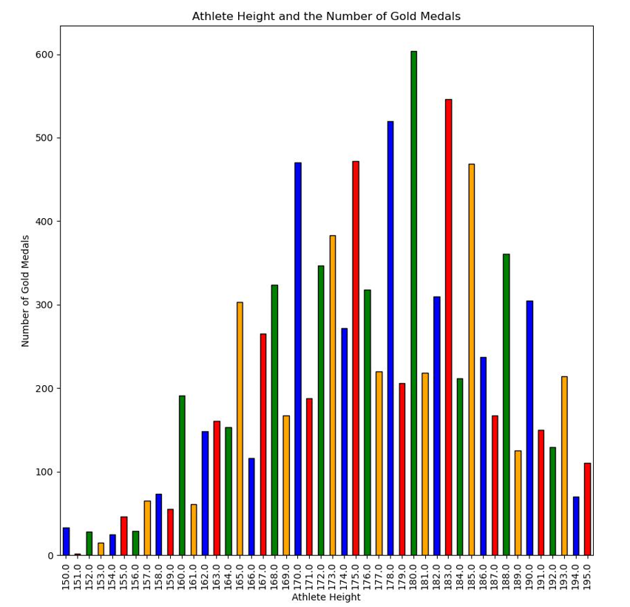
Visualization 2: Athlete Height and Gold Medals
The height of an athlete was thought to be important
How does the height compare to the trend seen with the age?
Takeaways:
There isn’t a trend seen that is as strong as for age
The most gold medals were received by an athlete that was around 180 cm tall
Being about 180 cm tall is helpful in earning a gold medal

Slide 7
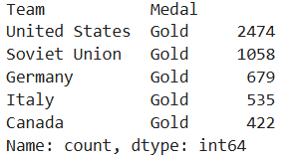
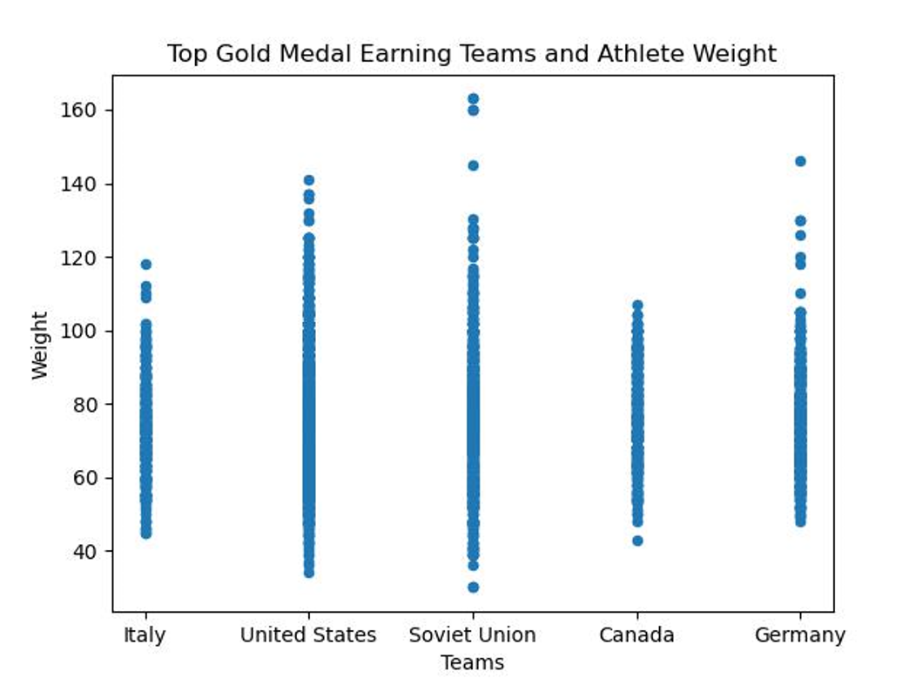
Visualization 3: Athlete Weight and Top Gold Medal Earners
Top 5 Teams with the most gold medals:
The dataset was simplified to only include the top gold medal earners
Takeaways:
Despite the United States having the most gold medals, Soviet Union and Germany have heavier athletes
The Soviet Union has the most outliers, having some athletes weighing around 160 kg
A visualization will be needed to study the weight further

Slide 8
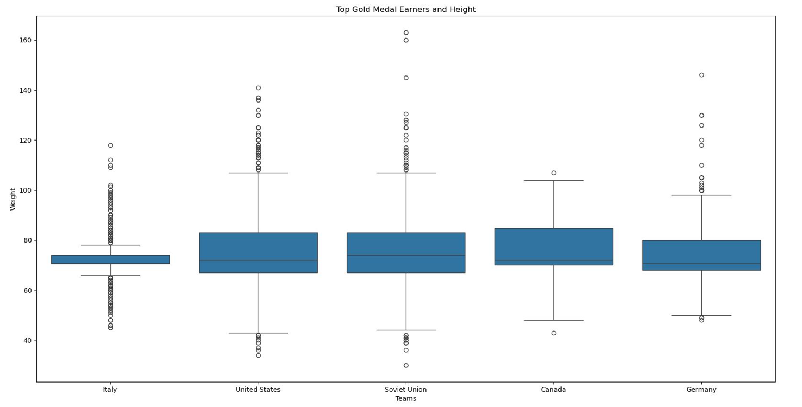
Visualization 3b: Athlete Weight and Top Gold Medal Earners
The average weight per top gold medal earner can be seen
Takeaways:
The average weight of each of the top earner athletes is between 60 and 80 kg
Italy has many outliers outside of the mean

Slide 9
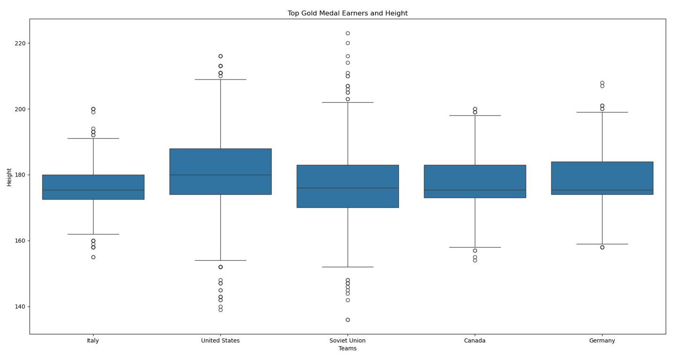
Visualization 4: Athlete Height and Top Gold Medal Earners
The dataset is simplified in the same way as the previous visualization
Takeaways:
The average height of each team is about 180 cm
The United States (ranked 1st in medals) has the largest average height and the second largest top outlier
Canada (ranked 5th in medals) has the smallest average height and the smallest range of values

Slide 10
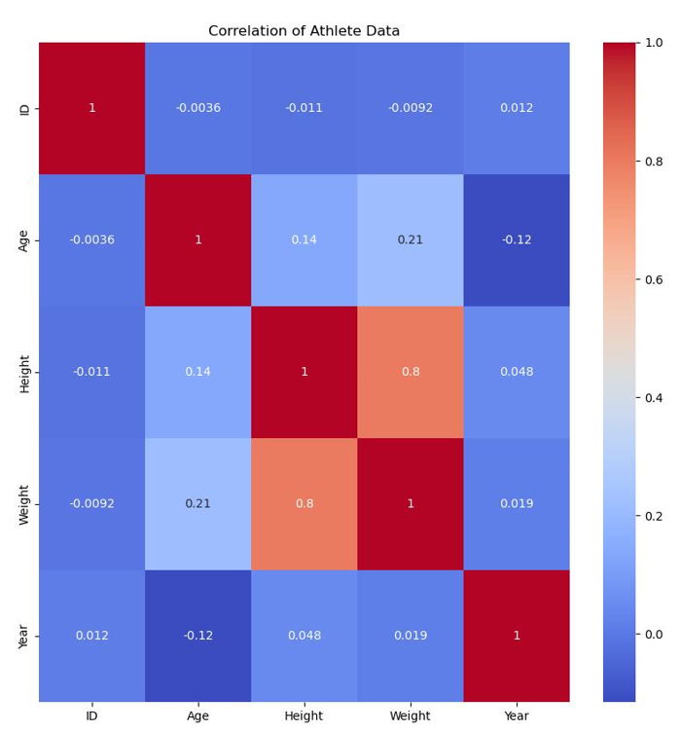
Visualization 5: Heatmap Correlation
How do the measurements of age, height, and weight correlate?
Takeaways:
Age has a stronger positive correlation with weight over height
Height and weight have a very strong positive correlation
Athletes with a high weight and height make up the majority of the dataset
Athletes with a high age will also have a high weight and maybe high height

Slide 11
Conclusion
The activity enhanced learning of how a dataset is analyzed
Further exploration into the field of manipulating datasets in the future is possible
The age, height, and weight of an athlete are essential in predicting their performance
Athletes around age 23, weighing about 70 kg, and being around 180 cm tall are the best at winning gold medals
This observation can be used in predicting the winners of events of the future Olympics

Slide 12
Acknowledgements
Professor Nerolu
Provided the dataset for analysis
Provided knowledge of Python and Pandas implementation
Rgriffin from Kaggle
Created and updated the dataset
Classmates of the Data Science Course
Questions asked in class helped in learning of concepts

Slide 13
References
120 years of Olympic history: athletes and results

Slide 14
Thank You

