Slide 1
Visualizing Protein Flexibility in VTK
Yunchao “Lance” Liu

Slide 2
Contents
Task definition
Basis about protein file (.pdb file)
How to import protein file into .vtk
Work Pipeline
Issue-Solution
Result
Further Disscusion

Slide 3
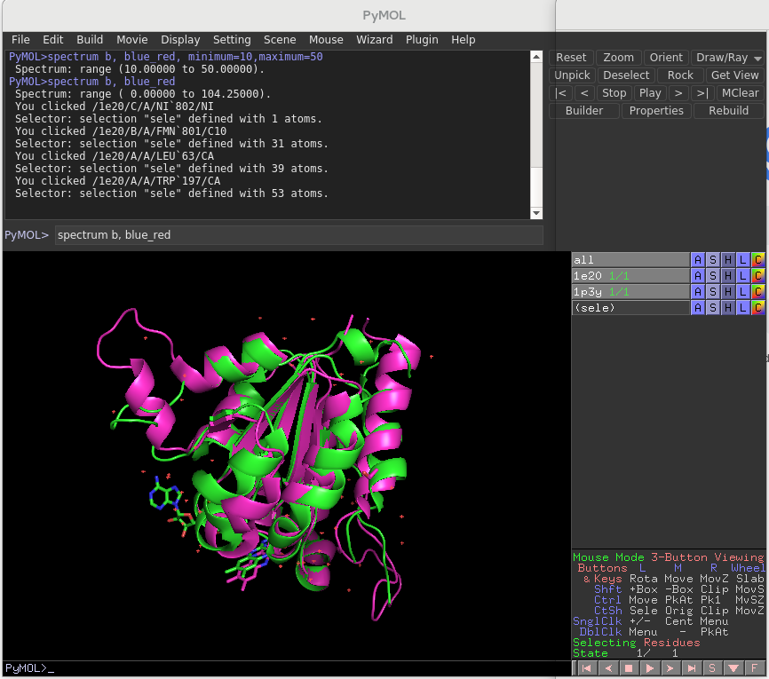
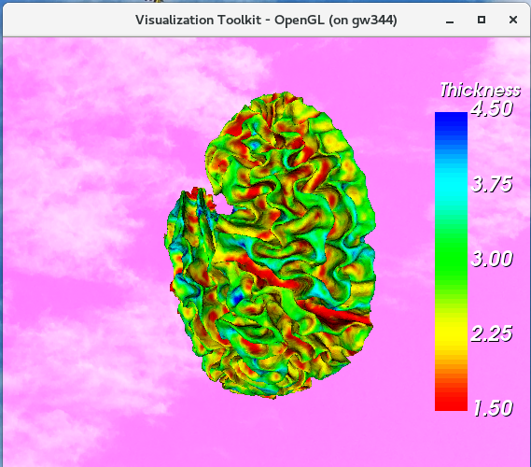
Task definition: visualizing distance (flexibility)

Slide 4
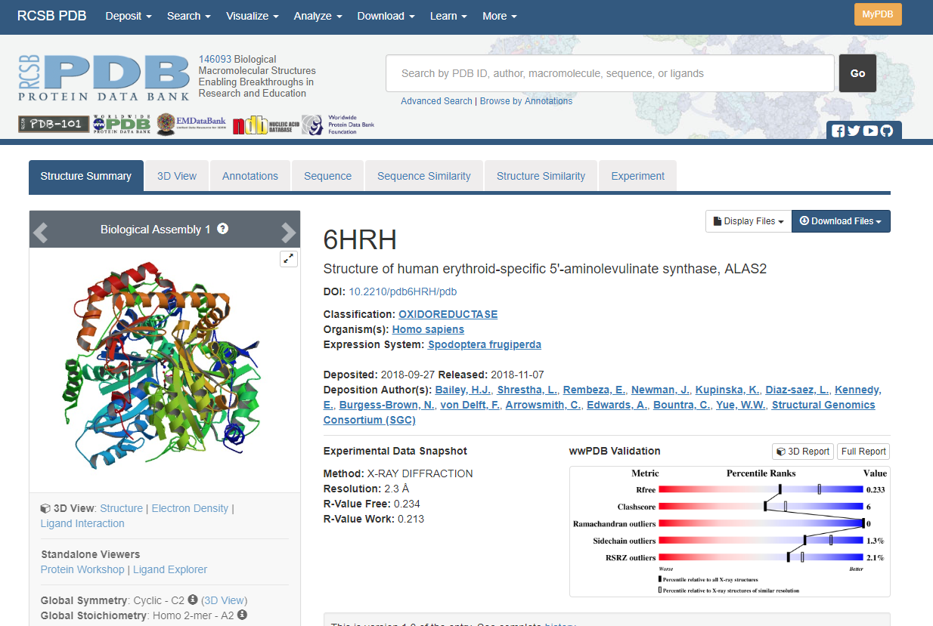

Slide 5
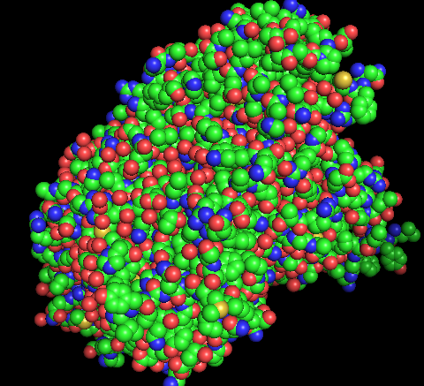
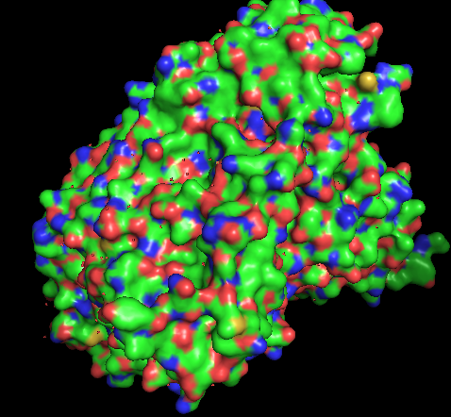
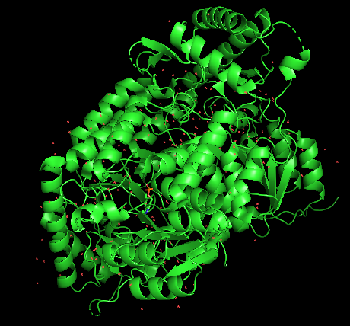
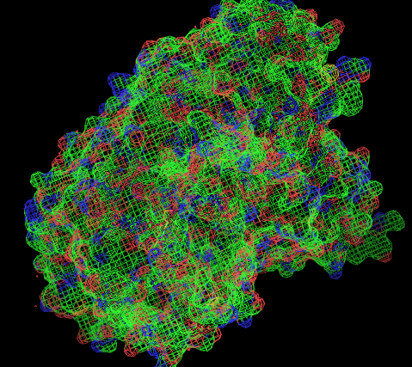
What is a .pdb file?
PDB stands for Protein Data Bank
It contains mostly importantly, the protein atoms’ identities and x, y, z positions. It also contains other miscellaneous info also, but normally not useful for visualization.
Not immediately readable

Slide 6
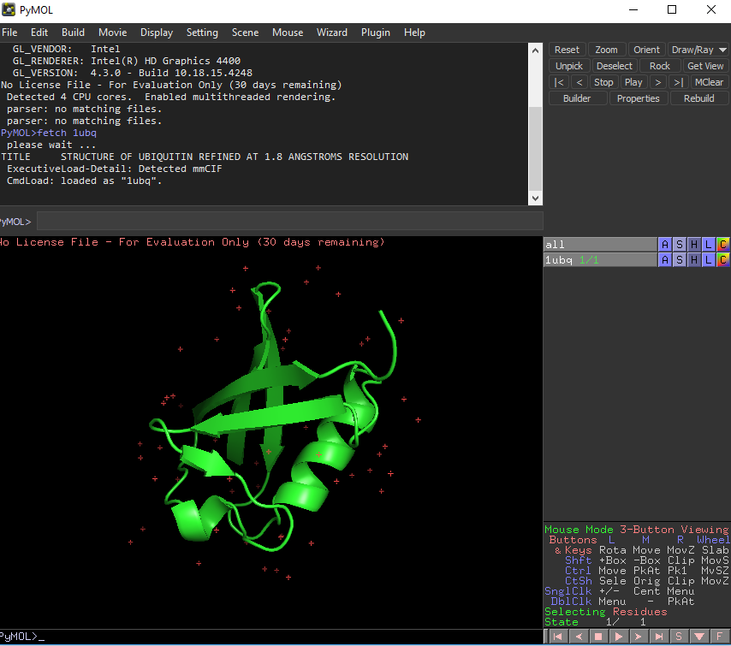
Programs that support .pdb
PyMOL
Commercial software made by Schrödinger

Slide 7
Import into vtk
Export from Pymol as VRML (.wrl)
Use VRML importer
vtkSmartPointer<vtkVRMLImporter> importer1 = vtkSmartPointer<vtkVRMLImporter>::New();
importer1->SetFileName ( input1.c_str() );
importer1->Update();
However, the imported protein file is not a polydata type but a scene

Slide 8
Working pipline
We need to get PolyData
GetInput()
GetMapper()
NextActor()
GetActors()
GetRenderer()
PolyData 1
Mapper 1
Actor 1
ActorCollection 1
Renderer 1
Importer 1
SetInput()
SetMapper()
AddActor()
vtkDistancePolyDataFilter
GetOutput()
PolyData
Mapper
Actor
Renderer 1
GetInput()
GetMapper()
NextActor()
GetActors()
GetRenderer()
PolyData 2
Mapper 2
Actor 2
ActorCollection 2
Renderer 2
Importer 2
Some details are omitted for simplicity. For example, initializing ActorCollection, casting and looping through actor

Slide 9
Issue
There are hundreds of actors!
Protein 1 has ~900 actors
Protein 2 has ~700 actors
They made the visualization moving slowly.
Why are there so many actors?

Slide 10
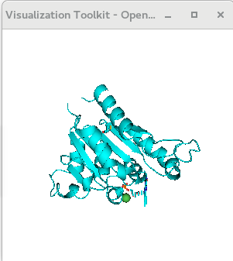
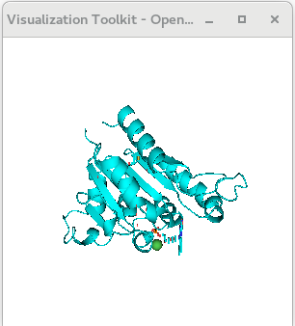
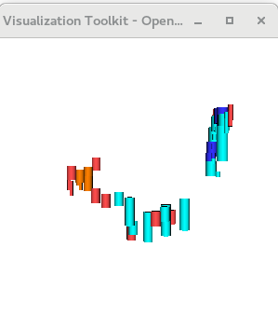
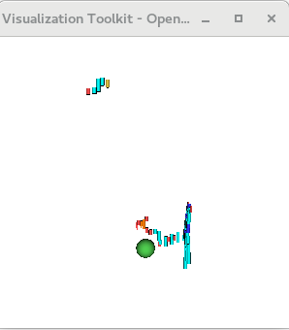
Issue: what are these actors
50 actors of protein 1
100 actors of protein 1
101 actors of protein 1
200 actors of protein 1

Slide 11
Issue: solution
Combine them! Not actors, but combine PolyData though
99 vtkSmartPointer<vtkAppendPolyData> appendFilter2 = vtkSmartPointer<vtkAppendPolyData>::New();
100 for (int i = 0; i < (actors2->GetNumberOfItems()); i++){
101 vtkSmartPointer < vtkActor > actor2 = actors2->GetNextActor() ;
102 vtkSmartPointer < vtkMapper > mapper2 = actor2->GetMapper() ;
103 vtkSmartPointer < vtkPolyData > dataset2 = dynamic_cast < vtkPolyData * > ( mapper2->GetInput() ) ;
104 appendFilter2->AddInputData(dataset2);
105 }
106 appendFilter2->Update();
107
108 //clean duplicate data for protein 2
109 vtkSmartPointer<vtkCleanPolyData> cleanFilter2 =vtkSmartPointer<vtkCleanPolyData>::New();
110 cleanFilter2->SetInputConnection(appendFilter2->GetOutputPort());
111 cleanFilter2->Update();
112
113 vtkSmartPointer<vtkPolyDataMapper> mapper2 = vtkSmartPointer<vtkPolyDataMapper>::New();
114 mapper2->SetInputConnection(cleanFilter2->GetOutputPort());

Slide 12
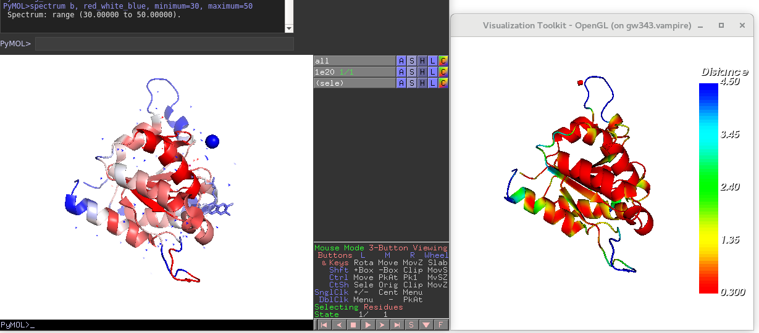
Result

Slide 13
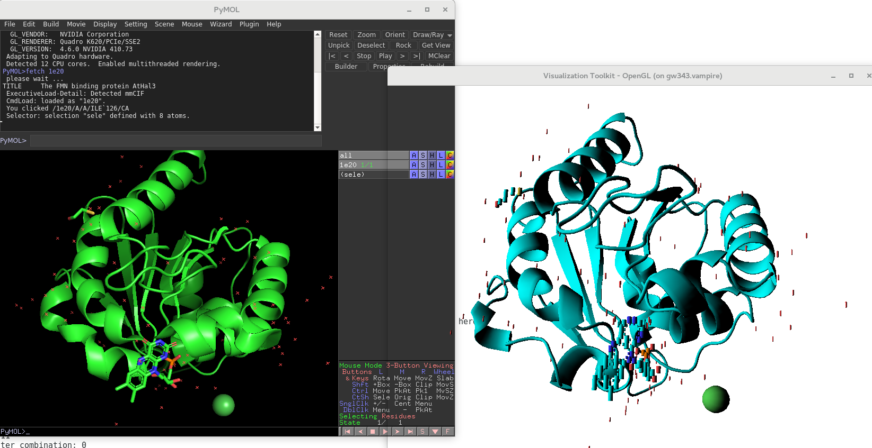
Further Discussion: bug 1
Before combination, the rings in original visualization(left) become cylinders in VTK(right)

Slide 14
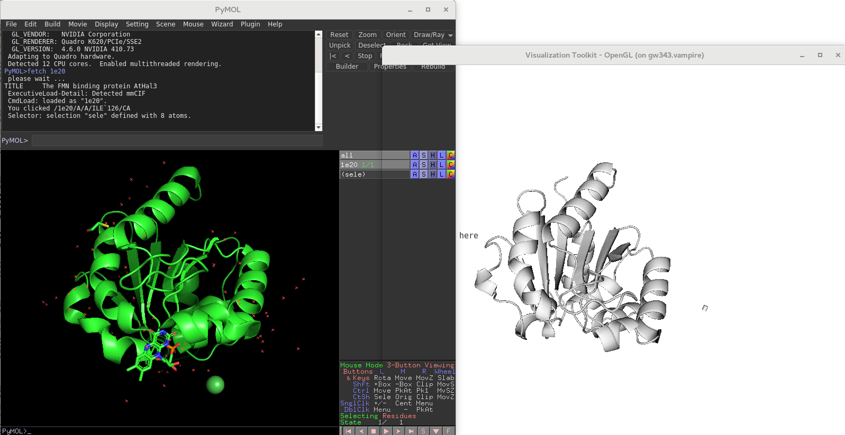
Further Discussion: bug 2
After combination, the ball and cylinders are even gone.

Slide 15
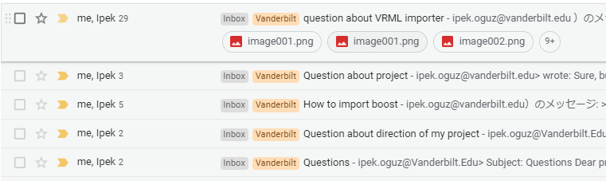
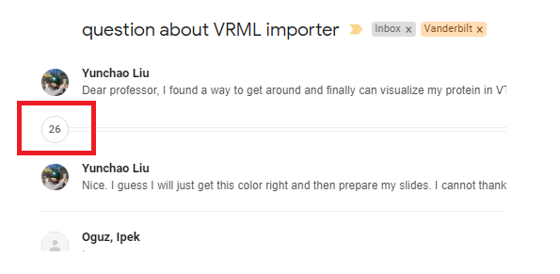
Acknowledgement
Special thanks to Prof. Ipek Oguz for being supportive and patient.

