Slide 1
Modernizing Enterprise Apps
Notes:
Description:
Come learn about the future of your WPF & Windows Forms applications. Windows, .NET and Visual Studio are making it easy to incrementally modernize your existing applications with Windows 10 features. Containerize your application for compatibility and installation isolation, take advantage of the new app local .NET Core 3.0 runtime and begin integrating new Windows 10 UI features with just a few clicks in Visual Studio. Modern applications are deeply connected to the people you work with and know which devices you’re using. We will cover the ways which M365 and the Microsoft Graph allow your existing application to connect users and help them complete tasks.
Objectives:
- How to use UWP XAML Islands to enhance your WPF & Windows Forms applications with modern features
- About the new containerization capabilities of MSIX
- How .NET Core 3 enables your desktop applications to move forward with the latest runtime features.
Demos:
Packaging project
Web View compatible on Win7
.NET Core 3 pie chart / self-contained app
WinForms graph login
Windows Template Studio new project experience

Slide 2
About
Chief Architect, DevOps & Modern Software at BlueMetal
Microsoft Regional Director
Microsoft MVP
Visual Studio ALM Ranger
Blog: //oren.codes
Twitter: @onovotny

Slide 3
Survey says?
WPF?
Windows Forms?
Notes:
Logos for these?

Slide 4
Windows desktop market and opportunity
2.4Million
Developers building desktop apps in Visual Studio every month
700Million
Windows 10 Desktops
+50%
In the last 18 months
Notes:
Why are we here having this talk…
Because even though MS and the industry has been talking to you about Cloud and Mobile for the past 4-5 years, our own VS telemetry tells us many of you are still active in desktop development – whether is maintaining existing apps by updating with new feature requests, the occasional bugfix, or even starting new desktop apps for new scenarios. Desktop development is still active, and many of you are looking for guidance on what to do with these assets and how to modernize them going forward.
The other trend is that Windows 10 is over 3 years old and most enterprises have either updated, started their update, or have plans to update soon given the EOL for Windows 7. This unblocks your apps to start taking advantage of these new features in Windows 10 which I will show you later in this talk

Slide 5
Windows 10
How many of your companies have moved to Windows 10?
Remain on Windows 7?
Plans to move by …?
Notes:
Windows 10 migration is heavily underway. Most organizations have started…

Slide 6
One “Windows” Platform
Modern
Desktop
Modern Application Platform
Desktop Application
Platform
Powerful
Robust & Secure
Notes:
With Desktop development still alive and well, and Windows 10 adoption at the tipping point for most enterprises to target, what are we doing to make developers lives easier?
First, a little background. Historically we’ve built these 2 different app platforms, Desktop & Modern/Universal. At a high level each has their own strengths and weaknesses, where Modern was built for a mobile with a touch based experience focused on consumer apps, and Desktop was all powerful focused on getting work done & productivity. To date, these 2 platforms do not cooperate very well, making it hard for apps on either platform to take advantage of the others strengths.
Moving forward we want to break this boundary. We want to make the Modern platform just another set of capabilities you can access from any of your apps. Additionally we want to make it easier for Modern Apps to have powerful desktop capabilities. Kevin Gallo introduced this concept at //build where we are moving to a developer model where there is just one app platform. And the more we do to reduce your barrier to modernize and give you the ability to adopt the features your scenarios require, the more you can make your apps powerful, secure, productive and compelling.

Slide 7
Overview
Distribution
Add modern controls
.NET Core 3: The future of WPF and Windows Forms
Bringing in cloud data with Graph
Create touch-friendly companion apps
Notes:
There’s a number of ways to enhance existing apps

Slide 8
Distribution
Notes:
Modernizing apps doesn’t always start with the parts you can see. Like anything, a solid foundation is key to a well-performing app.
One foundational piece is distribution
How many of you use ClickOne?
MSI Installers?
Squirrel?
Something else – what?

Slide 9
Challenges today
Installers put things everywhere
Machine rot
Clean uninstall virtually impossible
Auto-updating
Repackaging apps takes time
.NET SxS
Notes:
There’s no app model today, no container where apps can live.
Over time, files and registry keys get put everywhere
Auto updating apps can leave you without much control
Many orgs take third party installers and repackage them. This can add substantial delays and can break
When a new version of .NET comes out, how long does it take before you can use it?

Slide 10


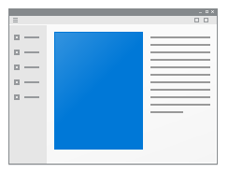


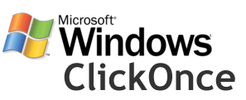
Evolve to a modern deployment technology
Setup.exe
MSI
script.vbs
MSIX
Notes:
Takes all of the existing techniques and moves forward

Slide 11
MSIX Benefits
Never regret installing an app: clean uninstall
Uses a type of container
Less disk space
Faster updates: differential updates at block level
OS Managed
Integrity protection
Notes:
Never Regret Installing an app
Predictable, safe, and reliable deployment
Clean uninstall … really!
Disk space optimization
Single instance storage of files (across apps and users)
Resource Packages
Network optimization
Differential updates at the block level
Streaming Installs
Easy componentization
OS Managed
Windows installs, updates and removes
Apps are installed per user
App state formalized
Windows provides integrity for the app
Tamper protection
Policies can limit the trusted sources via signing

Slide 12
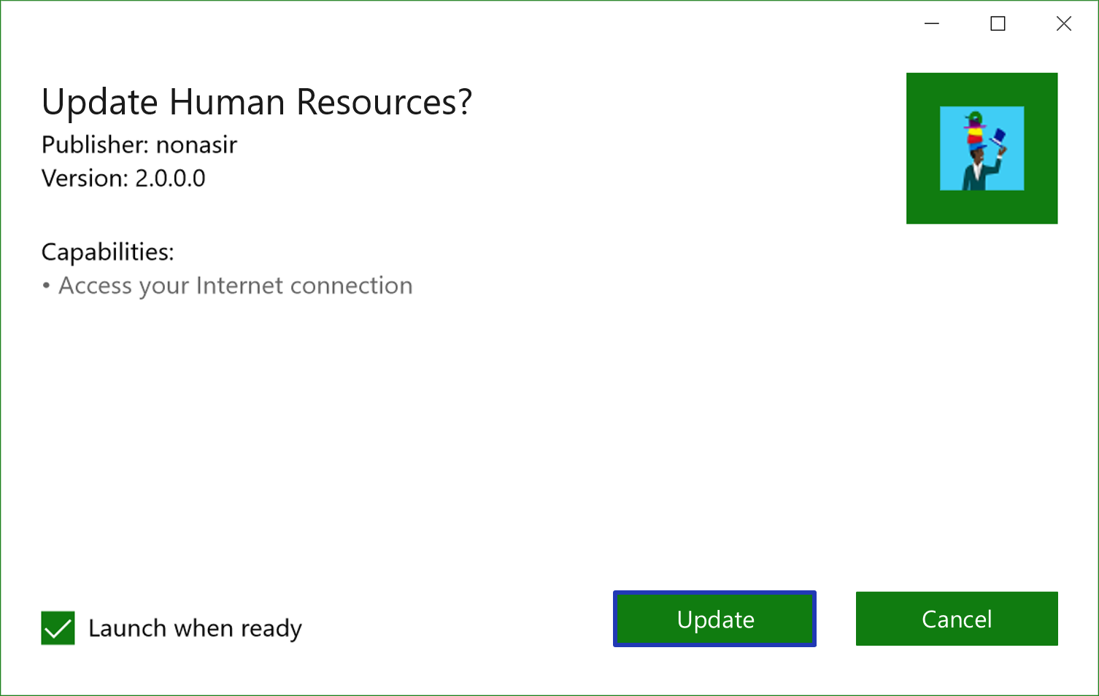

Automatic Updating
User Prompted Updates
Silent updates in background
Updates independently of app launch
API to check for app updates while app is running
Notes:
Apps can ask the user
Can update in the background while the app is running
Can update behind the scenes
Can check via api on-demand

Slide 13
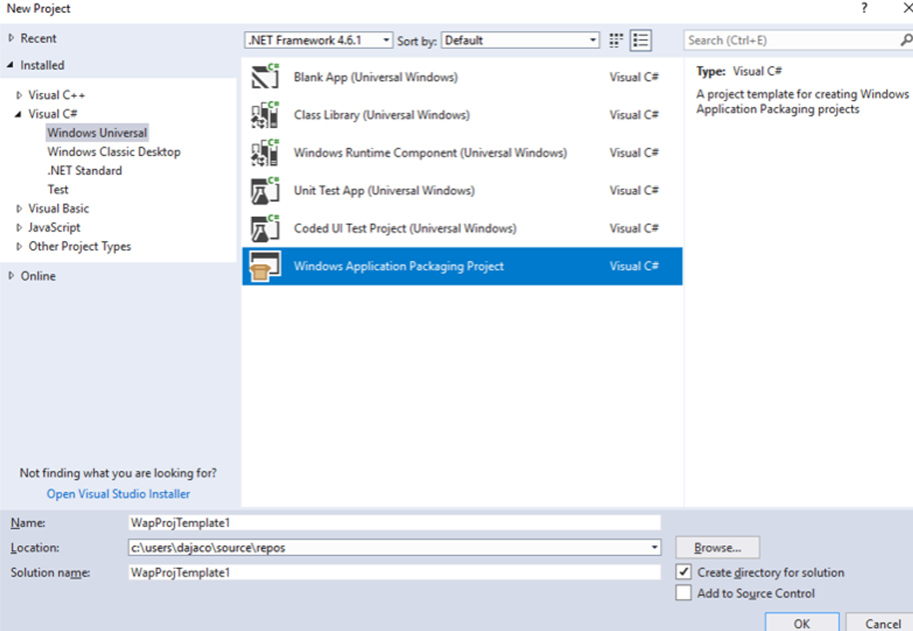
Migrate existing projects
New project template in VS 2017
Package your Windows project directly in VS for streamline deployment
You can reference your existing projects such as: WPF, Winforms, or MFC
Leverage the advanced Universal Windows Platform tools such as: Packaging, Manifest editing, and Store association

Slide 14
Demo
Packaging project as MSIX
Notes:
Open Knowzy WPF
Add Packaging project
Add reference to app
Create package for sideloading
Start

Slide 15
Modern UX
Notes:
UX is the thing most people tend to think about when talking about an app
It’s the first thing people see
Desktop apps can have higher engagement and more rich interactions with the user
There have been a lot of new UX in Windows 10, but most of it was out of reach because it was for UWP only.

Slide 16
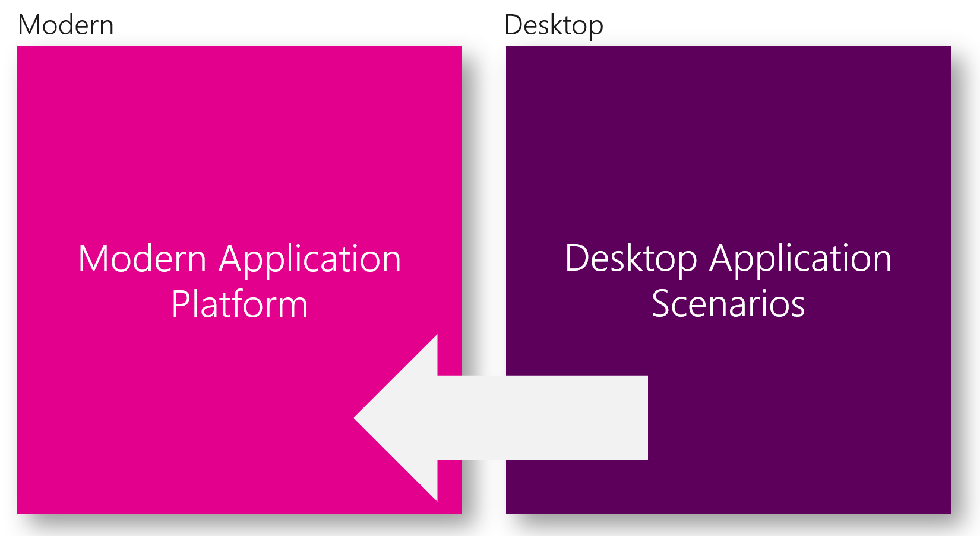
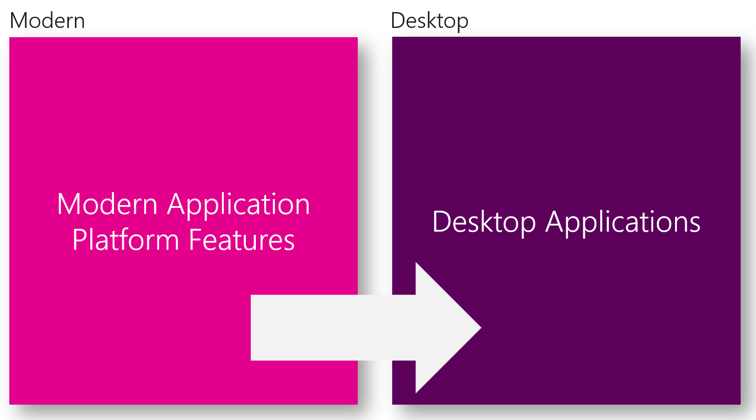
UWP XAML is LOB ready and hostable in your current apps
Improved Information Density
LOB Controls & Framework Features
Windowing APIs
XAML Islands
Notes:
Microsoft has been working on removing the line between UWP and desktop applications.
Coming at it from both directions, adding more features from desktop into UWP and then enabling UWP to be used from existing desktop apps.
Goal is to allow you to use the newer native Windows 10 controls in your existing apps
No need to rewrite as UWP

Slide 17
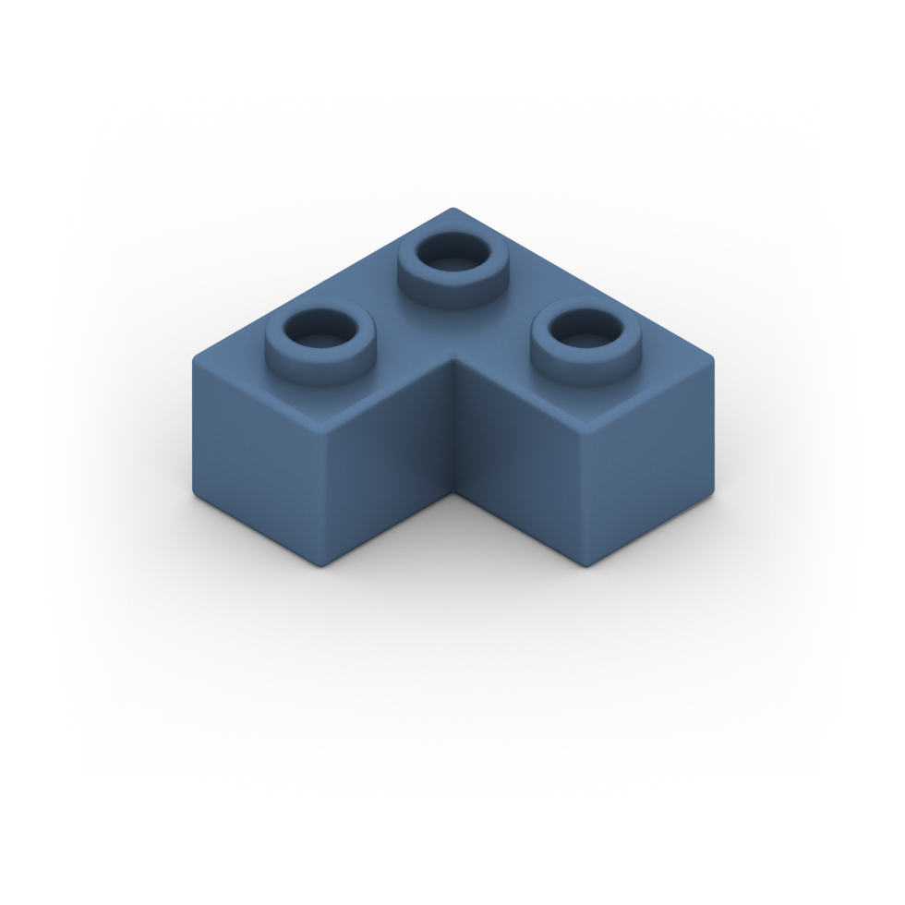

Density
Today
Notes:
One complaint of UWP was that the widgets are too big

Slide 18

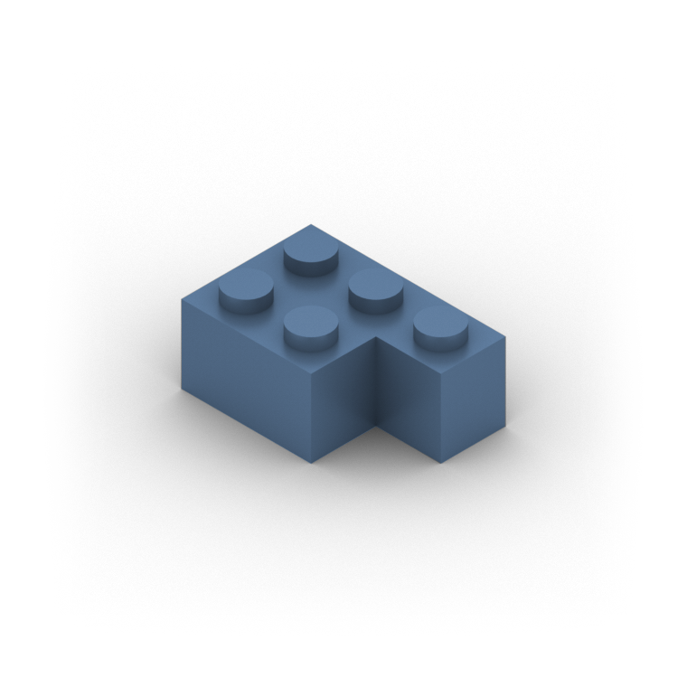
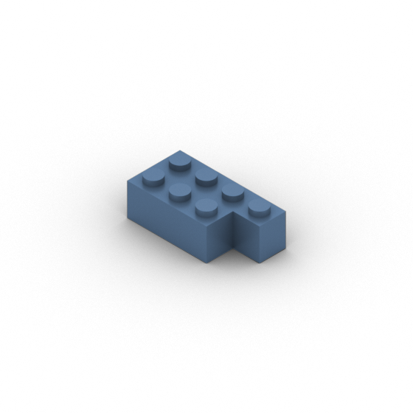
Density
Today
New Microsoft Standard
New Compact Size
Notes:
The October update makes the standard smaller
Introduces new compact size

Slide 19




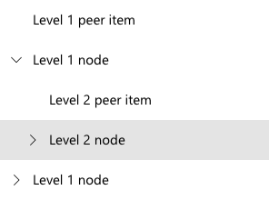

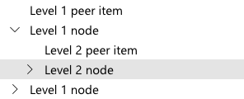

Density
Today
New Microsoft Standard
New Compact Size
Notes:
Does not sacrifice touchability

Slide 20
Density
Today
New Microsoft Standard
New Compact Size

Slide 21
Density
Today
New Microsoft Standard
New Compact Size

Slide 22
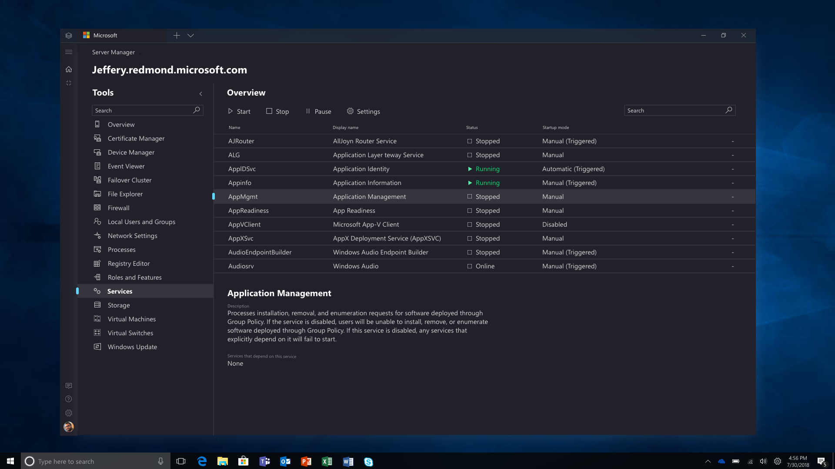
Notes:
Dark theme, with dense controls
All together, you can put together a UWP app that has the same sizing as regular
WPF/Forms app

Slide 23
Mix n’ match
Lots of existing applications
Rewriting isn’t an option (nor should you)
Want to use some of the modern controls
WebView based on Edge instead of IE
Media Element
Ink
Notes:
Not going to rewrite. Doesn’t add value
Use some modern controls in your existing apps

Slide 24

Xaml Island components
Your native Win32 C++ app
Your WPF/WinForms app
WPF/WinForms
Control Wrappers
Xaml Controls Wrappers
Xaml Host Wrapper
Windows Community Toolkit
Windows 10
WinRT Xaml Hosting API
Xaml Controls
Notes:
The following diagram displays, at a high level, the components that enable you to create Xaml Islands inside your app.
There are two set of enablers: The OS APIs and the Windows Community toolkit wrappers. Depending on the type of your app, you want to use one set or another.
If your app is Native Win32 you will use the only the Operation System APIs and the Xaml Controls to place Xaml content into a Xaml island.
If your app is .Net based like WPF and WinForms, the Windows Community Toolkit wrappers are more convenient.
Let’s dig into how these enablers work.

Slide 25

Windows 10 APIs
Record Signature
Ink your signature inside of this rectangle
You still need to take care of:
Set the new child Windows position.
Handle layout changes
Handle keyboard focus navigation
Save
Cancel
Windows 10
HWnd
HWnd (Child Window)
DesktopWindowsXamlSource
Windows.UI.Xaml.Controls
Content
Notes:
New WinRT API called DesktopWindowsXamlSource to host the Xaml content inside of a window.
You have to pass the Hwnd to this API (the red rectangle) and this API will create a new Child Window (the green rectangle) where it’ll place all the Xaml content.
The Xaml content is all the controls that you want to place on a Island. It could be a simple built-in control like a button or something like in the picture like a InkCanvas with the InkToolbar so user can ink into to your app.
There are still several things that left to do it. For instance, you will need to set a Child Window size, listening for layout changes, or manage the keyboard focus navigation.
As I said, if your app is Win32 C++, using the DesktopWindowsXamlSource is the way to go. There are some C++/WinRT samples that will teach you how to use it.

Slide 26
Windows Community Toolkit wrappers
Your WPF/WinForm app
WPF/WinForms
Control Wrappers
Xaml Controls Wrappers
WindowsXamlHost
Packages:
https://www.nuget.org/packages/Microsoft.Toolkit.Forms.UI.XamlHost
https://www.nuget.org/packages/Microsoft.Toolkit.Forms.UI.Controls.WebView
https://www.nuget.org/packages/Microsoft.Toolkit.Wpf.UI.XamlHost
https://www.nuget.org/packages/Microsoft.Toolkit.Wpf.UI.Controls.WebView
https://www.nuget.org/packages/Microsoft.Toolkit.Wpf.UI.Controls
No WinRT concepts needed for just using the Controls
Designer Support
Notes:
Now we are doing the heavy lifting for you via the WindowsXamlHost and Control Wrappers

Slide 27
Xaml Control Wrappers
Html 5 support
Most requested feature in UserVoice
No using DWXS API
Works on April 2018 Update
Tilted & Rotated views
Offline Support
3D data
Streetside
Traffic
Closed Captioning
Smooth Streaming
Adapted bitrates
Additional codecs support
Better power utilization
Custom Xaml content
WebView (EdgeHtml)
Map Control
MediaPlayerElement
Native DirectX11 support
Native DirectX12 support
Multithreading support
High DPI
HDR rendering
Super-wet Ink
Ink Toolbar
Text recognition
Shape recognition
Store and retrieve ink
Microsoft Graph
Microsoft 365
Azure AAD
Office 365
Enterprise Mobility
Windows 10
WindowsXamlHost
SwapChainPanel
Ink Canvas
Graph
Shipped
On review
in development
Notes:
Why do we need wrappers? Mostly design time/wpf designer binding scenarios? Otherwise devs are coding everything manually
These controls only works on RS5 except WebView Control.

Slide 28
Web View
How many of your apps use an embedded web view?
WPF/WinForms use Trident (IE’s rendering engine)
Two new controls
WebView
Works only on Windows 10, exposes more API
WebViewCompatible
Works on Win 7 & Win 10, exposes API subset
Uses Trident on Win 7, Edge on Win 10
Notes:
Come back to Knowzy app
Add reference to Toolkit
Switch WebBrowser with WebBrowserCompatible
Show on Win10 and Win7 (VM)
-- Or
https://github.com/onovotny/WebBrowserDemo
Open form
Drag WebView from tool box to show how it’s the same
Set Source url to the same html5test
Load app to show difference in score

Slide 29
Demos
WebView & XAML Islands
Notes:
https://github.com/onovotny/WebBrowserDemo
Open form
Drag WebView from tool box to show how it’s the same
Set Source url to the same html5test
Load app to show difference in score
--
XAML Island demo:
Run latest sample app from the Windows Community Toolkit and show them. Use 100% display scaling due to bugs!

Slide 30
XAML Island limitations
No Visual Studio support
WebView doesn’t work inside of custom content Island (DWXS)
Airspace issues
Only supported 100% DPI rate
Narrator doesn’t work with the Xaml content
Reveal brushes are grey
MessageDialogs are not modal,
…

Slide 31
XAML Island Road Map
October 2018 Update
Pre-release
1st Half 2019
V1
2sd Half 2019
V2
Low level Platform APIs
Wrappers
Acrylic for one island
Etc.
Visual Studio Support
Airspace issues in Popups
DPI awareness
Narrator works content
Multiple top level windows on one thread
Localization & resource loading
@ support in TextBoxes
Inline inking textboxes
Accelerators cross FW
Etc.
Acrylic for more than one
Connected Animations
WebView in an Island
MessageDialogs are modals
AccessKeys cross-FW
Release memory automatically
Reveal works
Etc.

Slide 32
WPF & WinForms Roadmap

Slide 33





.NET Core
3
2
.NET Core 3 expands supported workloads to include Windows Desktop, IoT & AI
.NET Core is perfectly suited for the requirements of cloud-native, cross-platform workloads
WEB
CLOUD
DESKTOP
IoT
AI
.NET CORE
.NET CORE 3
LIBRARIES
INFRASTRUCTURE
RUNTIME COMPONENTS
COMPILERS
LANGUAGES
Notes:
ANIMATED SLIDE – shows progression of entire .NET platform into .NET Core specific workloads.
Recap – assume no one knows anything about netcore
.NET Core is our cross-platform, open source implementation of .NET and is perfectly suited for requirements of cloud-native, cross-platform services. We’ve made significant investments in the core performance as well as the web stack so that you can easily take advantage of cloud patterns and scale.
.NET Core 3 will expand on the supported workloads to include IoT, AI and Windows Desktop.

Slide 34

Desktop Improvements
UI Framework Enhancements
XAML Islands - WinForms & WPF can host UWP
XAML Controls – WinForms & WPF browser and media UWP controls
High DPI fixes for WinForms
Access to all the Windows 10 APIs
Also available in next version of .NET Framework (4.8)

Slide 35
Why Windows Desktop on .NET Core?
Deployment Flexibility
Side-by-side support
Machine global or app local framework
Self-contained EXEs
Core runtime and API improvements
Performance
X
=

Slide 36
Update on .NET Core 3 since Build 2018
Internal SDK’s now build WinForms & WPF
dotnet new wpf
dotnet new winforms
Visual Studio supports building and debugging
Designers not available yet
Public Preview later this year

Slide 37
Demo
.NET Core 3 app
Notes:
Open buildDemos.sln
Show that we have two version of the same application. pieSample the .NET Framework version and pieSample.core the .NET Core version.
Right click on pieSample.core, Edit piSample.core.csproj. Show that the project is referencing .NET Core 2.1, show that it references System.WindowsForms and show that it references a pre-existing Telerik control (we did not have to rebuild this control, existing controls just work out of the box)
CoreFX the BCL that .NET Core runs on has taken tons of updates from the community and from us that we can’t do in .NET Framework for compatibility reasons. Since .NET Core is side by side we can take these updates in .NET Core. Because of this .NET Core is faster than .NET Framework.
Right click on pieSample, select Set As Startup Project, Debug | Start Without Debugging. Point this to a folder on the disk. Press run. See the pie chart and note how fast it ran in the lower right.
Right click on pieSample.core, select Set As Startup Project, Debug | Start Without Debugging. . Point this to a folder on the disk. Press run. See the pie chart and note it runs much faster than the .NET Framework version.
Click the “?” icon which will show which assemblies the application loaded, you can see it referencing .NET Core here.
Right click on pieSample.Core, Select Publish. Note that we can use linkers to take the .NET Core, WinForms and Telerik and link the application into a single .EXE which does not require anything to be installed on the machine. Click Publish and it will deploy a simple .EXE onto the desktop.
Right click on the .exe, see it is 66MB, our linker tech is early and we know we can make it much smaller. For fun you can copy this to a memory stick and it will run on any machine in the audience.

Slide 38


Update .NET Framework Apps
Modernize Desktop Apps with .NET Core 3
Highly compatible updates
Install .NET Core updates per your
needs
Existing App
.NET Framework 4.8
.NET Core 3
Windows-only
Windows-only
Cross-platform
Highly-compatible, targeted improvements, like last few releases
UWP
WEB
DATA
AI/ML
WPF
ASP.NET Core
EF 6
EF Core
ML.NET
Windows Forms
.NET STANDARD
.NET Framework support unchanged (supported for life of Windows)
Side-by-side support
Self-contained EXEs
XAML Islands - WinForms & WPF apps can host UWP controls
Full access to Windows 10 APIs
FEATURES IN BOTH FXs
Notes:
.NET Framework will continue with highly-compatible targeted improvements like the last few releases and support will remain unchanged. You will be able to retarget existing apps to 4.8 and gain these improvements.
When you’re ready to move to .NET Core 3 (to take advantage of SxS install, interop between desktop app frameworks, and .NET Core performance) you can retarget and rebuild your apps to .NET Core.

Slide 39
Connecting to the cloud

Slide 40
What is the Microsoft Graph?
User
Devices
Activities
Documents
People & Teams
Calendar & Tasks
Applications
Notes:
Microsoft Graph is the gateway to *your* data and intelligence that’s a part of Microsoft 365.
Essentially all of the information about you and your org that is a part of the Microsoft 365 – including user information, organizational hierarchies, your documents in Sharepoint & OneDrive, and your managed devices.
new services are being added all the time. recently added UserActivities in Windows10, that allow you to pickup activities across devices, ie: start an activity on your mobile phone and pick up on your desktop.
Essentially the Microsoft Graph provides a unified programmability model that you can use to take advantage of this tremendous amount of data all through a single endpoint.

Slide 41
Graph
Microsoft Graph SDK
Microsoft Graph controls in the Windows Community Toolkit
AadLogin, ProfileCard, PeoplePicker, and SharepointFileList
PlannerTaskList, PowerBIEmbedded
Wrappers for Win32/.NET coming soon via XAML Islands!
Participate in the Graph via UserActivities (Project Rome)
Integrate with Windows Timeline & Continue activities across devices
Notes:
How are we making this easier for desktop developers? You can call REST APIs but it doesn’t feel very natural. Enter the Graph SDK and the Graph controls.

Slide 42
Graph – Examples
Adding “smarts” to a pick-list of users
Accessing files from OneDrive
Profile information
Any data from SharePoint, Outlook, Planner, etc
Sharing activities between devices
Change notification (via webhooks)
Notes:
Injecting content into the activity timeline to help moving between devices –
Data loss prevention: reach in to messages to ensure people aren’t leaking information
Calendar addin: Intelligent calendar that says what time of day a meeting will be in in the location where the meeting is
“When a new employee is hired, do something…”
“When a new calendar entry comes in, ____”
Used to spend a lot of time standing up databases to store documents as blobs
Expense attachments, claims, invoices, etc
Invoices for a team can go to a sharepoint site
Can store as OneDrive
Replace SMTP servers to send mail – use graph to send email now, looks like its coming from either user or system account
Don’t need SMTP, SendGrid, etc
Booking shuttles between buildings can add entries to calendars
Peer reviews, needed three people, using find time api to find time, adding to calendar
Easily display profile data instead of copying it per app
IsInGroup / RBAC within apps
One endpoint, one model (no need to deal with EWS/CSOM)
New products don’t mean tons of change,
Front line workers:
App for taking photos of damage of a car (insurance), goes to sharepoint site for claim

Slide 43
Demo
Logging in with AAD
Notes:
https://docs.microsoft.com/en-us/windows/communitytoolkit/services/graphlogin
Register application in V2 portal
Add NuGet package
Show toolbox
Drag Item from toolbox
UWP Toolkit sample app?
ClientId: 278b27f4-72eb-4f6a-93c8-3613c7bd0322

Slide 44
Touch Friendly apps

Slide 45
Touch screens increasing
Many people are using Surface and other tablets
Some kinds of apps are better with touch
Maps
Field service
Embedded screens
Factory control systems
Medical devices

Slide 46
Creating projects is hard
Lots of plumbing code
Learning curve with new concepts
Notes:
Tell story…
When I first looked at UWP, was surprised by how much code you needed for basic things – nav, state

Slide 47
Windows Template Studio
Accelerates creation of new UWP apps
Wizard based
Uses proven patterns and best practices
Generated code has links to docs, SO and blogs
Built with the community, for the community
aka.ms/wts

Slide 48
Example
Field service app
Needs to remember settings
Connects to intranet for certain web content
Updates data in the background
Reports telemetry
Notes:
Master/detail
Web view for deep link
Grid,
Settings,
Background task to refresh data
Telemetry to report success/failure

Slide 49
Demo
Windows Template Studio
Notes:
Create app with WTS and pick some pages and talk through them

Slide 50
Thank you!

