Slide 1


Shared Userbase Across Multiple “Virtual” Portals - with Skinning
By Lance Nelson

Slide 2
Agenda
Overview
Different types of menus available
Building a menu
Oganization of pages
Demo w/ code samples
Notes:
Overview of what this can be used for and where

Slide 3
DNN Portals
DotNetNuke handles portals nicely
Complete separation of portals
Including Users
What if users need to see multiple sites?
And you want to avoid multiple usernames

Slide 4
Use Cases
A company website with public and private sections
A community portal, that all resides under one site
A collection of distinct sites with one top level owner
Simulating SSO between multiple sub sites
NOTE!
All pages will have the same domain/subdomain
Whichever technique you use will be reflected in the URL
Notes:
If these are dealbreakers for your specific situation, you still may get some ideas for skinning and working with menus.

Slide 5
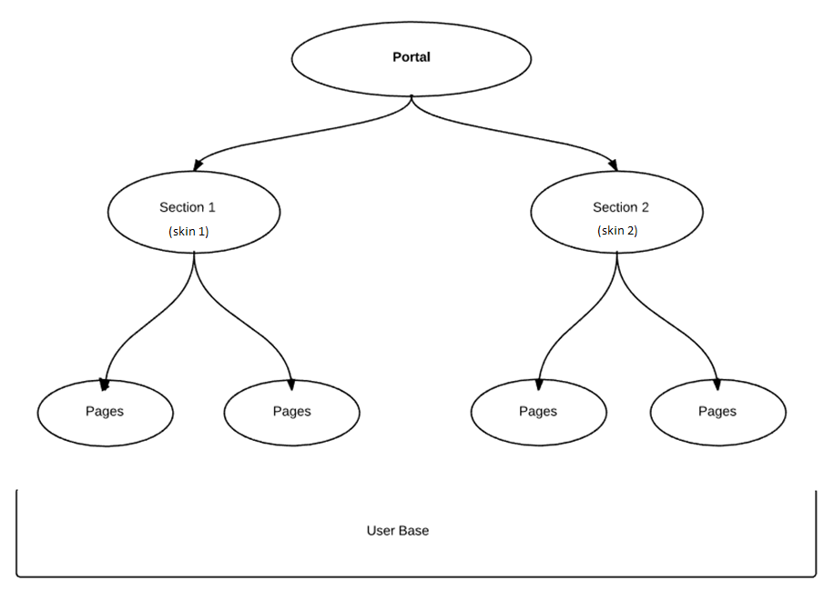

Slide 6
Different Menus implimentations
<%@ Register TagPrefix="dnn" TagName="NAV" Src="~/Admin/Skins/Nav.ascx" %>
<dnn:NAV runat="server" id="dnnNAV2" csscontrol="mainMenu" ProviderName="DNNMenuNavigationProvider" indicatechildren="false"></dnn:NAV>
<%@ Register TagPrefix="dnn" Namespace="DotNetNuke.Web.DDRMenu.TemplateEngine" Assembly="DotNetNuke.Web.DDRMenu" %>
<%@ Register TagPrefix="dnn" TagName="MENU" src="~/DesktopModules/DDRMenu/Menu.ascx" %>
<dnn:MENU MenuStyle="SpecificMenu" runat="server"></dnn:MENU>
Notes:
Started with DNN:Nav
Also DNN:SOLPARTMENU
DDRMenu new menu system as of DNN6
same look but with true hyperlinks, improved SEO and better browser support.

Slide 7
The DDR Menu
File Structure
[/DotNetNuke/Portals/_default/Skins/ThemeName]
LayoutName.ascx
[MenuName]
Menudef.xml
AnyName.cshtml
<manifest>
<template>AnyName.cshtml</template>
</manifest>

Slide 8
The DDR Manifest options
TEMPLATEHEAD
Path of a text file to insert into the <head> of the page
SCRIPTS
Path(s) of JavaScript file(s) to import
STYLESHEETS
Path(s) of stylesheet(s) to use.
DEFAULTCLIENTOPTIONS
Default client option values that the template may support
DEFAULTTEMPLATEARGUMENTS
Default template argument values that the template may support

Slide 9
DDR Menu Types
Token
XLST
Razor – as of DNN7
Best way to choose is to look at a few templates and use what you feel comfortable with

Slide 10
Token Menu
<ul id="dnn_pnav">
[*>NODE]
</ul>
[>NODE]
<li>
[?ENABLED]
<a href="[=URL]" target="[=TARGET]">[=TEXT]</a>
[?ELSE]
<span>[=TEXT]</span>
[/?]
[?NODE]
<ul>
[*>NODE]
</ul>
[/?]
</li>
[/>]

Slide 11
XSLT Menu
<?xml version="1.0" encoding="UTF-8"?>
<!DOCTYPE stylesheet [
<!ENTITY space "<xsl:text> </xsl:text>">
<!ENTITY cr "<xsl:text>
</xsl:text>">
]>
<xsl:stylesheet version="1.0" xmlns:xsl="http://www.w3.org/1999/XSL/Transform">
<xsl:output method="html"/>
<xsl:param name="ControlID" />
<xsl:param name="Options" />
<xsl:param name="ManifestPath" />
<xsl:template match="/*">
<xsl:apply-templates select="root" />
</xsl:template>
<xsl:template match="root">
<div id="{$ControlID}">
<ul class="dnnPEM-GlobalNav dnnClear">
<xsl:apply-templates select="node">
<xsl:with-param name="nodeType"/>
</xsl:apply-templates>
</ul>
</div>
</xsl:template>
<xsl:template match="node">
<xsl:param name="nodeType" />
<li>
<xsl:variable name="nodeClass">
<xsl:value-of select="$nodeType"/>
<xsl:if test="@first = 1">dnnPEM-NavFirst </xsl:if>
<xsl:if test="@last = 1">dnnPEM-NavLast </xsl:if>
<xsl:if test="node">hasChild </xsl:if>
<xsl:if test="@selected = 1">dnnPEM-NavOn </xsl:if>
</xsl:variable>
<xsl:attribute name="class">
<xsl:value-of select="$nodeClass"/>
</xsl:attribute>
<xsl:choose>
<xsl:when test="@enabled = 1">
<a href="{@url}">
<span>
<xsl:value-of select="@text" />
</span>
</a>
</xsl:when>
</xsl:choose>
</li>
</xsl:template>
</xsl:stylesheet>
Notes:
Not my strongest area, so we won’t go over this

Slide 12
Razor Menu
@using DotNetNuke.Web.DDRMenu;
@using System.Dynamic;
@inherits DotNetNuke.Web.Razor.DotNetNukeWebPage<dynamic>
@{ var root = Model.Source.root; }
@helper RenderNodes(IList<MenuNode> nodes) {
if (nodes.Count > 0) {
<ul>
@foreach (var node in nodes) {
var classString = " class=\"yourDynamicClass\"";
<li @classString>
@if (node.Enabled) {
<a href="@node.Url">@node.Text</a>
} else {
@node.Text
}
@RenderNodes(node.Children)
</li>
}
</ul>
}
}
@RenderNodes(root.Children)
Notes:
Full layout of sample menu
Standard RAZOR syntax

Slide 13
Razor Menu In Detail
@using DotNetNuke.Web.DDRMenu;
@using System.Dynamic;
@inherits DotNetNuke.Web.Razor.DotNetNukeWebPage<dynamic>
@{ var root = Model.Source.root; }
@helper RenderNodes(IList<MenuNode> nodes) {
if (nodes.Count > 0) {
<ul>
@foreach (var node in nodes) {
var classString = "yourDynamicClass";
<li class="@classString">
@if (node.Enabled) {
<a href="@node.Url">@node.Text</a>
} else {
@node.Text
}
@RenderNodes(node.Children)
</li>
}
</ul>
}
}
@RenderNodes(root.Children)
@{ var root = Model.Source.root; }
Notes:
Setting local variable based on model that is available
Model.Source

Slide 14
Model Objects Available
Source.root - The root menu node.
TabId - The page ID
Text - The page name (i.e. what should normally be displayed in the menu)
Title - The full page title
Url - The page URL
Enabled - Whether the page is enabled
Selected - Whether the page is selected
Breadcrumb - Whether the page is in the current breadcrumb
Separator - Whether the node is a separator
Icon - The URL of the page icon
LargeImage - The URL of the large page icon (DNN 6 only)
First - Whether the page is the first in its level
Last - Whether the page is the last in its level
Depth - The depth of the current page in the menu structure (starting at 0)
Keywords - The keywords defined for the current page
Description - The description of the current page
CommandName - The action command name (action menus only)
CommandArgument - The action command argument (action menus only)
Children - The child nodes of this node
Parent - The parent node of this node

Slide 15
Razor Menu In Detail
@helper RenderNodes(IList<MenuNode> nodes) {
if (nodes.Count > 0) {
<ul>
@foreach (var node in nodes) {
var classString = " class=\"yourDynamicClass\"";
<li @classString>
@if (node.Enabled) {
<a href="@node.Url">@node.Text</a>
} else {
@node.Text
}
@RenderNodes(node.Children)
</li>
}
</ul>
}
}
@RenderNodes(root.Children)
Notes:
Function doing all the work

Slide 16
Razor Menu In Detail
Declare function
@helper RenderNodes(IList<MenuNode> nodes) {
if (nodes.Count > 0) {
<ul>
@foreach (var node in nodes) {
var classString = "yourDynamicClass";
<li class="@classString">
@if (node.Enabled) {
<a href="@node.Url">@node.Text</a>
} else {
@node.Text
}
@RenderNodes(node.Children)
</li>
}
</ul>
}
}
@RenderNodes(root.Children)

Slide 17
Razor Menu In Detail
Item check
@helper RenderNodes(IList<MenuNode> nodes) {
if (nodes.Count > 0) {
<ul>
@foreach (var node in nodes) {
var classString = "yourDynamicClass";
<li class="@classString">
@if (node.Enabled) {
<a href="@node.Url">@node.Text</a>
} else {
@node.Text
}
@RenderNodes(node.Children)
</li>
}
</ul>
}
}
@RenderNodes(root.Children)

Slide 18
Razor Menu In Detail
Item loop
@helper RenderNodes(IList<MenuNode> nodes) {
if (nodes.Count > 0) {
<ul>
@foreach (var node in nodes) {
var classString = "yourDynamicClass";
<li class="@classString">
@if (node.Enabled) {
<a href="@node.Url">@node.Text</a>
} else {
@node.Text
}
@RenderNodes(node.Children)
</li>
}
</ul>
}
}
@RenderNodes(root.Children)

Slide 19
Razor Menu In Detail
Display Item
@helper RenderNodes(IList<MenuNode> nodes) {
if (nodes.Count > 0) {
<ul>
@foreach (var node in nodes) {
var classString = "yourDynamicClass";
<li class="@classString">
@if (node.Enabled) {
<a href="@node.Url">@node.Text</a>
} else {
@node.Text
}
@RenderNodes(node.Children)
</li>
}
</ul>
}
}
@RenderNodes(root.Children)

Slide 20
Razor Menu In Detail
@helper RenderNodes(IList<MenuNode> nodes) {
if (nodes.Count > 0) {
<ul>
@foreach (var node in nodes) {
var classString = "yourDynamicClass";
<li class="@classString">
@if (node.Enabled) {
<a href="@node.Url">@node.Text</a>
} else {
@node.Text
}
@RenderNodes(node.Children)
</li>
}
</ul>
}
}
@RenderNodes(root.Children)
Recursively Call Children for Submenus

Slide 21
Razor Menu In Detail
@helper RenderNodes(IList<MenuNode> nodes) {
if (nodes.Count > 0) {
<ul>
@foreach (var node in nodes) {
var classString = "yourDynamicClass";
<li class="@classString">
@if (node.Enabled) {
<a href="@node.Url">@node.Text</a>
} else {
@node.Text
}
@RenderNodes(node.Children)
</li>
}
</ul>
}
}
@RenderNodes(root.Children)
Initial Function Call

Slide 22
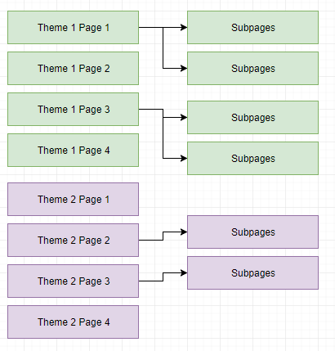
Page Organization
Positional
Nodes 0-3
Nodes 4-7
Notes:
In your loop, check indexes

Slide 23
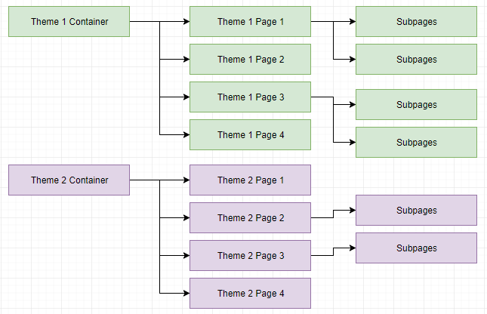
Page Organization
Parent Containers

Slide 24
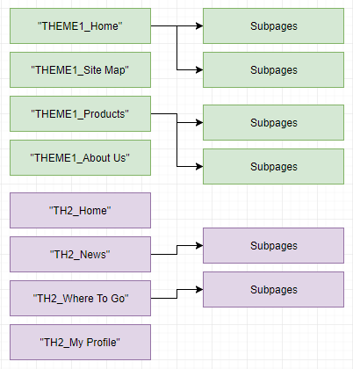
Page Organization
Via Page Names
(prefixes, suffixes, etc.)
Notes:
These are just a few suggestions. As you become familiar with the menus, you will likely come up with your own solution.

Slide 25
DEMO

Slide 26
Questions?

Slide 27
Resources
https://github.com/MarkXA/ddrmenutemplates
https://github.com/LanceNelson/DNNSummit2018
http://www.dnnsoftware.com/wiki/ddrmenu-user-guide
Notes:
DNN Hero Tip Of The Week #35
https://www.youtube.com/watch?v=L6hwIDLm0mU&feature=youtu.be

Slide 28


Slide 29
presentation TODO:
X-Put skin file structure into presentation
-check TFA / TLJ themes
- check demo-ing
Time: 26 min.
Need: 20 more minutes?

