Slide 2
Grid Hashing

Slide 3
Orthonormal Hashing

Slide 5
Overshoot
Point

Slide 8
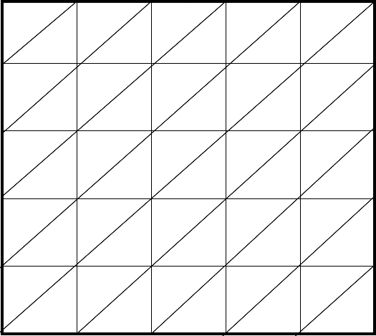

Slide 9
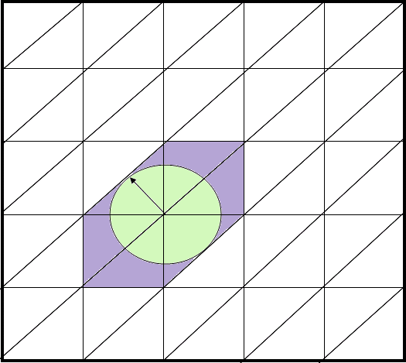
Orthonormal Overshoot
Overshoot
Point

Slide 13
Grid Overshoot

Slide 14
Orthonormal Overshoot

Slide 15
Orthonormal Overshoot

Slide 16
Orthonormal Overshoot

Slide 19
Grid Overshoot

Slide 20
Orthonormal Overshoot

