Slide 11
Overshoot
Point

Slide 14
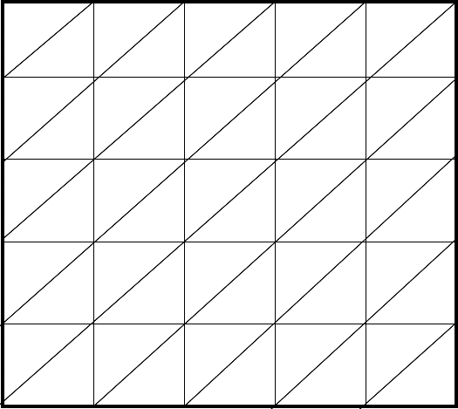

Slide 15
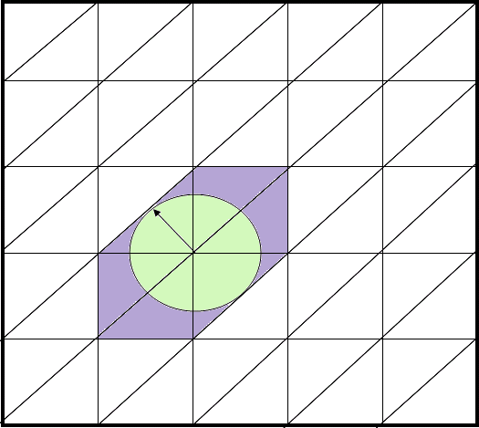
Orthonormal Overshoot
Overshoot
Point

Slide 19
Grid Overshoot

Slide 20
Orthonormal Overshoot

Slide 21
Orthonormal Overshoot

Slide 22
Orthonormal Overshoot

Slide 25
Grid Overshoot Final

Slide 26
Orthonormal Overshoot
5.0
X = 2.2, Y = 2.5
R = 0.707
0.0
5.0

Slide 27
Vertex Transitive Overshoot
5.0
X = 2.2, Y = 2.5
R = 0.707
0.0
5.0

Slide 28
Vertex Transitive Overshoot 2
X = 2.2, Y = 2.5
R = 0.707

Slide 29
Vertex Transitive Overshoot 4
X = 2.2, Y = 2.5

Slide 30
Vertex Transitive Overshoot 5
X = 2.2, Y = 2.5

Slide 31
Vertex Transitive Overshoot 4
X = 2.2, Y = 2.5
R = 0.707

Slide 32
Vertex Transitive Overshoot 5
X = 2.2, Y = 2.5
R = 0.707

Slide 33
Grid reference

Slide 34
Grid Overshoot
5.0
X = 2.2, Y = 2.5
R = 0.707
Overshoot = 3
0.0
5.0

Slide 35
Orthonormal Overshoot
5.0
X = 2.2, Y = 2.5
R = 0.707
0.0
5.0

Slide 36
5.0
X = 2.2, Y = 2.5
R = 0.707
0.0
5.0

Slide 37
VT 1

Slide 38
VT 2

Slide 39
research
5.0
X = 2.2, Y = 2.5
R = 0.707
0.0
5.0

Slide 40
Grid reference

Slide 41
VT Overshoot 6
X=2.2, y=.5,
R = 1

Slide 43
VT Overshoot 7
X=2.2, y=.5,
R = .886
5.0
Extra:
Corners = 12-3
Tris = 13-6
c/r = 5.6/3.16=2.28
0.0
5.0

Slide 44
Grid Filled
X=2.2, y=.2.7,
R = 0.5
Extra:
Corners = 8-4 = 4
Squares = 4-1 = 3
c/r = 4/(pi R^2)
= 1.3

Slide 45
Orthonormal Filled
5.0
X = 2, Y = 3
R = 0.707/2
= .353
Extra:
Corners = 7-3 = 4
Tris = 6-1 = 5
c/r = 3/(pi R^2)
= 7.7
0.0
5.0

Slide 46
VT Filled
X=2.2, y=.5,
R = .443
(4/sqrt3)/2
5.0
Extra:
Corners = 7-3 = 4
Tris = 6 – 1 = 5
c/r = (6a / (pi R^2))
= ((6*sqrt3)/4)/ pi R2
= 1.6
0.0
5.0

Slide 47
Chebychev Distance
X
X
Y
Y
Y
1,1
1,1
2,1
2,1
0,1
0,1
1,0
1,1
1,0
0,0

Slide 48
Chebychev Distance
X
X
Y
Y
Y
1,3
1,3
1,3
1,3
0,3
2,2
3,1
1,1
2,1
3,0
0,2
1,1
1,1
2,1
2,0
0,1
0,1
1,0
1,0
1,1
2,-1
1,1
2,-1
1,1
1,-1
0,0
1,-1
1,-1
1,-1
1,-1

Slide 49
Chebychev Distance
X
Y
Y
1,3
1,3
1,3
1,3
0,3
2,2
3,1
1,1
2,1
3,0
0,2
2,1
1,1
2,0
0,1
0,1
1,-1
1,0
1,0
1,1
2,-1
1,1
2,-1
1,1
0,0
1,-1
1,-1
1,-1
1,-1

Slide 50
Chebychev Distance

Slide 51
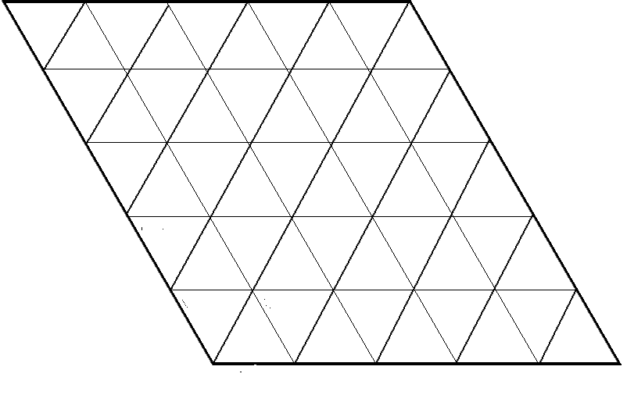
Chebychev Distance
0,0
0,0
0,0
1,2
2,0
0,0
0,1
1,1
0,1
1,0
0,0
1,0
1,0

Slide 52
Y
3,4
1,3
4,3
0,0
0,0
0,0
0,0
0,2
1,2
2,2
3,2
0,0
0,1
1,1
0,1
0,0
X
0,0
1,0
2,0
Euclidean: 3.6
Chebychev: 3

Slide 53
Y
3,4
0,3
1,3
4,3
0,0
0,0
0,2
1,2
2,2
3,2
0,0
0,1
1,1
0,0
0,1
0,0
X
0,0
1,0
2,0
Euclidean: 3.6,
Chebychev: 3

Slide 54
Y
0,4
3,4
0,0
0,3
1,3
4,3
0,0
0,2
1,2
2,2
3,2
0,0
0,1
1,1
0,1
X
0,0
1,0
2,0
3,0
Euclidean: 3.6, 5
Chebychev: 3,4

Slide 55
Y
0,4
3,4
0,0
0,3
1,3
4,3
0,0
0,2
1,2
2,2
3,2
0,0
0,1
1,1
0,1
X
0,0
1,0
2,0
3,0
Euclidean: 3.6, 5
Chebychev: 3,4

Slide 56
1,1
3,4
3,0
0,4
Euclidean: 3.6, 5
Chebychev: 3,4

