Slide 1



Analysis of S&P 500
Financial Institution Section

Slide 2
SP500 Financial Sector
Key Characteristics:
Sensitive to interest rate changes
Heavily regulated industry
Performance often tied to broader economic health
Generally pays higher dividends compared to other sectors

Slide 3
SP500
Banks
Make money on the spread between interest paid on deposits and interest earned on loans (net interest margin)
Insurance
Success depends on accurately pricing risk and managing claims while investing premiums profitably
Capital Markets
Revenue primarily tied to assets under management (AUM) and market activity levels
Consumer Finance
Profitability heavily influenced by consumer credit quality and default rates
Financial Services Technology
Benefits from the ongoing shift from cash to digital payments, with high operating margins due to scalable technology platforms

Slide 4
SP500
Banks
JPMorgan Chase, Bank of America, Wells Fargo, Citigroup, U.S. Bancorp
Insurance
Berkshire Hathaway, Progressive, Travelers, MetLife, AIG
Capital Markets
BlackRock, Morgan Stanley, Goldman Sachs, Charles Schwab, State Street
Consumer Finance
American Express, Capital One, Discover Financial, Synchrony Financial
Financial Services Technology
Visa, Mastercard, Fiserv, Fidelity National Information Services (FIS), Global Payments

Slide 5
15 Companies From S&P 500 Include:
JPM - JPMorgan Chase & Co.
BAC - Bank of America Corporation
WFC - Wells Fargo & Company
GS - The Goldman Sachs Group, Inc.
MS - Morgan Stanley
BLK - BlackRock, Inc.
C - Citigroup Inc.
SCHW - The Charles Schwab Corporation
AXP - American Express Company
PNC - The PNC Financial Services Group, Inc.
TFC - Truist Financial Corporation
USB - U.S. Bancorp
BK - The Bank of New York Mellon Corporation
STT - State Street Corporation
COF - Capital One Financial Corporation

Slide 6
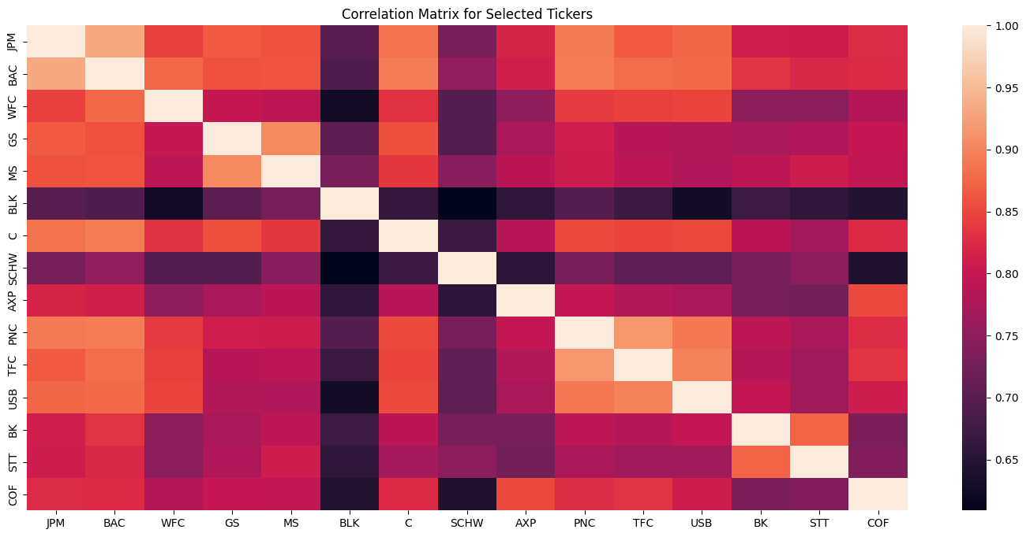
Correlation Matrix: Based on Price History (July 19 - Dec 22)

Slide 7
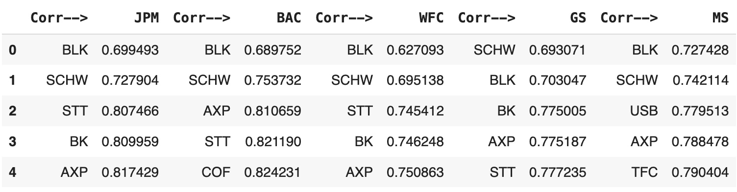

Sorted List According to Each Institution #1
Here is the top 5 with lowest correlation to:
JPMorgan (BLK) - 0.699
Bank of America (BLK) - 0.689
Wells Fargo & Company (BLK) - 0.627 min
Goldman Sachs Group (SCHW) - 0.693
Morgan Stanley (BLK) - 0.727

Slide 8
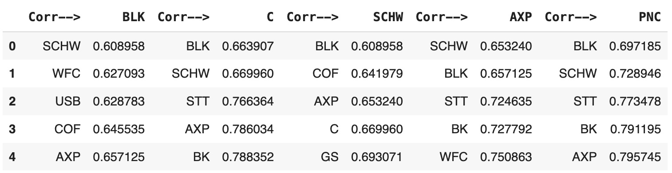
Sorted List According to Each Institution #2
Here is the top 5 with lowest correlation to:
Black&Rock (SCHW) - 0.609 min
Citigroup (BLK) - 0.664
The Charles Schwab Corporation (BLK) - 0.609 min
American Express Company (SCHW) - 0.653
The PNC Financial Service Group (BLK) - 0.697

Slide 9
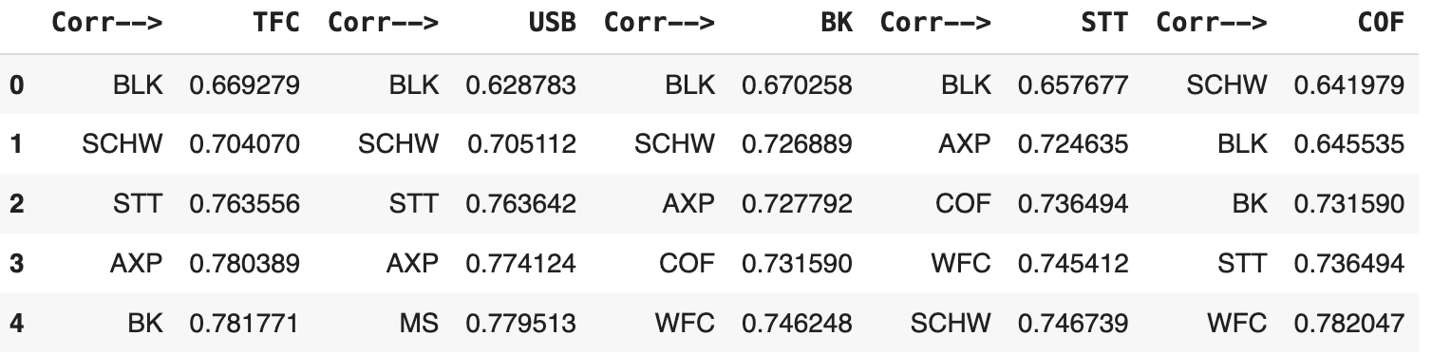
Sorted List According to Each Institution #3
Here is the top 5 with lowest correlation to:
Truist Financial Corporation (BLK) - 0.669
U.S. Bancorp (BLK) - 0.629 min
The Bank of New York Mellon Corporation (BLK)- 0.67
State Street Corporation (BLK) - 0.658
Capital One Financial Corporation (SCHW) - 0.642

Slide 10
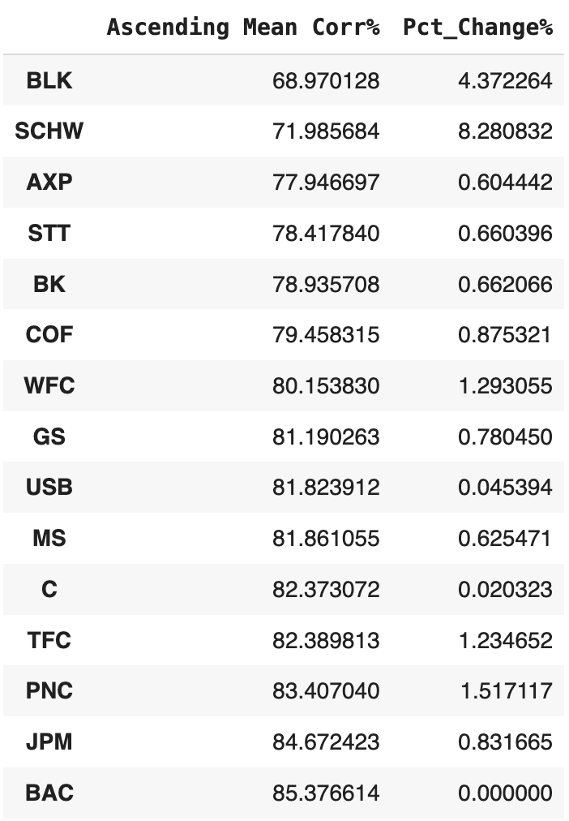
Sorted List According to Each Institution
The Global Minimum Corr:
BLK and SCHW - 0.609
Based the data on right hand side:
BLK and SCHW have relatively low correlation to other financial institution.

Slide 11
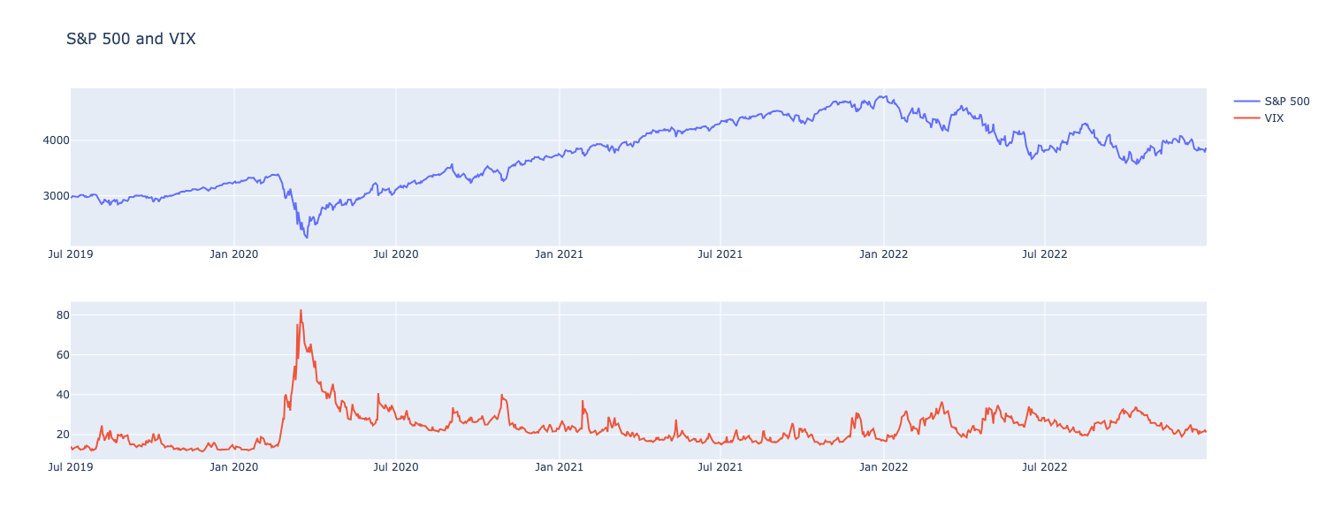
SPX & VIX

Slide 12
Chosen Technicals and Fundamentals
Technicals
SMA
RSI
MACD
Bollinger Bands
Volume Rate of Change
Fundamentals
D/E Ratio - Solvency
BPS -
Current Ratio - Liquidity
Equity Ratio
Net Debt
ROE -

Slide 13
BlackRock, Inc.

Slide 14
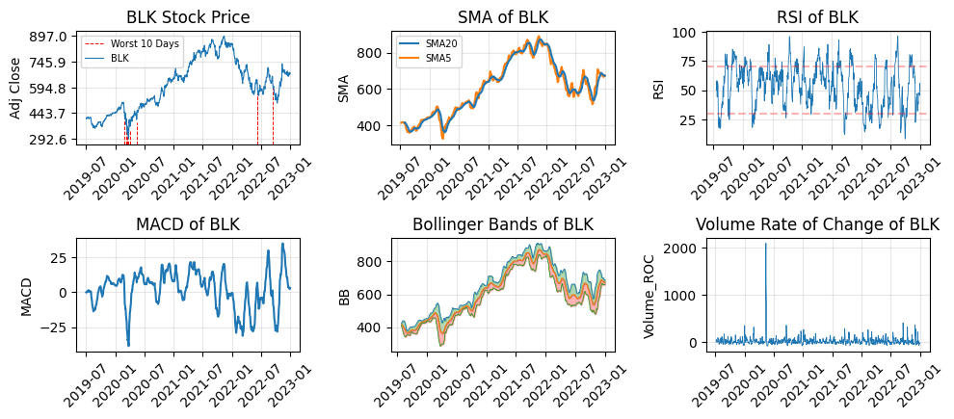
Overview:
Notes:
Worst 10 days:
S&P 500 experienced 4 fusings respectively on, March 09, March 12,March 16, March 18, due to the Covid-19.
Bureau of Labor Statistics Released CPI on 2022-09-13 8.3% 2022-06-10 8.6% The inflation rate are higher than market expectations
High VROC:
Government: US Fiscal stimulus -> CARES ACT, $2 Trillion economic relief, European Recovery plans
Central Banks: Low Interest rate policy, Unlimited QE program
Reopening of Economics: By may 2020, some countries had started to ease lockdown restrictions to reopen businesses, leading investors to anticipate a swift economic recovery

Slide 15
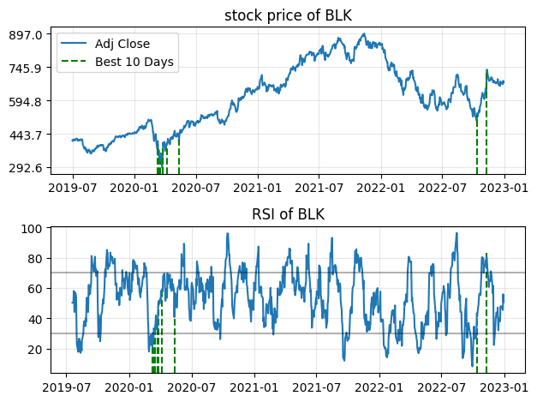
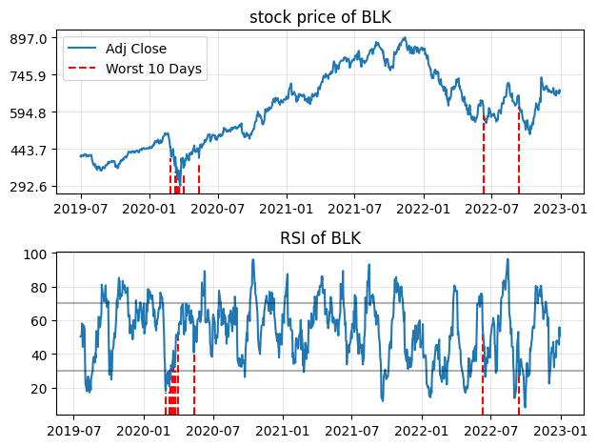
Relative Strength Index：
The best days in the market often occur close to the worst days (High Volatility)

Slide 16
Sharpe Ratio:
The Effective Annual Rate (EAR) of the geometric mean of the three-month Treasury yield over the period is used as the risk-free rate (Rf). The Sharpe Ratio for holding the equity is approximately 0.00416.

Slide 17
COVID 19 Impact (2020)
Sharp Volatility in Early 2020: The most significant period of volatility occurred during the global market crash in March 2020 due to the onset of the COVID-19 pandemic. Lockdowns, economic uncertainty and the subsequent market sell-off caused BlackRock's stock price to decline sharply, as seen in the early months of 2020.
Global Economic Restart: Later in 2020, the markets began to recover as governments and central banks initiated stimulus measures. BlackRock’s price rebounded strongly due to these efforts, coupled with its strong asset management portfolio, which benefited from the market recovery and increased investor confidence.

Slide 18
Inflationary Pressures and Supply Constraints (2021-2022)
By 2021, inflation began to rise due to global supply chain constraints, which resulted from the economic recovery post-pandemic. BlackRock's performance during this period was influenced by macroeconomic factors such as inflation driven by supply bottlenecks, as noted by BlackRock's own research. Increased demand for goods and supply shortages pushed inflation upward, creating market volatility​.
BlackRock also saw some volatility in late 2021 and early 2022 due to concerns over rising inflation, which impacted market sentiment. Asset management firms can see their stock prices fluctuate based on market performance and economic climate uncertainty, particularly when interest rates rise to combat inflation. By October 2022, BlackRock reported a 15% decline in AUM, dropping from $10 trillion at the end of 2021 to $8.5 trillion by Q2 2022. This was a result of both market volatility and clients pulling funds due to uncertain financial conditions. The drop in AUM led to lower revenues, exacerbating the stock's decline.

Slide 19
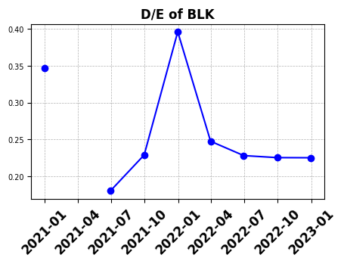
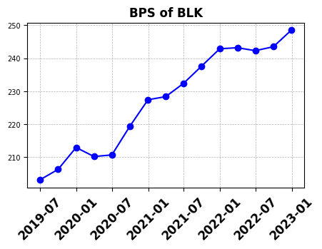
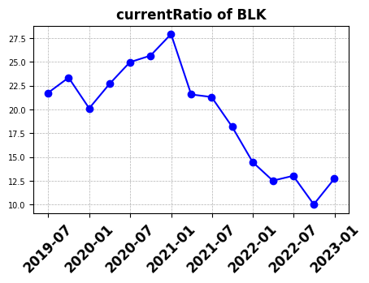
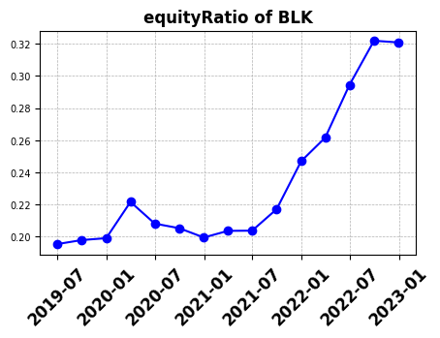
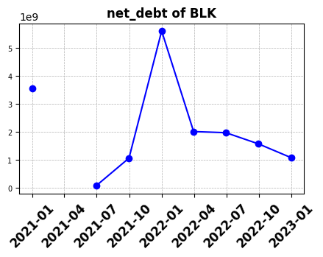
Fundamentals：

Slide 20
COVID 19 Impact and Aftershock (2020-2021)
Blackrock’s high liquidity, reflected by its high rising current ratio in 2020, provided a buffer against liquidity issues, which allowed the firm to withstand the immediate impact. The high volume ROC suggests investors actively reallocating their portfolios. The stock price initially dropped but recovered quickly due to massive fiscal stimulus measures, which injected liquidity into the markets. BlackRock likely benefited from increased trading volumes and market recovery efforts.
The D/E ratio begins to rise in late 2020, reaching its peak in late 2021 suggests that BlackRock took on more debt, possibly to capitalize on new investment opportunities and capture more assets during the bullish market phase. Rising BPS aligns with this expansion, as the company’s equity base strengthens due to reinvested profits and asset growth. The stock price and SMA-20 reflect strong bullish momentum, underscoring investor optimism as BlackRock’s fundamentals strengthened in line with the market.

Slide 21
Inflationary Concerns and Rate Hikes (2021-2022)
Inflation concerns began to surface in late 2021, prompting the Federal Reserve to signal upcoming interest rate hikes. BlackRock’s stabilized D/E ratio could indicate that the company anticipated these shifts, choosing to reduce debt exposure to avoid higher interest expenses. The sharper decline in the current ratio suggests that BlackRock’s liquidity became more constrained, possibly due to ongoing investments or preparation for a more uncertain economic climate. This period marks a turning point where BlackRock, while still fundamentally strong (as indicated by the rising BPS), starts facing potential liquidity challenges.
In 2022, the Federal Reserve implemented aggressive interest rate hikes to curb inflation. These changes led to tightening financial conditions, impacting leveraged firms. BlackRock’s high net debt and reduced current ratio suggest that the company’s liquidity was strained under the new economic pressures, particularly with increased interest rates. Although the equity ratio remained strong, indicating a solid shareholder base, BlackRock’s debt likely became more costly.

Slide 22
Charles Schwab Corporation

Slide 23
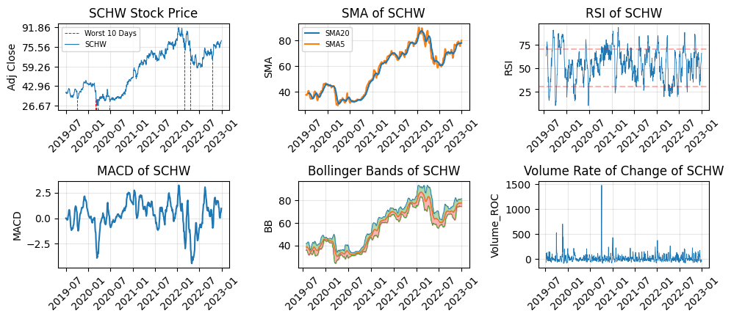
Overview:

Slide 24
Sharpe Ratio:
The Effective Annual Rate (EAR) of the geometric mean of the three-month Treasury yield over the period is used as the risk-free rate (Rf). The Sharpe Ratio for holding the equity is approximately 0.0633.

Slide 25
Early 2020 – COVID-19 Market Shock (March 2020)
Indicator: High spikes in the Bollinger Bands, Volume ROC, and MACD crossovers during early 2020.
Justification: The COVID-19 market shock caused unprecedented volatility as global markets plunged in March 2020. Schwab saw increased trading activity as investors reacted to the rapid market declines and then the massive rebound spurred by central bank interventions.
Firm Activities: Schwab likely benefited from the increased trading volumes as more clients turned to brokerage services to adjust their portfolios. However, uncertainty over the pandemic's duration caused market swings, further driving volatility.

Slide 26
Late 2021 – Early 2022: Inflation Concerns and Rate Hike Expectations
Indicator: Another period of Bollinger Band widening, reflecting increased volatility, as well as bearish MACD crossovers signaling a downtrend.
Justification: As inflation fears started to grow, the Federal Reserve signaled its intent to raise interest rates. Schwab’s stock, like much of the market, faced increased volatility as investors recalibrated expectations. Interest rate hikes tend to tighten financial conditions, which can lead to sell-offs in stocks, particularly those sensitive to borrowing costs.
Firm Activities: Schwab’s banking operations would be directly affected by higher rates, and while higher rates can improve profit margins on interest-sensitive products, they can also deter borrowers. Investors may have repositioned portfolios in anticipation of a rate hike cycle, increasing volatility.

Slide 27
Mid-2022 to Early 2023 – Fed’s Aggressive Rate Hikes
Indicator: High volatility in Volume ROC, further Bollinger Band widening, and bearish MACD crossovers.
Justification: The Fed's aggressive rate hikes to tame inflation led to heightened market uncertainty, as investors worried about economic slowdowns or recessions. These conditions tend to create volatility in financial markets. For Schwab, this would have translated into increased trading volume as clients adjusted their portfolios to account for rising rates and the risk of recession.
Firm Activities: Schwab’s trading volumes likely remained high as clients sought to reposition their investments. Rising interest rates, while generally positive for Schwab's interest income, likely led to concerns about a potential economic slowdown, adding to market volatility.

Slide 28
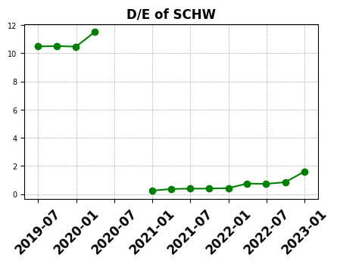
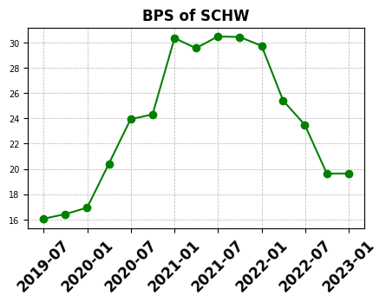
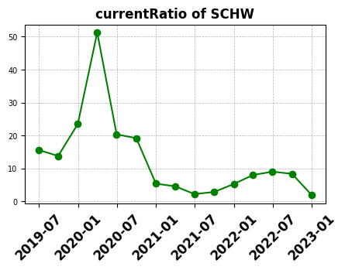
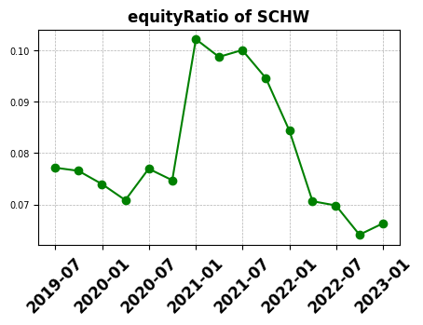
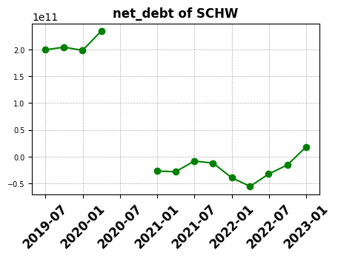
Fundamentals

Slide 29
Pandemic Shock (2020)
The onset of COVID-19 led to extreme market volatility. Schwab’s current ratio spike suggests a rapid influx of liquidity, likely due to a combination of new cash inflows from clients and a conservative approach to managing cash during uncertain times. High trading volumes (Volume ROC) indicate that investors were highly active, buying and selling frequently in response to market conditions. Schwab likely benefited from these high volumes, as increased trading activity translates into higher revenue for brokerage services. As markets reacted, Schwab's BPS increased rapidly, reflecting gains in equity value driven by market optimism. The low D/E ratio suggests that Schwab maintained a conservative debt position, relying more on organic growth than on leverage. The decrease in the current ratio suggests that Schwab redeployed some of its liquidity, possibly investing in growth opportunities or operations as market conditions stabilized.

Slide 30
Economic Tightening (2022)
The Federal Reserve’s aggressive rate hikes in 2022 to control inflation placed significant pressure on Schwab’s liquidity and growth potential. The rise in net debt indicates that Schwab may have turned to debt financing to maintain operations or investments as cash flows and liquidity decreased. The significant drop in the current ratio highlights the constrained liquidity environment Schwab faced, reflecting the broader economic challenges. The decline in BPS and equity ratio suggests shrinking intrinsic value and reduced equity-financed growth.
By late 2022, Schwab shifted towards a stabilization strategy, focusing on managing existing resources and debt levels rather than aggressive expansion. The stabilization of BPS suggests that Schwab’s equity value has found support, with efforts likely directed at maintaining shareholder value.

