Slide 1
5 ML Algorithm
Explanations
Decision Tree, Random Forest, KNN,
SVM, and Gradient Boosting
Reporter：Lance Liu

Slide 2
PART 01
01
Decision Tree
PART 02
02
Random Forest
Outline
PART 03
03
CONTENTS
KNN
PART 04
04
SVM
PART 05
05
Gradient Boosting

Slide 3
01
PART ONE
Decision Tree

Slide 4

General Explanation
A Decision Tree is a supervised learning algorithm used for classification and regression tasks.
It splits the dataset into branches based on feature values, leading to decisions at each node until a final outcome is reached.
It’s easy to interpret and visualize but can overfit if not properly tuned.

Slide 5
Six Hyperparameters
1) max_depth
Maximum depth of the tree (controls overfitting).
Options: None, integer values (e.g., 1, 2, 3…)
2) min_samples_split
Minimum number of samples required to split an internal node.
Options: Integer values or a float (percentage).
3) min_samples_leaf
Minimum number of samples required to be at a leaf node.
Options: Integer values or a float (percentage).

Slide 6
Six Hyperparameters
4) criterion:
Function to measure the quality of a split.
Options: “gini”, “entropy” for classification, For regression, “mse” (Mean Squared Error) or “mae” (Mean Absolute Error)
5) max_features:
Number of features to consider when looking for the best split.
Options: None, integer, or float (percentage).
6) splitter:
Strategy used to choose the split at each node.
Options: “best”, “random”.

Slide 7
02
PART TWO
Random Forest

Slide 8



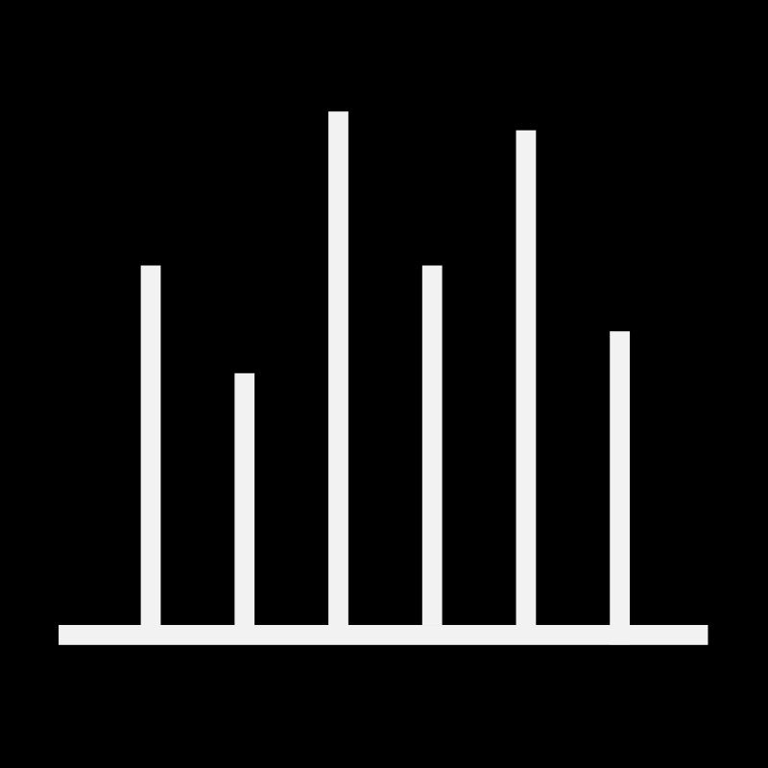
General Explanation
Ensemble
Improve
• A Random Forest is an ensemble method that combines multiple Decision Trees to improve predictive accuracy and control overfitting.
• It builds each tree on a random subset of data and features, then aggregates their outputs.
• It’s robust against noise and can handle high-dimensional spaces.
Against Noise
High Dimension

Slide 9
Two Mainly Diff Hyperparameters
1) n_estimators:
Description: The number of trees in the forest.
Options: Integer values (e.g., 100, 200).
Impact: More trees generally lead to better model stability and accuracy, but they also increase training time. Too few trees may result in higher bias.
2) boostrap:
Description: Whether to use boostrap sampling method (with replacement).
Options: Boolean options.
Impact: Using bootstrap sampling generates different training datasets for each tree, increasing model diversity; if False, all trees will use the same training data.

Slide 10
03
PART THREE
K-Nearest Neighbors

Slide 11
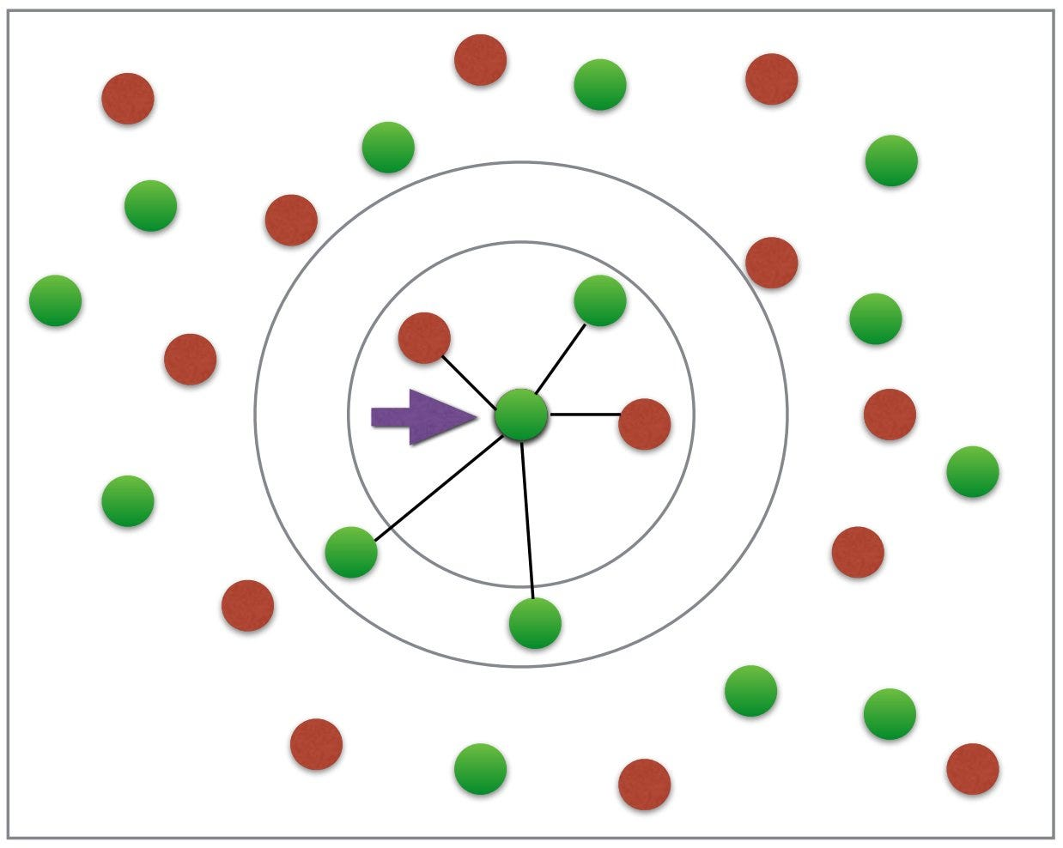
General Explanation
K-Nearest Neighbors (KNN) is a supervised, non-parametric, instance-based learning algorithm used for classification and regression.
It classifies data points based on the majority class among their K nearest neighbors in the feature space.
Its performance depends on the distance metric and the choice of K.

Slide 12
Six Hyperparameters
1) n_neighboors:
Description: The number of nearest neighbors to consider, denoted as K.
Impact: A small K value may lead to overfitting by making the model sensitive to noise, while a large K value may cause underfitting by oversimplifying the model.
2) weights:
Description: Determines how to assign weights to the neighbors for voting or value calculation.
Options: Boolean options.
Impact:
uniform: All neighbors have equal weight, depending on the majority of the class.
distance: Weights are assigned based on the distance to the neighbor, with closer neighbors having more influence.

Slide 13
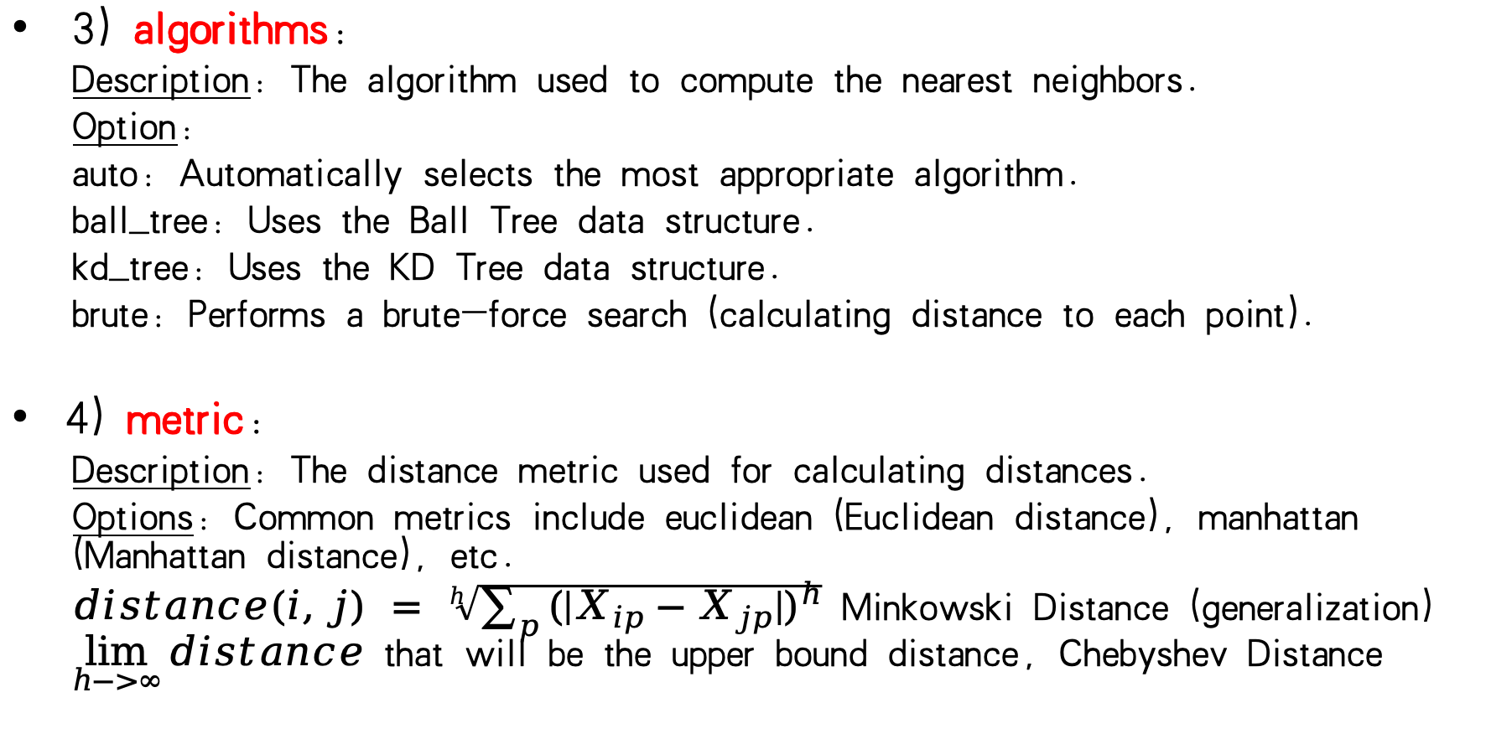
Six Hyperparameters
3) algorithms:
Description: The algorithm used to compute the nearest neighbors.
Option:
auto: Automatically selects the most appropriate algorithm.
ball_tree: Uses the Ball Tree data structure.
kd_tree: Uses the KD Tree data structure.
brute: Performs a brute-force search (calculating distance to each point).
4) metric:
Description: The distance metric used for calculating distances.
Options: Common metrics include euclidean (Euclidean distance), manhattan (Manhattan distance), etc.
$distance(i, j) = \sqrt[h]{\sum_{p}{{(|X_{ip}−X_{jp}|)}^{h}}}$ Minkowski Distance (generalization)
$\lim_{h−>∞}{distance}$that will be the upper bound distance, Chebyshev Distance

Slide 14
Six Hyperparameters
5) p:
Description: The parameter used to calculate Minkowski distance.
Option:
p=1: Calculates Manhattan distance.
p=2: Calculates Euclidean distance.
Other values: Calculates a more general Minkowski distance.
6) n_jobs:
Description: The number of parallel jobs to run for neighbors search.
Options:
-1: Use all available processors.
1 or any positive integer: Specifies the number of processors to use.

Slide 15
04
PART FOUR
Support Vecter Machine

Slide 16
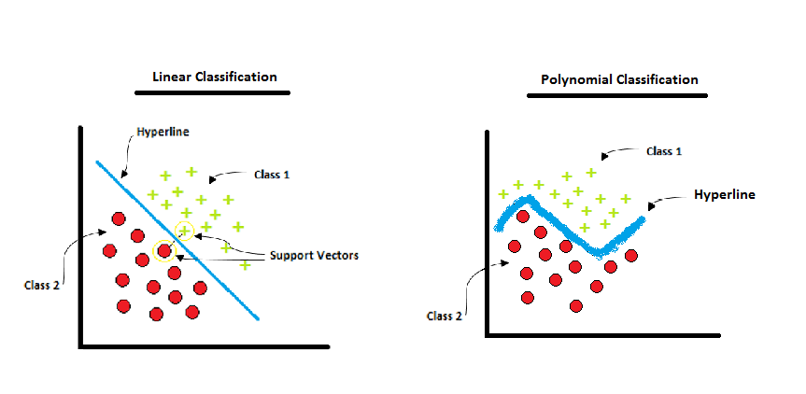
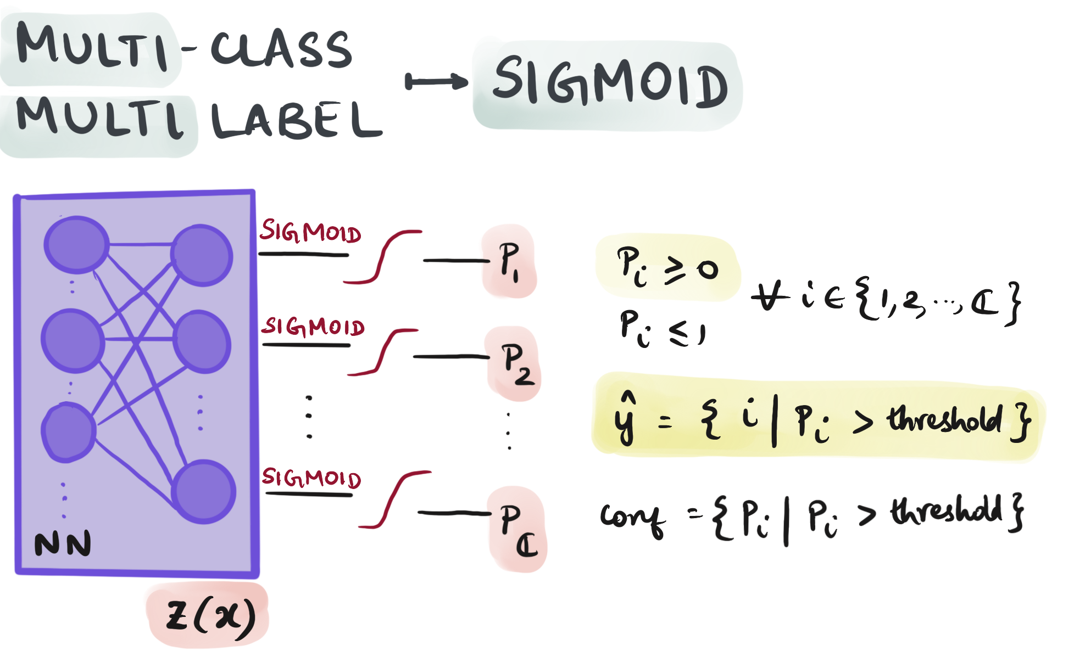
General Expanation
Support Vector Machine (SVM) is a powerful supervised learning algorithm for classification and regression tasks.
It works by finding the hyperplane that best separates data points of different classes.
SVM is effective in high-dimensional spaces and is versatile due to the use of different kernels.

Slide 17
Seven Hyperparameters
1) C:
Description: Regularization parameter that controls trade-off between maximizing the margin and minimizing classification error.
Option: Float values (e.g., 0.1, 1.0, 10.0)
2) Kernel:
Description: Type of kernel function to be used.
Options: “linear”, “poly”, “rbf”, “sigmoid”.
Impact:
Different kernel functions enable SVM to find decision boundaries in various feature spaces.Complex kernels can lead to overfitting, while simpler ones may miss key features.Linear kernels are efficient for large datasets, whereas RBF kernels can be slower in high dimensions.

Slide 18
Seven Hyperparameters
3) Kernel Parameters:
Description: Specific parameters that configure the chosen kernel function.
Options:
For RBF Kernel:gamma and for Polynomial Kernel: d.
4) Epsilon-Insensitive Loss Function Parameter:
Description: Used in Support Vector Regression (SVR) to define a margin of tolerance where no penalty is given to errors.
Options:
Low epsilon: Sensitive to small errors, which can lead to overfitting.
High epsilon: Less sensitive to errors, which may simplify the model.
5) Tolerance Parameter(tol):
Description: Sets the threshold for stopping the optimization process based on improvement in the objective function.
Options:
Small tol: The algorithm will iterate until a very precise solution is found, potentially increasing computation time.
Large tol: The algorithm may stop early, speeding up training but possibly sacrificing accuracy.

Slide 19
Seven Hyperparameters
6) Sample Weights:
Description: Specific parameters that configure the chosen kernel function.
Options:
Higher weights for minority classes: Helps the model pay more attention to underrepresented classes.
Lower weights for majority classes: Reduces the impact of overrepresented data.
7) Maximum Iterations:
Description: Limits the number of iterations during the training process.
Options:
High max_iter: Allows the optimization algorithm to run longer, which can lead to a better solution.
Low max_iter: Prevents excessive computation time but might lead to an incomplete solution.

Slide 20
05
PART Five
Gradient Boosting

Slide 21
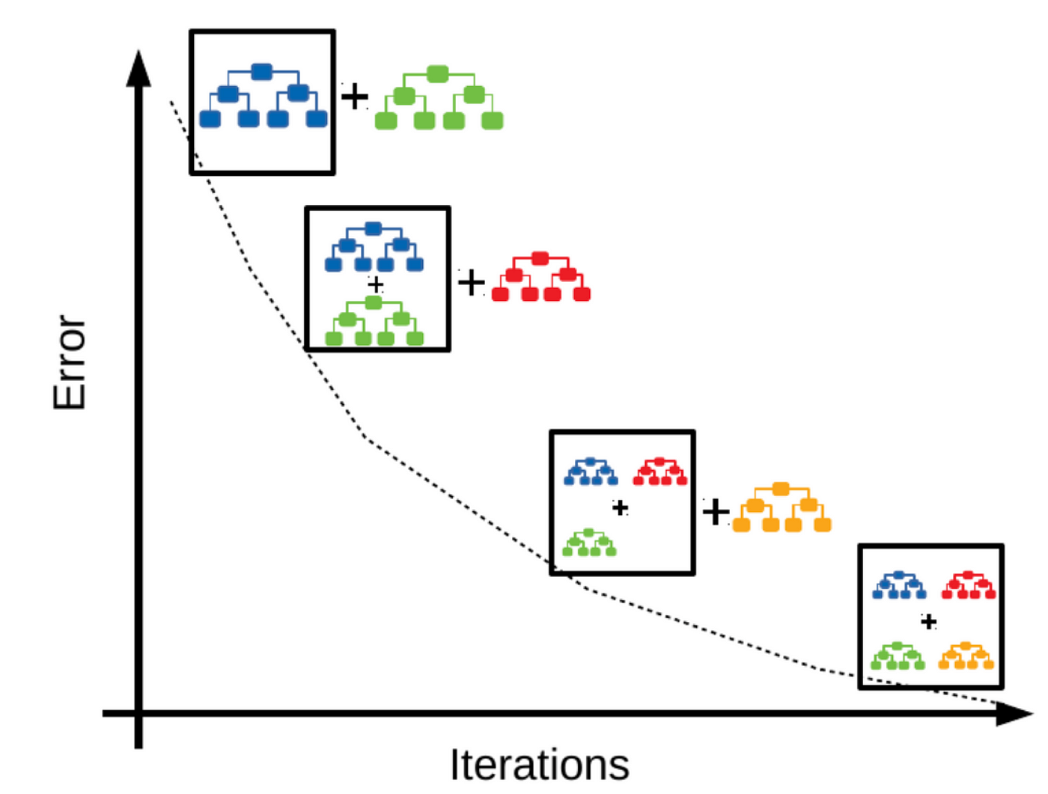
General Explanation
Gradient Boosting is an ensemble technique that builds models sequentially, with each new model attempting to correct the errors of the previous ones.
It combines weak learners (often Decision Trees) to create a strong predictive model.
Highly flexible and can be tuned for various loss functions.

Slide 22
Seven Hyperparameters
1) Learning Rate:
Description: Controls the contribution of each tree to the final prediction.
Option: A lower learning rate (e.g., 0.01) means the model learns more slowly but may result in better performance with more trees. A higher learning rate (e.g., 0.1) speeds up learning but risks overshooting the optimal solution.
2) Number of Estimators:
Description: The total number of trees in the ensemble.
Options: Increasing the number of estimators generally improves model performance but can lead to overfitting. Common values range from 100 to 1000, depending on the learning rate and dataset size.

Slide 23
Seven Hyperparameters
3) Max Depth:
Description: The maximum depth of each tree, limiting its complexity.
Options:
A deeper tree (e.g., max depth of 6 or more) can capture more intricate patterns but may overfit. Shallower trees (e.g., max depth of 3 or 4) are simpler and often lead to better generalization.
4) Subsample:
Description: The fraction of samples used to fit each individual tree.
Options:
A value less than 1 (e.g., 0.8) means only a portion of the data is used for training each tree, which can reduce overfitting. A value of 1 uses all data, potentially leading to overfitting.

Slide 24
Seven Hyperparameters
5) Min Samples Split:
Description: The minimum number of samples required to split an internal node. Options:
Higher values (e.g., 10 or 20) prevent the model from creating splits that capture noise, helping to control overfitting. Lower values allow for more splits, potentially improving performance on complex datasets.
7) Min Samples Leaf:
Description: The minimum number of samples that must be present in a leaf node.
Options:
Increasing this value (e.g., 5 or 10) ensures that leaf nodes contain enough samples, which can smooth predictions and reduce overfitting. A smaller value allows for more detailed splits.

Slide 25
Seven Hyperparameters
7) Regularization Parameters:
Description: Techniques to penalize more complex models and prevent overfitting.
Options:
L1 Regularization (Lasso): Adds a penalty equal to the absolute value of the coefficients. Useful for feature selection.
L2 Regularization (Ridge): Adds a penalty equal to the square of the coefficients. Helps prevent large coefficients, smoothing the model.

Slide 26
2024.SEP
THANK YOU
FOR WAHCTING
Reporter: Lance Liu

