Slide 1
Json and SSL module
Tutorial
簡報人：陳柏羽 數位銀行開發處
日 期：2019/07/22

Slide 2
Json and SSL module
Model
JsonFactory
Response
Request
SslClient
ESB
Service

Slide 3
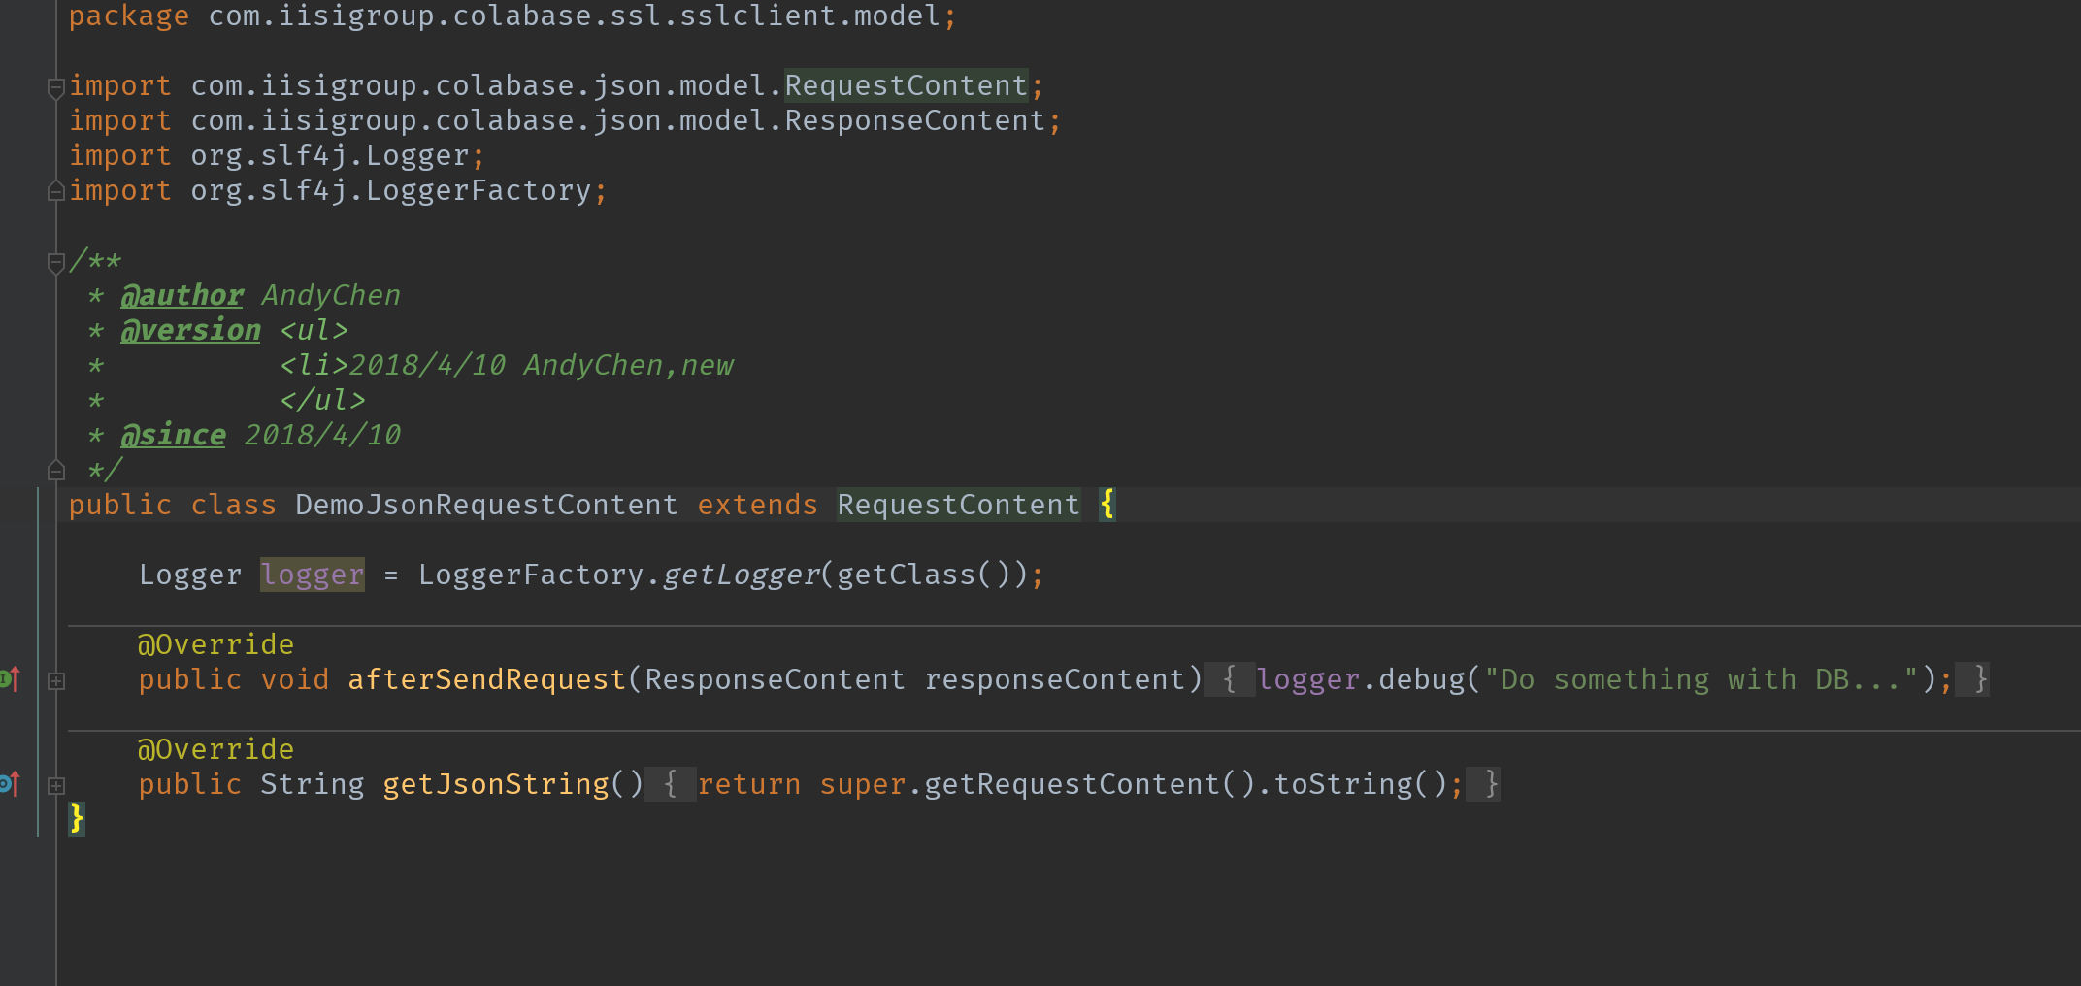
Step1
Request data model extend RequestContent

Slide 4
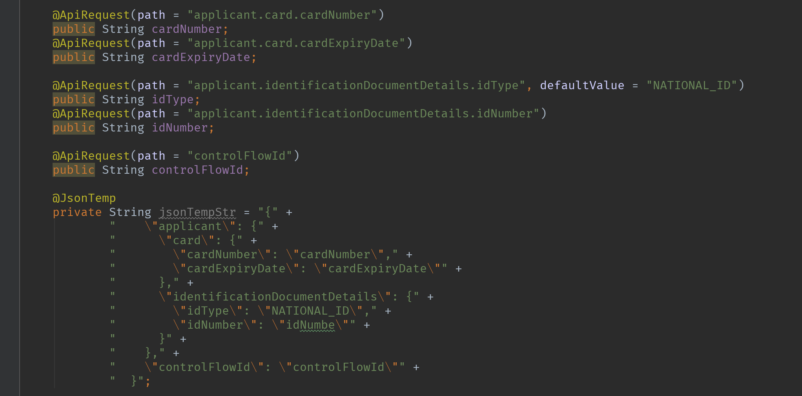
Step1.1
Request json structure MUST use @JsonTemp
Json variable as field and MUST use @ ApiRequest

Slide 5
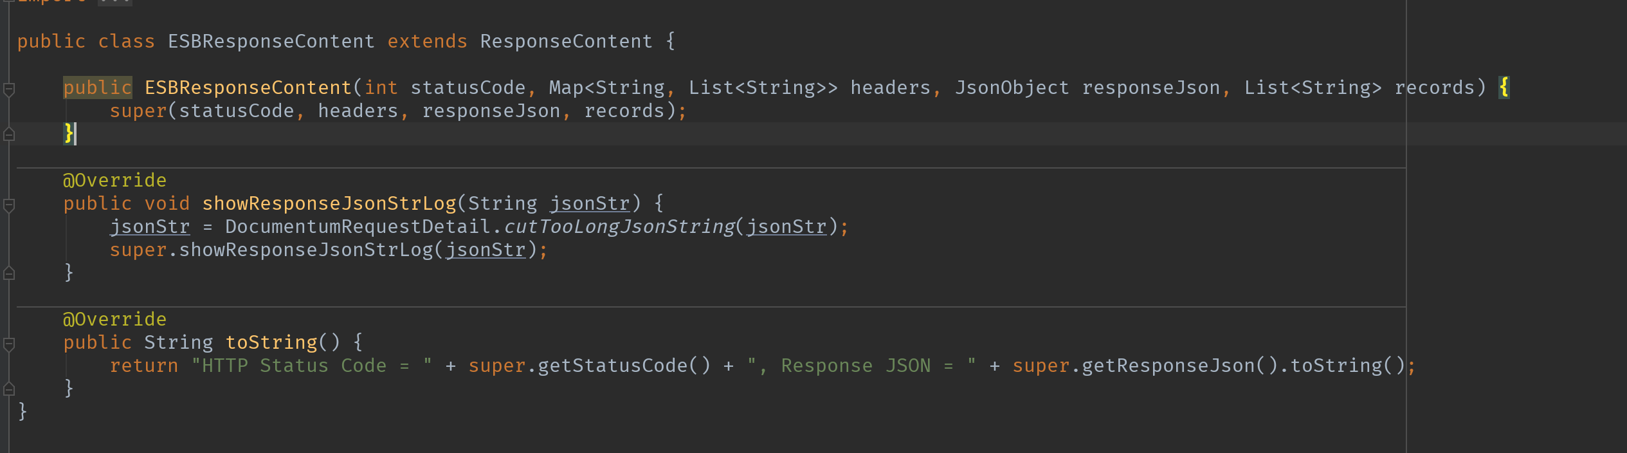
Step2
response data model extend ResponseContent (optional)

Slide 6
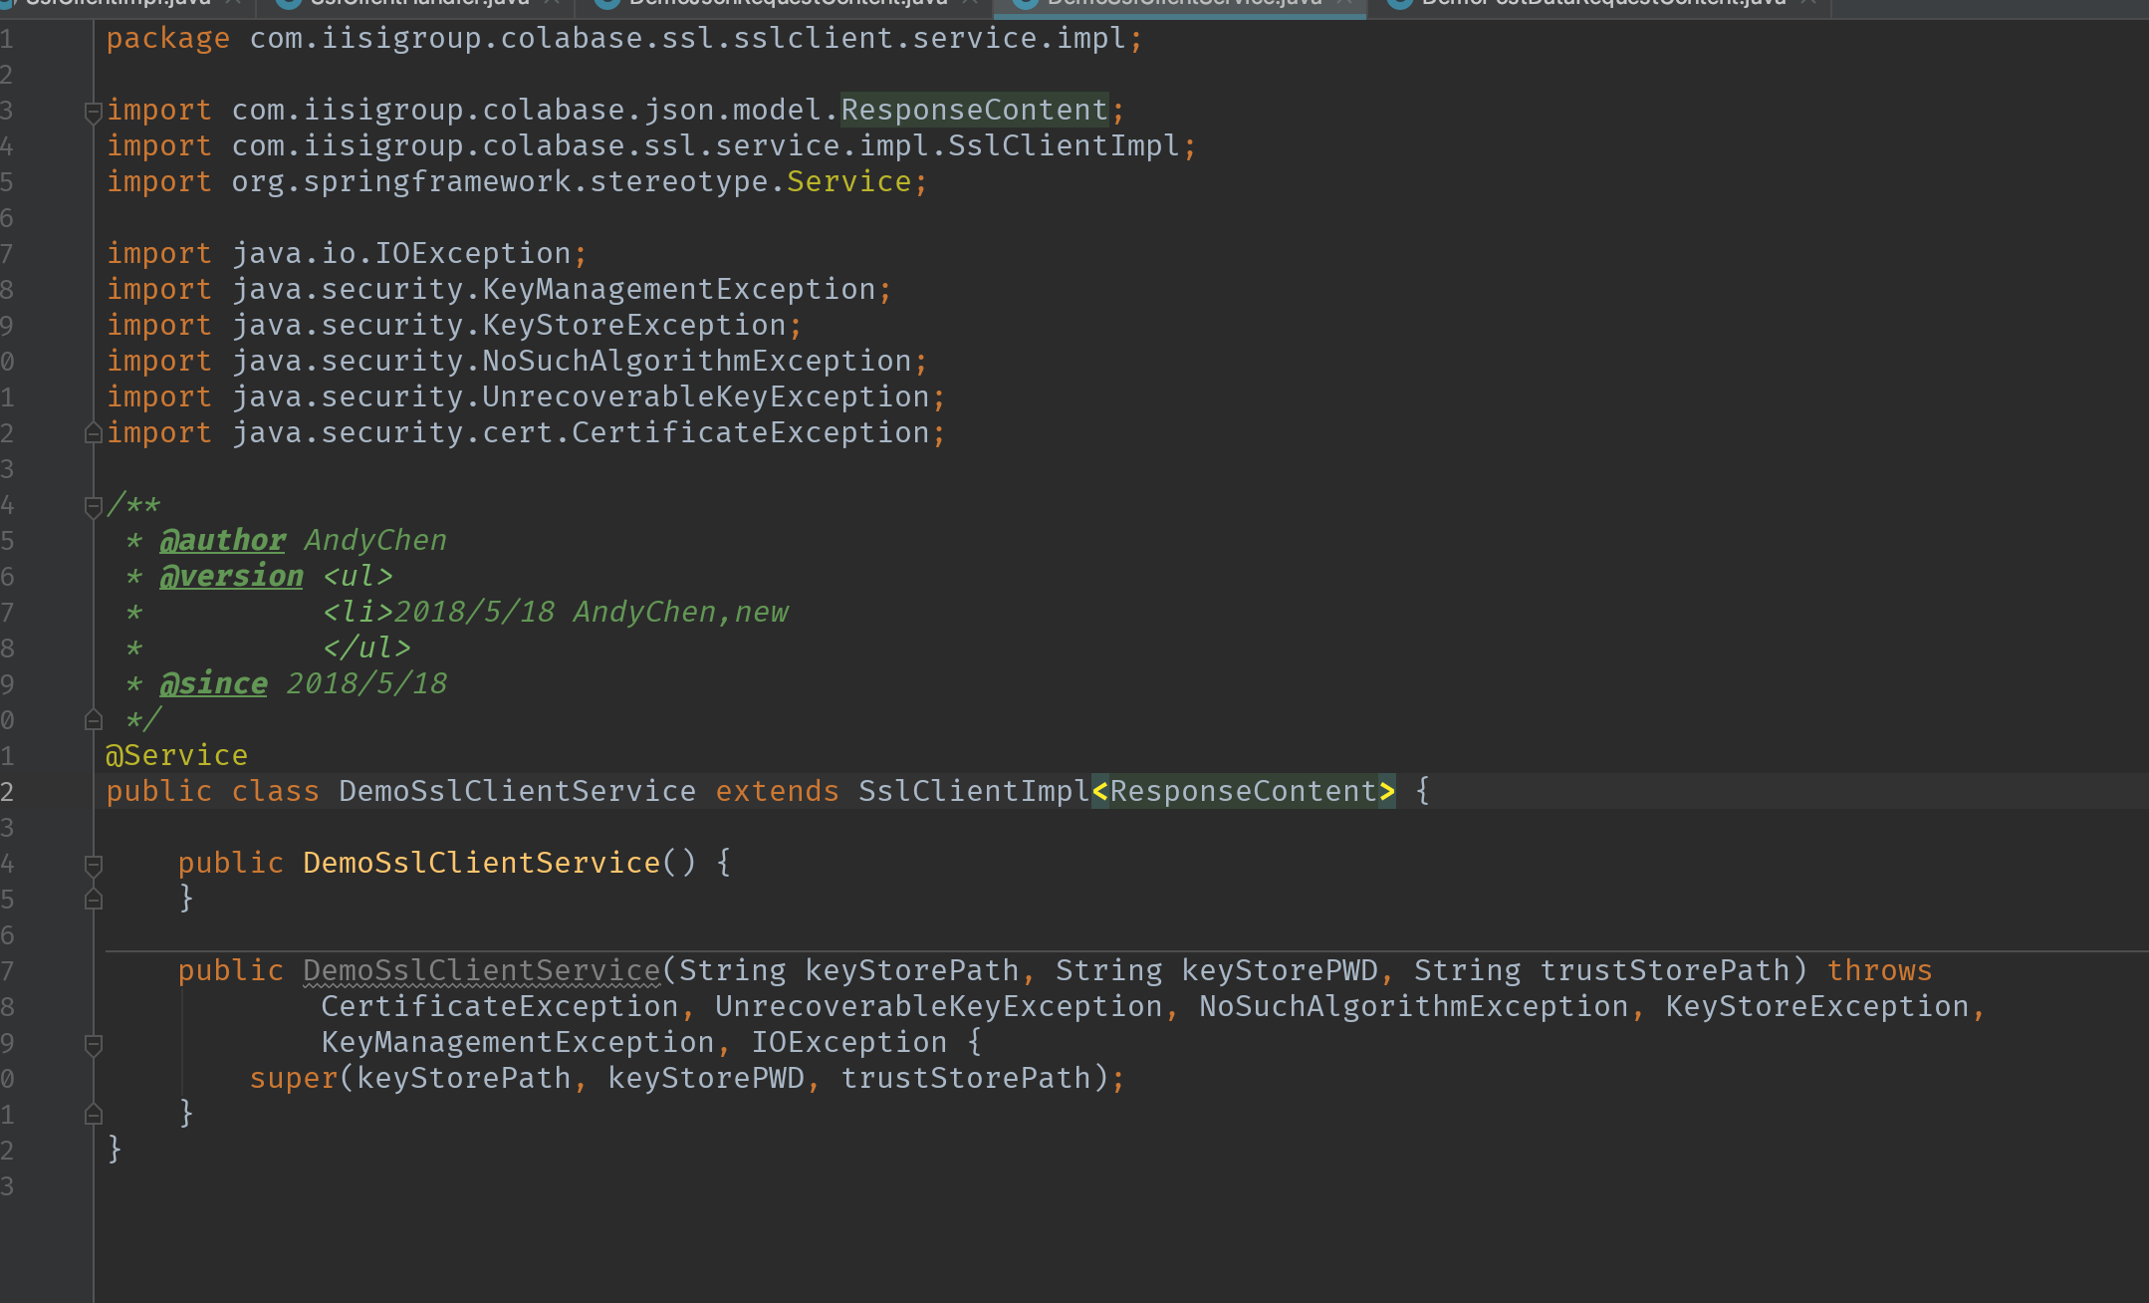
Step3
service extend SslClientImpl

Slide 7
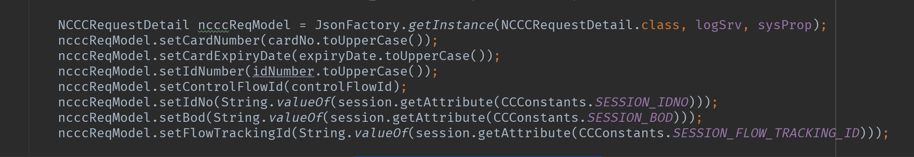
Step4
Initialize model use JsonFactory and set param with data model.

Slide 8
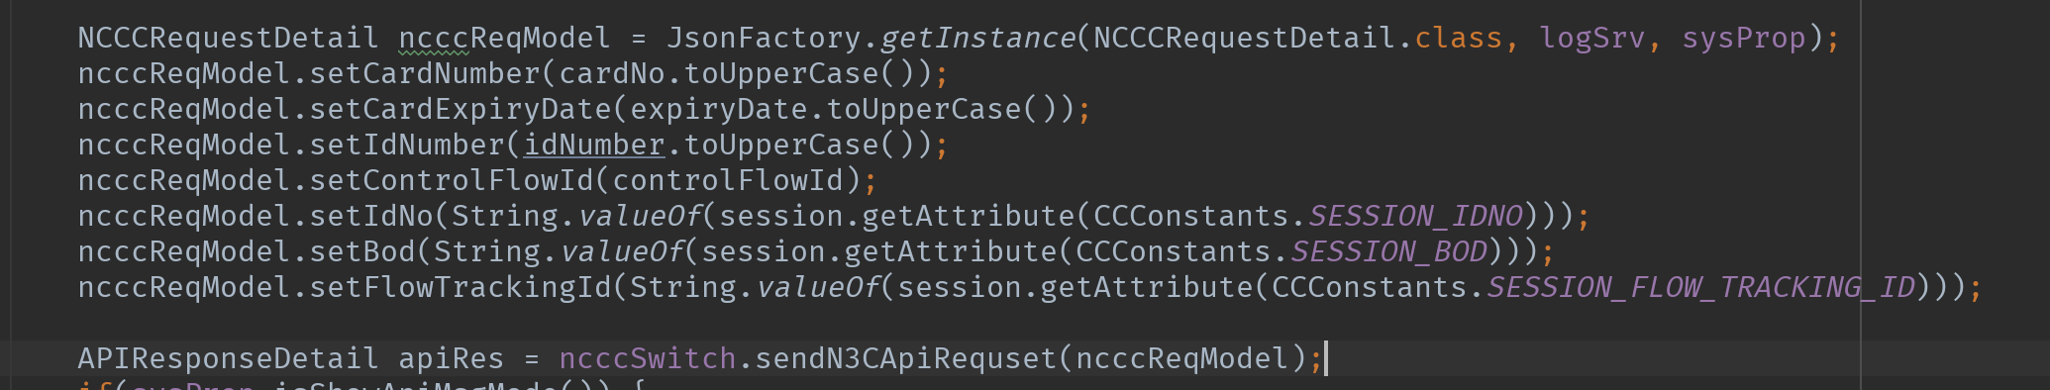
Step5
Use your own service send api with model

Slide 9
- 敬請指教 -

