Slide 1
AI6127 Presentation
Sha Long
Sudhakar Selvaraj
Deng Jie
Lei Litian
Chai Weichen
Notes:
Hi, we are group 17. I’m Sha Long, and I’ll be the presenter for our project on improving NMT on legal documents.

Slide 2
Table of contents
01
02
03
04
05
06
Data processing
Introduction
Dataset
Evaluation Methods
Model Finetuning
Results & Analysis
Notes:
Here’s our table of contents. We’ll start with introduction, and then dataset, data processing, evaluation method, model finetuning, and results & analysis

Slide 3
Introduction
Final Objective: Achieve a better legal domain translation model.
Approach: Fine-tune the existing OpusNMT (Helsinki-NLP/opus-mt-en-de) model.
Methods: Leverage domain-specific data (JRC-Acquis, with year 2000 as training and year 2006 as testing), enhanced XML processing, and regex-based term adjustments.
Outcome Expectation: Deliver a more accurate and robust translation system for legal documents.
Notes:
Our final objective is to achieve a better legal domain translation model. Instead of building a new system from scratch, we fine-tuned the existing OpusNMT model—the Helsinki-NLP/opus-mt-en-de—so it can better handle the unique challenges of legal text translation. We leveraged domain-specific data from the JRC-Acquis dataset, using documents from the year 2000 as our training set and those from 2006 for testing. In addition to the fine-tuning, we applied enhanced XML processing and regex-based term adjustments to further adapt the model to our targeted dataset. Our goal throughout this process has been to deliver a translation system that is more accurate and robust for real-world legal documents.

Slide 4
Dataset
Source: We used the JRC-Acquis English and German dataset.
Training Data: Documents from the year 2000 were selected as our training set.
Testing Data: Documents from the year 2006 were reserved for testing.
Domain Specific: This dataset provides robust legal document pairs with parallel alignment.
Notes:
In this slide, I’ll discuss the dataset we used. Our data source is the JRC-Acquis English and German dataset. This dataset is especially suitable for our needs because it provides well-aligned legal document pairs. For our project, we specifically selected documents from the year 2000 as our training data and reserved documents from 2006 as our testing data. This clear separation of training and testing data allows us to fine-tune the model on one period and evaluate its performance on another, thereby ensuring that our improvements are robust and generalize well to unseen legal texts

Slide 5
Data Processing
Extraction: Gather parallel English–German pairs from aligned XML files (matching *-en.xml with *-de.xml).
Tag Focus & Cleaning: Extract text from key XML tags (e.g., <title>, <head>, <p>, <note>), normalizing and removing unwanted characters.
Augmentation: Append curated legal term pairs to bolster domain-specific vocabulary.
Translation Pipeline: Process XML by selectively translating designated tags while preserving structural elements.
Post-Processing: Apply regex-based substitutions (e.g., “Official Journal” → “Amtsblatt”) and chunk lengthy texts for efficient processing.
Notes:
Next, let’s move on to data processing. Our approach starts by extracting parallel English and German sentence pairs from aligned XML files. We specifically match files ending in '-en.xml' with their corresponding '-de.xml' versions. To do this, we use Python’s ElementTree library to parse each XML file and then iterate over all elements.
We target key XML tags like <title>, <head>, <p>, and <note>, since these contain the text we need to translate. For each element, we first clean and normalize the text using a custom function. In our implementation, we call Python’s unicodedata.normalize with the 'NFKC' mode to standardize the text, and then use regular expressions to remove control characters and extra whitespace.
To further enhance our dataset for fine-tuning, we augment the extracted data by appending a set of carefully curated legal term pairs—like substituting 'Official Journal' with 'Amtsblatt', 'paper edition' with 'Papierausgabe', and others. This step ensures our model learns the appropriate translations for these key terms.
After this extraction and augmentation process, our translation pipeline processes the XML files with our custom XML Translator class. The translator selectively translates only the designated tags while preserving the structural integrity of the XML document. If the text in a tag exceeds a specific length (we use a threshold of 100 tokens), our ‘split_long_text’ function divides the text into smaller, manageable chunks. Each chunk is translated separately using a transformers pipeline with parameters such as a 5-beam search and a maximum length of 256 tokens. Once the chunks are translated, they are reassembled into the final translated text.
After translation, we apply regex-based post-processing on the output. This means that any predefined legal term patterns in the translated text are substituted with their target equivalents. Finally, our code updates the XML language attributes (setting the language to 'de') and writes the modified XML tree back to disk, ensuring that the document structure is fully preserved.
All these steps—extraction, cleaning, augmentation, chunked translation, and regex post-processing—work together to prepare our legal documents for fine-tuning and subsequent evaluation

Slide 6
Evaluation Methods
Metrics: Calculate BLEU, METEOR, TER, and COMET-QE scores using the evaluate library.
Metrics | Implementation
BLEU | evaluate.load('bleu')
METEOR | evaluate.load('meteor')
TER | evaluate.load('ter')
COMET-QE | evaluate.load('comet')
Notes:
In order to objectively measure the improvements achieved by our enhanced model, we use the evaluate library to compute several key metrics. Specifically, we calculate the BLEU, METEOR, TER, and COMET-QE scores. These metrics provide a comprehensive view of the translation quality improvements compared to our baseline model. By comparing the automated evaluation scores, we can quantify the effectiveness of our fine-tuning and data processing enhancements in terms of output fluency, accuracy, and overall coherence

Slide 7
Model Finetuning
Base Model: Use the existing Helsinki-NLP/opus-mt-en-de (OpusNMT) as the starting point.
Domain Fine-Tuning: Train the model on a curated legal corpus.
Parameter Freezing: Freeze encoder layers to retain pretrained knowledge.
Training Settings: Set a per-device batch size of 8, a maximum token length of 256, and run for 3 epochs with 5-beam search during inference.
Optimization: Enable FP16 precision when a suitable GPU is available.
Notes:
Now, let’s delve into the fine-tuning process in more detail. We started with the existing Helsinki-NLP/opus-mt-en-de model as our base OpusNMT, loading it along with its corresponding tokenizer from Hugging Face. Our legal corpus, which we curated and prepared as a TSV file, contains aligned English–German sentence pairs.
To ensure that the model retains its robust pretrained representations, we freeze the encoder layers by iterating through the encoder parameters and setting their requires_grad attribute to False. This means that during training, only the decoder and other trainable parts of the model are updated. We even printed out the number and names of the trainable parameters to verify this setup.
Next, we defined a custom preprocessing function that tokenizes the input English texts and target German texts. This function uses a maximum token length of 256, ensures that sequences are padded to a uniform length, and, crucially, replaces padding tokens in the target with -100 so that these tokens are ignored during loss computation. We then map this function over our entire dataset using the Hugging Face Dataset.map method, thereby converting our raw text data into tokenized inputs ready for training.
For training, we configured our training settings with the following parameters: a per-device batch size of 8, a learning rate of 5e-6, and training for 3 epochs. We also set a weight decay of 0.01 to help regularize the model and prevent overfitting. The training arguments also include settings for logging every 10 steps, saving a checkpoint at every epoch, and enabling FP16 precision if a compatible GPU is available, which significantly speeds up training while keeping memory usage in check. Additionally, during inference, we use a 5-beam search to generate higher quality translations.
Finally, we used Hugging Face’s Seq2SeqTrainer to combine our model, the training arguments, our tokenized dataset, and the tokenizer into one training loop. After training, we save the fine-tuned model and tokenizer to the output directory for subsequent use. All these implementation details in our fine-tuning process have been critical for adapting the model effectively to our specific legal domain.

Slide 8
Results & Analysis
Metric | Baseline(%) | Our System(%)
BLEU | 15.24 | 26.45
Avg Meteor | 32.81 | 40.04
COMET-QE | 44 | 63
TER | 125 | 95
Notes:
Let’s now review our results and analysis. Our enhanced model shows significant performance gains over the baseline. To give you specific numbers, the BLEU score increased substantially from 15.24 to 26.45, which indicates a strong improvement in n-gram overlap with reference translations. METEOR also rose from 32.81 to 40.04, demonstrating better handling of synonyms and morphological variations. Additionally, our COMET-QE score jumped from 44 to 63, providing evidence of higher quality translations even in reference-free evaluation. TER, on the other hand, was reduced from 125 to 95, meaning fewer edits are needed to match the reference, which shows enhanced coherence and accuracy. Overall, these results clearly confirm that our fine-tuning and post-processing methods have transformed the baseline into a more robust legal translation model ready for real-world applications.

Slide 9
Conclusion
Improved Model: Significant performance gains over the baseline.
Enhanced Adaptation: Domain-specific fine-tuning and post-processing have refined the translations.
Metric Gains: Notable increases in BLEU, METEOR, and COMET-QE scores; TER reduction.
Final Takeaway: A better, more robust legal translation model for real-world applications.
Notes:
In conclusion, our project has successfully enhanced the existing OpusNMT model for legal document translation. Through careful domain-specific fine-tuning and comprehensive data processing—including advanced XML handling and targeted regex-based term adjustments—we have achieved significant improvements in translation quality as evidenced by the evaluation metrics. Our work not only demonstrates the feasibility of adapting a general-purpose NMT model to a specialized legal domain but also provides a pathway for further optimization by expanding our terminology database and refining the fine-tuning parameters. Ultimately, this refined model is better suited to handle complex legal texts in practical applications. Thank you for your attention, and I’d be happy to answer any questions you might have.

Slide 10
References
JRC-Acquis Dataset: https://joint-research-centre.ec.europa.eu/language-technology-resources/jrc-acquis_en

Slide 11
Whoa!
This can be the part of the presentation where you introduce yourself, write your email…

Slide 12
01
Introduction
You can enter a subtitle here if you need it

Slide 13
Introduction
Mercury is the closest planet to the Sun and the smallest one in the entire Solar System. Contrary to popular belief, this planet’s name has nothing to do with the liquid metal. Mercury was, instead, named after the famous Roman messenger god Mercurius
Mercury takes a little more than 58 days to complete its rotation, so try to imagine how long days must be there! Since the temperatures are so extreme, albeit not as extreme as on Venus, Mercury has been deemed to be non-habitable for humans

Slide 14
Data collector & analysis
Do you know what helps you make your point crystal clear? Lists like this one:
They’re simple
You can organize your ideas clearly
You’ll never forget to buy milk!
And the most important thing: the audience won’t miss the point of your presentation

Slide 15
Data collection techniques
Surveying
Observation
Mercury is the closest planet to the Sun and the smallest one in the Solar System—it’s only a bit larger than the Moon
Venus has a beautiful name and is the second planet from the Sun. It’s hot and has a very poisonous atmosphere

Slide 16
Data analysis demystified
Descriptive
Inferential
Predictive
Mercury is the closest planet to the Sun and the smallest of them all
Venus has a beautiful name and is the second planet from the Sun
Despite being red, Mars is actually a cold place. It’s full of iron oxide dust

Slide 17
Unlocking the power
Data insights
Predictive modeling
Mercury is the closest planet to the Sun and the smallest of them all
Venus has a beautiful name, but also very high temperatures
Optimization
Data visualization
Saturn is the second-largest planet in the Solar System
Jupiter is a gas giant and the biggest planet in the Solar System

Slide 18
Data analysis for beginners
Collection
Cleaning
Exploratory
Despite being red, Mars is a cold place
Venus has extremely high temperatures
Neptune is the farthest planet from the Sun
Statistical
Visualization
Hypothesis
Mercury is the closest planet to the Sun
Saturn is a gas giant and has several rings
Jupiter is the biggest planet of them all

Slide 19
Awesome words

Slide 20
—Someone Famous
“This is a quote, words full of wisdom that someone important said and can make the reader get inspired”

Slide 21

A picture is worth a thousand words

Slide 22

A picture always reinforces
the concept
Images reveal large amounts of data, so remember: use an image instead of a long text. Your audience will appreciate it

Slide 23
98,300,000
Big numbers catch your audience’s attention

Slide 24
9h 55m 23s
333,000
386,000 km
Jupiter’s rotation period
The Sun’s mass compared to Earth’s
Distance between Earth and the Moon

Slide 25
Three percentages related
75%
50%
25%
Collection
Quality
Insight
Mercury is the closest planet to the Sun and the smallest of them all
Venus has a beautiful name and is the second planet from the Sun
Despite being red, Mars is actually a cold place. It’s full of iron oxide dust

Slide 26

Computer mockup
You can replace the image on the screen with your own work. Just right-click on it and select “Replace image”

Slide 27

Phone mockup
You can replace the image on the screen with your own work. Just right-click on it and select “Replace image”

Slide 28
Where did we take the sample from?
United Kingdom
Mercury is the closest planet to the Sun and the smallest of them all
United States
Venus has a beautiful name and is the second planet from the Sun

Slide 29
Historical
1XXX
1XXX
1XXX
1XXX
Venus has a beautiful name
Mercury is very small planet
Mars is full of iron oxide dust
Jupiter is an enormous planet
2XXX
2XXX
2XXX
Now
Saturn is a gas giant and has rings
Uranus is one of the ice giants
Earth is the planet that harbors life
Neptune is very far from the Sun

Slide 30
Data collection: best practices
Clarity
Precision
Mars is actually a very cold place
Saturn is a gas giant and has several rings
Privacy
Variety
Mercury is the closest planet to the Sun
Venus has extremely high temperatures

Slide 31
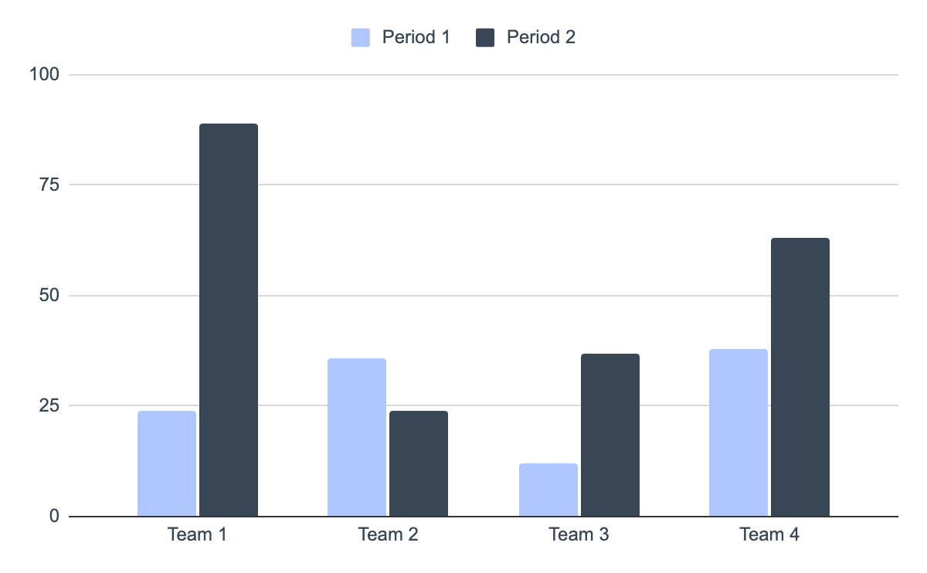
You can use this graph
Mercury
Mercury is the closest planet to the Sun and the smallest of them all
Venus
Venus has a beautiful name and is the second planet from the Sun
Follow the link in the graph to modify its data and then paste the new one here. For more info, click here

Slide 32


Our team
Alexander Hill
Maria Karla
You can speak a bit about this person here
You can speak a bit about this person here

Slide 33
Data collection vs data analysis
Data collection
Data analysis
Despite being red, Mars is actually a cold place. It’s full of iron oxide dust
Mercury is the closest planet to the Sun and the smallest of them all
Venus has a beautiful name and is the second planet from the Sun
Saturn has several rings. It’s composed mostly of hydrogen and helium
Neptune is the farthest planet from the Sun and the fourth-largest
Jupiter is a gas giant and the biggest planet in the Solar System

Slide 34
Project planner
November 2XXX
Project | Mon | Tue | Wed | Thu | Fri | Sat | Sun
Project 1
Project 2
Project 3
Project 4
Project 5

Slide 35
Assignment brief
Qualification | Mercury is a small planet
Unit number & tittle | Venus is a hot planet
Learning aim(s) | We all live on Earth
Assignment title | Saturn is a gas giant and has rings. It’s composed mostly of hydrogen and helium
Assessor | Jupiter is a huge gas giant
Issue date | 12/10/2XXX
Hand in deadline | 12/12/2XXX
Scenario | Community health and prevention research relies heavily on the collection and analysis of data to inform effective interventions. In this essay, critically examine the impact of different data collection methods on the success of community health initiatives
Task 1 | Discuss the advantages and limitations of various data collection techniques, such as surveys, interviews, observational studies, and secondary data analysis, and how they influence the development and implementation of prevention strategies

Slide 36
Rubric
 | Level 1 | Level 2 | Level 3 | Level 4
Performance 1 | You can add a description here | You can add a description here | You can add a description here | You can add a description here
Performance 2 | You can add a description here | You can add a description here | You can add a description here | You can add a description here
Performance 3 | You can add a description here | You can add a description here | You can add a description here | You can add a description here
Performance 4 | You can add a description here | You can add a description here | You can add a description here | You can add a description here

Slide 37
Exercise 1
What is the term for the process of ensuring that data collected is accurate and reliable?
In data collection, what is the term for a representative subset of a population?
A | Data analysis
A | Sample
B | Data interpretation
B | Survey
C | Data validation
C | Experiment
D | Data visualization
D | Observation

Slide 38
Exercise 2
Explain what is the difference between data collection and data analysis?
You can answer here
How to unlock the power of data collection and analysis?
You can answer here

Slide 39
What’s the difference?
Data collection
Data analysis
Survey
Descriptive
Mars is actually a very cold place
Jupiter is a huge gas giant
Interview
Inferential
Venus has high temperatures
Mercury is a small planet
Observation
Hypothesis
Earth is the planet with life
Saturn has several rings

Slide 40
Let’s review before wrapping up
Data collection
Data analysis
Information-gathering
Insights-generation
Venus has a beautiful name and is the second planet from the Sun
Despite being red, Mars is actually a cold place. It’s full of iron oxide dust

Slide 41
Thanks!
Do you have any questions?
youremail@freepik.com
+34 654 321 432
yourwebsite.com
Please keep this slide for attribution

Slide 42
Icon pack

Slide 43
Alternative resources
Here’s an assortment of alternative resources whose style fits that of this template:
Vectors
Geometric models background in flat design

Slide 44
Resources
Did you like the resources used in this template? Get them on these websites:
Vectors
International nurses day template
Icons
Icon Pack: Research and Development | Lineal
Photos
Student posing during a group study session with colleagues
Friends learning in a study group
Front view smiley man holding laptop
Portrait of senior woman in professional blazer outdoors

