Slide 1
Predicting Acute Kidney Injury in Septic ICU Patients Using Mean Arterial Pressure
HST.953 Final Presentation
Nalini Singh
Chen Xie
Juliann Corey, R.N., M.S.N.
Matthieu Komorowski, M.D.
Li-wei Lehman, Ph.D.
Notes:
Nalini

Slide 2
Background: Sepsis
Notes:
Chen

Slide 3
Background: AKI
Notes:
Nalini

Slide 4
Study Hypothesis
High severity and long duration of hypotensive episodes are associated with increased risk of AKI in septic ICU patients.
Notes:
Nalini

Slide 5
Cohort
Notes:
Chen

Slide 6
Methodology: MAP Features
Minimum MAP over entire ICU stay
Percent of ICU stay spent with average hourly MAP within the following bins:
30-40 mmHg
40-50 mmHg
50-60 mmHg
60-70 mmHg
70-80 mmHg
80-90 mmHg
90+ mmHg
Notes:
Nalini

Slide 7
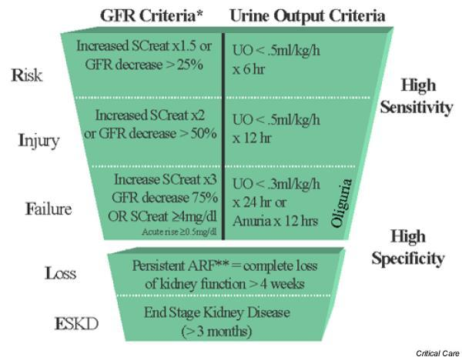
Methodology: AKI Criteria
Notes:
Chen

Slide 8
Methodology: AKI Criteria
Notes:
Chen

Slide 9
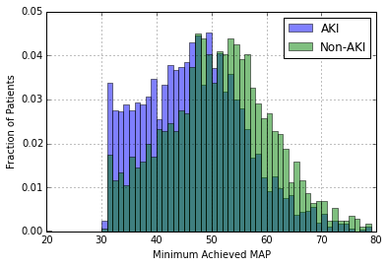
Results: MAP Distributions
Notes:
Nalini

Slide 10
Results: Logistic Regression
Notes:
Nalini

Slide 11
Results: Logistic Regression
Notes:
Nalini

Slide 12
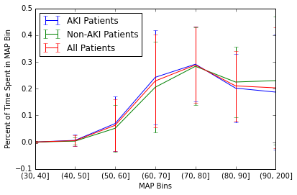
Results: Hypotension Durations
Notes:
Nalini

Slide 13
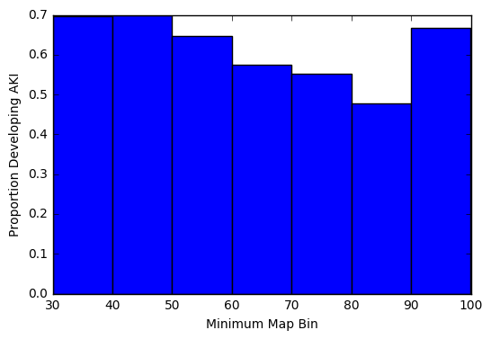
Results: Hypotension Durations
Notes:
Chen

Slide 14
Summary and Next Steps
Key Takeaways
Minimum MAP achieved lower for AKI patients than non-AKI patients
Higher proportion of patients with low MAPs have AKI
Future Directions
Investigate additional MAP features
Investigate hypertension

