Slide 1
Predicting Acute Kidney Injury in Septic ICU Patients Using Mean Arterial Pressure
HST.953 Final Presentation
Nalini Singh
Chen Xie
Juliann Corey, R.N., M.S.N.
Matthieu Komorowski, M.D.
Li-wei Lehman, Ph.D.
Notes:
Nalini

Slide 2
Background: Sepsis
>1 million
Americans afflicted per year. 28–50%
Mortality rate.
$14.2 billion
Estimated cost per year.
Sepsis:
overwhelming, life-threatening response to infection
Sepsis is the leading precipitating factor of AKI.
Notes:
Chen

Slide 3
Background: AKI
Acute Kidney Injury:
rapid decrease in kidney function
36%
Of ICU patients affected. 37–50%
Mortality rate.
Hypotension is a probable factor in development of AKI.
Notes:
Chen

Slide 4
Study Hypothesis
High severity and long duration of hypotensive episodes are associated with increased risk of AKI in septic ICU patients.
Notes:
Nalini

Slide 5
Cohort
MIMIC III
61,532 ICU stays
Age < 18 or ICU stay length < 3 days
Adult, ICU LOS > 3 days
19,534 ICU stays
Non-septic based on Angus criteria (Based on ICD9 Codes)
Septic
10,097 ICU stays
Chronic Kidney Disease (CKD)
(Based on ICD9 Codes)
No CKD
7,681 ICU stays
Missing lactate, creatinine, or has admission creatinine > 1.5 mg/dL
Pertinent Measurements
4,663 ICU stays
Notes:
Chen

Slide 6
Methodology: MAP Features
Minimum MAP over entire ICU stay
Percent of ICU stay spent with average hourly MAP within the following bins:
30-40 mmHg
40-50 mmHg
50-60 mmHg
60-70 mmHg
70-80 mmHg
80-90 mmHg
90+ mmHg
Notes:
Nalini

Slide 7
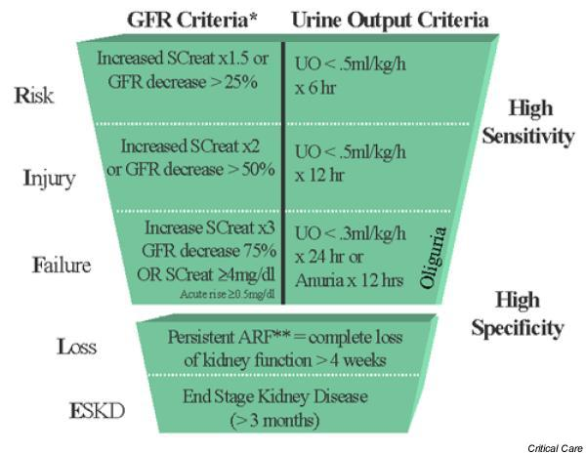
Methodology: AKI Criteria
Notes:
Chen

Slide 8
Methodology: AKI Criteria
Notes:
Chen

Slide 9
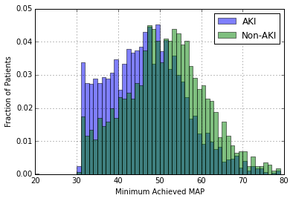
Results: MAP Distributions
Notes:
Nalini

Slide 10
Results: Logistic Regression
Covariate | P-value | Odds Ratio
Age | <0.001 | 1.00
Gender: Female | <0.001 | 1.03
Ethnicity (ref: White)
American Indian/Alaska Native | 0.686 | 0.55
Asian | <0.001 | 0.38
Black/African American | 0.841 | 0.97
Hispanic/Latino | 0.037 | 0.69
Multi/Other | 0.152 | 0.75
Unknown | 0.502 | 0.93
Length of Stay | <0.001 | 1.05
Maximum Lactate | <0.001 | 1.05
% Time on Vasopressors | 0.125 | 1.29
Minimum MAP | <0.001 | 0.97
Notes:
Nalini

Slide 11
Results: Logistic Regression
Covariate | P-value | Odds Ratio
Age | <0.001 | 1.00
Gender: Female | <0.001 | 1.03
Ethnicity (ref: White)
American Indian/Alaska Native | 0.686 | 0.55
Asian | <0.001 | 0.38
Black/African American | 0.841 | 0.97
Hispanic/Latino | 0.037 | 0.69
Multi/Other | 0.152 | 0.75
Unknown | 0.502 | 0.93
Length of Stay | <0.001 | 1.05
Maximum Lactate | <0.001 | 1.05
% Time on Vasopressors | 0.125 | 1.29
Minimum MAP | <0.001 | 0.97
Notes:
Nalini

Slide 12
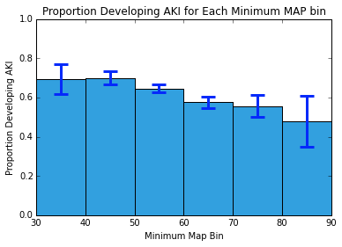
Results: Hypotension Severities
Notes:
Chen

Slide 13
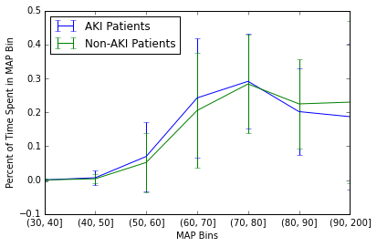
Results: Hypotension Durations
Notes:
Nalini

Slide 14
Summary and Next Steps
Summary
AKI associated with lower minimum MAP than non-AKI patients
No clear MAP cutoff for predicting AKI
Inconclusive regarding effect of hypotension duration on AKI likelihood
Next Steps
Investigate additional MAP duration features
Analyze results of hypertension

