Slide 1
State of the Craft Brewing Industry: A View from on Top

Slide 2
The Basic Layout
Brewery growth isn’t slowing
Sales growth is slowing
Larger craft brewers typically getting hit more
Local
Distribution
Large Brewers/High End Share
Variations on these themes – location, demographics, styles, model size, etc.
Vermont’s unique situation

Slide 3
Recent History

Slide 4
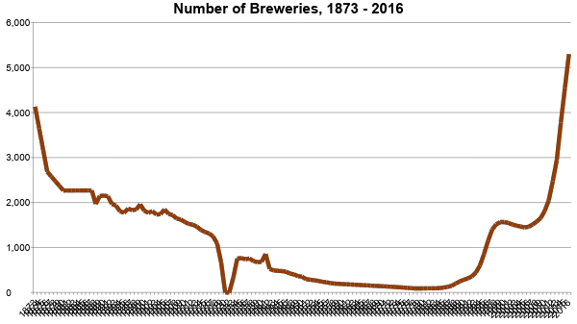
Sources:
Brewers Association
and Beer Institute

Slide 5
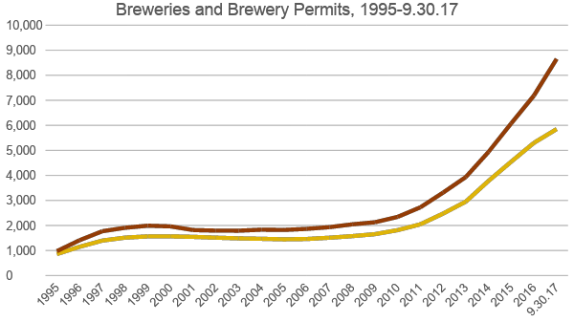

Slide 6
 | Domestic | Imports | Small and Independent | US Shipments
All figures in ‘000s of bbls (1 bbl = 31 gallons)
1981 | 177,034 | 5,221 | 35 | 182,290
2016 | 139,278 | 33,366 | 24,105 | 196,750
Change | -37,756 | 28,145 | 24,070 | 14,459

Slide 7
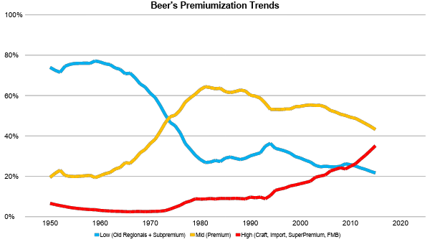

Slide 8
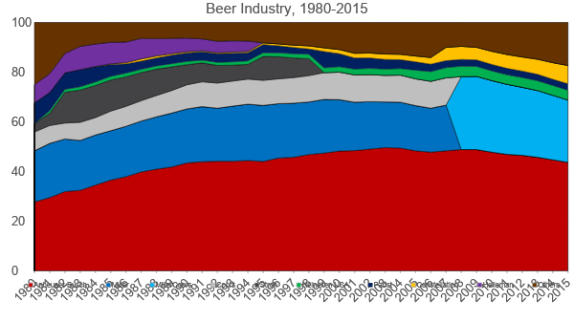

Slide 9
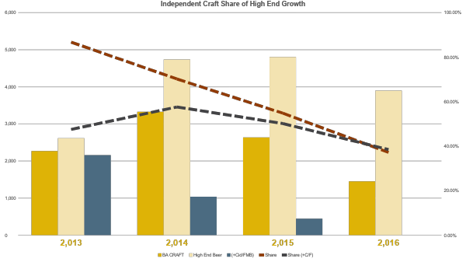

Slide 10
How Much Is Out There?
4 Million Barrels of “High End” Growth
- 2 Million for Imports
- 250K for Superpremium
= 1.75 M for “Craft”
- 500K for Large Brewer Craft
- 250K for new breweries (~800*300 barrels)
A million barrels left… split between 5,000 breweries
Micros (25% growth = 1.25M-.25 [new] = 1M)
Regionals (Up in mid-year, but not much)

Slide 11
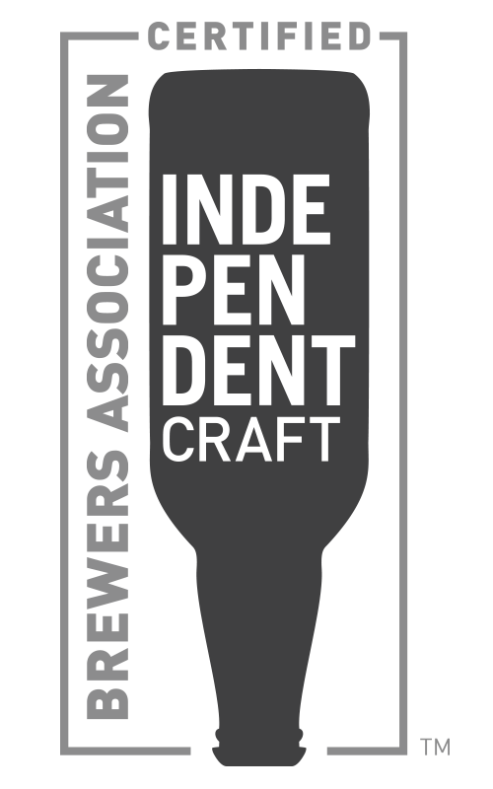
Independent Craft Brewer Seal
55% of craft purchases say they factor “small and independent” into purchase decision
Shoppers Drinkers
Low Awareness
Information helps in a cluttered world (why the “jam study” is wrong)

Slide 12
Current Status

Slide 13
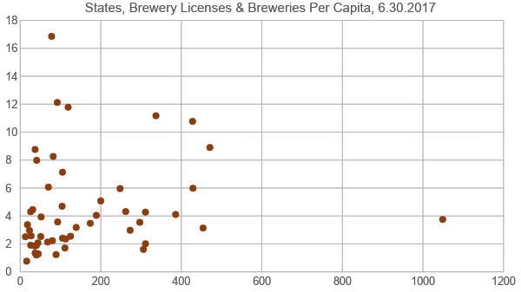

Slide 14
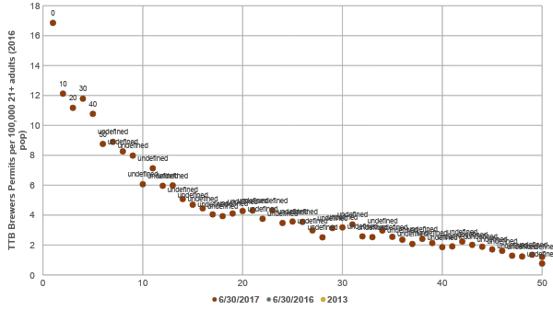
Sources: TTB, US Census Bureau,
and Brewers Association

Slide 15
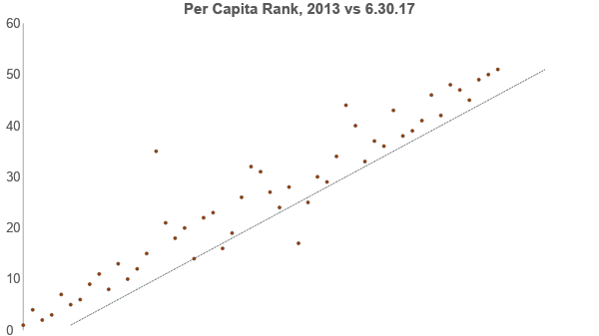
Sources: TTB, US Census Bureau,
and Brewers Association
Higher Rank
(less brewery growth)
vs 2013
Fewest Breweries
Per Capita
Most Breweries
Per Capita
Lower Rank
(more brewery growth)
vs 2013

Slide 16
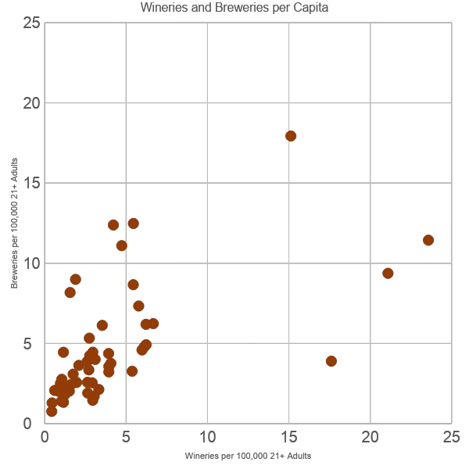

Slide 17
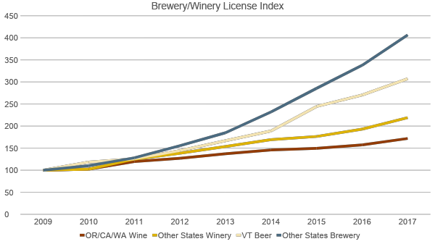

Slide 18
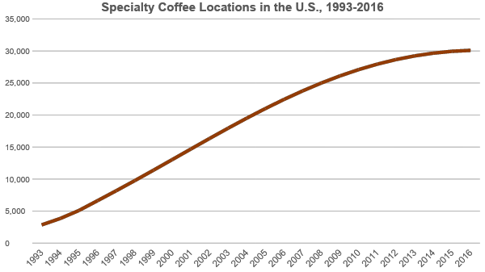

Slide 19
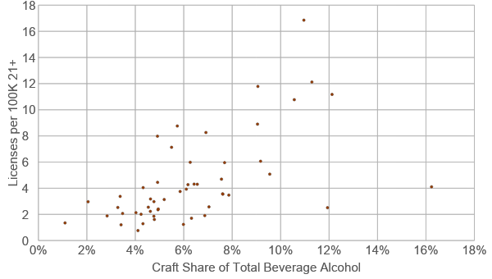

Slide 20
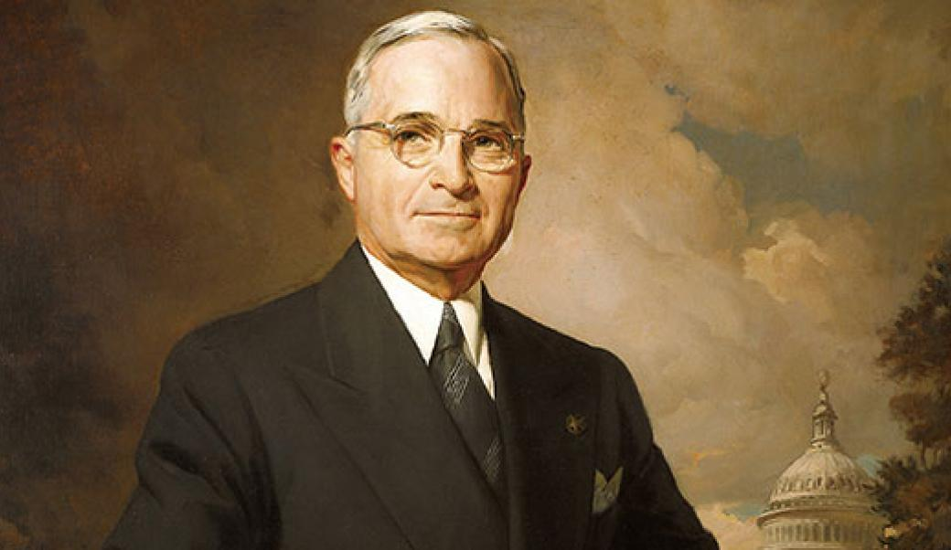
GIVE me a one-handed economist, all my economists say, ‘on the one hand...on the other‘
- Harry Truman

Slide 21
NUMBER OF BREWERS BY PRODUCTION SIZE - CY 2016
Revised: 10/25/2017
Production Size - CY 2016
Barrels (31 gallons) | Number of Breweries | Taxable Removals | % of Breweries | % of Removals
6,000,001 Barrels and Over | 14 | 119,774,531.97 | 0.3% | 69.3%
2,000,000 to 6,000,000 Barrels | 7 | 25,147,830.59 | 0.1% | 14.5%
1,000,001 to 1,999,999 Barrels | 4 | 4,994,536.90 | 0.1% | 2.9%
500,001 to 1,000,000 Barrels | 6 | 4,014,943.39 | 0.1% | 2.3%
100,001 to 500,000 Barrels | 45 | 8,618,323.45 | 0.9% | 5.0%
60,001 to 100,000 Barrels | 38 | 2,395,062.26 | 0.7% | 1.4%
30,001 to 60,000 Barrels | 53 | 2,069,205.94 | 1.0% | 1.2%
15,001 to 30,000 Barrels | 75 | 1,341,223.91 | 1.5% | 0.8%
7,501 to 15,000 Barrels | 148 | 1,351,541.96 | 2.9% | 0.8%
1,001 to 7,500 Barrels | 935 | 2,282,897.14 | 18.3% | 1.3%
0 to 1,000 Barrels | 3,771 | 967,080.60 | 74.0% | 0.6%
Total | 5,096 | 172,957,178.11 | 100.0% | 100.0%
DEPARTMENT OF THE TREASURY
Alcohol and Tobacco Tax and Trade Bureau

Slide 22
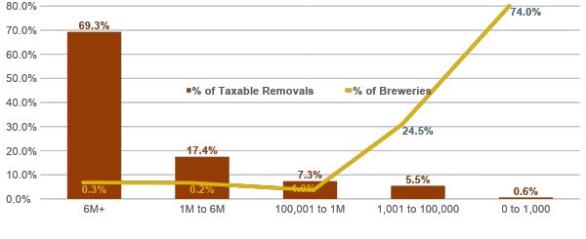
2016 US Breweries by Size

Slide 23
Beverage Alcohol
& Demographics

Slide 24
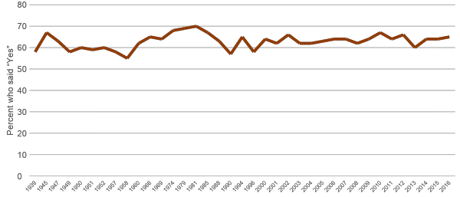
Alcohol Consumption Over Time Do You Have Occasion to Drink Alcohol?
Source: Gallup Poll, 2016.

Slide 25
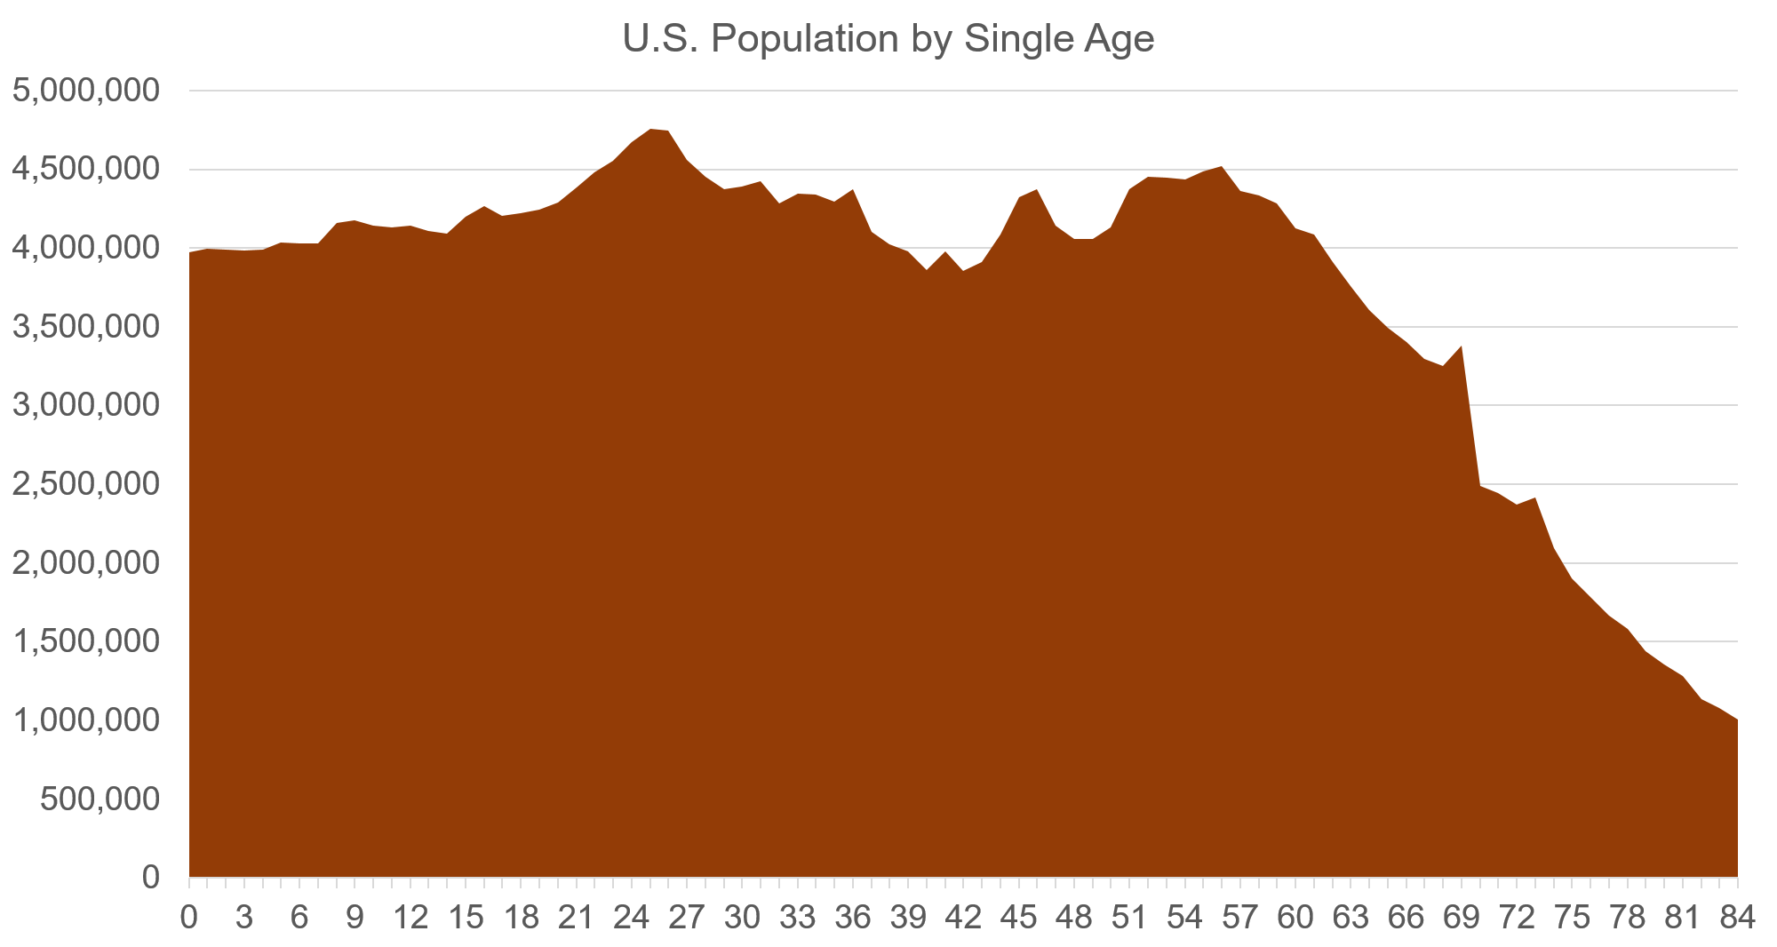
Source: U.S. Census

Slide 26
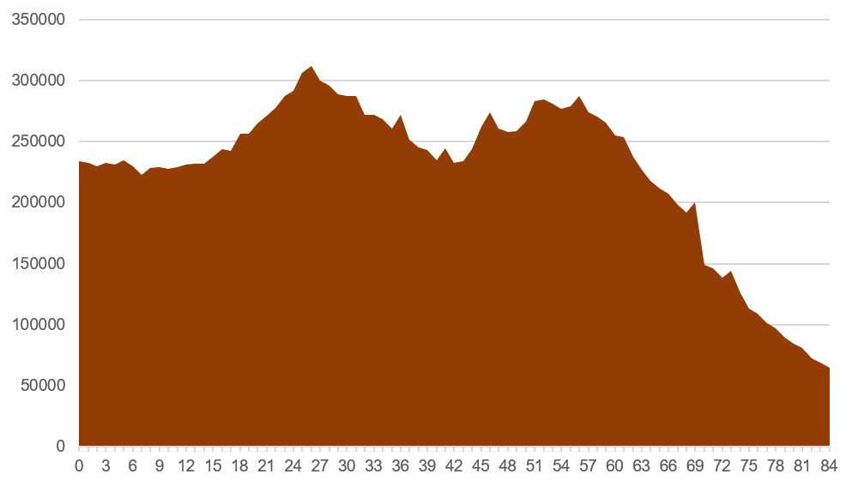
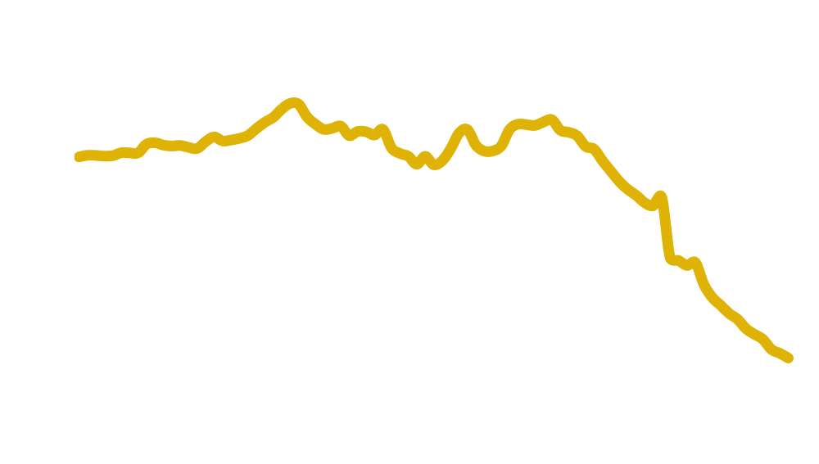
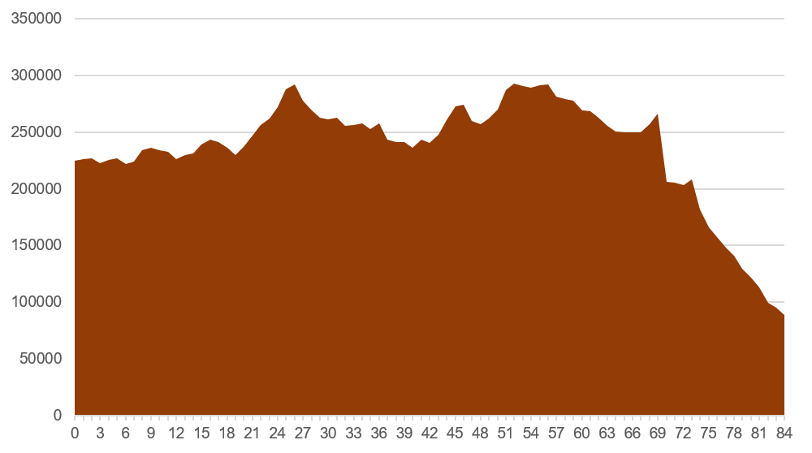
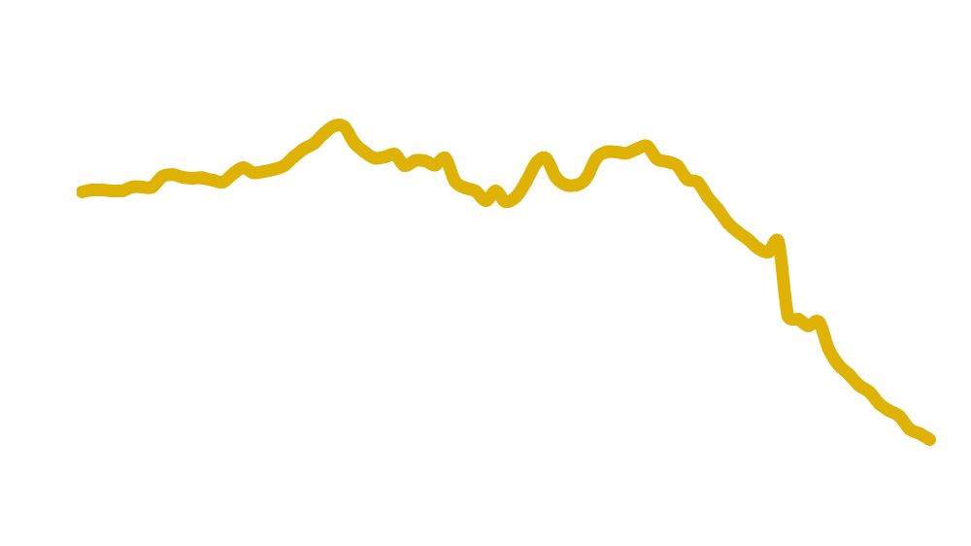
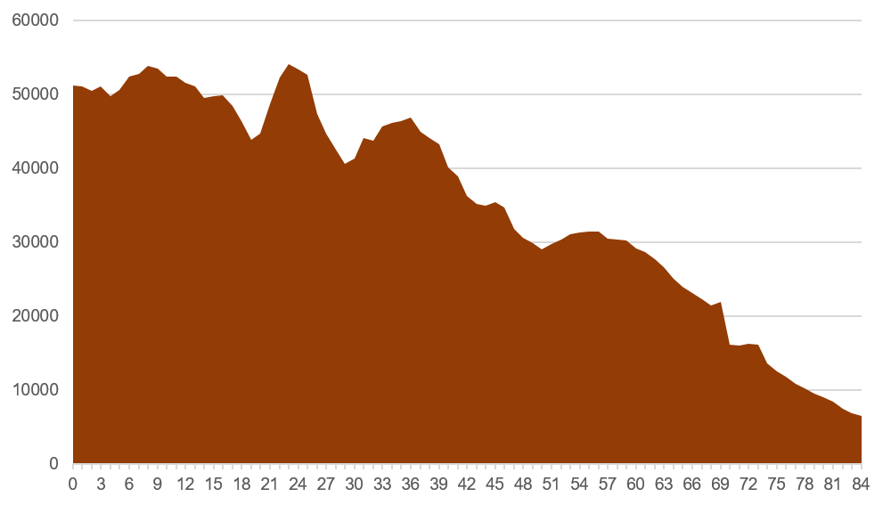
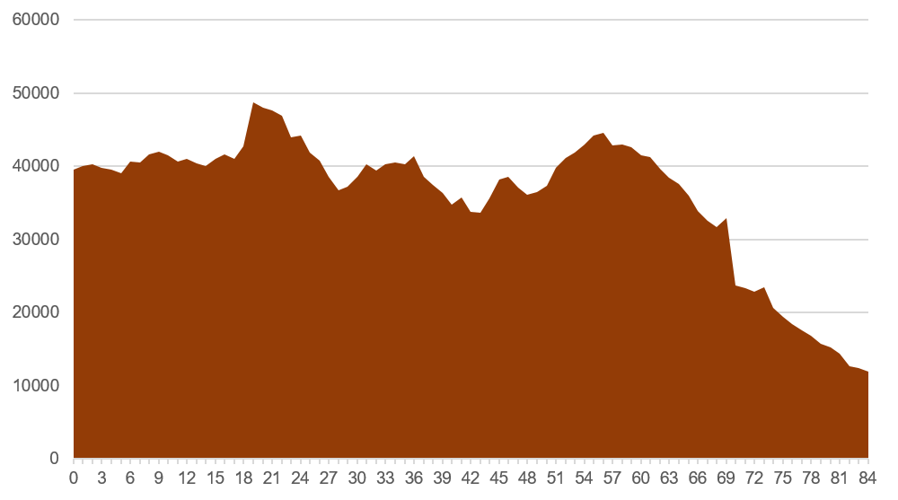
Florida
New York
Utah
Iowa

Slide 27
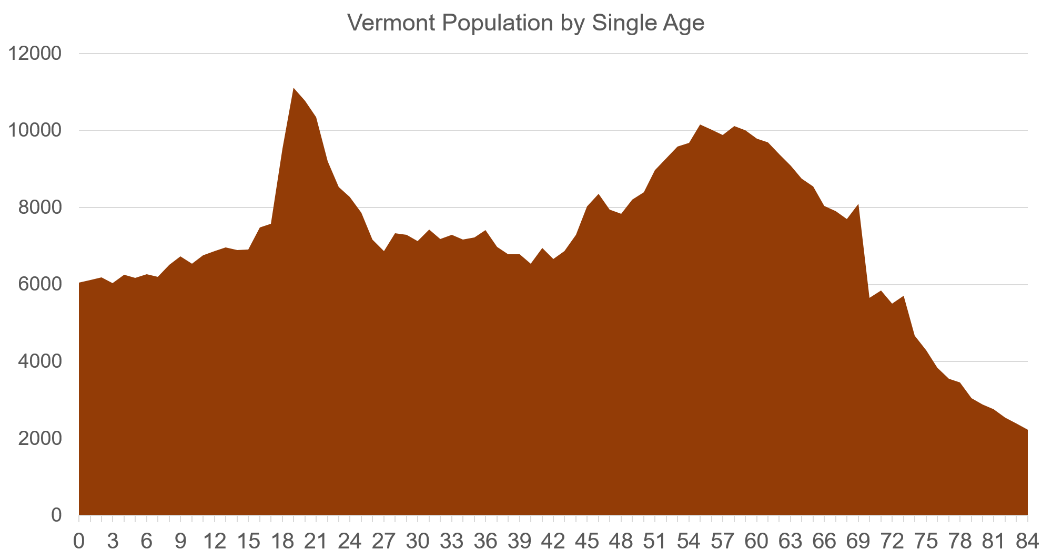
Source: U.S. Census

Slide 28
Total Beer vs Craft Age Breakdown
CRAFTS (incl DM SPECIALTY) – AGE/GENERATIONS; Index to % Adults
AGE 21+ | % Adults | TTL BEER |  | CRAFT*
 |  | % Volume | Index | % Volume | Index
21-34 | 25.6% | 35.1% | 137 | 35.5% | 138
35-44 | 18.0% | 20.7% | 115 | 24.3% | 135
45-64 | 37.1% | 33.3% | 90 | 31.6% | 85
65+ | 19.2% | 10.8% | 56 | 8.6% | 45
<80
>120
Source: Nielsen Spectra /Simmons (Data Version: Sept 2014); on plus off-premise

Slide 29
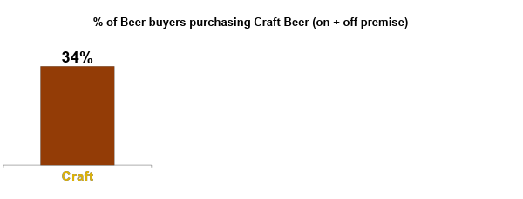
Other Demographic Variables
Which of the following types of beer (if any) have you or anyone in your household purchased in the past 12 months?
HIGHS (vs 34% avg) |  | LOWS (vs 34% avg)
Income $100K+ | 51% | Incomes <$50K | 23%
Millennials | 47% | Greatest Generation | 21%
Asians | 47% | African American | 16%
Affluent Suburbanites | 44% | Rural Living | 20%
Cosmopolitan Centers | 42%
Source: Nielsen Household Panel, Survey (March 2013); Total U.S.; prior12 months purchasing

Slide 30
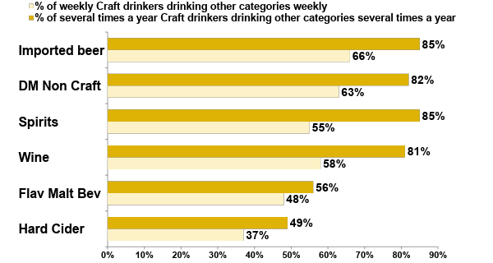
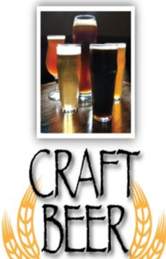
CRAFT BEER DRINKERS OFTEN DRINK OTHER ADULT BEVERAGES AS WELL
Source: Nielsen's Craft Beer Insights Poll (CIP) conducted June 2017 by Harris Poll (n=1,188 Craft Drinkers; n=379 weekly craft drinkers)
Notes:
We know that the regular Craft beer drinker for the main part doesn’t drink JUST craft beer… this shows the percentage of those craft drinkers that also regularly drink other categories --- both other Beer segments, but also Wine and Spirits. The dark bars represent the % of regular Craft beer drinkers that also regularly drink other Adult beverages – very, very high numbers in the 80’s across other key beer segments, as well as Wine and Spirits.
The light bars represent the % of weekly Craft beer drinkers that are drinking other categories also weekly. In the high 50’s and into the 60’s.
So you are competing for ‘share of wallet and share of stomach’ not just against other Craft brands or other Beer brands, but with the entire Adult Beverage category for each drinking occasion – at least among the community of regular Craft beer drinkers there are very few exclusive drinkers.
the CRAFT consumer is not JUST our consumer, but also one that has in their consideration set other beverage alcohol products, and that we need to fight for each occasion and every pour when the consumer is considering what to choose.

Slide 31
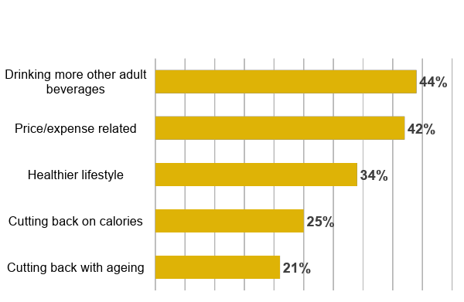
Of THOSE DRINKING LESS, DRINKING MORE ‘OTHER’ BEER HEADS THE LIST AMONG VARIOUS REASONS
What are the reasons you are drinking less craft beer than a year ago?
Base: those who are drinking less craft beer
Other beer: 20%
Spirits: 14%
Wine: 13%
Hard Seltzers: 9%
FMB’s: 8%
Hard Sodas: 8%
Ciders: 6%
Source: Nielsen's Craft Beer Insights Poll (CIP) conducted June 2017 by Harris Poll (n=1,188 Craft Drinkers; n=379 weekly craft drinkers)
Notes:
For that smaller percentage of craft beer drinkers that say they are drinking craft less often, it’s a combination of other Adult Beverages they say they are drinking, price and expense related factors, or health related reasons. Again, remember that is a pretty small group

Slide 32
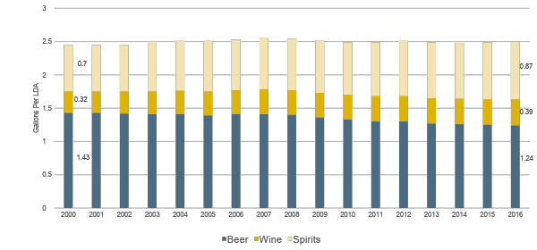
Per Capita Consumption of Ethanol U.S. from 2000 to 2016
ABV for Beer 4.6%, Wine 11.5% Spirits 38%

Slide 33
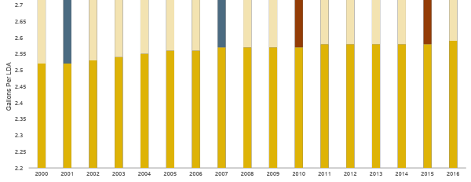
Competition for Drinking Occasions Total Ethanol Per Capita 2000 to 2016
+.1 gallon ethanol = ~23 drinks per capita/year;
Craft on avg. gets 1.3
Source: Compiled by NBWA from Beer Institute, Discus and BIG, 2017

Slide 34
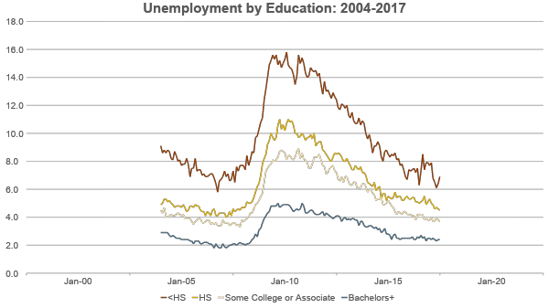

Slide 35
The Changing Craft Industry

Slide 36
Competition in a Mature Market
“Small States in World Markets”
Already dominate at home
Specialize
Exports?
Differences between channels

Slide 37
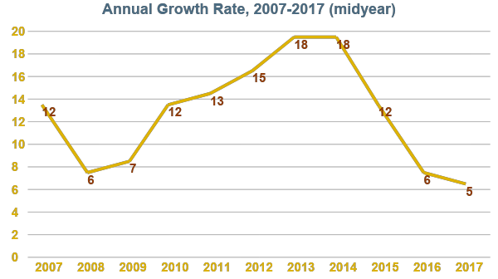

Slide 38


At home remains key location for craft beer drinkers, with increases outside the home
Which of the following describe when you typically drink craft beer? Please select all that apply.
87% of TOTAL Craft Beers Drinkers
93% of WEEKLY Craft Beers Drinkers
AT HOME/AT A FRIEND’S HOME
At an OUTDOOR recreational activity
During a craft brewing FESTIVAL/EVENT
While eating out at a RESTAURANT
GROWING
OCCASIONS
While out with my friends at a BAR/CLUB
DOWN VS. YEAR AGO
While visiting a CRAFT BREWERY
Source: Nielsen's Craft Beer Insights Poll (CIP) conducted June 2016 by Harris Poll (n=1,018 Craft Drinkers; n=555 weekly craft drinkers)

Slide 39
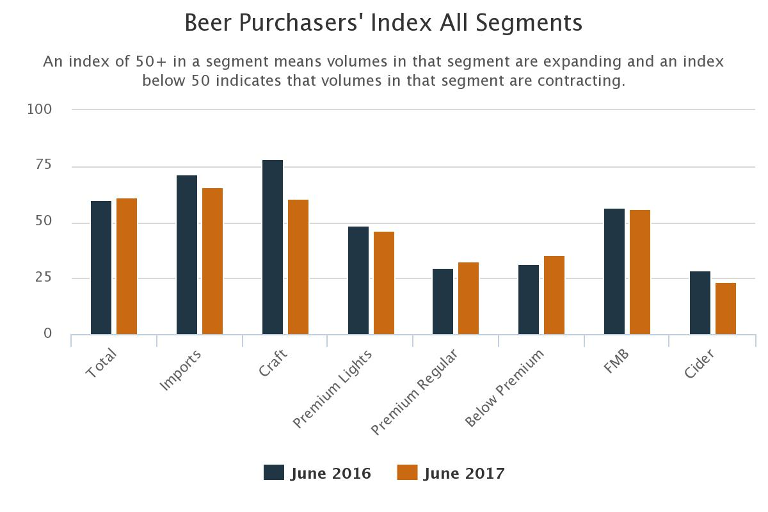
Clearly much of the slowdown is coming at wholesale
Distributors are crowded not expanding craft as much

Slide 40
Source: IRI MULO+C, (10/22/17) BA Craft Definition | United States |  | Vermont
National Size (CEs) | Growth % YTD | % Volume | Growth % YTD | % Volume
1,000,000+ | -1.8% | 61.2% | -9.6% | 19.0%
100k to 1M | 1.6% | 21.1% | -5.1% | 63.2%
10K to 100K | 12.9% | 14.1% | -6.7% | 16.8%
Less than 10K | 43.1% | 3.6% | -19.5% | 1.1%

Slide 41
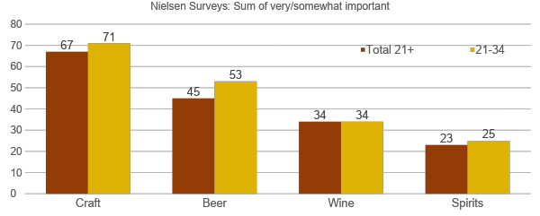
How important is “local” in purchase decisions?
Source: Nielsen Quick Query Omnibus Survey, 12-17, 2015. (Base: LDA consumers who drink at least several times per year)

Slide 42
Source: IRI MULO+C, 10/22/17 * Included Harpoon, IRI Craft Definition | Outside VT | In VT
VT Breweries | 0.9% | -3.9%
Other Craft Brewers | 4.0% | -5.9%
Vermont brewers hold 1.6% share of IRI Craft by volume nationally. They hold 60.4% in the State of Vermont.

Slide 43
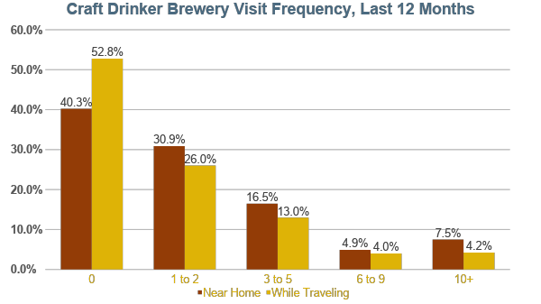

Slide 44
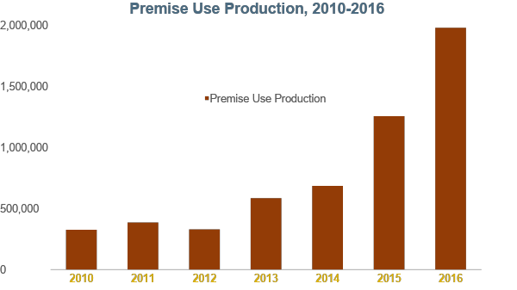

Slide 45
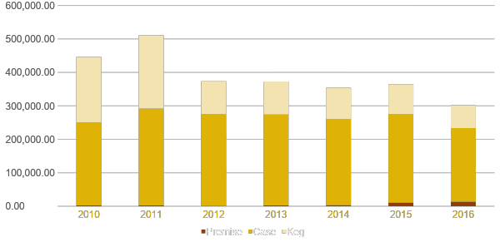
Vermont Production by Type
Source: TTB (2017)

Slide 46
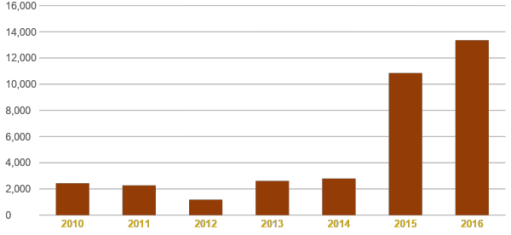
Premise Use in Vermont
~25% of Draught?,
9-10% Nationally

Slide 47
Percent of Craft Drinkers Who are Drinking More Craft & Say Brewery Visits are a Reason
 | Male | Females | Total
21-34 | 16% | 15% | 15%
35-44 | 13% | 12% | 13%
45-54 | 12% | 19% | 14%
55-64 | 11% | 9% | 10%
65+ | 5% | 3% | 5%
Total | 12% | 13% | 12%
Clear sign there is new demand here
Opportunity to grow the segment
Cuts across typical demographics
Ripples run further out

Slide 48
DTC Adds to Revenue
Brewery Size (bbls) | Sample Size | % of Beer Revenue (DTC) | % of Beer Revenue (Distributed) | Beer Revenue/Bbl (includes both DTC/Distributed)
60,001+ | 9 | 7.7% | 92.3% | $347.92
30,001-60,000 | 6 | 10.3% | 89.7% | $294.69
15,001-30,000 | 7 | 24.6% | 75.4% | $303.28
10,001-15,000 | 7 | 18.2% | 81.8% | $316.99
5,001-10,000 | 14 | 38.0% | 62.0% | $407.45
2,501-5,000 | 17 | 39.7% | 60.3% | $432.27
1,001-2,500 | 13 | 50.9% | 49.1% | $490.33
1-1,000 | 48 | 78.2% | 21.8% | $743.56

Slide 49
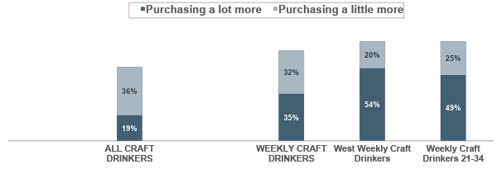


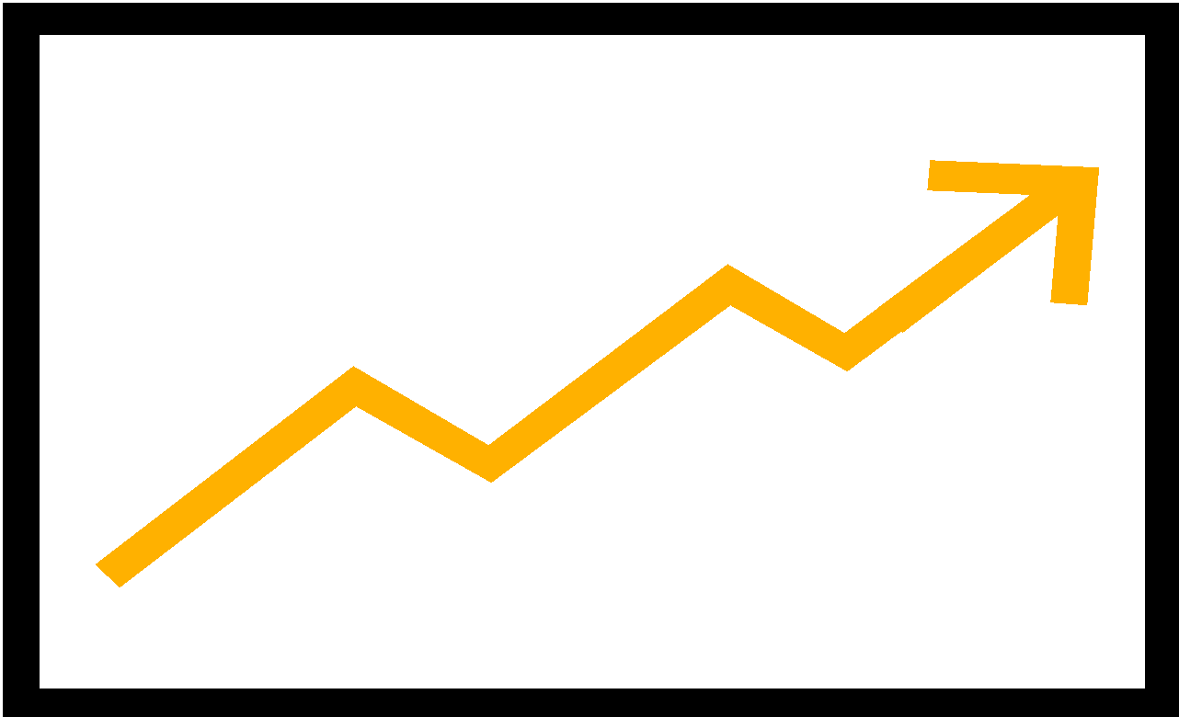
A VISIT TO A CRAFT BREWERY HAS SIGNIFICANT, AND INCREASING POST-VISIT SALES BENEFITS
After your visit(s) to a craft brewery, which of the following describe how, if at all, your purchasing habits of that craft brewer’s products changed?
>55% among 21-54
(64% men 21-34)
70% among $100K+
74%
74%
67%
55%
2015/16
2015/16
11%/16%
16%/24%
Source: Nielsen's Craft Beer Insights Poll (CIP) conducted June 2017 by Harris Poll (n=1,188 Craft Drinkers; n=379 weekly craft drinkers)
Base: Among those who visited Craft Brewery

Slide 50
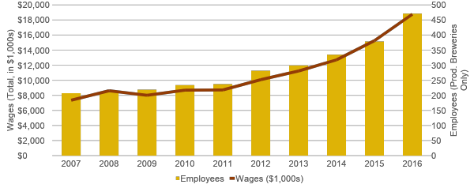
Breweries Having an Impact
Source: QCEW (BLS, 2017)

Slide 51
CHEERS! bart@brewersassociation.org @brewersstats

