Slide 1
SSCS Chipathon 2025 - Project Proposal
Time Transcenders
Hari Preeth
Shaikh Shoeb Dawood
Yuan Yancey Labay
Vasil Yordanov

Slide 2
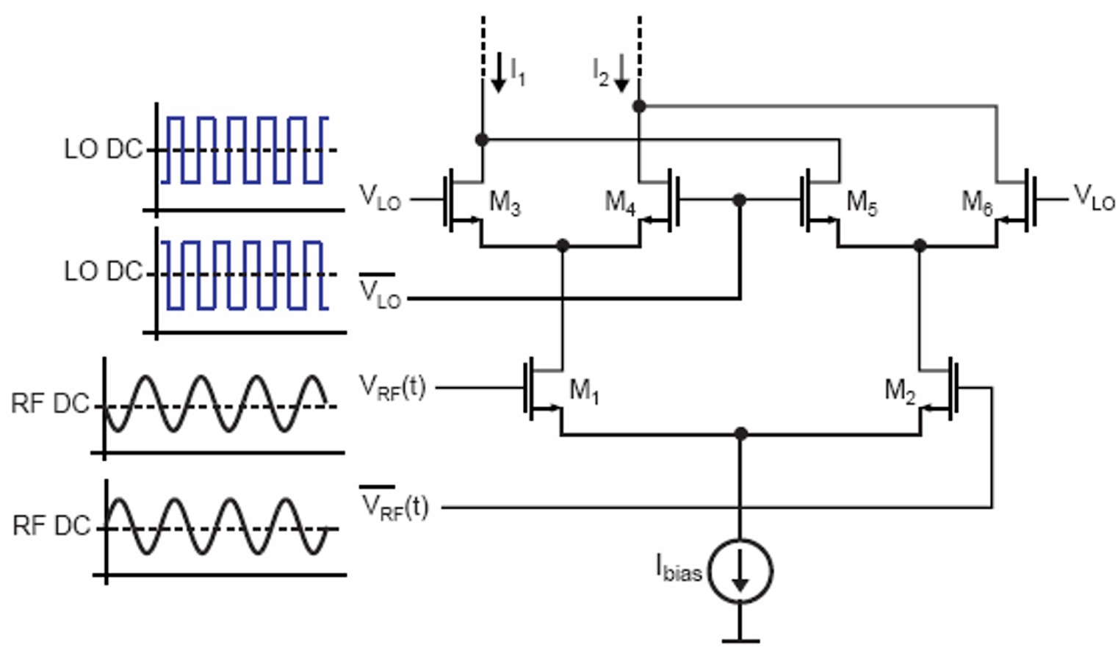
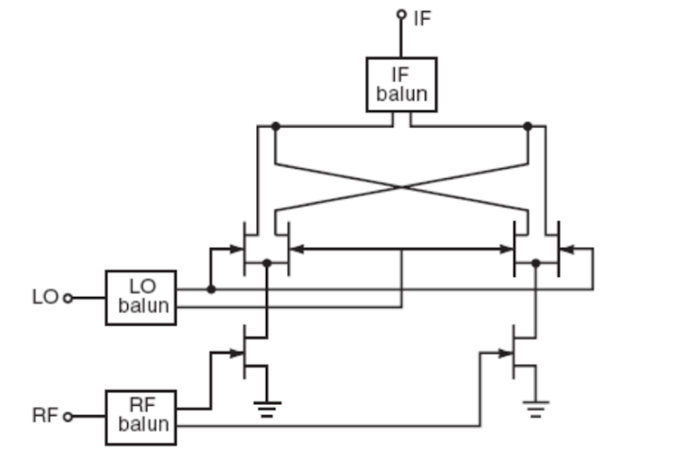
Mixer design in GF180MCU
Targeting an active double-balanced mixer at WiFi freq 2.4GHz
Advantages of double-balanced mixers over other mixer types:
Increased linearity
Improved suppression of spurious products
Good isolation between ports
interchangeable ports, thus easy filtering
Disadvantages:
Relatively high LO drive strength
Require transformer Baluns (if time permits these will be integrated on-chip)
Decided on Gilbert cell topology (other possibilities are ring diode, star diode, or FET as switches)
https://www.qsl.net/va3iul/RF%20Mixers/RF_Mixers.pdf

Slide 3
Specs
Target f_{RF} 2.4GHz
f_{LO} 2.41GHz
RF BW of 20MHz, with max 3dB droop over the baseband
Vdd=3.3V
Mixer conversion gain >15dB
SSB NF<9dB (baseband integrated from 1kHz to 100MHz)
IIP2 > 40dBm
IIP3 > 8dBm ( using 2 tones at 2400MHz and 2401MHz )
https://link.springer.com/article/10.1007/s11277-021-09115-6
https://ieeexplore.ieee.org/document/7280025
Sushmitha, D & Munivenkatappa, Nagabushanam. (2018). A 2.4GHz CMOS Double Balanced Down Conversion Gilbert Cell Mixer Design Using 180nm Technology. 1767-1770. 10.1109/RTEICT42901.2018.9012334.

Slide 4
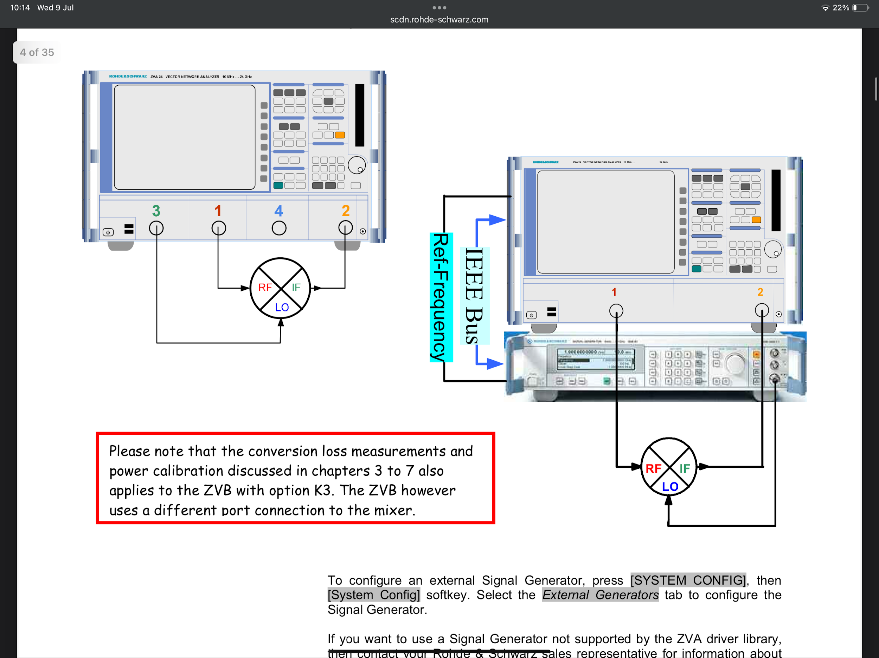
Testing equipment
Using either a 2 port Vector Network Analyzer (VNA) + signal generator
Or using a 4-port VNA
Conversion Loss
Intermodulation measurement
Port isolation measurement
https://scdn.rohde-schwarz.com/ur/pws/dl_downloads/dl_application/application_notes/1ez58/1EZ58_0E_Mixer-Measurements_ZVA-K4.pdf?utm_source=chatgpt.com

Slide 5
Appendix
`

Slide 6
Conversion gain
Mixer conversion gain >15dB
ratio of desired IF signal (V or W) to RF signal
Voltage gain = rms(IF)/rms(RF) - we will use this def in our specs
Power gain = IF power delivered to load / Available power from souce
Note: if load and input Z are matched, Power gain = Voltage gain

Slide 7
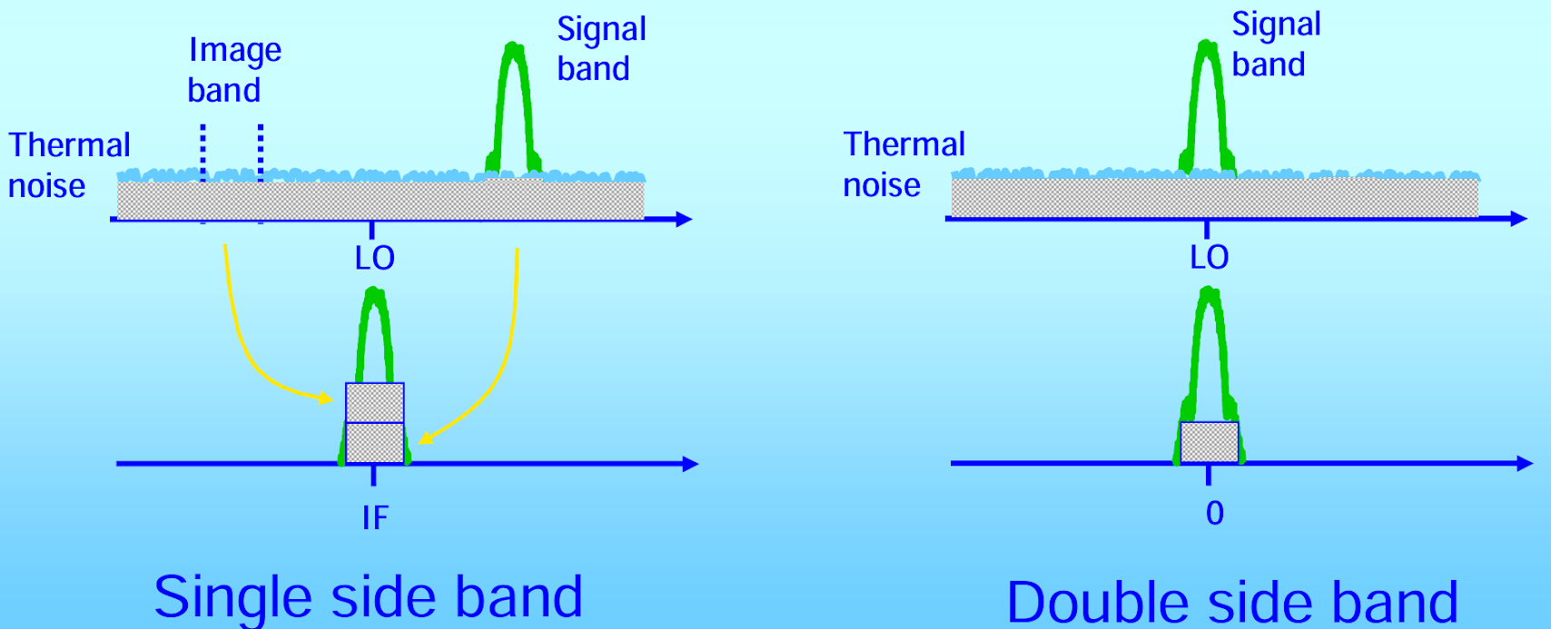
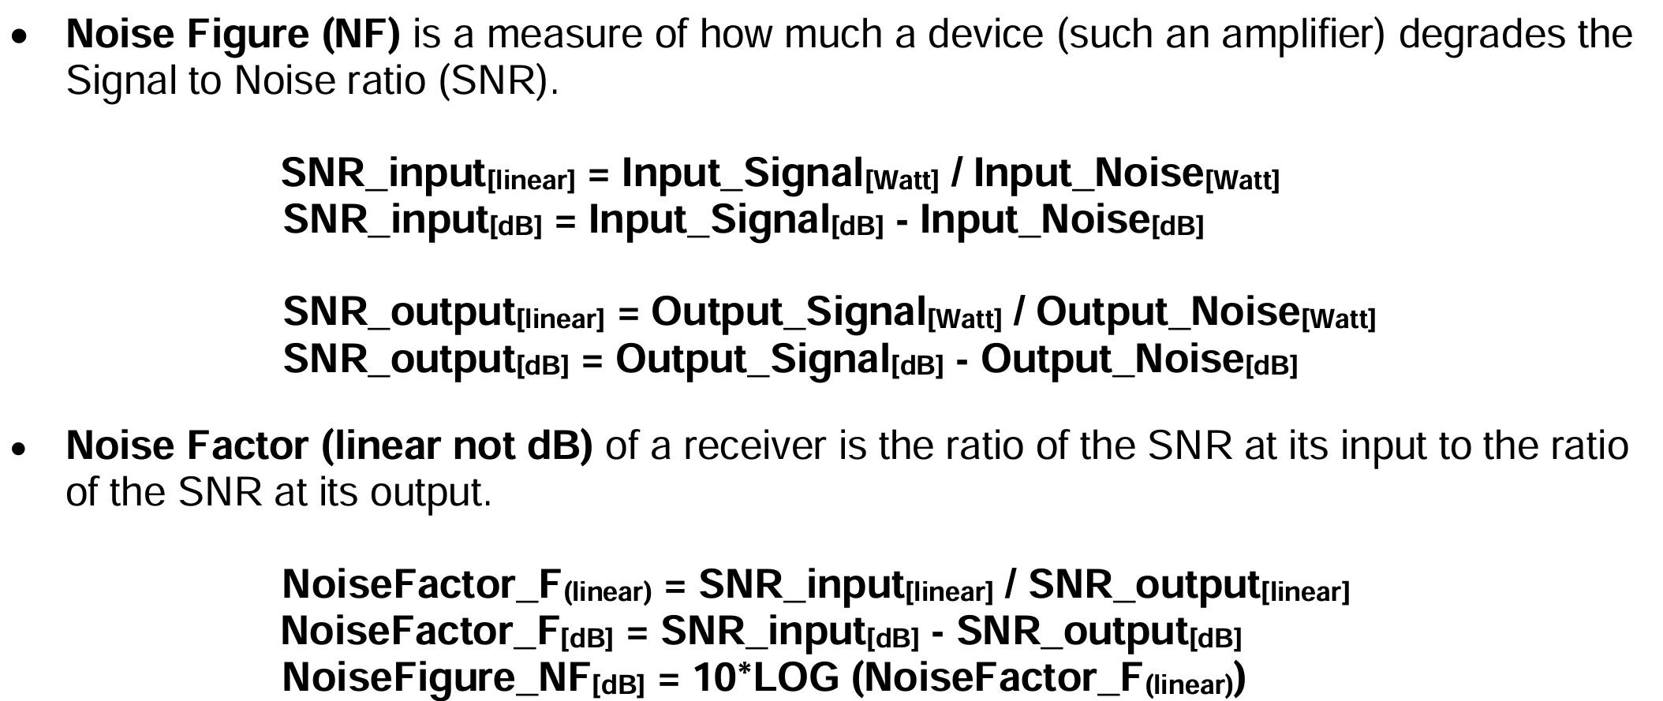
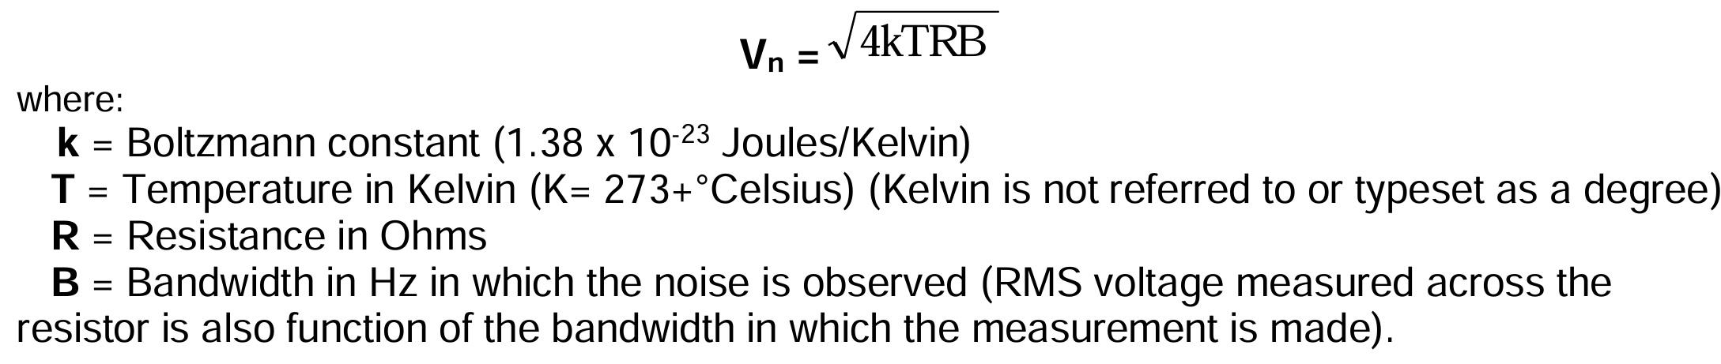
Noise figures: SSB
SSB Noise Figure < 9dB (baseband integrated from 1kHz to 10MHz)
signal from one sideband, noise from both bands
(SNR at IF) / (SNR of RF), both measured in a single sideband
https://markimicrowave.com/technical-resources/application-notes/a-practical-guide-to-noise-in-frequency-conversions/

Slide 8
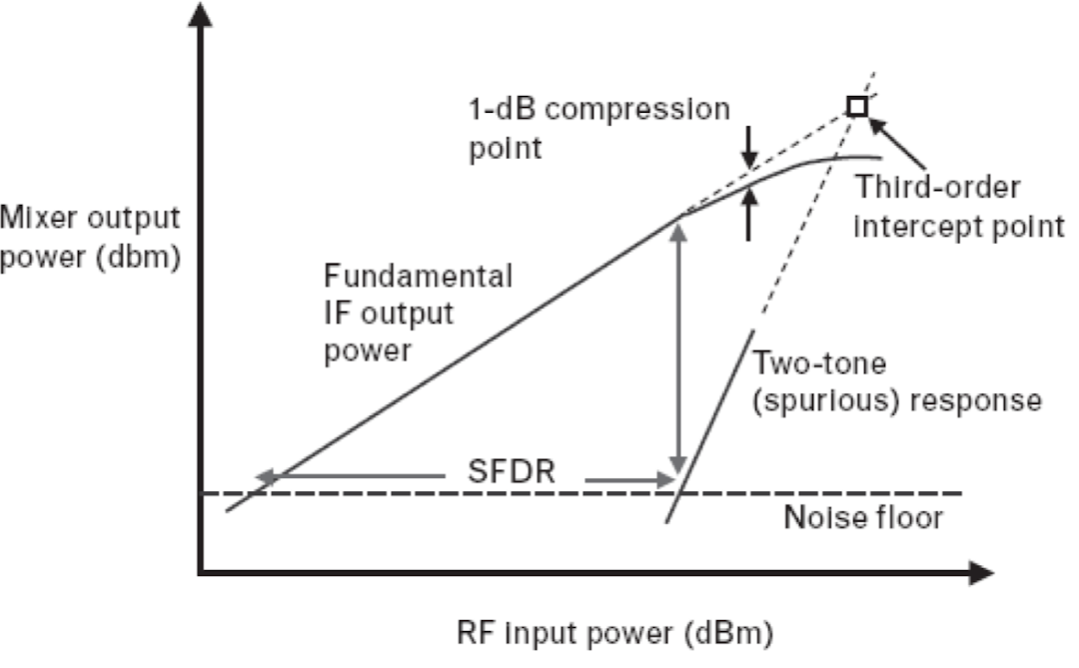
Intermodulation Intercept Point (IIP)
IIP3 and IIP2 referrer to the third and second order harmonics generated from the main signal. IIP3 and IIP2 are the intercept points, at which the power of these harmonics equals the linear term (IF).
IIP2 > 40dBm
IIP3 > 8dBm ( using 2 tones at 2400MHz and 2401MHz )
https://www.rfwireless-world.com/terminology/ip2-ip3-formulas-calculations-significance
https://www.test-and-measurement-world.com/measurements/rf/rf-mixer-testing?utm_source=chatgpt.com

Slide 9
References
https://www.ee.iitm.ac.in/vlsi/courses/ee6320_2022/start
https://www.ee.ucla.edu/~brweb/teaching/215C_W2013/Noise.pdf
http://class.ece.iastate.edu/djchen/ee507/Mixer%20Design.pdf
https://www.qsl.net/va3iul/RF%20Mixers/RF_Mixers.pdf
https://www.test-and-measurement-world.com/measurements/rf/rf-mixer-testing?utm_source=chatgpt.com
https://www.inf.ufrgs.br/sim-emicro/papers/emicro_palestra_inter_edgar.pdf
https://www.rfwireless-world.com/terminology/ip2-ip3-formulas-calculations-significance
https://markimicrowave.com/technical-resources/application-notes/a-practical-guide-to-noise-in-frequency-conversions/
339560320_A_24GHz_CMOS_Double_Balanced_Down_Conversion_Gilbert_Cell_Mixer_Design_Using_180nm_Technology
https://www.youtube.com/watch?v=8qBpyJxSngo
https://www.youtube.com/watch?v=sIyr0oMOsVc&pp=0gcJCfwAo7VqN5tD
https://www.test-and-measurement-world.com/measurements/rf/rf-mixer-testing?utm_source=chatgpt.com

