Slide 1
Track Controller (HW)
Interaction and sequence diagrams
Braden · Track Overflow

Slide 2
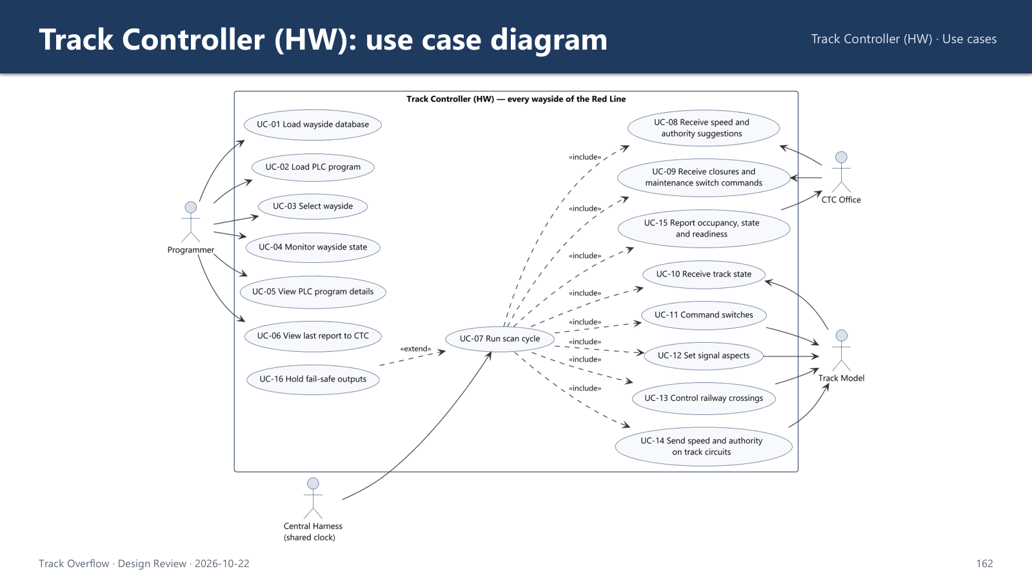

Slide 3
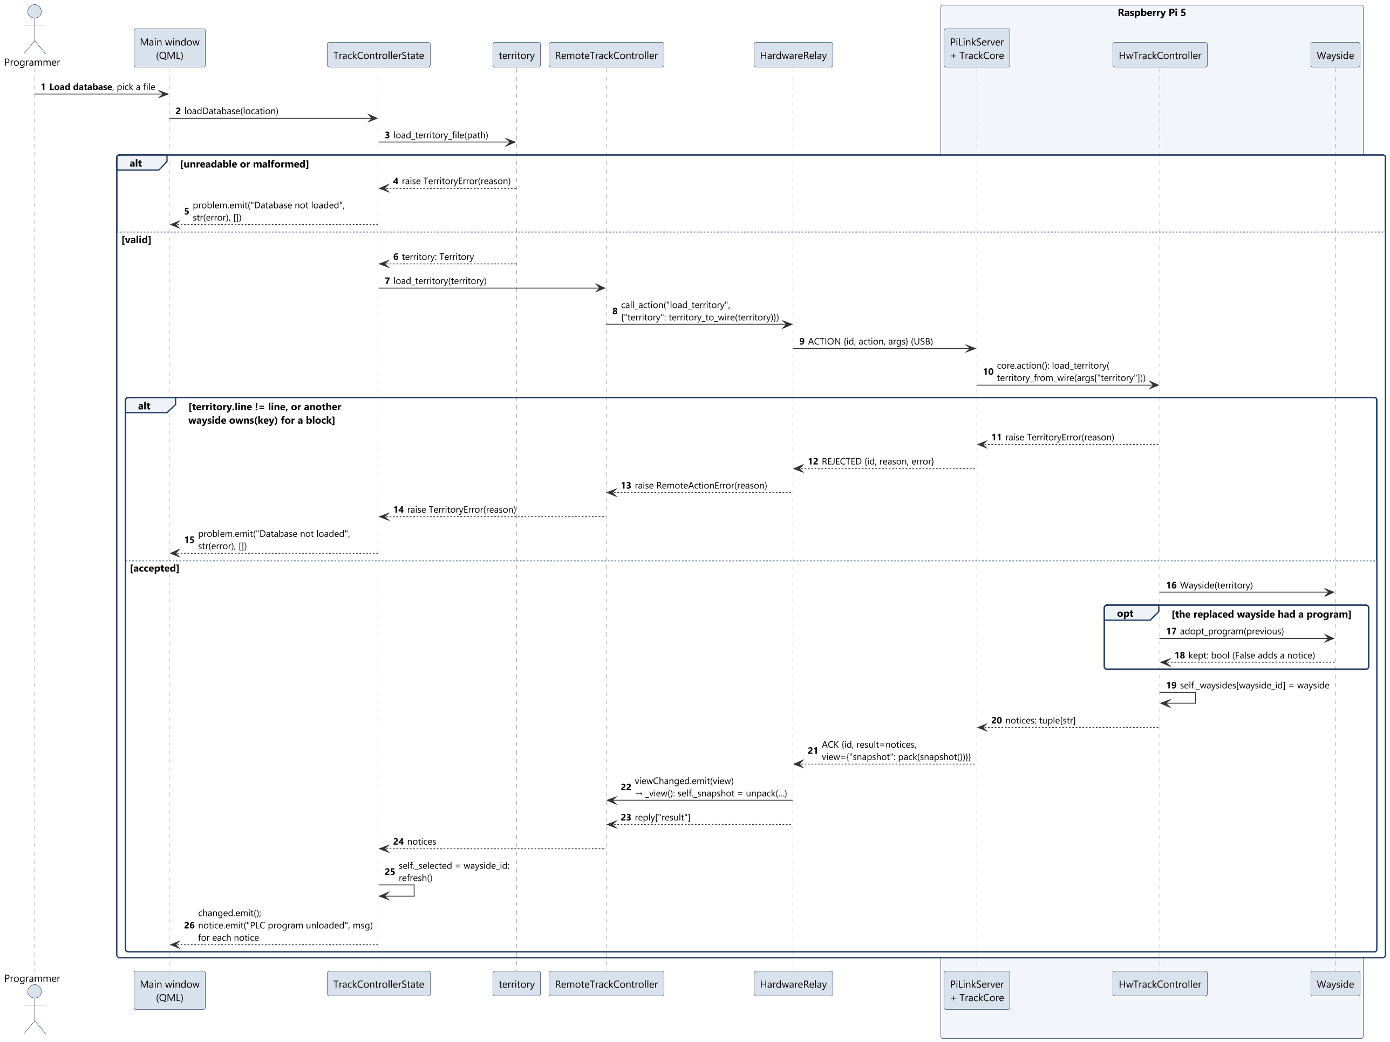
SD-01 Load wayside database (UC-01)
Sequence diagrams
3

Slide 4
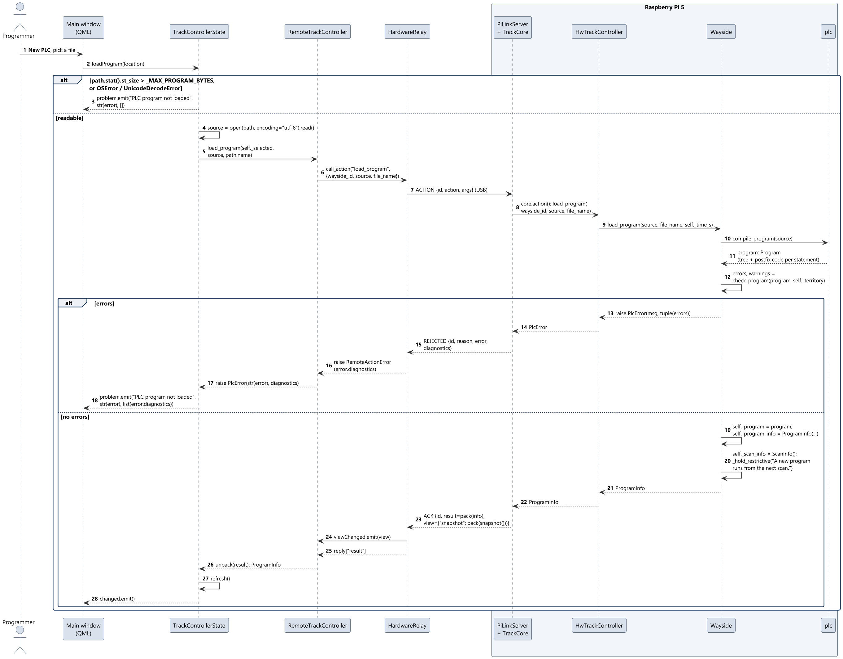
SD-02 Load PLC program (UC-02)
Sequence diagrams
4

Slide 5
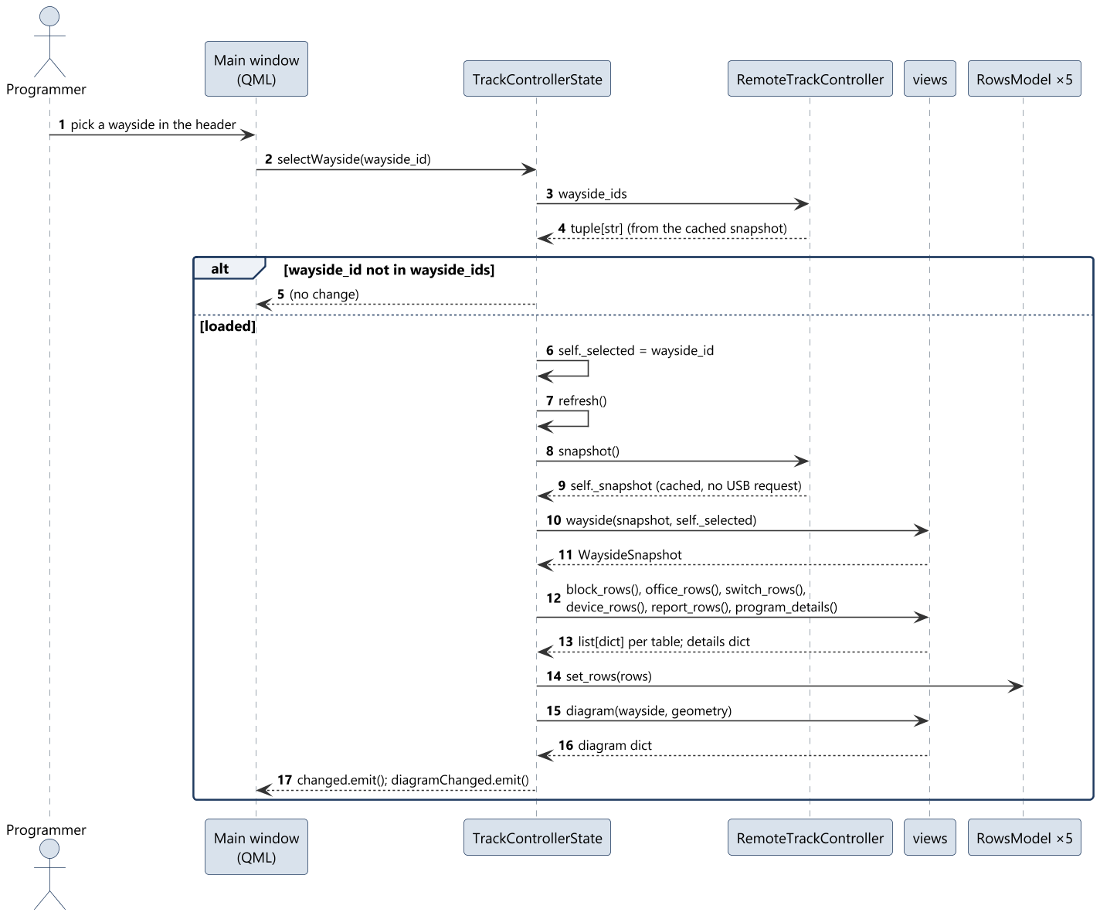
SD-03 Select wayside (UC-03)
Sequence diagrams
5

Slide 6
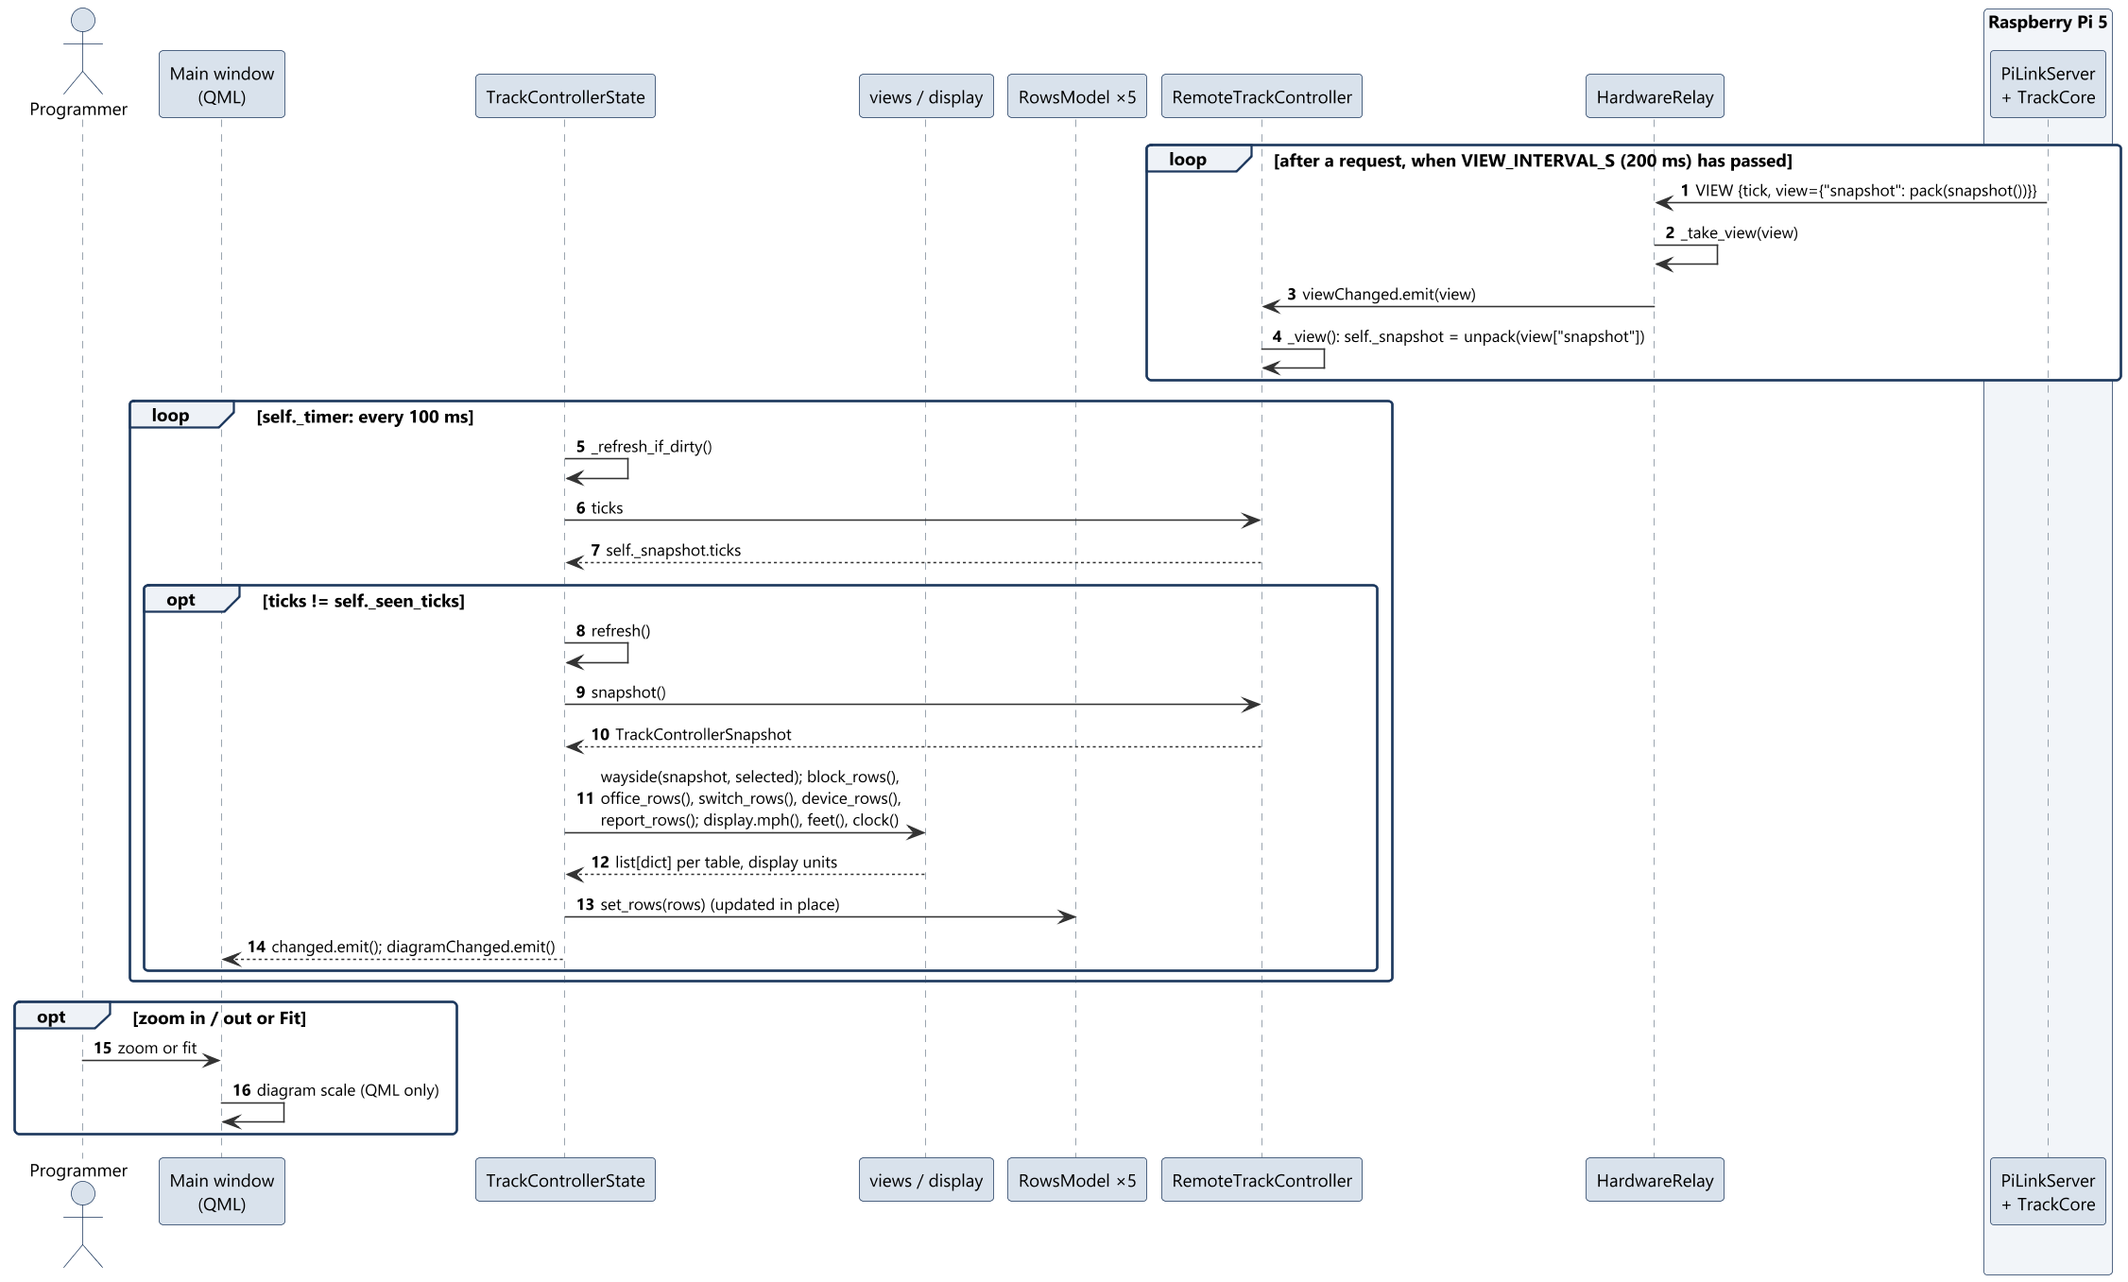
SD-04 Monitor wayside state (UC-04)
Sequence diagrams
6

Slide 7
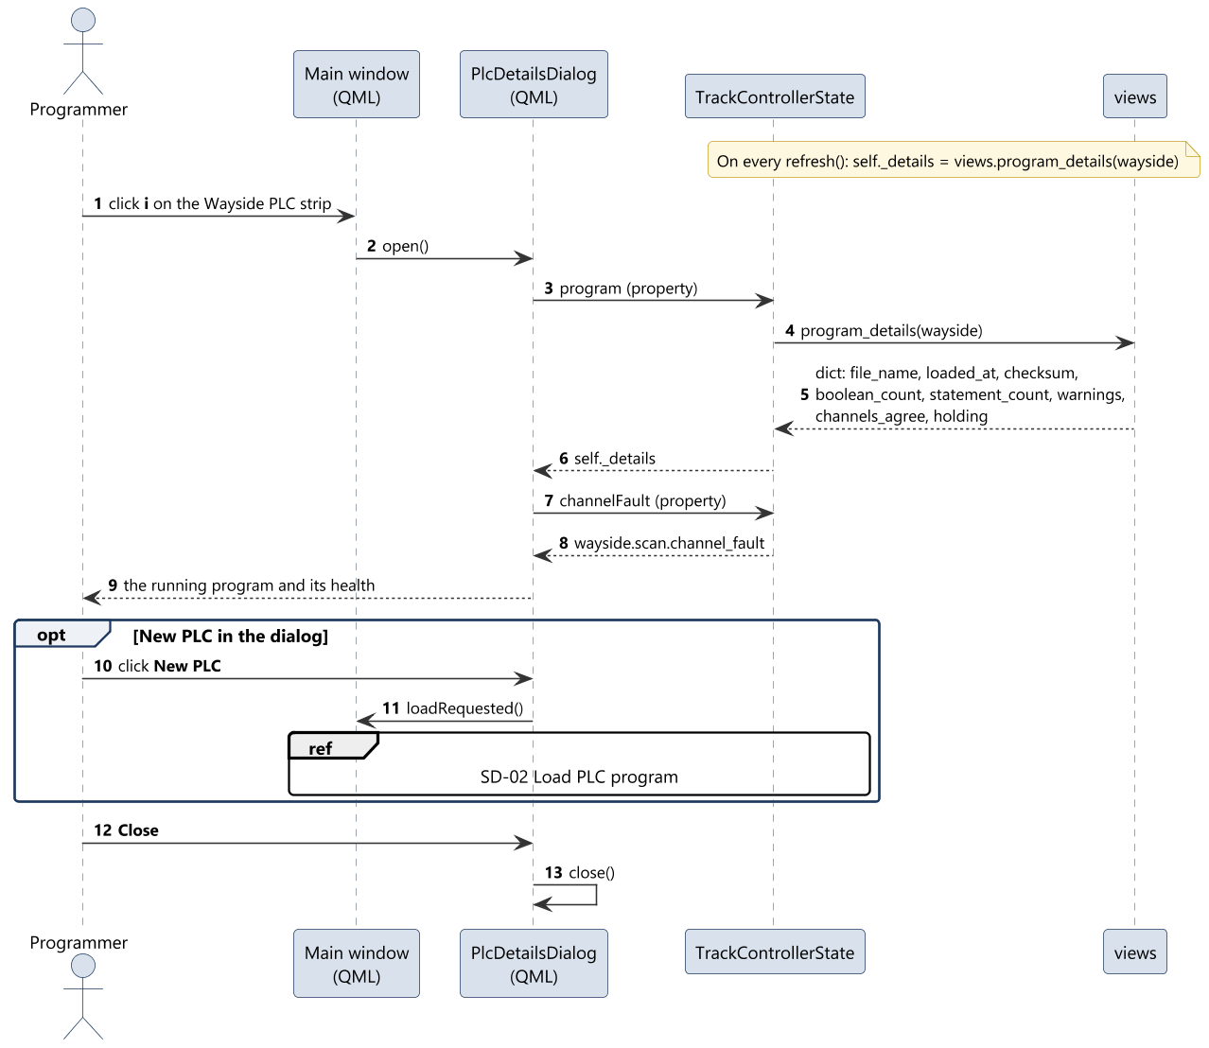
SD-05 View PLC program details (UC-05)
Sequence diagrams
7

Slide 8
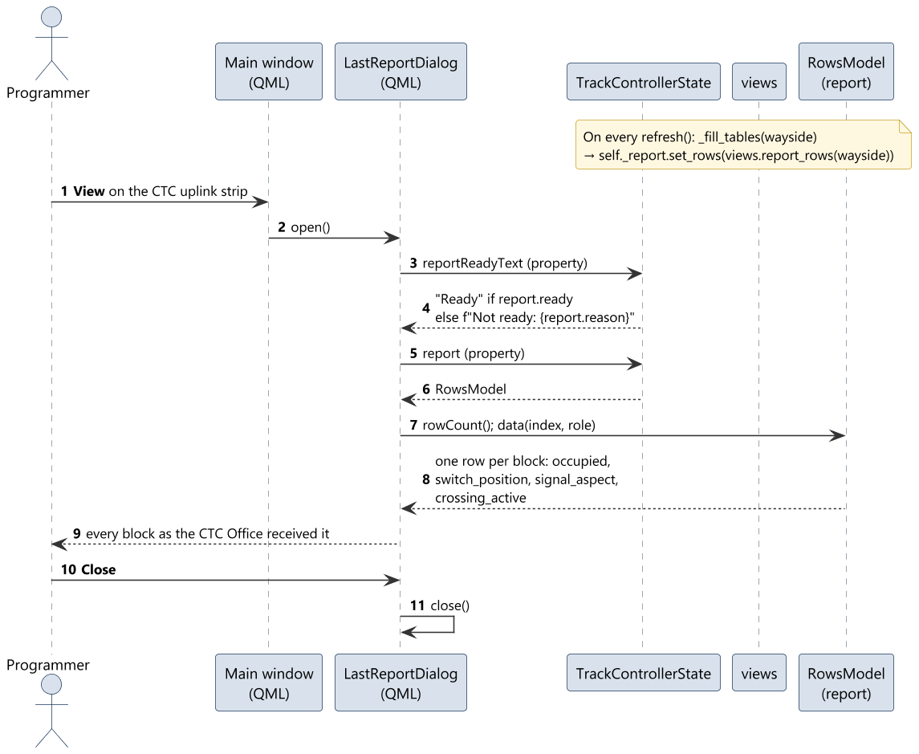
SD-06 View last report to the CTC Office (UC-06)
Sequence diagrams
8

Slide 9
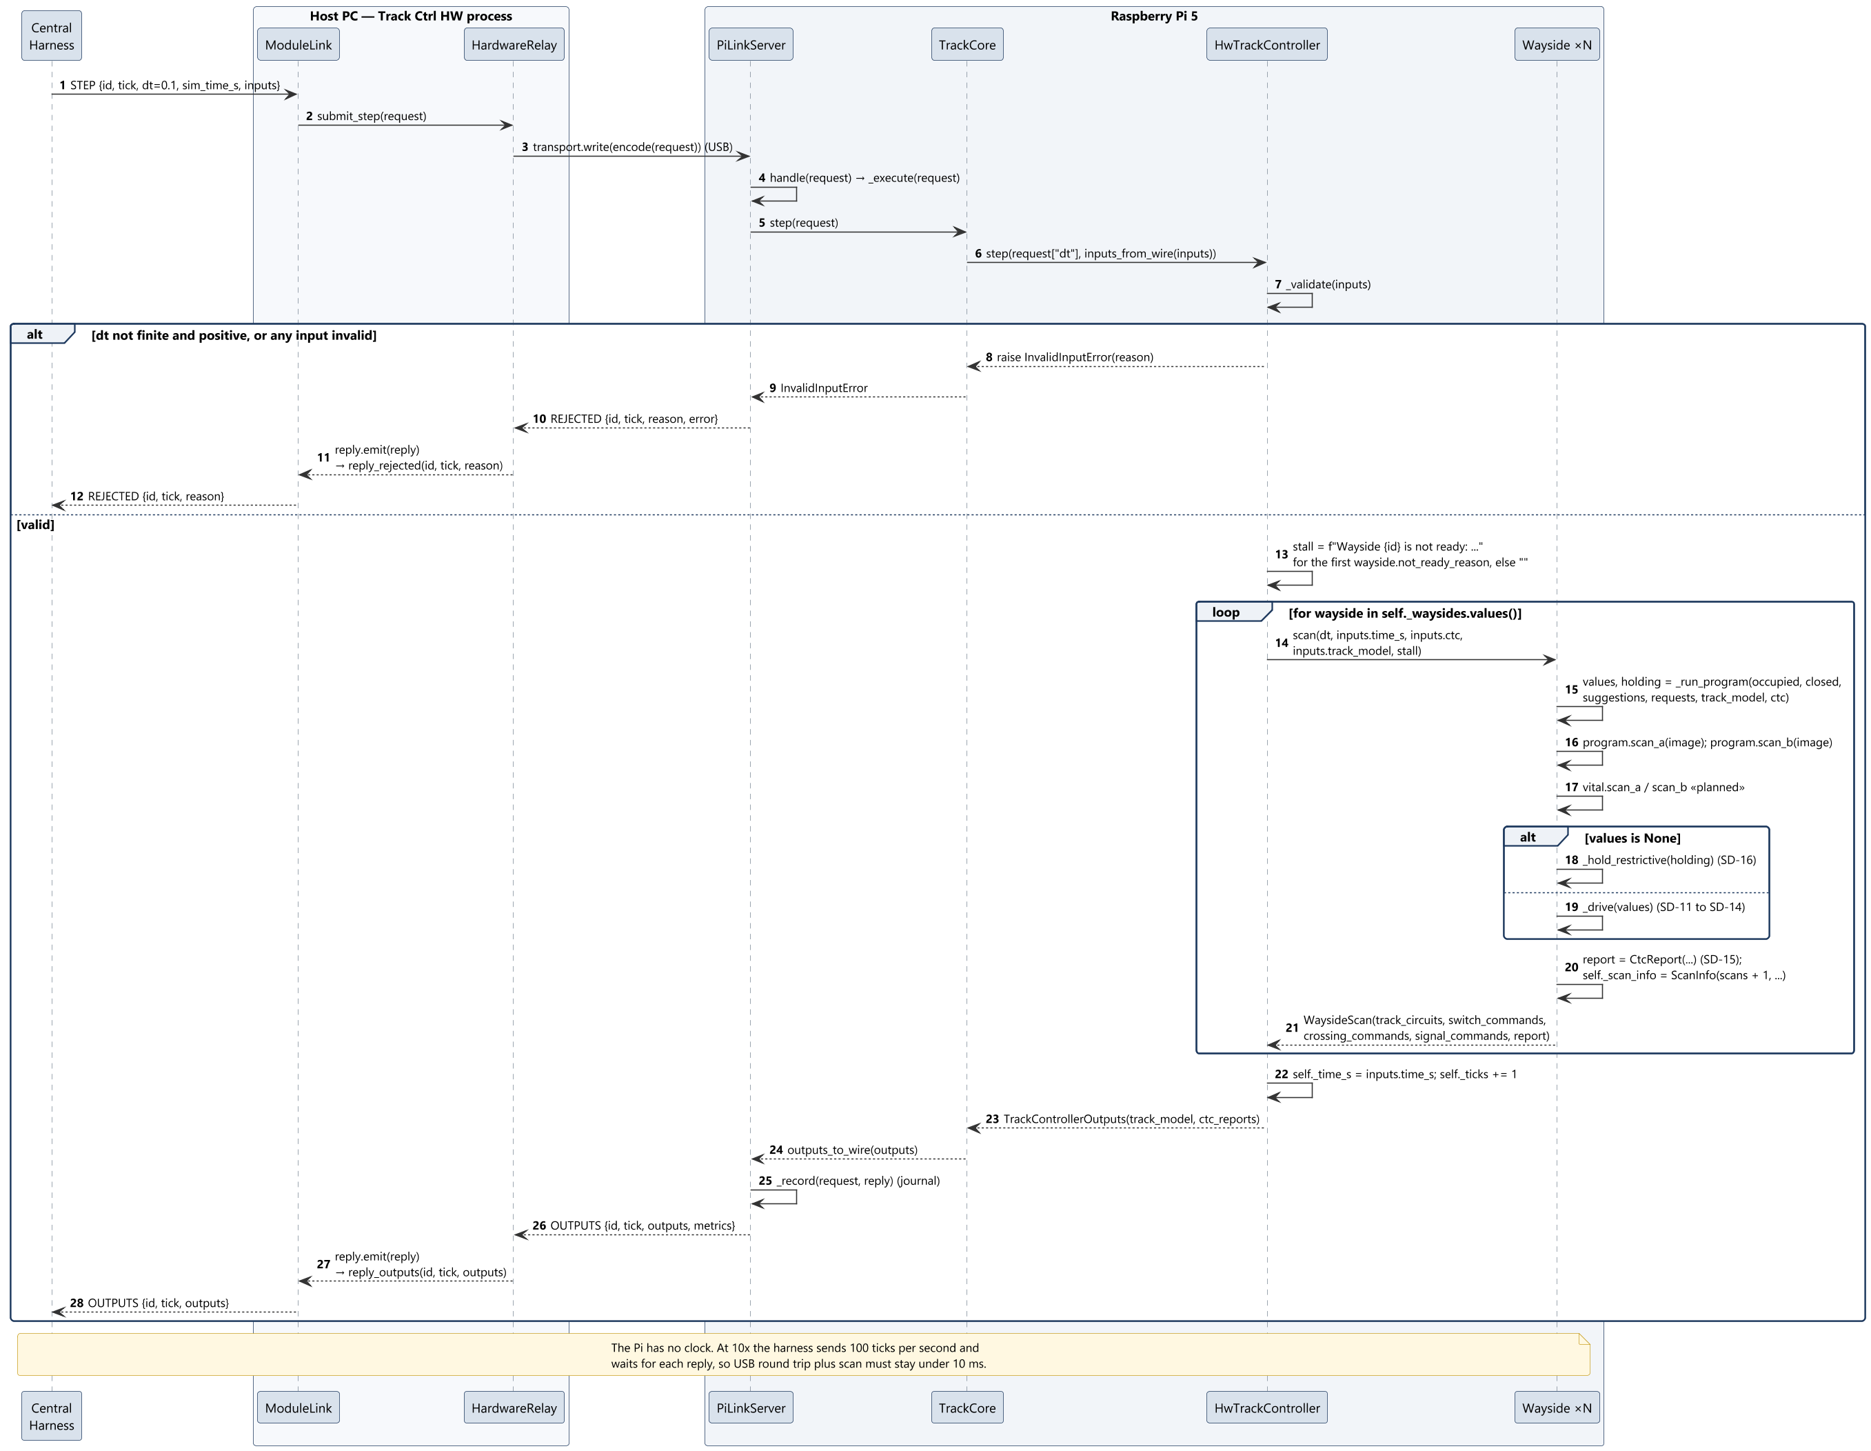
SD-07 Run scan cycle (UC-07)
Sequence diagrams
9

Slide 10
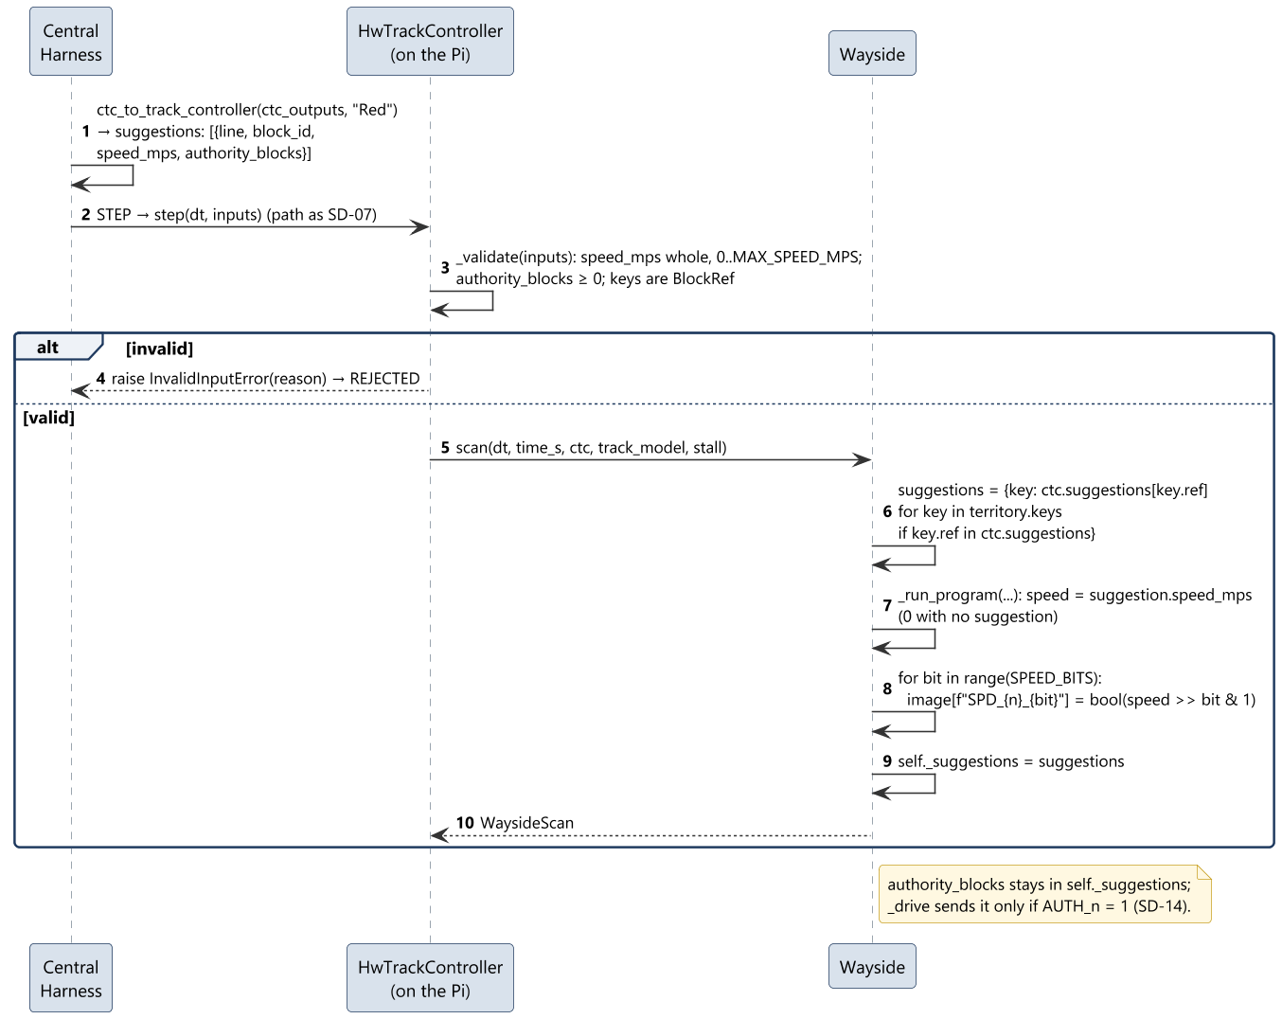
SD-08 Receive speed and authority suggestions (UC-08)
Sequence diagrams
10

Slide 11
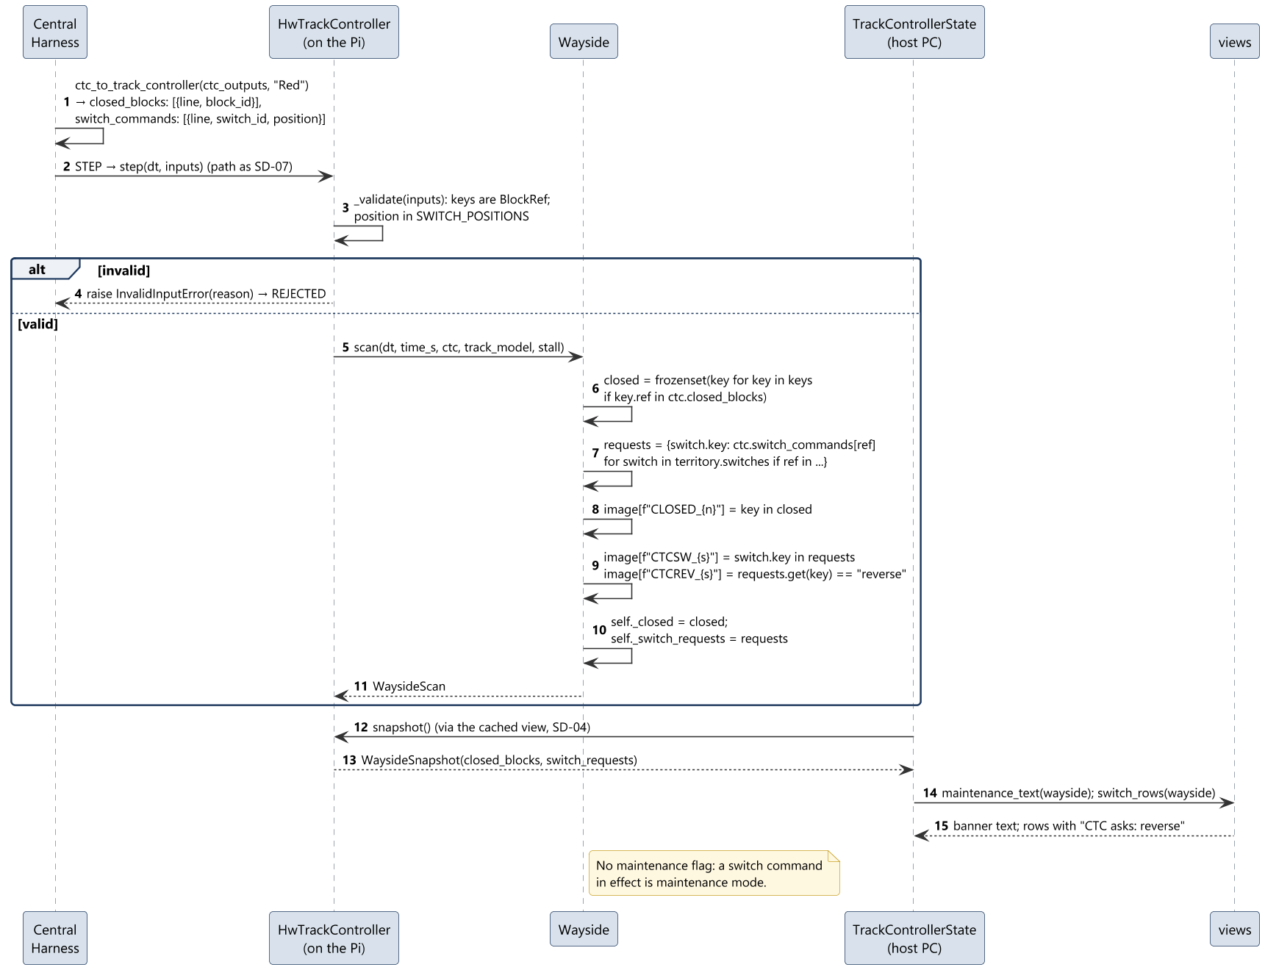
SD-09 Receive closures and maintenance switch commands (UC-09)
Sequence diagrams
11

Slide 12
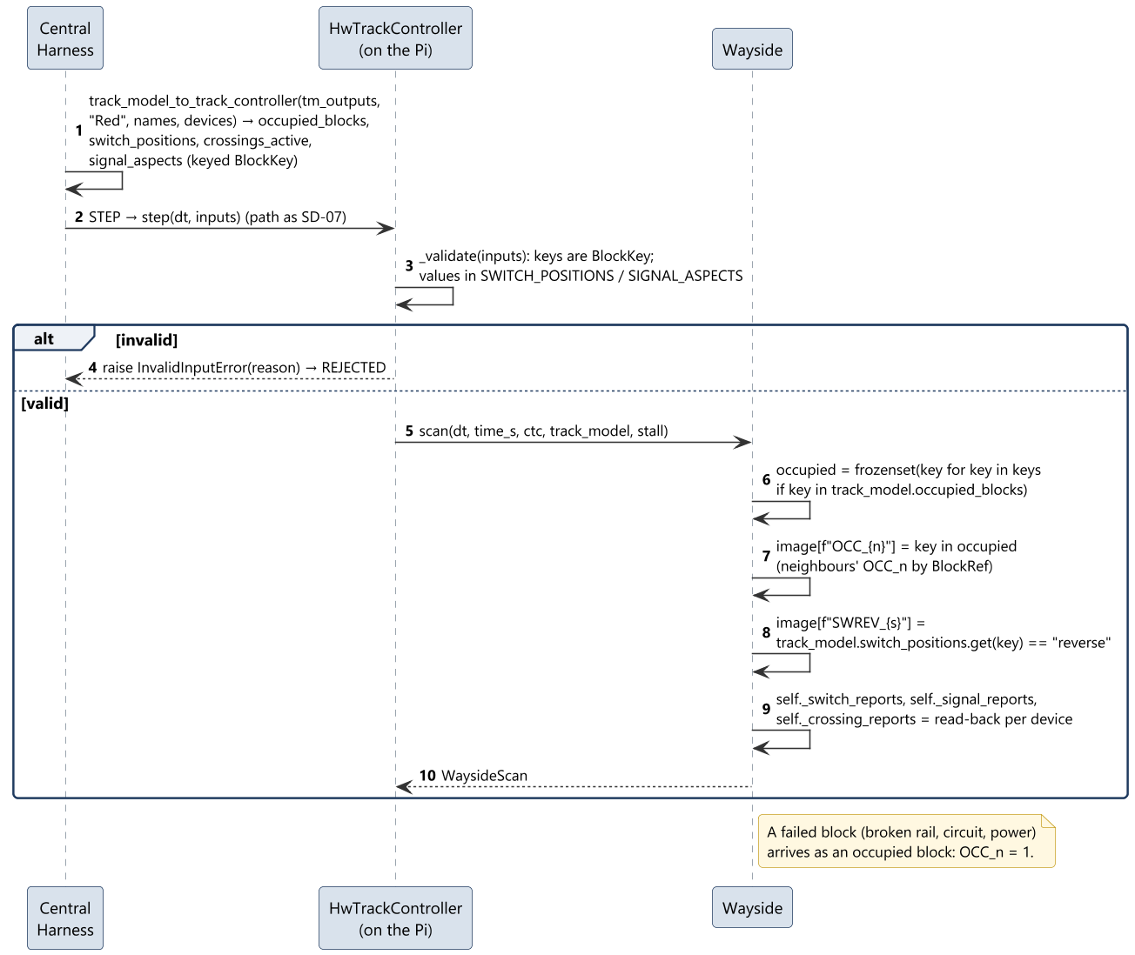
SD-10 Receive track state (UC-10)
Sequence diagrams
12

Slide 13
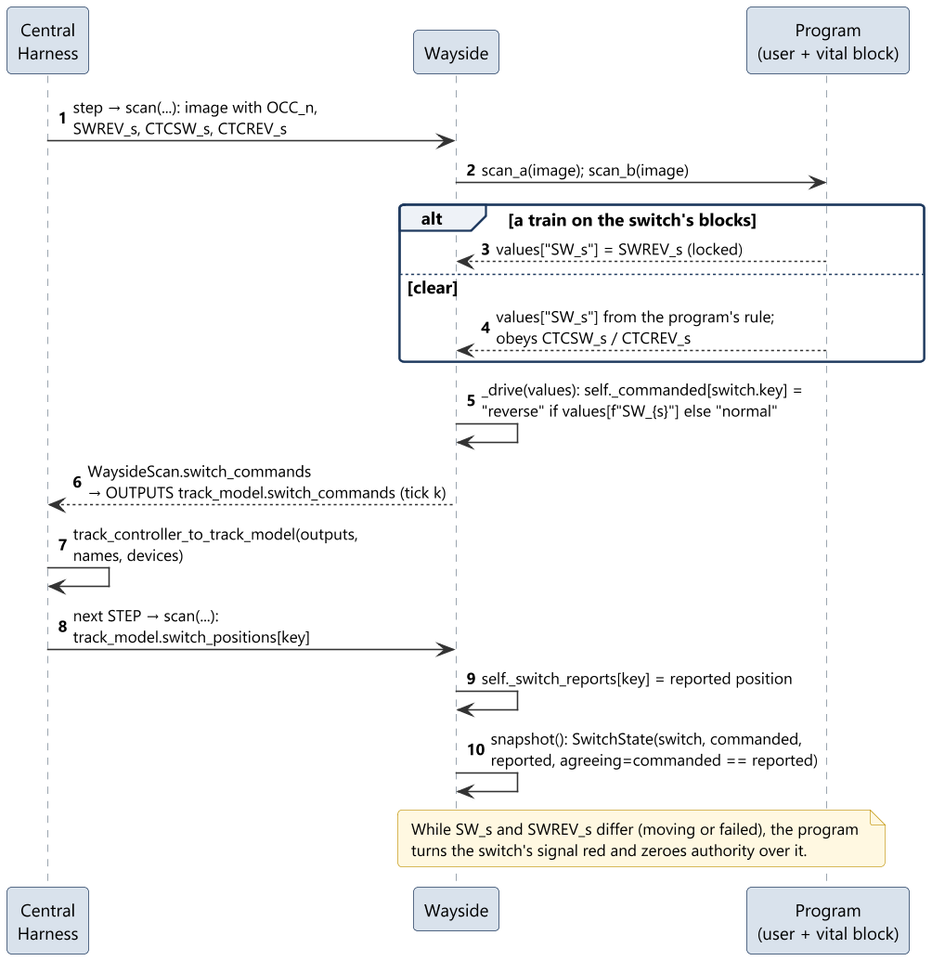
SD-11 Command switches (UC-11)
Sequence diagrams
13

Slide 14
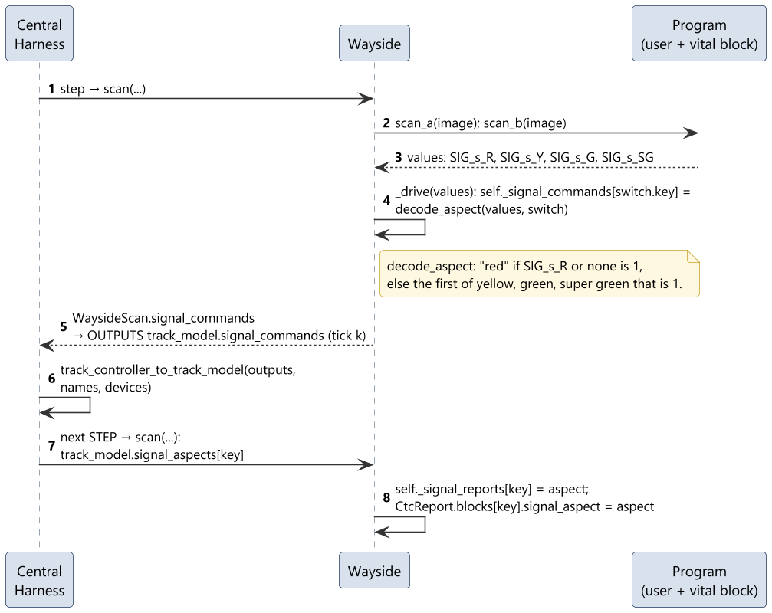
SD-12 Set signal aspects (UC-12)
Sequence diagrams
14

Slide 15
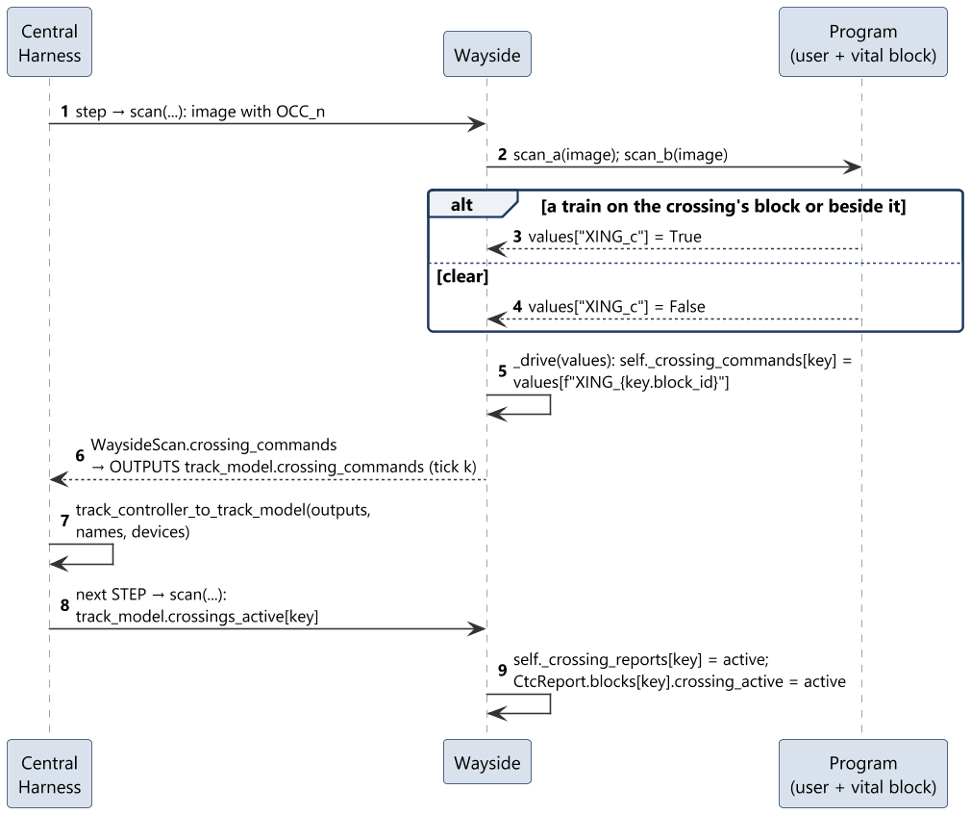
SD-13 Control railway crossings (UC-13)
Sequence diagrams
15

Slide 16
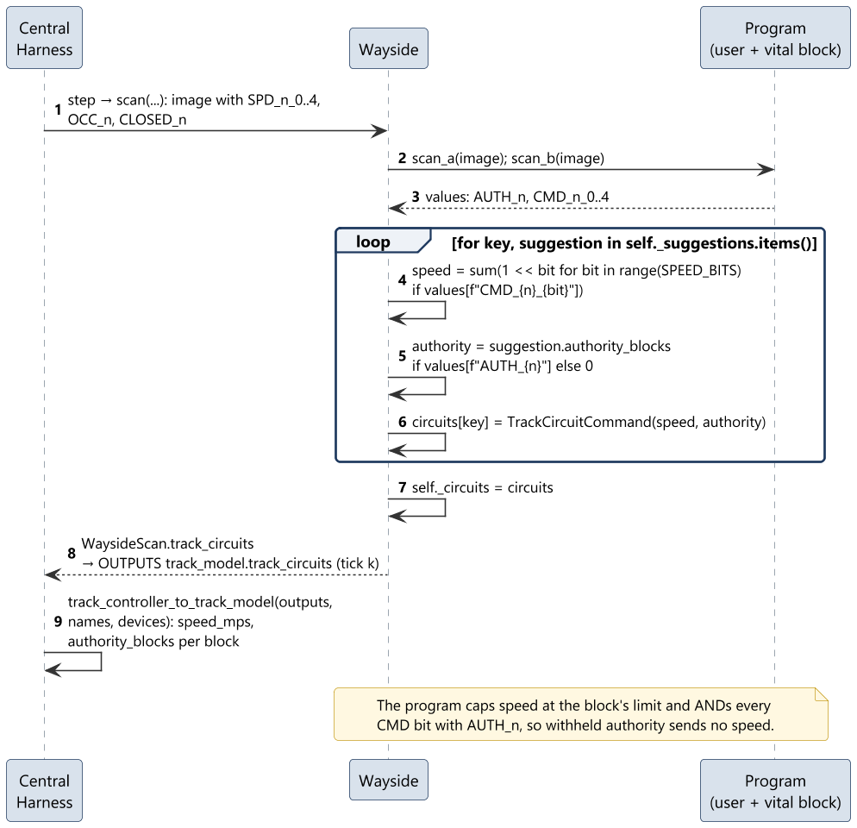
SD-14 Send speed and authority on track circuits (UC-14)
Sequence diagrams
16

Slide 17
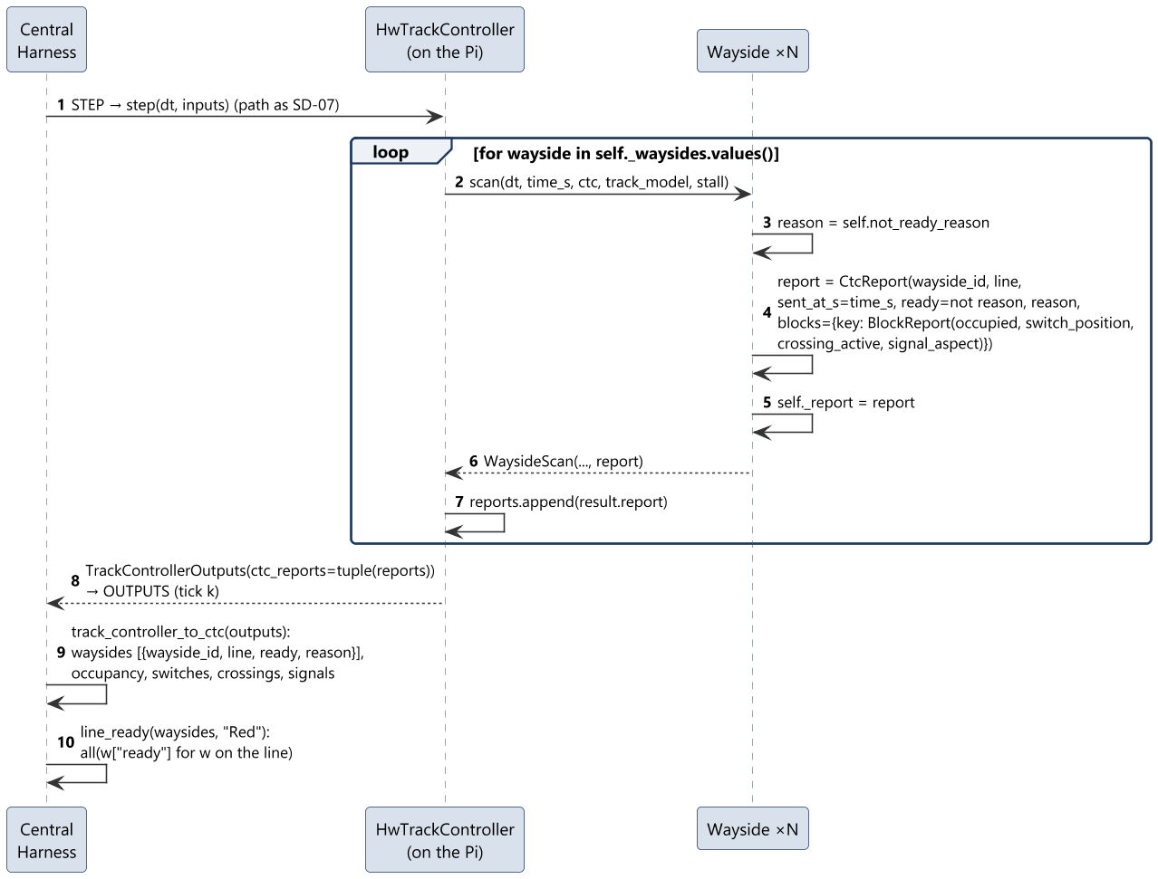
SD-15 Report occupancy, state and readiness (UC-15)
Sequence diagrams
17

Slide 18
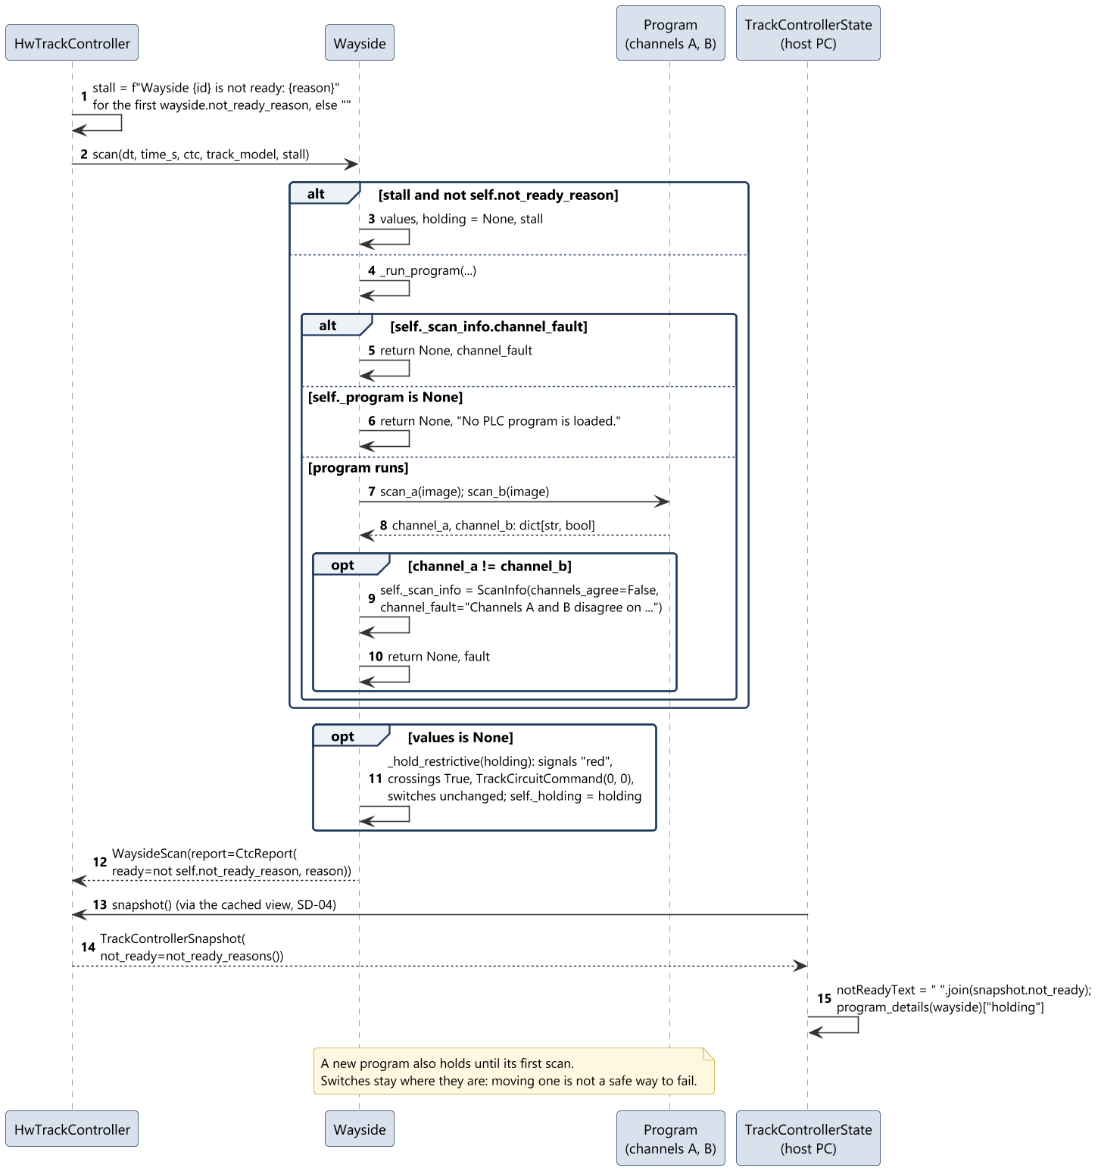
SD-16 Hold fail-safe outputs (UC-16)
Sequence diagrams
18

