Slide 1
Track Controller (HW)
Design review
Braden · Track Overflow · 2026-10-22

Slide 2
Overview

Slide 3
What the hardware Track Controller does
Overview
• Runs every wayside controller of the Red Line (Green: software variant)
• Each wayside: its own territory database and its own Boolean PLC program
• Knows blocks, never trains: everything it exchanges is keyed by block
  – A failure (broken rail, circuit, power) reaches it as an occupied block
• Core on a Raspberry Pi 5; window on the PC; linked by one USB cable
• Stepped once per tick by the central harness, like every module
  – Orange «planned» = designed, not built yet: the PC/Pi split and the vital block
Track Overflow · Design Review · Track Controller (HW) · Braden
3

Slide 4
Requirements coverage
Overview
Rubric | Requirement | SRS | Use cases
6.0 | Receive suggested speed and authority from the CTC | FUNC-049 | UC-08, UC-14
6.1 | Move switches by PLC execution | FUNC-052 | UC-07, UC-11
6.2 | Set traffic lights by PLC execution | FUNC-053 | UC-07, UC-12
6.3 | Receive train presence from the Track Model | FUNC-054 | UC-10
6.4 | Send track occupancy to the CTC | FUNC-055 | UC-15, UC-06
6.5 | Railway crossing lights and gates | FUNC-056 | UC-13
6.6 | PLC language based only on Boolean variables | FUNC-051 | UC-02, UC-07
6.7 | Load PLC file | FUNC-050 | UC-02
6.8 | Maintenance mode: set a switch position | FUNC-057 | UC-09, UC-11
6.9 | Safety-critical architecture | FUNC-058 | UC-07, UC-16
9.0 | Sub-system user interface | INTF-001.4 | UC-01 to UC-06
Track Overflow · Design Review · Track Controller (HW) · Braden
4

Slide 5
Use cases

Slide 6
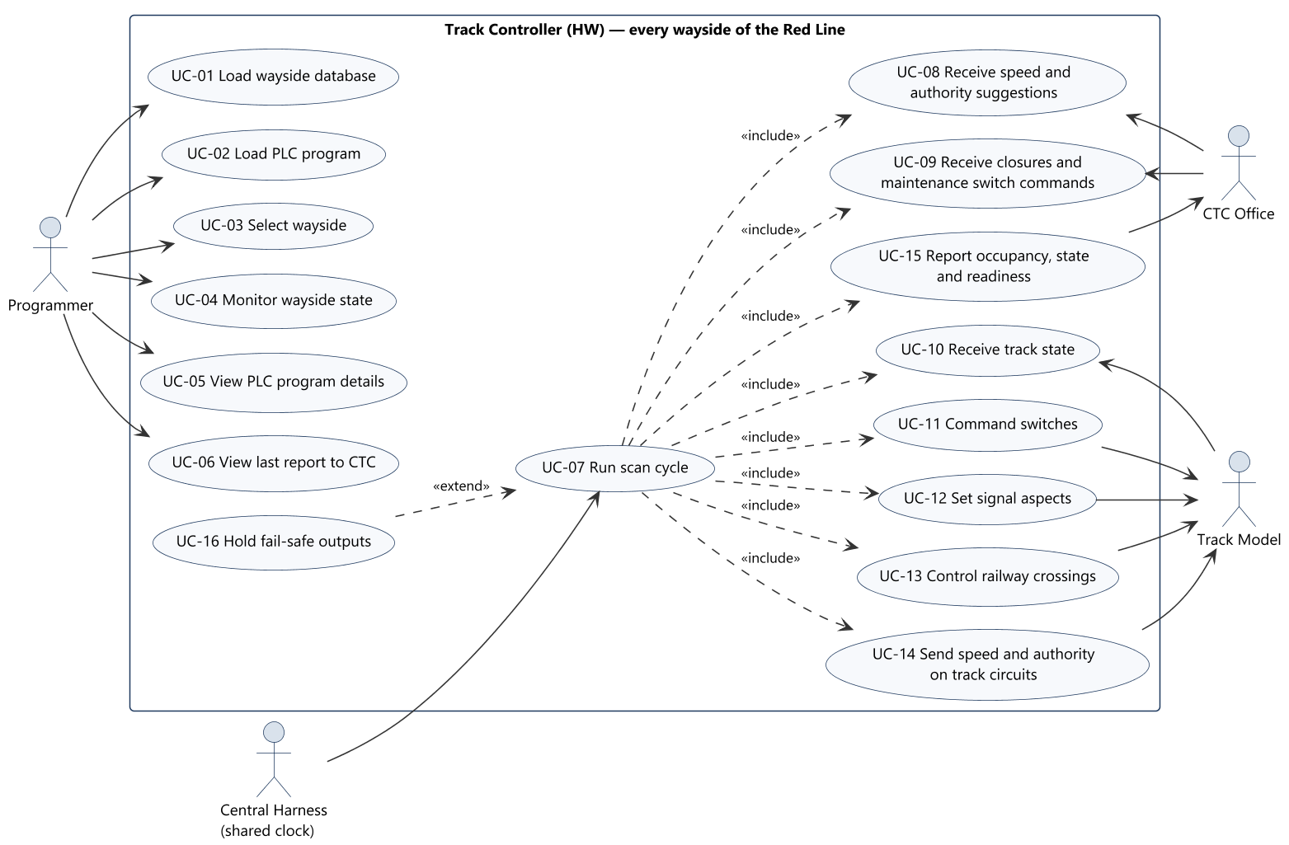
Use case diagram
Use cases
Programmer actions are every control of the window; the scan cycle runs once per tick
Track Overflow · Design Review · Track Controller (HW) · Braden
6

Slide 7
Architecture

Slide 8
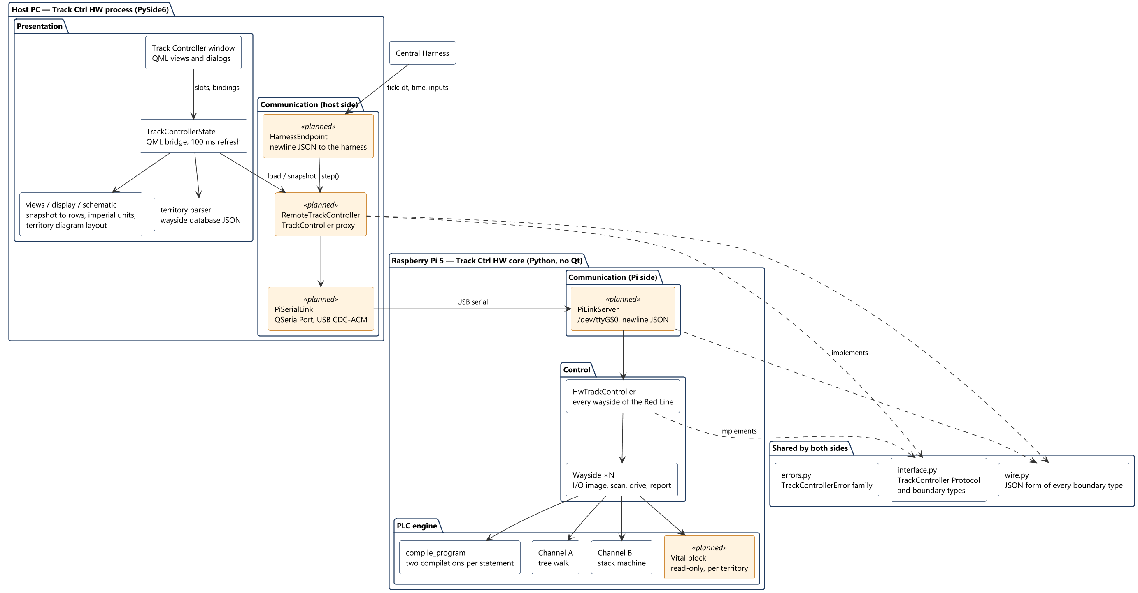
Software architecture
Architecture
Track Overflow · Design Review · Track Controller (HW) · Braden
8

Slide 9
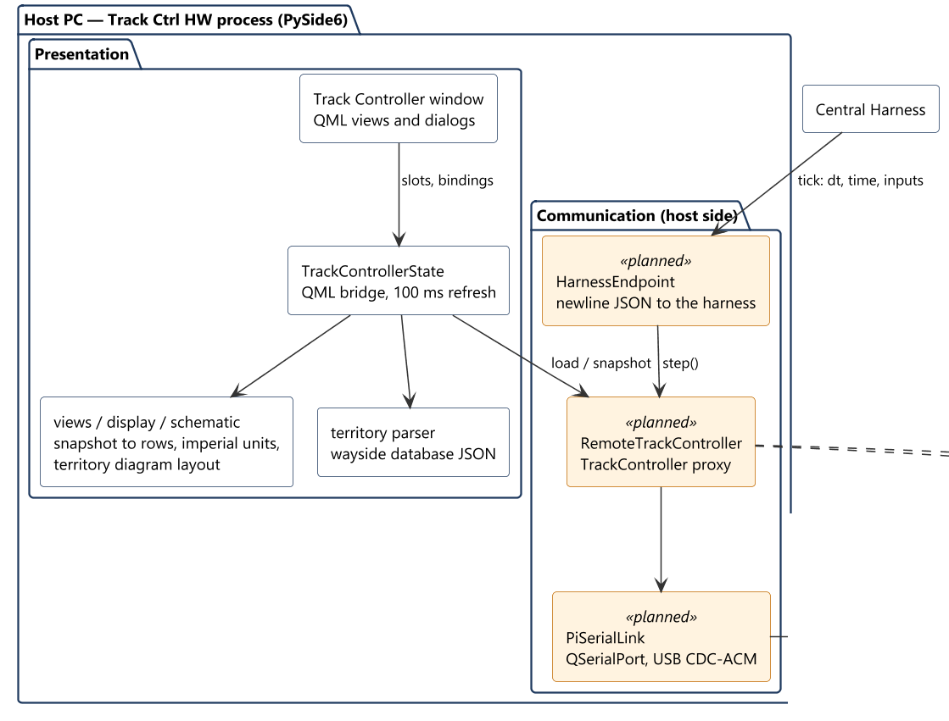
Software architecture: host PC
Architecture
Track Overflow · Design Review · Track Controller (HW) · Braden
9

Slide 10
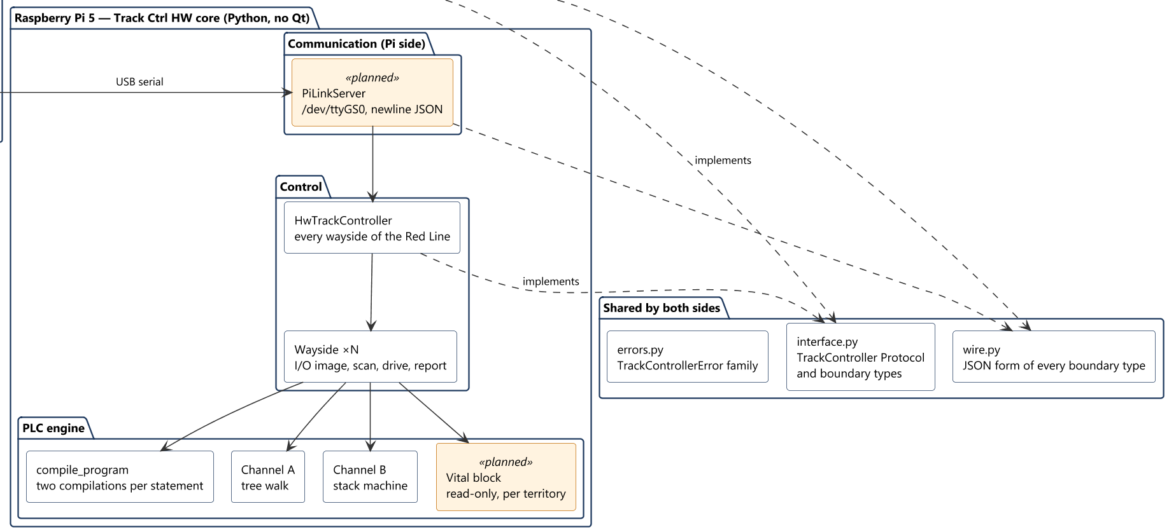
Software architecture: Raspberry Pi and shared code
Architecture
Track Overflow · Design Review · Track Controller (HW) · Braden
10

Slide 11
Architecture: design choices
Architecture
• One interface, three users: harness, window and test UI call only the TrackController Protocol
  – step, snapshot, load_territory, load_program, reset
• RemoteTrackController implements the same Protocol on the PC and forwards each call to the Pi
  – The window and the harness endpoint do not change when the core moves
• Core is Qt-free: runs on the Pi in plain Python; 74 unit tests run headless
• Validate, then change: a bad tick is rejected before any state changes
• Two channels: every statement compiled twice, by different algorithms, run every scan
Track Overflow · Design Review · Track Controller (HW) · Braden
11

Slide 12
Class diagrams

Slide 13
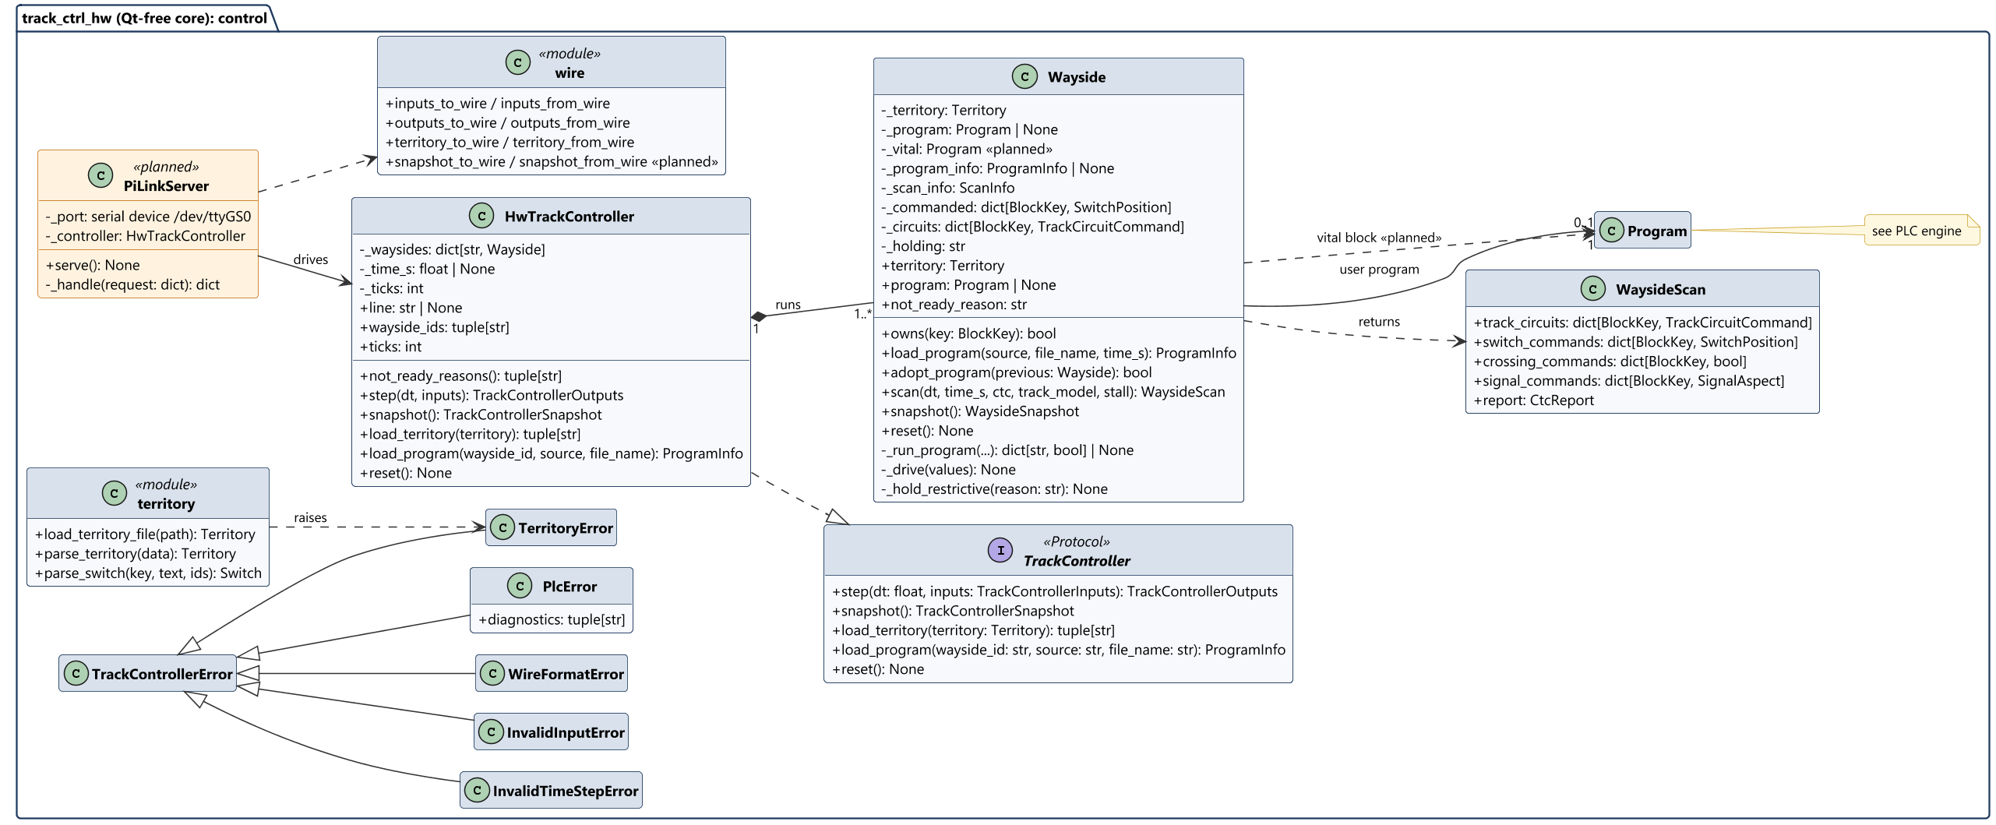
Core classes (Raspberry Pi): control
Class diagrams
Track Overflow · Design Review · Track Controller (HW) · Braden
13

Slide 14
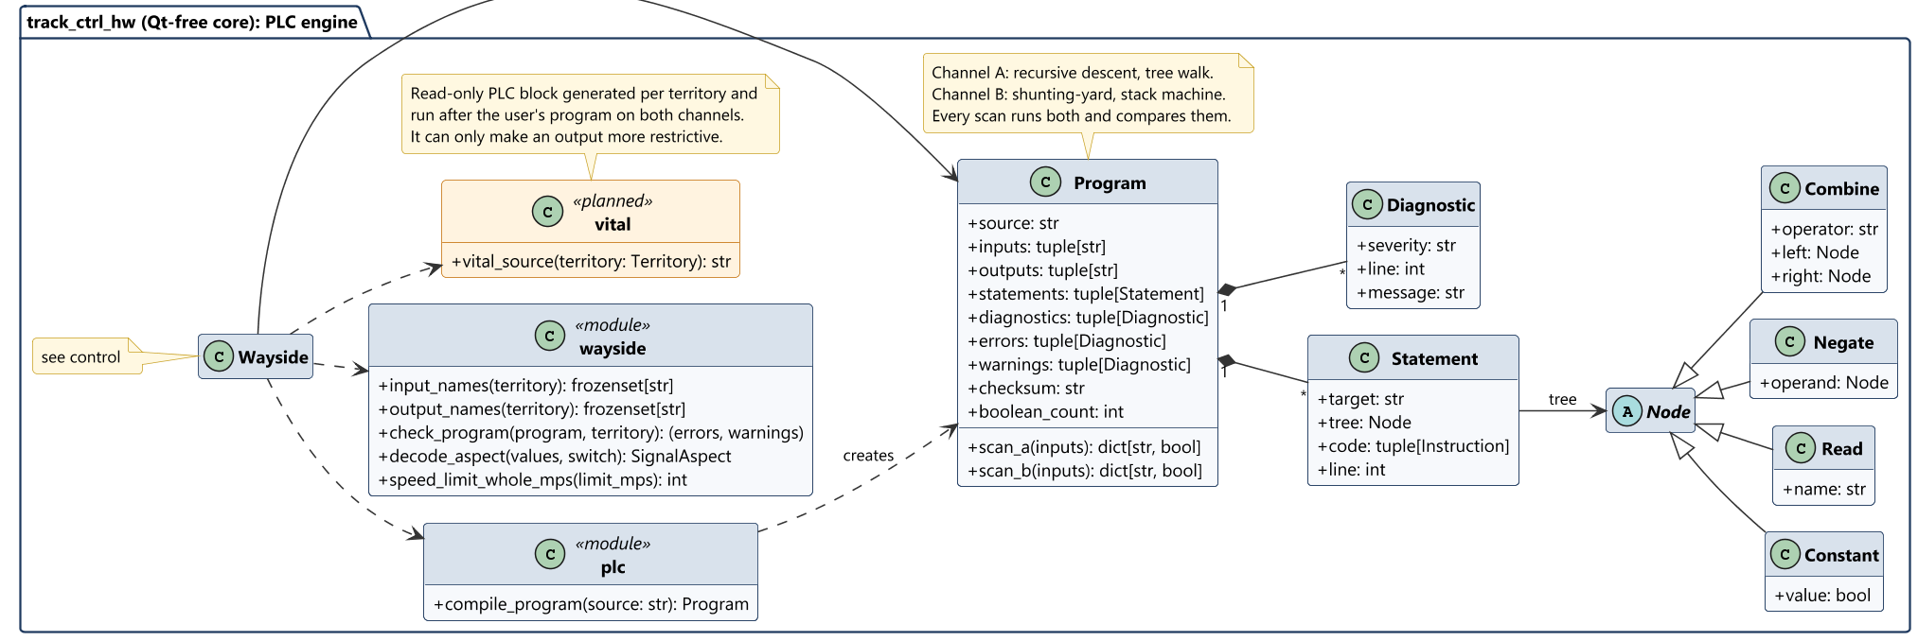
Core classes (Raspberry Pi): PLC engine
Class diagrams
Track Overflow · Design Review · Track Controller (HW) · Braden
14

Slide 15
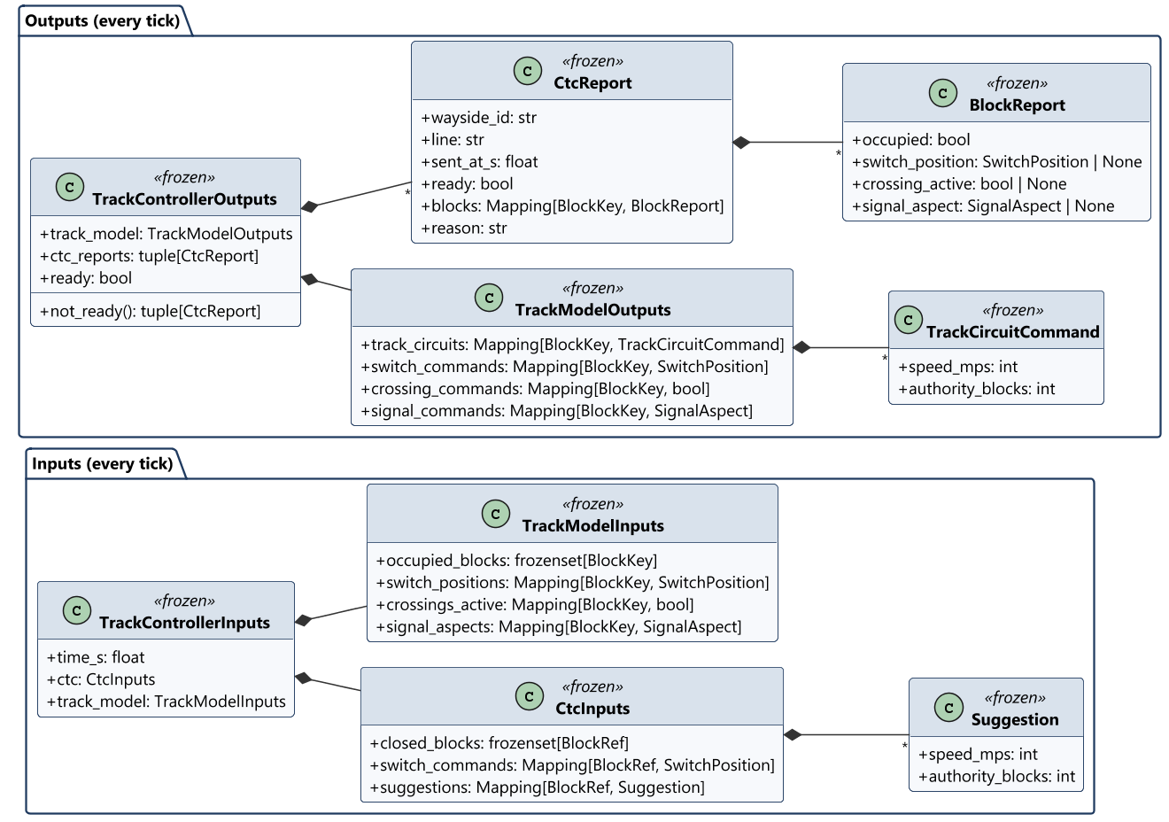
Boundary types: inputs and outputs
Class diagrams
15

Slide 16
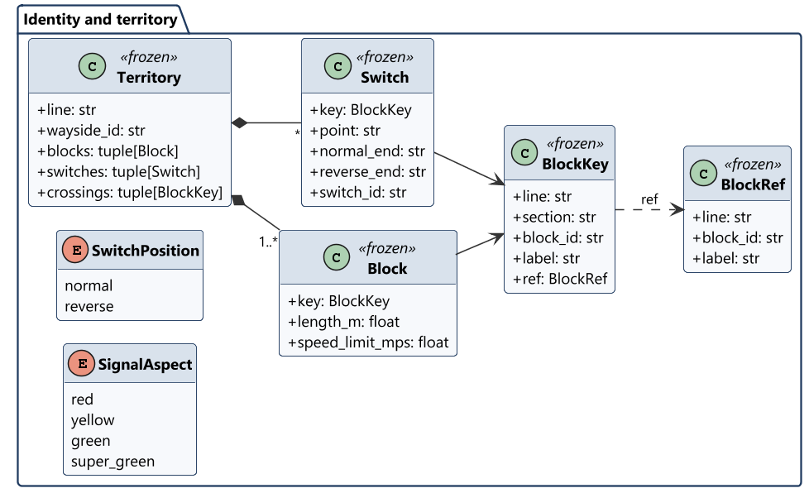
Boundary types: territory
Class diagrams
16

Slide 17
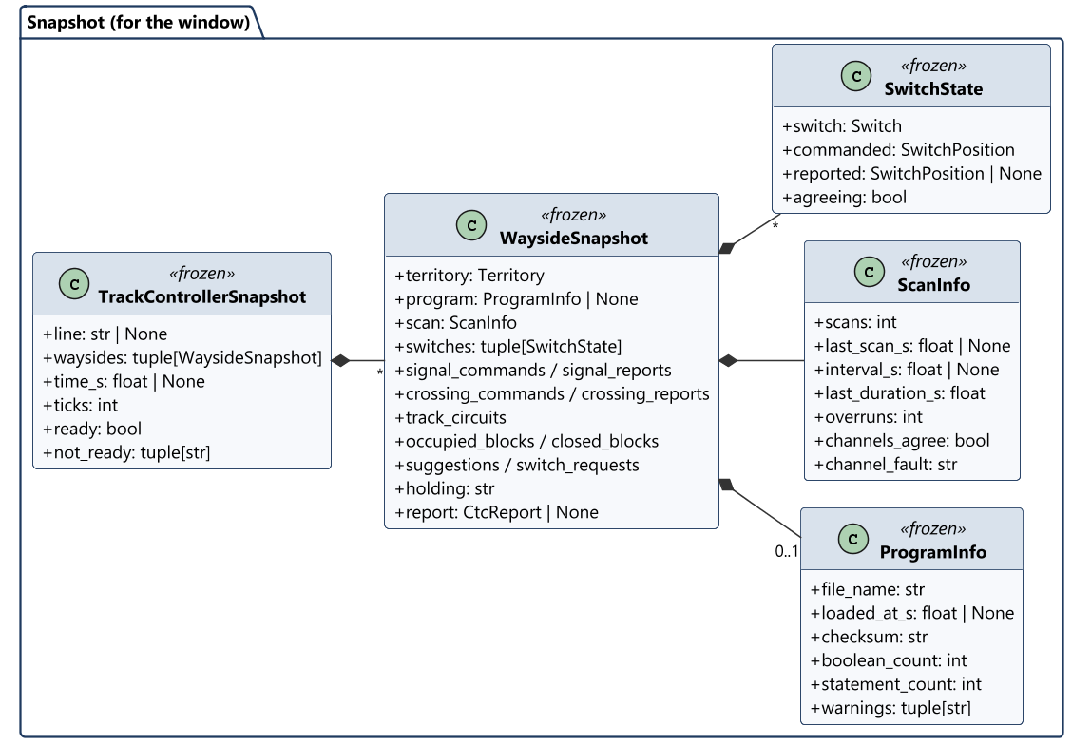
Boundary types: snapshot for the window
Class diagrams
17

Slide 18
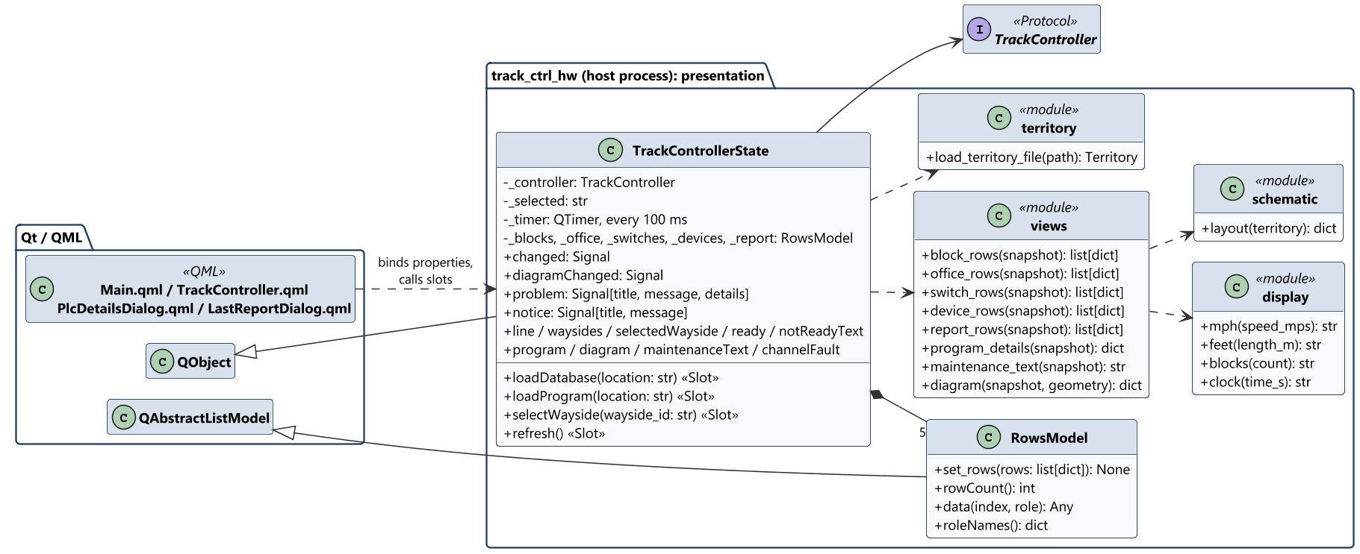
Host-side classes (PC): presentation
Class diagrams
QML only binds to TrackControllerState and calls its slots; rows update in place every 100 ms at most
Track Overflow · Design Review · Track Controller (HW) · Braden
18

Slide 19
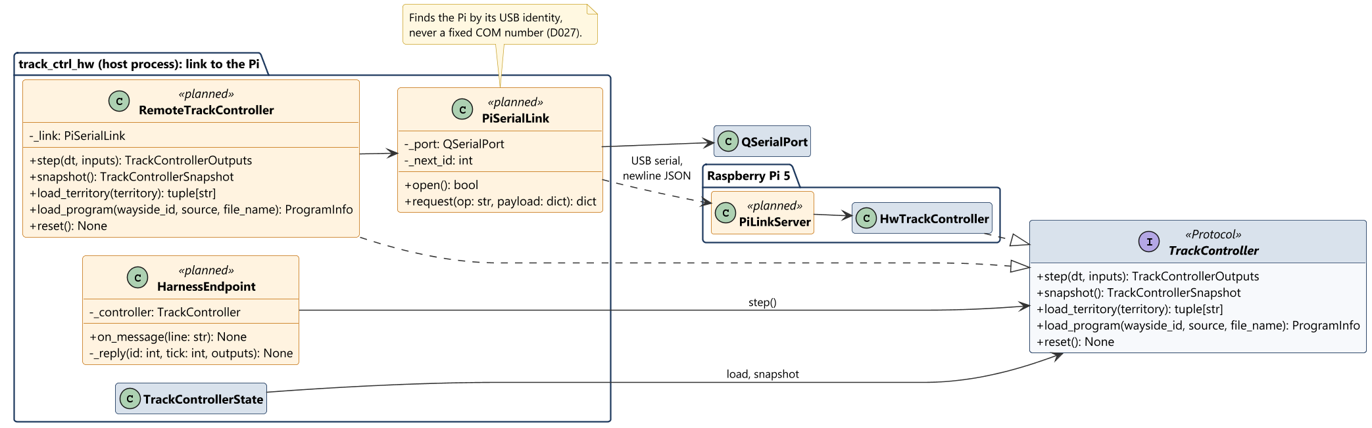
Host-side classes (PC): link to the Pi
Class diagrams
RemoteTrackController has the same Protocol as HwTrackController; each call is one request over USB
Track Overflow · Design Review · Track Controller (HW) · Braden
19

Slide 20
Sequence diagrams

Slide 21
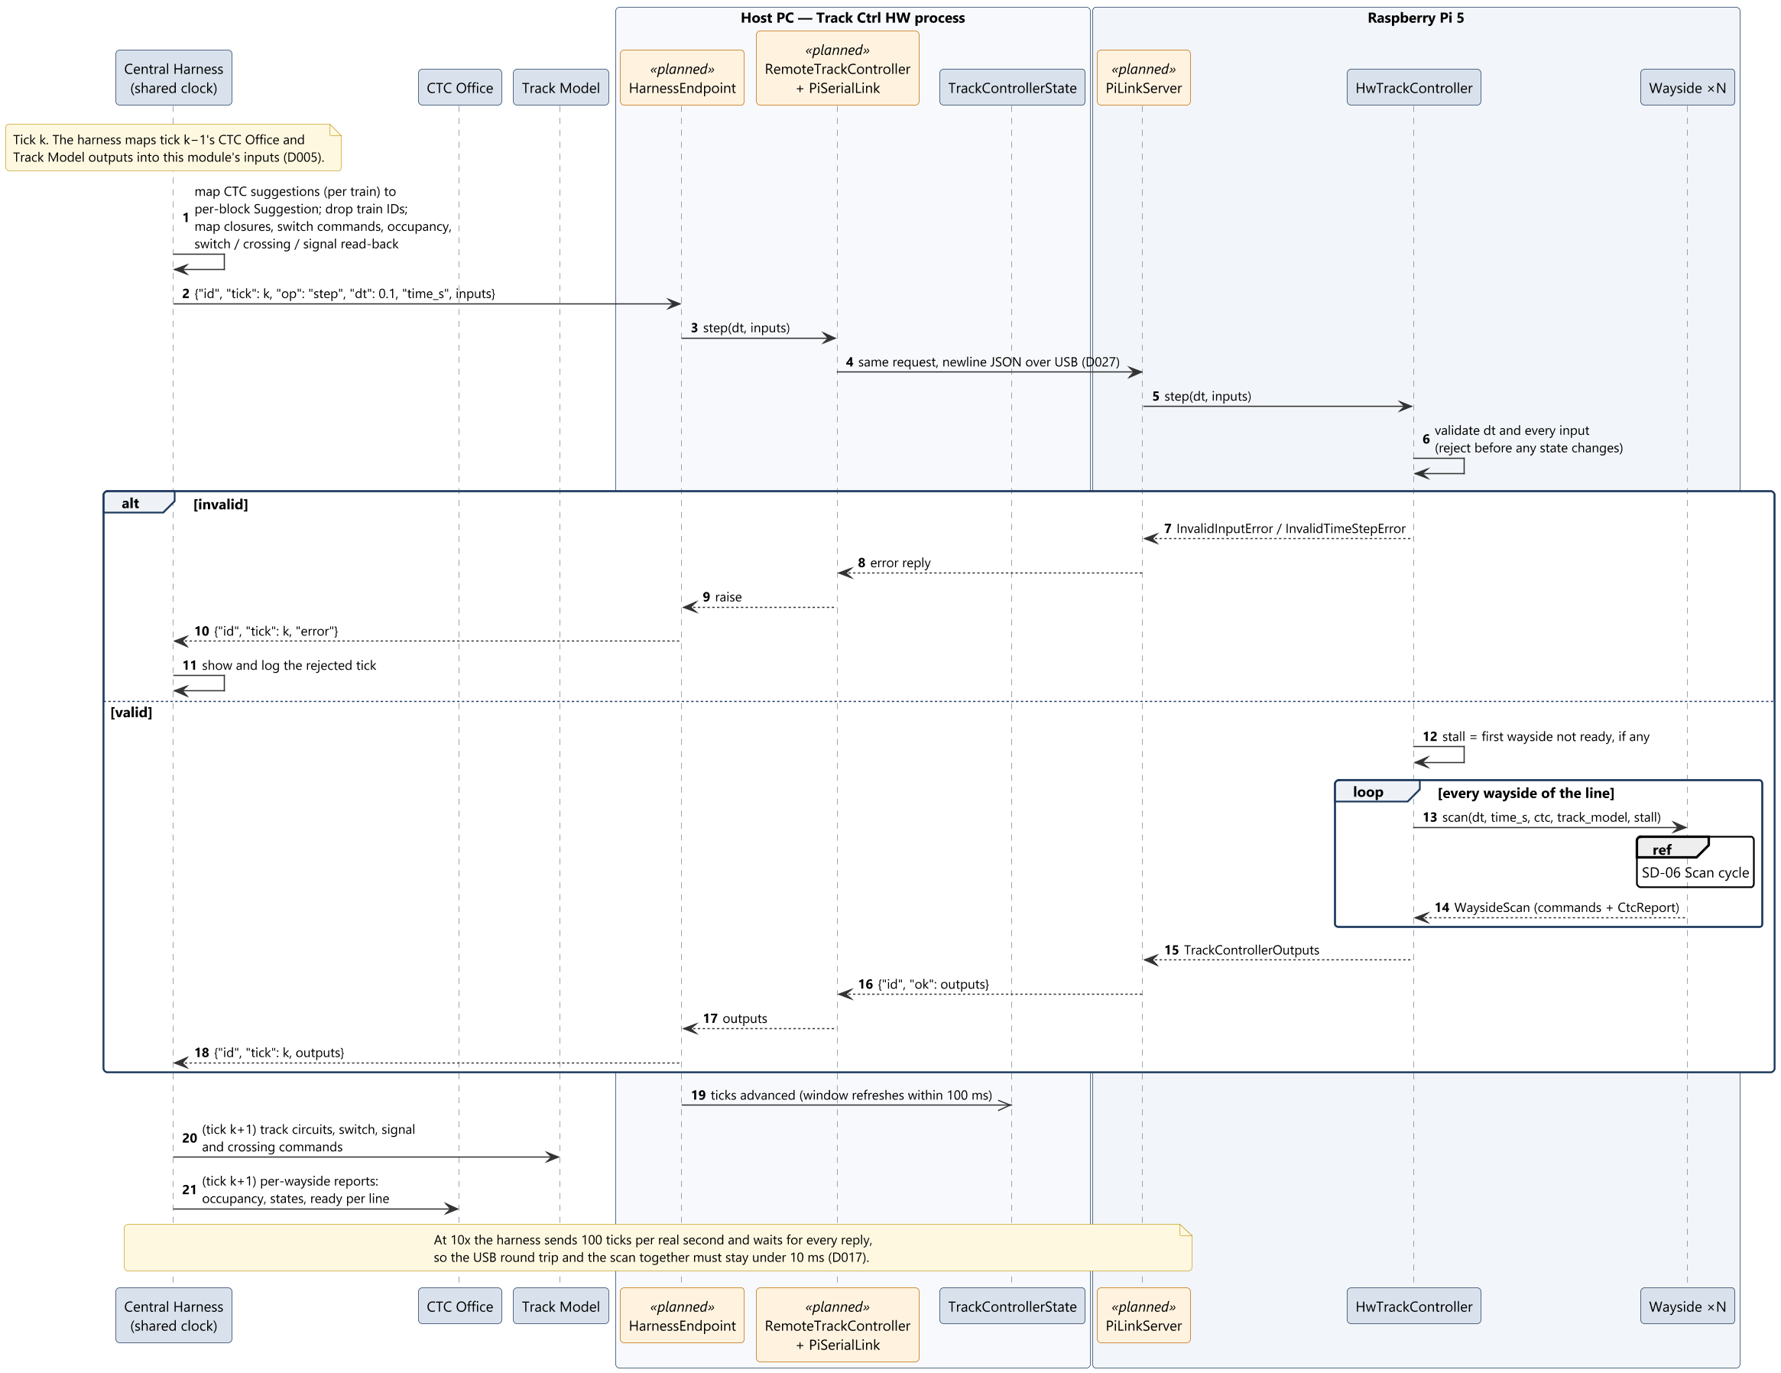
SD-05 One tick through the central harness
Sequence diagrams
Track Overflow · Design Review · Track Controller (HW) · Braden
21

Slide 22
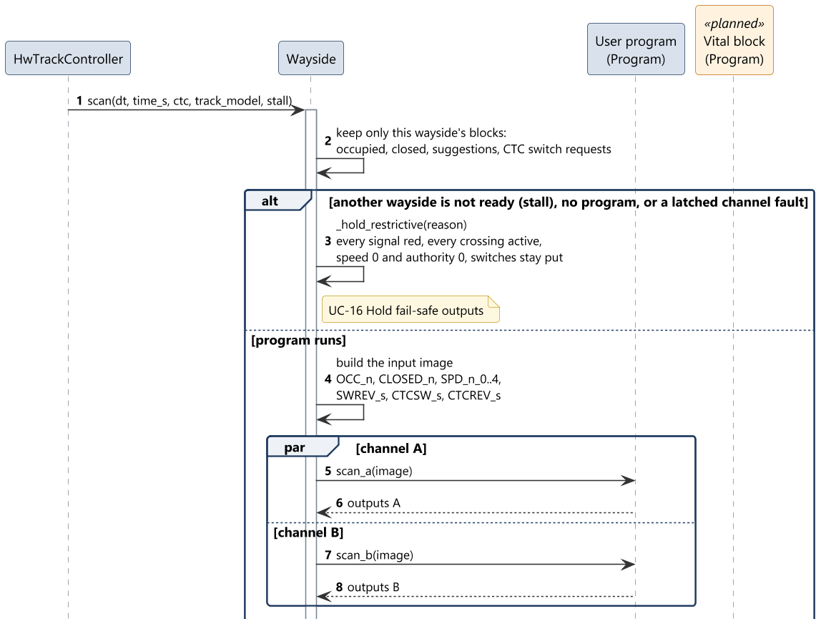
SD-06 Scan cycle of one wayside (1 of 2)
Sequence diagrams
Track Overflow · Design Review · Track Controller (HW) · Braden
22

Slide 23
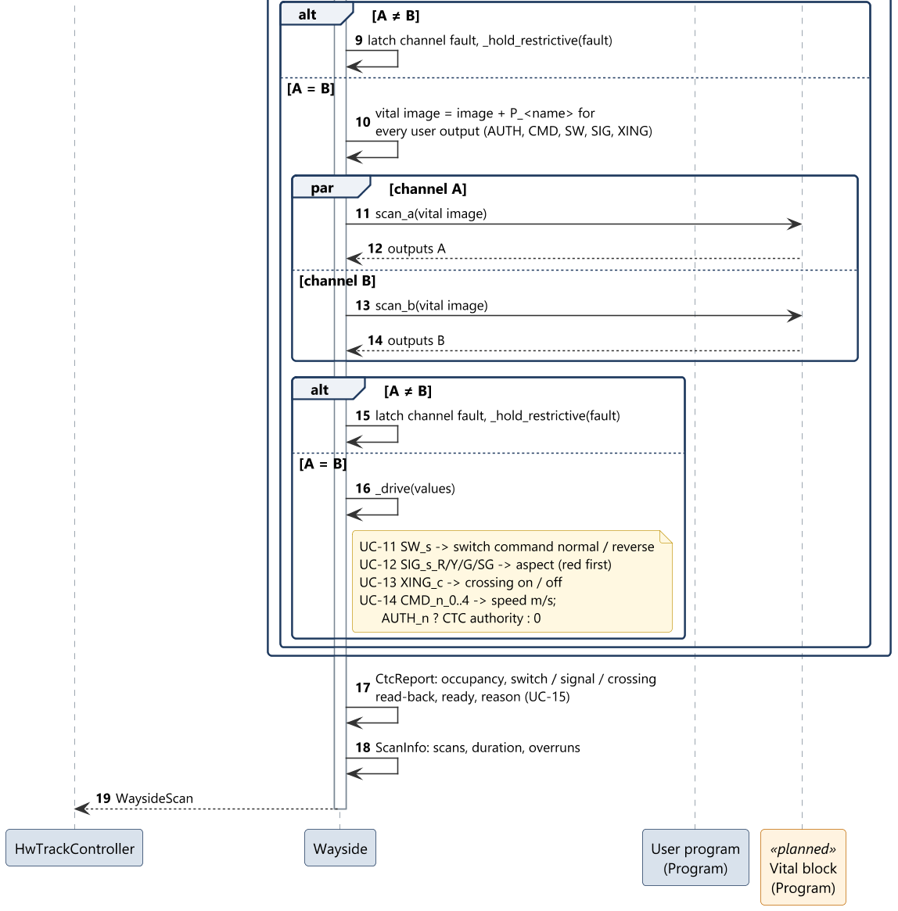
SD-06 Scan cycle of one wayside (2 of 2)
Sequence diagrams
Track Overflow · Design Review · Track Controller (HW) · Braden
23

Slide 24
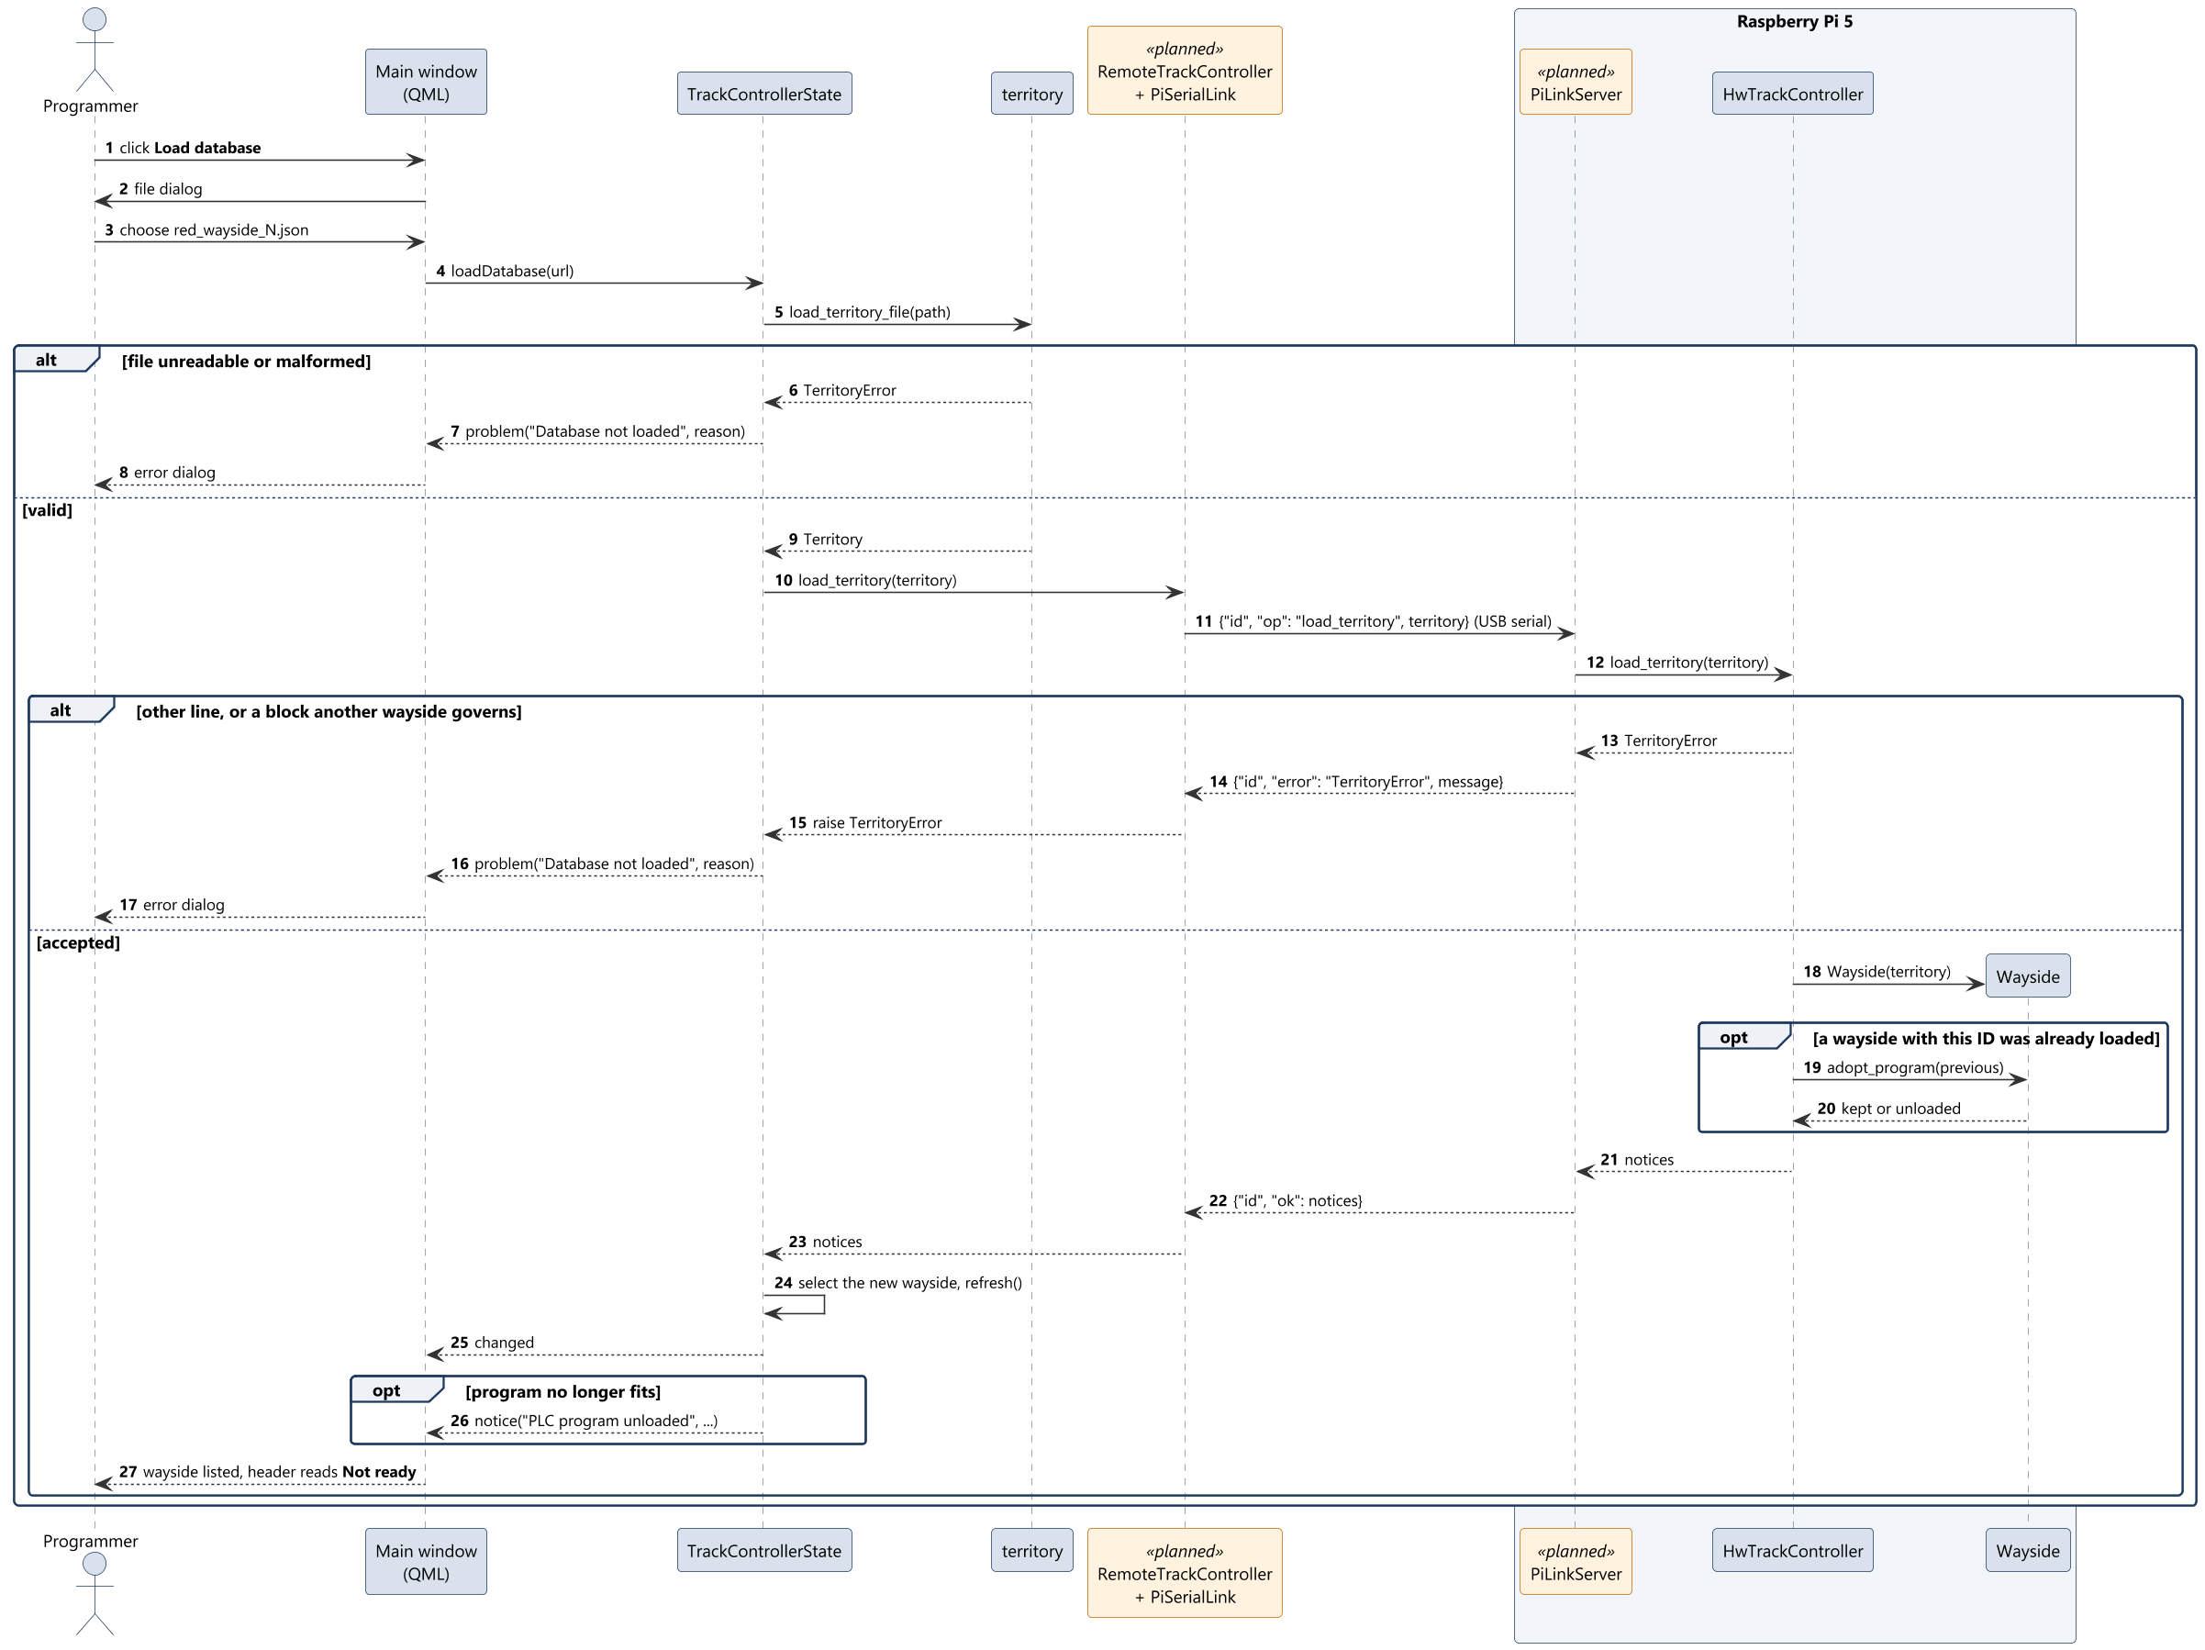
SD-01 Load wayside database
Sequence diagrams
Track Overflow · Design Review · Track Controller (HW) · Braden
24

Slide 25
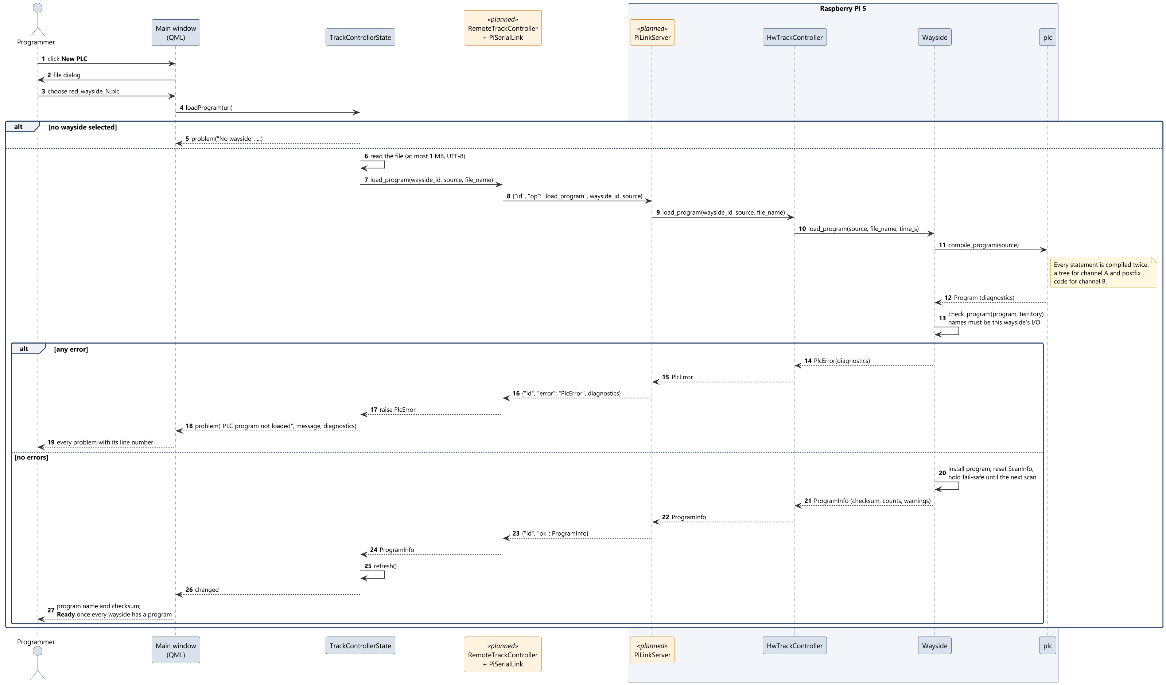
SD-02 Load PLC program
Sequence diagrams
Track Overflow · Design Review · Track Controller (HW) · Braden
25

Slide 26
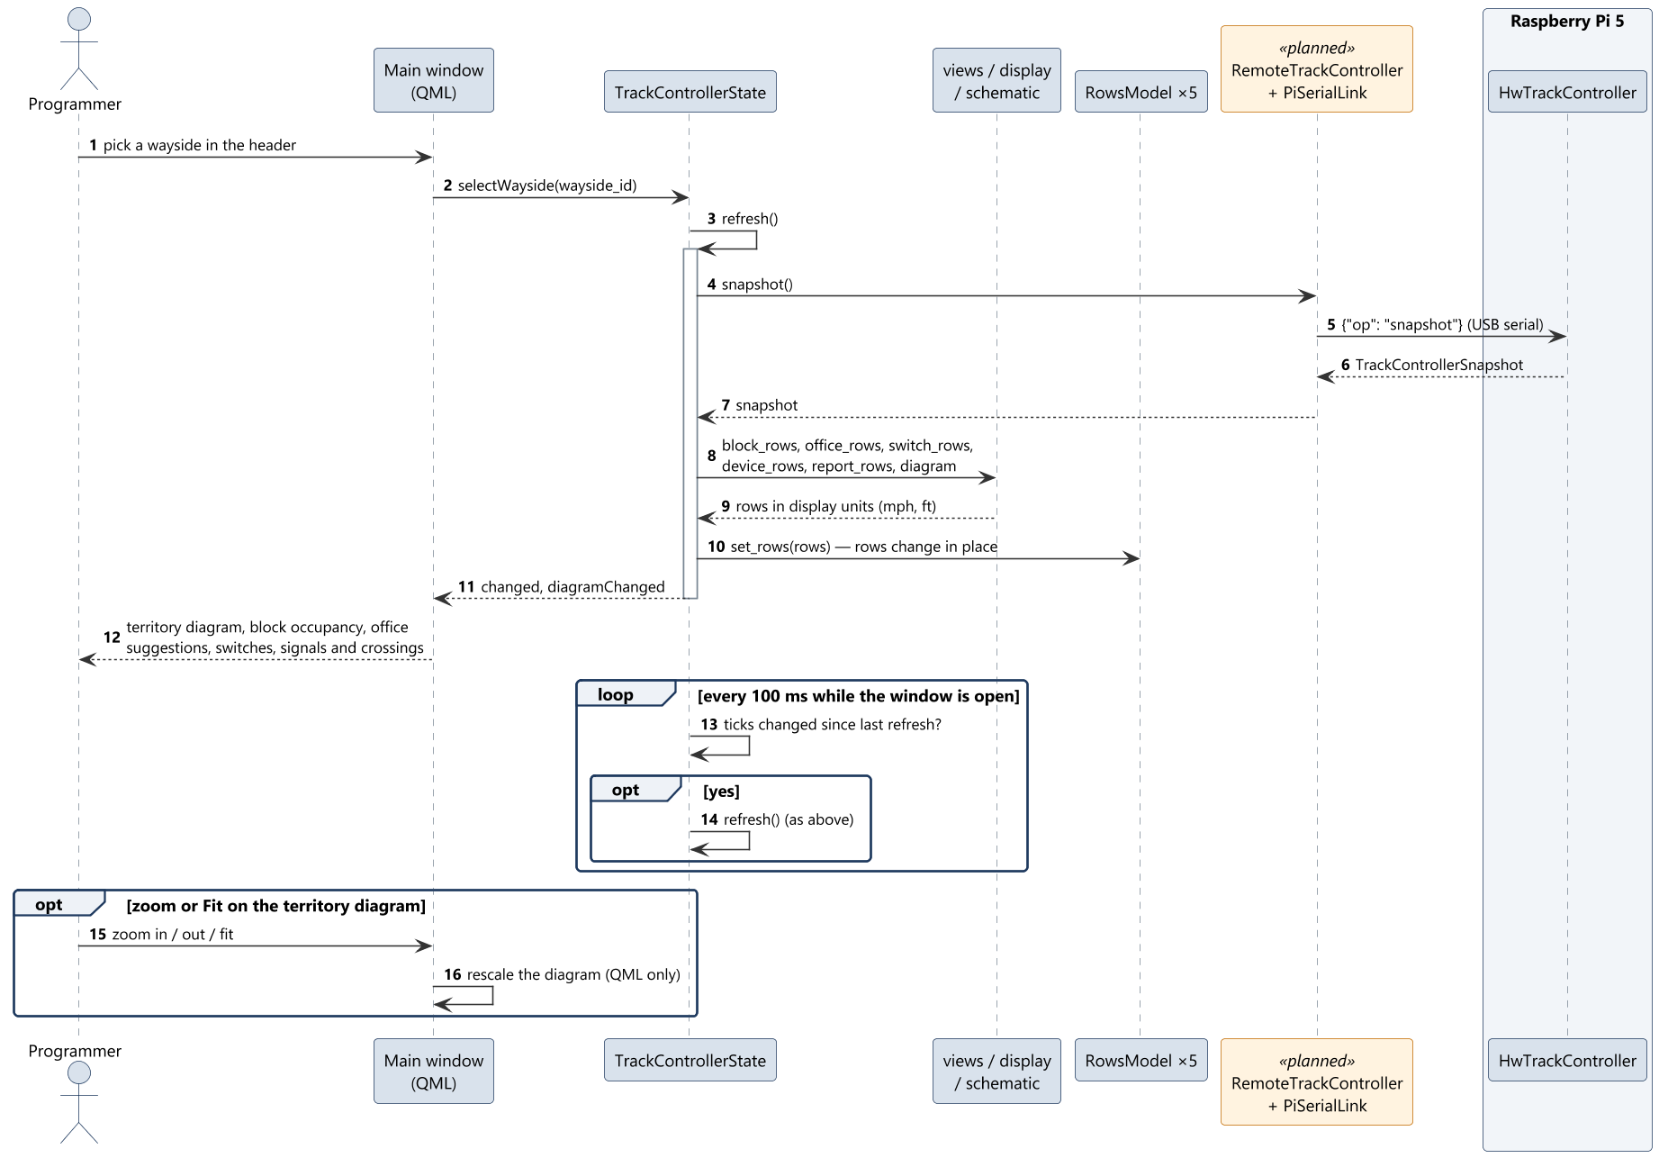
SD-03 Select wayside and monitor
Sequence diagrams
Track Overflow · Design Review · Track Controller (HW) · Braden
26

Slide 27
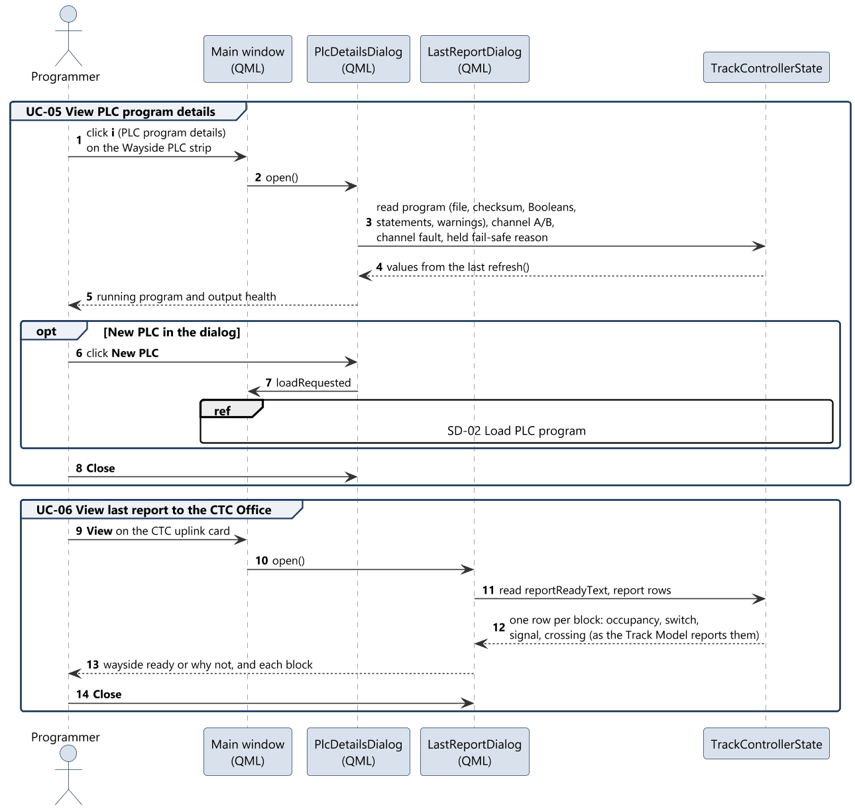
SD-04 PLC details and last report
Sequence diagrams
Track Overflow · Design Review · Track Controller (HW) · Braden
27

Slide 28
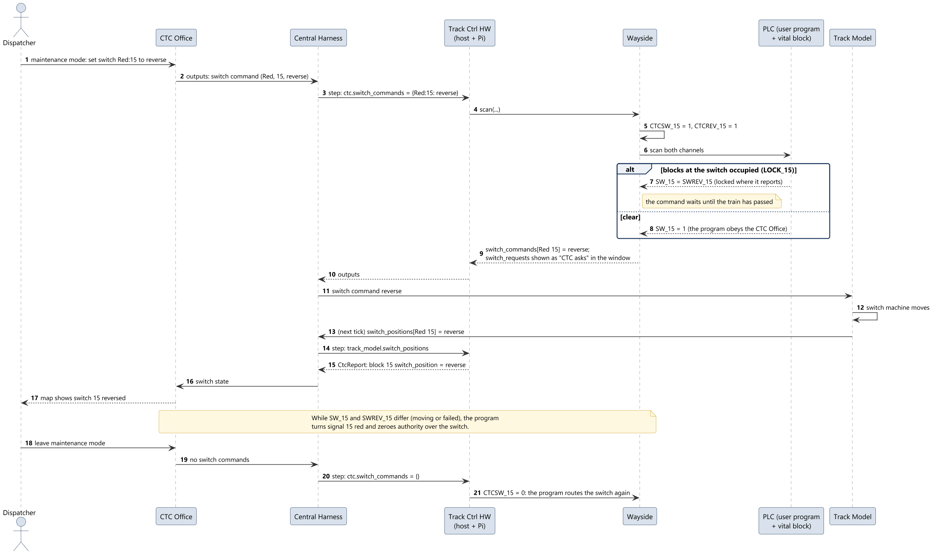
SD-07 Maintenance switch command
Sequence diagrams
Track Overflow · Design Review · Track Controller (HW) · Braden
28

Slide 29
Deployment

Slide 30
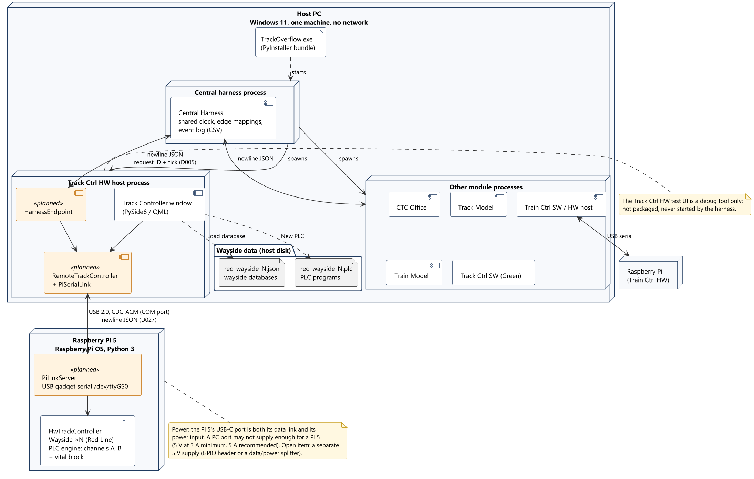
Deployment
Deployment
Track Overflow · Design Review · Track Controller (HW) · Braden
30

Slide 31
System concepts
Track Controller's part of the joint concepts, with Harry and Landis

Slide 32
Distribution of wayside controllers
System concepts
• One variant per line: HW runs the Red Line, SW the Green Line (D021)
• A wayside owns a contiguous run of blocks and every switch, signal and crossing on them
• One Raspberry Pi 5 runs every Red Line wayside
• A line runs only when every wayside on it is ready
  – Ready: a person has loaded the database and the PLC program, and the channels agree
  – Not ready anywhere on the line: the whole line holds fail-safe and the CTC dispatches nothing
• Red Line boundaries: to be chosen; a switch must lie inside one wayside
Track Overflow · Design Review · Track Controller (HW) · Braden
32

Slide 33
Authority, as the wayside handles it
System concepts
• Authority = blocks ahead the train may still enter; 0 = stop (D013)
• CTC Office computes it along the route and suggests it per block
• The program's AUTH_n passes the CTC count down block n's track circuit, or sends 0
  – Withheld for a closed block, a switch not where commanded, an occupied neighbour
• Speed travels with it as five bits, capped at the block's limit
• Track Model delivers both to the train in the block, then clears them
Track Overflow · Design Review · Track Controller (HW) · Braden
33

Slide 34
Wayside language
System concepts
// a comment
VAR_IN OCC_12 OCC_13 SWREV_12
VAR_IN CTCSW_12 CTCREV_12
VAR_OUT SW_12
LOCK_12 := OCC_12 OR OCC_13
WANT_12 := CTCSW_12 AND CTCREV_12
SW_12 := (LOCK_12 AND SWREV_12)
OR (NOT LOCK_12 AND WANT_12)
• Boolean only: NOT, AND, XOR, OR, 0, 1, parentheses
• Runs top to bottom once per tick; an unset name reads 0
• Speed crosses in and out as five bits (SPD_n_0..4, CMD_n_0..4)
• Every error reported with its line number; a program naming I/O its wayside lacks is refused
• Shared with the SW variant; the names still differ
Track Overflow · Design Review · Track Controller (HW) · Braden
34

Slide 35
Vitality
System concepts
• The OS only holds and parses the PLC program: every decision is PLC code
• Read-only vital block after the user's program «planned»
  – Generated per territory; can only make outputs more restrictive
• Diverse execution: two compilers, two interpreters, compared every scan
• Diverse implementations: HW and SW share a language, not code
• Fail-safe outputs: signals red, crossings active, speed and authority 0, switches stay
• Inputs checked whole before anything changes; a failure reads as occupancy
Track Overflow · Design Review · Track Controller (HW) · Braden
35

Slide 36
Hardware/software interface
System concepts
• Same TrackController Protocol and the same I/O in both variants (D021)
• Pi 5 in USB device mode: a standard USB serial (CDC-ACM) device (D027)
  – Windows' built-in driver: no installation, no admin rights
  – Found by its USB identity, never a fixed COM number
• Messages: the harness's newline JSON, with request ID and tick
• The PC process owns the COM port and relays harness messages to the Pi
• 10x: 100 ticks per second, so USB round trip + scan < 10 ms
Track Overflow · Design Review · Track Controller (HW) · Braden
36

Slide 37
Open items

Slide 38
Open items
Open items
# | Item | Owner
1 | Read-only vital PLC block: assumed, to confirm for both variants | Braden, Harry
2 | Manual switch at the wayside in maintenance (rubric 6.8); assumed CTC only | Braden, Harry
3 | Red Line wayside boundaries, databases and programs | Braden
4 | USB message framing; the Pi's identification | Kevin, Braden
5 | Pi 5 power through its USB-C port | Braden, Kevin
6 | Measure USB round trip + scan against the 10 ms budget | Braden
7 | PLC names differ between the variants (REQ-INTF-009) | Braden, Harry
8 | Aspect values: lower case here, upper case system-wide | Braden
Track Overflow · Design Review · Track Controller (HW) · Braden
38

