Slide 1
Railway Simulation
Design review: system and module design
Team 3, Track Overflow · ECE 1140 · 2026-10-22

Slide 2
Agenda
Overview
• The system: architecture, software architecture, interaction, deployment
• System-wide concepts: route, authority, wayside distribution, timing, vitality, language, HW/SW
• Each module: use cases, descriptions, architecture, classes, one sequence diagram per use case
  – CTC Office · Track Controller SW · Track Controller HW · Track Model · Train Model · Train Controller
• Open items
Track Overflow · Design Review · 2026-10-22
2

Slide 3
The system
Architecture, software architecture, interaction, deployment and the concepts every module relies on

Slide 4
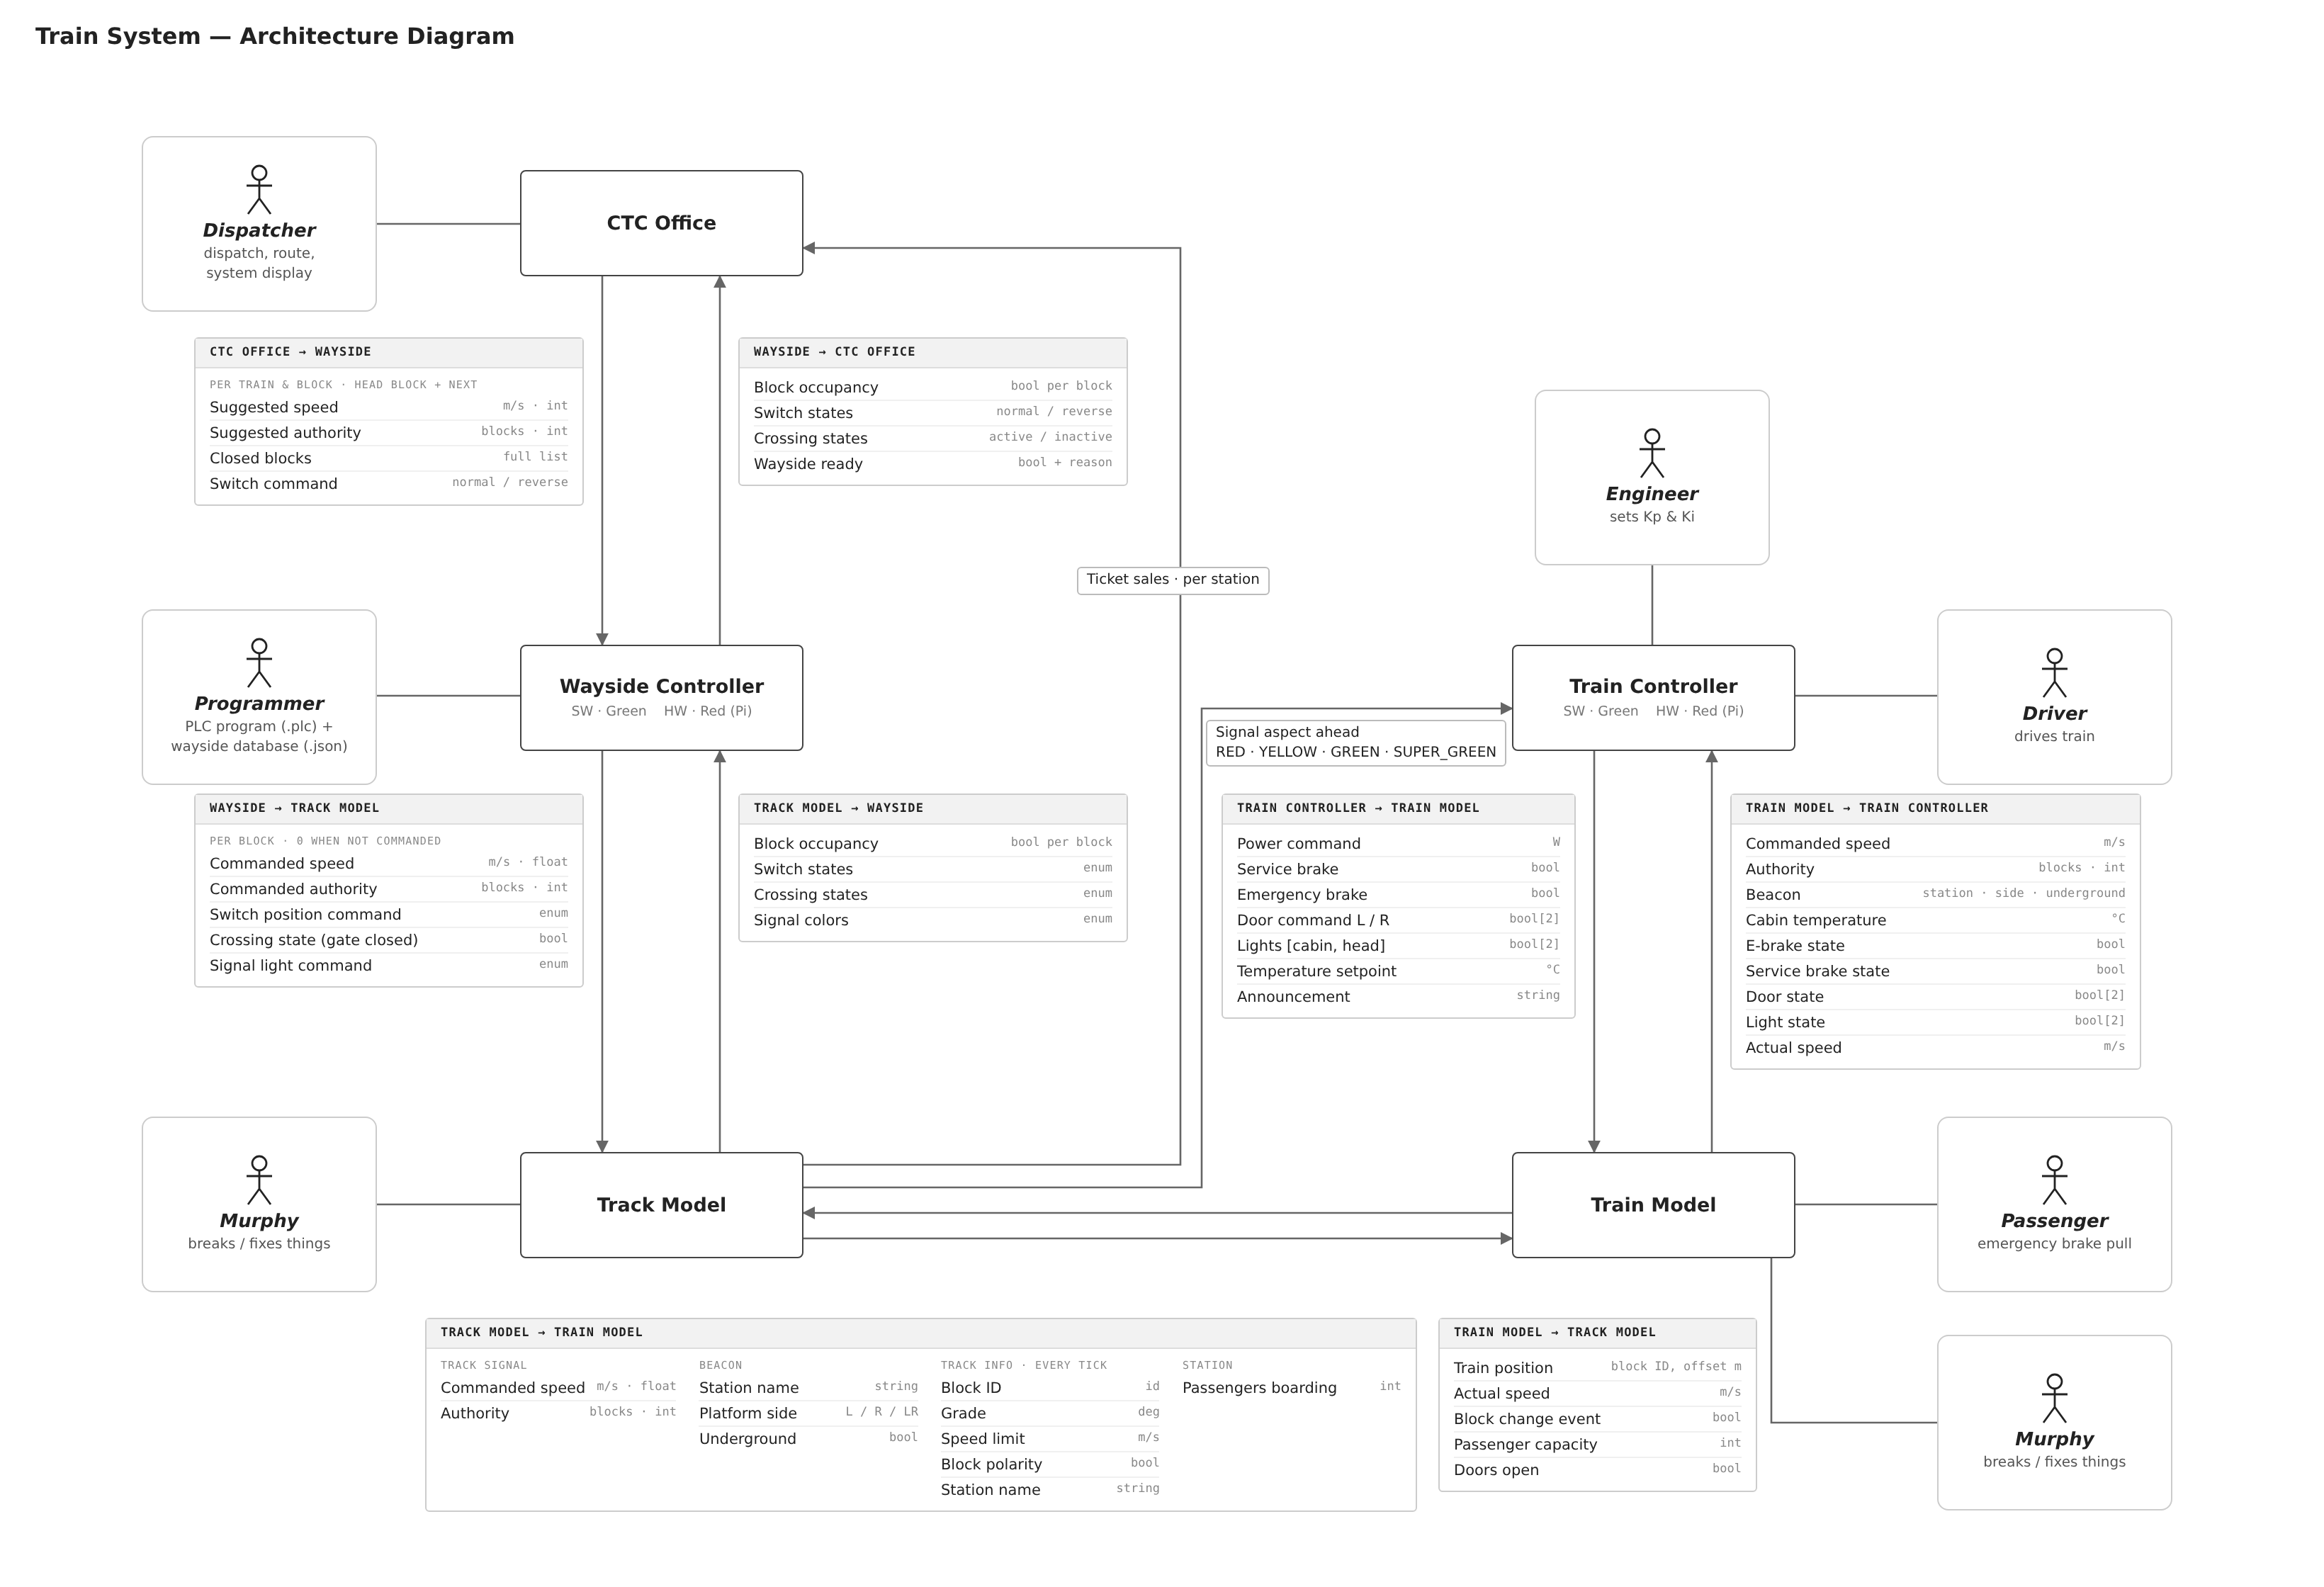
System architecture
System
4
Notes:
Presenter: Ivan. Five modules; the Track Controller and Train Controller each have a SW variant (Green Line) and a HW variant on a Raspberry Pi (Red Line). Commands go down from the CTC Office through the waysides and the track to the train; status comes back up. The Track Model also sends the signal ahead to the Train Controller and ticket sales to the CTC Office. In the running system every arrow passes through the central harness (D005).

Slide 5
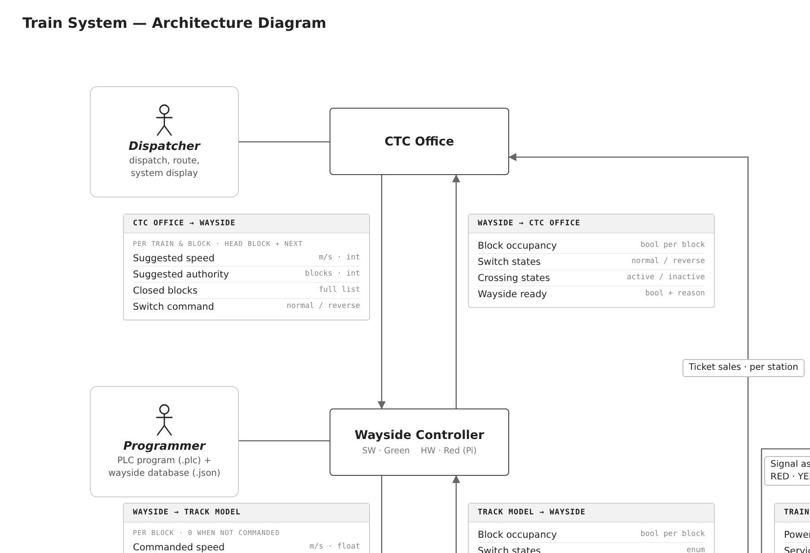
System architecture (detail 1 of 4)
System
5
Notes:
Close-up of the system architecture, in reading order.

Slide 6
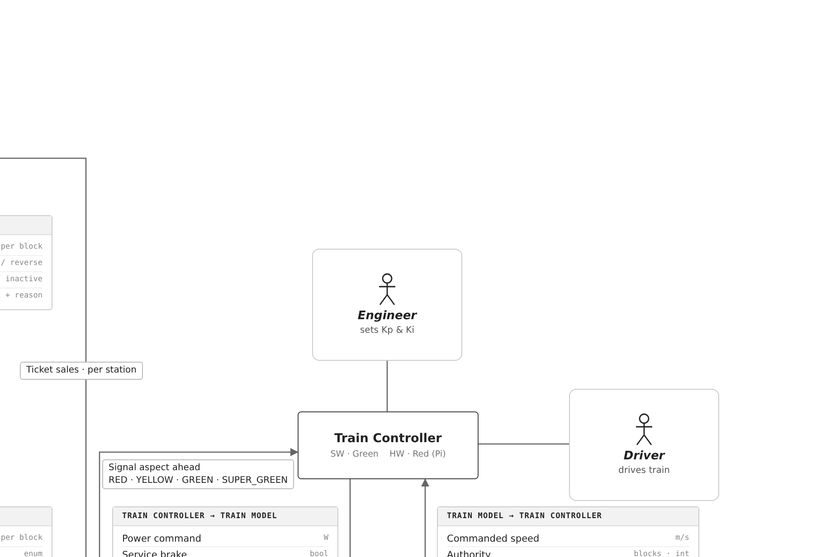
System architecture (detail 2 of 4)
System
6
Notes:
Close-up of the system architecture, in reading order.

Slide 7
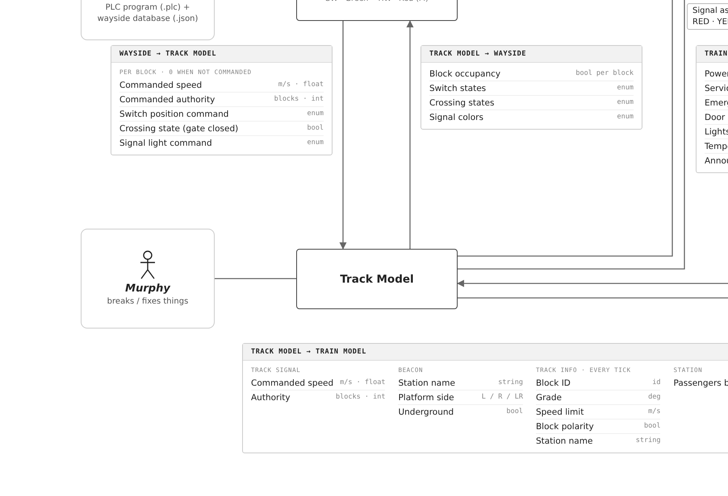
System architecture (detail 3 of 4)
System
7
Notes:
Close-up of the system architecture, in reading order.

Slide 8
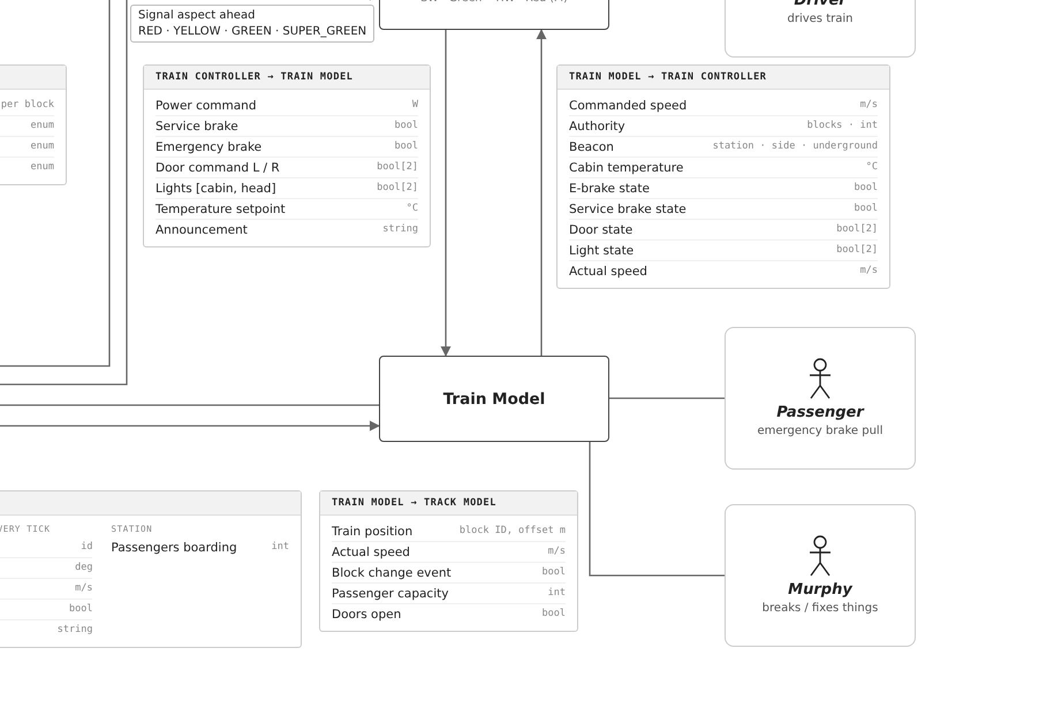
System architecture (detail 4 of 4)
System
8
Notes:
Close-up of the system architecture, in reading order.

Slide 9
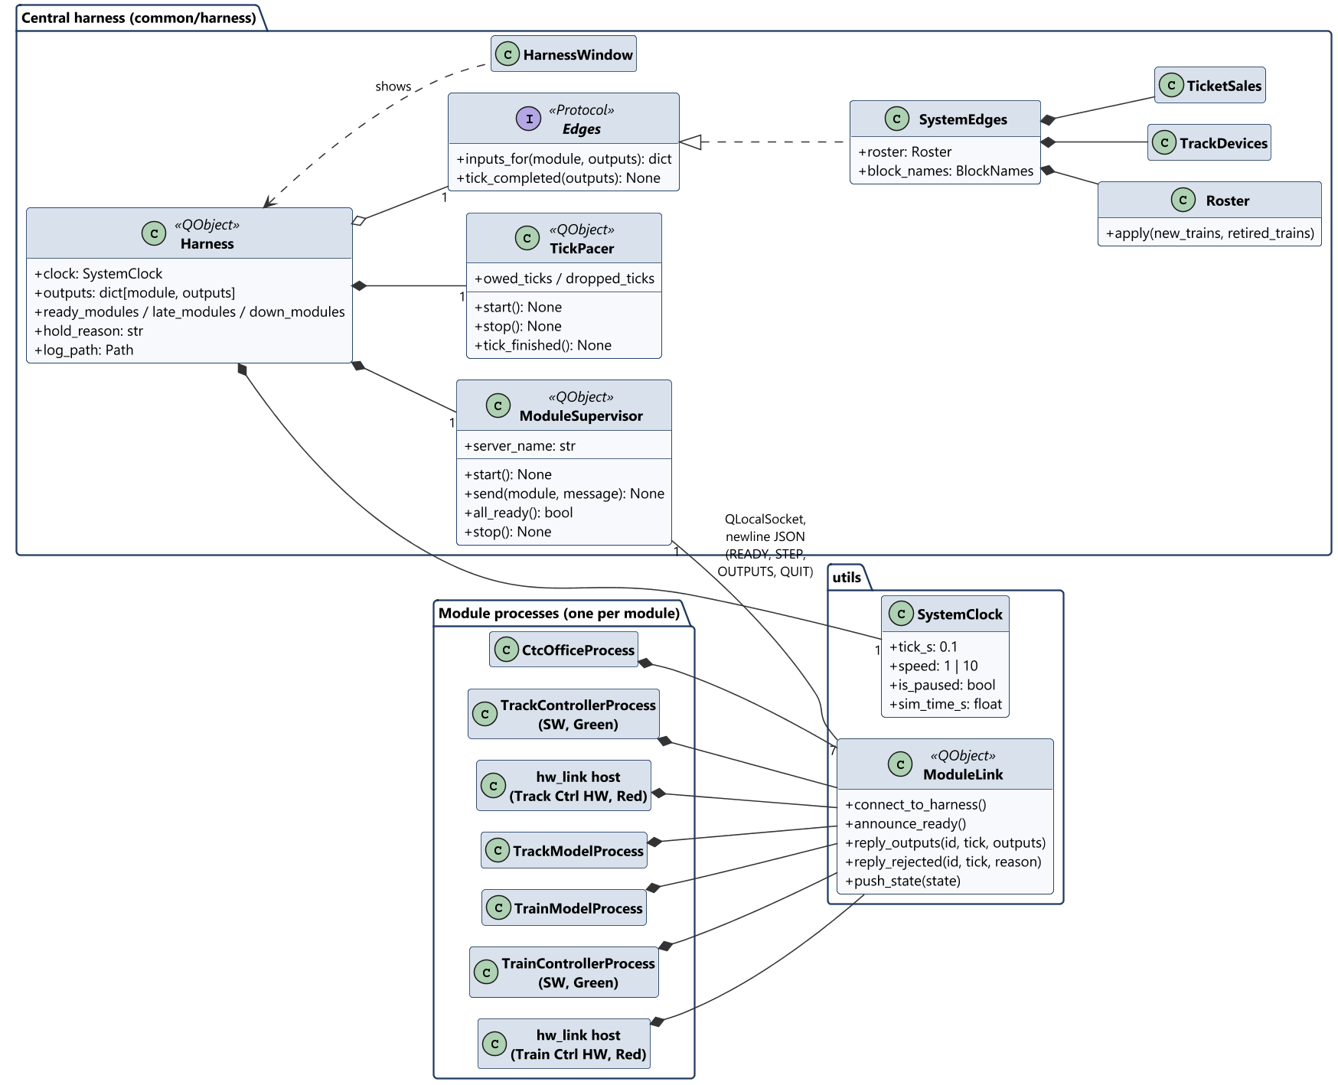
Software architecture (1 of 2): harness and processes
System
9
Notes:
Presenter: Braden. One executable: with no arguments it is the central harness; with --module it is one module process. The harness supervises the seven module processes, paces the ticks, maps every edge (SystemEdges) and keeps the roster of trains. Each module process holds its module and a ModuleLink to the harness: newline JSON over a local socket.

Slide 10
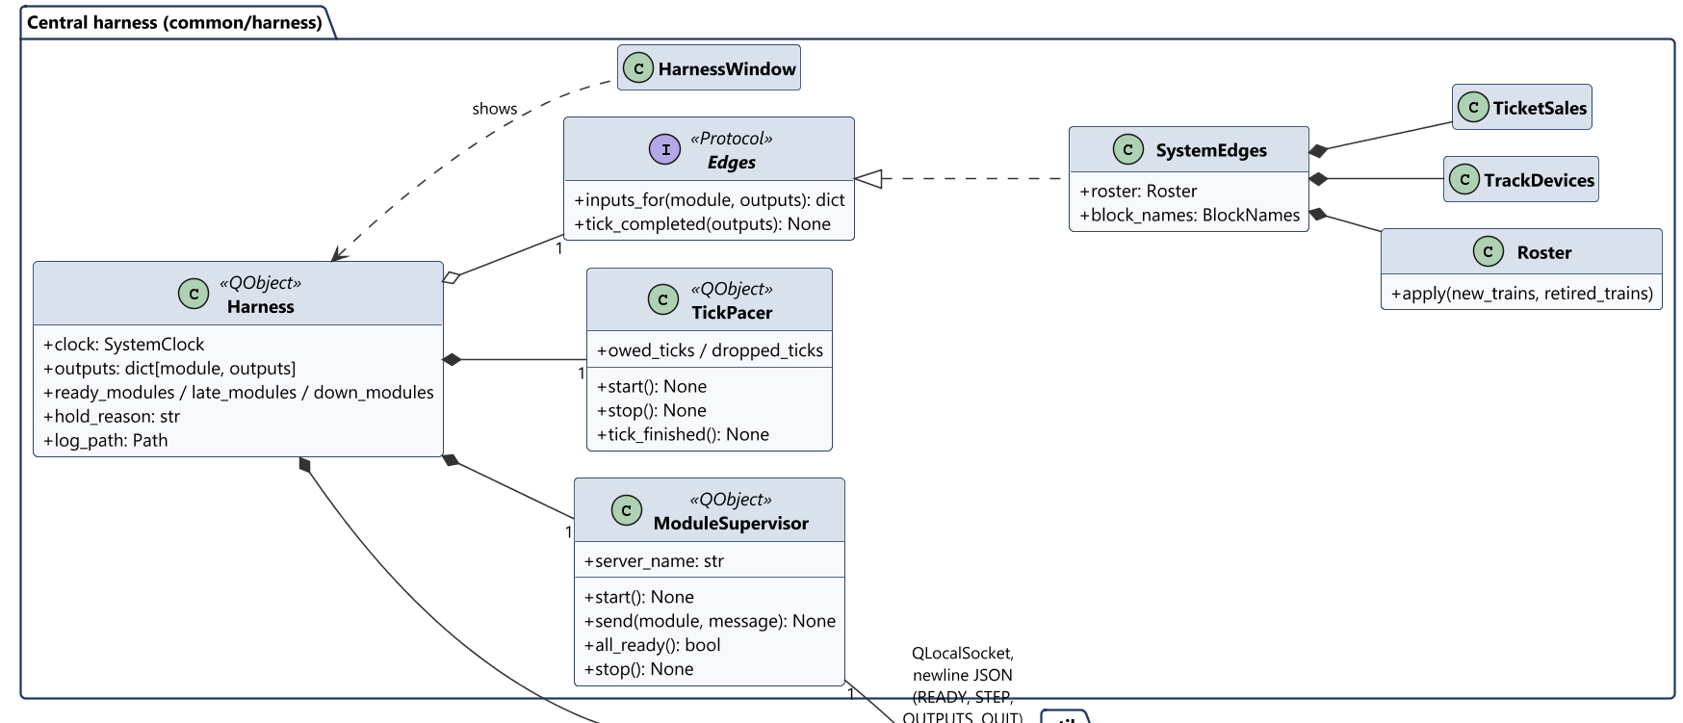
Software architecture (1 of 2) (detail 1 of 2)
System
10
Notes:
Close-up: the harness above, the module processes below.

Slide 11
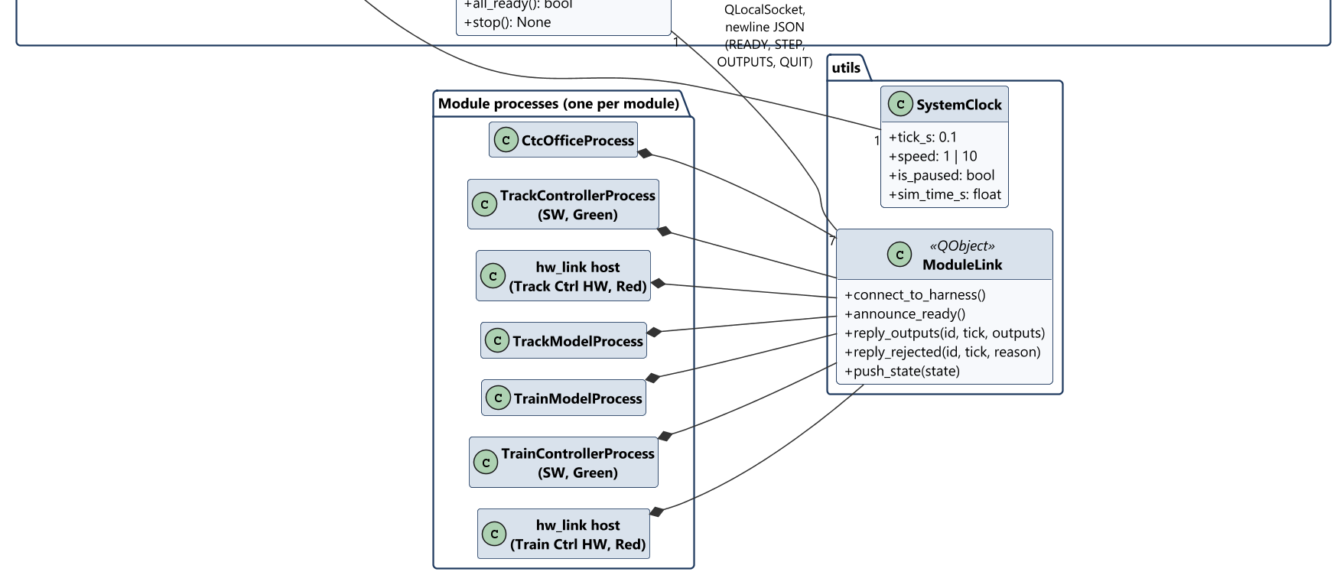
Software architecture (1 of 2) (detail 2 of 2)
System
11
Notes:
Close-up: the harness above, the module processes below.

Slide 12
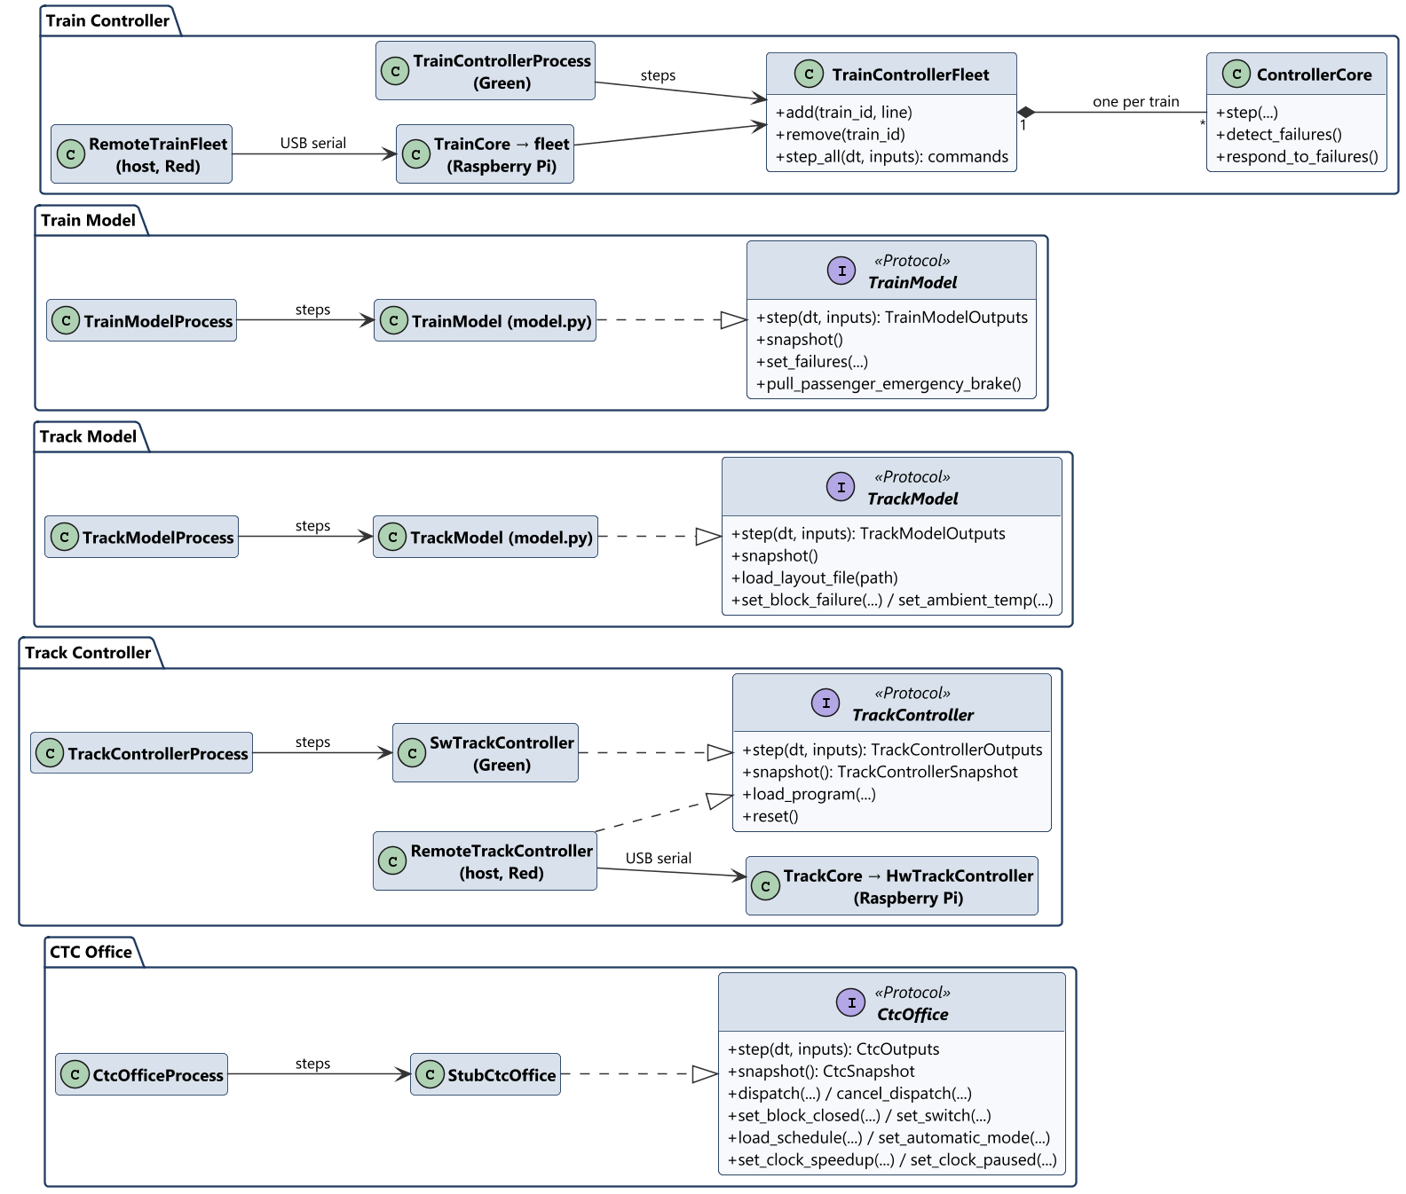
Software architecture (2 of 2): contracts and implementations
System
12
Notes:
Presenter: Braden. Each module owns its boundary types and its Protocol; each variant implements it. The HW hosts hold a remote proxy that relays the harness's steps over USB to the module's core on the Pi, behind PiLinkServer. No module imports another's types: the harness's edge functions translate.

Slide 13
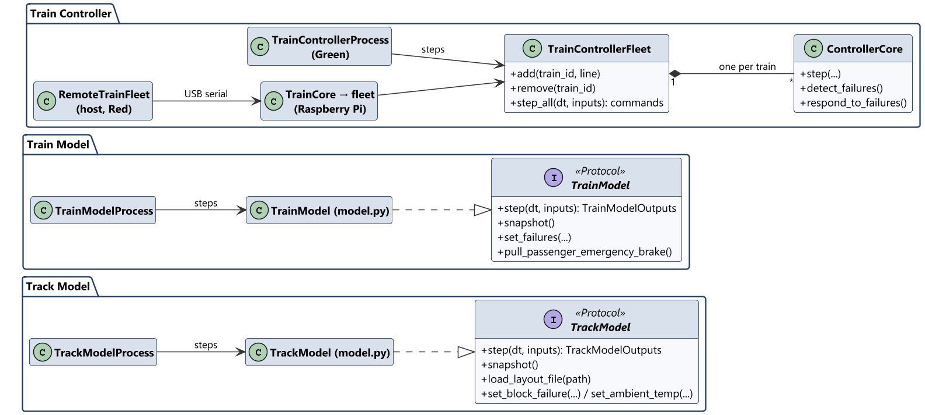
Software architecture (2 of 2) (detail 1 of 2)
System
13
Notes:
Close-up of the module contracts and their implementations.

Slide 14
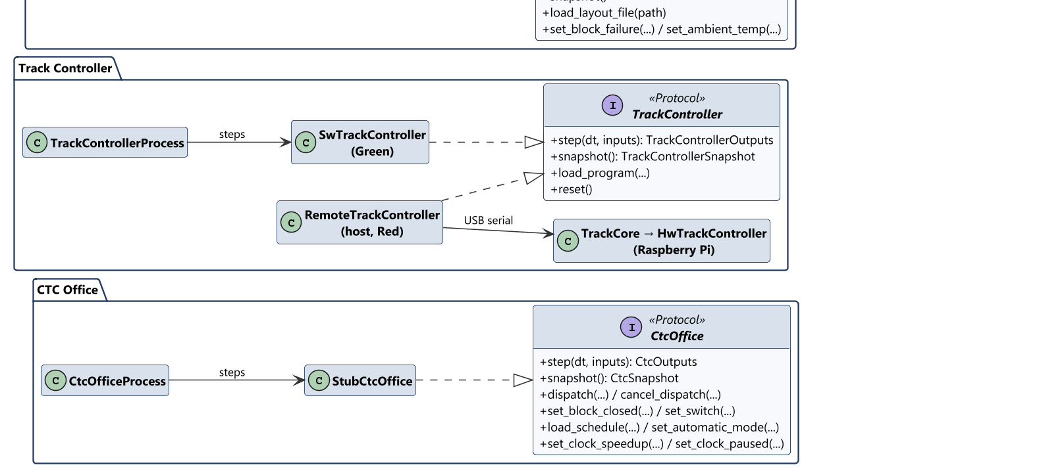
Software architecture (2 of 2) (detail 2 of 2)
System
14
Notes:
Close-up of the module contracts and their implementations.

Slide 15
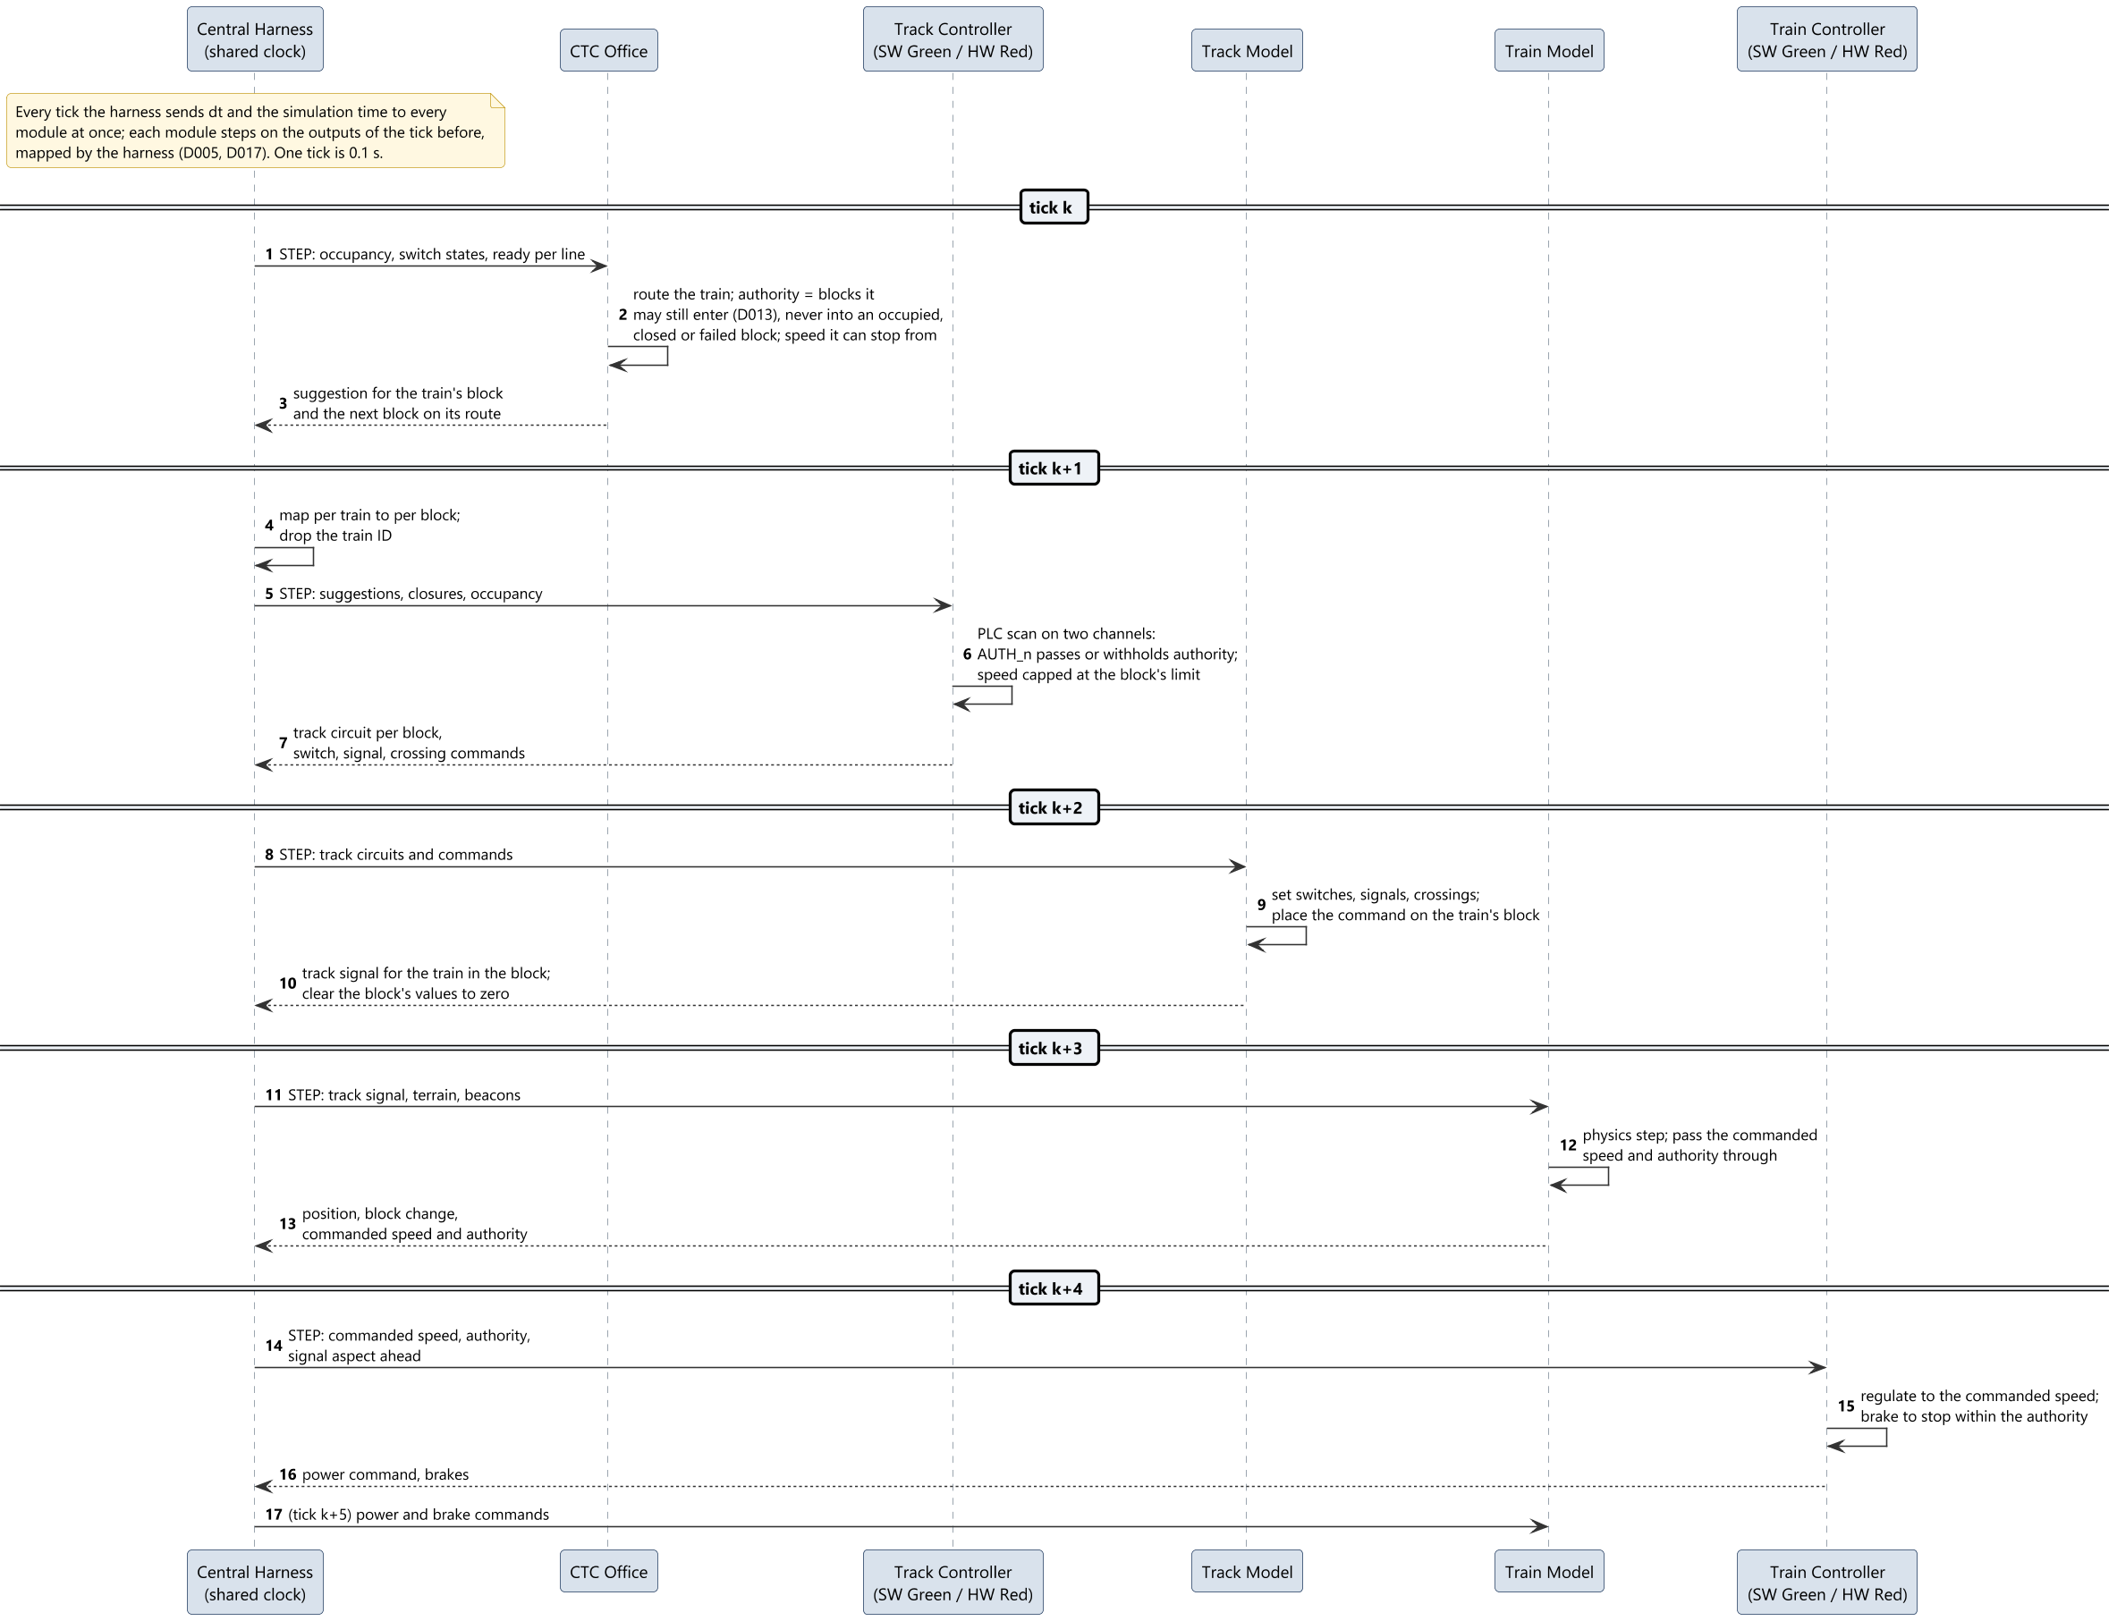
Representative interaction: movement authority
System
15
Notes:
Presenter: Braden. Ticks k to k+5. Every module steps on the outputs of the tick before, so the CTC Office's suggestion reaches the wayside on the next tick, the track circuit on the one after, and the train controller a few ticks after the decision. The harness waits for every reply before the next tick (D017).

Slide 16
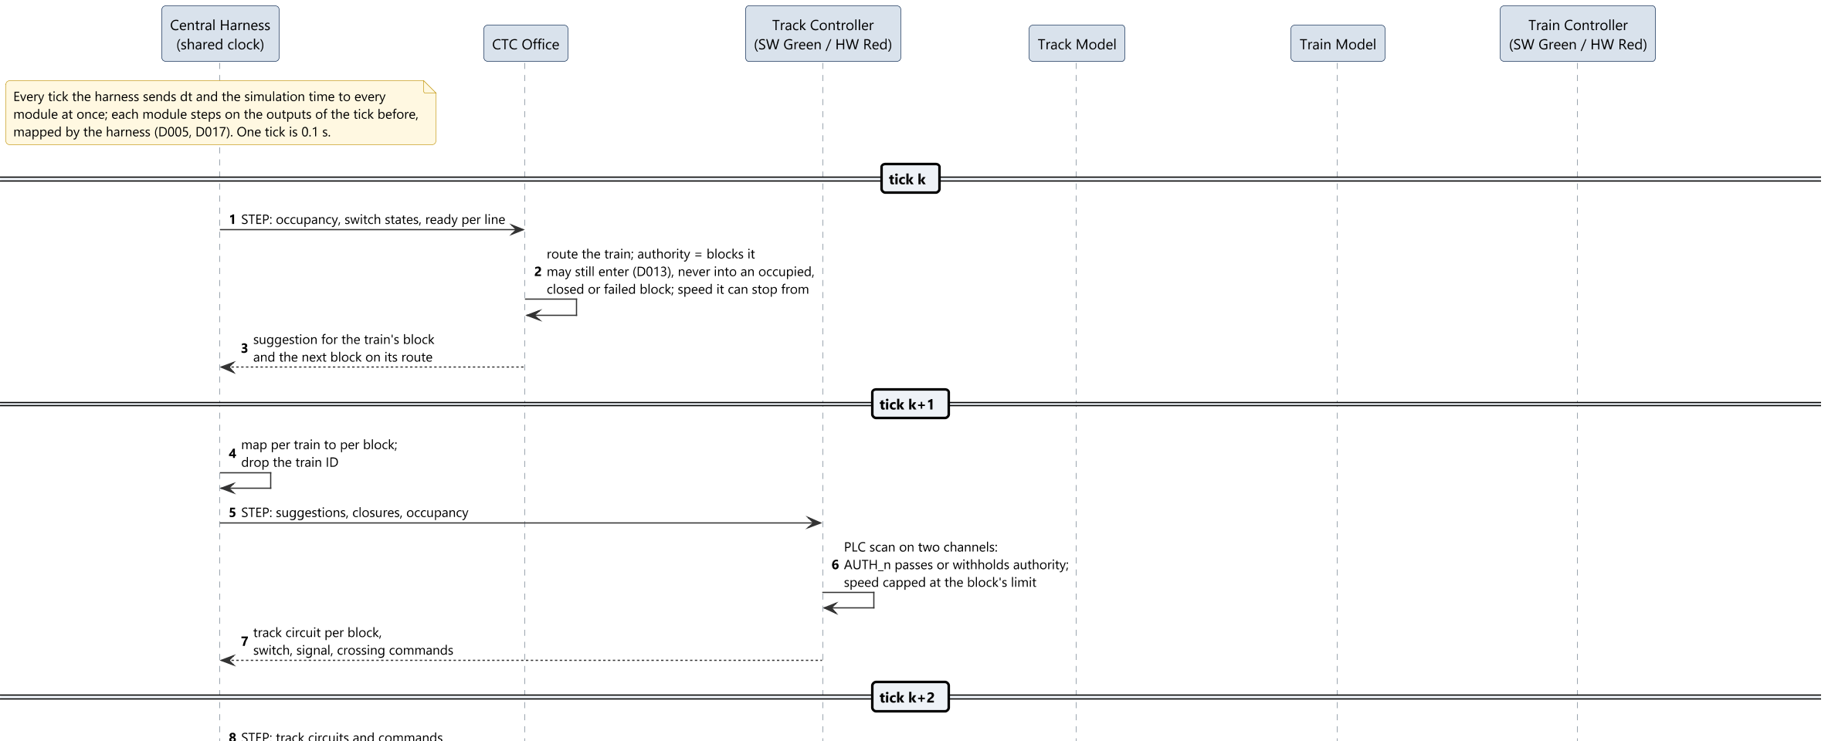
Representative interaction (detail 1 of 2)
System
16
Notes:
Close-up: the first ticks, then the last.

Slide 17
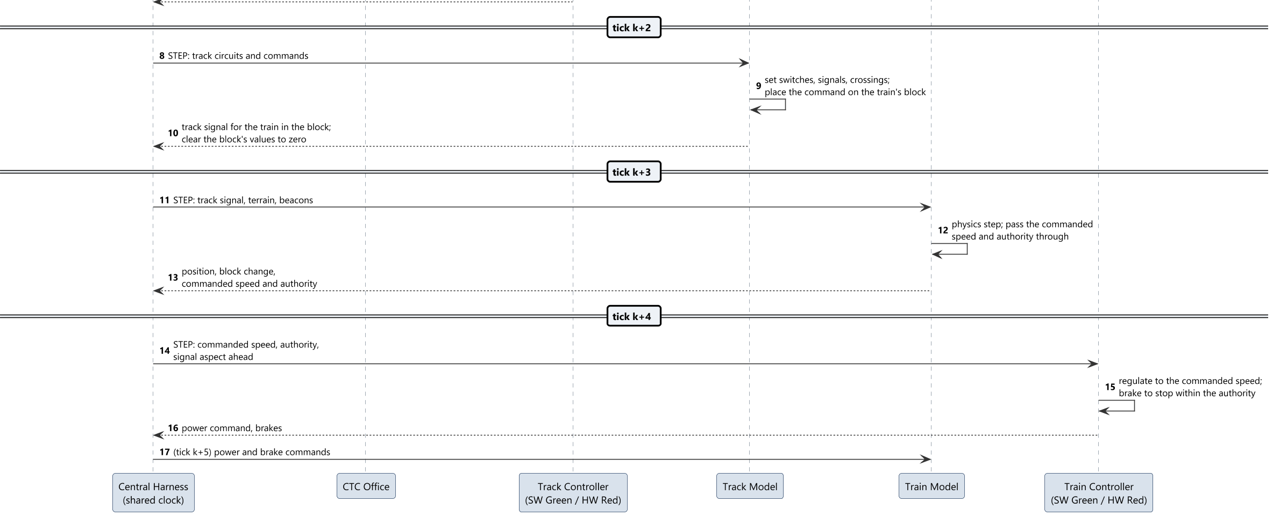
Representative interaction (detail 2 of 2)
System
17
Notes:
Close-up: the first ticks, then the last.

Slide 18
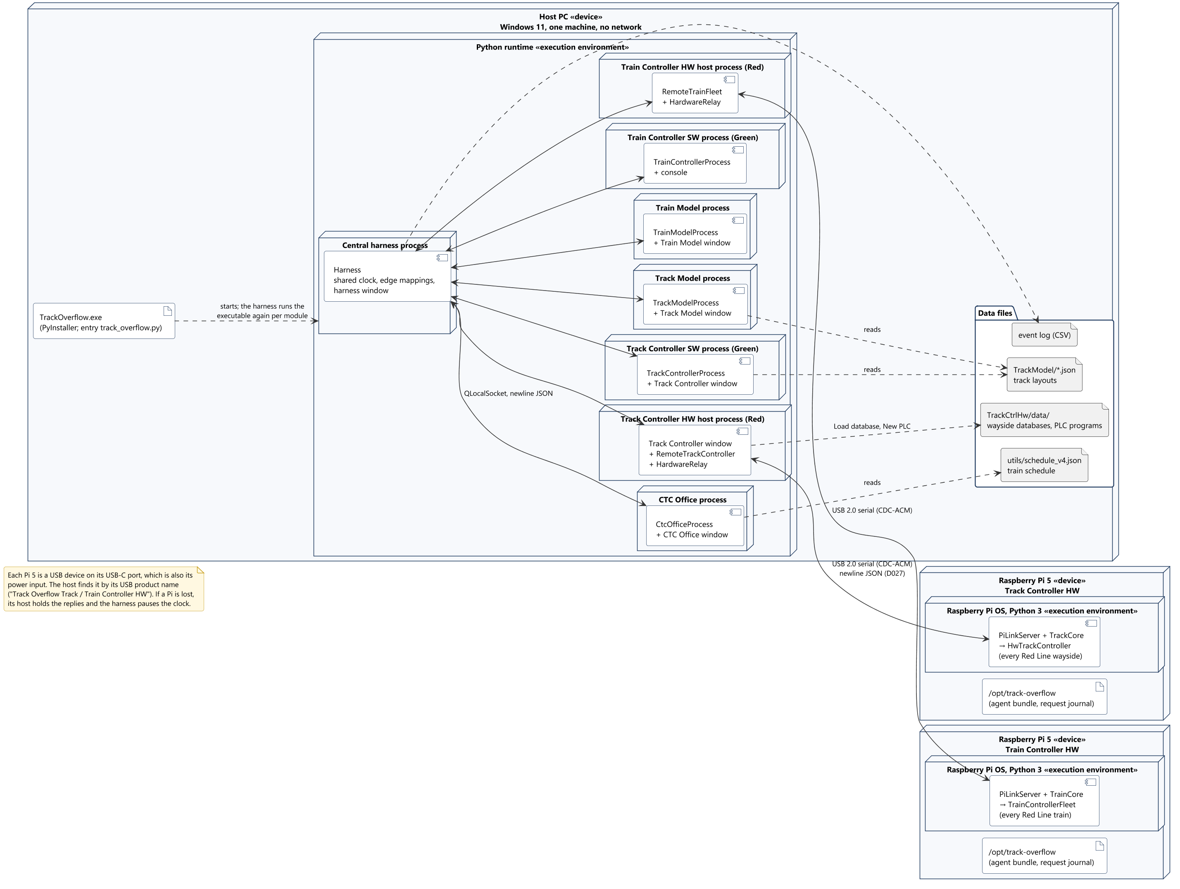
Deployment
System
18
Notes:
Presenter: Braden. One Windows 11 PC runs the executable as the harness and once per module. Data files: the line layouts, the schedule, the wayside databases and PLC programs, the event log. Two Raspberry Pi 5 boards, one per HW variant, each linked to its host process by one USB cable as a USB serial device, found by its product name (D027).

Slide 19
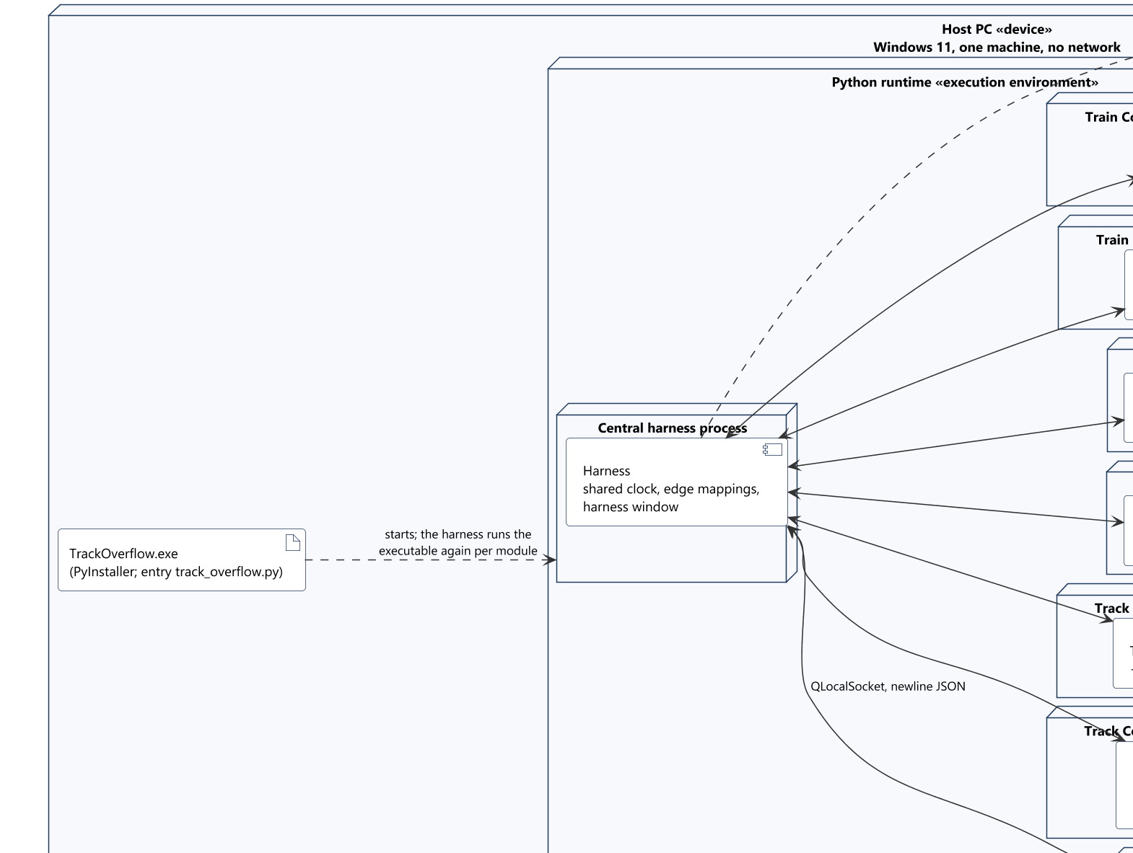
Deployment (detail 1 of 4)
System
19
Notes:
Close-up of the deployment, in reading order.

Slide 20
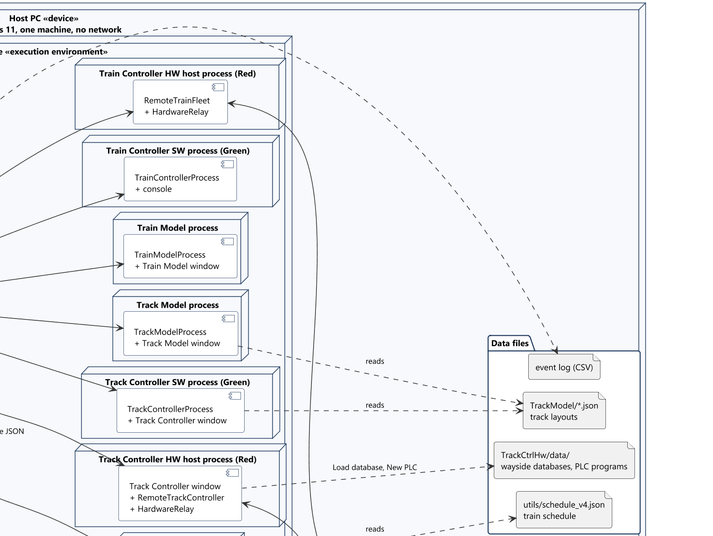
Deployment (detail 2 of 4)
System
20
Notes:
Close-up of the deployment, in reading order.

Slide 21
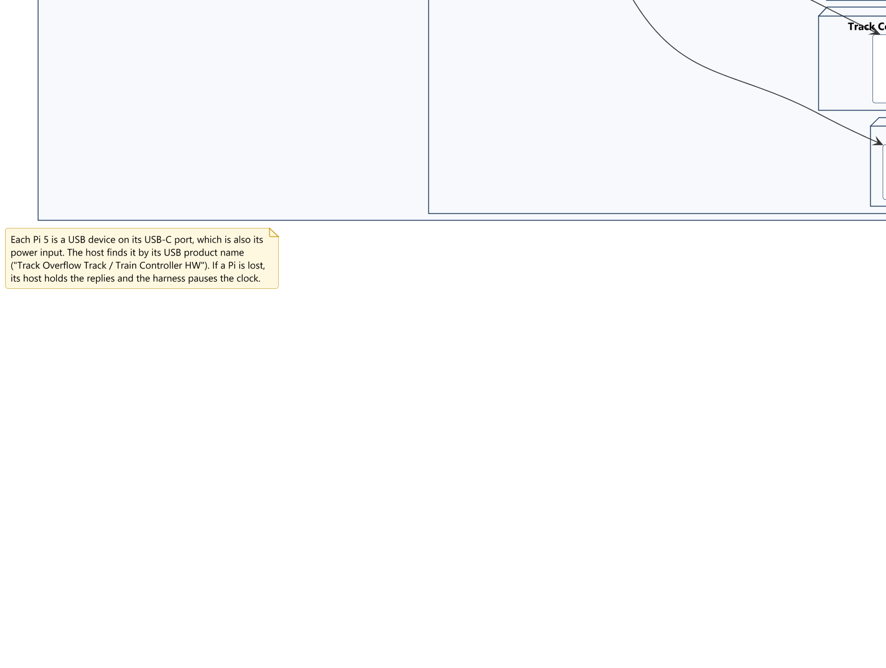
Deployment (detail 3 of 4)
System
21
Notes:
Close-up of the deployment, in reading order.

Slide 22
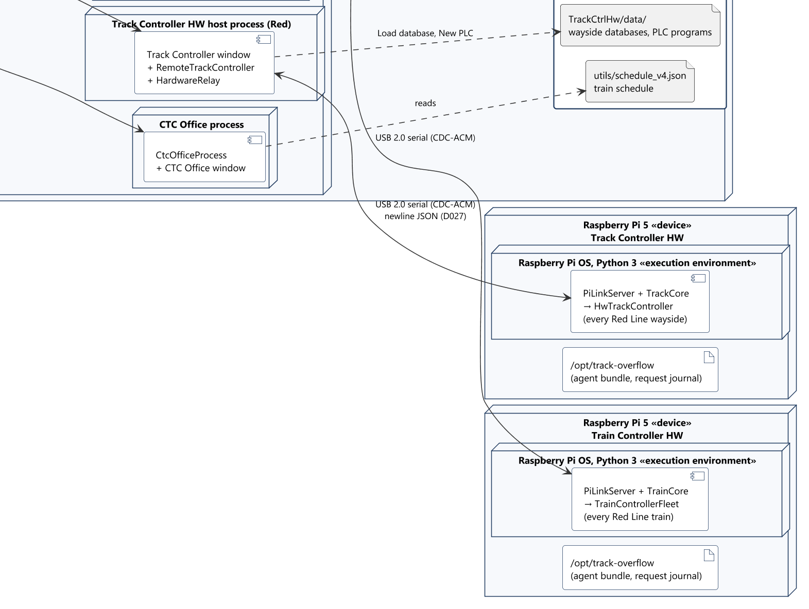
Deployment (detail 4 of 4)
System
22
Notes:
Close-up of the deployment, in reading order.

Slide 23
Route
System concepts
• The blocks a train runs from the yard to its stations and back (D020, D022)
• The CTC Office plans it: shortest route on the graph of blocks and switch legs
  – Never turns a train back; goes round closed, failed and blocked blocks; no detour over 2x
• Never sent whole: speed and authority for the train's block and the next
• The waysides' PLC programs set the switches; the CTC Office only in maintenance mode
  – Authority stops before a switch not yet set for the route
• The Track Model never routes: a train follows the rails as the switches lie
Track Overflow · Design Review · 2026-10-22
23

Slide 24
Authority
System concepts
• Blocks ahead of the train's block it may still enter; 0 = stop (D013)
• CTC Office: computes it, never into an occupied, closed or another train's block
• Track Controller: AUTH_n passes it down block n's circuit or sends 0; speed is ANDed with it
• Track Model: holds it as the block's track circuit; a failed circuit carries 0 and 0
• Train Controller: uses the count as given; at 0 it targets 0 and brakes while moving
  – A drop to 0 from 2 or more blocks reads as a signal pickup failure
Track Overflow · Design Review · 2026-10-22
24

Slide 25
Distribution of wayside controllers
System concepts
Line | Variant | Runs on | Waysides
Green | Track Controller SW | Host PC | 6 by default; 2 up to one per block
Red | Track Controller HW | Raspberry Pi 5 over USB | 3 proposed: 1–24 + 73–76, 25–45 + 67–72, 46–66
Rule | A wayside owns a contiguous run of blocks and its devices |  | A switch stays inside one wayside
Rule | A line runs only when every wayside on it is ready |  | Otherwise the line holds fail-safe
Rule | No other module depends on the split |  | Every I/O is keyed by block
Track Overflow · Design Review · 2026-10-22
25

Slide 26
Simulation timing
System concepts
• One clock, in the harness (D017); time from 05:00:00, unwrapped
• Fixed dt = 0.1 s (D006): 1x = 10 ticks/s, 10x = 100 ticks/s, same results
• Each module steps on the outputs of the tick before
• The harness waits for every reply; pauses and names a module late by about 1 s
• Pause, 1x and 10x are the CTC Office's commands
• HW variants at 10x: USB round trip + scan under 10 ms
Track Overflow · Design Review · 2026-10-22
26

Slide 27
Vitality
System concepts
• Channels are non-vital (REQ-INTF-021); Track and Train Controllers are vital
• Wayside: the OS only holds the PLC program; every protection is PLC code
  – Read-only vital block after the user's program «planned, pending Harry»
  – HW: two compilers, two interpreters, compared every scan
  – Fail-safe: signals red, crossings active, speed and authority 0
• Train: inputs validated all or nothing; failures latch the emergency brake
  – No traction under braking; no power until the gains are set
• System: a failure reads as occupancy; no two trains share a block
Track Overflow · Design Review · 2026-10-22
27

Slide 28
Wayside language
System concepts
// a comment
VAR_IN OCC_12 OCC_13 SWREV_12
VAR_IN CTCSW_12 CTCREV_12
VAR_OUT SW_12
LOCK_12 := OCC_12 OR OCC_13
WANT_12 := CTCSW_12 AND CTCREV_12
SW_12 := (LOCK_12 AND SWREV_12)
OR (NOT LOCK_12 AND WANT_12)
• Boolean only: NOT, AND, XOR, OR, 0, 1, parentheses
• Runs top to bottom once per tick; an unset name reads 0
• Speed crosses as five bits (SPD_n_0..4 in, CMD_n_0..4 out)
• Errors reported with line numbers; unknown I/O refused
• Shared by both variants; the names still differ
Track Overflow · Design Review · 2026-10-22
28

Slide 29
Hardware/software interface
System concepts
• Same Protocol and the same I/O in both variants: the harness cannot tell them apart (D021)
• Each HW core on its own Raspberry Pi 5; its window on the PC
• One USB cable: the Pi is a USB serial (CDC-ACM) device, Windows' own driver (D027)
  – Found by its USB product name, never a fixed COM number
• The harness's newline JSON, relayed by the host process, which owns the port
• The Pi journals every request, so a restarted Pi rebuilds its state
• A lost Pi: the harness pauses the clock and names the module
Track Overflow · Design Review · 2026-10-22
29

Slide 30
System design decisions
System
 | Decision | Outcome
4.1 | Interface contract | Each module's own types and Protocol; the harness maps every edge (D005)
4.2 | Boundary data | Frozen dataclasses, SI units, authority in blocks (D002, D013)
4.3 | Contract enforcement | Each module tests its contract; a shared CI job is open
4.4 | Stand-ins | Each module's test UI in its own process; harness stubs (D010, D018)
4.5 | Ownership | Each module owns its types; one owner per contract shard
4.6 | Input validation | Reject the whole tick before anything changes
4.7 | Decision log | The truth branch; proposals promoted by a person
Track Overflow · Design Review · 2026-10-22
30

Slide 31
CTC Office
Landis · SDD Section 5.1

Slide 32
CTC Office: what it does
CTC Office
• The dispatcher's console for the Green and Red Lines; one process on the host PC
• Creates every train and its ID, and releases it from the yard (D022)
• Dispatches by hand, or runs the loaded schedule automatically (D020)
• Every step: route, authority and suggested speed for each train's block and the next
  – Knows trains only from occupancy; a failed block reads occupied
• Closes blocks and sets switches in maintenance mode
• Commands the shared clock: run, pause, 1x and 10x (D017)
Track Overflow · Design Review · 2026-10-22
32

Slide 33
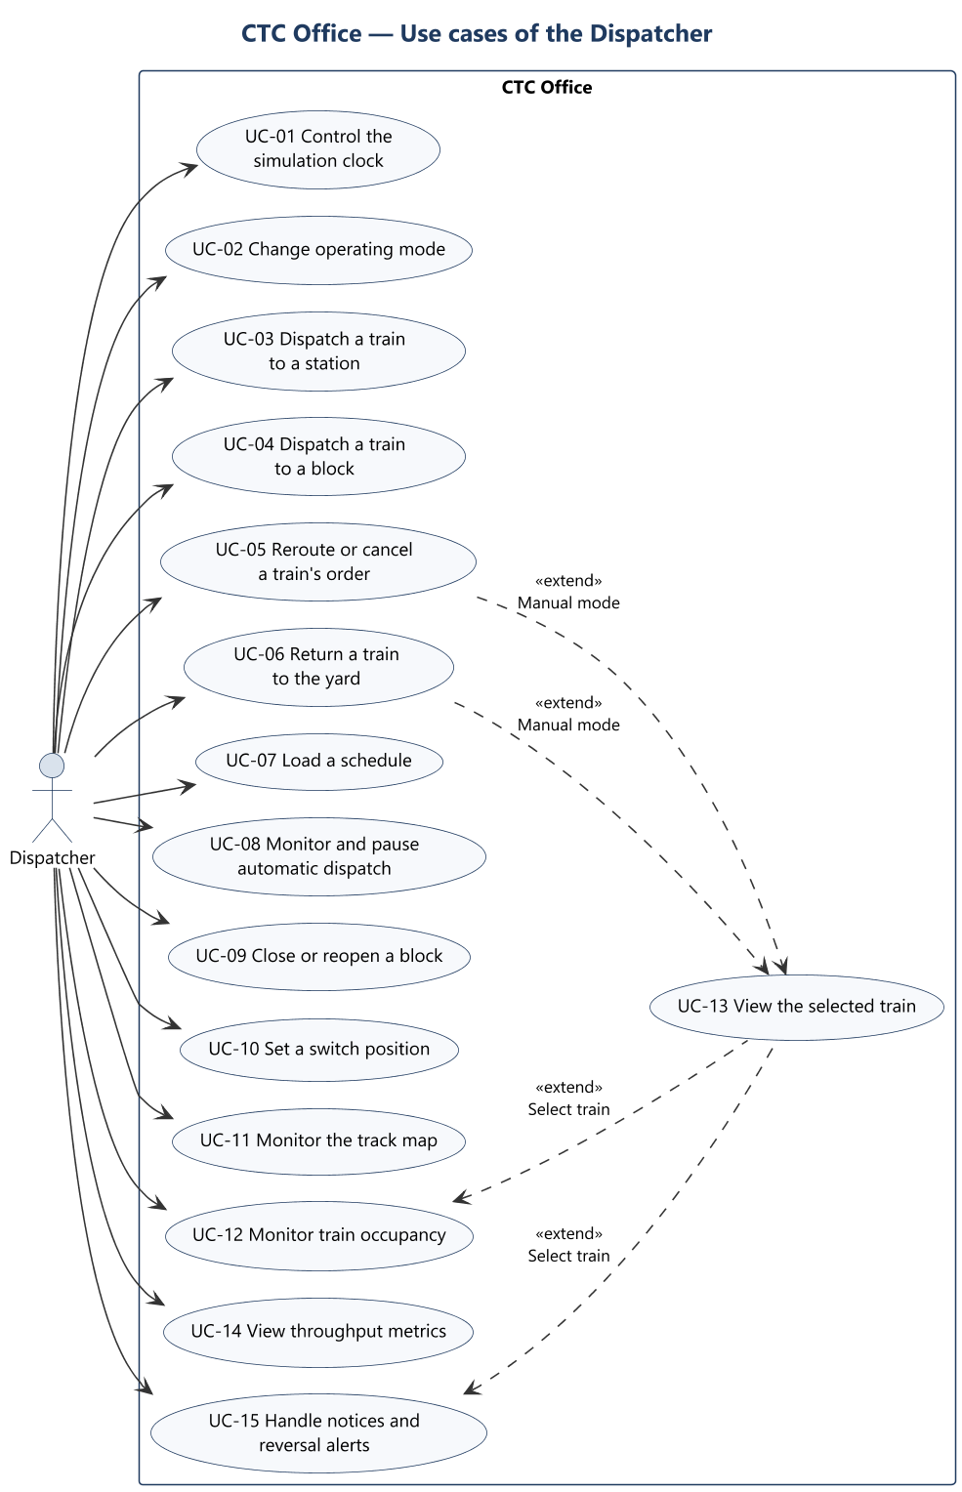
Use cases of the Dispatcher
CTC Office · Use cases
Track Overflow · Design Review · 2026-10-22
33
Notes:
Presenter: Landis. 24 use cases.

Slide 34
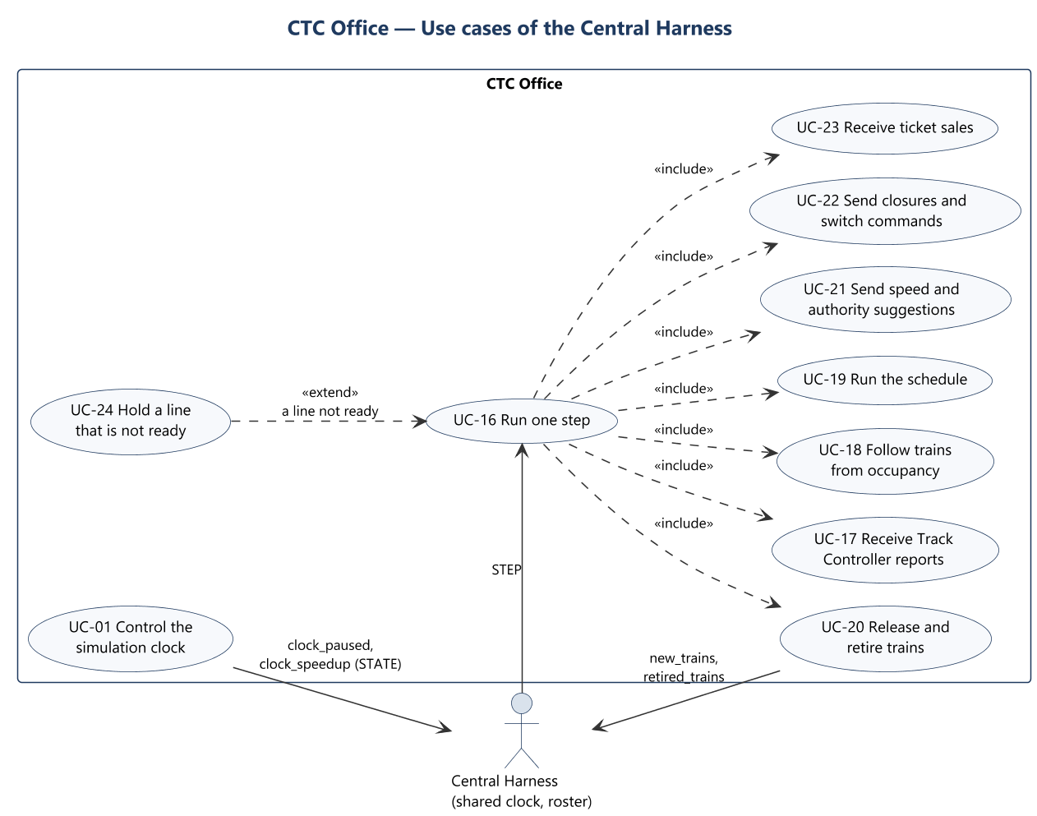
Use cases of the Central Harness
CTC Office · Use cases
Track Overflow · Design Review · 2026-10-22
34
Notes:
Presenter: Landis. 24 use cases.

Slide 35
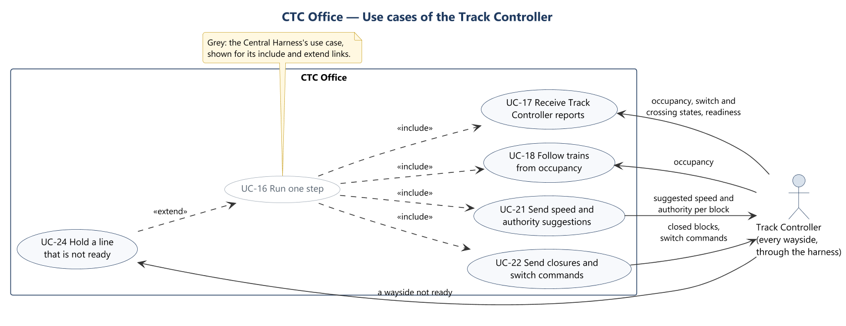
Use cases of the Track Controller
CTC Office · Use cases
Track Overflow · Design Review · 2026-10-22
35
Notes:
Presenter: Landis. 24 use cases.

Slide 36
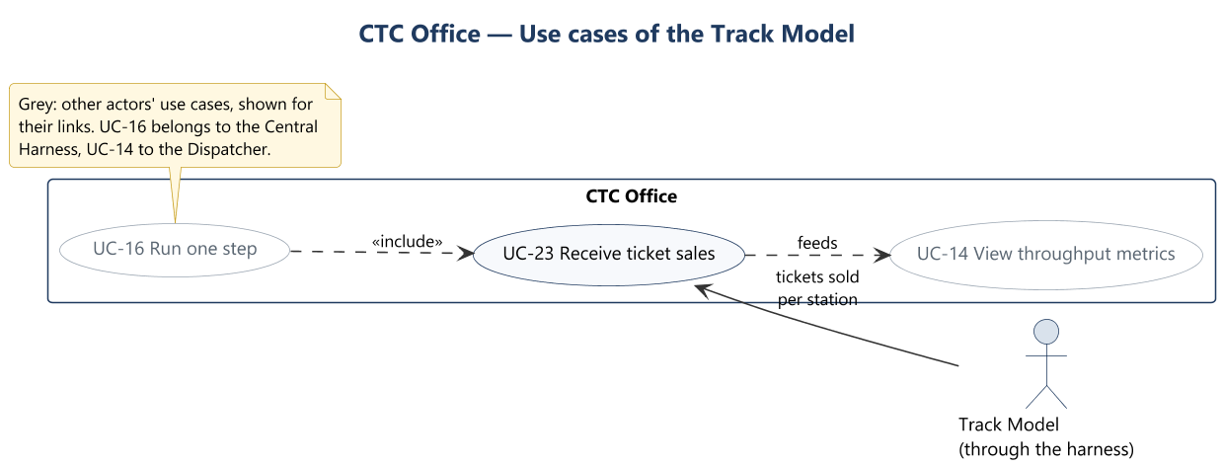
Use cases of the Track Model
CTC Office · Use cases
Track Overflow · Design Review · 2026-10-22
36
Notes:
Presenter: Landis. 24 use cases.

Slide 37
UC-01 Control the simulation clock
CTC Office · Use case descriptions
Actors | Dispatcher; Central Harness
Description | Runs, pauses and speeds up the one shared clock, for every module.
Data | clock_paused (true at start), clock_speedup (true for 10x). The header shows the harness's time, 24-hour, from 05:00:00.
Stimulus | Run / Pause and 1x / 10x under SIMULATION CLOCK in the header.
Response | The module's outputs change at once and go to the harness as STATE, since no step runs while the clock is paused. The harness starts, stops or speeds the ticks of every module. At 10x ticks come ten times as often; dt stays 0.1 s.
Alternatives | The harness allows Run only once every module has said it is ready (D005). Pressing the control that is already set changes nothing.
Requirements | Rubric 1.2 to 1.4; REQ-FUNC-001, 002, 003; REQ-INTF-013; REQ-NFR-002
Sequence | SD-01
Track Overflow · Design Review · 2026-10-22
37
Notes:
Presenter: Landis. Use case description; skip if short on time. Runs, pauses and speeds up the one shared clock, for every module.

Slide 38
UC-02 Change operating mode
CTC Office · Use case descriptions
Actors | Dispatcher
Description | Chooses Automatic, Manual or Maintenance mode.
Data | One mode at a time.
Stimulus | OPERATING MODE toggle in the header.
Response | The right-hand column shows that mode's view. Automatic: the loaded schedule's runs dispatch themselves. Manual: Dispatch train, and reroute, cancel or return to yard for the selected train. Maintenance: Close block, Active closures and Set switch position. Leaving Automatic holds every scheduled run where it is; leaving Maintenance drops every switch command, while closed blocks stay closed. The mode itself is sent to no module: the Track Controller gets the closed blocks instead.
Requirements | Rubric 2.2; REQ-FUNC-006, 007, 008
Sequence | SD-02
Track Overflow · Design Review · 2026-10-22
38
Notes:
Presenter: Landis. Use case description; skip if short on time. Chooses Automatic, Manual or Maintenance mode.

Slide 39
UC-03 Dispatch a train to a station
CTC Office · Use case descriptions
Actors | Dispatcher
Description | Orders a train to a station of its line, with an optional arrival time.
Data | Line; train: one already on the line, or New train (T*n*) with the next free ID; destination station (the line's station blocks); arrival HH:MM, optional.
Stimulus | Dispatch train (Manual view). It reads Reroute train when the train already has an order.
Response | The order is recorded, replacing any earlier one. A new train waits in the yard until the CTC Office releases it (UC-20). From then on the train gets authority toward the station every step (UC-21). The panel shows the suggested speed and authority sent for it. The arrival time ranks the train for contested blocks: the train most behind schedule goes first.
Alternatives | Refused with a message, and nothing changes: the line's waysides are not all ready (the message names the wayside and why); the destination is closed or closing; the train is on the other line; the train ID is empty, unprintable or longer than 32 characters; the arrival is not a time of day. A destination the CTC Office takes for a failure is accepted: the train waits short of it until it clears.
Requirements | Rubric 2.0; REQ-FUNC-004, 004.1, 004.2, 006; REQ-NFR-003, 004
Sequence | SD-03
Track Overflow · Design Review · 2026-10-22
39
Notes:
Presenter: Landis. Use case description; skip if short on time. Orders a train to a station of its line, with an optional arrival time.

Slide 40
UC-04 Dispatch a train to a block
CTC Office · Use case descriptions
Actors | Dispatcher
Description | Sends a train straight to any block of its line.
Data | Line, train, block.
Stimulus | Set authority ("or dispatch directly to a block"), Manual view.
Response | An order to that block with no arrival time. The CTC Office turns it into a count of blocks every step (D013).
Alternatives | As UC-03.
Requirements | Rubric 2.3; REQ-FUNC-009
Sequence | SD-04
Track Overflow · Design Review · 2026-10-22
40
Notes:
Presenter: Landis. Use case description; skip if short on time. Sends a train straight to any block of its line.

Slide 41
UC-05 Reroute or cancel a train's order
CTC Office · Use case descriptions
Actors | Dispatcher
Description | Changes where the selected train is going, or withdraws its order.
Data | Train; new destination.
Stimulus | Reroute or Cancel order in Selected train (Manual mode).
Response | A reroute replaces the order; the route is worked out again from where the train is, carrying on the way it is going. A cancel drops the order, so the train's authority is 0 from the next step and it stops.
Alternatives | A reroute is refused as UC-03 refuses.
Requirements | Rubric 2.3; REQ-FUNC-009
Sequence | SD-05
Track Overflow · Design Review · 2026-10-22
41
Notes:
Presenter: Landis. Use case description; skip if short on time. Changes where the selected train is going, or withdraws its order.

Slide 42
UC-06 Return a train to the yard
CTC Office · Use case descriptions
Actors | Dispatcher
Description | Sends a manual train on the track back to the yard, where it is retired (D022).
Data | Train.
Stimulus | Return to yard in Selected train (Manual mode).
Response | An order to the line's yard entry block (Green 57, Red 9). Once the train has stopped there with authority 0 it is retired (UC-20). A later order or a cancel withdraws it.
Alternatives | Refused for a train not on the track (cancel its order instead), for a run of the loaded schedule (the schedule returns it), and as UC-03 refuses.
Requirements | D022
Sequence | SD-06
Track Overflow · Design Review · 2026-10-22
42
Notes:
Presenter: Landis. Use case description; skip if short on time. Sends a manual train on the track back to the yard, where it is retired (D022).

Slide 43
UC-07 Load a schedule
CTC Office · Use case descriptions
Actors | Dispatcher
Description | Loads the schedule that automatic mode runs.
Data | Schedule JSON in the utils/schedule_v4.json format: per run, the line, run number and timed stops.
Stimulus | Load schedule (Automatic view) and a file.
Response | Each run is planned at once (D020). Its train ID is the line's initial and run number (G1, R1). It stops only at its scheduled stations, in the order the track reaches them from the yard, then returns to the yard. It is due out of the yard at 05:00 plus its departure, and at each stop after the run time and a 45 s dwell at each stop before (D007). DEPARTURES lists every run.
Alternatives | A malformed file, a stop not on the layout, a run listed twice, or two runs with one train ID: "Schedule not loaded: …", and the current schedule is kept.
Requirements | Rubric 2.6; REQ-FUNC-010; REQ-NFR-003, 004
Sequence | SD-07
Track Overflow · Design Review · 2026-10-22
43
Notes:
Presenter: Landis. Use case description; skip if short on time. Loads the schedule that automatic mode runs.

Slide 44
UC-08 Monitor and pause automatic dispatch
CTC Office · Use case descriptions
Actors | Dispatcher
Description | Shows how far each run has got, and holds or releases them all.
Data | DEPARTURES: train, due time, status (Queued, Held, In yard, To station, At station, To yard, Done).
Stimulus | Pause dispatch / Resume dispatch; any step.
Response | While paused, no run leaves the yard or a stop; a run already on its way carries on to its next stop.
Requirements | Rubric 2.6; REQ-FUNC-007, 010
Sequence | SD-08
Track Overflow · Design Review · 2026-10-22
44
Notes:
Presenter: Landis. Use case description; skip if short on time. Shows how far each run has got, and holds or releases them all.

Slide 45
UC-09 Close or reopen a block
CTC Office · Use case descriptions
Actors | Dispatcher
Description | Takes a block out of service for maintenance, and back.
Data | Line, block.
Stimulus | Close block, then Yes, close block (Maintenance view); Reopen block or Cancel closing under Active closures.
Response | A clear block closes at once. An occupied block is listed as "Closing — train in block" and closes by itself once the train has left. Either way, orders into it are cancelled at once with a notice, no authority is given into it, and it is in closed_blocks from the moment it is requested until it is reopened.
Alternatives | Already closed or closing: says so. Outside maintenance mode: refused.
Requirements | Rubric 2.4; REQ-FUNC-011
Sequence | SD-09
Track Overflow · Design Review · 2026-10-22
45
Notes:
Presenter: Landis. Use case description; skip if short on time. Takes a block out of service for maintenance, and back.

Slide 46
UC-10 Set a switch position
CTC Office · Use case descriptions
Actors | Dispatcher
Description | Commands a switch, in maintenance mode.
Data | Line; switch, named by its block; Normal (the first connection the layout file lists) or Reverse (the second). The panel shows the position the Track Controller reports and the one commanded.
Stimulus | Send to track controller or Release (Maintenance view).
Response | The command is in switch_commands every step while maintenance mode lasts; the wayside's PLC program carries it out, and the reported position follows.
Alternatives | The switch's block is occupied: refused. Outside maintenance mode: refused.
Requirements | Rubric 2.7; REQ-FUNC-012
Sequence | SD-10
Track Overflow · Design Review · 2026-10-22
46
Notes:
Presenter: Landis. Use case description; skip if short on time. Commands a switch, in maintenance mode.

Slide 47
UC-11 Monitor the track map
CTC Office · Use case descriptions
Actors | Dispatcher
Description | Shows both lines and what is on them.
Data | Every block from the layout files, coloured by line; occupied, closed and closing blocks; each train the CTC Office follows, as a car tagged with its ID on its head block; an untagged car on any other occupied block (an inferred failure among them); active crossings.
Stimulus | Any step; + / − zoom, drag to pan, Fit.
Response | The map redraws. A selected train's route is highlighted (UC-13).
Requirements | Rubric 2.5; REQ-FUNC-013; REQ-INTF-002.1, 002.2
Sequence | SD-11
Track Overflow · Design Review · 2026-10-22
47
Notes:
Presenter: Landis. Use case description; skip if short on time. Shows both lines and what is on them.

Slide 48
UC-12 Monitor train occupancy
CTC Office · Use case descriptions
Actors | Dispatcher
Description | Lists every train the CTC Office follows or has an order for.
Data | Train, line, block (both blocks while it crosses into the next), suggested speed (mph; its actual speed is never known), authority (blocks, and the block it ends at), destination, requested arrival, status (En route, In yard, Not located, No order).
Stimulus | Train occupancy window, or its dock ("Keep open at bottom"); filter by line, status or train ID.
Response | Rows update after each step. Select train loads the row into Selected train (UC-13).
Requirements | Rubric 2.5; REQ-FUNC-013
Sequence | SD-12
Track Overflow · Design Review · 2026-10-22
48
Notes:
Presenter: Landis. Use case description; skip if short on time. Lists every train the CTC Office follows or has an order for.

Slide 49
UC-13 View the selected train
CTC Office · Use case descriptions
Actors | Dispatcher
Description | Shows one train in detail.
Data | Current block, next station, suggested speed, authority and the block it runs to, why it ends there (destination, a block occupied, closed or closing, a switch not set, a block reserved by another train), destination, arrival, dwell at the next stop, the route, and where it would have to reverse.
Stimulus | Select train in the occupancy window or on a reversal alert.
Response | The panel fills, and the route is highlighted on the map, within authority and beyond it. In Manual mode the panel adds UC-05 and UC-06.
Requirements | Rubric 2.1 (display); REQ-FUNC-005, 013
Sequence | SD-13
Track Overflow · Design Review · 2026-10-22
49
Notes:
Presenter: Landis. Use case description; skip if short on time. Shows one train in detail.

Slide 50
UC-14 View throughput metrics
CTC Office · Use case descriptions
Actors | Dispatcher
Description | Shows passenger throughput per line, from ticket sales.
Data | Tickets per hour on each line since 05:00; tickets sold on each line in each clock hour, last 12 hours.
Stimulus | Any step; hover a bar for its value.
Response | The tiles, table and charts update.
Requirements | Rubric 2.8; REQ-FUNC-014
Sequence | SD-14
Track Overflow · Design Review · 2026-10-22
50
Notes:
Presenter: Landis. Use case description; skip if short on time. Shows passenger throughput per line, from ticket sales.

Slide 51
UC-15 Handle notices and reversal alerts
CTC Office · Use case descriptions
Actors | Dispatcher
Description | Tells the dispatcher what needs their attention.
Data | Notices: each wayside not ready and why; orders the CTC Office cancelled itself (block closed or closing); Track Controller reports staged while paused. Reversal alert: the train, what holds it, and the block where it would have to reverse.
Stimulus | Dismiss (notices); Select train or Dismiss (alert).
Response | The CTC Office never reverses a train: it waits, and the alert says so. A dismissed alert does not come back unless the situation clears and happens again.
Requirements | REQ-INTF-004
Sequence | SD-15
Track Overflow · Design Review · 2026-10-22
51
Notes:
Presenter: Landis. Use case description; skip if short on time. Tells the dispatcher what needs their attention.

Slide 52
UC-16 Run one step
CTC Office · Use case descriptions
Actors | Central Harness (primary); Track Controller and Track Model through it
Description | Once per tick, takes that tick's inputs, moves every train and run on, and returns the outputs.
Data | Tick number; dt (fixed, 0.1 s); simulation time (unwrapped seconds, 05:00:00 is 18 000); the tick's inputs (UC-17, UC-23).
Stimulus | A STEP message from the harness.
Response | In order: follow the trains (UC-18), add ticket sales (UC-23), run the schedule (UC-19), close pending closures whose block is clear, retire trains (UC-20), work out authority and commit it, release a waiting train (UC-20), and return the outputs (UC-21, UC-22, clock commands, train events). The reply goes before the window redraws, which it does at most every 200 ms.
Alternatives | Malformed or invalid input, a dt that is not finite and positive, or a time not after the module's: the whole tick is refused before anything changes, and the harness logs it and keeps the last outputs. The module's time is the harness's, so a refused tick does not put the schedule behind. A line not ready: UC-24.
Requirements | REQ-INTF-013; REQ-NFR-002, 003, 004; REQ-DSN-004
Sequence | SD-16
Track Overflow · Design Review · 2026-10-22
52
Notes:
Presenter: Landis. Use case description; skip if short on time. Once per tick, takes that tick's inputs, moves every train and run on, and returns the outputs.

Slide 53
UC-17 Receive Track Controller reports
CTC Office · Use case descriptions
Actors | Track Controller (through the harness)
Description | Takes what every wayside reports.
Data | Occupied blocks; switch positions; crossing states; each wayside's ID, line, ready and why not. The harness maps them from every wayside's CtcReport.
Stimulus | Every step.
Response | Occupancy drives tracking (UC-18). A switch not reported set for a train's route cuts its authority short. Crossings show on the map. Readiness gates each line (UC-24).
Alternatives | An unknown block, switch or crossing, or a switch reported in two positions: the tick is refused.
Requirements | Rubric 2.5; REQ-FUNC-013; REQ-INTF-020
Sequence | SD-17
Track Overflow · Design Review · 2026-10-22
53
Notes:
Presenter: Landis. Use case description; skip if short on time. Takes what every wayside reports.

Slide 54
UC-18 Follow trains from occupancy
CTC Office · Use case descriptions
Actors | Central Harness (included in UC-16); Track Controller (its occupancy)
Description | Works out where each of its trains is, and which occupied blocks are failures, from occupancy alone.
Data | Occupancy now and at the last step; each train's route, authority and suggested speeds; the trains it has released.
Stimulus | Every step.
Response | The train in a yard exit block (Green 63, Red 9) is the one the CTC Office last released there. A train moves into the next block of its route when that block becomes occupied, and leaves a block when it clears; it holds both while crossing.
Alternatives | The next block occupied sooner than half the time the train would need, or an occupancy no train explains: a failure. No authority is given into it and routes go round it, but it is shown only as occupied, and orders into it are kept. A train whose blocks all clear outside the yard is dropped quietly ("Not located"); its order stays.
Requirements | Rubric 2.5; REQ-FUNC-013
Sequence | SD-18
Track Overflow · Design Review · 2026-10-22
54
Notes:
Presenter: Landis. Use case description; skip if short on time. Works out where each of its trains is, and which occupied blocks are failures, from occupancy alone.

Slide 55
UC-19 Run the schedule
CTC Office · Use case descriptions
Actors | Central Harness (included in UC-16)
Description | In automatic mode, gives the orders that carry the loaded schedule out (D020).
Data | Each run's plan and progress; the time; ready lines; where each train is.
Stimulus | Every step, in Automatic mode with dispatch not paused.
Response | A run that is due is dispatched from the yard and released (UC-20). It is sent to its next scheduled station, where its authority ends; once its head reaches that block it is held 45 s, then sent on. After its last stop it returns to the yard and is retired. Runs are never sent to meet head-on: where runs use the same track in both directions (Green 77 to 100 and 1 to 28; Red 16 to 66) one scheduled train at a time is let in, and a run due to enter a busy stretch waits at its last stop or in the yard as Held.
Alternatives | A closed or closing stop is skipped. A line not ready: its runs wait.
Requirements | Rubric 2.6; REQ-FUNC-007, 010
Sequence | SD-19
Track Overflow · Design Review · 2026-10-22
55
Notes:
Presenter: Landis. Use case description; skip if short on time. In automatic mode, gives the orders that carry the loaded schedule out (D020).

Slide 56
UC-20 Release and retire trains
CTC Office · Use case descriptions
Actors | Central Harness (included in UC-16; applies the events to its roster)
Description | Lets trains out of the yard and takes them back (D022).
Data | new_trains: train ID and line; retired_trains: train ID. Each appears in exactly one step's outputs.
Stimulus | Every step.
Response | Release: per line, one train at a time, the waiting train most behind schedule first, and only when every wayside on the line is ready, the yard exit block is clear and not closed or closing, no train is authorized into it, and the scheduler is not holding the run. The harness adds the train to the Train Model and the line's Train Controller at the yard exit block. Retire: a train sent to the yard that has stopped at the yard entry block (Green 57, Red 9) with authority 0 at its destination. The harness removes it; its block clears; its run is done and its order dropped.
Requirements | Rubric 2.0; REQ-FUNC-004; D022
Sequence | SD-20
Track Overflow · Design Review · 2026-10-22
56
Notes:
Presenter: Landis. Use case description; skip if short on time. Lets trains out of the yard and takes them back (D022).

Slide 57
UC-21 Send speed and authority suggestions
CTC Office · Use case descriptions
Actors | Track Controller (through the harness)
Description | Suggests each train's speed and authority, for the block it is in and the next block on its route.
Data | Up to two per train: train ID, line, block, speed (whole m/s), authority (blocks). The second is for the next block, while the authority is at least 1, with one block less.
Stimulus | Every step.
Response | Authority and speed are worked out as in section 4.1. The harness sends each line's suggestions to its Track Controller by block, dropping the train ID; the next block always lies within the train's own exclusive authority, so no two trains name one block.
Alternatives | A train still in the yard gets neither. A line not ready: UC-24.
Requirements | Rubric 2.1; REQ-FUNC-005, 005.1, 005.2; REQ-INTF-019
Sequence | SD-21
Track Overflow · Design Review · 2026-10-22
57
Notes:
Presenter: Landis. Use case description; skip if short on time. Suggests each train's speed and authority, for the block it is in and the next block on its route.

Slide 58
UC-22 Send closures and switch commands
CTC Office · Use case descriptions
Actors | Track Controller (through the harness)
Description | Tells the waysides which blocks are closed and, in maintenance mode, where to set switches.
Data | closed_blocks: the full set every step, closing blocks included; switch_commands: only in maintenance mode.
Stimulus | Every step.
Response | The Track Controller may not override a listed block; the PLC program carries out a switch command.
Alternatives | A line not ready: nothing is sent for it; closures and commands are kept and go out once it is ready (UC-24).
Requirements | Rubric 2.4, 2.7; REQ-FUNC-011, 012; REQ-INTF-019
Sequence | SD-22
Track Overflow · Design Review · 2026-10-22
58
Notes:
Presenter: Landis. Use case description; skip if short on time. Tells the waysides which blocks are closed and, in maintenance mode, where to set switches.

Slide 59
UC-23 Receive ticket sales
CTC Office · Use case descriptions
Actors | Track Model (through the harness)
Description | Takes the tickets sold at each station.
Data | Tickets sold since the previous step, by station name as the layout files write it (GLENBURY). The harness delivers each tick's sales exactly once.
Stimulus | Every step.
Response | Added to each station's count since the start, which gives each line's throughput (UC-14).
Alternatives | An unknown station, or a count that is negative or not a whole number: the tick is refused.
Requirements | Rubric 2.8; REQ-FUNC-014
Sequence | SD-23
Track Overflow · Design Review · 2026-10-22
59
Notes:
Presenter: Landis. Use case description; skip if short on time. Takes the tickets sold at each station.

Slide 60
UC-24 Hold a line that is not ready
CTC Office · Use case descriptions
Actors | Central Harness (extends UC-16); Track Controller (a wayside not ready)
Description | Keeps a line still while any wayside on it is not ready (no PLC program loaded). The waysides are vital, so nothing is sent to a line until every wayside on it runs its program.
Data | Each wayside's ready and reason. A line is ready once a wayside on it has reported and every wayside on it is ready.
Stimulus | Any step on which a line is not ready.
Response | For that line only: no suggestions, closed blocks or switch commands are sent; no authority is granted; no train is released; automatic dispatch waits; a dispatch is refused, naming the wayside and why; the window lists each wayside not ready. Closures and switch commands are kept. The other line keeps running. Everything resumes on the first step the line is ready.
Requirements | REQ-FUNC-005; D022 (release conditions)
Sequence | SD-24
Track Overflow · Design Review · 2026-10-22
60
Notes:
Presenter: Landis. Use case description; skip if short on time. Keeps a line still while any wayside on it is not ready (no PLC program loaded). The waysides are vital, so nothing is sent to a line until every wayside on it runs its program.

Slide 61
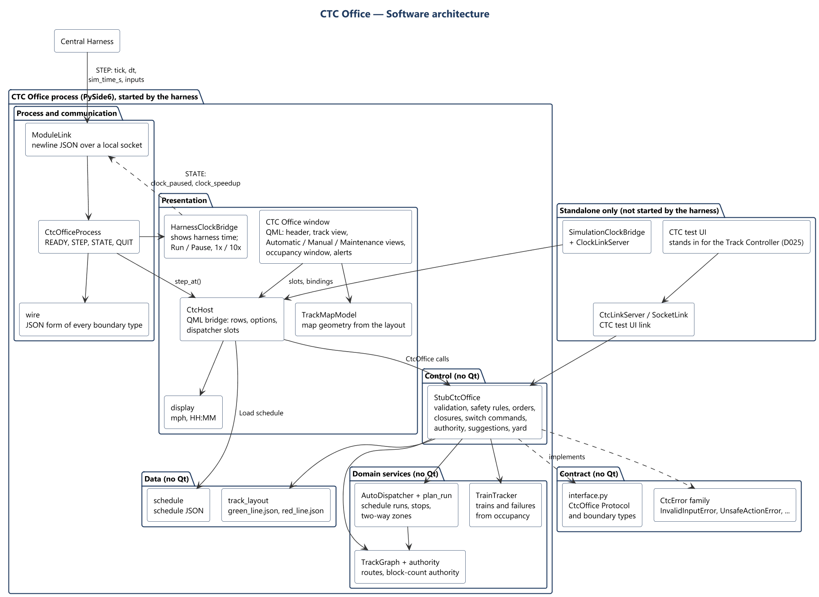
CTC Office architecture (component view)
CTC Office · Architecture
Track Overflow · Design Review · 2026-10-22
61
Notes:
Presenter: Landis. The module's parts and how they depend on each other.

Slide 62
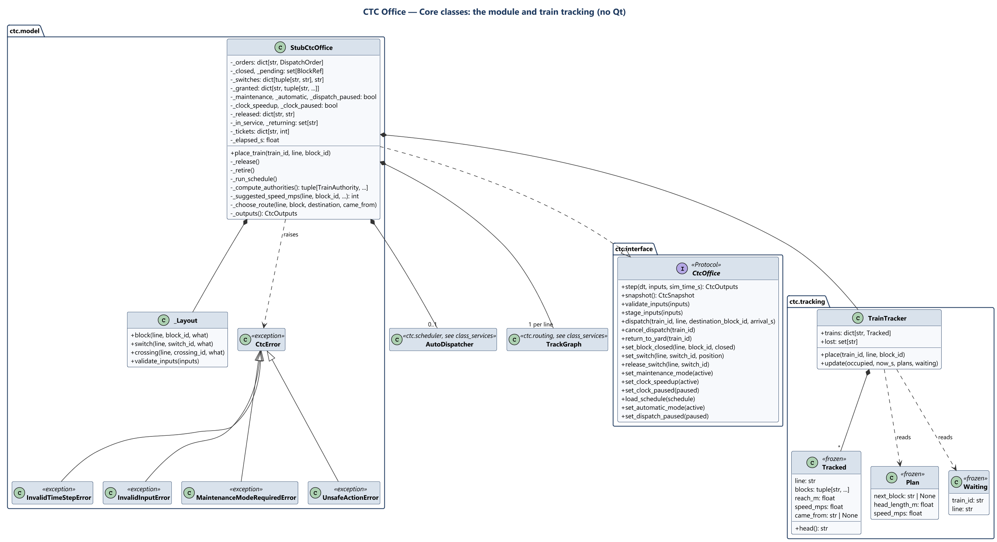
Core classes: module and tracking
CTC Office · Class diagrams
Track Overflow · Design Review · 2026-10-22
62
Notes:
Presenter: Landis. - StubCtcOffice implements CtcOffice. It holds the orders, closures, switch commands and granted blocks, and owns one TrackGraph per line, the TrainTracker and, once a schedule is loaded, the AutoDispatcher. - _Layout checks every reference and input against the layout files. - Every refusal is a CtcError: InvalidInputError (bad value), InvalidTimeStepError, MaintenanceModeRequiredError, UnsafeActionError (a safety rule). - TrainTracker keeps one Tracked per train: its blocks, how far it may have got, the fastest it may be going and the block it came from. Each step it reads the last step's Plan per train and the trains released (Waiting).

Slide 63
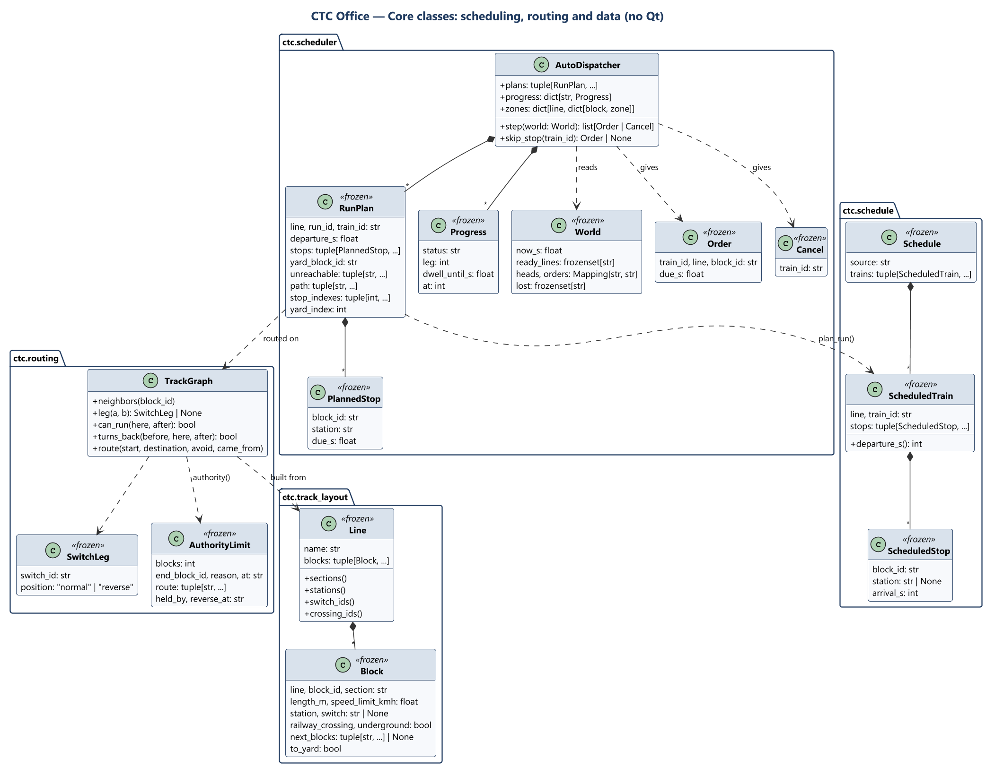
Core classes: scheduling, routing and data
CTC Office · Class diagrams
Track Overflow · Design Review · 2026-10-22
63
Notes:
Presenter: Landis. - plan_run turns each ScheduledTrain into a RunPlan: its stops in track order with due times, the path out and back, and where on it each stop is. - AutoDispatcher keeps a Progress per run and the two-way zones per line. Each step it reads a World and gives Order and Cancel actions, which the model carries out with the dispatcher's own safety checks. - TrackGraph is built from a Line's blocks; authority() counts an AuthorityLimit along a route.

Slide 64
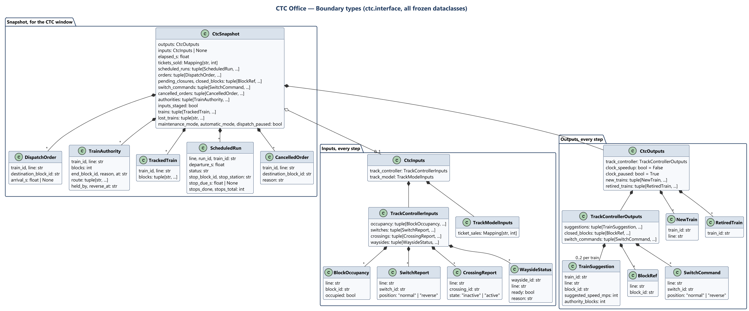
CTC Office: boundary types
CTC Office · Class diagrams
Track Overflow · Design Review · 2026-10-22
64
Notes:
Presenter: Landis. All are frozen dataclasses in ctc/interface.py, owned by the CTC Office (D005); other modules' types never appear in them, and common/interfaces.py is not used (D008). CtcSnapshot is for the CTC window only and crosses no module boundary.

Slide 65
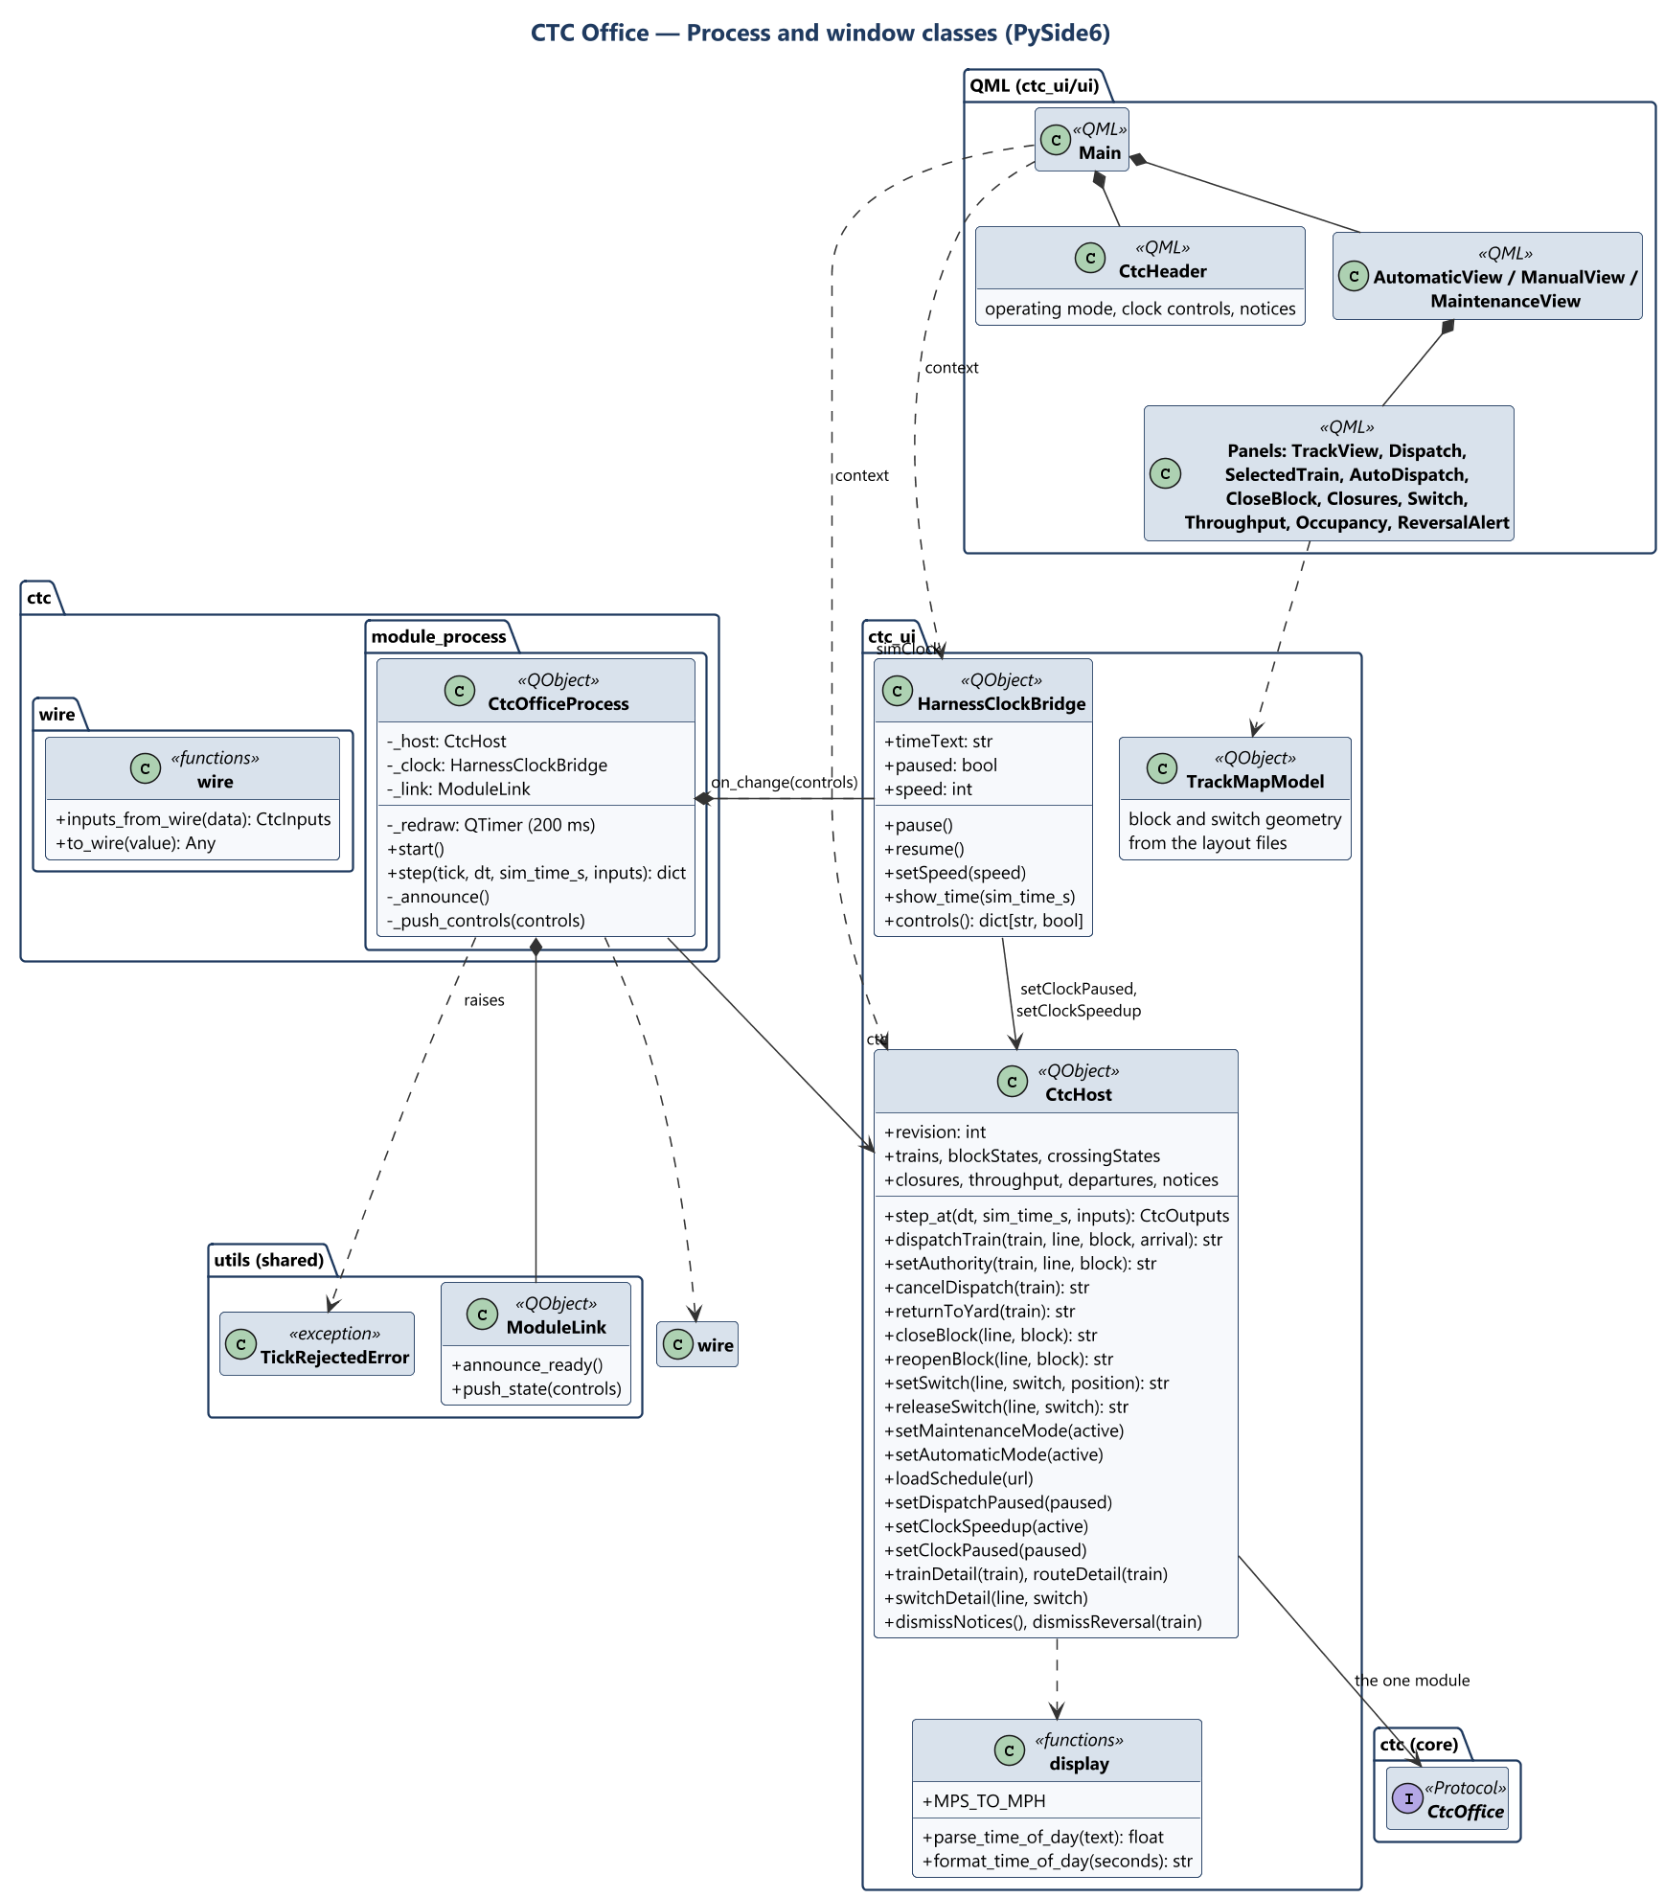
Process and window classes
CTC Office · Class diagrams
Track Overflow · Design Review · 2026-10-22
65
Notes:
Presenter: Landis. - CtcOfficeProcess answers the harness through ModuleLink and steps the module through CtcHost. - CtcHost is the only object QML talks to: it reads snapshots into rows, and its slots return an empty string or the refusal's text. - HarnessClockBridge gives QML the same clock face as the standalone clock, but shows the harness's time, and hands Run, Pause and 1x / 10x to the module and the harness.

Slide 66
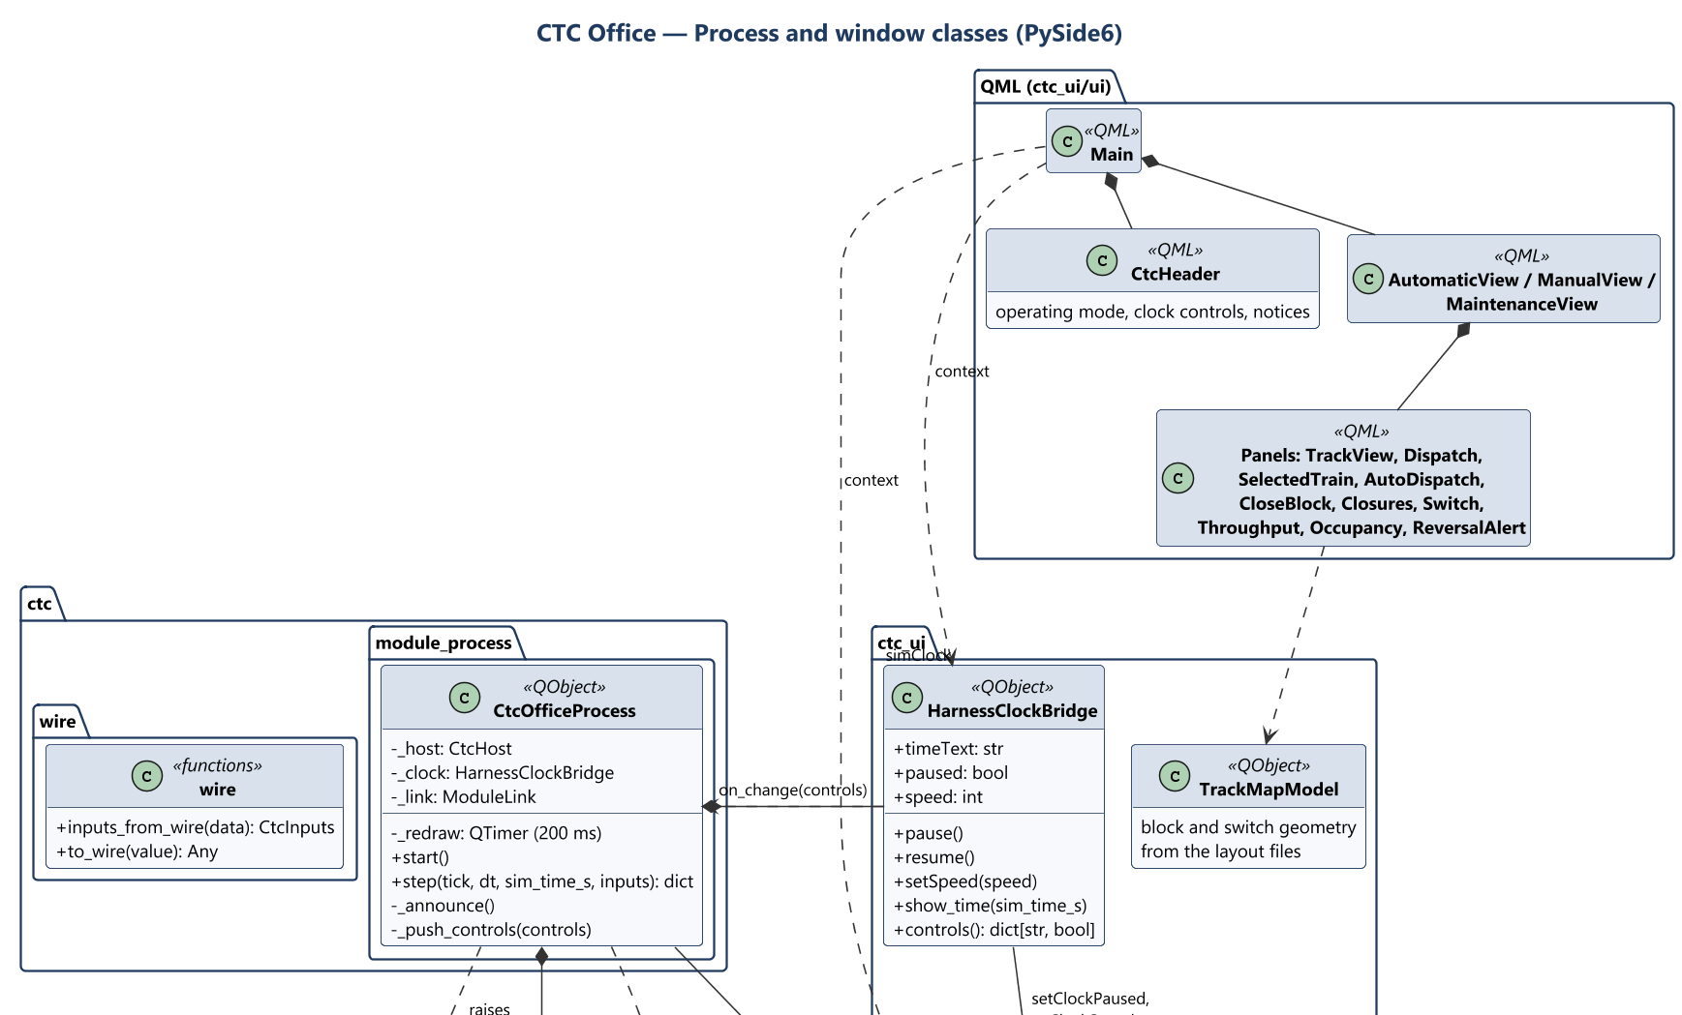
Process and window classes (detail 1 of 2)
CTC Office · Class diagrams
66
Notes:
Close-up of the previous slide. Presenter: Landis. - CtcOfficeProcess answers the harness through ModuleLink and steps the module through CtcHost. - CtcHost is the only object QML talks to: it reads snapshots into rows, and its slots return an empty string or the refusal's text. - HarnessClockBridge gives QML the same clock face as the standalone clock, but shows the harness's time, and hands Run, Pause and 1x / 10x to the module and the harness.

Slide 67
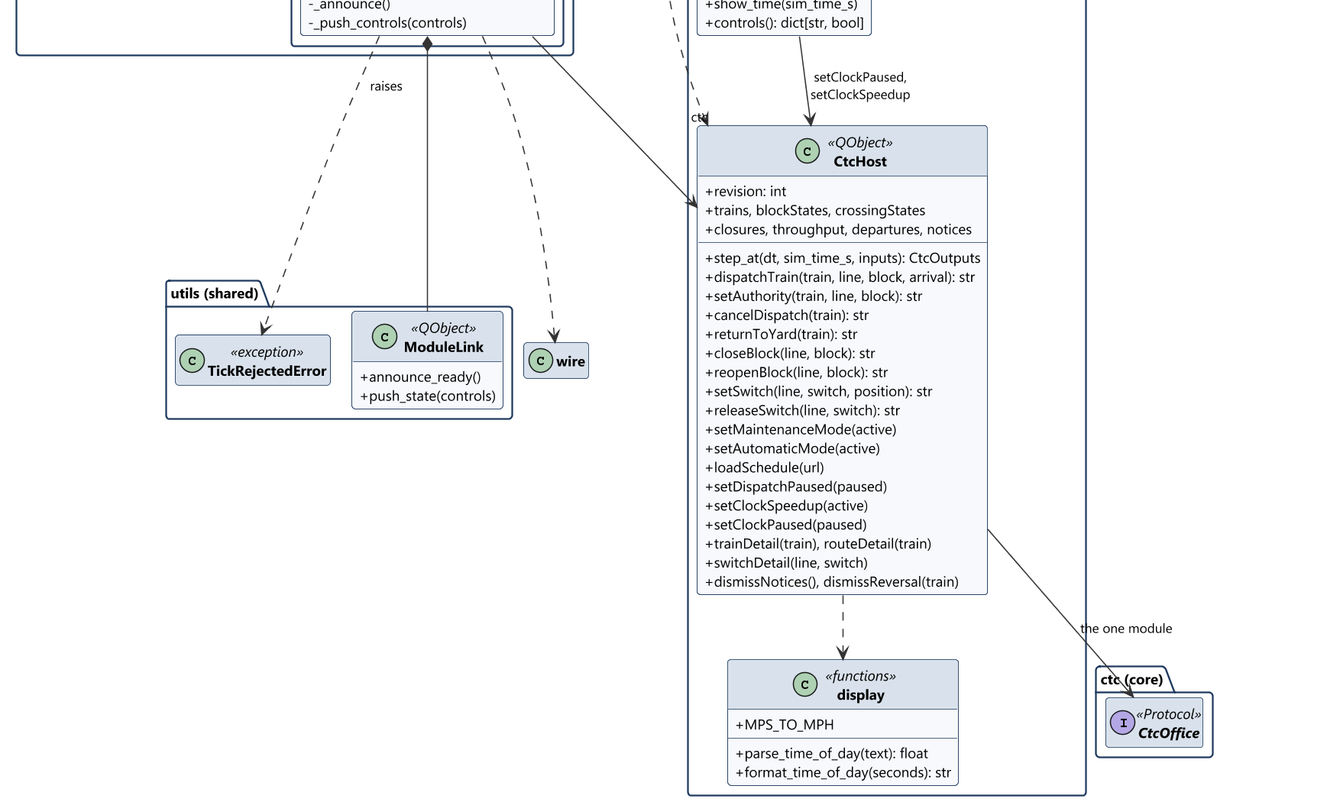
Process and window classes (detail 2 of 2)
CTC Office · Class diagrams
67
Notes:
Close-up of the previous slide. Presenter: Landis. - CtcOfficeProcess answers the harness through ModuleLink and steps the module through CtcHost. - CtcHost is the only object QML talks to: it reads snapshots into rows, and its slots return an empty string or the refusal's text. - HarnessClockBridge gives QML the same clock face as the standalone clock, but shows the harness's time, and hands Run, Pause and 1x / 10x to the module and the harness.

Slide 68
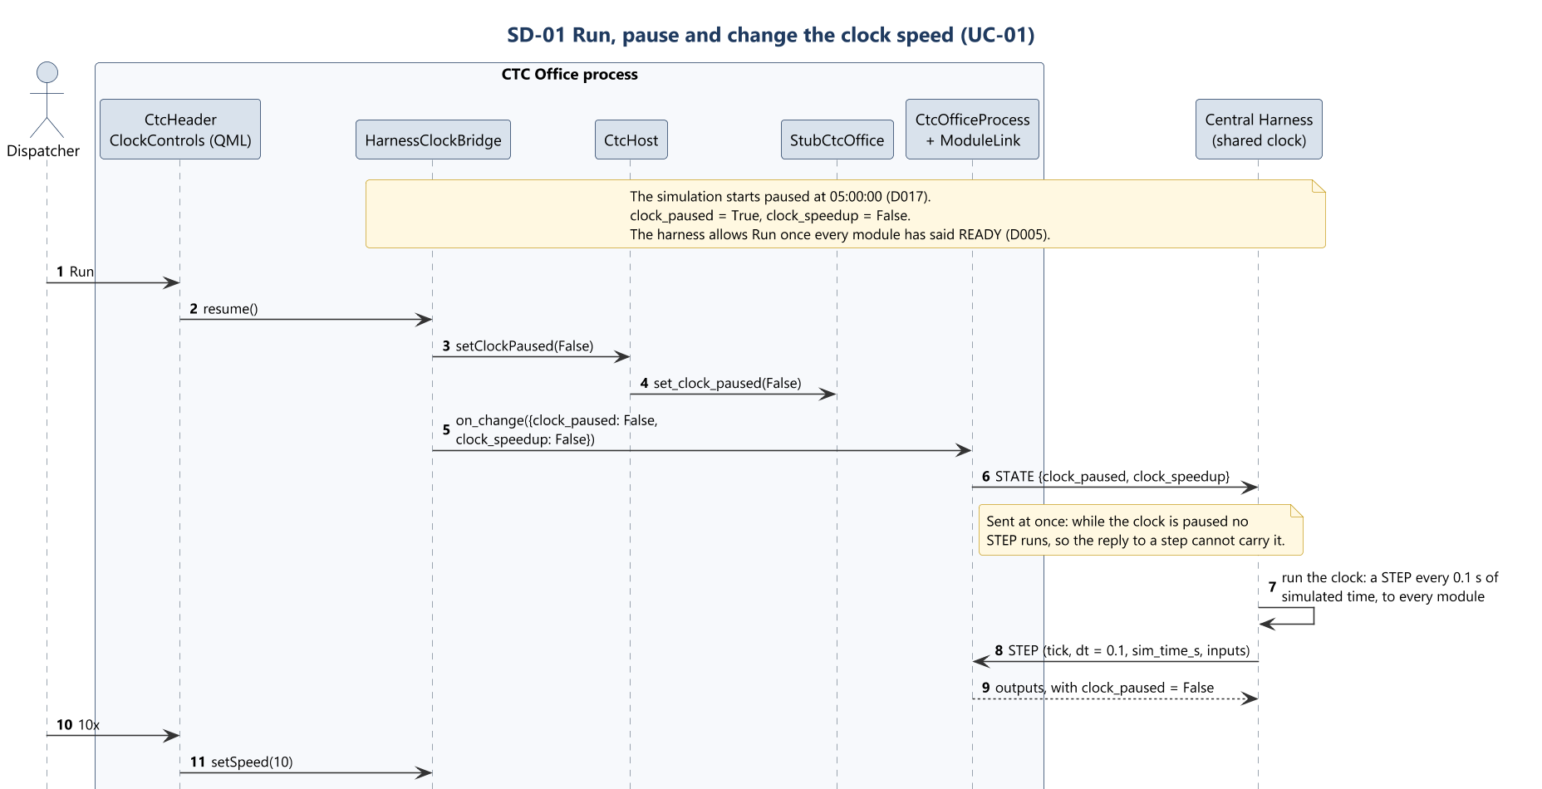
SD-01 Control the simulation clock (1 of 2)
CTC Office · Sequence diagrams
Track Overflow · Design Review · 2026-10-22
68
Notes:
Presenter: Landis. Use case: Control the simulation clock. Runs, pauses and speeds up the one shared clock, for every module.

Slide 69
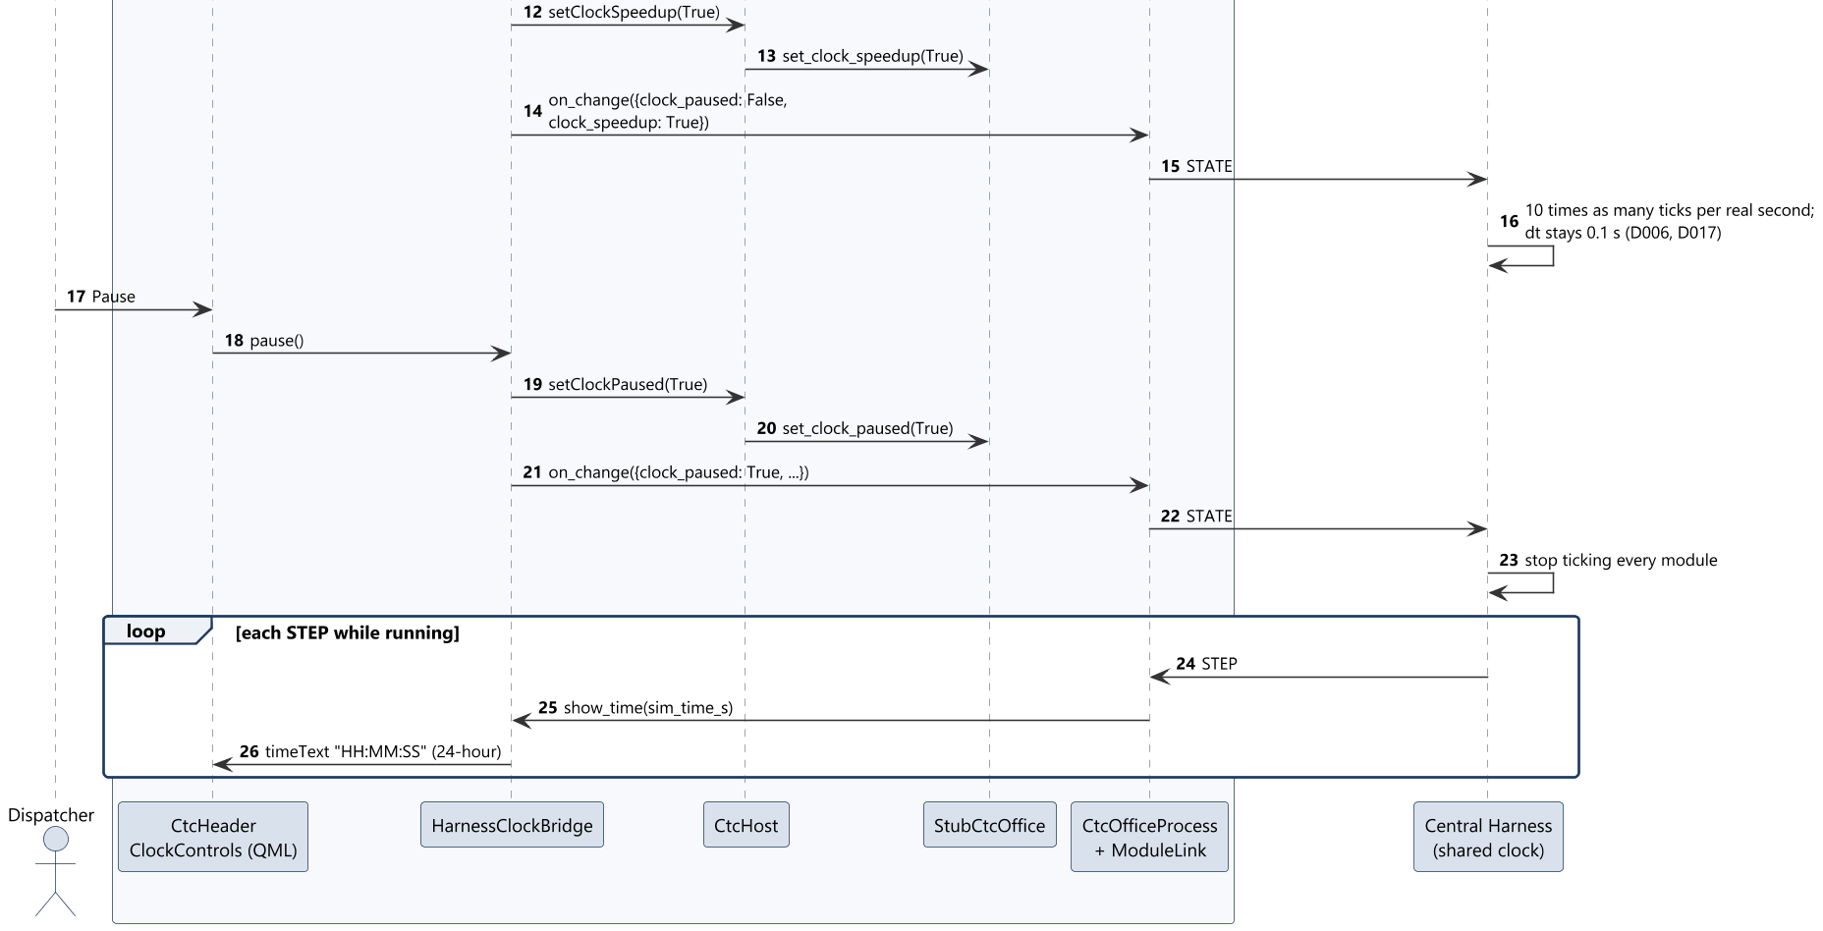
SD-01 Control the simulation clock (2 of 2)
CTC Office · Sequence diagrams
Track Overflow · Design Review · 2026-10-22
69
Notes:
Presenter: Landis. Use case: Control the simulation clock. Runs, pauses and speeds up the one shared clock, for every module.

Slide 70
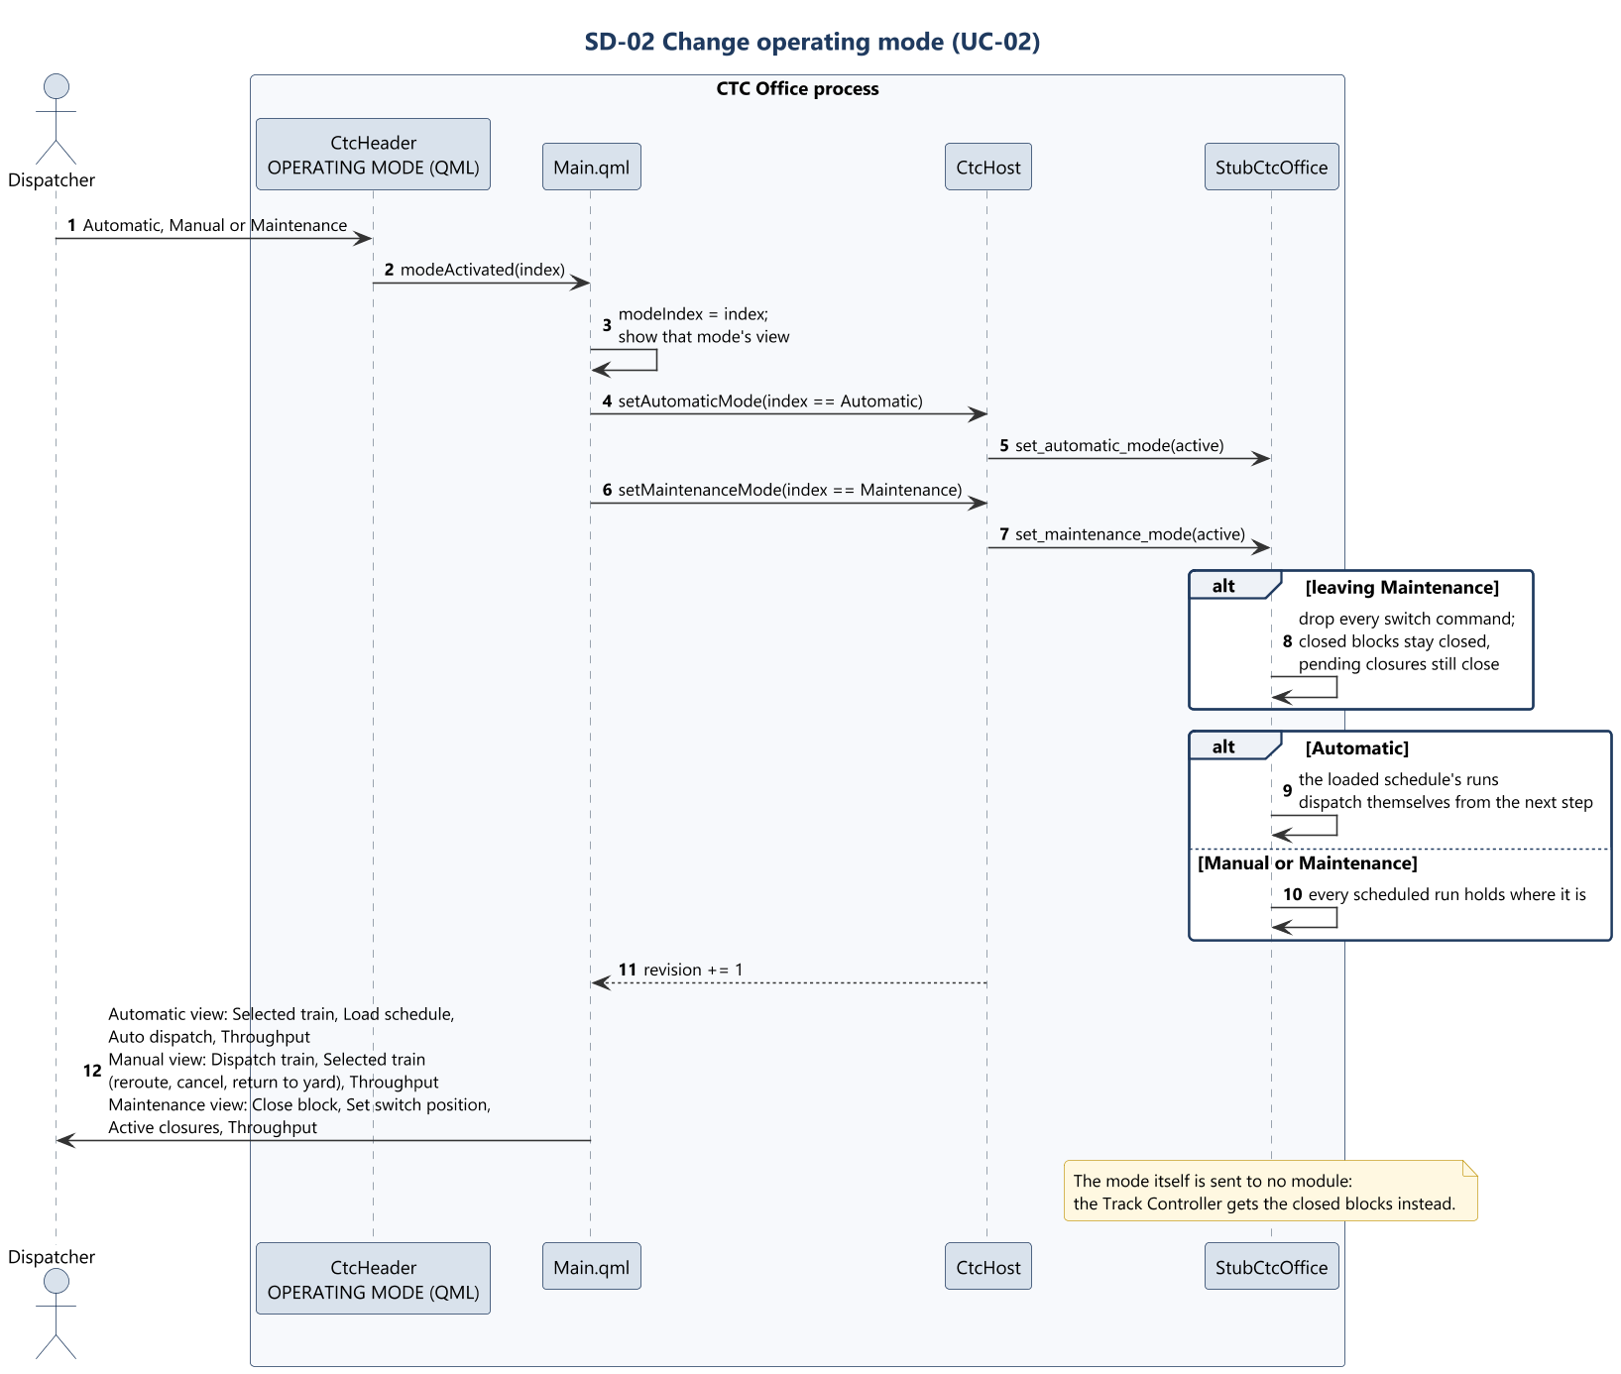
SD-02 Change operating mode
CTC Office · Sequence diagrams
Track Overflow · Design Review · 2026-10-22
70
Notes:
Presenter: Landis. Use case: Change operating mode. Chooses Automatic, Manual or Maintenance mode.

Slide 71
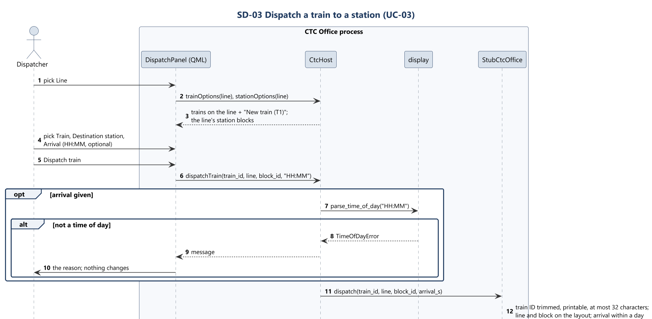
SD-03 Dispatch a train to a station (1 of 2)
CTC Office · Sequence diagrams
Track Overflow · Design Review · 2026-10-22
71
Notes:
Presenter: Landis. Use case: Dispatch a train to a station. Orders a train to a station of its line, with an optional arrival time.

Slide 72
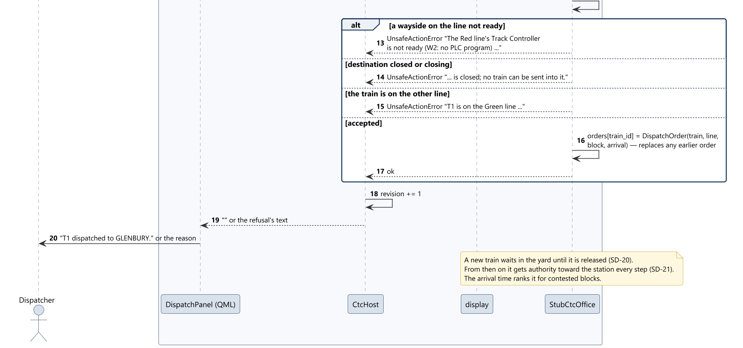
SD-03 Dispatch a train to a station (2 of 2)
CTC Office · Sequence diagrams
Track Overflow · Design Review · 2026-10-22
72
Notes:
Presenter: Landis. Use case: Dispatch a train to a station. Orders a train to a station of its line, with an optional arrival time.

Slide 73
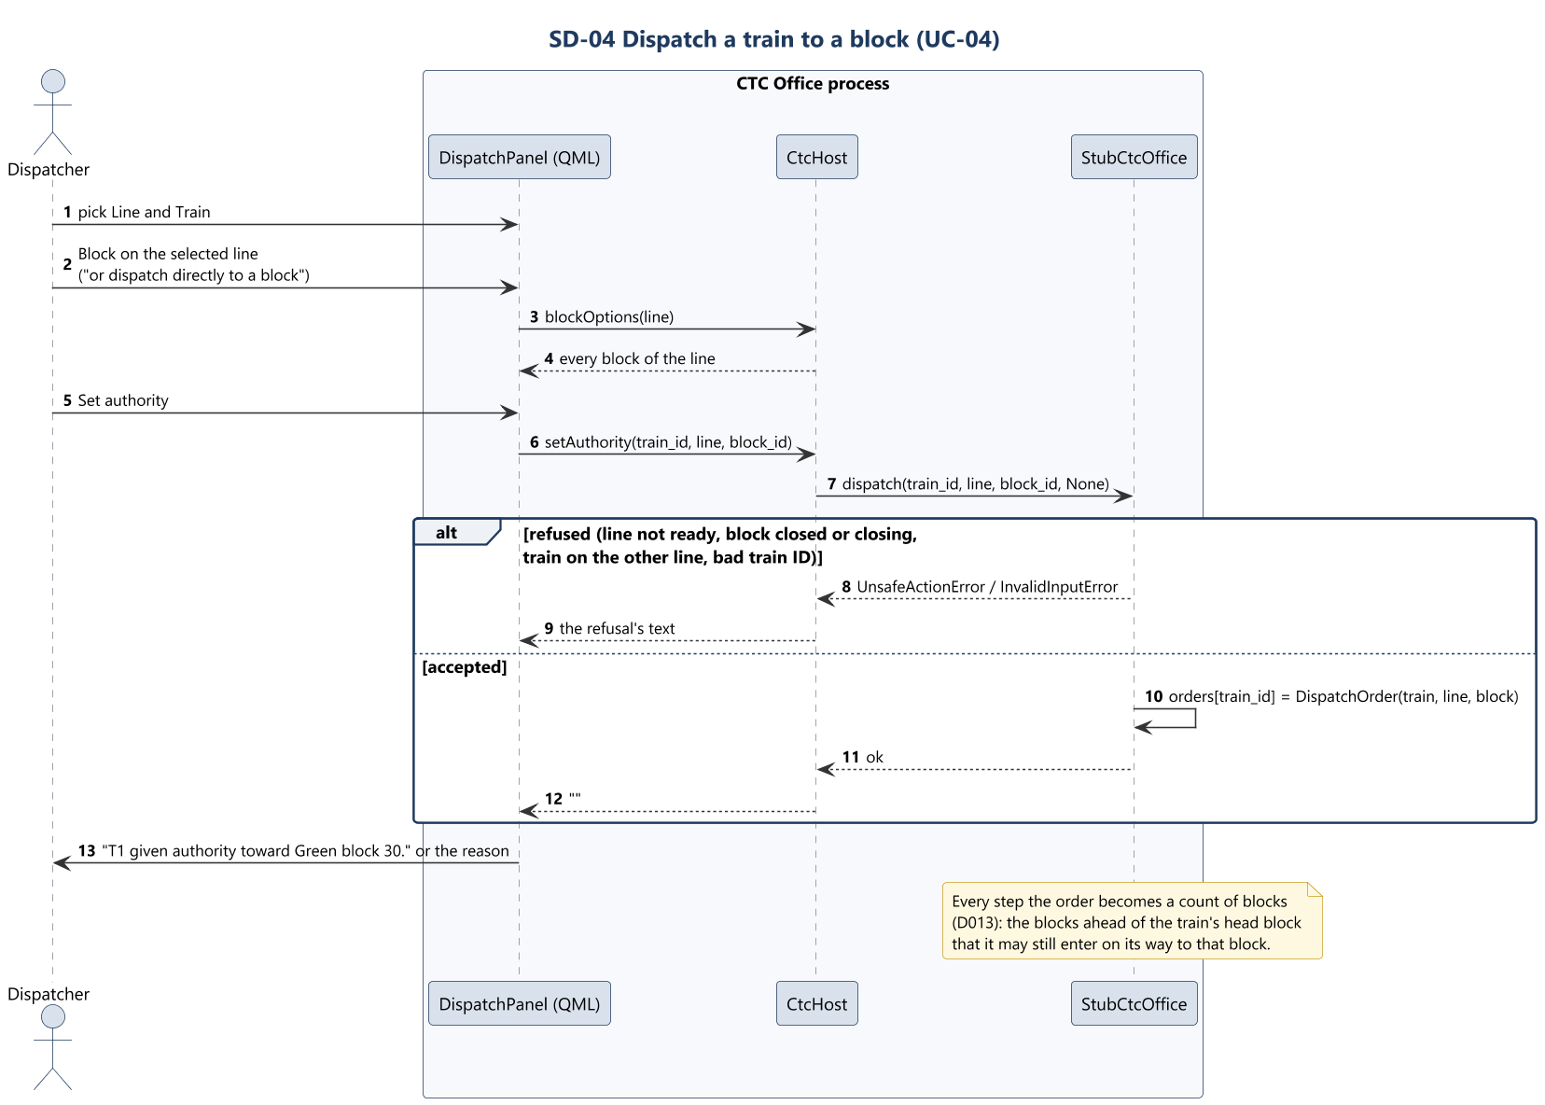
SD-04 Dispatch a train to a block
CTC Office · Sequence diagrams
Track Overflow · Design Review · 2026-10-22
73
Notes:
Presenter: Landis. Use case: Dispatch a train to a block. Sends a train straight to any block of its line.

Slide 74
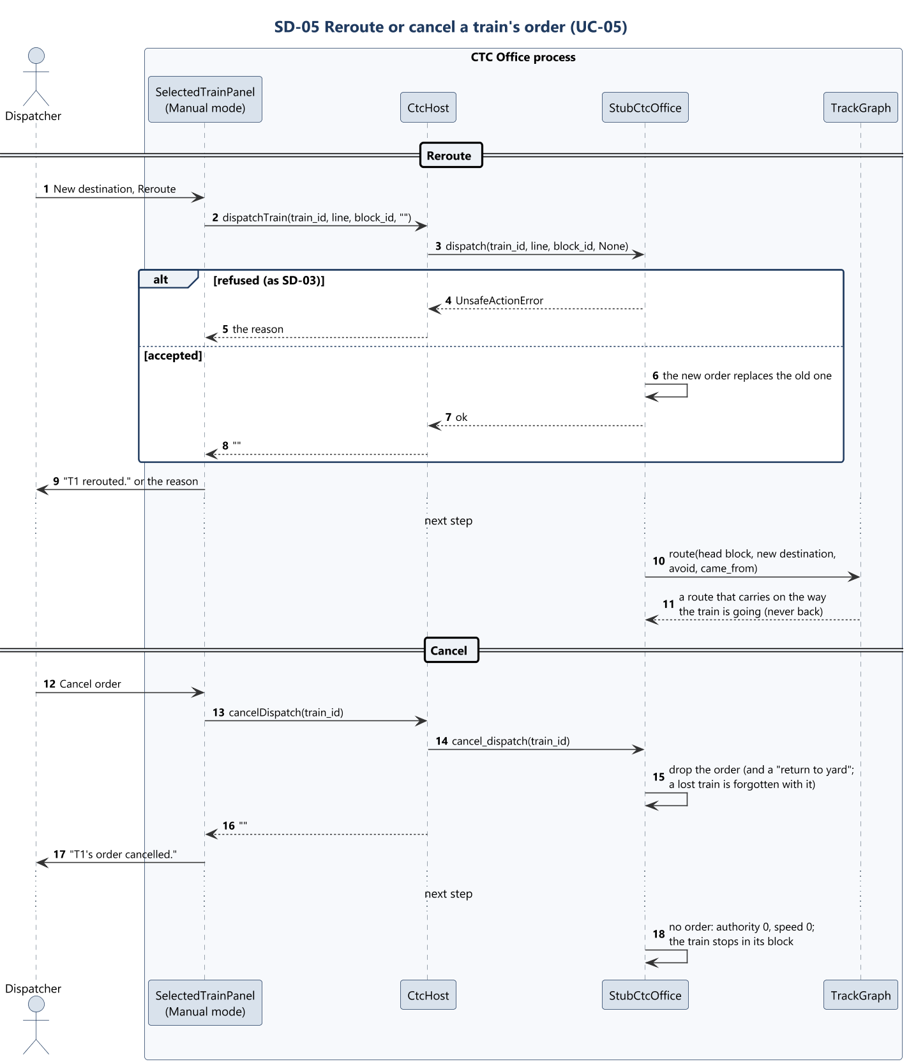
SD-05 Reroute or cancel a train's order
CTC Office · Sequence diagrams
Track Overflow · Design Review · 2026-10-22
74
Notes:
Presenter: Landis. Use case: Reroute or cancel a train's order. Changes where the selected train is going, or withdraws its order.

Slide 75
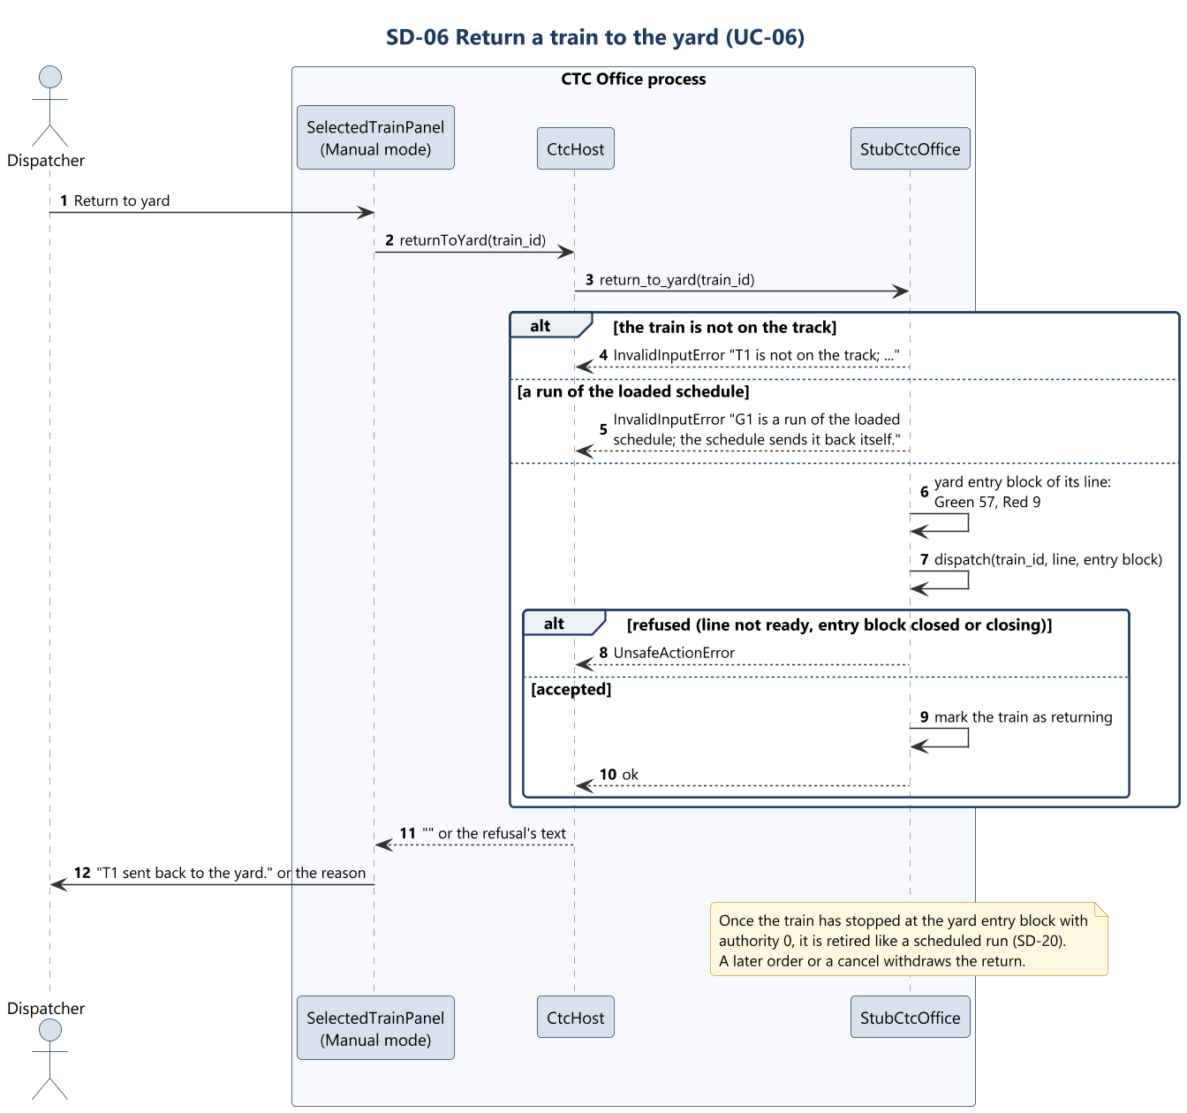
SD-06 Return a train to the yard
CTC Office · Sequence diagrams
Track Overflow · Design Review · 2026-10-22
75
Notes:
Presenter: Landis. Use case: Return a train to the yard. Sends a manual train on the track back to the yard, where it is retired (D022).

Slide 76
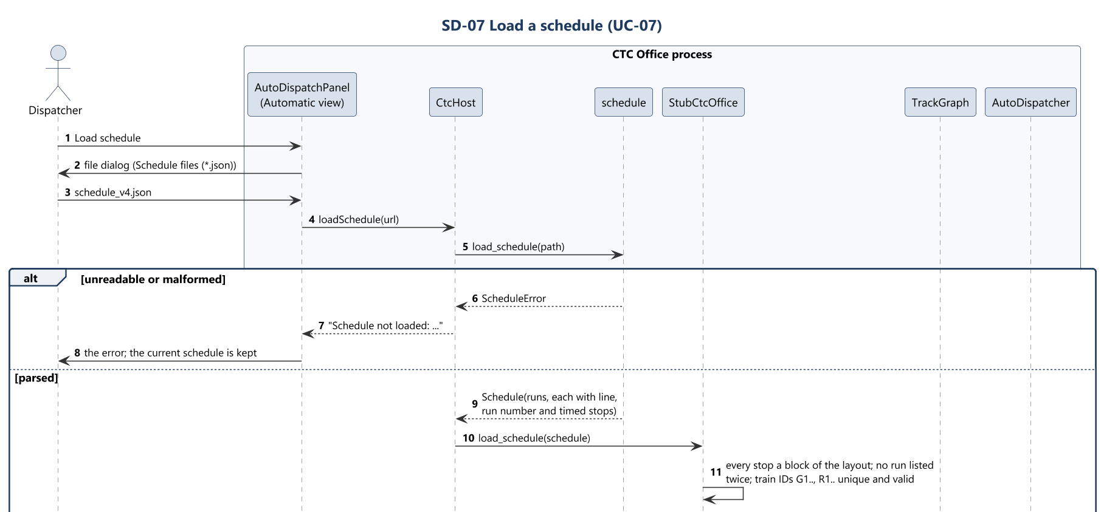
SD-07 Load a schedule (1 of 2)
CTC Office · Sequence diagrams
Track Overflow · Design Review · 2026-10-22
76
Notes:
Presenter: Landis. Use case: Load a schedule. Loads the schedule that automatic mode runs.

Slide 77
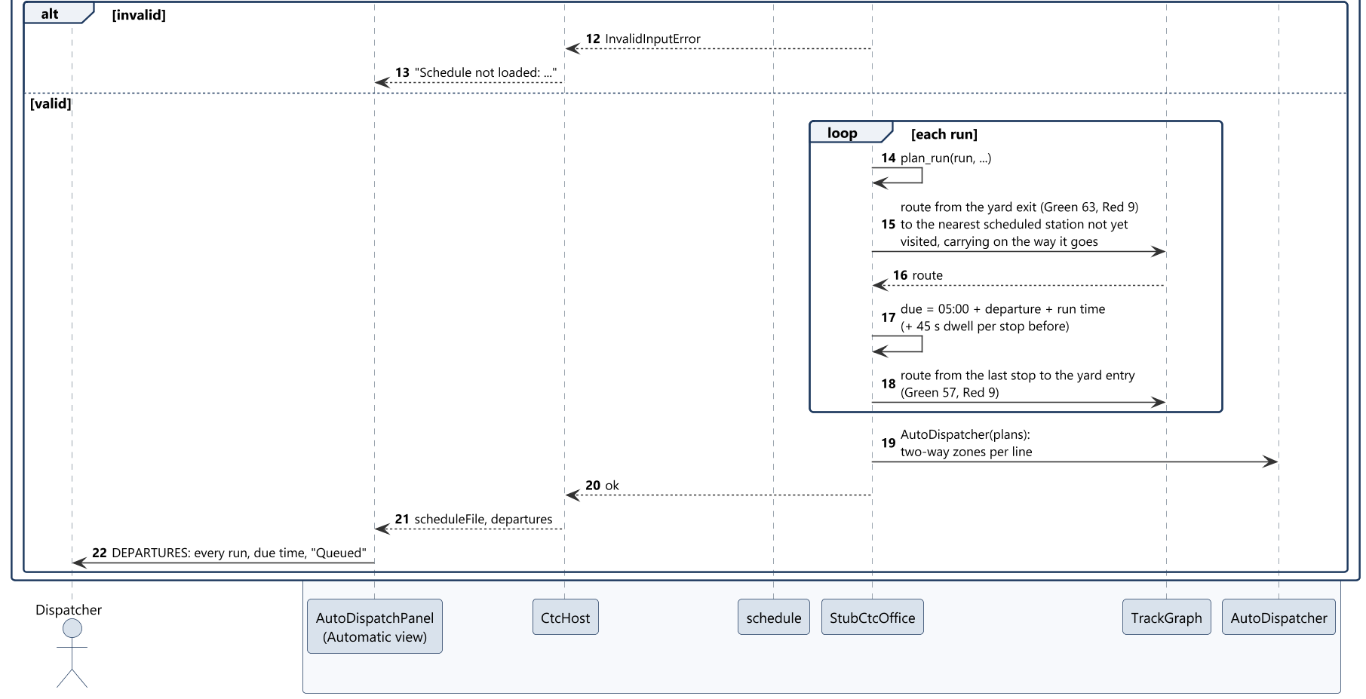
SD-07 Load a schedule (2 of 2)
CTC Office · Sequence diagrams
Track Overflow · Design Review · 2026-10-22
77
Notes:
Presenter: Landis. Use case: Load a schedule. Loads the schedule that automatic mode runs.

Slide 78
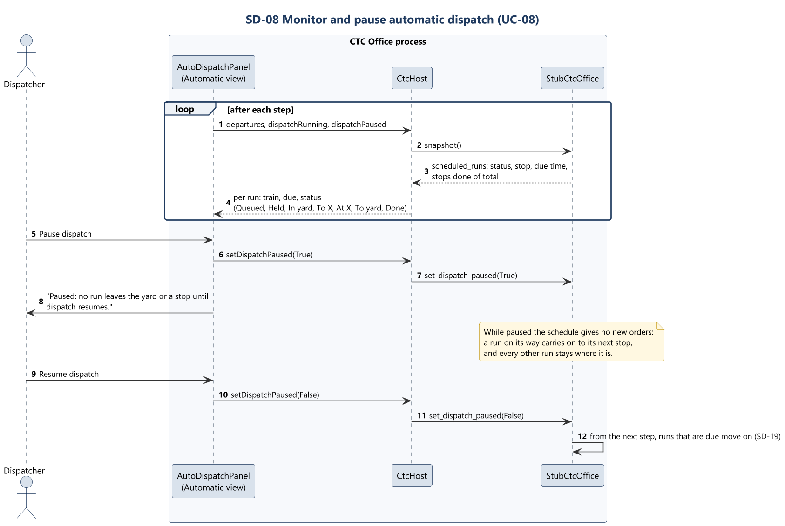
SD-08 Monitor and pause automatic dispatch
CTC Office · Sequence diagrams
Track Overflow · Design Review · 2026-10-22
78
Notes:
Presenter: Landis. Use case: Monitor and pause automatic dispatch. Shows how far each run has got, and holds or releases them all.

Slide 79
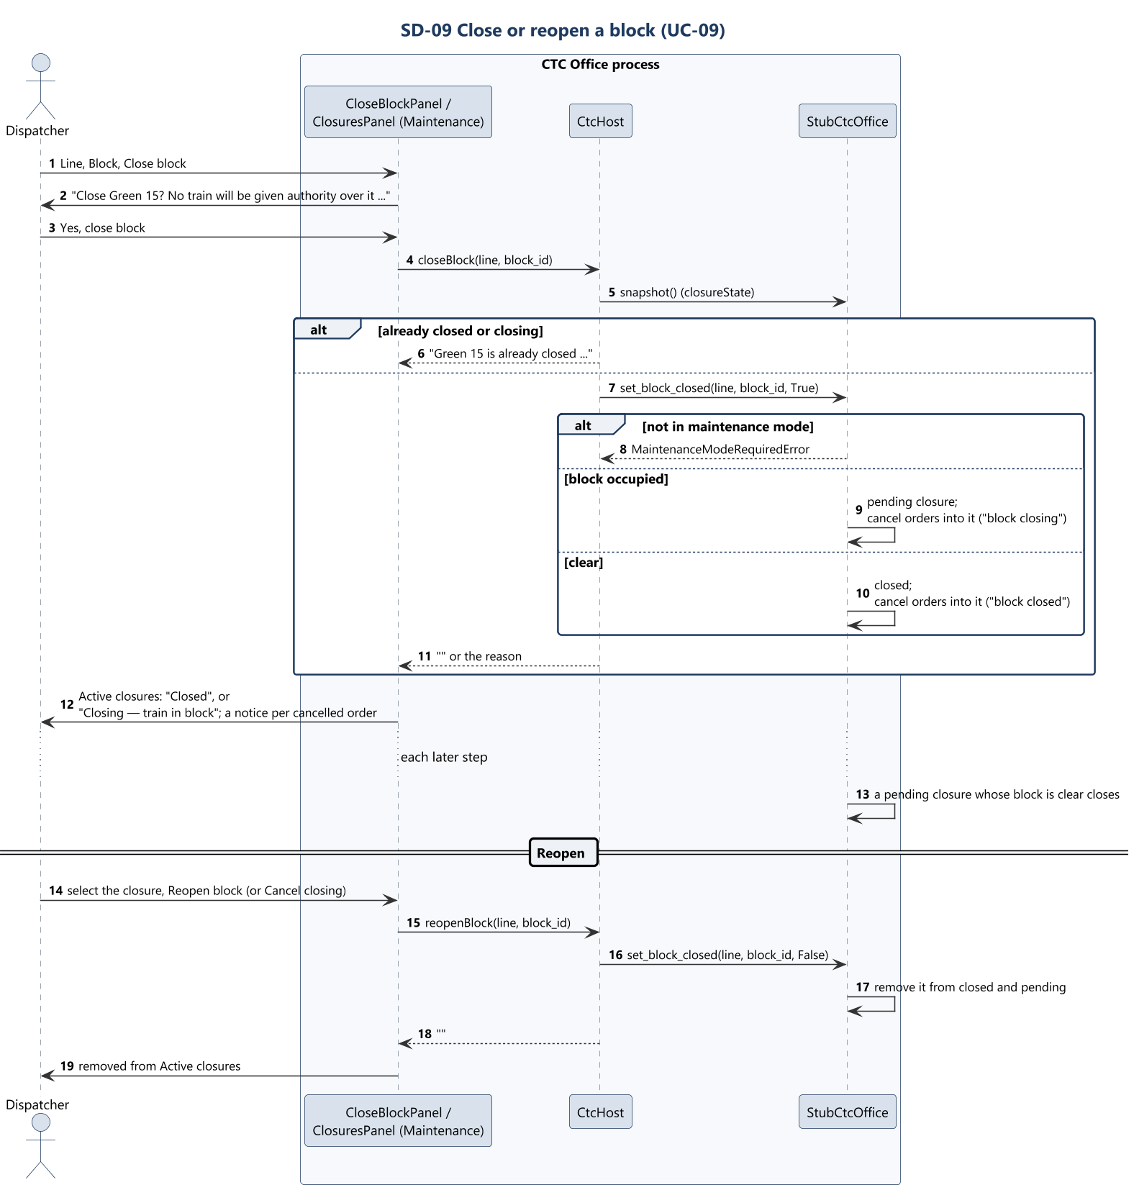
SD-09 Close or reopen a block
CTC Office · Sequence diagrams
Track Overflow · Design Review · 2026-10-22
79
Notes:
Presenter: Landis. Use case: Close or reopen a block. Takes a block out of service for maintenance, and back.

Slide 80
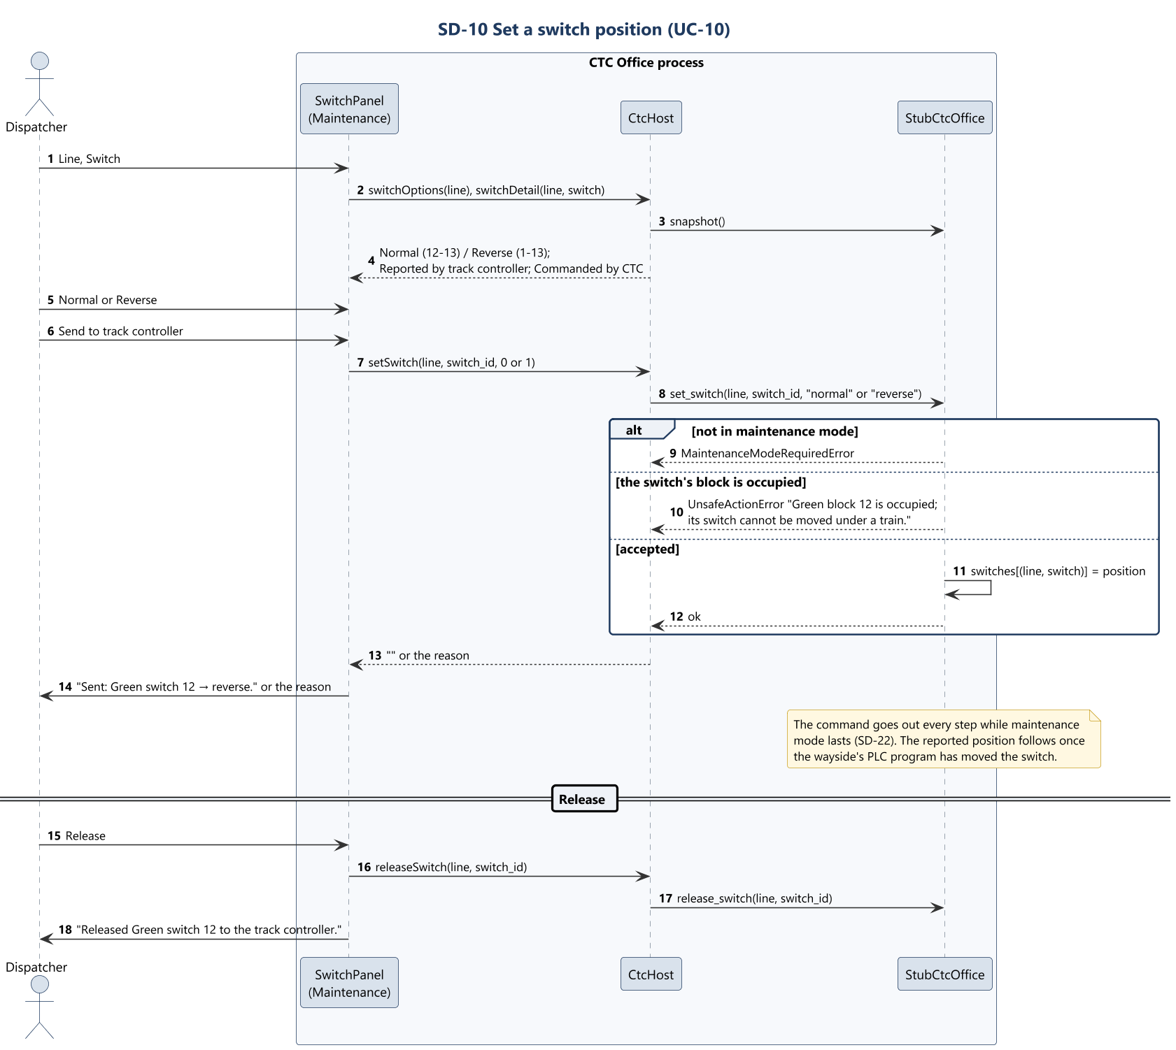
SD-10 Set a switch position
CTC Office · Sequence diagrams
Track Overflow · Design Review · 2026-10-22
80
Notes:
Presenter: Landis. Use case: Set a switch position. Commands a switch, in maintenance mode.

Slide 81
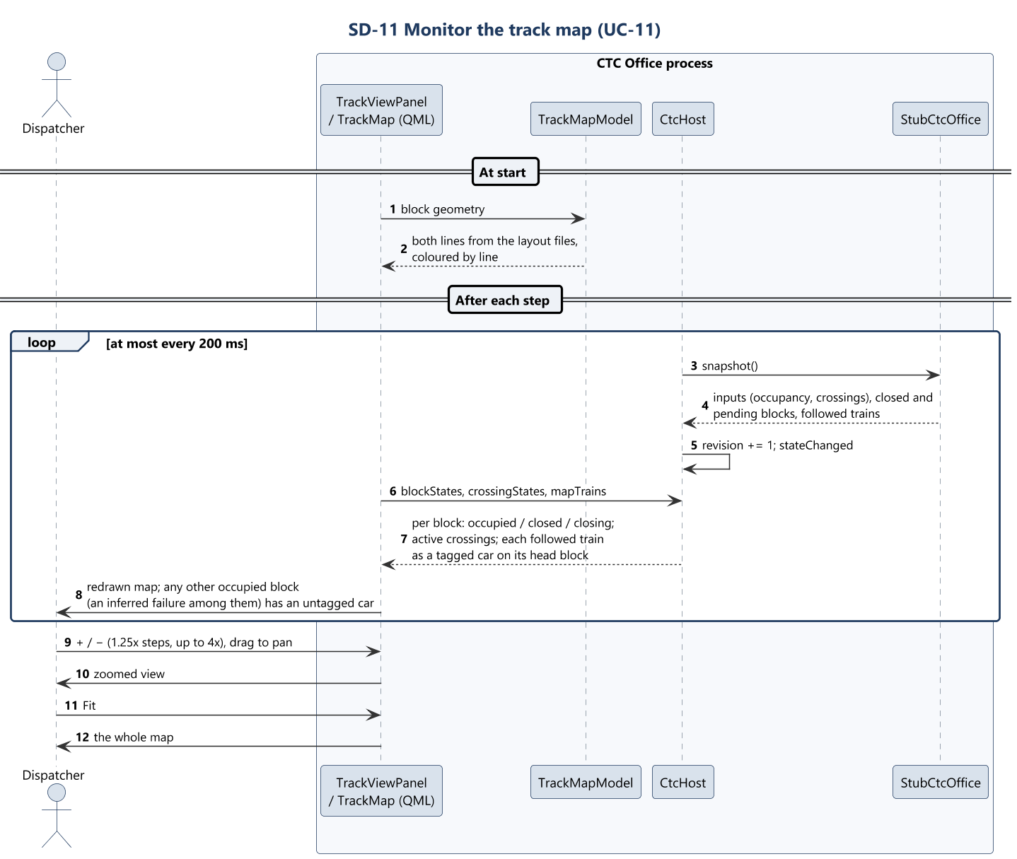
SD-11 Monitor the track map
CTC Office · Sequence diagrams
Track Overflow · Design Review · 2026-10-22
81
Notes:
Presenter: Landis. Use case: Monitor the track map. Shows both lines and what is on them.

Slide 82
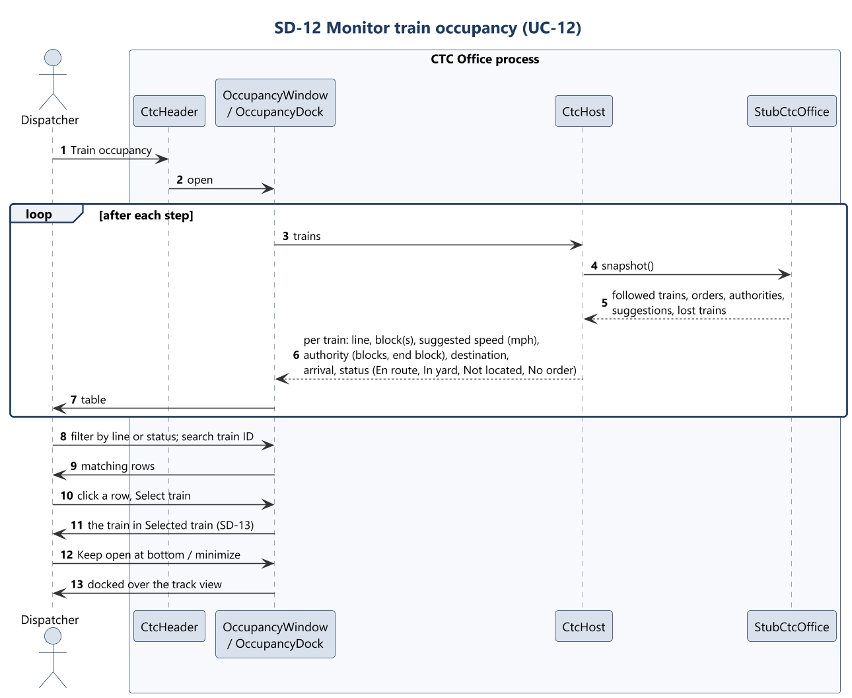
SD-12 Monitor train occupancy
CTC Office · Sequence diagrams
Track Overflow · Design Review · 2026-10-22
82
Notes:
Presenter: Landis. Use case: Monitor train occupancy. Lists every train the CTC Office follows or has an order for.

Slide 83
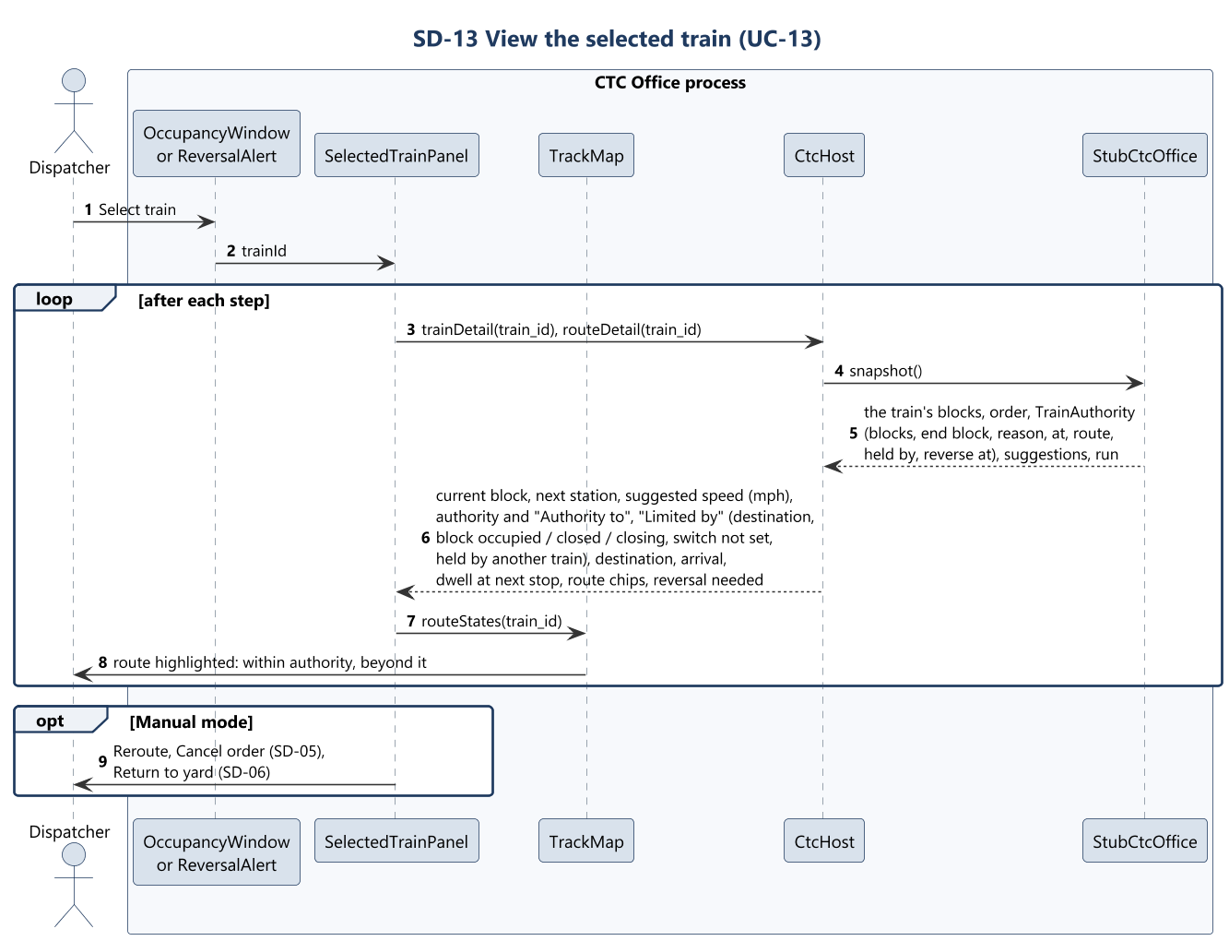
SD-13 View the selected train
CTC Office · Sequence diagrams
Track Overflow · Design Review · 2026-10-22
83
Notes:
Presenter: Landis. Use case: View the selected train. Shows one train in detail.

Slide 84
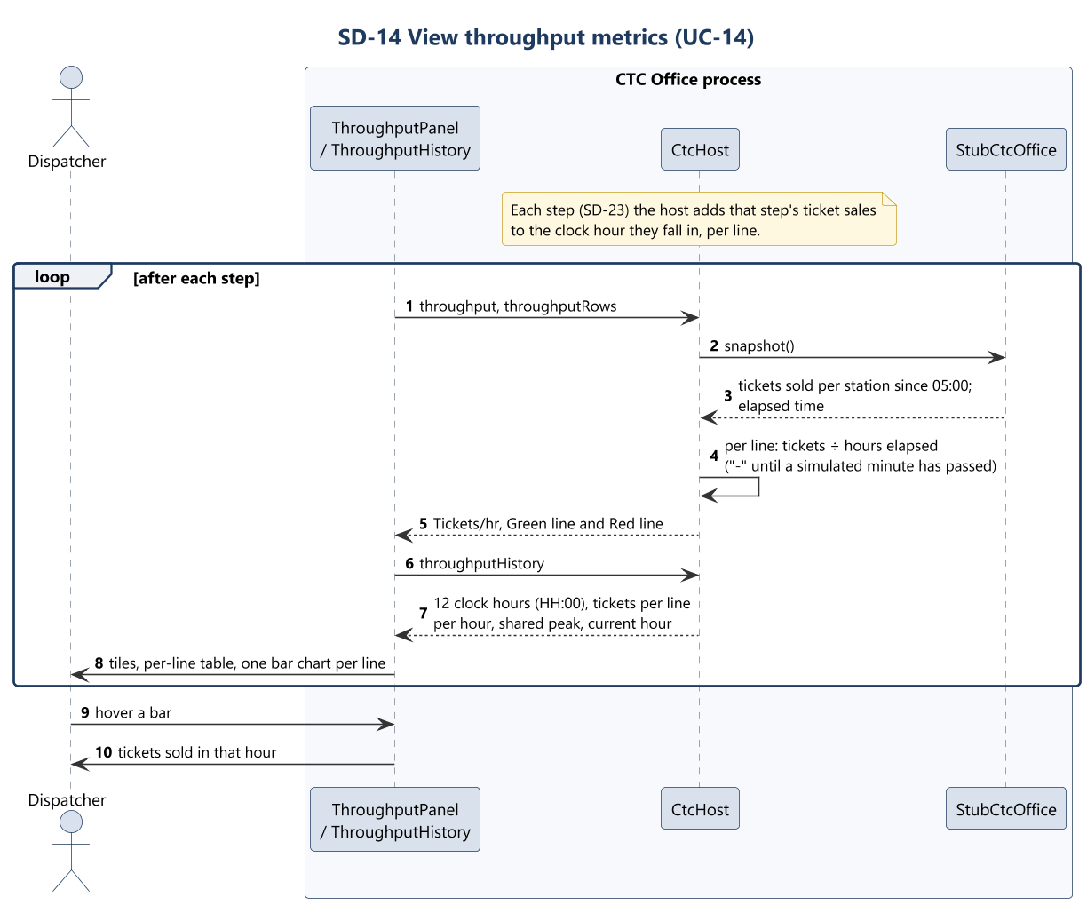
SD-14 View throughput metrics
CTC Office · Sequence diagrams
Track Overflow · Design Review · 2026-10-22
84
Notes:
Presenter: Landis. Use case: View throughput metrics. Shows passenger throughput per line, from ticket sales.

Slide 85
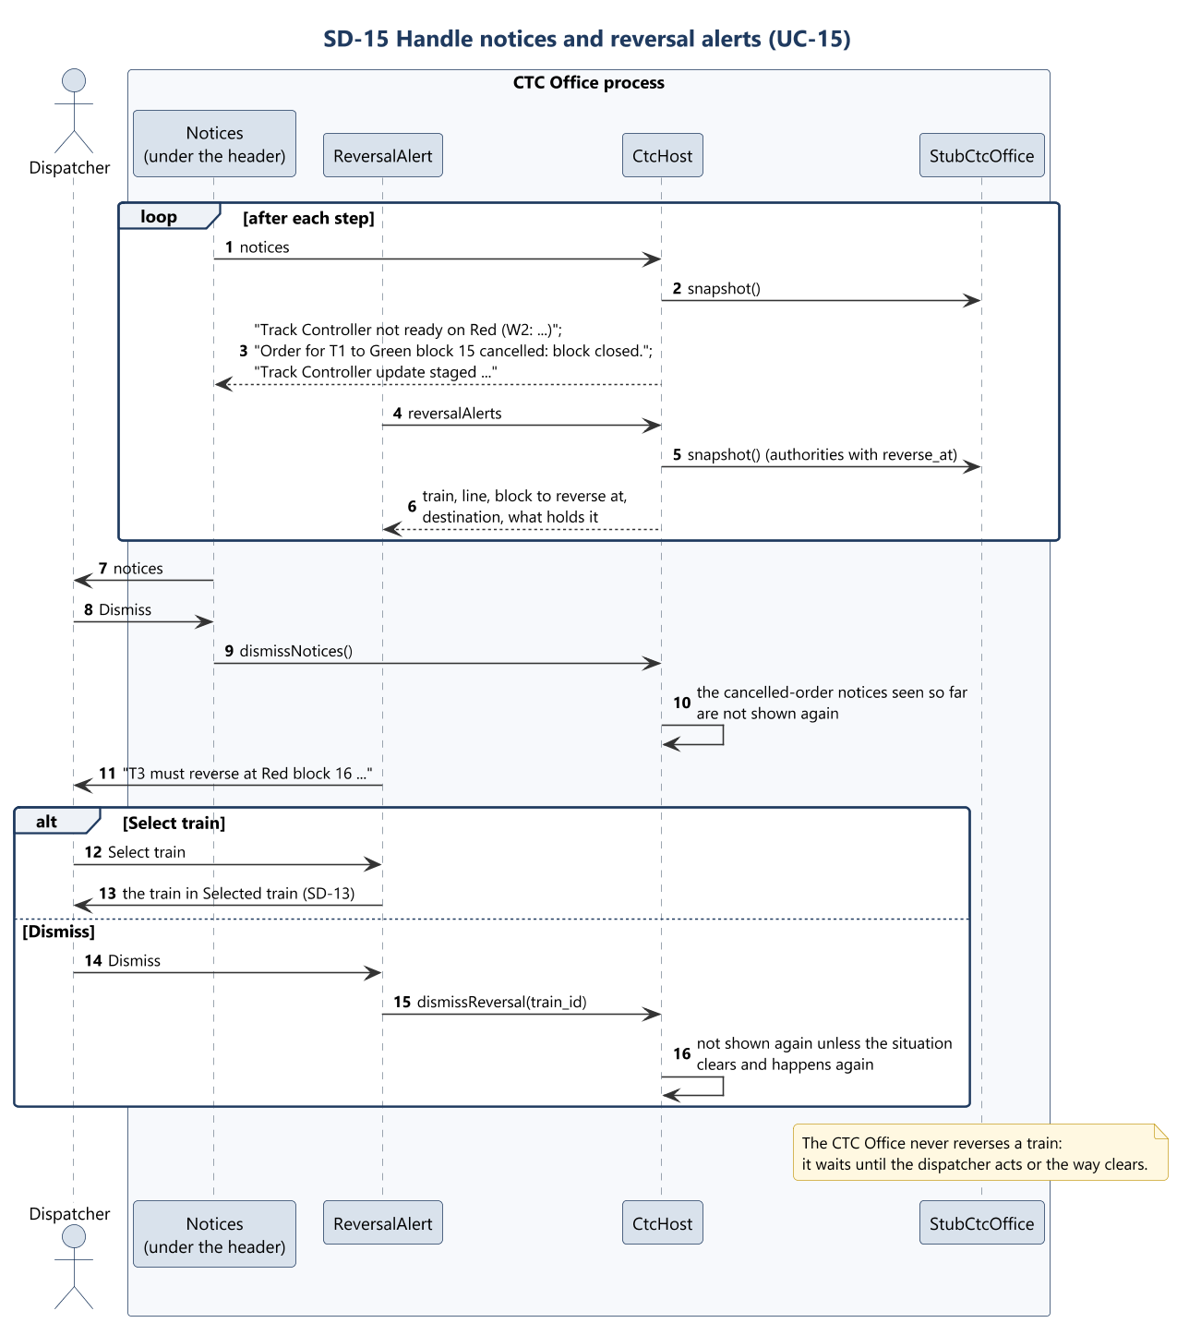
SD-15 Handle notices and reversal alerts
CTC Office · Sequence diagrams
Track Overflow · Design Review · 2026-10-22
85
Notes:
Presenter: Landis. Use case: Handle notices and reversal alerts. Tells the dispatcher what needs their attention.

Slide 86
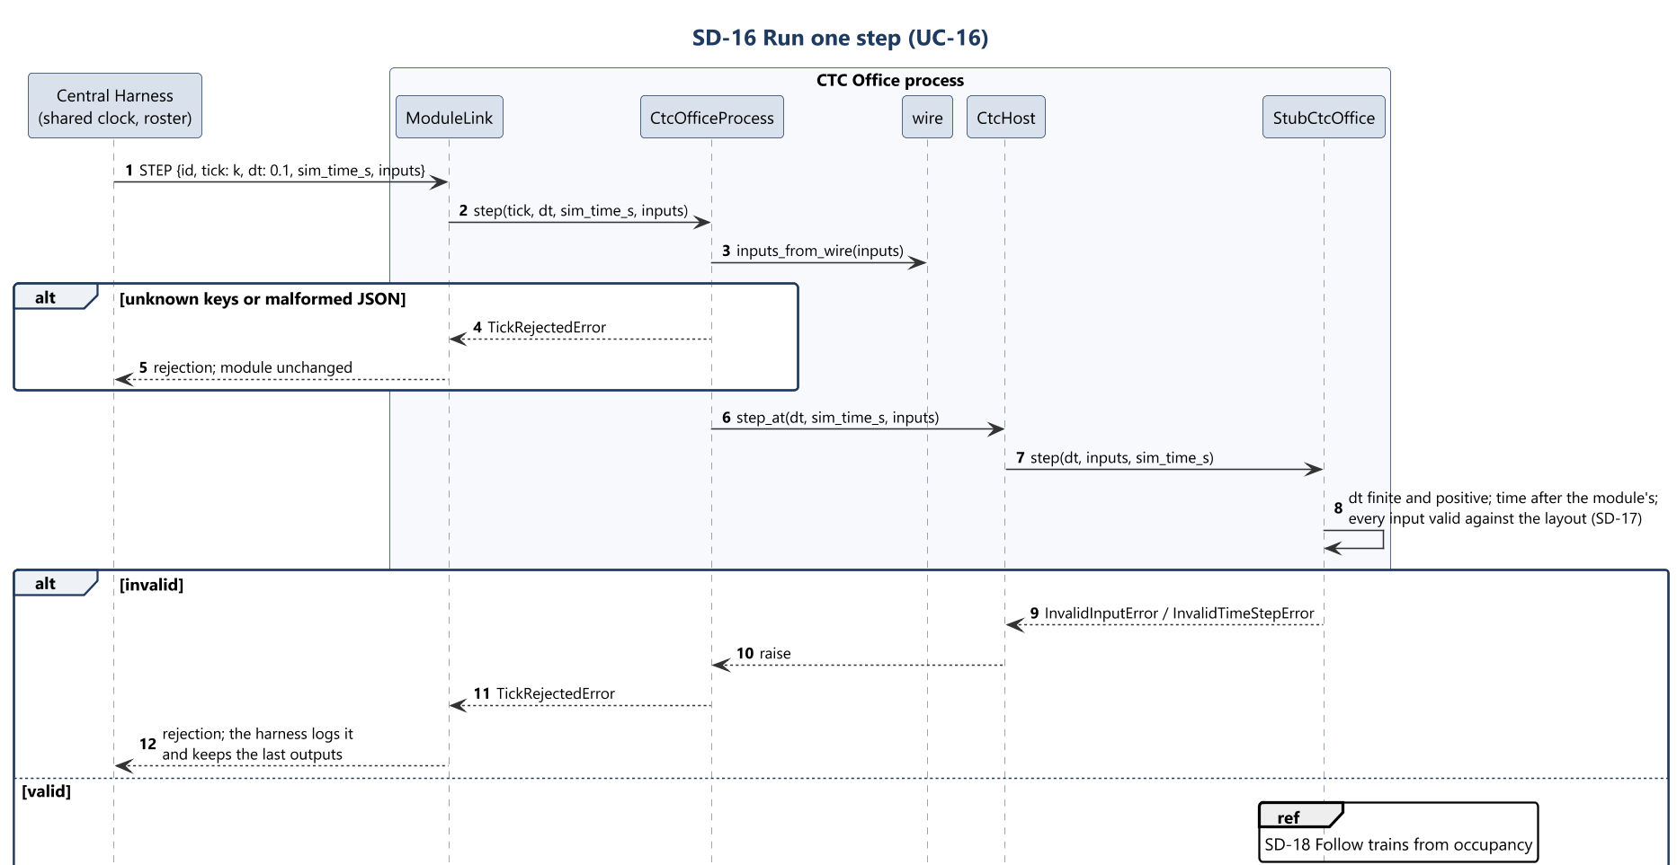
SD-16 Run one step (1 of 2)
CTC Office · Sequence diagrams
Track Overflow · Design Review · 2026-10-22
86
Notes:
Presenter: Landis. Use case: Run one step. Once per tick, takes that tick's inputs, moves every train and run on, and returns the outputs.

Slide 87
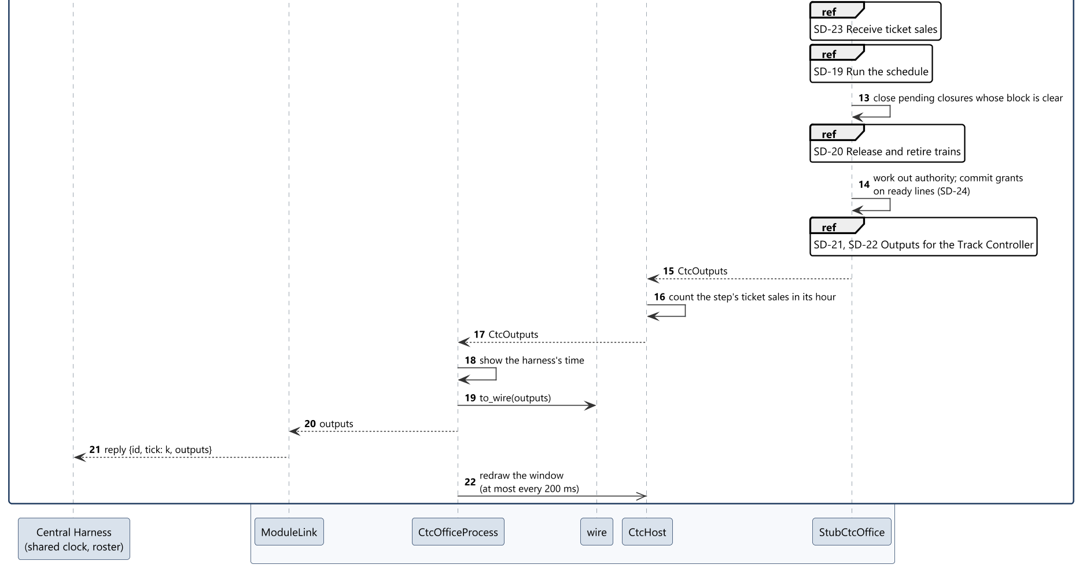
SD-16 Run one step (2 of 2)
CTC Office · Sequence diagrams
Track Overflow · Design Review · 2026-10-22
87
Notes:
Presenter: Landis. Use case: Run one step. Once per tick, takes that tick's inputs, moves every train and run on, and returns the outputs.

Slide 88

SD-17 Receive Track Controller reports
CTC Office · Sequence diagrams
Track Overflow · Design Review · 2026-10-22
88
Notes:
Presenter: Landis. Use case: Receive Track Controller reports. Takes what every wayside reports.

Slide 89

SD-18 Follow trains from occupancy (1 of 2)
CTC Office · Sequence diagrams
Track Overflow · Design Review · 2026-10-22
89
Notes:
Presenter: Landis. Use case: Follow trains from occupancy. Works out where each of its trains is, and which occupied blocks are failures, from occupancy alone.

Slide 90

SD-18 Follow trains from occupancy (2 of 2)
CTC Office · Sequence diagrams
Track Overflow · Design Review · 2026-10-22
90
Notes:
Presenter: Landis. Use case: Follow trains from occupancy. Works out where each of its trains is, and which occupied blocks are failures, from occupancy alone.

Slide 91

SD-19 Run the schedule (1 of 2)
CTC Office · Sequence diagrams
Track Overflow · Design Review · 2026-10-22
91
Notes:
Presenter: Landis. Use case: Run the schedule. In automatic mode, gives the orders that carry the loaded schedule out (D020).

Slide 92

SD-19 Run the schedule (2 of 2)
CTC Office · Sequence diagrams
Track Overflow · Design Review · 2026-10-22
92
Notes:
Presenter: Landis. Use case: Run the schedule. In automatic mode, gives the orders that carry the loaded schedule out (D020).

Slide 93

SD-20 Release and retire trains (1 of 2)
CTC Office · Sequence diagrams
Track Overflow · Design Review · 2026-10-22
93
Notes:
Presenter: Landis. Use case: Release and retire trains. Lets trains out of the yard and takes them back (D022).

Slide 94

SD-20 Release and retire trains (2 of 2)
CTC Office · Sequence diagrams
Track Overflow · Design Review · 2026-10-22
94
Notes:
Presenter: Landis. Use case: Release and retire trains. Lets trains out of the yard and takes them back (D022).

Slide 95

SD-21 Send speed and authority suggestions
CTC Office · Sequence diagrams
Track Overflow · Design Review · 2026-10-22
95
Notes:
Presenter: Landis. Use case: Send speed and authority suggestions. Suggests each train's speed and authority, for the block it is in and the next block on its route.

Slide 96

SD-22 Send closures and switch commands
CTC Office · Sequence diagrams
Track Overflow · Design Review · 2026-10-22
96
Notes:
Presenter: Landis. Use case: Send closures and switch commands. Tells the waysides which blocks are closed and, in maintenance mode, where to set switches.

Slide 97

SD-23 Receive ticket sales
CTC Office · Sequence diagrams
Track Overflow · Design Review · 2026-10-22
97
Notes:
Presenter: Landis. Use case: Receive ticket sales. Takes the tickets sold at each station.

Slide 98

SD-24 Hold a line that is not ready
CTC Office · Sequence diagrams
Track Overflow · Design Review · 2026-10-22
98
Notes:
Presenter: Landis. Use case: Hold a line that is not ready. Keeps a line still while any wayside on it is not ready (no PLC program loaded). The waysides are vital, so nothing is sent to a line until every wayside on it runs its program.

Slide 99
Track Controller (SW)
Harry Tye · SDD Section 5.2

Slide 100
Track Controller (SW): what it does
Track Controller (SW)
• Runs every wayside controller of the Green Line, on the host PC
  – Six waysides by default; set when the line is loaded
• Each wayside: its territory from the layout and its own Boolean PLC program
• Write, load, run and commit PLC programs in the window
• Scans once per tick: switches, signals, crossings, and speed and authority on each track circuit
• Reports occupancy, read-back and readiness to the CTC Office; sends nothing while not ready
Track Overflow · Design Review · 2026-10-22
100

Slide 101

Track Controller (SW): use case diagram
Track Controller (SW) · Use cases
Track Overflow · Design Review · 2026-10-22
101
Notes:
Presenter: Harry Tye. 18 use cases.

Slide 102

Track Controller (SW): use case diagram (detail 1 of 2)
Track Controller (SW) · Use cases
102
Notes:
Close-up of the previous slide. Presenter: Harry Tye. 18 use cases.

Slide 103

Track Controller (SW): use case diagram (detail 2 of 2)
Track Controller (SW) · Use cases
103
Notes:
Close-up of the previous slide. Presenter: Harry Tye. 18 use cases.

Slide 104
UC-01 Load track layout
Track Controller (SW) · Use case descriptions
Actors | Programmer
Description | Loads one line of the course layout and divides it among that line's waysides.
Data | Track layout (JSON): the line, and for each block its section, number, length, grade, speed limit, station, switch and railway crossing. A file in the shape of the course layout, for example TrackModel/green_line.json.
Stimulus | The programmer clicks Load track…, picks a file, checks the summary and clicks Load.
Response | The summary lists the line, block, switch and crossing counts and the number of waysides, which the track fixes (WAYSIDE_COUNTS, six for Green). On Load, the line's blocks are divided among the waysides, each wayside is created with no program, and its vital code is generated and compiled. The line and its first wayside are selected, the editor is empty and the header reads NOT READY. Loading a line that is already loaded replaces it and drops its programs.
Alternatives | A file that cannot be read, is not a layout, or is a single wayside's database is refused with the reason, and nothing changes.
Requirements | REQ-INTF-001.5, REQ-INTF-012, REQ-NFR-003, REQ-NFR-004
Sequence | SD-01
Track Overflow · Design Review · 2026-10-22
104
Notes:
Presenter: Harry Tye. Use case description; skip if short on time. Loads one line of the course layout and divides it among that line's waysides.

Slide 105
UC-02 Select wayside
Track Controller (SW) · Use case descriptions
Actors | Programmer
Description | Chooses which wayside of a loaded line the window shows.
Data | Line name, wayside ID.
Stimulus | The programmer picks a line, then a wayside, in the header.
Response | The editor, file list, block grid and header show that wayside. The editor holds its committed program, or nothing. Uncommitted edits in the editor are discarded.
Alternatives | No track loaded: the pickers are empty. An unknown wayside leaves the selection as it was.
Requirements | REQ-INTF-001.5
Sequence | SD-02
Track Overflow · Design Review · 2026-10-22
105
Notes:
Presenter: Harry Tye. Use case description; skip if short on time. Chooses which wayside of a loaded line the window shows.

Slide 106
UC-03 Load PLC program
Track Controller (SW) · Use case descriptions
Actors | Programmer
Description | Reads a PLC program file into the editor of the selected wayside.
Data | PLC source text (.plc, UTF-8).
Stimulus | The programmer clicks Load .plc file and picks a file.
Response | The program appears in the editor marked NOT COMMITTED. Nothing reaches the wayside yet: the program must still be run (UC-05) and committed (UC-06).
Alternatives | A file that cannot be read: the terminal says so and the editor is unchanged.
Requirements | Rubric 6.7; REQ-FUNC-050
Sequence | SD-03
Track Overflow · Design Review · 2026-10-22
106
Notes:
Presenter: Harry Tye. Use case description; skip if short on time. Reads a PLC program file into the editor of the selected wayside.

Slide 107
UC-04 Write PLC program
Track Controller (SW) · Use case descriptions
Actors | Programmer
Description | Writes or edits a PLC program in the editor.
Data | The language is Boolean only, and the same as the hardware variant's. A program has VAR_IN and VAR_OUT declarations, then statements NAME := expression built from NOT, AND, XOR, OR, 0, 1 and parentheses. Inputs per block n: OCC_n, CLOSED_n, FAIL_n. Per switch s: SWREV_s. And MAINT. Outputs: AUTH_n, SW_s, SIG_s_R, SIG_s_Y, SIG_s_G, SIG_s_SG, and per crossing c: XING_c.
Stimulus | The programmer clicks New, or types in the editor.
Response | The editor shows Edited, and Commit is disabled until the new text is run cleanly.
Requirements | Rubric 6.6; REQ-FUNC-051
Sequence | SD-04
Track Overflow · Design Review · 2026-10-22
107
Notes:
Presenter: Harry Tye. Use case description; skip if short on time. Writes or edits a PLC program in the editor.

Slide 108
UC-05 Run PLC program
Track Controller (SW) · Use case descriptions
Actors | Programmer
Description | Compiles the editor's program and runs one scan of it in a sandbox, so that its effect can be checked before it is committed.
Data | The editor's text, and a copy of the selected wayside's current inputs.
Stimulus | The programmer clicks Run.
Response | The program is compiled and then checked against this wayside's I/O: every name must be one of its inputs or outputs, and every output must be driven. One scan then runs on the copy of the inputs. The OS decodes the inputs, the program runs, the attached vital code runs, and the OS encodes the outputs. The window shows the sandbox outputs, the log, and every output the vital code overrode. Commit is enabled only if the run had no diagnostic. The live outputs and the track are untouched.
Alternatives | No track loaded: refused. A syntax error, an unknown name or an undriven output: the parser pane lists each problem with its line number, and nothing runs.
Requirements | Rubric 6.6, 6.9; REQ-FUNC-051, REQ-FUNC-058
Sequence | SD-05
Track Overflow · Design Review · 2026-10-22
108
Notes:
Presenter: Harry Tye. Use case description; skip if short on time. Compiles the editor's program and runs one scan of it in a sandbox, so that its effect can be checked before it is committed.

Slide 109
UC-06 Commit PLC program
Track Controller (SW) · Use case descriptions
Actors | Programmer (extends UC-05, after a clean run)
Description | Installs the program that was just run on the selected wayside.
Data | The verified source and its file name.
Stimulus | The programmer clicks Commit iteration.
Response | The program is compiled and checked again, then installed as the next iteration. The wayside keeps its last five iterations, and any of them can be reopened from the file list. It runs from the next scan, and the editor shows COMMITTED. Once every wayside on the line has a program, the header's NOT READY clears and the line's waysides report ready (UC-17).
Alternatives | No clean run of exactly this text, or any diagnostic: refused, the terminal says why, and the previous program keeps running.
Requirements | Rubric 6.7; REQ-FUNC-050
Sequence | SD-06
Track Overflow · Design Review · 2026-10-22
109
Notes:
Presenter: Harry Tye. Use case description; skip if short on time. Installs the program that was just run on the selected wayside.

Slide 110
UC-07 Monitor wayside state
Track Controller (SW) · Use case descriptions
Actors | Programmer
Description | Shows the live state of the selected wayside, in imperial units.
Data | Block grid: occupancy and closure per block. Outputs: track-circuit speed and authority, switch, signal and crossing commands. Also shown: the CTC suggestions, the vital overrides, maintenance mode, the clock, and READY or NOT READY with the reason.
Stimulus | The programmer opens the View tab. The window refreshes after each scan, at most every 200 ms.
Response | The rows update in place. Speeds are converted from m/s to mph at the edge. This view is read-only.
Requirements | REQ-INTF-001.5, REQ-INTF-011. It displays rubric 6.1 to 6.5.
Sequence | SD-07
Track Overflow · Design Review · 2026-10-22
110
Notes:
Presenter: Harry Tye. Use case description; skip if short on time. Shows the live state of the selected wayside, in imperial units.

Slide 111
UC-08 Hand-set switch
Track Controller (SW) · Use case descriptions
Actors | Programmer
Description | In maintenance mode, sets one of the wayside's switches by hand.
Data | Switch ID; normal or reverse.
Stimulus | The programmer clicks Set switch manually, picks a switch and a position, or clicks Release.
Response | The position is held as HAND_s and HANDREV_s, which only the vital code can read; no program can declare them. Precedence is the CTC command, then the hand-set position, then the program. The position is sent to the Track Model on the next scan (UC-13). It holds until it is released or maintenance ends.
Alternatives | Not in maintenance: refused, with the reason.
Requirements | Rubric 6.8; REQ-FUNC-057
Sequence | SD-08
Track Overflow · Design Review · 2026-10-22
111
Notes:
Presenter: Harry Tye. Use case description; skip if short on time. In maintenance mode, sets one of the wayside's switches by hand.

Slide 112
UC-09 Run scan cycle
Track Controller (SW) · Use case descriptions
Actors | Central Harness (primary); the CTC Office and Track Model through it
Description | Once per tick, every wayside of a ready line runs its program and the attached vital code against that tick's inputs, and drives the result.
Data | dt (fixed, D006), the simulation time, and the tick's inputs (UC-10 to UC-12).
Stimulus | step(dt, inputs) from the harness.
Response | The whole tick is validated first. Maintenance is in effect while the CTC Office has a switch command in effect on a switch the module governs. Each wayside then scans: the OS decodes the inputs to bits, the user program runs, and the vital code runs and writes the OUT_ bits. The OS encodes those bits into commands. The scan produces track-circuit, switch, signal and crossing commands (UC-13 to UC-16) and one report per wayside (UC-17), all returned before the next tick.
Alternatives | An invalid dt or input rejects the whole tick before anything changes. A line that is not ready triggers UC-18.
Requirements | Rubric 6.1, 6.2, 6.9; REQ-FUNC-058, REQ-INTF-013, REQ-NFR-002
Sequence | SD-09
Track Overflow · Design Review · 2026-10-22
112
Notes:
Presenter: Harry Tye. Use case description; skip if short on time. Once per tick, every wayside of a ready line runs its program and the attached vital code against that tick's inputs, and drives the result.

Slide 113
UC-10 Receive speed and authority suggestions
Track Controller (SW) · Use case descriptions
Actors | CTC Office (through the harness)
Description | Takes the CTC Office's suggested speed and authority for each block.
Data | Per block: Suggestion(speed_mps, authority_blocks), both whole numbers of 0 or more (D013). The CTC Office sends TrainSuggestion(train_id, line, block_id, suggested_speed_mps, authority_blocks). The harness (ctc_edges) keys it by block and drops the train ID. If two suggestions name one block, the more restrictive speed and authority win.
Stimulus | Every tick.
Response | Each suggestion is stored on the wayside that governs the block. The numbers never enter the PLC: the program decides only AUTH_n, pass or stop (UC-16). A block with no suggestion gets no track-circuit command.
Alternatives | A negative or fractional value rejects the tick. Blocks no wayside governs are ignored.
Requirements | Rubric 6.0; REQ-FUNC-049, REQ-INTF-019
Sequence | SD-10
Track Overflow · Design Review · 2026-10-22
113
Notes:
Presenter: Harry Tye. Use case description; skip if short on time. Takes the CTC Office's suggested speed and authority for each block.

Slide 114
UC-11 Receive closures and switch commands
Track Controller (SW) · Use case descriptions
Actors | CTC Office (through the harness)
Description | Takes the blocks the dispatcher has closed and, in maintenance mode, the switch positions the dispatcher commands.
Data | Closed blocks, and switch commands {switch block: normal or reverse}. The CTC Office sends switch commands only in maintenance mode, and sends no maintenance flag.
Stimulus | Every tick.
Response | The program receives CLOSED_n and MAINT. Only the vital code can read CTCCMD_s and CTCREV_s. A closed block gets no authority, and a commanded switch follows the command. Ending maintenance releases every hand-set switch and CTC command.
Requirements | Rubric 6.8; REQ-FUNC-057, REQ-FUNC-012
Sequence | SD-11
Track Overflow · Design Review · 2026-10-22
114
Notes:
Presenter: Harry Tye. Use case description; skip if short on time. Takes the blocks the dispatcher has closed and, in maintenance mode, the switch positions the dispatcher commands.

Slide 115
UC-12 Receive track state
Track Controller (SW) · Use case descriptions
Actors | Track Model (through the harness)
Description | Takes occupancy and the actual state of the waysides' equipment.
Data | Occupied blocks (a train and a failure look the same), switch positions, crossing states and signal aspects lit.
Stimulus | Every tick.
Response | The program receives OCC_n and SWREV_s, and the read-back goes into the report (UC-17). A failed block is protected exactly like an occupied one. FAIL_n is always 0, because the Track Model reports failures as occupancy.
Requirements | Rubric 6.3; REQ-FUNC-054, REQ-FUNC-059, REQ-INTF-018
Sequence | SD-12
Track Overflow · Design Review · 2026-10-22
115
Notes:
Presenter: Harry Tye. Use case description; skip if short on time. Takes occupancy and the actual state of the waysides' equipment.

Slide 116
UC-13 Command switches
Track Controller (SW) · Use case descriptions
Actors | Track Model
Description | Drives each switch machine from OUT_SW_s.
Data | SW_s from the program; OUT_SW_s, where 1 is reverse and 0 is normal.
Stimulus | Each scan (UC-09).
Response | The vital code picks the request: the CTC command, else the hand-set position, else the program. It keeps a switch on an occupied block where it actually is. While a switch moves, its block's OUT_AUTH_n is 0. The scan sends a switch command to the Track Model.
Requirements | Rubric 6.1, 6.8; REQ-FUNC-052
Sequence | SD-13
Track Overflow · Design Review · 2026-10-22
116
Notes:
Presenter: Harry Tye. Use case description; skip if short on time. Drives each switch machine from OUT_SW_s.

Slide 117
UC-14 Set signal aspects
Track Controller (SW) · Use case descriptions
Actors | Track Model
Description | Lights each signal from the program's four aspect outputs.
Data | SIG_s_R, _Y, _G, _SG.
Stimulus | Each scan.
Response | The vital code passes the program's aspect only if exactly one aspect is lit and the block is clear and open. Otherwise the signal shows red. A yellow signal sets OUT_HALF_n, which halves its block's speed. The scan sends a signal command to the Track Model.
Requirements | Rubric 6.2; REQ-FUNC-053
Sequence | SD-14
Track Overflow · Design Review · 2026-10-22
117
Notes:
Presenter: Harry Tye. Use case description; skip if short on time. Lights each signal from the program's four aspect outputs.

Slide 118
UC-15 Control railway crossings
Track Controller (SW) · Use case descriptions
Actors | Track Model
Description | Activates each crossing from OUT_XING_c.
Data | XING_c from the program; the occupancy of the approach blocks.
Stimulus | Each scan.
Response | OUT_XING_c is XING_c OR a train on the approach. When it is 1, the lights are on and the gates down. The scan sends a crossing command to the Track Model.
Requirements | Rubric 6.5; REQ-FUNC-056
Sequence | SD-15
Track Overflow · Design Review · 2026-10-22
118
Notes:
Presenter: Harry Tye. Use case description; skip if short on time. Activates each crossing from OUT_XING_c.

Slide 119
UC-16 Send speed and authority on track circuits
Track Controller (SW) · Use case descriptions
Actors | Track Model (delivers them to the train in the block)
Description | Sends each block that has a suggestion its commanded speed and authority.
Data | OUT_AUTH_n = AUTH_n AND NOT CLOSED_n AND NOT (its switch moving); OUT_HALF_n.
Stimulus | Each scan.
Response | Each block with a suggestion gets one track-circuit command: the suggestion when OUT_AUTH_n is 1 (half the speed if OUT_HALF_n is set), else speed 0 and authority 0. The CTC Office keeps speeds under the posted limit and gives zero speed for zero authority.
Requirements | Rubric 6.0, 6.9; REQ-INTF-017, REQ-FUNC-058.1
Sequence | SD-16
Track Overflow · Design Review · 2026-10-22
119
Notes:
Presenter: Harry Tye. Use case description; skip if short on time. Sends each block that has a suggestion its commanded speed and authority.

Slide 120
UC-17 Report occupancy, read-back and readiness
Track Controller (SW) · Use case descriptions
Actors | CTC Office (through the harness)
Description | Tells the CTC Office what each wayside sees, every tick.
Data | One CtcReport per wayside: wayside, line, time, ready, and the reason if not. Per block: occupied, and the Track Model's own switch, crossing and signal read-back. No failures, no trains.
Stimulus | Each scan.
Response | The harness passes the reports to the CTC Office. The CTC Office dispatches nothing on a line until every wayside on it is ready.
Requirements | Rubric 6.4; REQ-FUNC-055, REQ-INTF-020
Sequence | SD-17
Track Overflow · Design Review · 2026-10-22
120
Notes:
Presenter: Harry Tye. Use case description; skip if short on time. Tells the CTC Office what each wayside sees, every tick.

Slide 121
UC-18 Transmit nothing while not ready
Track Controller (SW) · Use case descriptions
Actors | Central Harness (extends UC-09)
Description | A line where any wayside has no program runs nothing and transmits nothing.
Data | Why: no track loaded, or a wayside on the line has no PLC program.
Stimulus | Either condition at a scan.
Response | Every wayside of that line idles. It sends no switch, signal, crossing or track-circuit command. Its outputs are absent, not safe defaults, because a wayside running no program cannot drive anything. The reports say not ready and why, the window shows NOT READY with the reason, and the CTC Office holds the line. Another, ready line is not held.
Requirements | Rubric 6.9; REQ-FUNC-058
Sequence | SD-18
Track Overflow · Design Review · 2026-10-22
121
Notes:
Presenter: Harry Tye. Use case description; skip if short on time. A line where any wayside has no program runs nothing and transmits nothing.

Slide 122

Track Controller (SW) architecture (component view)
Track Controller (SW) · Architecture
Track Overflow · Design Review · 2026-10-22
122
Notes:
Presenter: Harry Tye. The module's parts and how they depend on each other.

Slide 123

Track Controller (SW) architecture (component view) (detail 1 of 2)
Track Controller (SW) · Architecture
123
Notes:
Close-up of the previous slide. Presenter: Harry Tye. The module's parts and how they depend on each other.

Slide 124

Track Controller (SW) architecture (component view) (detail 2 of 2)
Track Controller (SW) · Architecture
124
Notes:
Close-up of the previous slide. Presenter: Harry Tye. The module's parts and how they depend on each other.

Slide 125

Core classes
Track Controller (SW) · Class diagrams
Track Overflow · Design Review · 2026-10-22
125
Notes:
Presenter: Harry Tye. - SwTrackController holds one _Wayside per wayside of every loaded line, and scans each once per step. While any wayside of a line has no program, every wayside of that line idles. - TrackController is one wayside. - It owns its territory (ControllerConfig, Blocks), its ControllerInputs, the user's Program, and the compiled vital Program. - scan decodes the inputs, runs both programs and encodes the OUT_ bits into ControllerOutputs. - run_program does the same on a copy of the inputs (UC-05). - commit installs a program as a new Iteration, keeping the last five. - Program is immutable: a compiled program never changes while it is scanned. diagnostics lists any problems; any diagnostic blocks a commit.

Slide 126

Core classes (detail 1 of 2)
Track Controller (SW) · Class diagrams
126
Notes:
Close-up of the previous slide. Presenter: Harry Tye. - SwTrackController holds one _Wayside per wayside of every loaded line, and scans each once per step. While any wayside of a line has no program, every wayside of that line idles. - TrackController is one wayside. - It owns its territory (ControllerConfig, Blocks), its ControllerInputs, the user's Program, and the compiled vital Program. - scan decodes the inputs, runs both programs and encodes the OUT_ bits into ControllerOutputs. - run_program does the same on a copy of the inputs (UC-05). - commit installs a program as a new Iteration, keeping the last five. - Program is immutable: a compiled program never changes while it is scanned. diagnostics lists any problems; any diagnostic blocks a commit.

Slide 127

Core classes (detail 2 of 2)
Track Controller (SW) · Class diagrams
127
Notes:
Close-up of the previous slide. Presenter: Harry Tye. - SwTrackController holds one _Wayside per wayside of every loaded line, and scans each once per step. While any wayside of a line has no program, every wayside of that line idles. - TrackController is one wayside. - It owns its territory (ControllerConfig, Blocks), its ControllerInputs, the user's Program, and the compiled vital Program. - scan decodes the inputs, runs both programs and encodes the OUT_ bits into ControllerOutputs. - run_program does the same on a copy of the inputs (UC-05). - commit installs a program as a new Iteration, keeping the last five. - Program is immutable: a compiled program never changes while it is scanned. diagnostics lists any problems; any diagnostic blocks a commit.

Slide 128

Track layout
Track Controller (SW) · Class diagrams
Track Overflow · Design Review · 2026-10-22
128
Notes:
Presenter: Harry Tye. - layout.parse_layout reads the course layout into a ParsedLayout. - build_line divides its blocks among the fixed number of waysides (WAYSIDE_COUNTS) into ControllerConfigs, so that every switch lies inside one wayside. - Switch, WaysideSignal and Crossing name their PLC outputs (SW_s, SIG_s_*, XING_c).

Slide 129

Track Controller (SW): boundary types
Track Controller (SW) · Class diagrams
Track Overflow · Design Review · 2026-10-22
129
Notes:
Presenter: Harry Tye. - All the boundary types are frozen dataclasses. - Every block is named by BlockKey(line, block_id). A switch, its signal and a crossing are named by the block they sit on. - Speeds are whole m/s; authorities are block counts (D013). - TrackControllerOutputs.ready is derived from the per-wayside CtcReports.

Slide 130

Track Controller (SW): boundary types (detail 1 of 2)
Track Controller (SW) · Class diagrams
130
Notes:
Close-up of the previous slide. Presenter: Harry Tye. - All the boundary types are frozen dataclasses. - Every block is named by BlockKey(line, block_id). A switch, its signal and a crossing are named by the block they sit on. - Speeds are whole m/s; authorities are block counts (D013). - TrackControllerOutputs.ready is derived from the per-wayside CtcReports.

Slide 131

Track Controller (SW): boundary types (detail 2 of 2)
Track Controller (SW) · Class diagrams
131
Notes:
Close-up of the previous slide. Presenter: Harry Tye. - All the boundary types are frozen dataclasses. - Every block is named by BlockKey(line, block_id). A switch, its signal and a crossing are named by the block they sit on. - Speeds are whole m/s; authorities are block counts (D013). - TrackControllerOutputs.ready is derived from the per-wayside CtcReports.

Slide 132

Host-side classes
Track Controller (SW) · Class diagrams
Track Overflow · Design Review · 2026-10-22
132
Notes:
Presenter: Harry Tye. - TrackControllerState is the only object QML talks to. It owns the SwTrackController, holds the editor buffer and its last clean run, and pushes rows into BlockListModel, which updates in place. - StimulusServer accepts one test client at a time on a named pipe. It runs step, user (a window action), clock and hello messages against TrackControllerState. - TestClientState runs in the test UI process. - Its StandInWorld plays the CTC Office and the Track Model, moving simple Trains block by block. - Its ClockDriver plays the shared clock.

Slide 133

Host-side classes (detail 1 of 2)
Track Controller (SW) · Class diagrams
133
Notes:
Close-up of the previous slide. Presenter: Harry Tye. - TrackControllerState is the only object QML talks to. It owns the SwTrackController, holds the editor buffer and its last clean run, and pushes rows into BlockListModel, which updates in place. - StimulusServer accepts one test client at a time on a named pipe. It runs step, user (a window action), clock and hello messages against TrackControllerState. - TestClientState runs in the test UI process. - Its StandInWorld plays the CTC Office and the Track Model, moving simple Trains block by block. - Its ClockDriver plays the shared clock.

Slide 134

Host-side classes (detail 2 of 2)
Track Controller (SW) · Class diagrams
134
Notes:
Close-up of the previous slide. Presenter: Harry Tye. - TrackControllerState is the only object QML talks to. It owns the SwTrackController, holds the editor buffer and its last clean run, and pushes rows into BlockListModel, which updates in place. - StimulusServer accepts one test client at a time on a named pipe. It runs step, user (a window action), clock and hello messages against TrackControllerState. - TestClientState runs in the test UI process. - Its StandInWorld plays the CTC Office and the Track Model, moving simple Trains block by block. - Its ClockDriver plays the shared clock.

Slide 135

SD-01 Load track layout (UC-01) (1 of 2)
Track Controller (SW) · Sequence diagrams
Track Overflow · Design Review · 2026-10-22
135
Notes:
Presenter: Harry Tye. Use case: Load track layout. Loads one line of the course layout and divides it among that line's waysides.

Slide 136

SD-01 Load track layout (UC-01) (2 of 2)
Track Controller (SW) · Sequence diagrams
Track Overflow · Design Review · 2026-10-22
136
Notes:
Presenter: Harry Tye. Use case: Load track layout. Loads one line of the course layout and divides it among that line's waysides.

Slide 137
SD-02 Select wayside (UC-02) (1 of 2)
Track Controller (SW) · Sequence diagrams
Track Overflow · Design Review · 2026-10-22
137
Notes:
Presenter: Harry Tye. Use case: Select wayside. Chooses which wayside of a loaded line the window shows.

Slide 138
SD-02 Select wayside (UC-02) (2 of 2)
Track Controller (SW) · Sequence diagrams
Track Overflow · Design Review · 2026-10-22
138
Notes:
Presenter: Harry Tye. Use case: Select wayside. Chooses which wayside of a loaded line the window shows.

Slide 139
SD-03 Load PLC program (UC-03)
Track Controller (SW) · Sequence diagrams
Track Overflow · Design Review · 2026-10-22
139
Notes:
Presenter: Harry Tye. Use case: Load PLC program. Reads a PLC program file into the editor of the selected wayside.

Slide 140
SD-04 Write PLC program (UC-04)
Track Controller (SW) · Sequence diagrams
Track Overflow · Design Review · 2026-10-22
140
Notes:
Presenter: Harry Tye. Use case: Write PLC program. Writes or edits a PLC program in the editor.

Slide 141
SD-05 Run PLC program (UC-05) (1 of 2)
Track Controller (SW) · Sequence diagrams
Track Overflow · Design Review · 2026-10-22
141
Notes:
Presenter: Harry Tye. Use case: Run PLC program. Compiles the editor's program and runs one scan of it in a sandbox, so that its effect can be checked before it is committed.

Slide 142
SD-05 Run PLC program (UC-05) (2 of 2)
Track Controller (SW) · Sequence diagrams
Track Overflow · Design Review · 2026-10-22
142
Notes:
Presenter: Harry Tye. Use case: Run PLC program. Compiles the editor's program and runs one scan of it in a sandbox, so that its effect can be checked before it is committed.

Slide 143
SD-06 Commit PLC program (UC-06) (1 of 2)
Track Controller (SW) · Sequence diagrams
Track Overflow · Design Review · 2026-10-22
143
Notes:
Presenter: Harry Tye. Use case: Commit PLC program. Installs the program that was just run on the selected wayside.

Slide 144
SD-06 Commit PLC program (UC-06) (2 of 2)
Track Controller (SW) · Sequence diagrams
Track Overflow · Design Review · 2026-10-22
144
Notes:
Presenter: Harry Tye. Use case: Commit PLC program. Installs the program that was just run on the selected wayside.

Slide 145
SD-07 Monitor wayside state (UC-07)
Track Controller (SW) · Sequence diagrams
Track Overflow · Design Review · 2026-10-22
145
Notes:
Presenter: Harry Tye. Use case: Monitor wayside state. Shows the live state of the selected wayside, in imperial units.

Slide 146
SD-08 Hand-set switch (UC-08) (1 of 2)
Track Controller (SW) · Sequence diagrams
Track Overflow · Design Review · 2026-10-22
146
Notes:
Presenter: Harry Tye. Use case: Hand-set switch. In maintenance mode, sets one of the wayside's switches by hand.

Slide 147
SD-08 Hand-set switch (UC-08) (2 of 2)
Track Controller (SW) · Sequence diagrams
Track Overflow · Design Review · 2026-10-22
147
Notes:
Presenter: Harry Tye. Use case: Hand-set switch. In maintenance mode, sets one of the wayside's switches by hand.

Slide 148
SD-09 Run scan cycle (UC-09) (1 of 2)
Track Controller (SW) · Sequence diagrams
Track Overflow · Design Review · 2026-10-22
148
Notes:
Presenter: Harry Tye. Use case: Run scan cycle. Once per tick, every wayside of a ready line runs its program and the attached vital code against that tick's inputs, and drives the result.

Slide 149
SD-09 Run scan cycle (UC-09) (2 of 2)
Track Controller (SW) · Sequence diagrams
Track Overflow · Design Review · 2026-10-22
149
Notes:
Presenter: Harry Tye. Use case: Run scan cycle. Once per tick, every wayside of a ready line runs its program and the attached vital code against that tick's inputs, and drives the result.

Slide 150
SD-10 Receive speed and authority suggestions (UC-10)
Track Controller (SW) · Sequence diagrams
Track Overflow · Design Review · 2026-10-22
150
Notes:
Presenter: Harry Tye. Use case: Receive speed and authority suggestions. Takes the CTC Office's suggested speed and authority for each block.

Slide 151
SD-11 Receive closures and switch commands (UC-11)
Track Controller (SW) · Sequence diagrams
Track Overflow · Design Review · 2026-10-22
151
Notes:
Presenter: Harry Tye. Use case: Receive closures and switch commands. Takes the blocks the dispatcher has closed and, in maintenance mode, the switch positions the dispatcher commands.

Slide 152
SD-12 Receive track state (UC-12)
Track Controller (SW) · Sequence diagrams
Track Overflow · Design Review · 2026-10-22
152
Notes:
Presenter: Harry Tye. Use case: Receive track state. Takes occupancy and the actual state of the waysides' equipment.

Slide 153
SD-13 Command switches (UC-13)
Track Controller (SW) · Sequence diagrams
Track Overflow · Design Review · 2026-10-22
153
Notes:
Presenter: Harry Tye. Use case: Command switches. Drives each switch machine from OUT_SW_s.

Slide 154
SD-14 Set signal aspects (UC-14)
Track Controller (SW) · Sequence diagrams
Track Overflow · Design Review · 2026-10-22
154
Notes:
Presenter: Harry Tye. Use case: Set signal aspects. Lights each signal from the program's four aspect outputs.

Slide 155
SD-15 Control railway crossings (UC-15)
Track Controller (SW) · Sequence diagrams
Track Overflow · Design Review · 2026-10-22
155
Notes:
Presenter: Harry Tye. Use case: Control railway crossings. Activates each crossing from OUT_XING_c.

Slide 156
SD-16 Send speed and authority on track circuits (UC-16) (1 of 2)
Track Controller (SW) · Sequence diagrams
Track Overflow · Design Review · 2026-10-22
156
Notes:
Presenter: Harry Tye. Use case: Send speed and authority on track circuits. Sends each block that has a suggestion its commanded speed and authority.

Slide 157
SD-16 Send speed and authority on track circuits (UC-16) (2 of 2)
Track Controller (SW) · Sequence diagrams
Track Overflow · Design Review · 2026-10-22
157
Notes:
Presenter: Harry Tye. Use case: Send speed and authority on track circuits. Sends each block that has a suggestion its commanded speed and authority.

Slide 158
SD-17 Report occupancy, read-back and readiness (UC-17)
Track Controller (SW) · Sequence diagrams
Track Overflow · Design Review · 2026-10-22
158
Notes:
Presenter: Harry Tye. Use case: Report occupancy, read-back and readiness. Tells the CTC Office what each wayside sees, every tick.

Slide 159
SD-18 Transmit nothing while not ready (UC-18)
Track Controller (SW) · Sequence diagrams
Track Overflow · Design Review · 2026-10-22
159
Notes:
Presenter: Harry Tye. Use case: Transmit nothing while not ready. A line where any wayside has no program runs nothing and transmits nothing.

Slide 160
Track Controller (HW)
Braden Bosilovich · SDD Section 5.3

Slide 161
Track Controller (HW): what it does
Track Controller (HW)
• Runs every wayside controller of the Red Line (D021)
• Each wayside: its own territory database and its own Boolean PLC program
• Knows blocks, never trains: everything it exchanges is keyed by block
• Core on a Raspberry Pi 5; window on the PC; one USB cable (D027)
• Every statement compiled twice and run on two channels, compared every scan
  – Orange «planned» = designed, not built: the read-only vital PLC block
Track Overflow · Design Review · 2026-10-22
161

Slide 162
Track Controller (HW): use case diagram
Track Controller (HW) · Use cases
Track Overflow · Design Review · 2026-10-22
162
Notes:
Presenter: Braden Bosilovich. 16 use cases.

Slide 163
UC-01 Load wayside database
Track Controller (HW) · Use case descriptions
Actors | Programmer
Description | Adds one wayside to the Track Controller, or replaces the wayside with the same ID.
Data | Wayside database (JSON): line, wayside ID, and per block the number, section, length, speed limit, switch and railway crossing. A cut of the course layout file.
Stimulus | The programmer clicks Load database and picks a file.
Response | The PC parses the file and sends the territory to the Pi. The wayside appears in the header's picker, selected, and the header reads Not ready until it has a PLC program. A replaced wayside keeps its program if the program still fits; otherwise the program is unloaded with a notice.
Alternatives | An unreadable or malformed file, a database for another line, or a block another wayside already governs: refused with a message; nothing changes.
Requirements | REQ-INTF-001.4, REQ-INTF-012, REQ-NFR-003, REQ-NFR-004
Sequence | SD-01
Track Overflow · Design Review · 2026-10-22
163
Notes:
Presenter: Braden Bosilovich. Use case description; skip if short on time. Adds one wayside to the Track Controller, or replaces the wayside with the same ID.

Slide 164
UC-02 Load PLC program
Track Controller (HW) · Use case descriptions
Actors | Programmer
Description | Installs a PLC program on the selected wayside.
Data | PLC source text, Boolean only: VAR_IN and VAR_OUT declarations, then NAME := expression over NOT, AND, XOR, OR, 0, 1 and parentheses.
Stimulus | The programmer clicks New PLC (on the Wayside PLC strip or in the PLC details dialog) and picks a file.
Response | The program is compiled twice, once per channel, and checked against the names this wayside provides. It runs from the next scan; until then the wayside holds its outputs fail-safe. The window shows the file name, checksum and any warnings. Once every wayside has a program, the header reads Ready.
Alternatives | A syntax error, or a name that is not this wayside's input or output: refused; a dialog lists every problem with its line number, and the previous program keeps running. No wayside loaded: refused.
Requirements | Rubric 6.6, 6.7; REQ-FUNC-050, REQ-FUNC-051
Sequence | SD-02
Track Overflow · Design Review · 2026-10-22
164
Notes:
Presenter: Braden Bosilovich. Use case description; skip if short on time. Installs a PLC program on the selected wayside.

Slide 165
UC-03 Select wayside
Track Controller (HW) · Use case descriptions
Actors | Programmer
Description | Chooses which loaded wayside the window shows.
Data | Wayside ID.
Stimulus | The programmer picks a wayside in the header.
Response | Every panel and dialog shows that wayside.
Requirements | REQ-INTF-001.4
Sequence | SD-03
Track Overflow · Design Review · 2026-10-22
165
Notes:
Presenter: Braden Bosilovich. Use case description; skip if short on time. Chooses which loaded wayside the window shows.

Slide 166
UC-04 Monitor wayside state
Track Controller (HW) · Use case descriptions
Actors | Programmer
Description | Shows the live state of the selected wayside, in imperial units.
Data | Territory diagram (blocks, switches with the set leg, signals, crossings); block table (section, block, length, speed limit, occupancy or closure, track-circuit speed and authority); CTC suggestions; switches (commanded, reported, CTC request, agreement); signals and crossings (commanded, reported); header (line, clock, ready, maintenance banner with closures and CTC switch commands).
Stimulus | Any tick; the window refreshes at most every 100 ms. Zoom and Fit on the diagram.
Response | Tables update in place; the diagram redraws.
Requirements | REQ-INTF-001.4, REQ-INTF-011; displays rubric 6.1 to 6.5
Sequence | SD-04
Track Overflow · Design Review · 2026-10-22
166
Notes:
Presenter: Braden Bosilovich. Use case description; skip if short on time. Shows the live state of the selected wayside, in imperial units.

Slide 167
UC-05 View PLC program details
Track Controller (HW) · Use case descriptions
Actors | Programmer
Description | Shows the running program and the health of its two channels.
Data | File, load time, checksum, Boolean and statement counts, warnings; channel A/B agreement, channel fault, why outputs are held. Planned: the vital block's checksum, shown read-only.
Stimulus | The programmer clicks i on the Wayside PLC strip.
Response | The PLC program details dialog opens; New PLC there starts UC-02.
Requirements | Rubric 6.9; REQ-FUNC-050
Sequence | SD-05
Track Overflow · Design Review · 2026-10-22
167
Notes:
Presenter: Braden Bosilovich. Use case description; skip if short on time. Shows the running program and the health of its two channels.

Slide 168
UC-06 View last report to the CTC Office
Track Controller (HW) · Use case descriptions
Actors | Programmer
Description | Shows exactly what the selected wayside last sent the CTC Office.
Data | Wayside ready, or why not; per block: occupancy, switch position, signal aspect, crossing state.
Stimulus | The programmer clicks View on the CTC uplink strip.
Response | The Last report dialog opens.
Requirements | Rubric 6.4; REQ-FUNC-055
Sequence | SD-06
Track Overflow · Design Review · 2026-10-22
168
Notes:
Presenter: Braden Bosilovich. Use case description; skip if short on time. Shows exactly what the selected wayside last sent the CTC Office.

Slide 169
UC-07 Run scan cycle
Track Controller (HW) · Use case descriptions
Actors | Central Harness (primary); CTC Office and Track Model through it
Description | Once per tick, every wayside of the line runs its PLC program against that tick's inputs and drives the result onto the track.
Data | dt (fixed, 0.1 s), simulation time, the tick's inputs (UC-08 to UC-10).
Stimulus | A step message from the harness.
Response | Before the next tick: track-circuit commands, switch, signal and crossing commands, and one report per wayside. Each statement runs on two independently written channels and both must agree; the vital block then runs the same way.
Alternatives | Invalid dt or input: the whole tick is rejected before anything changes, and the harness logs it. Any wayside not ready: UC-16.
Requirements | Rubric 6.1, 6.2, 6.6, 6.9; REQ-FUNC-058, REQ-INTF-013, REQ-NFR-002
Sequence | SD-07
Track Overflow · Design Review · 2026-10-22
169
Notes:
Presenter: Braden Bosilovich. Use case description; skip if short on time. Once per tick, every wayside of the line runs its PLC program against that tick's inputs and drives the result onto the track.

Slide 170
UC-08 Receive speed and authority suggestions
Track Controller (HW) · Use case descriptions
Actors | CTC Office (through the harness)
Description | Takes the CTC Office's suggested speed and authority for each block.
Data | Per block: speed in whole m/s (0 to 31), authority in blocks (D013).
Stimulus | Every tick.
Response | The speed enters the program as five bits, SPD_n_0..4; the authority waits for the program's AUTH_n. Blocks of other lines or no wayside are ignored.
Alternatives | A negative, fractional or too-large value rejects the tick.
Requirements | Rubric 6.0; REQ-FUNC-049, REQ-INTF-019
Sequence | SD-08
Track Overflow · Design Review · 2026-10-22
170
Notes:
Presenter: Braden Bosilovich. Use case description; skip if short on time. Takes the CTC Office's suggested speed and authority for each block.

Slide 171
UC-09 Receive closures and maintenance switch commands
Track Controller (HW) · Use case descriptions
Actors | CTC Office (through the harness)
Description | Takes the blocks the dispatcher has closed and, in maintenance mode, the switch positions the dispatcher commands.
Stimulus | Every tick.
Response | CLOSED_n, CTCSW_s and CTCREV_s inputs to the program. The window shows each command as "CTC asks" and lists closures and commands in the maintenance banner.
Requirements | Rubric 6.8; REQ-FUNC-057, REQ-FUNC-012
Sequence | SD-09
Track Overflow · Design Review · 2026-10-22
171
Notes:
Presenter: Braden Bosilovich. Use case description; skip if short on time. Takes the blocks the dispatcher has closed and, in maintenance mode, the switch positions the dispatcher commands.

Slide 172
UC-10 Receive track state
Track Controller (HW) · Use case descriptions
Actors | Track Model (through the harness)
Description | Takes occupancy and the actual state of the wayside's equipment.
Data | Occupied blocks (a train or a failure, indistinguishable); switch positions; crossing states; signal aspects lit.
Stimulus | Every tick.
Response | OCC_n and SWREV_s inputs to the program; the read-back goes into the report (UC-15). A failed block is protected exactly like an occupied one.
Requirements | Rubric 6.3; REQ-FUNC-054, REQ-FUNC-059, REQ-INTF-018
Sequence | SD-10
Track Overflow · Design Review · 2026-10-22
172
Notes:
Presenter: Braden Bosilovich. Use case description; skip if short on time. Takes occupancy and the actual state of the wayside's equipment.

Slide 173
UC-11 Command switches
Track Controller (HW) · Use case descriptions
Actors | Track Model
Description | Drives each switch machine from the program's SW_s output.
Data | SW_s: 1 reverse, 0 normal.
Stimulus | Each scan (UC-07).
Response | A switch command to the Track Model. The vital block holds a switch where it reports while a train is on its blocks.
Requirements | Rubric 6.1, 6.8; REQ-FUNC-052
Sequence | SD-11
Track Overflow · Design Review · 2026-10-22
173
Notes:
Presenter: Braden Bosilovich. Use case description; skip if short on time. Drives each switch machine from the program's SW_s output.

Slide 174
UC-12 Set signal aspects
Track Controller (HW) · Use case descriptions
Actors | Track Model
Description | Lights each signal from the program's four aspect outputs.
Data | SIG_s_R, _Y, _G, _SG. Red when _R is 1 or none is; otherwise the first lit of yellow, green, super green.
Stimulus | Each scan.
Response | A signal command to the Track Model.
Requirements | Rubric 6.2; REQ-FUNC-053
Sequence | SD-12
Track Overflow · Design Review · 2026-10-22
174
Notes:
Presenter: Braden Bosilovich. Use case description; skip if short on time. Lights each signal from the program's four aspect outputs.

Slide 175
UC-13 Control railway crossings
Track Controller (HW) · Use case descriptions
Actors | Track Model
Description | Activates each crossing from the program's XING_c output.
Data | XING_c: 1 lights on and gates down.
Stimulus | Each scan.
Response | A crossing command to the Track Model.
Requirements | Rubric 6.5; REQ-FUNC-056
Sequence | SD-13
Track Overflow · Design Review · 2026-10-22
175
Notes:
Presenter: Braden Bosilovich. Use case description; skip if short on time. Activates each crossing from the program's XING_c output.

Slide 176
UC-14 Send speed and authority on track circuits
Track Controller (HW) · Use case descriptions
Actors | Track Model (delivers them to the train in the block)
Description | Sends each block that has a suggestion its commanded speed and authority.
Data | Speed from CMD_n_0..4 in whole m/s; authority is the CTC Office's count when AUTH_n is 1, else 0.
Stimulus | Each scan.
Response | One track-circuit command per block with a suggestion.
Requirements | Rubric 6.0, 6.9; REQ-INTF-017, REQ-FUNC-058.1
Sequence | SD-14
Track Overflow · Design Review · 2026-10-22
176
Notes:
Presenter: Braden Bosilovich. Use case description; skip if short on time. Sends each block that has a suggestion its commanded speed and authority.

Slide 177
UC-15 Report occupancy, state and readiness
Track Controller (HW) · Use case descriptions
Actors | CTC Office (through the harness)
Description | Tells the CTC Office what each wayside sees, every tick.
Data | One report per wayside: line, wayside, time, ready and why not; per block: occupied, switch position, signal aspect, crossing state, as the Track Model reports them.
Stimulus | Each scan.
Response | The harness maps the reports into the CTC Office's inputs. The CTC Office dispatches nothing on a line until every wayside of it is ready.
Requirements | Rubric 6.4; REQ-FUNC-055, REQ-INTF-020
Sequence | SD-15
Track Overflow · Design Review · 2026-10-22
177
Notes:
Presenter: Braden Bosilovich. Use case description; skip if short on time. Tells the CTC Office what each wayside sees, every tick.

Slide 178
UC-16 Hold fail-safe outputs
Track Controller (HW) · Use case descriptions
Actors | Central Harness (extends UC-07)
Description | Puts a wayside's outputs in their safe state whenever no trustworthy program runs.
Data | Why: no program; a new program that has not scanned yet; channels A and B disagreed (latched until a new program is loaded); or another wayside of the line is not ready.
Stimulus | Any of those conditions at a scan.
Response | Every signal red, every crossing active, speed 0 and authority 0 on every track circuit, switches left where they are. The report says not ready and why.
Requirements | Rubric 6.9; REQ-FUNC-058
Sequence | SD-16
Track Overflow · Design Review · 2026-10-22
178
Notes:
Presenter: Braden Bosilovich. Use case description; skip if short on time. Puts a wayside's outputs in their safe state whenever no trustworthy program runs.

Slide 179
Track Controller (HW) architecture (component view)
Track Controller (HW) · Architecture
Track Overflow · Design Review · 2026-10-22
179
Notes:
Presenter: Braden Bosilovich. The module's parts and how they depend on each other.

Slide 180
Core classes: control
Track Controller (HW) · Class diagrams
Track Overflow · Design Review · 2026-10-22
180
Notes:
Presenter: Braden Bosilovich. - HwTrackController holds one Wayside per loaded database, all on one line, and scans each once per step. While any wayside is not ready, every wayside holds fail-safe. - Wayside owns its territory, the user's Program, and (planned) the generated vital Program. scan builds the input image, runs the programs on both channels, compares them, drives the outputs and builds the CtcReport. - Program is immutable: a compiled program never changes while it is scanned. Each Statement carries a tree (channel A) and postfix code (channel B). - On the Pi, PiLinkServer (common/hw_link/agent.py) reads requests from the USB gadget serial port, journals them, and passes them to TrackCore, which steps the controller, runs the allowlisted window actions (load_territory, load_program, reset) and packs snapshots for the window.

Slide 181
Core classes: PLC engine
Track Controller (HW) · Class diagrams
Track Overflow · Design Review · 2026-10-22
181
Notes:
Presenter: Braden Bosilovich. - HwTrackController holds one Wayside per loaded database, all on one line, and scans each once per step. While any wayside is not ready, every wayside holds fail-safe. - Wayside owns its territory, the user's Program, and (planned) the generated vital Program. scan builds the input image, runs the programs on both channels, compares them, drives the outputs and builds the CtcReport. - Program is immutable: a compiled program never changes while it is scanned. Each Statement carries a tree (channel A) and postfix code (channel B). - On the Pi, PiLinkServer (common/hw_link/agent.py) reads requests from the USB gadget serial port, journals them, and passes them to TrackCore, which steps the controller, runs the allowlisted window actions (load_territory, load_program, reset) and packs snapshots for the window.

Slide 182

Boundary types: inputs and outputs
Track Controller (HW) · Class diagrams
Track Overflow · Design Review · 2026-10-22
182
Notes:
Presenter: Braden Bosilovich. All are frozen dataclasses. The CTC Office names a block by BlockRef (line and number, Red:15); the Track Model by BlockKey (line, section, number). A switch, its signal and a crossing are named by the block they are listed on. Speeds are whole m/s; authorities are block counts (D013).

Slide 183
Boundary types: territory
Track Controller (HW) · Class diagrams
Track Overflow · Design Review · 2026-10-22
183
Notes:
Presenter: Braden Bosilovich. All are frozen dataclasses. The CTC Office names a block by BlockRef (line and number, Red:15); the Track Model by BlockKey (line, section, number). A switch, its signal and a crossing are named by the block they are listed on. Speeds are whole m/s; authorities are block counts (D013).

Slide 184
Boundary types: snapshot
Track Controller (HW) · Class diagrams
Track Overflow · Design Review · 2026-10-22
184
Notes:
Presenter: Braden Bosilovich. All are frozen dataclasses. The CTC Office names a block by BlockRef (line and number, Red:15); the Track Model by BlockKey (line, section, number). A switch, its signal and a crossing are named by the block they are listed on. Speeds are whole m/s; authorities are block counts (D013).

Slide 185
Host-side classes: presentation
Track Controller (HW) · Class diagrams
Track Overflow · Design Review · 2026-10-22
185
Notes:
Presenter: Braden Bosilovich. - TrackControllerState is the only object QML talks to. It reads a snapshot, turns it into rows through views, and pushes them into five RowsModels that update in place. - RemoteTrackController (common/hw_link/remote_track.py) implements the same Protocol as HwTrackController, so the window is unchanged. It caches the snapshot the Pi pushes and turns each window action into one request through HardwareRelay; errors come back typed. - ModuleLink answers the harness: each STEP goes to HardwareRelay.submit_step, and the Pi's reply comes back as OUTPUTS or REJECTED. HardwareRelay keeps requests in order, holds replies while the USB link is lost, and SerialTransport finds the Pi by its USB identity.

Slide 186
Host-side classes: link to the Pi
Track Controller (HW) · Class diagrams
Track Overflow · Design Review · 2026-10-22
186
Notes:
Presenter: Braden Bosilovich. - TrackControllerState is the only object QML talks to. It reads a snapshot, turns it into rows through views, and pushes them into five RowsModels that update in place. - RemoteTrackController (common/hw_link/remote_track.py) implements the same Protocol as HwTrackController, so the window is unchanged. It caches the snapshot the Pi pushes and turns each window action into one request through HardwareRelay; errors come back typed. - ModuleLink answers the harness: each STEP goes to HardwareRelay.submit_step, and the Pi's reply comes back as OUTPUTS or REJECTED. HardwareRelay keeps requests in order, holds replies while the USB link is lost, and SerialTransport finds the Pi by its USB identity.

Slide 187
SD-01 Load wayside database (UC-01) (1 of 2)
Track Controller (HW) · Sequence diagrams
Track Overflow · Design Review · 2026-10-22
187
Notes:
Presenter: Braden Bosilovich. Use case: Load wayside database. Adds one wayside to the Track Controller, or replaces the wayside with the same ID.

Slide 188
SD-01 Load wayside database (UC-01) (2 of 2)
Track Controller (HW) · Sequence diagrams
Track Overflow · Design Review · 2026-10-22
188
Notes:
Presenter: Braden Bosilovich. Use case: Load wayside database. Adds one wayside to the Track Controller, or replaces the wayside with the same ID.

Slide 189
SD-02 Load PLC program (UC-02) (1 of 2)
Track Controller (HW) · Sequence diagrams
Track Overflow · Design Review · 2026-10-22
189
Notes:
Presenter: Braden Bosilovich. Use case: Load PLC program. Installs a PLC program on the selected wayside.

Slide 190
SD-02 Load PLC program (UC-02) (2 of 2)
Track Controller (HW) · Sequence diagrams
Track Overflow · Design Review · 2026-10-22
190
Notes:
Presenter: Braden Bosilovich. Use case: Load PLC program. Installs a PLC program on the selected wayside.

Slide 191
SD-03 Select wayside (UC-03)
Track Controller (HW) · Sequence diagrams
Track Overflow · Design Review · 2026-10-22
191
Notes:
Presenter: Braden Bosilovich. Use case: Select wayside. Chooses which loaded wayside the window shows.

Slide 192
SD-04 Monitor wayside state (UC-04)
Track Controller (HW) · Sequence diagrams
Track Overflow · Design Review · 2026-10-22
192
Notes:
Presenter: Braden Bosilovich. Use case: Monitor wayside state. Shows the live state of the selected wayside, in imperial units.

Slide 193
SD-05 View PLC program details (UC-05)
Track Controller (HW) · Sequence diagrams
Track Overflow · Design Review · 2026-10-22
193
Notes:
Presenter: Braden Bosilovich. Use case: View PLC program details. Shows the running program and the health of its two channels.

Slide 194
SD-06 View last report to the CTC Office (UC-06)
Track Controller (HW) · Sequence diagrams
Track Overflow · Design Review · 2026-10-22
194
Notes:
Presenter: Braden Bosilovich. Use case: View last report to the CTC Office. Shows exactly what the selected wayside last sent the CTC Office.

Slide 195
SD-07 Run scan cycle (UC-07) (1 of 2)
Track Controller (HW) · Sequence diagrams
Track Overflow · Design Review · 2026-10-22
195
Notes:
Presenter: Braden Bosilovich. Use case: Run scan cycle. Once per tick, every wayside of the line runs its PLC program against that tick's inputs and drives the result onto the track.

Slide 196
SD-07 Run scan cycle (UC-07) (2 of 2)
Track Controller (HW) · Sequence diagrams
Track Overflow · Design Review · 2026-10-22
196
Notes:
Presenter: Braden Bosilovich. Use case: Run scan cycle. Once per tick, every wayside of the line runs its PLC program against that tick's inputs and drives the result onto the track.

Slide 197
SD-08 Receive speed and authority suggestions (UC-08)
Track Controller (HW) · Sequence diagrams
Track Overflow · Design Review · 2026-10-22
197
Notes:
Presenter: Braden Bosilovich. Use case: Receive speed and authority suggestions. Takes the CTC Office's suggested speed and authority for each block.

Slide 198
SD-09 Receive closures and maintenance switch commands (UC-09)
Track Controller (HW) · Sequence diagrams
Track Overflow · Design Review · 2026-10-22
198
Notes:
Presenter: Braden Bosilovich. Use case: Receive closures and maintenance switch commands. Takes the blocks the dispatcher has closed and, in maintenance mode, the switch positions the dispatcher commands.

Slide 199
SD-10 Receive track state (UC-10)
Track Controller (HW) · Sequence diagrams
Track Overflow · Design Review · 2026-10-22
199
Notes:
Presenter: Braden Bosilovich. Use case: Receive track state. Takes occupancy and the actual state of the wayside's equipment.

Slide 200
SD-11 Command switches (UC-11)
Track Controller (HW) · Sequence diagrams
Track Overflow · Design Review · 2026-10-22
200
Notes:
Presenter: Braden Bosilovich. Use case: Command switches. Drives each switch machine from the program's SW_s output.

Slide 201
SD-12 Set signal aspects (UC-12)
Track Controller (HW) · Sequence diagrams
Track Overflow · Design Review · 2026-10-22
201
Notes:
Presenter: Braden Bosilovich. Use case: Set signal aspects. Lights each signal from the program's four aspect outputs.

Slide 202
SD-13 Control railway crossings (UC-13)
Track Controller (HW) · Sequence diagrams
Track Overflow · Design Review · 2026-10-22
202
Notes:
Presenter: Braden Bosilovich. Use case: Control railway crossings. Activates each crossing from the program's XING_c output.

Slide 203
SD-14 Send speed and authority on track circuits (UC-14)
Track Controller (HW) · Sequence diagrams
Track Overflow · Design Review · 2026-10-22
203
Notes:
Presenter: Braden Bosilovich. Use case: Send speed and authority on track circuits. Sends each block that has a suggestion its commanded speed and authority.

Slide 204
SD-15 Report occupancy, state and readiness (UC-15)
Track Controller (HW) · Sequence diagrams
Track Overflow · Design Review · 2026-10-22
204
Notes:
Presenter: Braden Bosilovich. Use case: Report occupancy, state and readiness. Tells the CTC Office what each wayside sees, every tick.

Slide 205
SD-16 Hold fail-safe outputs (UC-16)
Track Controller (HW) · Sequence diagrams
Track Overflow · Design Review · 2026-10-22
205
Notes:
Presenter: Braden Bosilovich. Use case: Hold fail-safe outputs. Puts a wayside's outputs in their safe state whenever no trustworthy program runs.

Slide 206
Track Model
Deni Ephraim · SDD Section 5.4

Slide 207
Track Model: what it does
Track Model
• Simulates the physical track of the Green and Red Lines from the layout files
• Places trains from the Train Model's block and offset; derives occupancy
• Carries each block's speed and authority on its track circuit; beacons; the signal light ahead
• Applies switch, signal and crossing commands and reports their actual state
• Stations: ticket sales to the CTC Office, boarding; temperature and track heaters
• Murphy injects broken rail, track circuit and power failures
Track Overflow · Design Review · 2026-10-22
207

Slide 208
Use case diagram: Track Model, all actors
Track Model · Use cases
Track Overflow · Design Review · 2026-10-22
208
Notes:
Presenter: Deni Ephraim. 14 use cases.

Slide 209
Use case diagram: Track Model, all actors (detail 1 of 2)
Track Model · Use cases
209
Notes:
Close-up of the previous slide. Presenter: Deni Ephraim. 14 use cases.

Slide 210
Use case diagram: Track Model, all actors (detail 2 of 2)
Track Model · Use cases
210
Notes:
Close-up of the previous slide. Presenter: Deni Ephraim. 14 use cases.

Slide 211
Use cases of the Track Builder
Track Model · Use cases
Track Overflow · Design Review · 2026-10-22
211
Notes:
Presenter: Deni Ephraim. 14 use cases.

Slide 212
Use cases of Murphy
Track Model · Use cases
Track Overflow · Design Review · 2026-10-22
212
Notes:
Presenter: Deni Ephraim. 14 use cases.

Slide 213
Use cases of the Track Controller
Track Model · Use cases
Track Overflow · Design Review · 2026-10-22
213
Notes:
Presenter: Deni Ephraim. 14 use cases.

Slide 214
Use cases of the Train Model
Track Model · Use cases
Track Overflow · Design Review · 2026-10-22
214
Notes:
Presenter: Deni Ephraim. 14 use cases.

Slide 215
Use cases of the Train Controller
Track Model · Use cases
Track Overflow · Design Review · 2026-10-22
215
Notes:
Presenter: Deni Ephraim. 14 use cases.

Slide 216
Use cases of the CTC Office
Track Model · Use cases
Track Overflow · Design Review · 2026-10-22
216
Notes:
Presenter: Deni Ephraim. 14 use cases.

Slide 217
UC 1: Load Track Layout
Track Model · Use case descriptions
Actors | Track Builder
Description | (1) The builder chooses a layout JSON file with Load track... (2) The module reads each block and its infrastructure, converts grade and speed to backend units, finds switches, signals and beacons and builds the track graph. (3) The file replaces the loaded line of the same name or adds a new line, and the module restarts. At startup the module loads each *_line.json file beside it.
Data | In: layout file. Out: loaded line, or an error message.
Stimulus and response | File chosen. A bad file changes nothing and shows why.
Sequence | SD-01
Track Overflow · Design Review · 2026-10-22
217
Notes:
Presenter: Deni Ephraim. Use case description; skip if short on time. (1) The builder chooses a layout JSON file with Load track... (2) The module reads each block and its infrastructure, converts grade and speed to backend units, finds switches, signals and beacons and builds the track graph. (3) The file replaces the loaded line of the same name or adds a new line, and the module restarts. At startup the module loads each *_line.json file beside it.

Slide 218
UC 2: Display Track Properties
Track Model · Use case descriptions
Actors | Track Builder
Description | (1) The user selects a block. (2) The window shows its length, grade, speed limit, elevation, commanded speed, authority, station, platform, direction of travel, beacon, heater, track temperature, underground flag, crossing, signal, switch and occupancy, in imperial units.
Data | In: selected block. Out: block table and detail panel.
Stimulus and response | Block selected. All properties are shown.
Sequence | SD-02
Track Overflow · Design Review · 2026-10-22
218
Notes:
Presenter: Deni Ephraim. Use case description; skip if short on time. (1) The user selects a block. (2) The window shows its length, grade, speed limit, elevation, commanded speed, authority, station, platform, direction of travel, beacon, heater, track temperature, underground flag, crossing, signal, switch and occupancy, in imperial units.

Slide 219
UC 3: Track Train Position and Occupancy
Track Model · Use case descriptions
Actors | Train Model
Description | (1) Each tick the Train Model reports each train's block and offset. (2) The Track Model adds the offset to the distance it kept from earlier blocks and moves the train to the next block when that passes the block length, or back when it goes below 0, following the switches as set. (3) A block is occupied when a train is in it or its track circuit has failed.
Data | In: TrainReport per train. Out: occupancy.
Stimulus and response | Tick. Occupancy matches the train positions.
Sequence | SD-03
Track Overflow · Design Review · 2026-10-22
219
Notes:
Presenter: Deni Ephraim. Use case description; skip if short on time. (1) Each tick the Train Model reports each train's block and offset. (2) The Track Model adds the offset to the distance it kept from earlier blocks and moves the train to the next block when that passes the block length, or back when it goes below 0, following the switches as set. (3) A block is occupied when a train is in it or its track circuit has failed.

Slide 220
UC 4: Report State to Track Controller
Track Model · Use case descriptions
Actors | Track Controller
Description | (1) Every tick the Track Model builds the actual state of every device: block occupancy, switch positions, crossing gates, signal aspects, failure status, heater states and track temperature. (2) It returns it for the Track controller. The CTC office reads it through the Track controller.
Data | Out: TrackControllerOutputs.
Stimulus and response | Tick or failure injected. The read-back shows the actual state, which a failure can make differ from the command.
Sequence | SD-04
Track Overflow · Design Review · 2026-10-22
220
Notes:
Presenter: Deni Ephraim. Use case description; skip if short on time. (1) Every tick the Track Model builds the actual state of every device: block occupancy, switch positions, crossing gates, signal aspects, failure status, heater states and track temperature. (2) It returns it for the Track controller. The CTC office reads it through the Track controller.

Slide 221
UC 5: Apply Switch Position
Track Model · Use case descriptions
Actors | Track Controller
Description | (1) The Track controller commands a switch position. (2) The switch moves to it unless its block has lost power. (3) The actual position is reported.
Data | In: switch commands. Out: switch states.
Stimulus and response | Command received. The switch shows its actual position.
Sequence | SD-05
Track Overflow · Design Review · 2026-10-22
221
Notes:
Presenter: Deni Ephraim. Use case description; skip if short on time. (1) The Track controller commands a switch position. (2) The switch moves to it unless its block has lost power. (3) The actual position is reported.

Slide 222
UC 6: Apply Signal Lights and Crossing Gates
Track Model · Use case descriptions
Actors | Track Controller
Description | (1) The Track controller commands signal aspects and crossing gates. (2) A light shows its commanded aspect, or RED without power. A gate is down when commanded, or without power.
Data | In: signal and crossing commands. Out: signal and gate states.
Stimulus and response | Command received. Lights and gates show the new state.
Sequence | SD-06
Track Overflow · Design Review · 2026-10-22
222
Notes:
Presenter: Deni Ephraim. Use case description; skip if short on time. (1) The Track controller commands signal aspects and crossing gates. (2) A light shows its commanded aspect, or RED without power. A gate is down when commanded, or without power.

Slide 223
UC 7: Deliver Track Circuit Signal
Track Model · Use case descriptions
Actors | Track Controller, Train Model
Description | (1) The Track controller sends a speed (whole m/s) and an authority (blocks) for each block. (2) The Track Model stores them as the signal of that block's track circuit. (3) Each train receives the signal of the block it is in. A failed circuit, or a block never commanded, carries speed 0 and authority 0.
Data | In: speed and authority per block. Out: TrackSignal in the train feed.
Stimulus and response | Tick. The train gets the signal of its block.
Sequence | SD-07
Track Overflow · Design Review · 2026-10-22
223
Notes:
Presenter: Deni Ephraim. Use case description; skip if short on time. (1) The Track controller sends a speed (whole m/s) and an authority (blocks) for each block. (2) The Track Model stores them as the signal of that block's track circuit. (3) Each train receives the signal of the block it is in. A failed circuit, or a block never commanded, carries speed 0 and authority 0.

Slide 224
UC 8: Send Beacon Data
Track Model · Use case descriptions
Actors | Train Model
Description | (1) Beacons stand on the blocks next to a station block. (2) When a train is in a beacon block, its feed carries the station name, platform side and underground flag.
Data | Out: Beacon in the train feed.
Stimulus and response | Train in a beacon block. The feed carries the beacon.
Sequence | SD-08
Track Overflow · Design Review · 2026-10-22
224
Notes:
Presenter: Deni Ephraim. Use case description; skip if short on time. (1) Beacons stand on the blocks next to a station block. (2) When a train is in a beacon block, its feed carries the station name, platform side and underground flag.

Slide 225
UC 9: Send Signal Light to Train Controller
Track Model · Use case descriptions
Actors | Train Controller
Description | (1) A signal stands on the block before each switch. (2) On the tick a train enters such a block, the Track Model reports the light's colour for that train; on every other tick it reports none. (3) The harness sends it to the Train controller, which keeps it.
Data | Out: signal_seen per train.
Stimulus and response | Train enters a signal block. The Train controller receives the colour once.
Sequence | SD-09
Track Overflow · Design Review · 2026-10-22
225
Notes:
Presenter: Deni Ephraim. Use case description; skip if short on time. (1) A signal stands on the block before each switch. (2) On the tick a train enters such a block, the Track Model reports the light's colour for that train; on every other tick it reports none. (3) The harness sends it to the Train controller, which keeps it.

Slide 226
UC 10: Sell Tickets and Board Passengers
Track Model · Use case descriptions
Actors | Train Model
Description | (1) Each station may sell one ticket per tick, at a configured probability, and keeps a queue of waiting passengers. (2) A train that is stopped in a station block with a door open takes min(waiting, capacity) passengers. (3) The count is returned in the train feed.
Data | In: speed, doors, capacity. Out: passengers boarded.
Stimulus and response | Train stopped with a door open. The waiting count falls and the train is told how many boarded.
Sequence | SD-10
Track Overflow · Design Review · 2026-10-22
226
Notes:
Presenter: Deni Ephraim. Use case description; skip if short on time. (1) Each station may sell one ticket per tick, at a configured probability, and keeps a queue of waiting passengers. (2) A train that is stopped in a station block with a door open takes min(waiting, capacity) passengers. (3) The count is returned in the train feed.

Slide 227
UC 11: Report Ticket Sales
Track Model · Use case descriptions
Actors | CTC Office
Description | (1) Every tick the Track Model reports the tickets sold on that tick, by station. (2) It keeps no running total and sends none. (3) The harness sends the sales to the CTC office as (count, station) pairs.
Data | Out: tickets_sold_now.
Stimulus and response | Tick. The CTC office receives the sales of that tick.
Sequence | SD-11
Track Overflow · Design Review · 2026-10-22
227
Notes:
Presenter: Deni Ephraim. Use case description; skip if short on time. (1) Every tick the Track Model reports the tickets sold on that tick, by station. (2) It keeps no running total and sends none. (3) The harness sends the sales to the CTC office as (count, station) pairs.

Slide 228
UC 12: Set Ambient Temperature
Track Model · Use case descriptions
Actors | Murphy
Description | (1) Murphy enters a temperature in °F in the Track Model window. (2) It replaces the temperature the harness or test UI sends, until the module restarts.
Data | In: temperature. Out: displayed ambient temperature.
Stimulus and response | Value entered. Track temperature follows it.
Sequence | SD-12
Track Overflow · Design Review · 2026-10-22
228
Notes:
Presenter: Deni Ephraim. Use case description; skip if short on time. (1) Murphy enters a temperature in °F in the Track Model window. (2) It replaces the temperature the harness or test UI sends, until the module restarts.

Slide 229
UC 13: Switch Track Heaters
Track Model · Use case descriptions
Actors | Murphy (indirect)
Description | (1) The Track Model switches each section's heaters itself (D026). (2) Each section's track temperature eases toward ambient, or toward ambient plus 10 °C while its heaters run. (3) A power failure in any block of the section stops its heaters.
Data | In: ambient temperature. Out: heater state and track temperature per section.
Stimulus and response | Temperature change. Heater states and track temperatures change.
Sequence | SD-13
Track Overflow · Design Review · 2026-10-22
229
Notes:
Presenter: Deni Ephraim. Use case description; skip if short on time. (1) The Track Model switches each section's heaters itself (D026). (2) Each section's track temperature eases toward ambient, or toward ambient plus 10 °C while its heaters run. (3) A power failure in any block of the section stops its heaters.

Slide 230
UC 14: Inject or Clear Failure
Track Model · Use case descriptions
Actors | Murphy
Description | (1) Murphy selects a block and a failure: broken rail, track circuit or power. (2) The block reads occupied and its track circuit carries nothing, so a train in it gets speed 0 and authority 0. (3) A power failure also holds the block's switch, shows its light RED, drops its crossing gates and stops its section's heaters.
Data | In: block and failure. Out: failure shown in the window and in the read-back.
Stimulus and response | Failure selected. The Track controller sees it at once, between ticks.
Sequence | SD-14
Track Overflow · Design Review · 2026-10-22
230
Notes:
Presenter: Deni Ephraim. Use case description; skip if short on time. (1) Murphy selects a block and a failure: broken rail, track circuit or power. (2) The block reads occupied and its track circuit carries nothing, so a train in it gets speed 0 and authority 0. (3) A power failure also holds the block's switch, shows its light RED, drops its crossing gates and stops its section's heaters.

Slide 231
Track Model architecture (component view)
Track Model · Architecture
Track Overflow · Design Review · 2026-10-22
231
Notes:
Presenter: Deni Ephraim. The module's parts and how they depend on each other.

Slide 232
Boundary types of the Track Model (`track_model/interface.py`)
Track Model · Class diagrams
Track Overflow · Design Review · 2026-10-22
232
Notes:
Presenter: Deni Ephraim. Boundary types of the Track Model (`track_model/interface.py`).

Slide 233
Class diagram 1: module core
Track Model · Class diagrams
Track Overflow · Design Review · 2026-10-22
233
Notes:
Presenter: Deni Ephraim. Class diagram 1: module core.

Slide 234
Class diagram 2: window and test link
Track Model · Class diagrams
Track Overflow · Design Review · 2026-10-22
234
Notes:
Presenter: Deni Ephraim. Class diagram 2: window and test link.

Slide 235
The `TrackModel` Protocol and the harness edge functions
Track Model · Class diagrams
Track Overflow · Design Review · 2026-10-22
235
Notes:
Presenter: Deni Ephraim. The `TrackModel` Protocol and the harness edge functions.

Slide 236
Block state machine
Track Model · Class diagrams
Track Overflow · Design Review · 2026-10-22
236
Notes:
Presenter: Deni Ephraim. Block state machine.

Slide 237
SD-01 Load a track layout (UC-1)
Track Model · Sequence diagrams
Track Overflow · Design Review · 2026-10-22
237
Notes:
Presenter: Deni Ephraim. Use case: Load Track Layout. (1) The builder chooses a layout JSON file with Load track... (2) The module reads each block and its infrastructure, converts grade and speed to backend units, finds switches, signals and beacons and builds the track graph. (3) The file replaces the loaded line of the same name or adds a new line, and the module restarts. At startup the module loads each *_line.json file beside it.

Slide 238
SD-02 Display track properties (UC-2)
Track Model · Sequence diagrams
Track Overflow · Design Review · 2026-10-22
238
Notes:
Presenter: Deni Ephraim. Use case: Display Track Properties. (1) The user selects a block. (2) The window shows its length, grade, speed limit, elevation, commanded speed, authority, station, platform, direction of travel, beacon, heater, track temperature, underground flag, crossing, signal, switch and occupancy, in imperial units.

Slide 239
SD-03 Track train position and occupancy (UC-3)
Track Model · Sequence diagrams
Track Overflow · Design Review · 2026-10-22
239
Notes:
Presenter: Deni Ephraim. Use case: Track Train Position and Occupancy. (1) Each tick the Train Model reports each train's block and offset. (2) The Track Model adds the offset to the distance it kept from earlier blocks and moves the train to the next block when that passes the block length, or back when it goes below 0, following the switches as set. (3) A block is occupied when a train is in it or its track circuit has failed.

Slide 240
SD-04 Report state to the Track Controller (UC-4)
Track Model · Sequence diagrams
Track Overflow · Design Review · 2026-10-22
240
Notes:
Presenter: Deni Ephraim. Use case: Report State to Track Controller. (1) Every tick the Track Model builds the actual state of every device: block occupancy, switch positions, crossing gates, signal aspects, failure status, heater states and track temperature. (2) It returns it for the Track controller. The CTC office reads it through the Track controller.

Slide 241
SD-05 Apply a switch position (UC-5)
Track Model · Sequence diagrams
Track Overflow · Design Review · 2026-10-22
241
Notes:
Presenter: Deni Ephraim. Use case: Apply Switch Position. (1) The Track controller commands a switch position. (2) The switch moves to it unless its block has lost power. (3) The actual position is reported.

Slide 242
SD-06 Apply signal lights and crossing gates (UC-6)
Track Model · Sequence diagrams
Track Overflow · Design Review · 2026-10-22
242
Notes:
Presenter: Deni Ephraim. Use case: Apply Signal Lights and Crossing Gates. (1) The Track controller commands signal aspects and crossing gates. (2) A light shows its commanded aspect, or RED without power. A gate is down when commanded, or without power.

Slide 243
SD-07 Deliver the track circuit signal (UC-7)
Track Model · Sequence diagrams
Track Overflow · Design Review · 2026-10-22
243
Notes:
Presenter: Deni Ephraim. Use case: Deliver Track Circuit Signal. (1) The Track controller sends a speed (whole m/s) and an authority (blocks) for each block. (2) The Track Model stores them as the signal of that block's track circuit. (3) Each train receives the signal of the block it is in. A failed circuit, or a block never commanded, carries speed 0 and authority 0.

Slide 244
SD-08 Send beacon data (UC-8)
Track Model · Sequence diagrams
Track Overflow · Design Review · 2026-10-22
244
Notes:
Presenter: Deni Ephraim. Use case: Send Beacon Data. (1) Beacons stand on the blocks next to a station block. (2) When a train is in a beacon block, its feed carries the station name, platform side and underground flag.

Slide 245
SD-09 Send the signal light to the Train Controller (UC-9)
Track Model · Sequence diagrams
Track Overflow · Design Review · 2026-10-22
245
Notes:
Presenter: Deni Ephraim. Use case: Send Signal Light to Train Controller. (1) A signal stands on the block before each switch. (2) On the tick a train enters such a block, the Track Model reports the light's colour for that train; on every other tick it reports none. (3) The harness sends it to the Train controller, which keeps it.

Slide 246
SD-10 Sell tickets and board passengers (UC-10)
Track Model · Sequence diagrams
Track Overflow · Design Review · 2026-10-22
246
Notes:
Presenter: Deni Ephraim. Use case: Sell Tickets and Board Passengers. (1) Each station may sell one ticket per tick, at a configured probability, and keeps a queue of waiting passengers. (2) A train that is stopped in a station block with a door open takes min(waiting, capacity) passengers. (3) The count is returned in the train feed.

Slide 247
SD-11 Report ticket sales (UC-11)
Track Model · Sequence diagrams
Track Overflow · Design Review · 2026-10-22
247
Notes:
Presenter: Deni Ephraim. Use case: Report Ticket Sales. (1) Every tick the Track Model reports the tickets sold on that tick, by station. (2) It keeps no running total and sends none. (3) The harness sends the sales to the CTC office as (count, station) pairs.

Slide 248
SD-12 Set the ambient temperature (UC-12)
Track Model · Sequence diagrams
Track Overflow · Design Review · 2026-10-22
248
Notes:
Presenter: Deni Ephraim. Use case: Set Ambient Temperature. (1) Murphy enters a temperature in °F in the Track Model window. (2) It replaces the temperature the harness or test UI sends, until the module restarts.

Slide 249
SD-13 Switch the track heaters (UC-13)
Track Model · Sequence diagrams
Track Overflow · Design Review · 2026-10-22
249
Notes:
Presenter: Deni Ephraim. Use case: Switch Track Heaters. (1) The Track Model switches each section's heaters itself (D026). (2) Each section's track temperature eases toward ambient, or toward ambient plus 10 °C while its heaters run. (3) A power failure in any block of the section stops its heaters.

Slide 250
SD-14 Inject or clear a failure (UC-14)
Track Model · Sequence diagrams
Track Overflow · Design Review · 2026-10-22
250
Notes:
Presenter: Deni Ephraim. Use case: Inject or Clear Failure. (1) Murphy selects a block and a failure: broken rail, track circuit or power. (2) The block reads occupied and its track circuit carries nothing, so a train in it gets speed 0 and authority 0. (3) A power failure also holds the block's switch, shows its light RED, drops its crossing gates and stops its section's heaters.

Slide 251
SD-15 One tick in the Track Model (overview)
Track Model · Sequence diagrams
Track Overflow · Design Review · 2026-10-22
251
Notes:
Presenter: Deni Ephraim.

Slide 252
SD-16 Dispatch a train (system level)
Track Model · Sequence diagrams
Track Overflow · Design Review · 2026-10-22
252
Notes:
Presenter: Deni Ephraim.

Slide 253
Train Model
Kevin Schillinger · SDD Section 5.5

Slide 254
Train Model: what it does
Train Model
• Physics of every train: power, grade, rolling resistance and brakes give its motion
• Five-car Bombardier Flexity 2; passengers change its mass
• Doors, lights, cabin temperature and announcements follow the Train Controller
• Passes the track circuit and beacon on to the Train Controller
• Reports each train's block and offset to the Track Model
• Murphy injects engine, signal pickup and brake failures; passengers pull the emergency brake
Track Overflow · Design Review · 2026-10-22
254

Slide 255
Train Model use case diagram
Train Model · Use cases
Track Overflow · Design Review · 2026-10-22
255
Notes:
Presenter: Kevin Schillinger. 7 use cases.

Slide 256
Train Model: use cases by role
Train Model · Use cases
Track Overflow · Design Review · 2026-10-22
256
Notes:
Presenter: Kevin Schillinger. 7 use cases.

Slide 257
UC-TM-01 Advance physical motion
Train Model · Use case descriptions
Primary actor | Harness / simulation clock.
Supporting actors | Train Controller and Track Model.
Requirements | REQ-FUNC-039, REQ-INTF-013.
Preconditions | A train exists and has valid controller and track inputs.
Trigger | A fixed-duration tick arrives.
Main success scenario | Validate inputs; determine operating mass and active forces; integrate signed motion; update temperature and elapsed time; return controller and track outputs. The window refreshes the train's readouts.
Alternate flows | Invalid input rejects that train's step without changing its physical state. Engine failure removes traction. A grade may hold the train or cause rollback. Pause produces no new physical step.
Postcondition | Accepted outputs describe the end of the tick.
Track Overflow · Design Review · 2026-10-22
257
Notes:
Presenter: Kevin Schillinger. Use case description; skip if short on time. Validate inputs; determine operating mass and active forces; integrate signed motion; update temperature and elapsed time; return controller and track outputs. The window refreshes the train's readouts.

Slide 258
UC-TM-02 View and select a train
Train Model · Use case descriptions
Primary actor | Observer.
Requirements | REQ-FUNC-040.1 through 040.6, REQ-FUNC-041.1/041.2, REQ-INTF-001.3.
Preconditions | The module window is open.
Trigger | A train is selected or its state changes.
Main success scenario | Select a fleet entry; bind to its state; display dimensions, operating mass, acceleration, speed, crew/passenger counts, power command, doors, brakes, lights, cabin temperature, position, and station data. Convert values only for display.
Alternate flows | An empty fleet displays the idle state. Removing the selected train selects another remaining entry. Arrival time is omitted from the intended window; station name and platform-side information remain. Selecting an unknown ID is ignored.
Postcondition | The window observes the selected train; every active train continues to be stepped independently.
Track Overflow · Design Review · 2026-10-22
258
Notes:
Presenter: Kevin Schillinger. Use case description; skip if short on time. Select a fleet entry; bind to its state; display dimensions, operating mass, acceleration, speed, crew/passenger counts, power command, doors, brakes, lights, cabin temperature, position, and station data. Convert values only for display.

Slide 259
UC-TM-03 Apply onboard equipment commands
Train Model · Use case descriptions
Primary actor | Train Controller.
Supporting actor | Passenger.
Requirements | REQ-FUNC-043, 044, 045.
Preconditions | Valid equipment commands are available.
Trigger | A tick contains new or held door, light, temperature, or announcement commands.
Main success scenario | Apply door and light states; move cabin temperature toward the target; report resulting states; show each new announcement in a passenger popup.
Alternate flows | Invalid flags or values reject the step. The Train Model follows door commands at any speed; the Train Controller owns the door interlock.
Postcondition | Feedback represents equipment state and temperature; the UI presents the announcement without advancing physics independently.
Track Overflow · Design Review · 2026-10-22
259
Notes:
Presenter: Kevin Schillinger. Use case description; skip if short on time. Apply door and light states; move cabin temperature toward the target; report resulting states; show each new announcement in a passenger popup.

Slide 260
UC-TM-04 Receive track circuit, terrain, and beacon data
Train Model · Use case descriptions
Primary actor | Track Model.
Supporting actor | Train Controller.
Requirements | REQ-FUNC-042, 046.
Preconditions | Valid block data and any current beacon are supplied.
Trigger | A track input accompanies a tick.
Main success scenario | Use grade in the force balance; detect a block transition from polarity; pass commanded speed, authority, speed limit, and the current beacon to controller outputs; publish block, offset, and transition flag to the Track Model.
Alternate flows | The first polarity sample establishes a baseline. Under pickup failure, commanded speed and authority become zero; terrain and beacon pass-through remain available. A tick without a beacon reports None.
Postcondition | The controller receives the modeled pickup information, and the Track Model receives current position feedback.
Track Overflow · Design Review · 2026-10-22
260
Notes:
Presenter: Kevin Schillinger. Use case description; skip if short on time. Use grade in the force balance; detect a block transition from polarity; pass commanded speed, authority, speed limit, and the current beacon to controller outputs; publish block, offset, and transition flag to the Track Model.

Slide 261
UC-TM-05 Board and disembark passengers
Train Model · Use case descriptions
Primary actors | Passenger and Track Model.
Requirement | REQ-FUNC-041; passenger exchange supports the displayed count and physical mass.
Preconditions | The train is stopped with at least one door open.
Trigger | An eligible stopped tick, optionally containing a boarding event.
Main success scenario | Draw the disembark count once for the stop; subtract those passengers; add the received boarding count up to remaining capacity; recompute operating mass; return remaining capacity and update the window count.
Alternate flows | A boarding event while moving or with both doors shut is ignored and not deferred. Negative or out-of-range counts reject the step. Door reopening during the same stop does not cause another disembark draw.
Postcondition | Passenger count stays within 0 to 222, with mass consistent with that count. Station scheduling and the 45 s dwell remain control/test duties.
Track Overflow · Design Review · 2026-10-22
261
Notes:
Presenter: Kevin Schillinger. Use case description; skip if short on time. Draw the disembark count once for the stop; subtract those passengers; add the received boarding count up to remaining capacity; recompute operating mass; return remaining capacity and update the window count.

Slide 262
UC-TM-06 Pull and release the passenger emergency brake
Train Model · Use case descriptions
Primary actor | Passenger.
Supporting actor | Train Controller.
Requirement | REQ-FUNC-047; promoted passenger-brake-release signal.
Preconditions | The selected train exists.
Trigger | The passenger activates the emergency-brake button in the Train Model window.
Main success scenario | Latch the passenger pull; report emergency brake active immediately; apply its physical braking force on subsequent steps. The Train Controller later sends a one-shot passenger_brake_release to clear the pull.
Alternate flows | A brake failure does not disable the emergency brake. A held controller emergency command keeps emergency braking active after passenger release. The module window provides no passenger-release action.
Postcondition | The pull remains latched until the release command is accepted.
Track Overflow · Design Review · 2026-10-22
262
Notes:
Presenter: Kevin Schillinger. Use case description; skip if short on time. Latch the passenger pull; report emergency brake active immediately; apply its physical braking force on subsequent steps. The Train Controller later sends a one-shot passenger_brake_release to clear the pull.

Slide 263
UC-TM-07 Inject or clear a failure
Train Model · Use case descriptions
Failure | Simulated effect
Engine | Zero traction despite a nonzero power command.
Signal pickup | Zero commanded speed and authority in controller feedback.
Brake | Block service braking; emergency braking remains available.
Track Overflow · Design Review · 2026-10-22
263
Notes:
Presenter: Kevin Schillinger. Use case description; skip if short on time.

Slide 264
Train Model class diagram
Train Model · Class diagrams
Track Overflow · Design Review · 2026-10-22
264
Notes:
Presenter: Kevin Schillinger. Train Model class diagram.

Slide 265
Train Model class diagram (detail 1 of 4)
Train Model · Class diagrams
265
Notes:
Close-up of the previous slide. Presenter: Kevin Schillinger. Train Model class diagram.

Slide 266
Train Model class diagram (detail 2 of 4)
Train Model · Class diagrams
266
Notes:
Close-up of the previous slide. Presenter: Kevin Schillinger. Train Model class diagram.

Slide 267
Train Model class diagram (detail 3 of 4)
Train Model · Class diagrams
267
Notes:
Close-up of the previous slide. Presenter: Kevin Schillinger. Train Model class diagram.

Slide 268
Train Model class diagram (detail 4 of 4)
Train Model · Class diagrams
268
Notes:
Close-up of the previous slide. Presenter: Kevin Schillinger. Train Model class diagram.

Slide 269
UC-TM-01 Advance physical motion: One accepted or rejected Train Model tick
Train Model · Sequence diagrams
Track Overflow · Design Review · 2026-10-22
269
Notes:
Presenter: Kevin Schillinger. Use case: Advance physical motion. Validate inputs; determine operating mass and active forces; integrate signed motion; update temperature and elapsed time; return controller and track outputs. The window refreshes the train's readouts.

Slide 270
UC-TM-01 Advance physical motion: validate step inputs
Train Model · Sequence diagrams
Track Overflow · Design Review · 2026-10-22
270
Notes:
Presenter: Kevin Schillinger. Use case: Advance physical motion. Validate inputs; determine operating mass and active forces; integrate signed motion; update temperature and elapsed time; return controller and track outputs. The window refreshes the train's readouts.

Slide 271
UC-TM-01 Advance physical motion: compute train motion
Train Model · Sequence diagrams
Track Overflow · Design Review · 2026-10-22
271
Notes:
Presenter: Kevin Schillinger. Use case: Advance physical motion. Validate inputs; determine operating mass and active forces; integrate signed motion; update temperature and elapsed time; return controller and track outputs. The window refreshes the train's readouts.

Slide 272
UC-TM-01 Advance physical motion: update passengers
Train Model · Sequence diagrams
Track Overflow · Design Review · 2026-10-22
272
Notes:
Presenter: Kevin Schillinger. Use case: Advance physical motion. Validate inputs; determine operating mass and active forces; integrate signed motion; update temperature and elapsed time; return controller and track outputs. The window refreshes the train's readouts.

Slide 273
UC-TM-01 Advance physical motion: detect block change
Train Model · Sequence diagrams
Track Overflow · Design Review · 2026-10-22
273
Notes:
Presenter: Kevin Schillinger. Use case: Advance physical motion. Validate inputs; determine operating mass and active forces; integrate signed motion; update temperature and elapsed time; return controller and track outputs. The window refreshes the train's readouts.

Slide 274
UC-TM-01 Advance physical motion: update cabin temperature
Train Model · Sequence diagrams
Track Overflow · Design Review · 2026-10-22
274
Notes:
Presenter: Kevin Schillinger. Use case: Advance physical motion. Validate inputs; determine operating mass and active forces; integrate signed motion; update temperature and elapsed time; return controller and track outputs. The window refreshes the train's readouts.

Slide 275
UC-TM-01 Advance physical motion: publish outputs
Train Model · Sequence diagrams
Track Overflow · Design Review · 2026-10-22
275
Notes:
Presenter: Kevin Schillinger. Use case: Advance physical motion. Validate inputs; determine operating mass and active forces; integrate signed motion; update temperature and elapsed time; return controller and track outputs. The window refreshes the train's readouts.

Slide 276
UC-TM-02 View and select a train: view train status
Train Model · Sequence diagrams
Track Overflow · Design Review · 2026-10-22
276
Notes:
Presenter: Kevin Schillinger. Use case: View and select a train. Select a fleet entry; bind to its state; display dimensions, operating mass, acceleration, speed, crew/passenger counts, power command, doors, brakes, lights, cabin temperature, position, and station data. Convert values only for display.

Slide 277
UC-TM-02 View and select a train: view announcement
Train Model · Sequence diagrams
Track Overflow · Design Review · 2026-10-22
277
Notes:
Presenter: Kevin Schillinger. Use case: View and select a train. Select a fleet entry; bind to its state; display dimensions, operating mass, acceleration, speed, crew/passenger counts, power command, doors, brakes, lights, cabin temperature, position, and station data. Convert values only for display.

Slide 278
UC-TM-02 View and select a train: view announcement (detail 1 of 2)
Train Model · Sequence diagrams
278
Notes:
Close-up of the previous slide. Presenter: Kevin Schillinger. Use case: View and select a train. Select a fleet entry; bind to its state; display dimensions, operating mass, acceleration, speed, crew/passenger counts, power command, doors, brakes, lights, cabin temperature, position, and station data. Convert values only for display.

Slide 279
UC-TM-02 View and select a train: view announcement (detail 2 of 2)
Train Model · Sequence diagrams
279
Notes:
Close-up of the previous slide. Presenter: Kevin Schillinger. Use case: View and select a train. Select a fleet entry; bind to its state; display dimensions, operating mass, acceleration, speed, crew/passenger counts, power command, doors, brakes, lights, cabin temperature, position, and station data. Convert values only for display.

Slide 280
UC-TM-03 Apply onboard equipment commands: apply controller commands
Train Model · Sequence diagrams
Track Overflow · Design Review · 2026-10-22
280
Notes:
Presenter: Kevin Schillinger. Use case: Apply onboard equipment commands. Apply door and light states; move cabin temperature toward the target; report resulting states; show each new announcement in a passenger popup.

Slide 281
UC-TM-04 Receive track circuit, terrain, and beacon data: receive track data
Train Model · Sequence diagrams
Track Overflow · Design Review · 2026-10-22
281
Notes:
Presenter: Kevin Schillinger. Use case: Receive track circuit, terrain, and beacon data. Use grade in the force balance; detect a block transition from polarity; pass commanded speed, authority, speed limit, and the current beacon to controller outputs; publish block, offset, and transition flag to the Track Model.

Slide 282
UC-TM-04 Receive track circuit, terrain, and beacon data: receive track data (detail 1 of 2)
Train Model · Sequence diagrams
282
Notes:
Close-up of the previous slide. Presenter: Kevin Schillinger. Use case: Receive track circuit, terrain, and beacon data. Use grade in the force balance; detect a block transition from polarity; pass commanded speed, authority, speed limit, and the current beacon to controller outputs; publish block, offset, and transition flag to the Track Model.

Slide 283
UC-TM-04 Receive track circuit, terrain, and beacon data: receive track data (detail 2 of 2)
Train Model · Sequence diagrams
283
Notes:
Close-up of the previous slide. Presenter: Kevin Schillinger. Use case: Receive track circuit, terrain, and beacon data. Use grade in the force balance; detect a block transition from polarity; pass commanded speed, authority, speed limit, and the current beacon to controller outputs; publish block, offset, and transition flag to the Track Model.

Slide 284
UC-TM-05 Board and disembark passengers
Train Model · Sequence diagrams
Track Overflow · Design Review · 2026-10-22
284
Notes:
Presenter: Kevin Schillinger. Use case: Board and disembark passengers. Draw the disembark count once for the stop; subtract those passengers; add the received boarding count up to remaining capacity; recompute operating mass; return remaining capacity and update the window count.

Slide 285
UC-TM-05 Board and disembark passengers (detail 1 of 2)
Train Model · Sequence diagrams
285
Notes:
Close-up of the previous slide. Presenter: Kevin Schillinger. Use case: Board and disembark passengers. Draw the disembark count once for the stop; subtract those passengers; add the received boarding count up to remaining capacity; recompute operating mass; return remaining capacity and update the window count.

Slide 286
UC-TM-05 Board and disembark passengers (detail 2 of 2)
Train Model · Sequence diagrams
286
Notes:
Close-up of the previous slide. Presenter: Kevin Schillinger. Use case: Board and disembark passengers. Draw the disembark count once for the stop; subtract those passengers; add the received boarding count up to remaining capacity; recompute operating mass; return remaining capacity and update the window count.

Slide 287
UC-TM-06 Pull and release the passenger emergency brake: pull passenger emergency brake
Train Model · Sequence diagrams
Track Overflow · Design Review · 2026-10-22
287
Notes:
Presenter: Kevin Schillinger. Use case: Pull and release the passenger emergency brake. Latch the passenger pull; report emergency brake active immediately; apply its physical braking force on subsequent steps. The Train Controller later sends a one-shot passenger_brake_release to clear the pull.

Slide 288
UC-TM-06 Pull and release the passenger emergency brake: pull passenger emergency brake (detail 1 of 2)
Train Model · Sequence diagrams
288
Notes:
Close-up of the previous slide. Presenter: Kevin Schillinger. Use case: Pull and release the passenger emergency brake. Latch the passenger pull; report emergency brake active immediately; apply its physical braking force on subsequent steps. The Train Controller later sends a one-shot passenger_brake_release to clear the pull.

Slide 289
UC-TM-06 Pull and release the passenger emergency brake: pull passenger emergency brake (detail 2 of 2)
Train Model · Sequence diagrams
289
Notes:
Close-up of the previous slide. Presenter: Kevin Schillinger. Use case: Pull and release the passenger emergency brake. Latch the passenger pull; report emergency brake active immediately; apply its physical braking force on subsequent steps. The Train Controller later sends a one-shot passenger_brake_release to clear the pull.

Slide 290
UC-TM-07 Inject or clear a failure: inject clear failure
Train Model · Sequence diagrams
Track Overflow · Design Review · 2026-10-22
290
Notes:
Presenter: Kevin Schillinger. Use case: Inject or clear a failure.

Slide 291
Sequence diagram: report state to train controller
Train Model · Sequence diagrams
Track Overflow · Design Review · 2026-10-22
291
Notes:
Presenter: Kevin Schillinger.

Slide 292
Sequence diagram: report position to track model
Train Model · Sequence diagrams
Track Overflow · Design Review · 2026-10-22
292
Notes:
Presenter: Kevin Schillinger.

Slide 293
Train Controller (SW and HW)
Jonathan Tsang, Ivan Zheng · SDD Section 5.6

Slide 294
Train Controller (SW and HW): what it does
Train Controller (SW and HW)
• The vital on-board controller of each train: one code base, SW (Green) and HW on a Pi (Red)
• PI speed law to traction power, 0 to 480 kW; Manual and Automatic
• Commanded speed is the only cap; service brake at authority 0; no traction under braking
• Infers engine, brake and signal pickup failures; latches the emergency brake
• Doors, lights, cabin temperature and station announcements
• The engineer commissions Kp and Ki before a train may move
Track Overflow · Design Review · 2026-10-22
294

Slide 295
Train Controller (SW and HW): use case diagram
Train Controller (SW and HW) · Use cases
Track Overflow · Design Review · 2026-10-22
295
Notes:
Presenter: Jonathan Tsang, Ivan Zheng. Signal aspect ahead stands in for the light seen through the front window. Only the driver releases the e-brake (M2).

Slide 296
UC 1: Set target speed (Manual)
Train Controller (SW and HW) · Use case descriptions
System | HW Train Controller
Use case | Set target speed (Manual)
Actors | Driver
Description | • The driver turns the speed dial in 1 mph steps; a press in the bottom gap reads 0 (M14). • Accepted only when the driver is signed in, the train is in Manual, authority is above 0 and no failure is latched. • The target is capped at the commanded speed, the only cap; when the commanded speed drops, the target drops with it (M1). • Each tick the PI law drives power toward the target.
Data | Input: dial value (mph) Output: target speed; power command (W) each tick
Stimulus | The driver moves the speed dial.
Response | The train accelerates or slows to the target; the dial shows the new setpoint.
Track Overflow · Design Review · 2026-10-22
296
Notes:
Presenter: Jonathan Tsang, Ivan Zheng. Use case description; skip if short on time. • The driver turns the speed dial in 1 mph steps; a press in the bottom gap reads 0 (M14).
• Accepted only when the driver is signed in, the train is in Manual, authority is above 0 and no failure is latched.
• The target is capped at the commanded speed, the only cap; when the commanded speed drops, the target drops with it (M1).
• Each tick the PI law drives power toward the target.

Slide 297
UC 2: Switch Manual / Automatic
Train Controller (SW and HW) · Use case descriptions
System | HW Train Controller
Use case | Switch Manual / Automatic
Actors | Driver
Description | • The signed-in operator picks Manual or Automatic for the selected train. • Allowed with a failure latched, so the driver can reach Manual to try the train; the failure still holds the target at 0 (M3). • Automatic: the target follows the commanded speed, and the cab controls lock except the emergency brake and the mode switch. • Manual: the driver's own target applies (use case 1).
Data | Input: mode selection Output: control mode; which cab controls are enabled
Stimulus | The driver selects a mode.
Response | The mode changes, and controls that are no longer available are disabled.
Track Overflow · Design Review · 2026-10-22
297
Notes:
Presenter: Jonathan Tsang, Ivan Zheng. Use case description; skip if short on time. • The signed-in operator picks Manual or Automatic for the selected train.
• Allowed with a failure latched, so the driver can reach Manual to try the train; the failure still holds the target at 0 (M3).
• Automatic: the target follows the commanded speed, and the cab controls lock except the emergency brake and the mode switch.
• Manual: the driver's own target applies (use case 1).

Slide 298
UC 3: Apply service brake
Train Controller (SW and HW) · Use case descriptions
System | HW Train Controller
Use case | Apply service brake
Actors | Driver
Description | • In Manual, the driver toggles a service brake request. • Also allowed under a brake failure, so the driver can try the brake (M4). • While it is applied, traction is cut to 0 and the integrator holds. • The Train Model reports back whether the brake is actually applied (Brake State).
Data | Input: service brake press Output: brake command [emergency, service] with service on; power 0 W
Stimulus | The driver presses the service brake.
Response | The train slows at the service rate (1.2 m/s² on the data sheet) until the driver releases it.
Track Overflow · Design Review · 2026-10-22
298
Notes:
Presenter: Jonathan Tsang, Ivan Zheng. Use case description; skip if short on time. • In Manual, the driver toggles a service brake request.
• Also allowed under a brake failure, so the driver can try the brake (M4).
• While it is applied, traction is cut to 0 and the integrator holds.
• The Train Model reports back whether the brake is actually applied (Brake State).

Slide 299
UC 4: Doors, lights, temperature, announce
Train Controller (SW and HW) · Use case descriptions
System | HW Train Controller
Use case | Doors, lights, temperature, announce
Actors | Driver (Manual only)
Description | • Doors open only at a stand (under 0.1 m/s), and at a station only on the platform side from the beacon; closing is always allowed (M6). • Interior and exterior lights toggle independently. • Cabin temperature setpoint from 60 to 80 °F, sent to the Train Model in °C. • Announce repeats the last automatic announcement, held 5 s of system time; the Train Model plays it (M7).
Data | Input: tile presses, thermostat (°F) Output: door, light, temperature setpoint and announcement commands
Stimulus | The driver presses a tile or sets the thermostat.
Response | The command goes out; tiles show the state the Train Model reports, and a tile that is not available now is greyed out.
Track Overflow · Design Review · 2026-10-22
299
Notes:
Presenter: Jonathan Tsang, Ivan Zheng. Use case description; skip if short on time. • Doors open only at a stand (under 0.1 m/s), and at a station only on the platform side from the beacon; closing is always allowed (M6).
• Interior and exterior lights toggle independently.
• Cabin temperature setpoint from 60 to 80 °F, sent to the Train Model in °C.
• Announce repeats the last automatic announcement, held 5 s of system time; the Train Model plays it (M7).

Slide 300
UC 5: Engage the emergency brake
Train Controller (SW and HW) · Use case descriptions
System | HW Train Controller
Use case | Engage the emergency brake
Actors | Driver; Passenger (through the Train Model)
Description | • The driver engages it in any mode; it acts at once and latches. • A passenger pull arrives as Brake State from the Train Model and latches it too. • While it is applied, traction is cut to 0. • Only the driver can release it (use case 6, M2).
Data | Input: emergency brake button; Brake State [emergency] Output: brake command [emergency, service] with emergency on; power 0 W
Stimulus | The driver presses the emergency brake, or a passenger pulls it.
Response | The train stops on the emergency brake (2.73 m/s² on the data sheet); the console shows it engaged.
Track Overflow · Design Review · 2026-10-22
300
Notes:
Presenter: Jonathan Tsang, Ivan Zheng. Use case description; skip if short on time. • The driver engages it in any mode; it acts at once and latches.
• A passenger pull arrives as Brake State from the Train Model and latches it too.
• While it is applied, traction is cut to 0.
• Only the driver can release it (use case 6, M2).

Slide 301
UC 6: Release the emergency brake
Train Controller (SW and HW) · Use case descriptions
System | HW Train Controller
Use case | Release the emergency brake
Actors | Driver
Description | • Only the driver releases it (M2); passengers and the engineer cannot. • Only below 0.1 m/s: with no failure latched, in either mode; with one latched, only in Manual, so the driver can try the train (M2, M3). • A Train Model report of off never releases it. • A refused release says why: still moving, or which failure is active.
Data | Input: emergency brake button Output: brake command with emergency off; brake message
Stimulus | The driver presses the emergency brake while it is engaged.
Response | The brake releases, or the console says why it cannot.
Track Overflow · Design Review · 2026-10-22
301
Notes:
Presenter: Jonathan Tsang, Ivan Zheng. Use case description; skip if short on time. • Only the driver releases it (M2); passengers and the engineer cannot.
• Only below 0.1 m/s: with no failure latched, in either mode; with one latched, only in Manual, so the driver can try the train (M2, M3).
• A Train Model report of off never releases it.
• A refused release says why: still moving, or which failure is active.

Slide 302
UC 7: Commission Kp and Ki
Train Controller (SW and HW) · Use case descriptions
System | HW Train Controller
Use case | Commission Kp and Ki
Actors | Engineer
Description | • The engineer signs in on the selected train; refused if it is already commissioned. • Kp and Ki go in the gains pop-up (defaults 400,000 W per m/s and 8,000 W per m); they must be numbers, and negatives become 0. • The gains are fixed for the run, and the console hands back to the driver after 1.5 s. • Until then the train commands 0 W, but its brakes and safety path still work.
Data | Input: Kp, Ki Output: a commissioned train; a confirmation message
Stimulus | The engineer commits the gains.
Response | The pop-up confirms "Set to Kp …, Ki …. Fixed for this run." and the train can now be driven.
Track Overflow · Design Review · 2026-10-22
302
Notes:
Presenter: Jonathan Tsang, Ivan Zheng. Use case description; skip if short on time. • The engineer signs in on the selected train; refused if it is already commissioned.
• Kp and Ki go in the gains pop-up (defaults 400,000 W per m/s and 8,000 W per m); they must be numbers, and negatives become 0.
• The gains are fixed for the run, and the console hands back to the driver after 1.5 s.
• Until then the train commands 0 W, but its brakes and safety path still work.

Slide 303
Train Controller (SW and HW) architecture (component view)
Train Controller (SW and HW) · Architecture
Track Overflow · Design Review · 2026-10-22
303
Notes:
Presenter: Jonathan Tsang, Ivan Zheng. Either the harness or the bench drives the fleet, never both, and the controller cannot tell which (M0). - More Information: HARNESS_INTEGRATION.md gives the call sequence and import path. import train_ctrl imports no Qt and does not re-export bench_sim.

Slide 304
Class diagram: controller core
Train Controller (SW and HW) · Class diagrams
Track Overflow · Design Review · 2026-10-22
304
Notes:
Presenter: Jonathan Tsang, Ivan Zheng. Class diagram: controller core.

Slide 305
Class diagram: State and exceptions
Train Controller (SW and HW) · Class diagrams
Track Overflow · Design Review · 2026-10-22
305
Notes:
Presenter: Jonathan Tsang, Ivan Zheng. Class diagram: State and exceptions.

Slide 306
Class diagram: console
Train Controller (SW and HW) · Class diagrams
Track Overflow · Design Review · 2026-10-22
306
Notes:
Presenter: Jonathan Tsang, Ivan Zheng. Boundary types this module produces: TrainModelCommands (one per train per tick). Boundary type it consumes: a plain dict per train with the keys in 004-interface, checked by read_inputs. It defines no typing.Protocol yet (§4.1).

Slide 307
UC 1: Set target speed (Manual)
Train Controller (SW and HW) · Sequence diagrams
Track Overflow · Design Review · 2026-10-22
307
Notes:
Presenter: Jonathan Tsang, Ivan Zheng. Use case: Set target speed (Manual). • The driver turns the speed dial in 1 mph steps; a press in the bottom gap reads 0 (M14).
• Accepted only when the driver is signed in, the train is in Manual, authority is above 0 and no failure is latched.
• The target is capped at the commanded speed, the only cap; when the commanded speed drops, the target drops with it (M1).
• Each tick the PI law drives power toward the target.

Slide 308
UC 2: Switch Manual / Automatic
Train Controller (SW and HW) · Sequence diagrams
Track Overflow · Design Review · 2026-10-22
308
Notes:
Presenter: Jonathan Tsang, Ivan Zheng. Use case: Switch Manual / Automatic. • The signed-in operator picks Manual or Automatic for the selected train.
• Allowed with a failure latched, so the driver can reach Manual to try the train; the failure still holds the target at 0 (M3).
• Automatic: the target follows the commanded speed, and the cab controls lock except the emergency brake and the mode switch.
• Manual: the driver's own target applies (use case 1).

Slide 309
UC 3: Apply service brake
Train Controller (SW and HW) · Sequence diagrams
Track Overflow · Design Review · 2026-10-22
309
Notes:
Presenter: Jonathan Tsang, Ivan Zheng. Use case: Apply service brake. • In Manual, the driver toggles a service brake request.
• Also allowed under a brake failure, so the driver can try the brake (M4).
• While it is applied, traction is cut to 0 and the integrator holds.
• The Train Model reports back whether the brake is actually applied (Brake State).

Slide 310
UC 4: Doors, lights, temperature, announce: Open or close doors
Train Controller (SW and HW) · Sequence diagrams
Track Overflow · Design Review · 2026-10-22
310
Notes:
Presenter: Jonathan Tsang, Ivan Zheng. Use case: Doors, lights, temperature, announce. • Doors open only at a stand (under 0.1 m/s), and at a station only on the platform side from the beacon; closing is always allowed (M6).
• Interior and exterior lights toggle independently.
• Cabin temperature setpoint from 60 to 80 °F, sent to the Train Model in °C.
• Announce repeats the last automatic announcement, held 5 s of system time; the Train Model plays it (M7).

Slide 311
UC 4: Doors, lights, temperature, announce: Turn lights on or off
Train Controller (SW and HW) · Sequence diagrams
Track Overflow · Design Review · 2026-10-22
311
Notes:
Presenter: Jonathan Tsang, Ivan Zheng. Use case: Doors, lights, temperature, announce. • Doors open only at a stand (under 0.1 m/s), and at a station only on the platform side from the beacon; closing is always allowed (M6).
• Interior and exterior lights toggle independently.
• Cabin temperature setpoint from 60 to 80 °F, sent to the Train Model in °C.
• Announce repeats the last automatic announcement, held 5 s of system time; the Train Model plays it (M7).

Slide 312
UC 4: Doors, lights, temperature, announce: Set cabin temperature
Train Controller (SW and HW) · Sequence diagrams
Track Overflow · Design Review · 2026-10-22
312
Notes:
Presenter: Jonathan Tsang, Ivan Zheng. Use case: Doors, lights, temperature, announce. • Doors open only at a stand (under 0.1 m/s), and at a station only on the platform side from the beacon; closing is always allowed (M6).
• Interior and exterior lights toggle independently.
• Cabin temperature setpoint from 60 to 80 °F, sent to the Train Model in °C.
• Announce repeats the last automatic announcement, held 5 s of system time; the Train Model plays it (M7).

Slide 313
UC 4: Doors, lights, temperature, announce: Announce station
Train Controller (SW and HW) · Sequence diagrams
Track Overflow · Design Review · 2026-10-22
313
Notes:
Presenter: Jonathan Tsang, Ivan Zheng. Use case: Doors, lights, temperature, announce. • Doors open only at a stand (under 0.1 m/s), and at a station only on the platform side from the beacon; closing is always allowed (M6).
• Interior and exterior lights toggle independently.
• Cabin temperature setpoint from 60 to 80 °F, sent to the Train Model in °C.
• Announce repeats the last automatic announcement, held 5 s of system time; the Train Model plays it (M7).

Slide 314
UC 5: Engage the emergency brake: Engage e-brake
Train Controller (SW and HW) · Sequence diagrams
Track Overflow · Design Review · 2026-10-22
314
Notes:
Presenter: Jonathan Tsang, Ivan Zheng. Use case: Engage the emergency brake. • The driver engages it in any mode; it acts at once and latches.
• A passenger pull arrives as Brake State from the Train Model and latches it too.
• While it is applied, traction is cut to 0.
• Only the driver can release it (use case 6, M2).

Slide 315
UC 6: Release the emergency brake: Release e-brake
Train Controller (SW and HW) · Sequence diagrams
Track Overflow · Design Review · 2026-10-22
315
Notes:
Presenter: Jonathan Tsang, Ivan Zheng. Use case: Release the emergency brake. • Only the driver releases it (M2); passengers and the engineer cannot.
• Only below 0.1 m/s: with no failure latched, in either mode; with one latched, only in Manual, so the driver can try the train (M2, M3).
• A Train Model report of off never releases it.
• A refused release says why: still moving, or which failure is active.

Slide 316
UC 7: Commission Kp and Ki: Set Kp and Ki
Train Controller (SW and HW) · Sequence diagrams
Track Overflow · Design Review · 2026-10-22
316
Notes:
Presenter: Jonathan Tsang, Ivan Zheng. Use case: Commission Kp and Ki. • The engineer signs in on the selected train; refused if it is already commissioned.
• Kp and Ki go in the gains pop-up (defaults 400,000 W per m/s and 8,000 W per m); they must be numbers, and negatives become 0.
• The gains are fixed for the run, and the console hands back to the driver after 1.5 s.
• Until then the train commands 0 W, but its brakes and safety path still work.

Slide 317
Sequence diagram: one 0.1 s tick
Train Controller (SW and HW) · Sequence diagrams
Track Overflow · Design Review · 2026-10-22
317
Notes:
Presenter: Jonathan Tsang, Ivan Zheng.

Slide 318
Open items

Slide 319
Open items
Open items
Item | Owner
Read-only vital PLC block; move the SW supervisor into PLC code | Harry
One PLC language with identical names in both variants | Harry, Braden
Red Line wayside territories (three proposed) | Braden
Power for a Pi 5 through the USB-C port that carries the link | Braden, Jonathan, Ivan
HW at 10x: USB round trip + scan under 10 ms | Braden, Jonathan, Ivan
Train Controller Protocol and typed inputs | Jonathan, Ivan
A shared CI job for every module's contract tests | Team
Fourth signal aspect: SUPER_GREEN vs SUPER GREEN | Deni, Jonathan
Track Overflow · Design Review · 2026-10-22
319

