Slide 1
<Module name>
Design review
<Name> · Track Overflow · 2026-10-22

Slide 2
Style guide for these slides
Copy this deck, or call build_decks.py's Deck class, so the decks combine cleanly.

Slide 3
How to keep the decks consistent
Template
• 16:9, Segoe UI; navy title bar, white body, footer with module and slide number
• One idea per slide; a diagram slide holds one diagram, centred, with an optional one-line caption
• Section dividers in this order: Overview, Use cases, Use case descriptions, Architecture, Class diagrams, Sequence diagrams; system architecture, deployment and concepts are drawn once, for the system
• Diagrams: PlantUML with documents/uml/style.iuml, rendered to PNG at 150 dpi
  – Designed-but-not-built elements are orange and marked «planned»
• Requirement IDs as in the SRS (REQ-FUNC-049); rubric items as 6.0 to 6.9
• Use case descriptions on their own slides, in one block after the use case diagram, so a presenter can skip past them
Track Overflow · Design Review · <your module>
3

Slide 4
Table slide
Template
Column | Column | Column
Navy header row | Alternate row shading | 16 pt text
Keep tables under 12 rows | Split longer ones
Track Overflow · Design Review · <your module>
4

Slide 5
Code slide
Template
VAR_IN OCC_1..20
VAR_OUT AUTH_1..20
AUTH_2 := NOT (OCC_1 OR OCC_3)
• Monospace on a light panel
• Notes on the right
Track Overflow · Design Review · <your module>
5

Slide 6
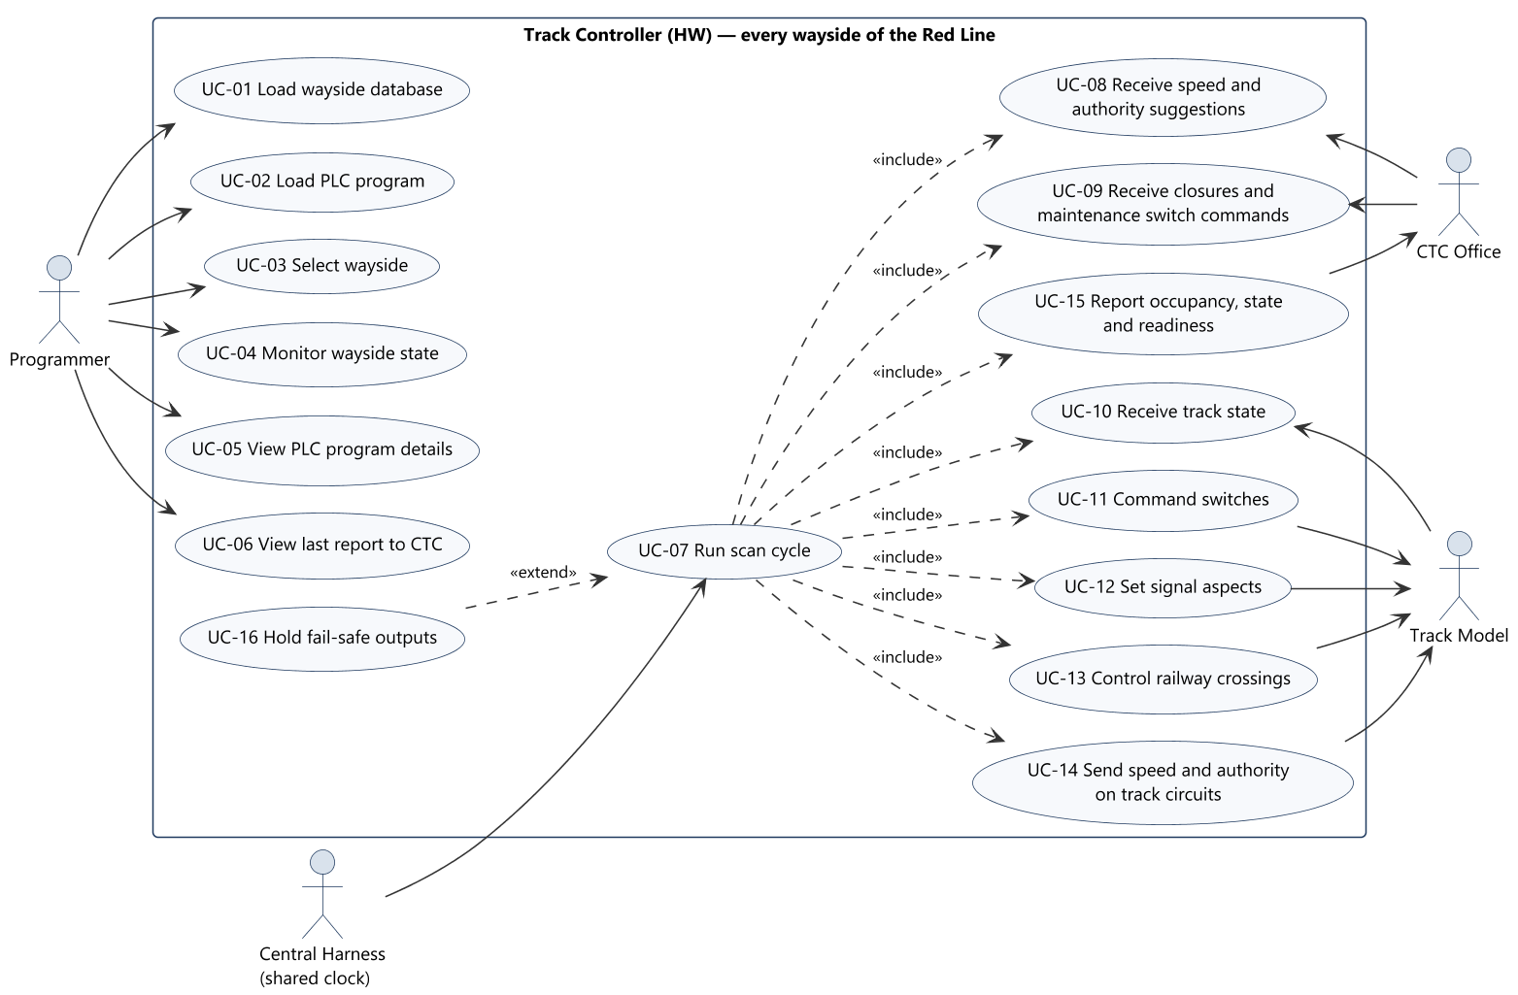
Diagram slide
Template
Optional one-line caption
Track Overflow · Design Review · <your module>
6

