Slide 1
Track Model
Design Review: Railway Simulation
[Your name] | [Group name] | ECE 1140
Notes:
Introduce yourself and the module. The Track Model is the simulated physical track: it holds the layout, places trains on it from the offsets they report, detects occupancy, and gives each train the speed and authority of its block.

Slide 2
What this review covers
1
2
3
4
5
System architecture
Software design
Use cases and UI
Class and interactions
Deployment
Modules, interfaces, route, authority, wayside, timing, vitality
Architecture, boundary types and the interface contract
Who uses the Track Model and for what
Class diagrams, sequence diagrams, block state
How it runs, decisions and open items
The system-wide concepts apply to all five modules; the design from slide 9 on is the Track Model.
Notes:
Roadmap. The system-level material is shared across the group; the software design onward is the Track Model.

Slide 3
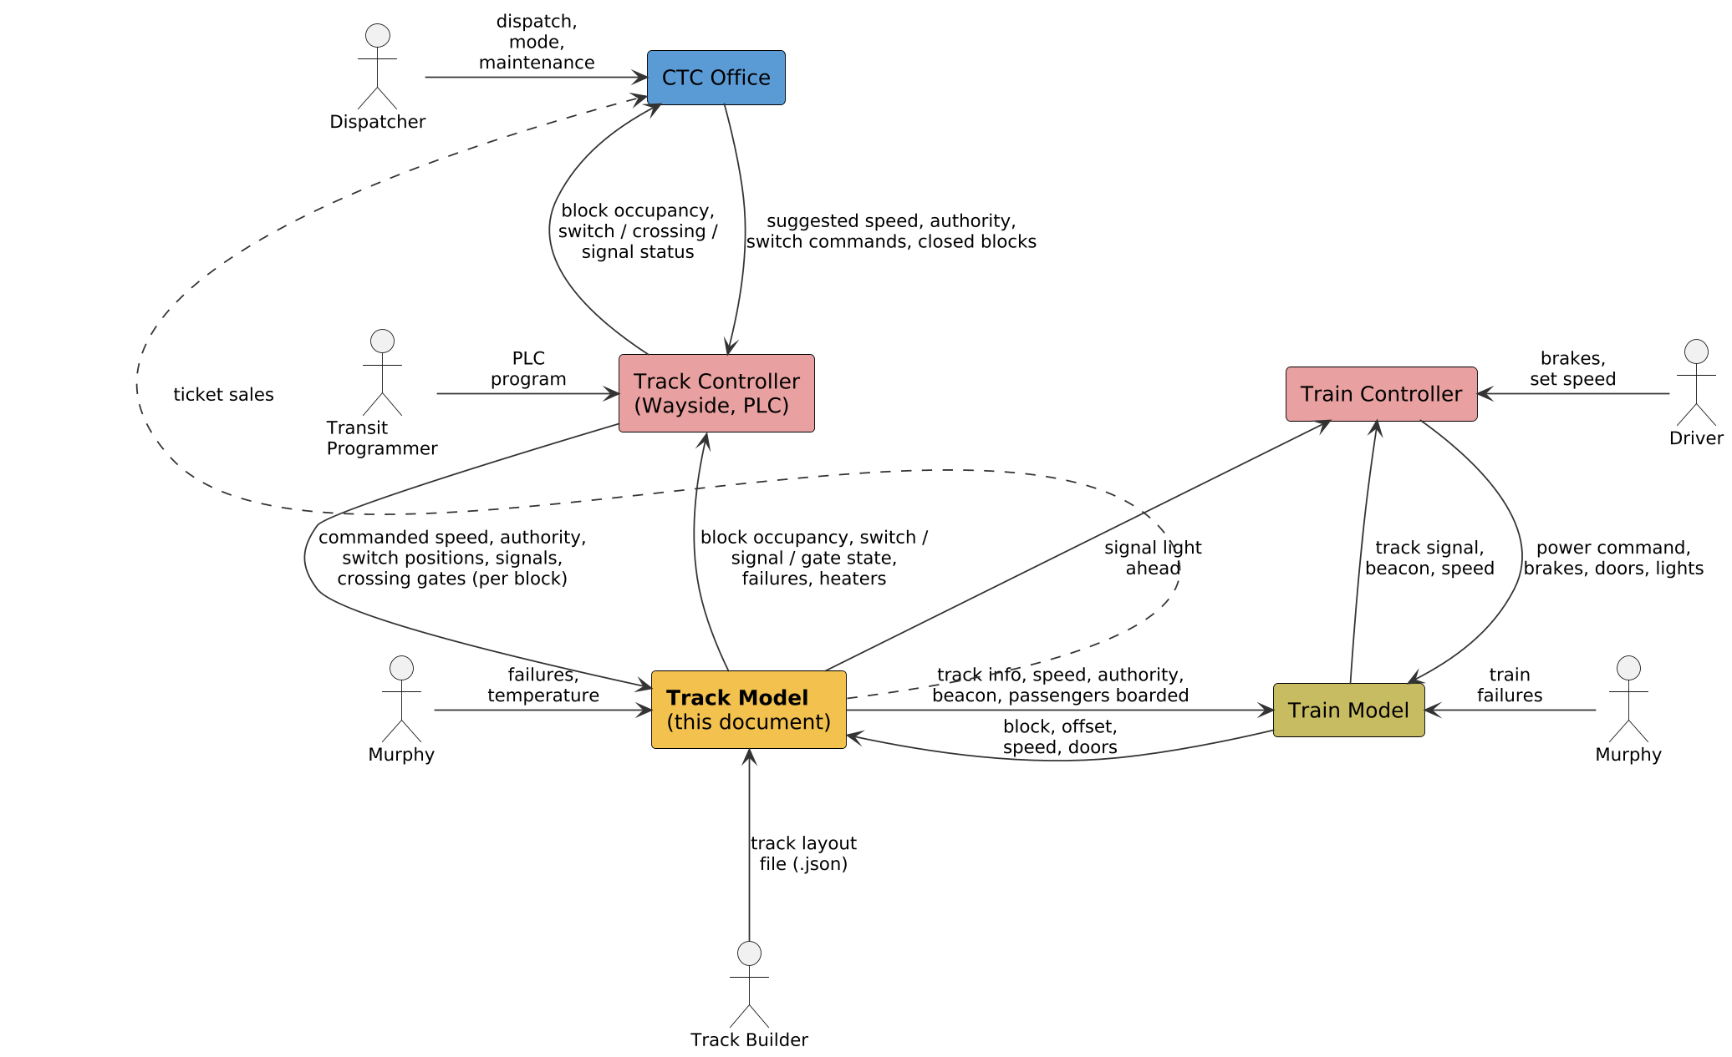
System architecture
Between wayside and train: the Track Model gets commands from the Track controller and feeds the Train model.
Direct to the Train controller: the signal light the train saw on entering a block.
Direct to the CTC office: tickets sold each tick.
Every connection passes through the central harness.
Notes:
Walk the diagram: CTC suggests, wayside validates and controls, Track Model simulates the physical track, Train model and controller run the train. Feedback goes back up the same path. Two links skip a step: signal light to the Train controller, ticket sales to the CTC.

Slide 4
Track Model inputs and outputs
Inputs
Outputs
Track controller: speed (whole m/s) and authority (blocks) per block; switch, signal and crossing commands
Train model: block, offset, speed, doors and capacity for each train
Murphy: failure on a block; ambient temperature
Track Builder: layout file (JSON)
Harness: a tick every 0.1 s
Track controller: occupancy; switch, signal and gate state; failures; heaters; track temperature
Train model: track info, speed and authority of its block, beacon, passengers boarded
Train controller: the signal light seen on entering a block (direct)
CTC office: tickets sold this tick, by station (direct)
Notes:
The full list with types and units is the interface dictionary, Appendix G of the SDD.

Slide 5
Route: who owns what
1
2
3
CTC office
Track controller
Track Model
Owns the route. Releases a train at the yard, sends it station to station, and suggests speed and authority per block.
Sets switches from its PLC program, which knows blocks, not trains. The CTC commands a switch only in maintenance.
Never routes. A train follows the rails as the switches lie. Direction of travel is `next_blocks` in the layout file.
If a switch is set wrong, the train still goes where the track leads, as on a real railway. The CTC computes authority through the switches as they lie.
Notes:
A route is a list of blocks plus the switch positions needed. The Track Model keeps topology and switch state only.

Slide 6
Authority: a count of blocks
1
2
3
4
CTC computes
Wayside passes or withholds
Track Model delivers
Train stops
Along the route; never into an occupied, closed or failed block
The PLC bit AUTH_n: send the count, or send 0 and speed 0
The signal of the block the train is in
The Train controller brakes to stop inside it
Block count (D013)
Per block, not per train
Fail-safe
Blocks ahead of the current one. The current block is not counted. 0 means stop before leaving it.
Like the signal on the rails, a block carries one speed and one authority.
A failed circuit, or a block never commanded, carries speed 0 and authority 0.
Notes:
Authority is the only thing that tells a train where to stop. A train in block 5 that may run through block 8 and stop there has an authority of 3.

Slide 7
Wayside controllers and their language
Distribution
PLC program (Boolean only)
Line | Variant | Runs on | Waysides
Green | Software | Host PC | 6 by default, at least 2
Red | Hardware | One Raspberry Pi | One per database; boundaries to choose
VAR_IN OCC_12 .. OCC_38
VAR_OUT AUTH_12..38 SW_12
AHEAD := OCC_13 OR OCC_14
AUTH_20 := NOT (OCC_19 OR OCC_21)
A wayside owns a contiguous run of blocks, with their switches, signals and crossings.
A line runs only when every wayside on it is ready.
The Track Model keys everything by block, so the split does not touch it.
AND, OR, XOR, NOT. No loops, no numbers, so a scan always ends.
One scan per tick. The two controller variants still use different names (D016 pending).
Notes:
The Track Model never reads PLC text. It only receives the speed and authority, switch, signal and crossing outputs.

Slide 8
Timing and vitality
Timing
Vitality
0.1 s
1x / 10x
1 clock
Fail-safe
Restrict
Occupied
fixed tick (D006)
and pause, set by the CTC
owned by the harness
no program: stop, red, gates down
the vital layer only restricts outputs
a failed block reads occupied
The harness sends dt and the time to every module, waits for every reply, and pauses the clock if one is late. The Track Model steps on the last tick's train reports.
The Track Model is not vital, but it supports the scheme: a failed circuit gives the train speed 0 and authority 0, and an invalid tick is rejected whole.
Notes:
Timing: one clock in the harness, fixed dt of 0.1 s; 10x means 100 ticks per real second. Vitality: the Track controller and Train controller are the vital modules; their channels are non-vital, so they check what they are given.

Slide 9
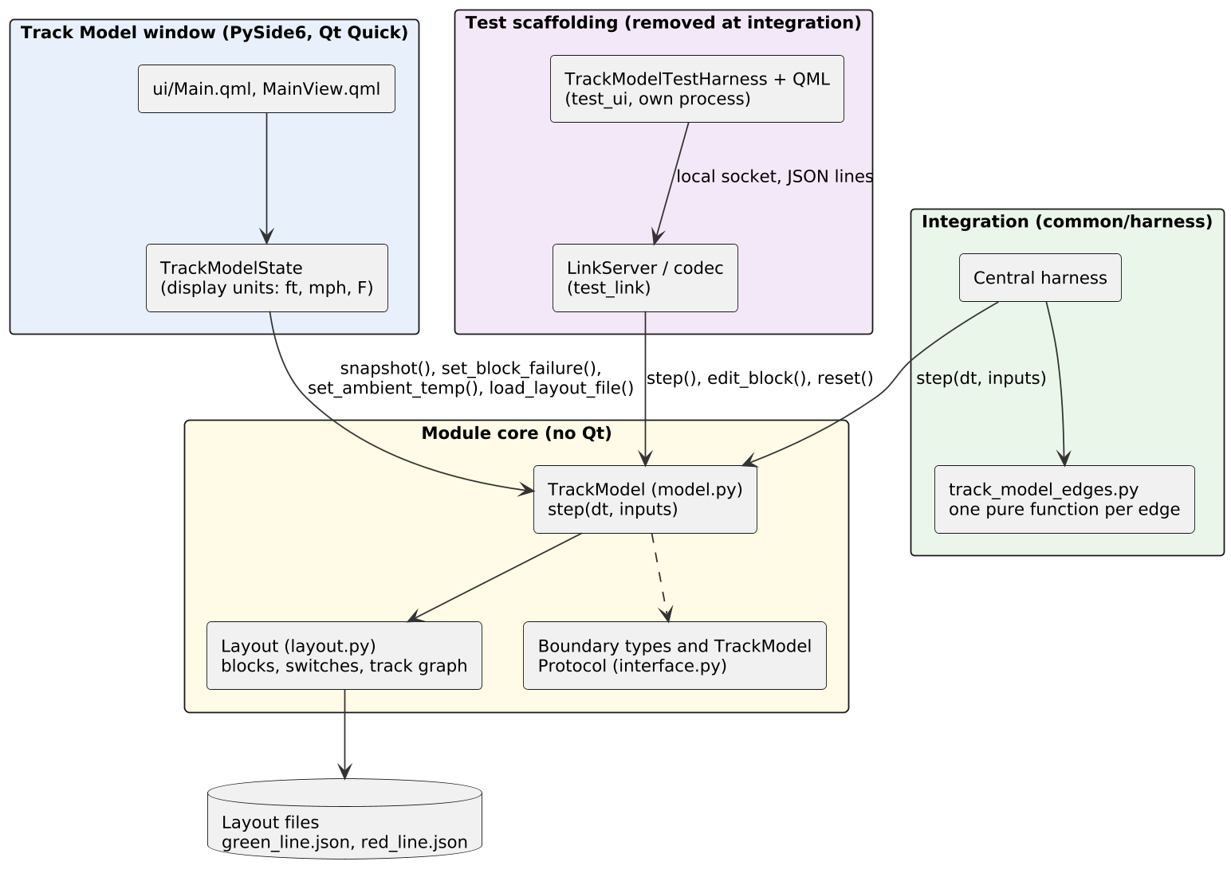
Software architecture
Module core: model.py and layout.py, no Qt code.
Window: Qt Quick, fed by a state object in display units.
Test scaffolding: its own process, removed at integration.
Integration: the harness calls step() through the edge functions.
Notes:
The module core has no Qt code, so it runs headless and is unit tested. The window reads snapshot() and converts to ft, mph and F. The test UI reaches the module only through a local socket.

Slide 10
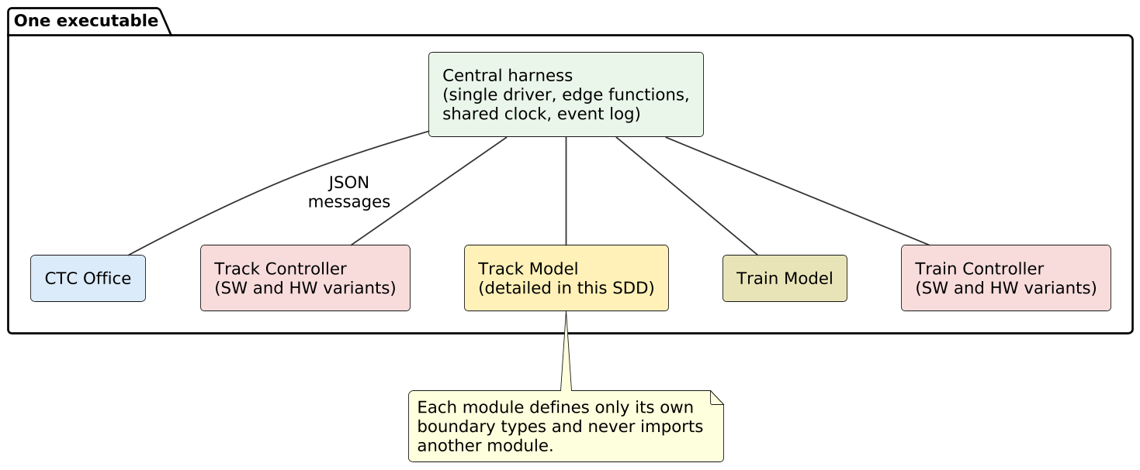
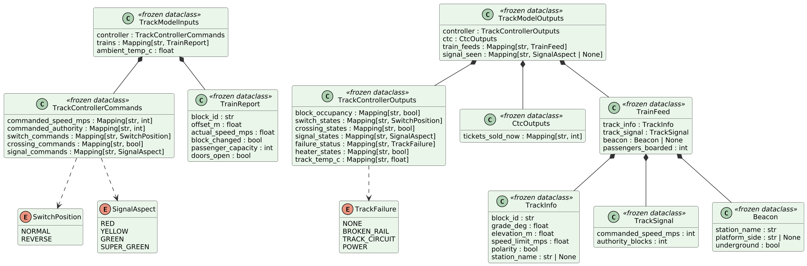
Module composition and boundary types
One executable: the harness starts a process per module and drives each once per tick.
Own types: a module defines only its own boundary types and imports no other module.
Frozen and SI: frozen dataclasses, backend units, string IDs such as GREEN D-13.
Notes:
Each module defines its own boundary types. The harness owns one pure mapping function per edge.

Slide 11
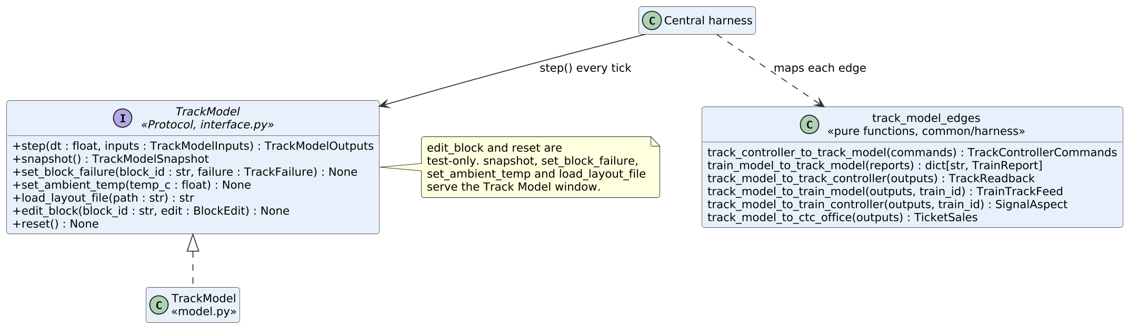
Module interface contract
The whole interface is step(dt, inputs). Other methods serve the window and the test UI. The harness maps each edge with a pure function.
Notes:
The TrackModel Protocol lives in track_model/interface.py. edit_block and reset are test-only.

Slide 12
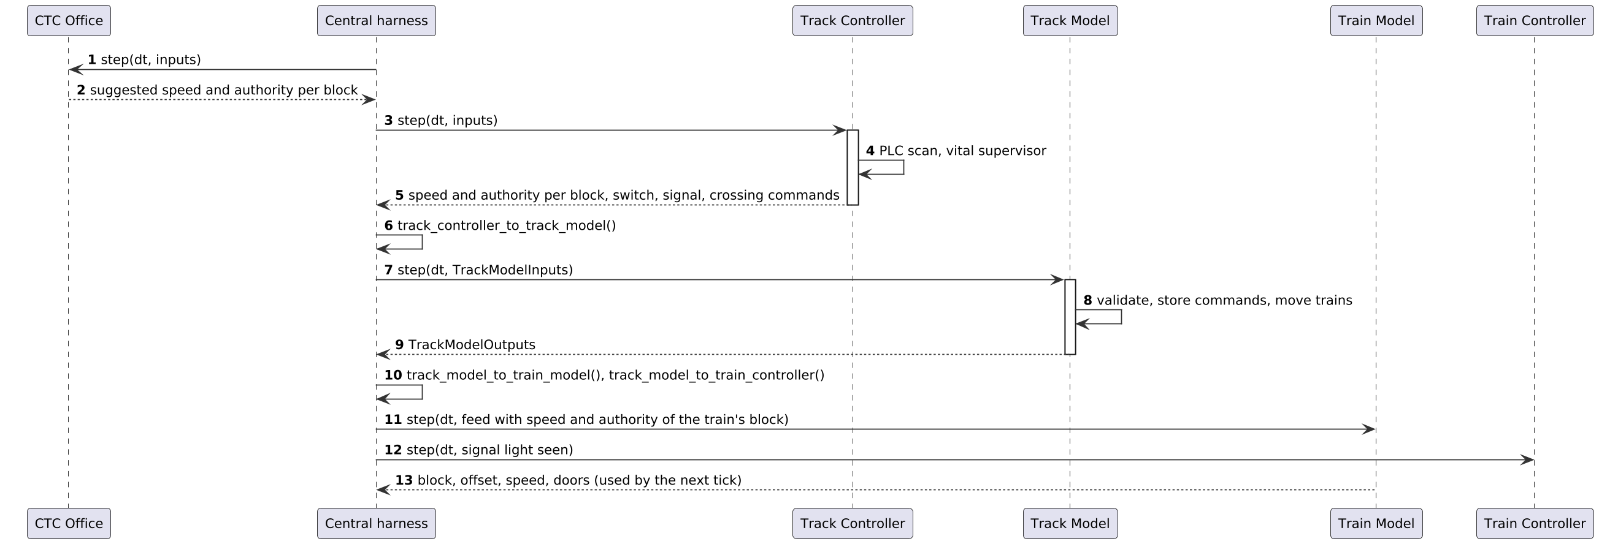
Movement authority request
One tick: CTC suggests, the wayside decides, the Track Model checks the whole tick, stores speed and authority per block, and builds a feed for each train.
Notes:
The harness maps each output to the next module's input with the edge functions. The Train model gets the speed and authority of the block it is in; the Train controller gets the light seen.

Slide 13
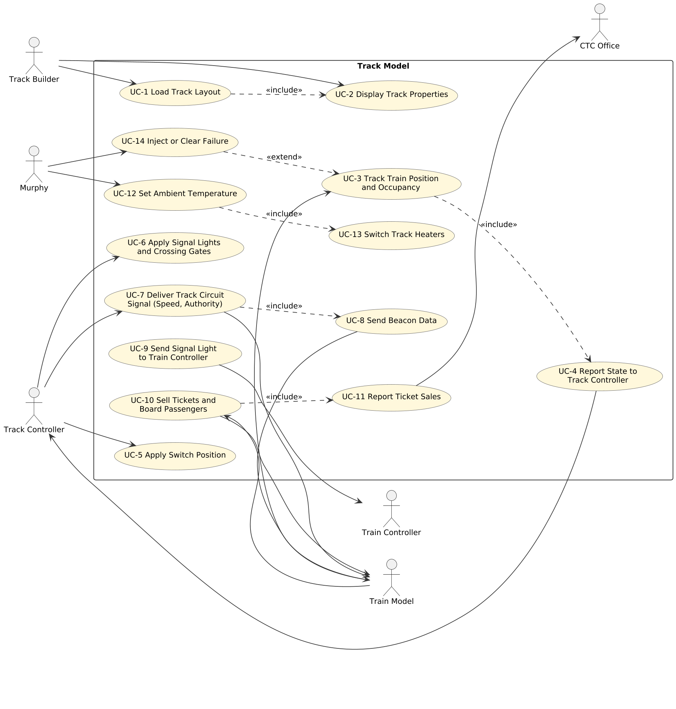
Main use cases
Actors
People: Track Builder, Murphy.
Systems: Track controller, Train model, Train controller, CTC office.
Core flows
Load and display a track layout
Track trains; report occupancy
Apply switches, signals, gates
Deliver speed, authority, beacon
Tickets and boarding
Failures and temperature
Notes:
Fourteen use cases. The descriptions are in the SDD, Appendix B.

Slide 14
User interface (for context)
Header
Running or Paused, elapsed time, ambient temperature (°F), line, filter, Load track...
Block table
Selected block
Block, direction, length, grade, limit, Cmd mph, Auth, station, beacon, heater, occupied, signal, failure.
All properties of the block, and Murphy's failure selector.
Switches and signals
Sections
Trains and stations
Position and aspect.
Heater and track temperature.
Block, offset, speed; waiting passengers.
Notes:
Shown for context only. The window is Qt Quick (PySide6) and shows imperial units. A separate test UI process stands in for the other modules until integration.

Slide 15
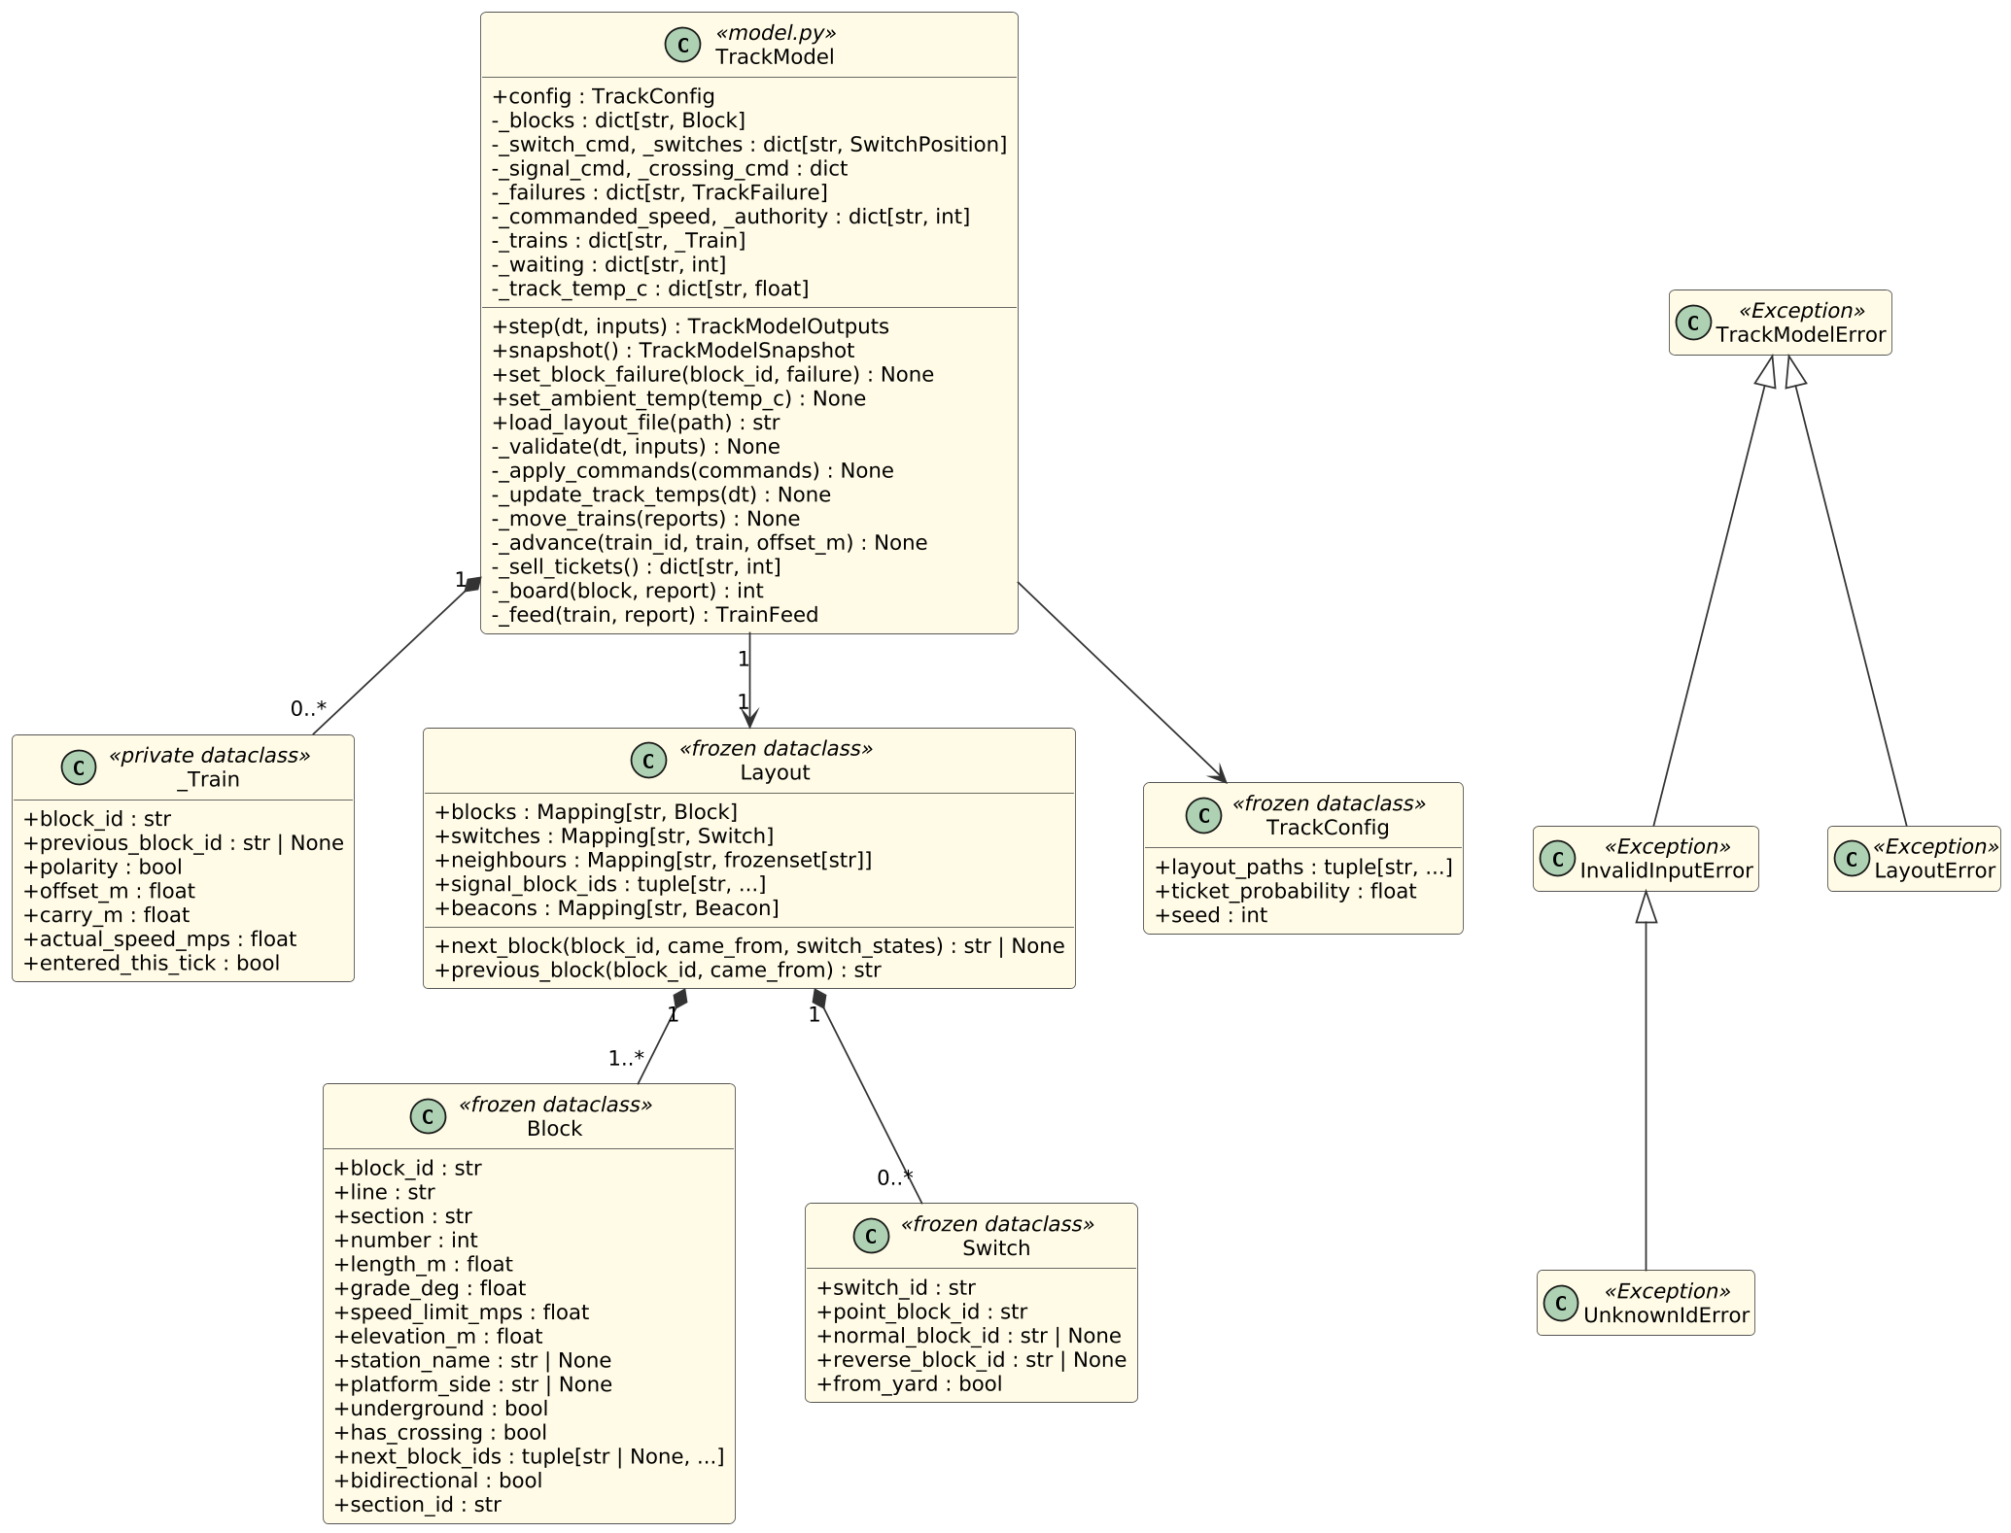
Class diagram: module core
TrackModel holds the state and runs step(): validate, commands, temperatures, trains, tickets, outputs.
Layout is the track graph; next_block follows the switches.
Block, Switch are frozen records from the layout file.
Errors: a tick is rejected whole.
Notes:
Layout.next_block answers where the train goes next, following the switches as set. The private _Train keeps the offset carry.

Slide 16
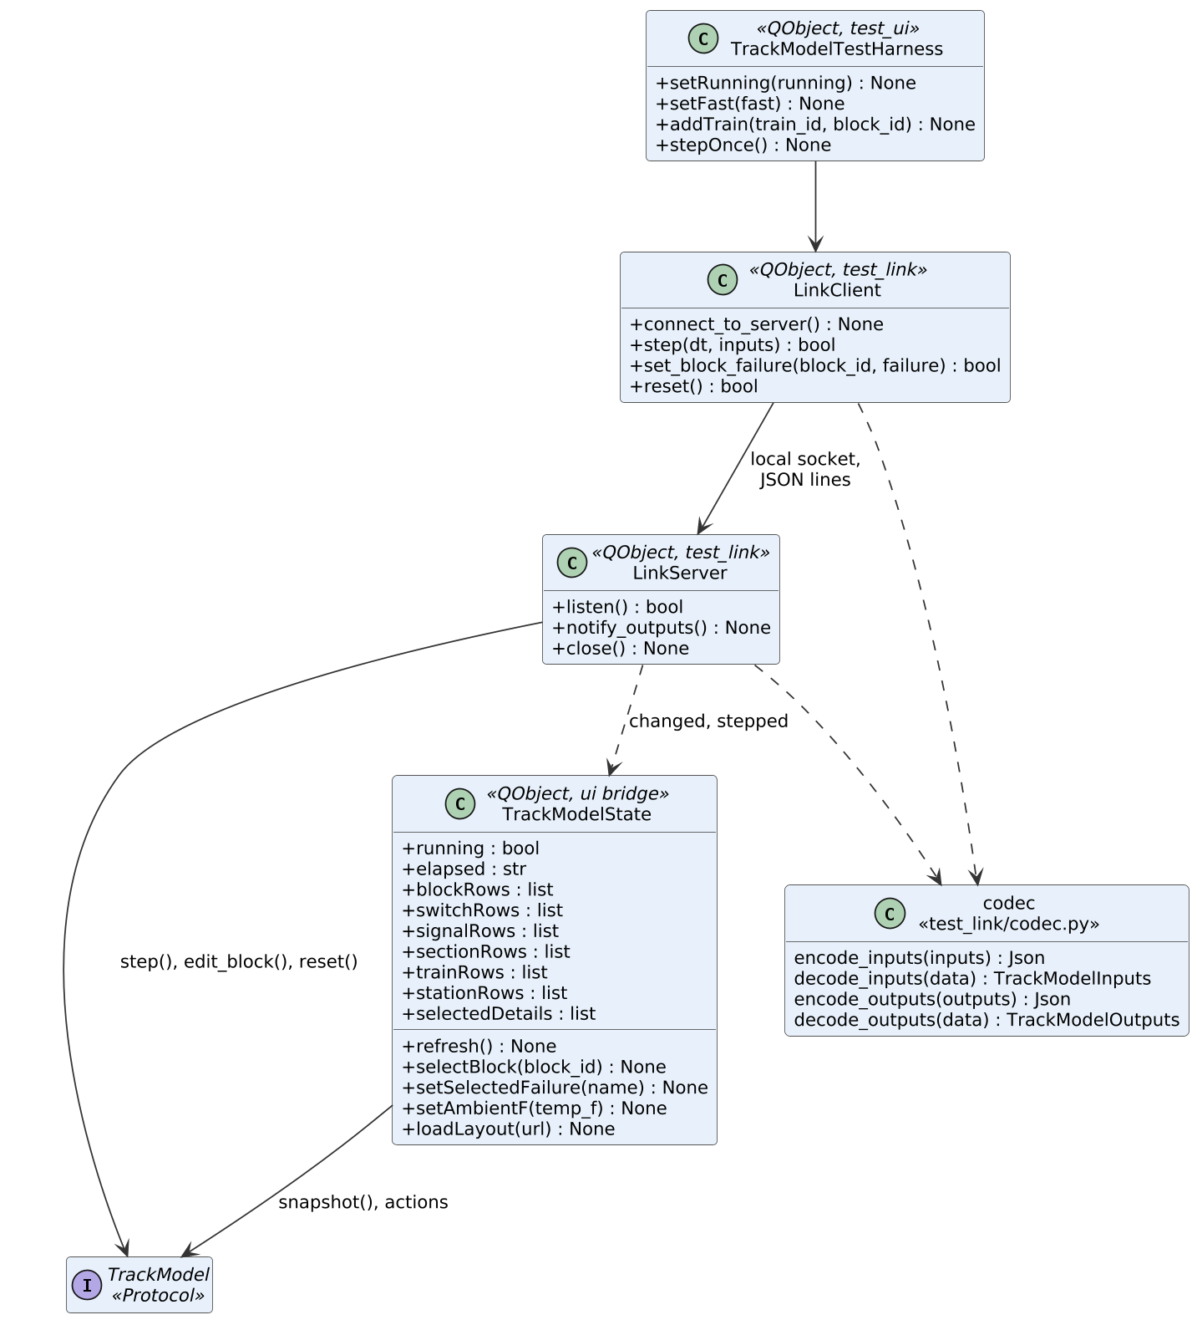
Class diagram: window and test link
TrackModelState is the only object the QML talks to; it converts to display units.
LinkServer, LinkClient: a local socket carrying JSON lines.
Test harness: stands in for the other modules and is removed at integration.
Notes:
The window never decides anything; it reads snapshot() and calls Murphy's failure, temperature and load actions.

Slide 17
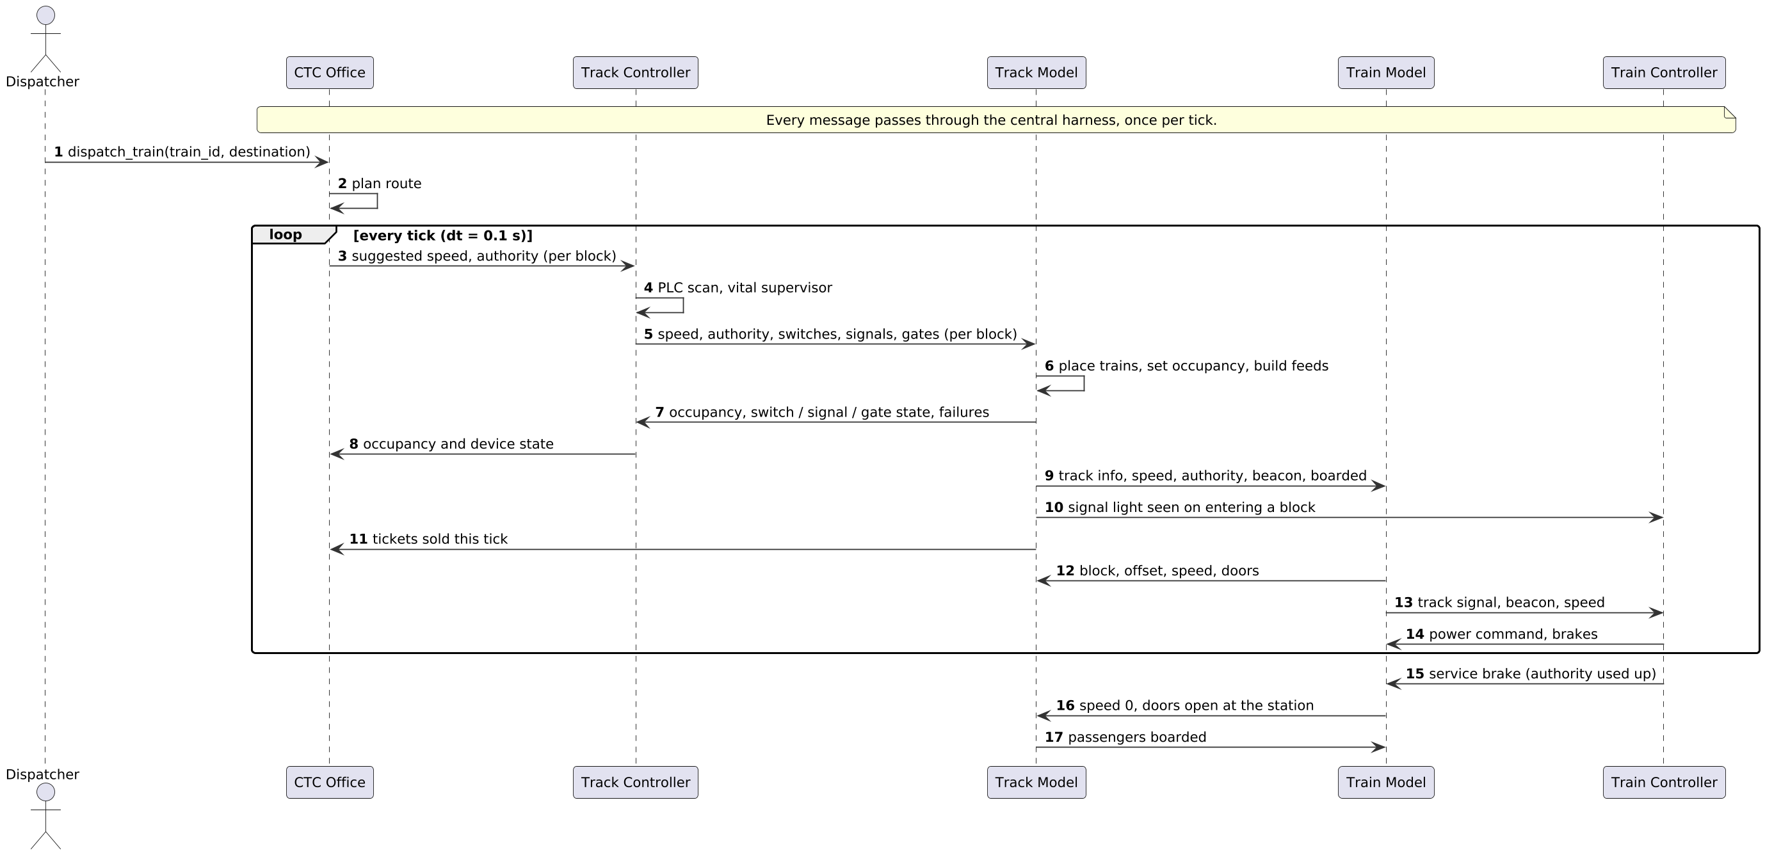
Sequence: dispatch a train
Per tick: commands down, state up.
Direct: light seen to the Train controller, tickets to the CTC.
Arrival: stop with doors open, boarding.
Notes:
The system-level use case. Every message passes through the central harness, once per tick.

Slide 18
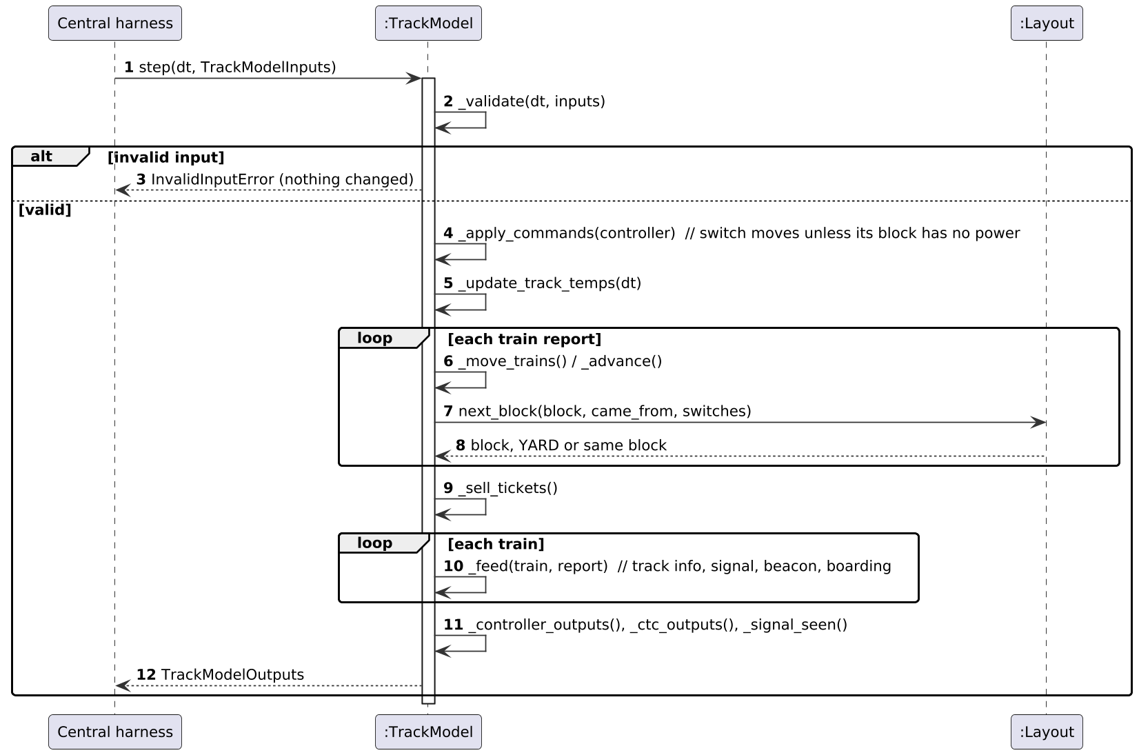
Sequence: one tick in the Track Model
Validate first: a bad tick changes nothing.
Switches move unless their block has lost power.
Trains move across blocks through Layout.
Outputs: read-back, tickets, feeds, signal seen.
Notes:
This is step(): validate, apply commands, update temperatures, move trains, sell tickets, build feeds and outputs.

Slide 19
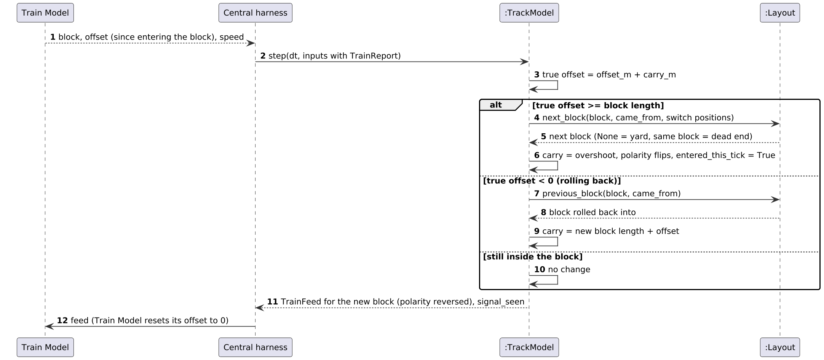
Sequence: a train crosses a block
The Train Model restarts its offset at 0 in each block. The Track Model keeps the overshoot (the carry), so position stays exact, forward or rolling back.
Notes:
True offset is reported offset plus carry. Past the block length the train moves to Layout.next_block; below zero it rolls back.

Slide 20
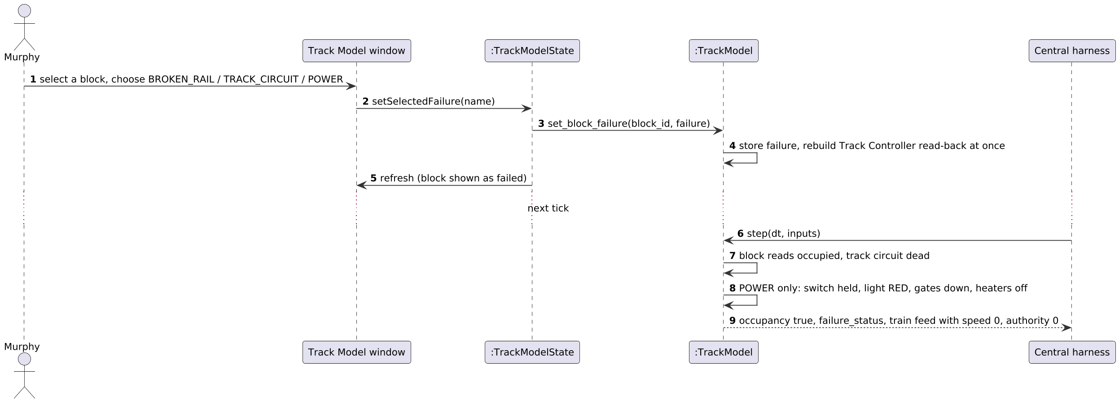
Sequence: Murphy injects a failure
Every failure reads occupied and cuts the track circuit: the train gets speed 0 and authority 0. A power failure also holds the switch, shows red and drops the gates.
Notes:
The Track controller sees the failure at once, between ticks, because the read-back is rebuilt when Murphy injects it.

Slide 21
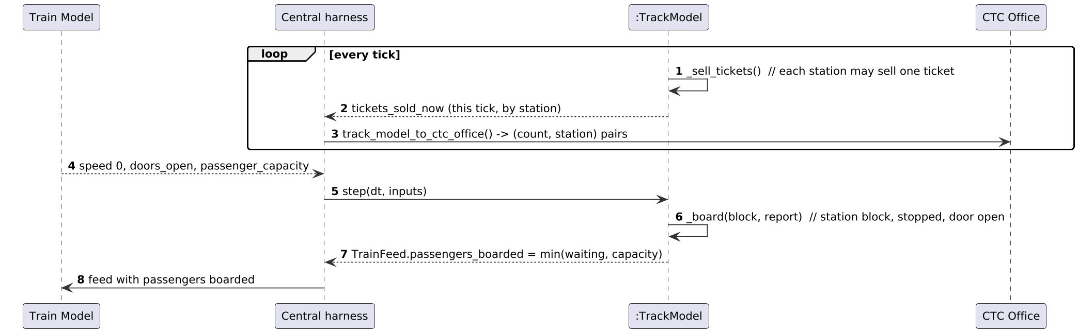
Sequence: tickets and boarding
Tickets: Each station may sell one per tick; sales go to the CTC as events.
Boarding: Only when stopped in a station block with a door open.
No total: The Track Model keeps no running total.
Notes:
Boarding takes min(waiting, capacity) and is returned in the train feed.

Slide 22
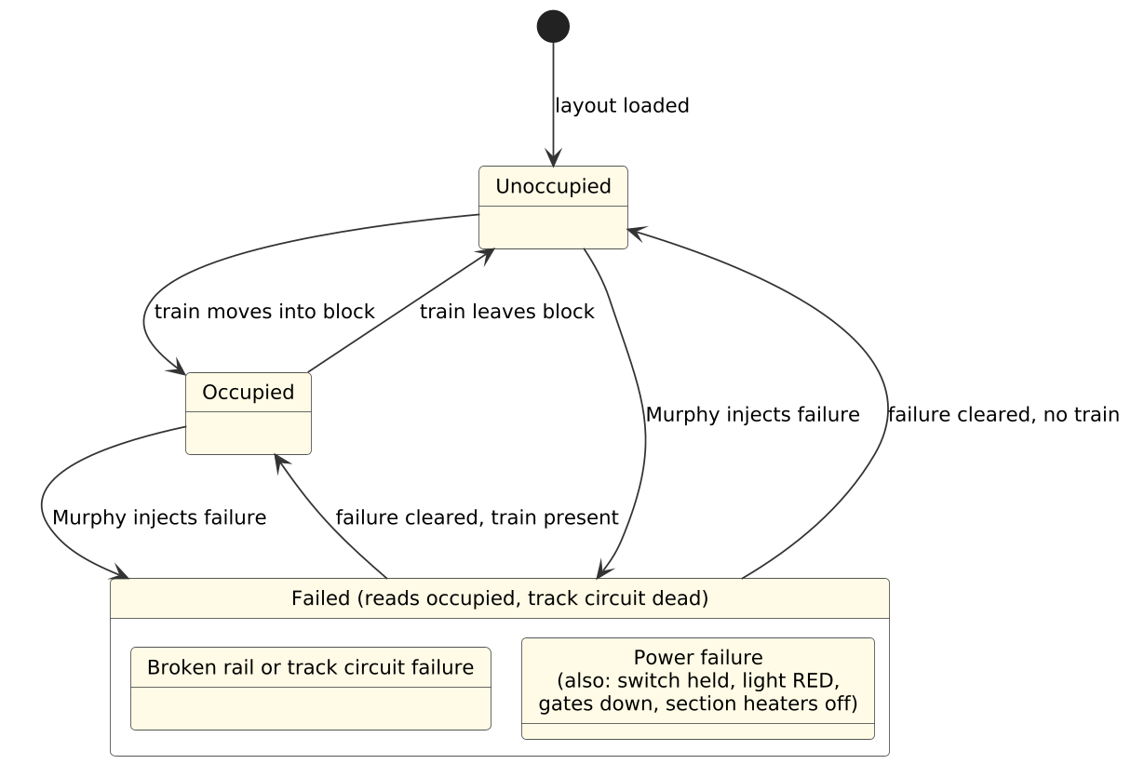
Block state machine
Unoccupied / Occupied follow the train.
Failed overrides both and reads occupied.
Cleared returns by train presence.
Notes:
Optional diagram; shows the three block states and how a failure overrides occupancy.

Slide 23
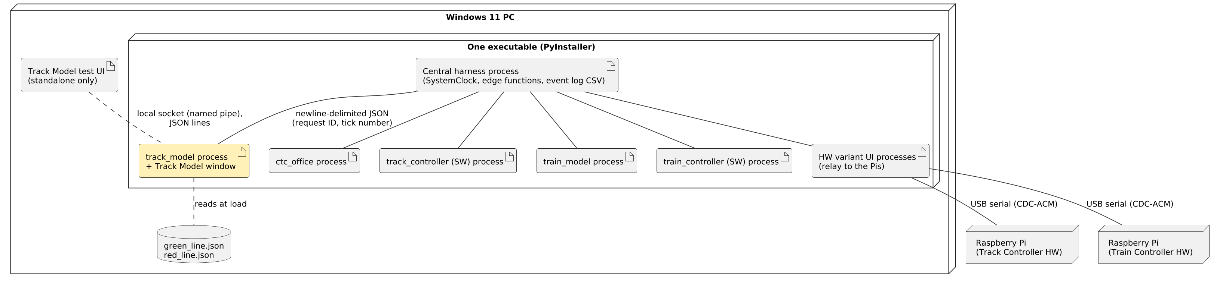
Deployment
Windows 11 PC: One executable. The harness starts a process per module.
Newline JSON: Messages carry a request ID and the tick number.
Raspberry Pis: Hardware variants over USB serial; their windows run on the PC.
Notes:
The Track Model has no hardware variant. Its test UI exists only when the module runs alone.

Slide 24
Decisions and open items
Decisions on record
Still open
D005: central harness, pure edge functions
D002, D013: SI units, authority in blocks
D006, D017: fixed 0.1 s tick, one shared clock
D023: Blue Line out of scope
D026: Track Model switches the heaters
Heater switching rule (D026)
Signal light seen: agree with the Train controller
Platform side LR: the Train model accepts L or R
Disembarking is not an input yet
Is the track signal cleared after delivery?
Notes:
Heaters: D026 says the Track Model switches them, but the code and test UI still take heater commands.

Slide 25
What I learned from colleagues
From CTC office
From Track controller
From Train model and controller
[Fill in during the review: one thing you learned and what changes in your design.]
[Fill in during the review: one thing you learned and what changes in your design.]
[Fill in during the review: one thing you learned and what changes in your design.]
Notes:
The rubric gives 10 points for what you learned from colleagues. Fill these in after the other teams present.

Slide 26
Next: integration and questions
1
Integrate
2
Heaters
Run through the harness; the test UI is removed
Switch them in the Track Model per D026
3
Agree interfaces
4
Dispatch a train
Signal light seen, platform side, disembarking
Yard to a station for Iteration 3
Questions?
Notes:
Iteration 3 is the system demonstration: dispatch a train from the yard to a station with all modules communicating.

