Slide 1
Avionics Bay CoDR
sunbeam
CU Sounding Rocket Laboratory – 1/27/2026 – Rowan Eklund
For internal use only

Slide 2

Agenda
Requirements
Avionics Bay Architecture – High Level Overview
Subcomponent Design Decisions
Recovery System
For internal use only

Slide 3
Requirements
For internal use only

Slide 4
SUNBEAM AVIONICS (REMINDER)
ID | Description
Program Requirements
AVP.1 | Avionics shall have a Critical Design Review
Technical Requirements
AVT.1 | Flight computers shall be no less than dual redundant in triggering deployment of recovery system
AVT.2 | Flight computers shall record at least GPS location (2x redundant), acceleration (2x redundant), barometric pressure (2x redundant), attitude (2x redundant), and temperature of key components
AVT.3 | All flight computers controlling pyros (in-the-loop) shall be tested actuating the deployment apparatus at least 3 times without failure
AVT.4 | Flight computers shall be powered and armed for flight with a system rated to no less than 1.5x peak expected acceleration of the vehicle
AVT.5 | Flight computers shall have auditory power-on confirmation that is sufficiently individually distinguishable
AVT.6 | Flight computers shall have an approved deployment flowchart
AVT.7 | Avionics electronics shall be sized for a minimum of 1.5 hours of runtime in direct sunlight at 85 degrees F (with margin, should be at least 3 hours)
AVT.8 | Avionics batteries shall have total discharge protection
For internal use only

Slide 5
SUNBEAM AV BAY STRUCTURE
ID | Descriptions
Program Requirements
ABSP.1 | Launch, seperation, and landing environments shall be characterized
ABSP.2 | Analysis shall be preformed on all critical structures to prove survivability
Technical Requirements
ABST.1 | PCB's shall mount only to the outter face of the sleds
ABST.2 | Sled assemblies, including pcbs, shall share no physical contact with one another other than mounting locations
ABST.3 | Bulkhead shall support mounting features for the retaining ring, sleds, eye-bolts, and connector pcb, and recovery system
ABST.4 | Bulkhead shall be capable of maintaining pressure in recovery bay through deployement
ABST.5 | Retaining ring and pins shall support entire mass of avionics bay and recovery system through all environments
ABST.6 | All fasteners shall survive expected environments
ABST.7 | The bottom connector board shall serve as the sole designated pass-through for wiring harnesses
Good Textbooks and Sources Found Here
For internal use only

Slide 6
SUNBEAM RECOVERY
ID | Description
Program Requirements
RP.1 | Recovery shall have a Critical Design Review
Technical Requirements
RT.1 | Recovery system shall be fit checked with vehicle in full flight configuration including all hardware pertaining to the volume it takes up
RT.2 | Vehicle descent rate at touchdown shall be no higher than 40 m/s (Mamba III touchdown velocity)
RT.3 | Deployment system shall be effective in vacuum
RT.4 | Parachute lines shall be packed in such a manner as to not tangle upon release
RT.5 | Parachute shall be packed in such a manner as to not tangle with lines upon release
RT.6 | Parachute lines shall be sized to prevent vehicle component-on-component contact during descent
For internal use only

Slide 7
Av Bay Architecture
For internal use only

Slide 8
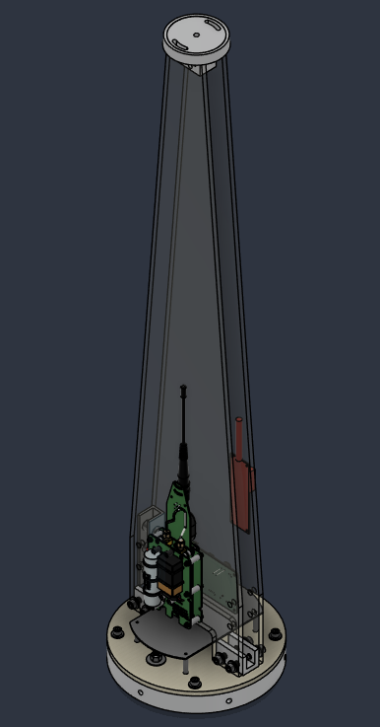
Av Bay Architecture
Retaining ring
  Al 6061-T6xx
  Pin sizing TBD based on B.C./loads
Bulkhead
  G10 Fiberglass
  Need to seal passthroughs
Sleds
  G10 Fiberglass
  Base is fixed to bulkhead w/ Al 6061-T6xx block
  Top is constrained using a metal “plug” surrounded by rubber
    Isolate sleds from NC vibe/loads
Switch Mount
  Material TBD (Low dialectic 3D printed)
For internal use only

Slide 9
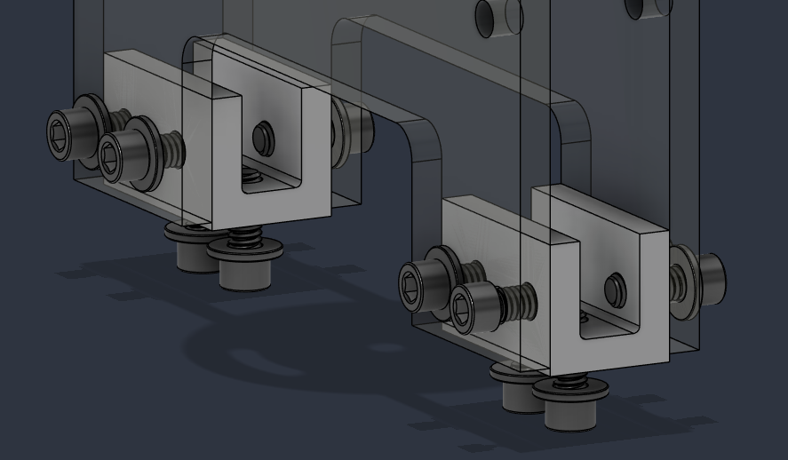
Sled Mounts
Machined 6061-T6xx Al
Steel helical inserts
  Ease of assembly
  2 joint path attenuates 30% of pyro shock per joint
Geometry of this mount also attenuates part of this shock
Sleds have feet to allow a passthrough board to be mounted to meet requirement ABST.7
For internal use only

Slide 10
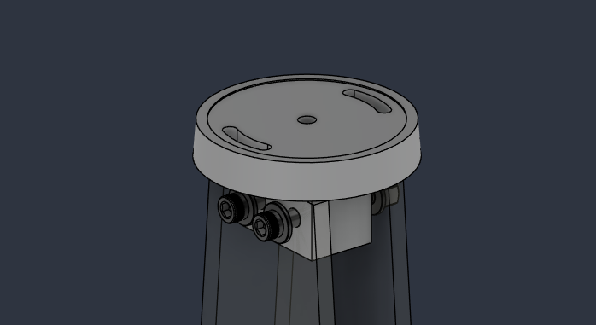
Top Retainer
Machined 6061-T6xx Al
Rubber strip surrounding metal retainer
  Nominal compression between 10% to 15%
  Acts as a vibration damper to decouple sleds from NC
Goal is to constrain sleds and increase assembly stiffness
For internal use only

Slide 11
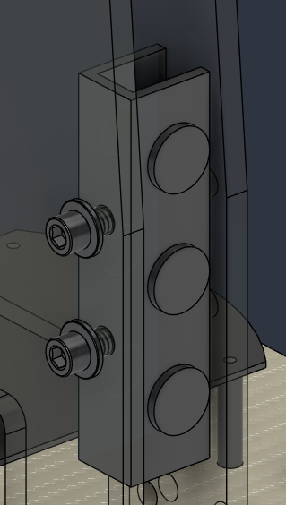
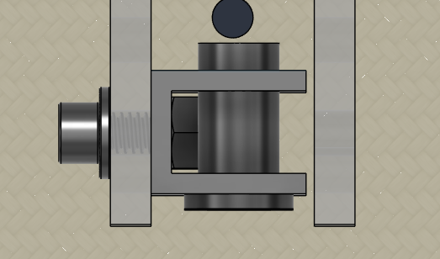
Switch Mount
Ideally 3D printed material
Only constrained to one sled
Switch mounts
  Two steel bolts + locknut
  Nut on threaded portion of switch constrain it to the mount
Possible testing on material?
  If someone has material recommendations, please let me know
For internal use only

Slide 12
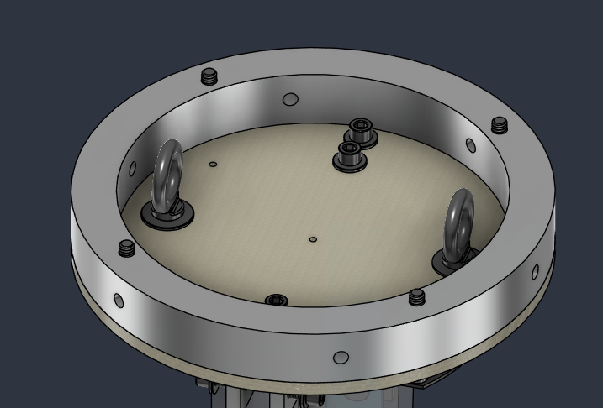
Bulkhead
Two eyebolts (TBD)
  Give space for separation mechanism
  Distributes chute load to stiffer section of the bulkhead (closer to retaining ring)
    This is probably of minimal concern, but will give us higher margines
For internal use only

Slide 13
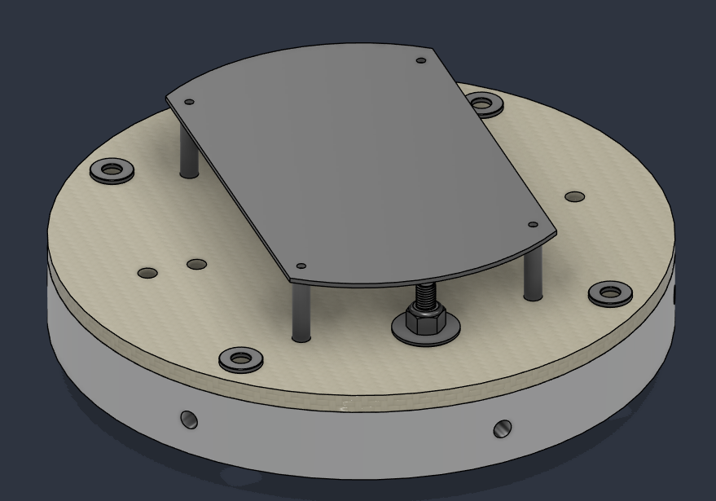
Passthrough Board
Purpose of ABST.7 is to keep harnessing to their respective side of the sled
  Avoids complicated harness paths as well as sharp bend radii
  Sleds can be fully decoupled
Failure modes
  Bending – will confirm with calcs to ensure during all events, this board does not exceed deflection allowable (TBD)
  Shock – pyro shock travels directly through the bulkhead into this board. We want to attenuate this using elastomer isolators (TBD w/ Josh?)
For internal use only

Slide 14
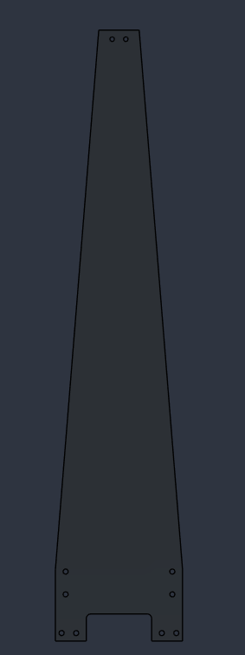
G10 Sleds
Length TBD
Will include all mounting features for PCB’s, batteries, and additional components (Camera, switches, etc.)
Failure concern:
  Low stiffness and therefore natural frequency will lead to large grms accelerations on PCBs.
    If this is an issue, the idea is to add stiffening ribs on the inside faces. This takes up space and makes assembly and integration harder but may be needed.
  Feet strength
    On landing these may see huge loads, is there good reason for concern here? Will run analysis before CDR unless team believes design pivot is needed
For internal use only

Slide 15
Recovery System
For internal use only

Slide 16
Recovery – Sizing Math
Sized to fill the av bay with required pressure to break shear pins
Assume Av Bay is empty cylinder
  Height is 14” from bulkhead to bulkhead
  ID is 8”
  Volume is 704 in³
Will use CEA to estimate sizing for:
  BP
  Pyrodex
  Smokeless
For internal use only

Slide 17
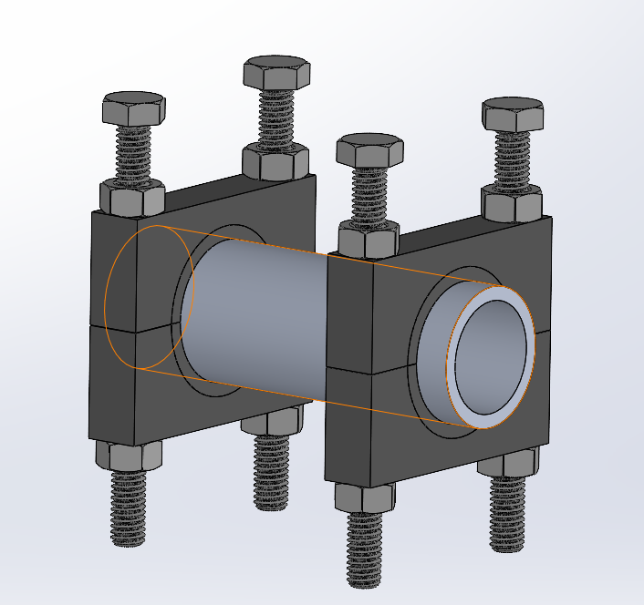
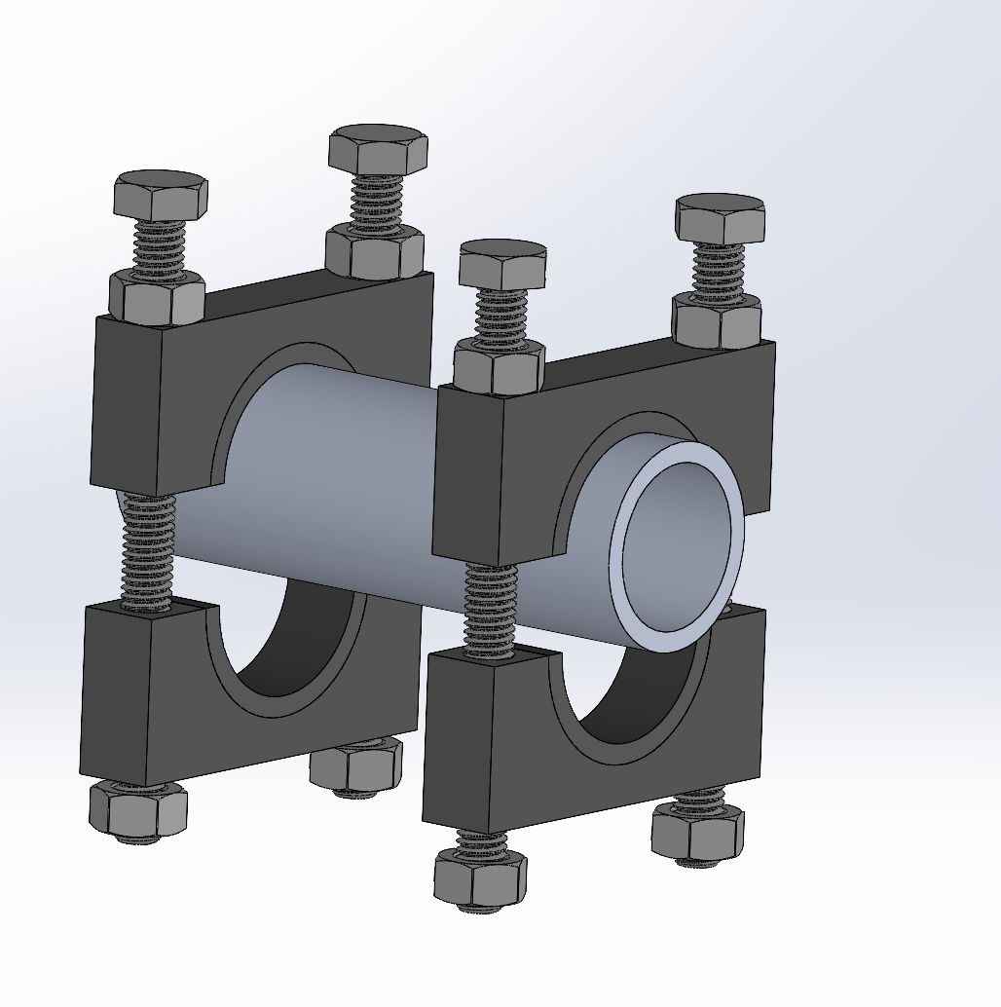
Recovery - Design Overview
  2 charges, and each has 3 ematches (for FC redundancy)
  3D printed mounts
For internal use only

Slide 18
PDR (Preliminary Design Review)
Goal is to get feedback on concept of operations and general construction of your project (this is the main goal – spend 70%+ time on it!)
Analysis should be done or major decision-driving features, but should not be final or done on all components
Concept of operations (con-ops) is almost always where the rest of design comes from, make sure you have this right!!!!! If you don’t correctly articulate con-ops and someone doesn’t like it, this can lead to late-stage changes further down the line
General layout
Requirements
Con-Ops
Design Overview
Driving Calcs
Test/Completion Plan
Feedback is the goal here, streamline how each slide contributes to your narrative
Someone should be taking notes on action items for you, make sure you designate that person!
For internal use only

