Slide 1


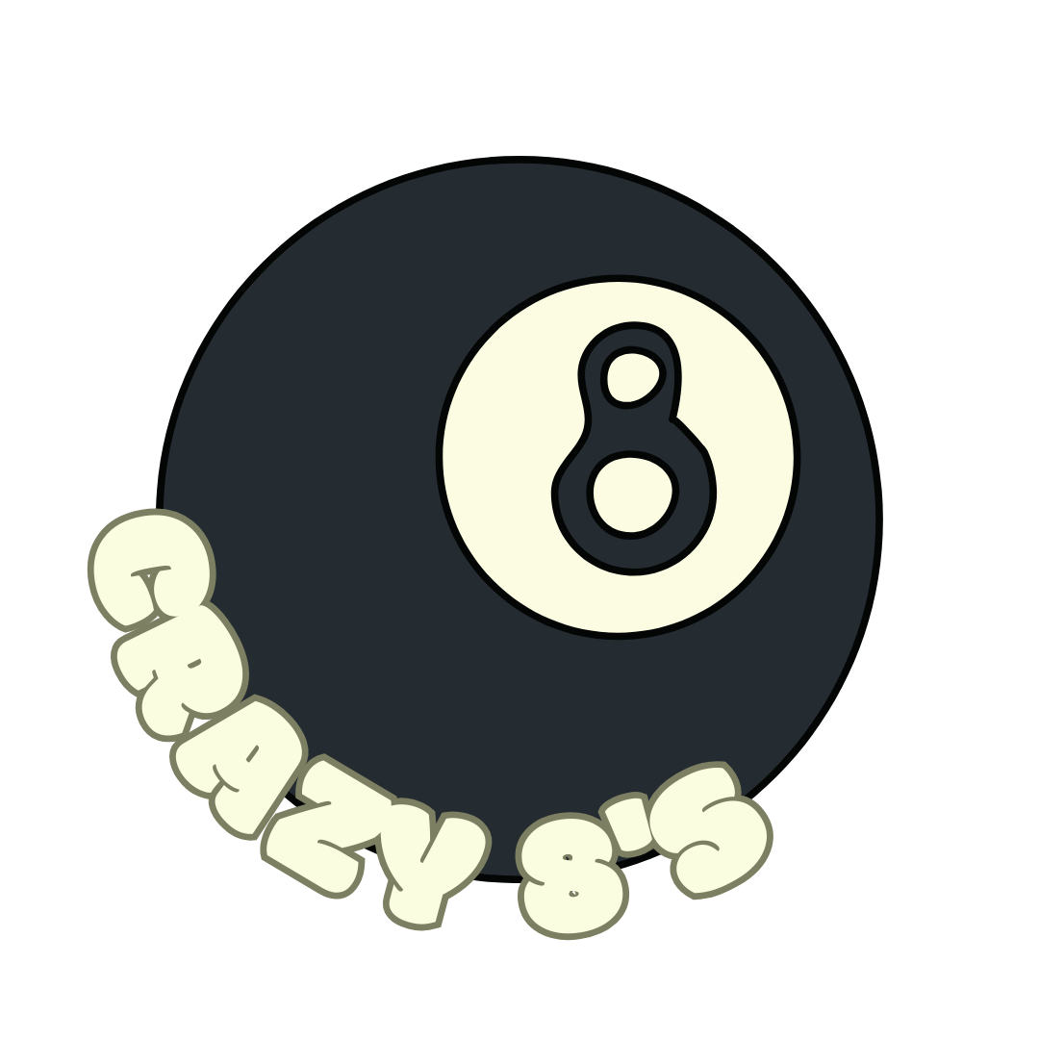

Crazy 8’s
Preliminary Design Review
Team Members:
Jackson Billings, Josiah Ebuen, Chloe Ganry, Landon Holligan, Aja Kimsey, Roderick Mohar, Ben Rogers, Luke Walter
Date:
3/11/24

Slide 2

Mission Overview
Our objective is to design, model, test, and manufacture a balloon satellite with an extendable boom arm that is capable of withstanding stratospheric conditions.
The main purpose of this mission is to test how the craft interacts with the environment in the different stages of flight. We are also expecting to create an image with a 360-degree view of the environment around our craft. Doing so will allow maximal observation of the space around the craft.
2

Slide 3
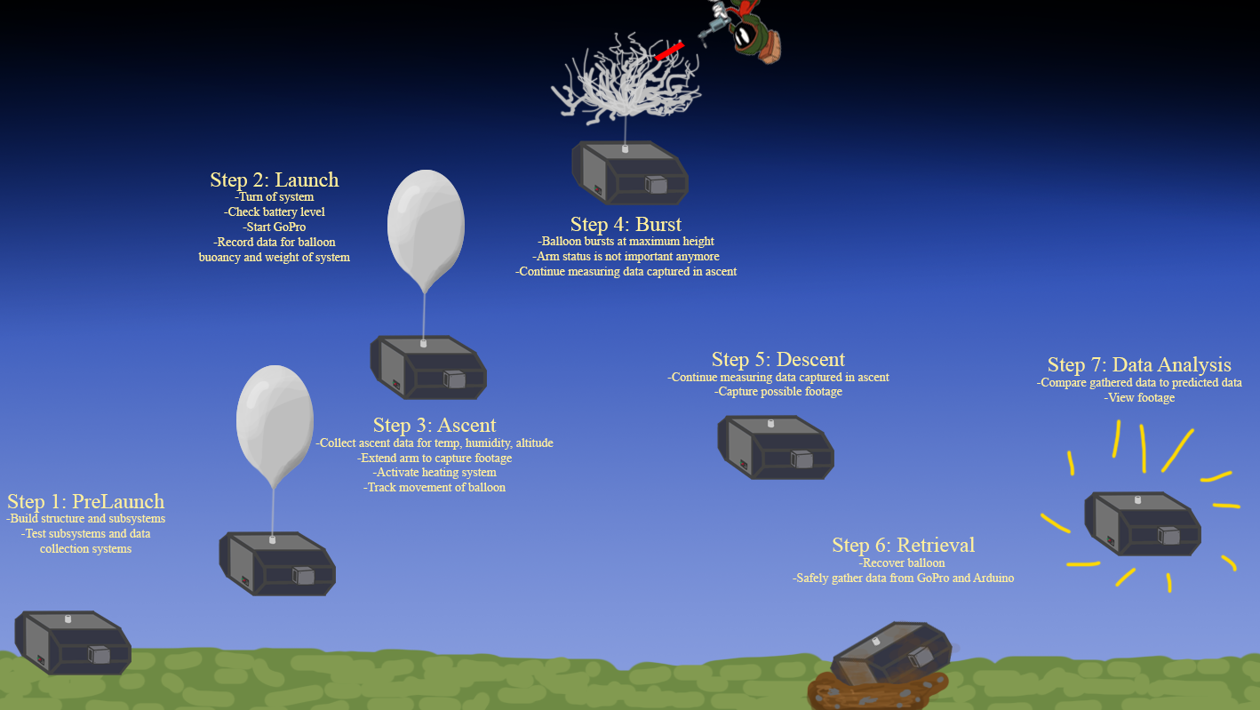
3

Slide 4
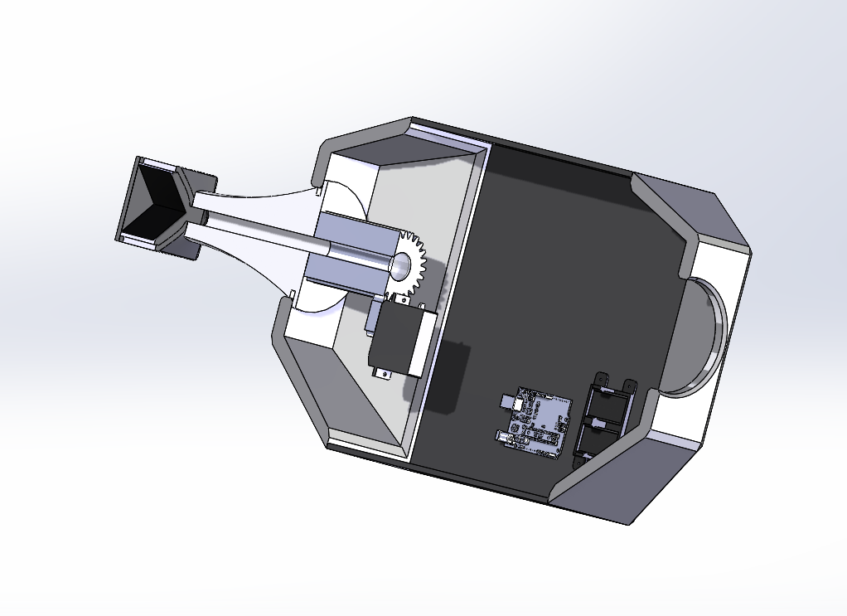
Design: Drawings/Models(Overall)
4

Slide 5
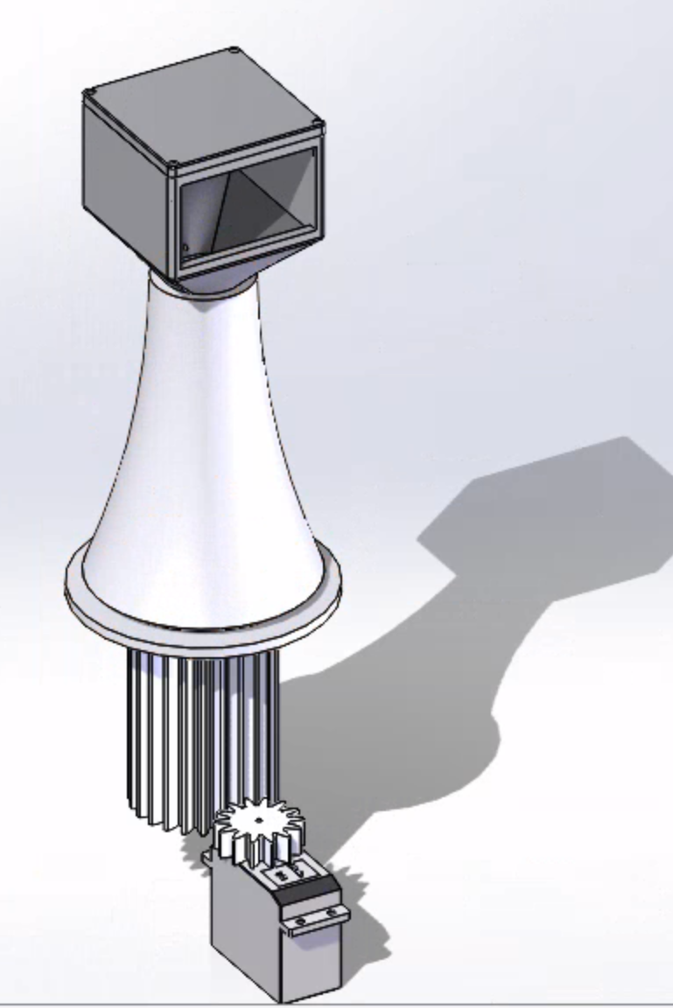
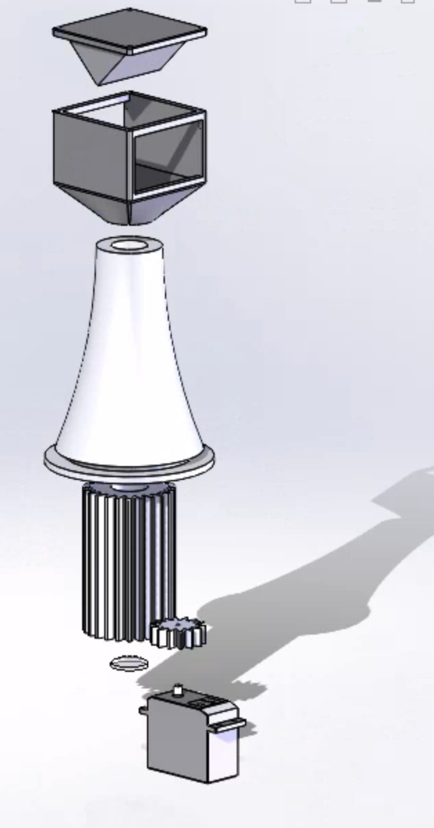
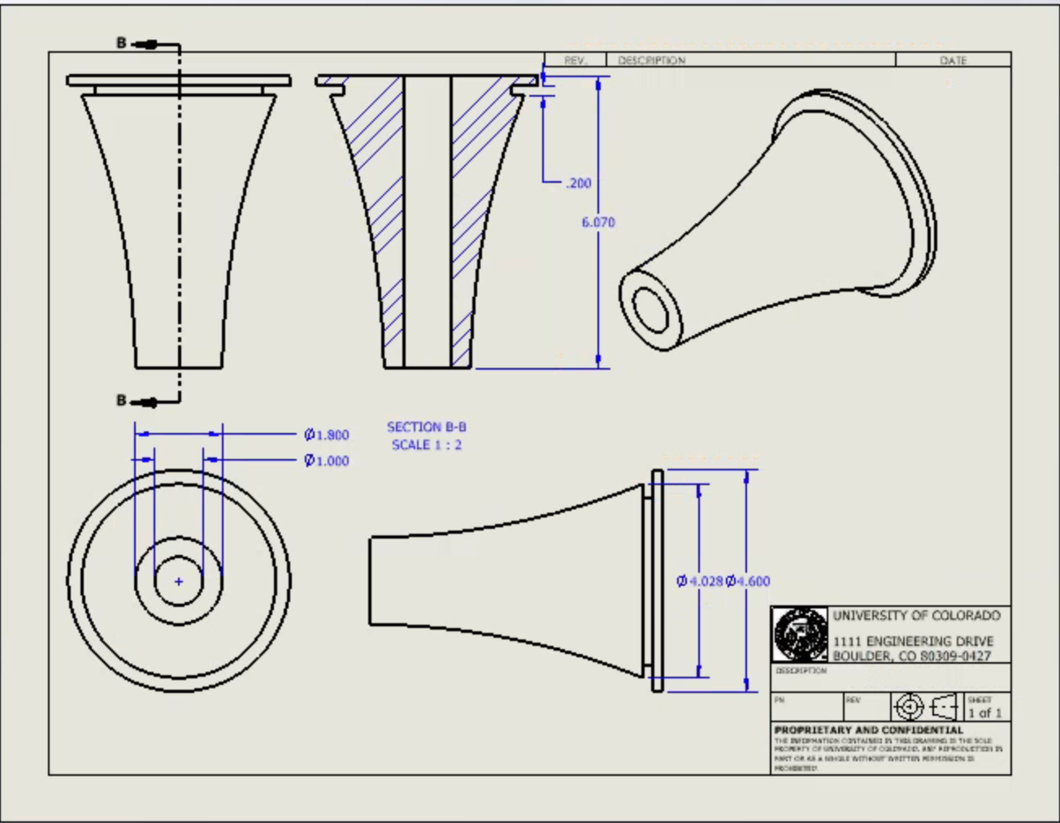
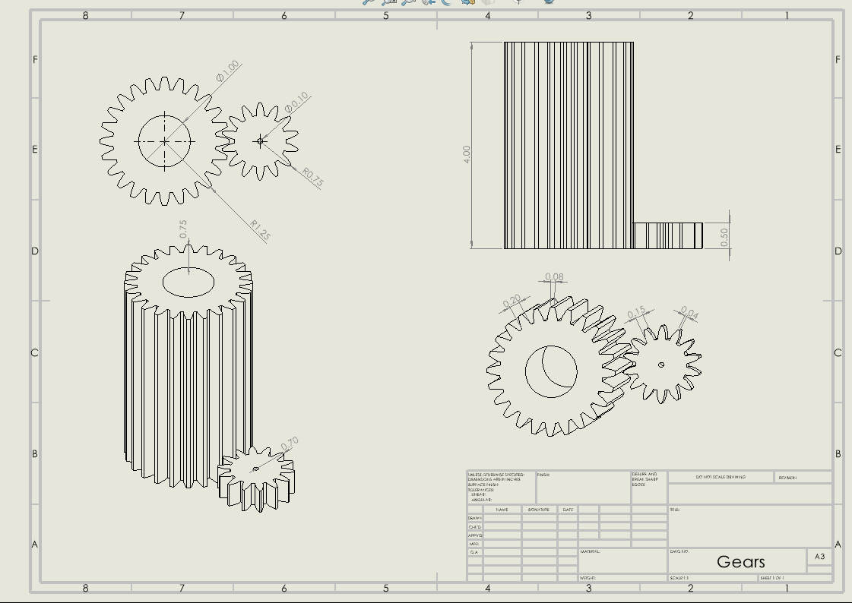
Arm Housing Design
5
Notes:
Josiah, Landon, and Ben Present this?

Slide 6
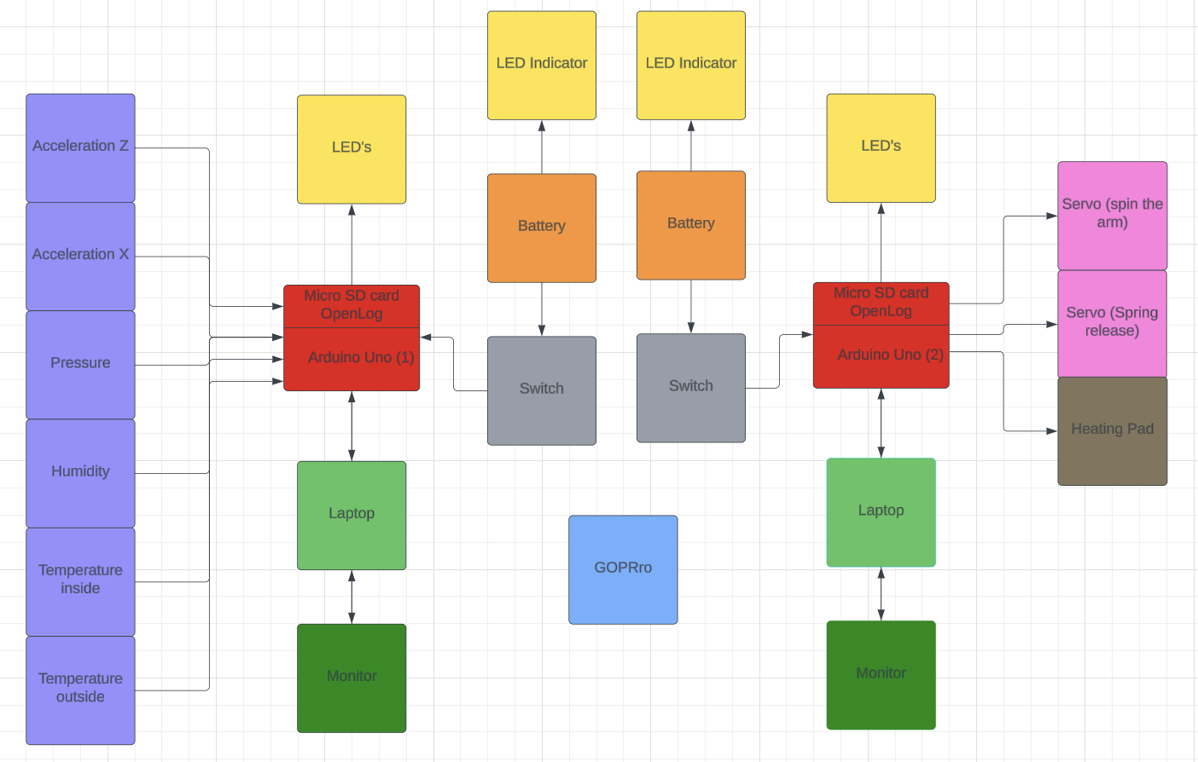
Design: FBD
6

Slide 7
Design: Test Plan
The testing plan of the Balloon Satellite will involve the following:
Whip Test
Drop Test
Kick Test
Electronics Tests
Functional Test
Cooler Test
7

Slide 8
Design: Test Plan: Survivability Tests
The Whip, Drop, and Kick Tests will all be done to simulate the Payload's Survivability in descent and possible landing conditions. Note, in all tests a dead weight prototype will be used to simulate the Payload interior to avoid damage of the interior in the event of a failed test:
The Whip Test will be done to simulate the Balloon's Pop and consists of the spinning of the Payload on the end of a Balloon String cord and rapidly decelerating it on a strong surface.
The Drop Test will be done to simulate a possible parachute malfunction and will consist of a 20 foot dropping of the Payload onto a hard surface.
The Kick Test will be done to simulate a possible dragging of the Payloads with a reinflation of the parachute and will consist of kicking the Payload down a full flight of concrete stairs.
These tests will be done after the Payload exterior is completed and interior estimated for weight. The tests will also be conducted far from other persons given the test's dangerous nature. Should the Payload survive these tests it will be cleared for Weigh-In.
8

Slide 9
Design: Test Plan: Functionality Tests
The Electronics, Function, and Cooler Tests will all be done to simulate the Payload's Operation in Normal and Frigid Conditions:
The Electronics Tests will serve as a preliminary verification of the successful operation of all electronic sensors and modules, and will consist of testing gathered data for functionality and accuracy as well as, the testing of electronics modules, such as servos and cameras.
The Function Test will serve as a verification of the successful operation of the Payload's modules in tandem, and will consists of an hour and a half testing of the given operations of the Payload.
The Cooler Test will be done to guarantee the Payload's survival and operations in adverse atmospheric conditions and will consist of a three hour operation of the Payload in a non-conductive cooler quarter-filled with dry ice.
The Electronics Tests will be done as the Payload is constructed while the Function and Cooler Tests will be done on the completion of the Payload. Should the Payload pass these tests it will be cleared for Weigh-In.
9

Slide 10
Expected Data(Ascent)
Important Notes from Data:
Flight Time: 3 hours until peak
Peak altitude 30 km when popped
Constant Acceleration after 34 s
Constant Velocity of ascent is about 2.78 m/s
10
Notes:
Josiah Presents This

Slide 11
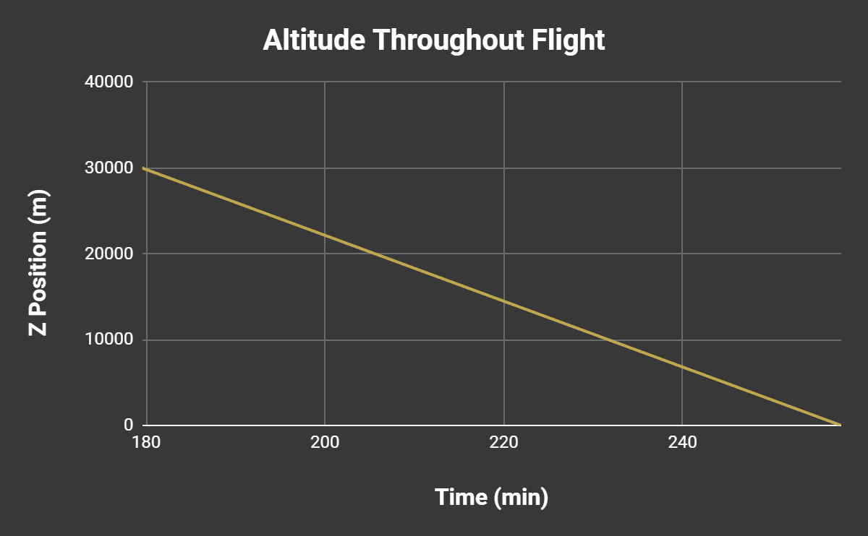
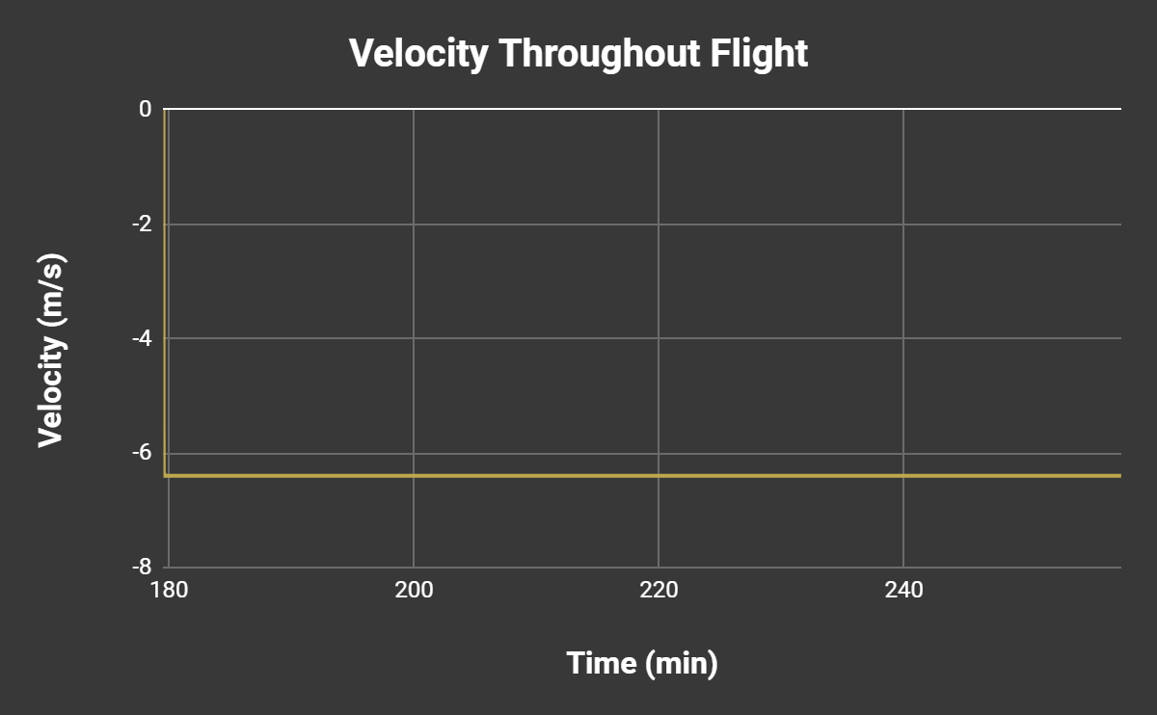
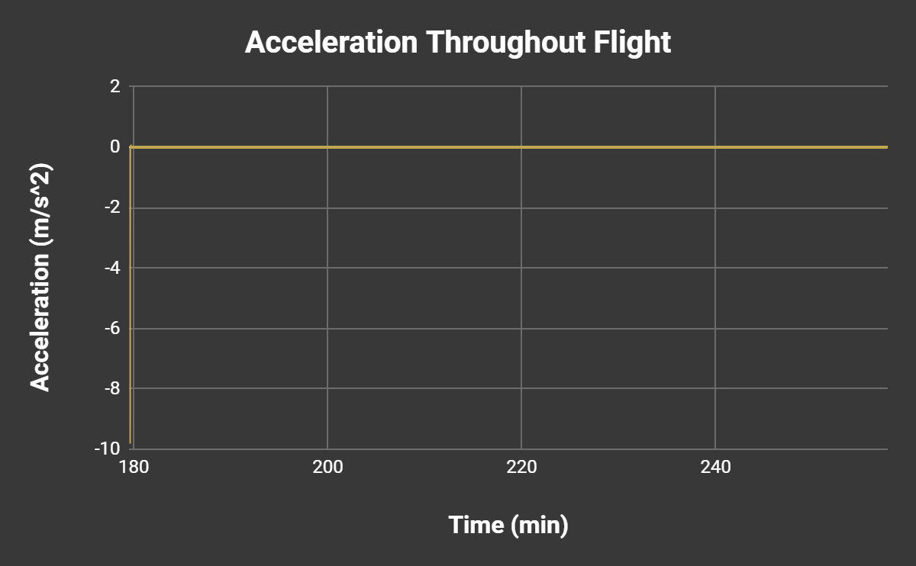
Expected Data(Descent)
Important Notes from Data:
Descent Time: 1.3 hours after descent starts
Constant Acceleration after 16 s
Constant Velocity of descent is about 6.4 m/s
11

Slide 12
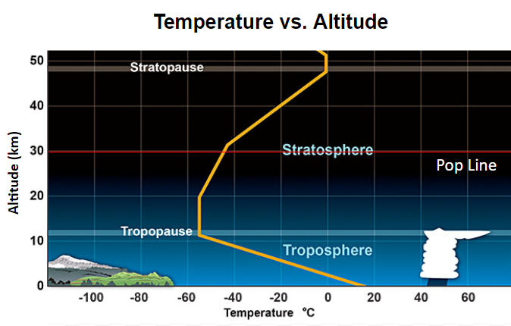
Expected Data from Other Sensors
12

Slide 13
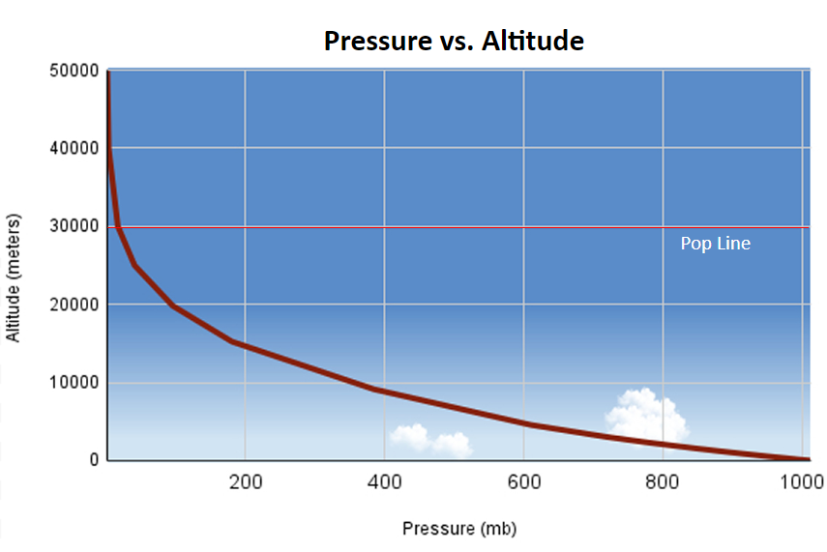
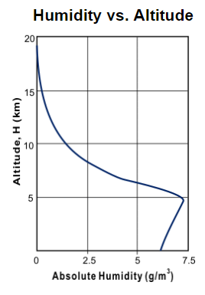
Expected Data from Other Sensors
13

Slide 14
Expected Data from Engineering Challenge
No arm Side
Arm Side
SAT Box
The expected view from the GoPro should appear like:
No Arm View | Arm View
One Direction Magnified for better results “Telescope” | Two Directions always Rotated about an axis 360-degree view about axis
Arm View 1
No Arm View
Arm View 2
14
Notes:
Josiah Presents This

Slide 15
Potential Issues
  Running out of time to accomplish the mission for the engineering challenge
  Receiving all our supplies in time to begin building out satellite
  Having issues getting the mirrors out and working
  Finding and applying appropriate anti-fog for mirrors
  Structure of the craft not withholding during the flight
  Footage being distorted in a manner where it is not to our liking
  GoPro mishaps
  Parts breaking mid-flight
15

Slide 16
Appendix: Weight/Cost Summary
Item | Cost | Weight (g)
Mirrors(4) | $15.00 | 25.00
Anti-Fog Mirror Spray | $10.00 | 0.00
Servos (2) | $14.00 | 18.00
Spring (1) | $7.36 | 45.00
3D Printed Gears | $0.00 | 100.00
Arm | $0.00 | 90.00
Mirror Housing | $0.00 | 75.00
Battery | $8.86 | 45.00
Heat Pad | $26.48 | 28.35
Magnification Lenses (2) | $6.79 | 20.00
Insulation and Aluminum for Outside | $0.00 | 100.00
GoPro | $0.00 | 72.00
Arduino | $0.00 | 40.00
Dry Ice | $20.00 | 0.00
Total: | $108.49 | 658.35
16

Slide 17
Project Timeline
Event | Date | Days Until Launch
Finalize Overall Concept and Soldering Components | February 26, 2024 | 54
Finalize Arduino Code | February 26,2024-March 13/2024 | 38
Order parts based on final list. | March 18, 2024 | 33
Prototype is created and parts are received. | March 20, 2024 – March 29, 2024 | 19
Structural Testing begins with prototype and dead weight | April 1, 2024-April 3, 2024 | 17
Revisions are made and final construction begins. | April 3, 2024-April 8, 2024 | 12
Troubleshooting and functionality tests begin. | April 8, 2024- April 15, 2024 | 5
Final adjustments are done, and the SAT is weighed in for launch | April 15, 2024 – April 19, 2024 | 1
Satellite is launched | April 20, 2024 | 0
17
Notes:
Josiah Presents This

