Slide 1
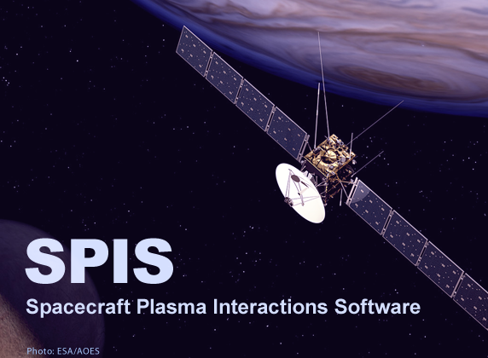
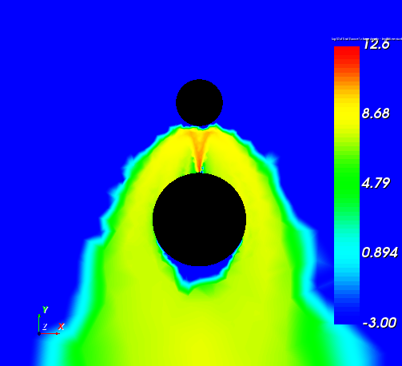
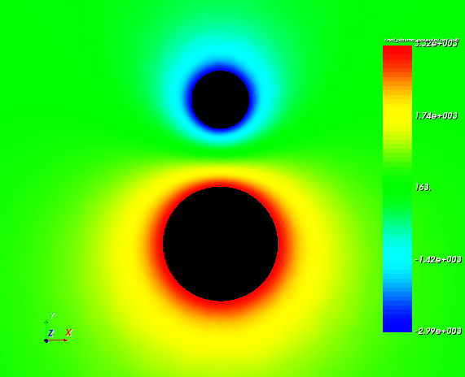
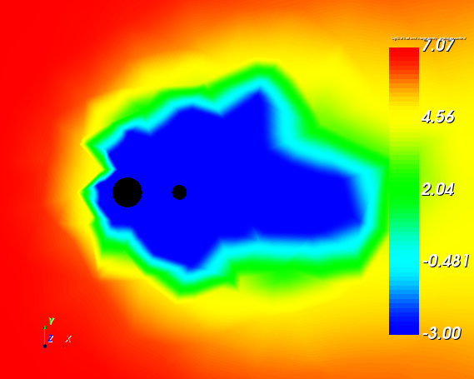
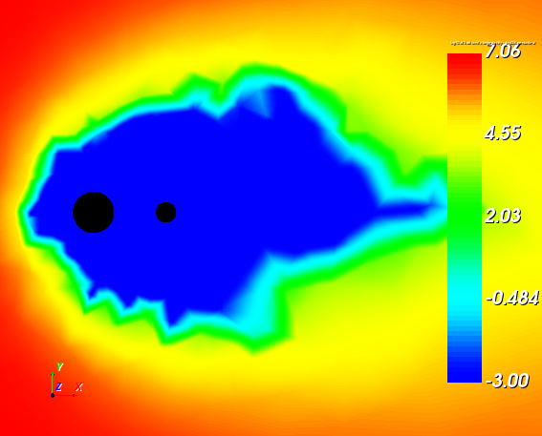
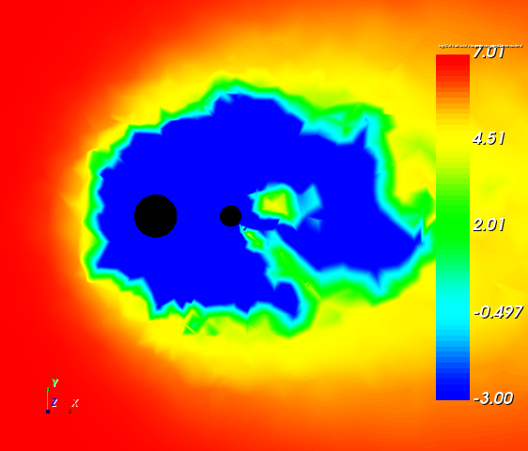
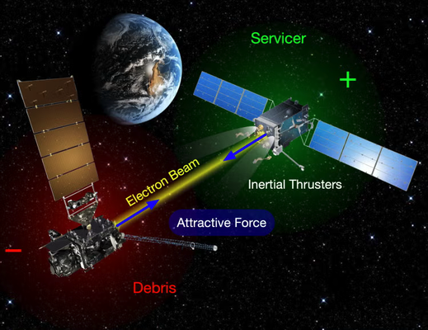
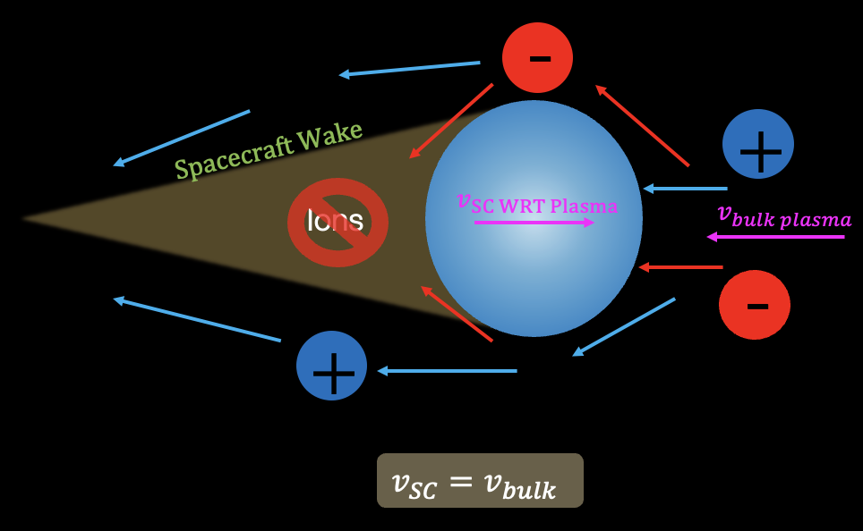
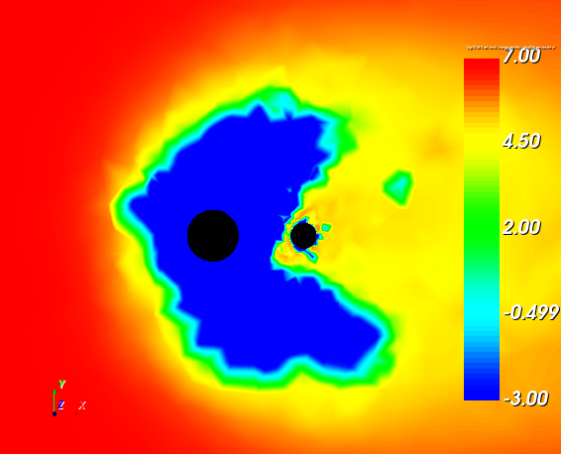
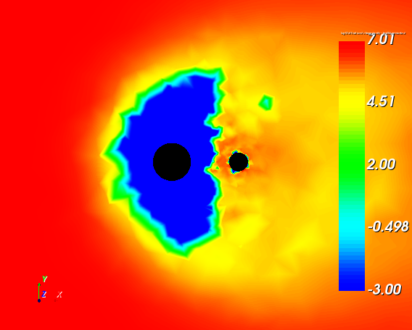
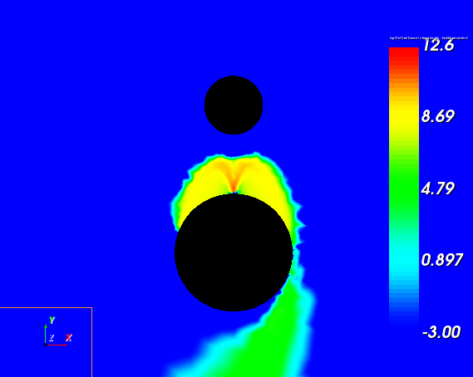
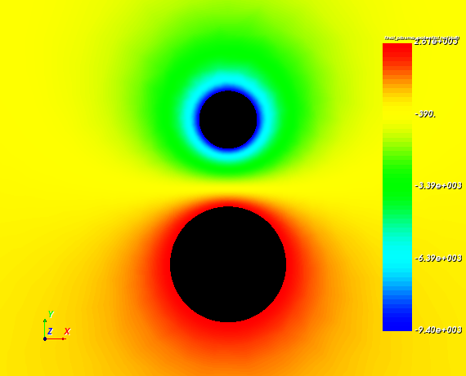
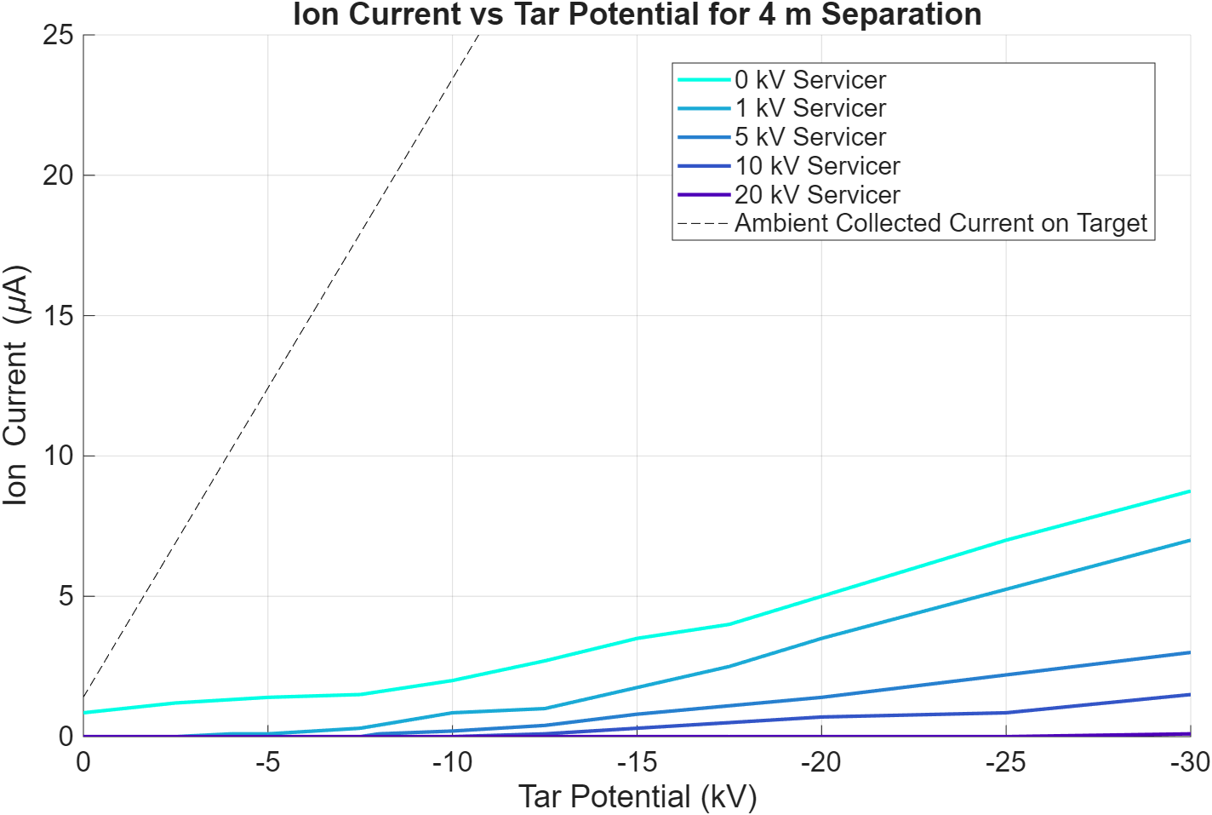





Electrostatic Tractor Supercharging in Cislunar Space
Landon Holligan, Kaylee Champion, Dr. Hanspeter Schaub
Ann and H.J. Smead Aerospace Engineering Sciences, University of Colorado Boulder
Motivation & Background
Plasma Wake Characterization
Validation
Space debris is a growing issue in near-Earth orbits. As companies look towards the Moon as a new objective, it becomes critical to develop and implement safe debris mitigation and removal strategies.
One proposed technology is electrostatic actuation, which involves a servicer spacecraft equipped with an electron gun aimed at a target spacecraft or piece of debris.
    The servicer charges positively while the target charges negatively, creating an attractive force between them.
Spacecraft Wakes are regions on the eclipse, or anti-velocity side of the spacecraft, depending on the environment, devoid of ions.
Supercharging occurs when the target and servicer reach a potential difference larger than the beam energy.
Initially seen when target is in servicer’s spacecraft wake
SPIS was the main analytical tool used in this research. It is a powerful plasma interaction solver that enables the ability to model realistic spacecraft geometries and plasma interactions. This enabled the ability to characterize plasma wakes in the magnetosheath which then led to full scale modeling of supercharging in a realistic environment.
Electron Beam Density
Potential Distribution
Target
-3 kV
Servicer
3.32 kV
10 kV Servicer, 4m Separation
Initial Parameters:
$ϕ_{T}=−3 kV$
$$ϕ_{S}=2 kV$$
$$∆φ=5 kV$$
$$E_{Beam}=5 keV$$
$$F_{e}=0.104 mN$$
Final Parameters:
$ϕ_{T}=−3 kV$
$$ϕ_{S}=3.32 kV$$
$$∆φ=6.32 kV$$
$$E_{Beam}=5 keV$$
$$F_{e}=0.178 mN$$
Servicer
$$v_{bulk}$$
Target
After emitting the electron beam at a target within a wake, it is possible to increase the potential difference to greater than the beam energy. In this case, the change in equilibrium potential increases the electrostatic force by 71.2%.
0 V Target
-5 kV Target
-10 kV Target
Application
Electrostatic Tractor Concept
Spacecraft Wakes
Electron Beam Density
Potential Distribution
Objectives & Methods
-15 kV Target
-20 kV Target
Spacecraft Wake Characterization in SPIS ($log_{10}$ of Ion Density)
-9.4 kV
Build on AVS Lab’s findings to prove and characterize supercharging
Use SPIS and MATLAB to characterize wakes
Use SIMION and MATLAB to characterize beam width of electron gun
Use SPIS to model supercharging in a realistic plasma environment
2.61 kV
Initial Parameters:
$$ϕ_{T }=−9.5 kV$$
$$ϕ_{S }=2.7 kV$$
$$∆ϕ =12.2 kV$$
$$E_{Beam}=15 keV$$
$F_{e}=0.512 mN$
Final Parameters:
$$ϕ_{T }=−9.4 kV$$
$$ϕ_{S }=2.61 kV$$
$$∆ϕ=12.01 kV$$
$$E_{Beam}=5 keV$$
$F_{e}=0.493 mN$
Future Work
Apply supercharging concepts to more realistic geometries
Optimize beam width, separation distance and beam energy and current
Explore uses in active charge control or attitude control
To model supercharging in a realistic scenario, equilibrium is first achieved using a 15 keV beam. The beam energy is then reduced to 5 keV. Despite lowering the beam power to one-third of the original, 96.3% of the initial force is maintained thanks to supercharging.
Collected Ion Current on Target at Different Servicer Potentials
Notes:
Spiel:
Introduce myself and project name
Mention Debris Issue in near earth orbit + Electrostatic actuation
State Objective (Build on labs findings to increase efficiency of debris removal through supercharging)
Results

