Slide 1
Groundstation Mechanisms Design Review 2

Slide 2
Agenda
General Design
Sizing and Pointing Precision
Azimuth Coupling Mechanism
Elevation Coupling Mechanism
Dish Attachment Mechanism
Counterweight

Slide 3
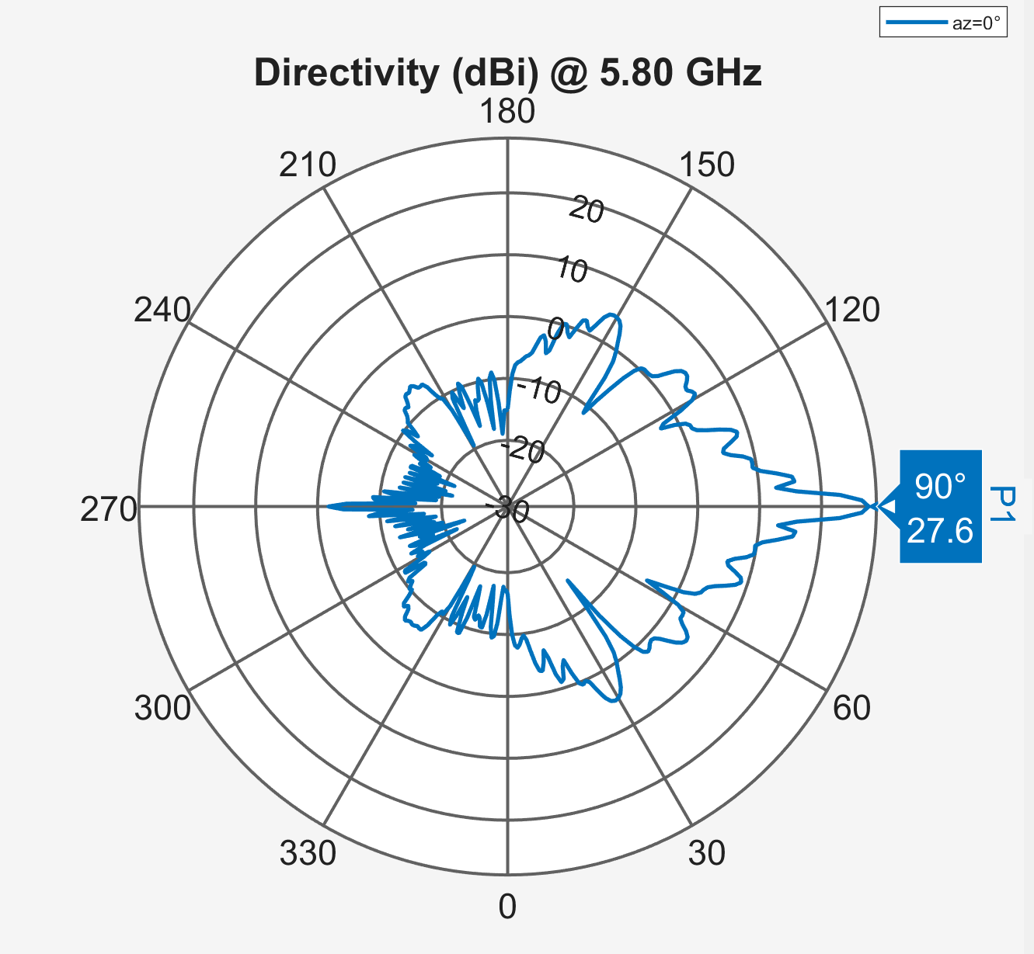
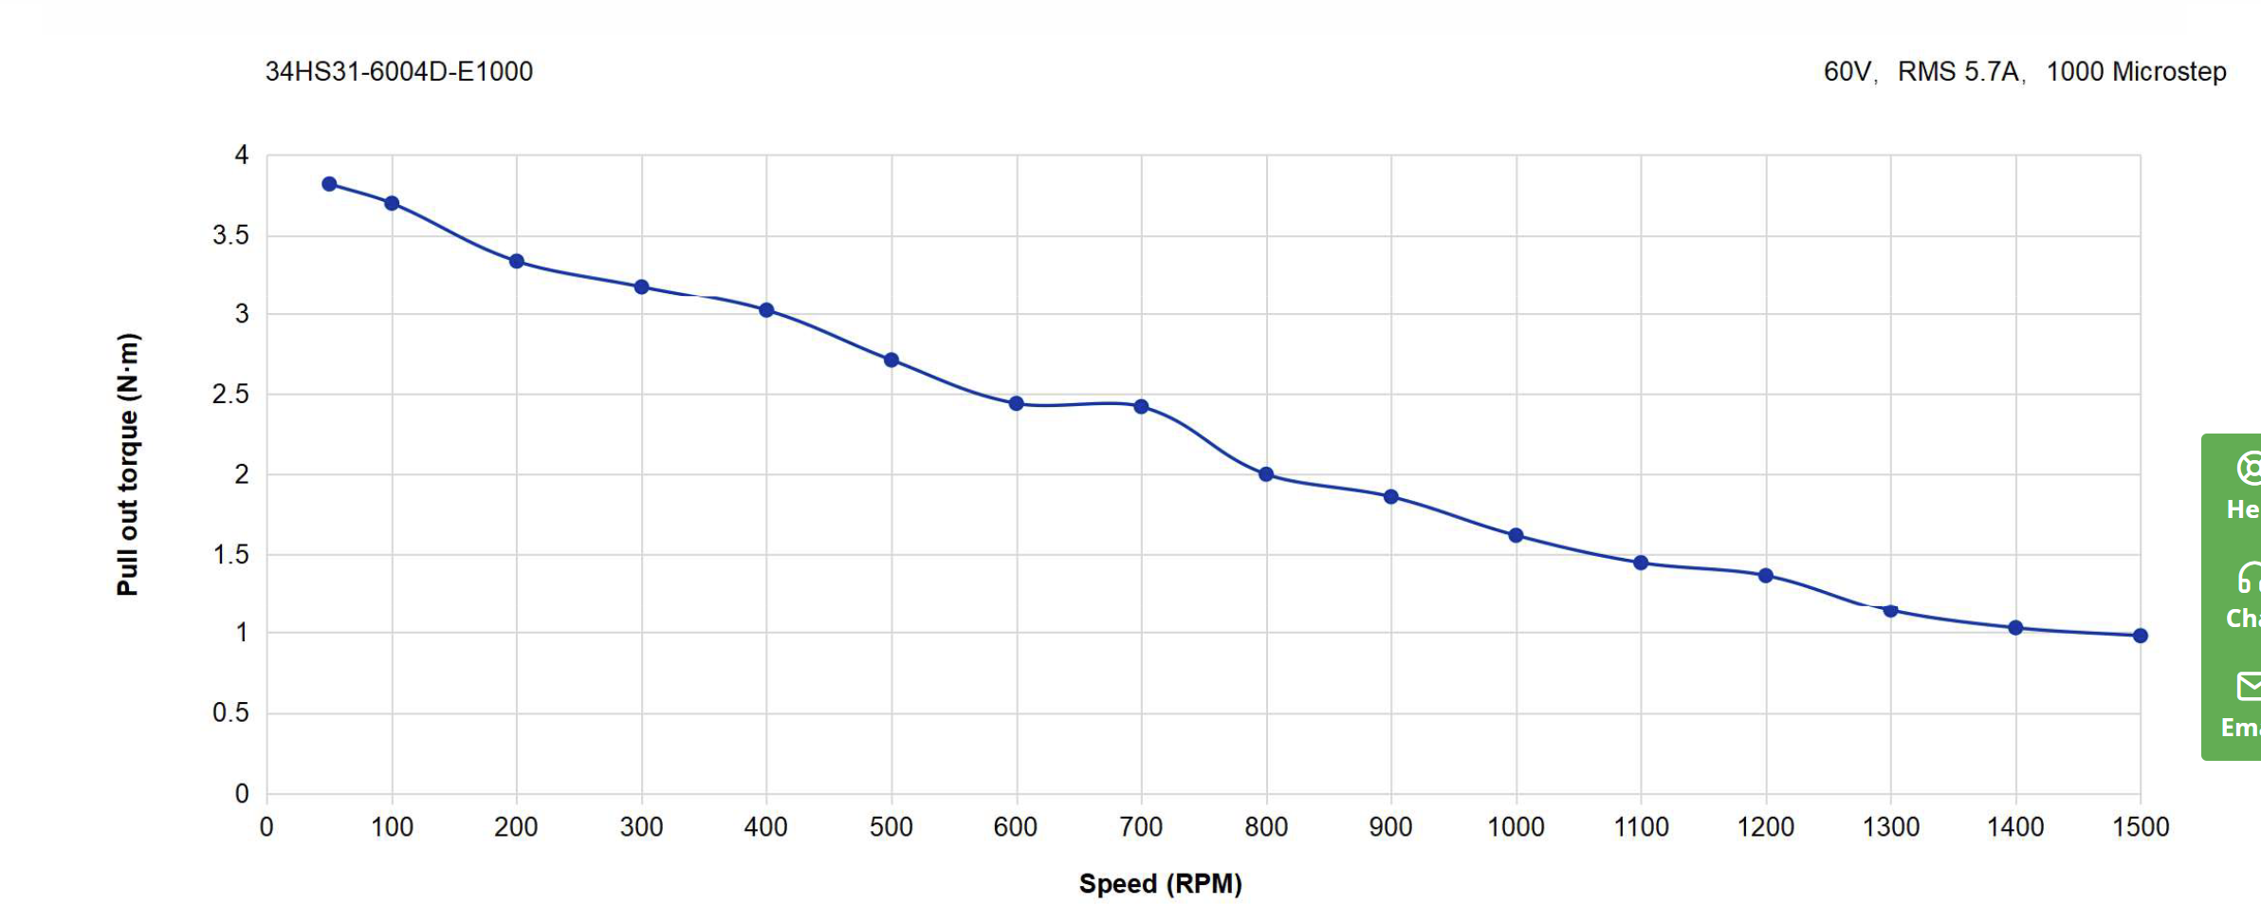
Sizing and Pointing Precision
Torque curve
Motor accuracy
Microstepping up to 40000 pulse/rev = 0.009°
Dish –3dB BW is pretty small but the first null is at ~30° so there's a good amount of margin
    Accuracy bottleneck will be angle of arrival accuracy, not motors (theoretically 0.034°)

Slide 4
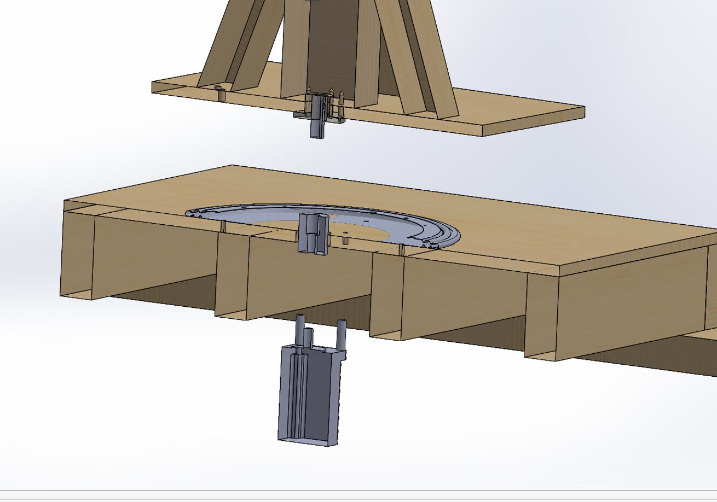
Azimuth Coupling Mechanism

Slide 5
ITEM NO. | QTY. | PART NUMBER | DESCRIPTION | MFG
1 | 4 | 1.001 | MOTOR STANDOFF | MANUAL LATHE
2 | 1 | 1.002 | AZIMUTH TURN TABLE BEARING | COTS
3 | 4 | 1.003 | BALL TRANSFER BEARINGS | COTS
4 | 1 | 1.004 | MOTOR SHAFT 14MM TO 14MM JOINT COUPLER | COTS
5 | 2 | 1.005 | FLANGE COUPLING 14MM SHAFT | COTS

Slide 6
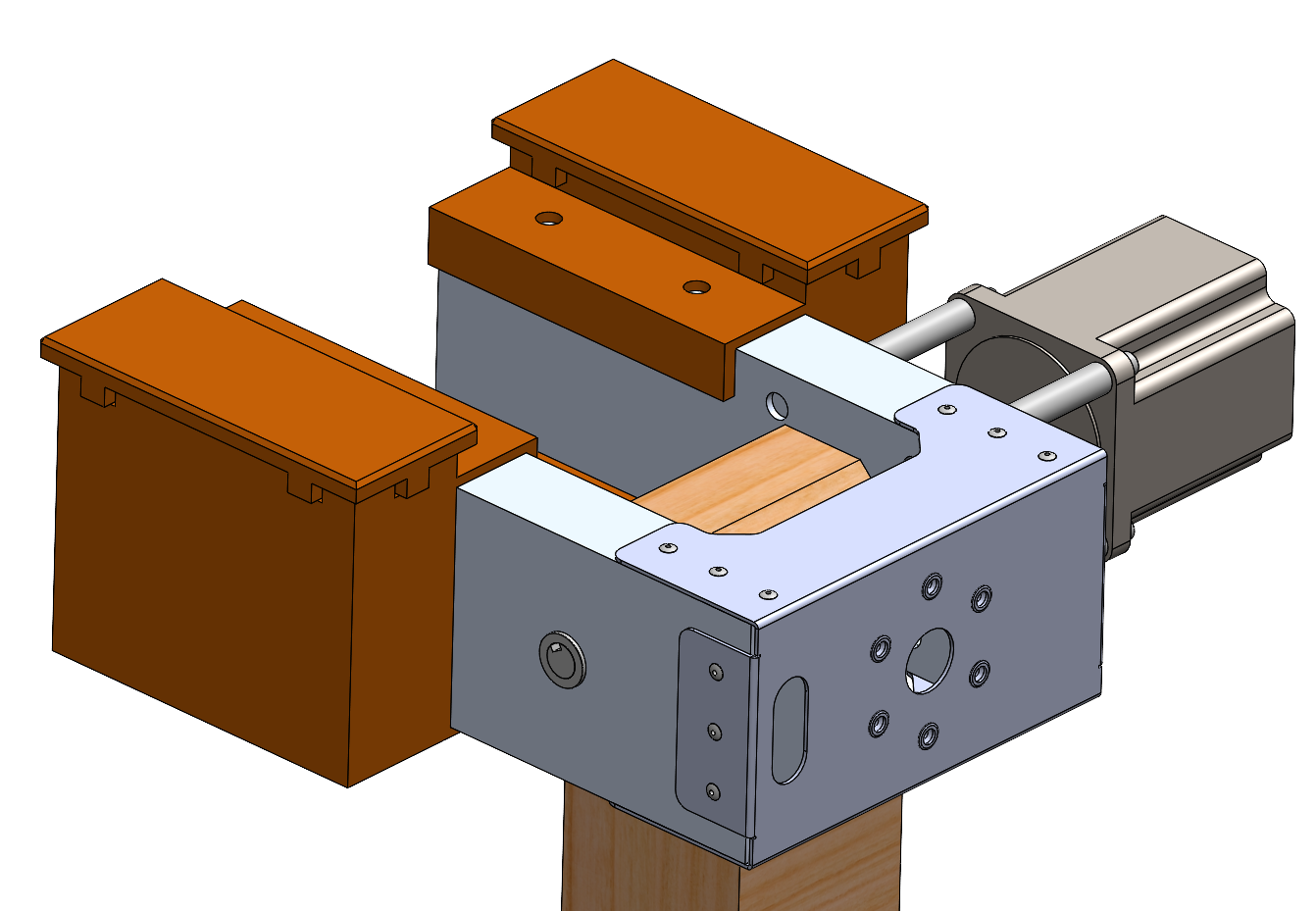
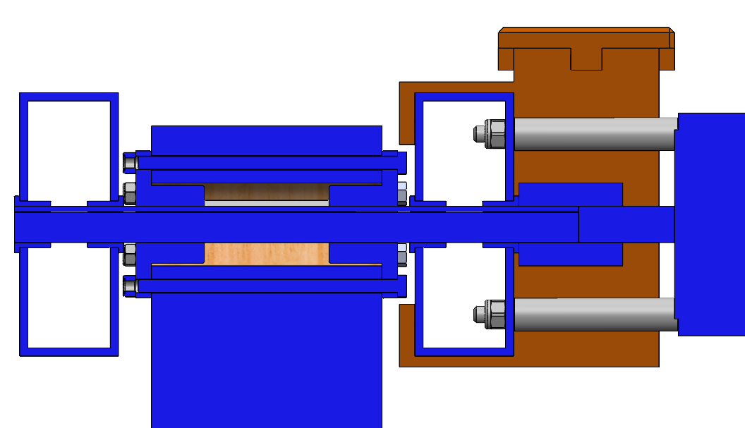
Elevation Assembly
Rotates 180 degrees
Supports MAX 10 lb Antenna
Max Acceleration at +/-24.5rad/s TBR
Max Velocity 2.45rad/s
Contain Location for RF PCB
Mounts to Antenna on Front

Slide 7
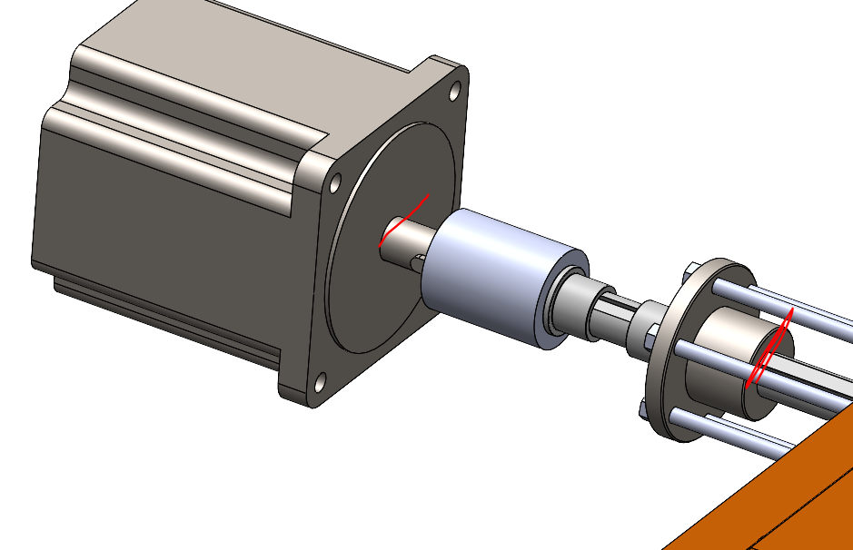
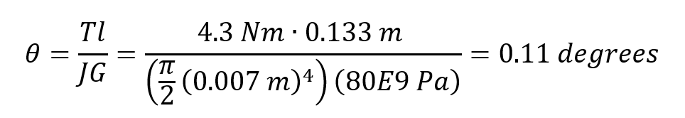
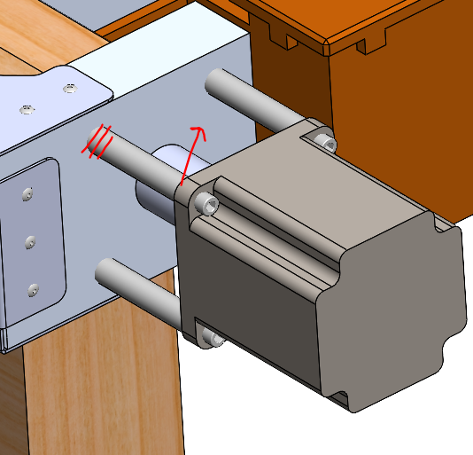
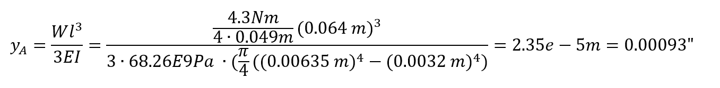
Elevation Assembly – Hand Calculations
Analysis:
Torsion of the shaft - PASS
  G from AZO Materials 1045 Carbon Steel, Equation from Roarks
Bending of Motor Standoffs - PASS
  E from MMPDS Al 6061, Equation from Roarks

Slide 8
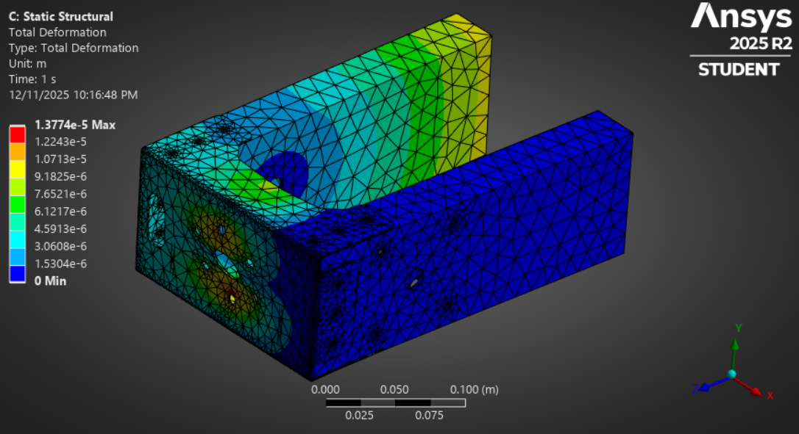
Elevation Assembly – Acceleration Deflection Analysis
ANSYS Static Structural Analysis:
Large Deflections Off
Assuming Max Acceleration: 24.5rad/s
Assuming Antenna Mass: 9.9lbs
Max Deflection: ~0.0005"
Max Stress: 9.687 MPa << Yield
TBD Non-Constant Accelerations
  May lead to analysis being under-conservative
PASS

Slide 9
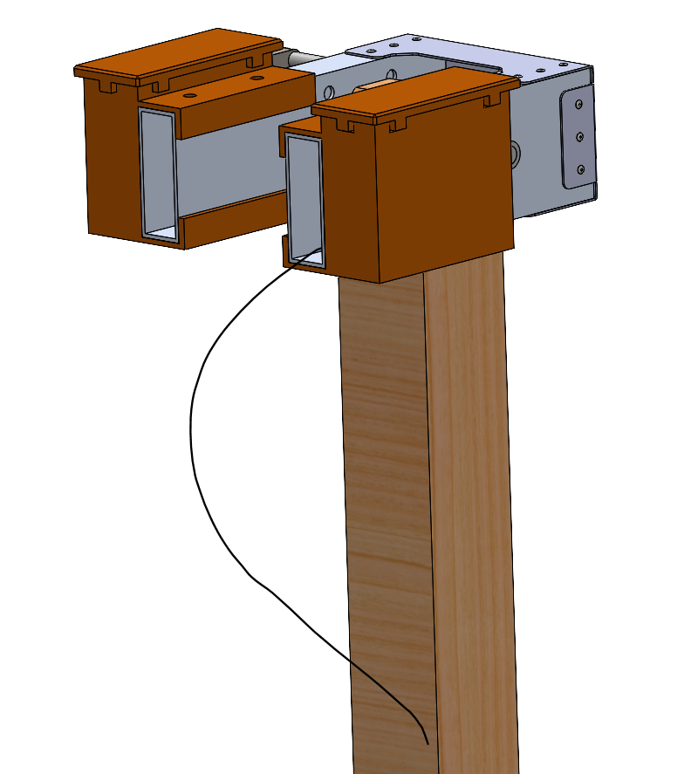
Elevation Assembly – Harnessing
Use Cable from Rear Side
If Needed Add Stiffening Using Sheet Metal
  Similar to 3d Printers
Harness Contents TBD
  All RF cabling shall be constrained to the elevation stage
  Motor power
  Motor control serial
  Ranging to CDH serial
  WALRUS to CDH serial
  L-band radio to CDH serial
Discussion items (potentially leave for later)
Batteries for RF boards on elevation stage?
PCB placement

Slide 10
Elevation Assembly – Parts List 1
ITEM NO. | QTY. | PART NUMBER | DESCRIPTION | MFG
1 | 1 | 2.001 | VERTICAL STANCHION | DRILL PRESS, CIRCULAR SAW
2 | 1 | 2.002 | DISH ATTACHMENT STRUCTURE, ELEVATION | WJ, METAL BENDING
3 | 1 | 2.003 | RIGHT ELEVATION TUBE | MANUAL MILL
4 | 1 | 2.004 | LEFT ELEVATION TUBE | MANUAL MILL
5 | 2 | 2.005 | COUNTERWEIGHT BOX | 3D PRINTING
6 | 2 | 2.006 | COUNTERWEIGHT LID | 3D PRINTING
7 | 2 | 2.007 | FLANGE COUPLING 14MM SHAFT | COTS
8 | 2 | 2.008 | ELEVATION SPACER | MANUAL LATHE
9 | 4 | 2.009 | MOTOR STANDOFF | MANUAL LATHE
10 | 1 | 34HS31-6004D-E1000 | 4.3Nm Closed loop stepper motor | COTS

Slide 11
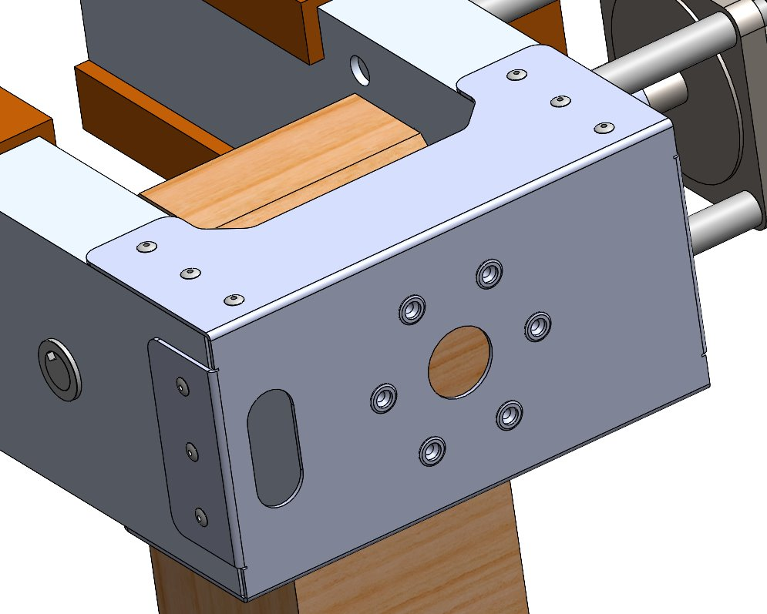
Dish Attachment Mechanism

Slide 12
Elevation Assembly – Parts List 2
ITEM NO. | QTY. | PART NUMBER | DESCRIPTION | MFG
11 | 1 | 1252089 | MOTOR SHAFT 14MM TO 14MM JOINT COUPLER | COTS
12 | 1 | 1439K27 | 1045 Carbon Steel Keyed Rotary Shaft | COTS
13 | 6 | 91180A177 | Medium-Strength Class 8.8 Steel Hex Head Screw | COTS
14 | 6 | 94645A102 | NUT | COTS
15 | 4 | 6659K21 | Oil-Embedded Flanged Sleeve Bearing | COTS
16 | 6 | 95105A135 | Zinc-Plated Steel Heavy-Duty Rivet Nut | COTS
17 | 1 | 92288A493 | Machine Key Stock | COTS
18 | 4 | 92196A556 | 18-8 Stainless Steel Socket Head Screw | COTS
19 | 4 | 95615A120 | Medium-Strength Steel Nylon-Insert Locknut | COTS
20 | 18 | 97519A025 | Zinc-Plated Blind Rivets | COTS

Slide 13

Counterweight:
Total Steel Shot Volume Needed for 2.5 kg: 320 cm^3
CW Volume (per side): 576 cm^3
Adjusting weight on each side to reduce wobble?
RF PCBs will be part of counterweight TBR

