Slide 1
Electrostatic Tractor Supercharging in Cislunar Space
Landon Holligan

Slide 2
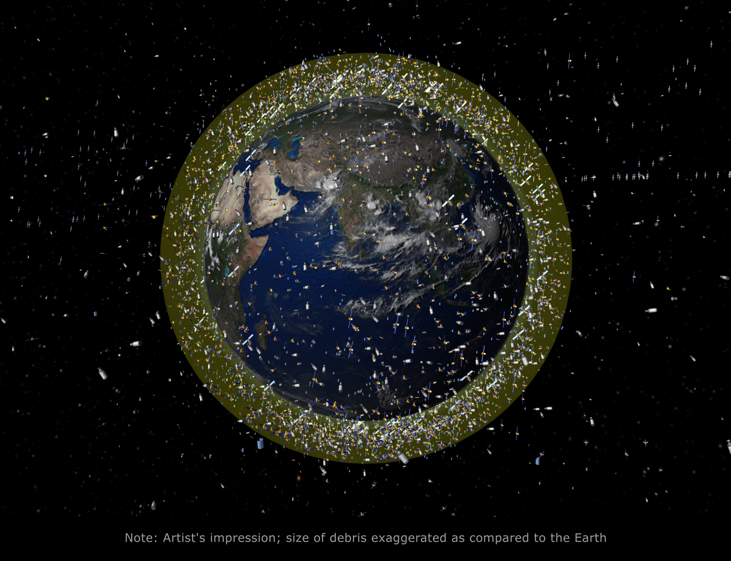
Space Debris Problem
Near Earth orbits are crowded with hundreds of thousands of pieces of debris
With more mission objectives pointing toward Cislunar Space, space debris is a major concern
Highlights a need for safe debris removal/mitigation strategies

Slide 3
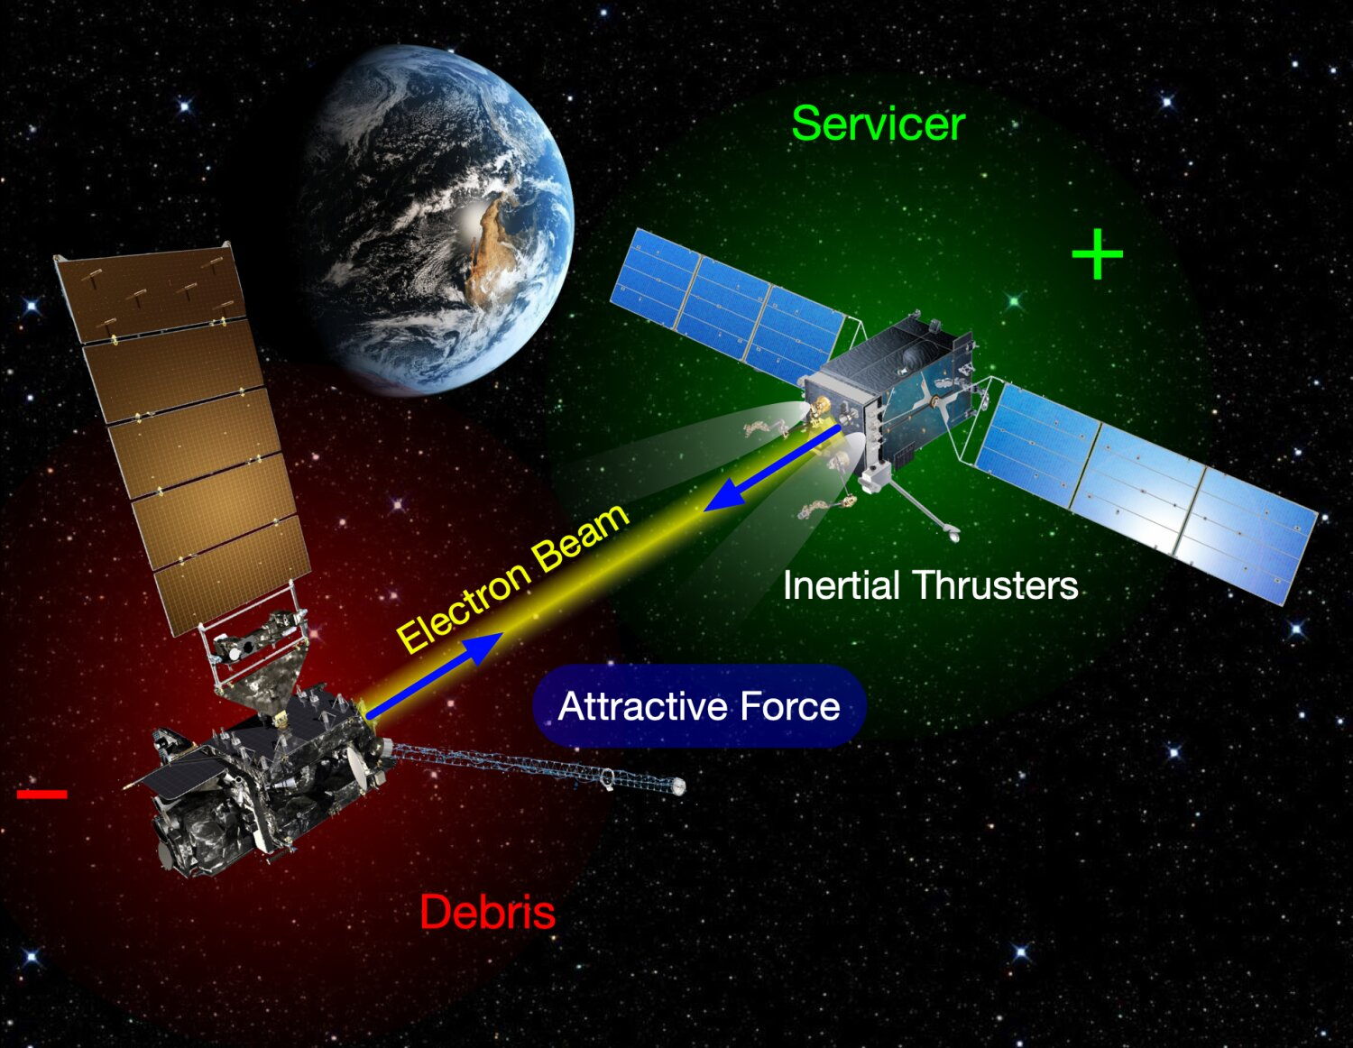
Electrostatic Tractor Basics
Servicer equipped with an electron beam
Servicer charges positive and target charges negative
Creates tugging force on target

Slide 4
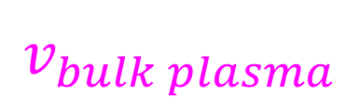
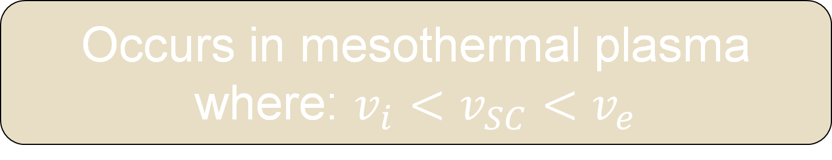
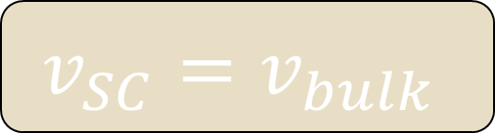

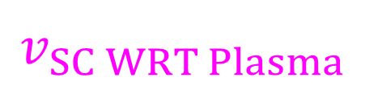
Intro To Plasma Wakes
-
Spacecraft “pushes” and absorbs ions as it flows through plasma
+
$$Spacecraft Wake$$
Ions
$$v_{SC WRT Plasma}$$
$$v_{bulk plasma}$$
Occurs in mesothermal plasma where: $v_{i}<v_{SC}<v_{e}$
-
+
$$v_{SC}=v_{bulk}$$

Slide 5
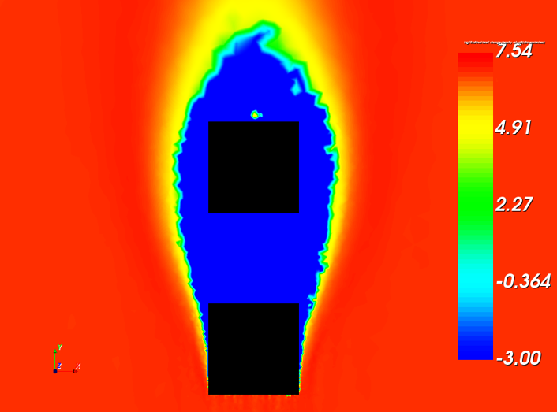
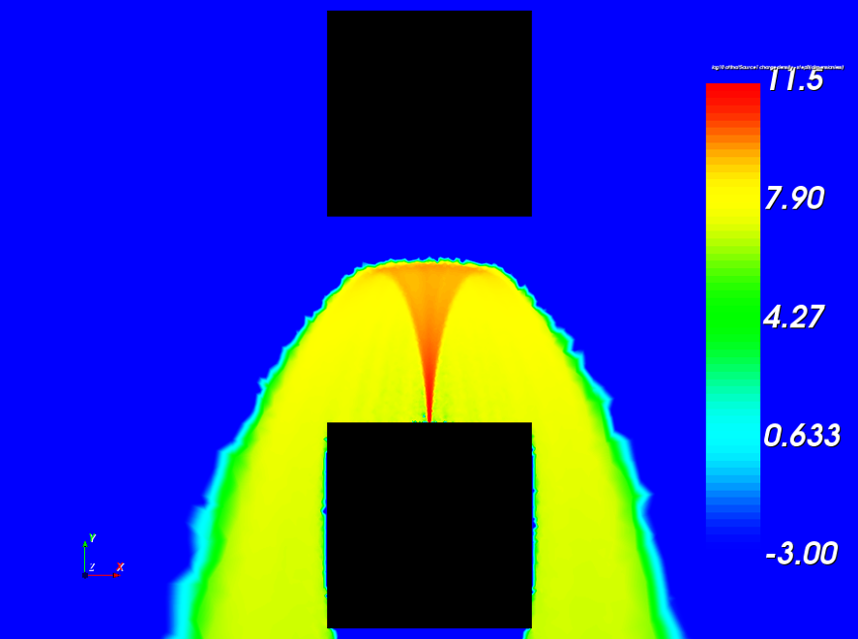
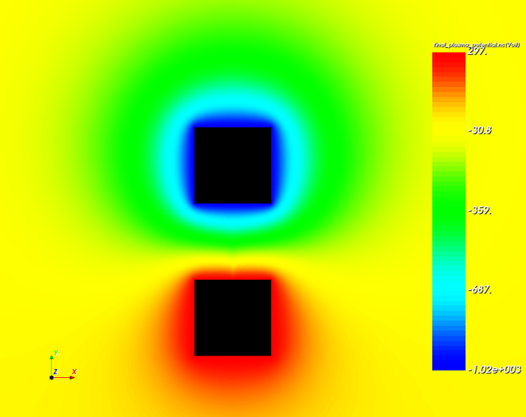
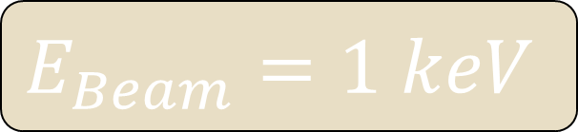
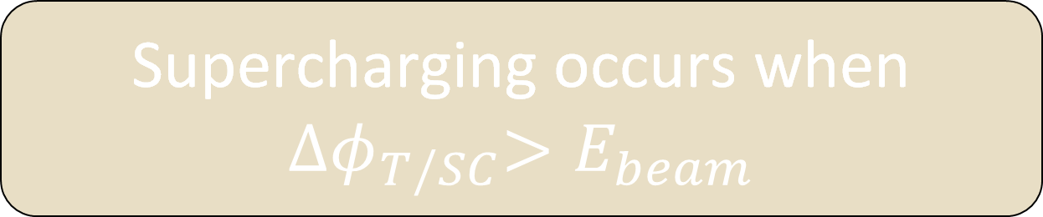

Supercharging Concept
Supercharging occurs when ${∆φ}_{T/SC}>E_{beam}$
T
SC
Must occur inside a plasma wake so target does not collect ions
Target in Servicer’s Wake.
Electron Beam not Fully Recollected by Servicer
-1.02 kV
Generates larger potential difference, creating stronger tugging forces
$$E_{Beam}=1 keV$$
297 V
${∆φ}_{T/SC}$ > $E_{beam}$

Slide 6
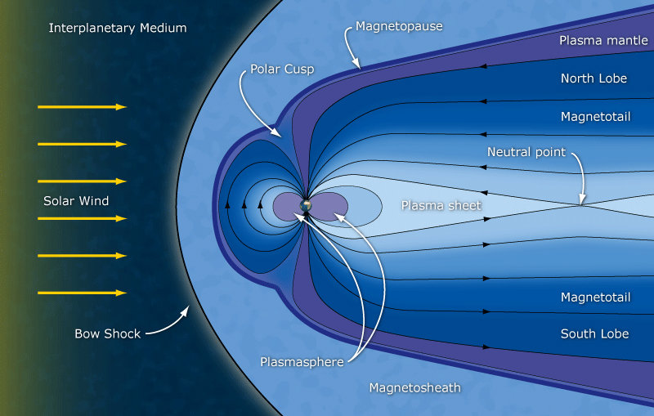
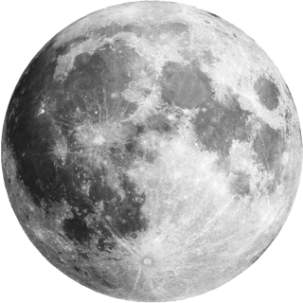


Cislunar Plasma Region

Slide 7
Objective:
Build on our lab’s findings to prove that supercharging can occur and characterize possible conditions.
Steps
Use SPIS and MATLAB to characterize wakes
Use SIMION and MATLAB to find beam width of electron gun
Use SPIS to model supercharging

Slide 8
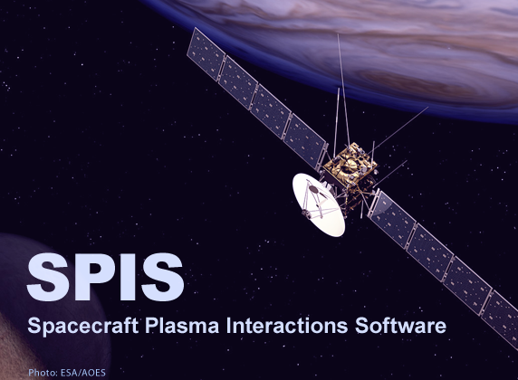
SPIS
3D plasma-interaction solver
Able to model complex spacecraft geometry
Detailed sheath/wake modeling

Slide 9
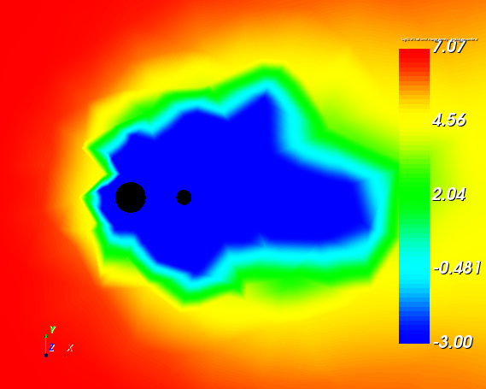
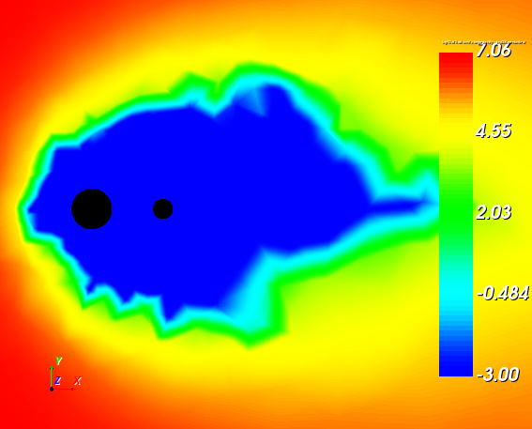
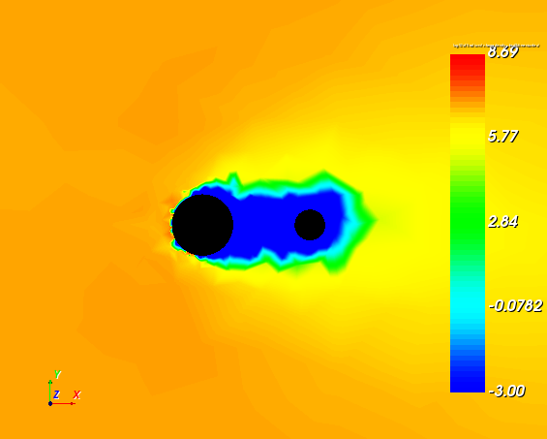
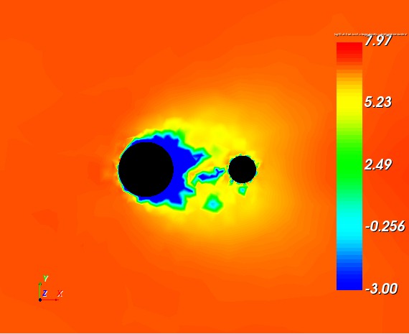
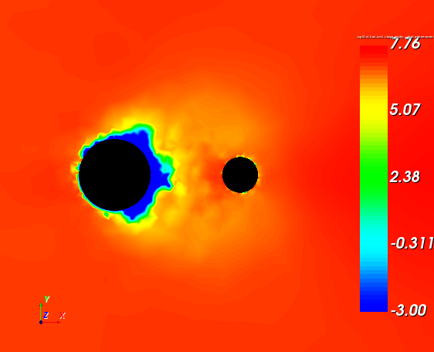
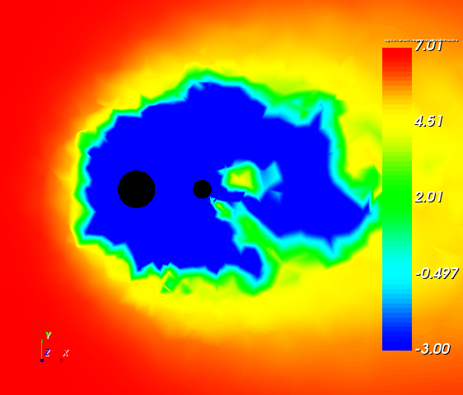
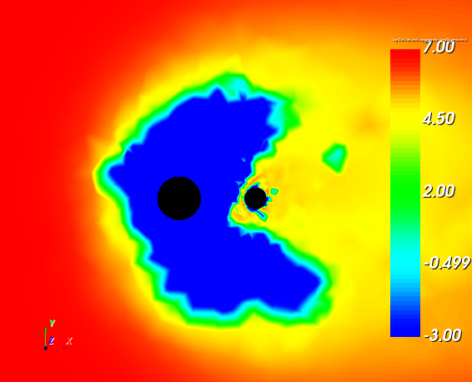
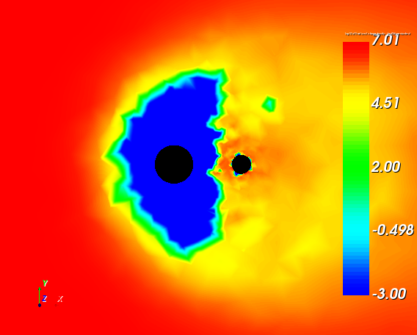
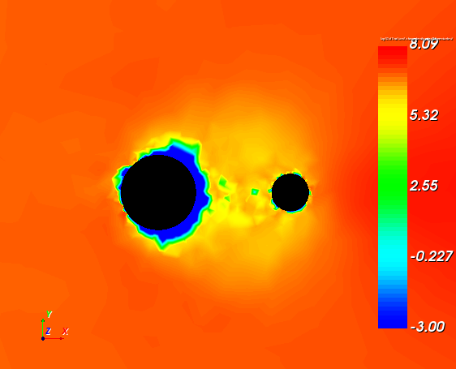
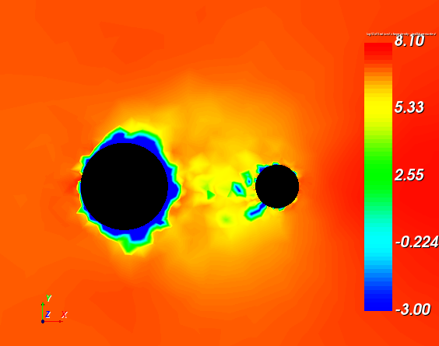



SPIS Wake Figures
Much Larger Wake
1 kV Servicer, 4m Separation
10 kV Servicer, 4m Separation
$$Servicer$$
$$Target$$
$$v_{bulkplasma}$$
0 V Target
-5 kV Target
-10 kV Target
0 V Target
-5 kV Target
-10 kV Target
Fully Collapsed
-20 kV Target
-15 kV Target
-20 kV Target
-15 kV Target

Slide 10
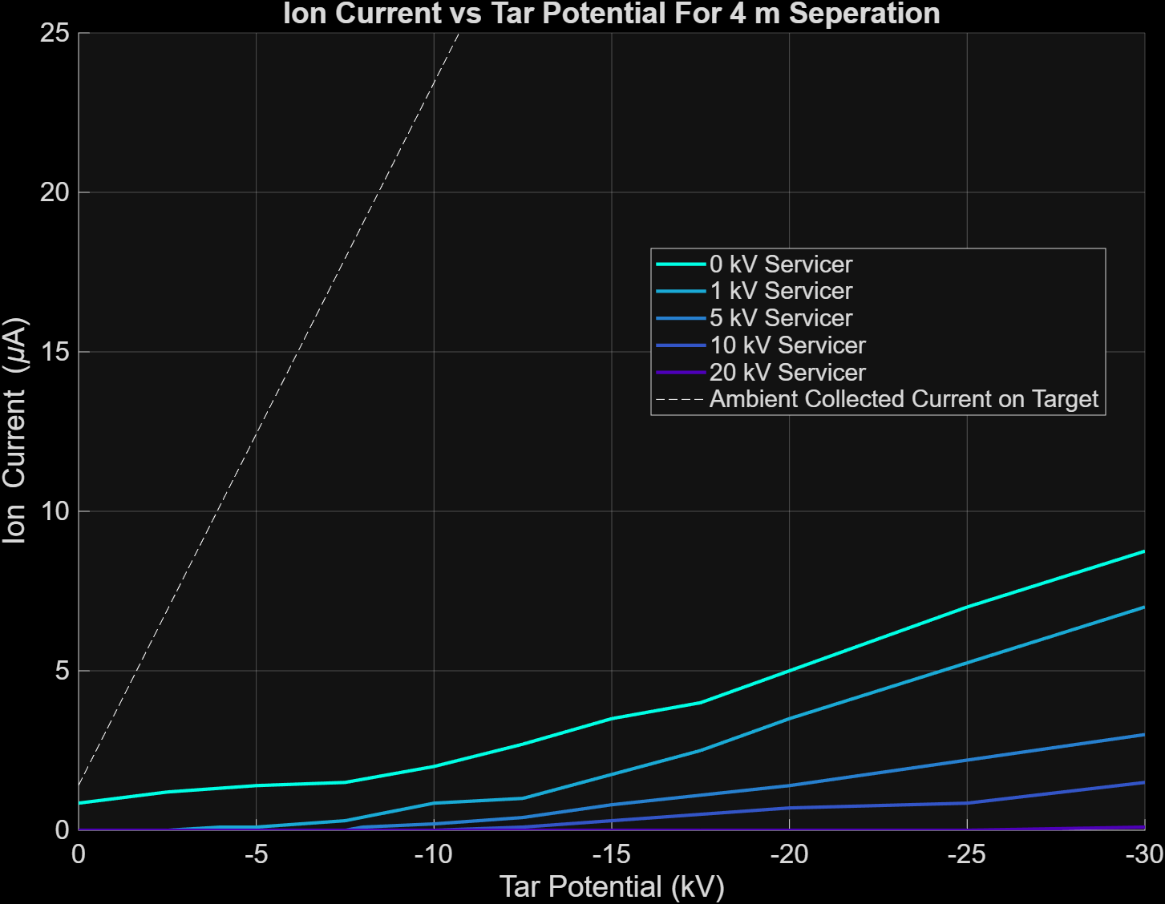
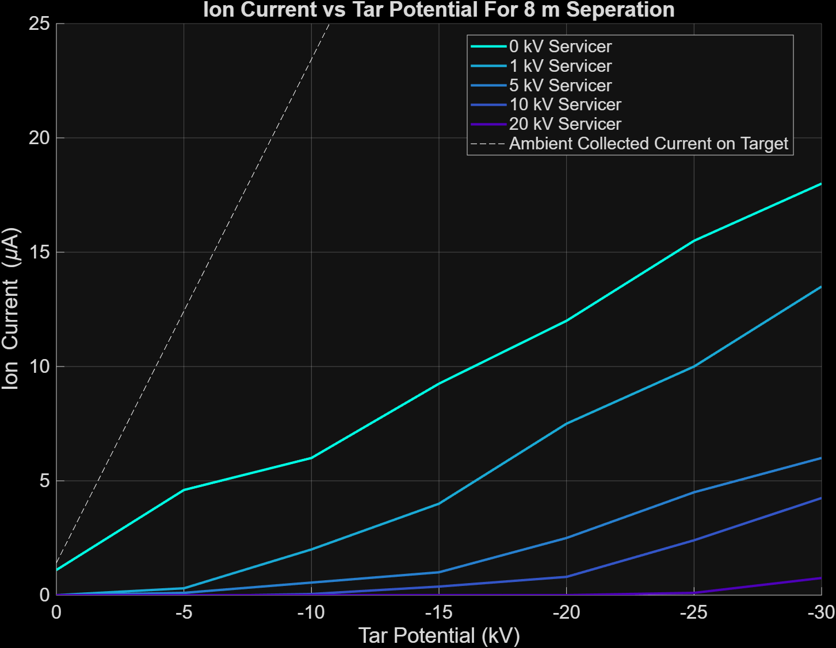
SPIS Current Results

Slide 11
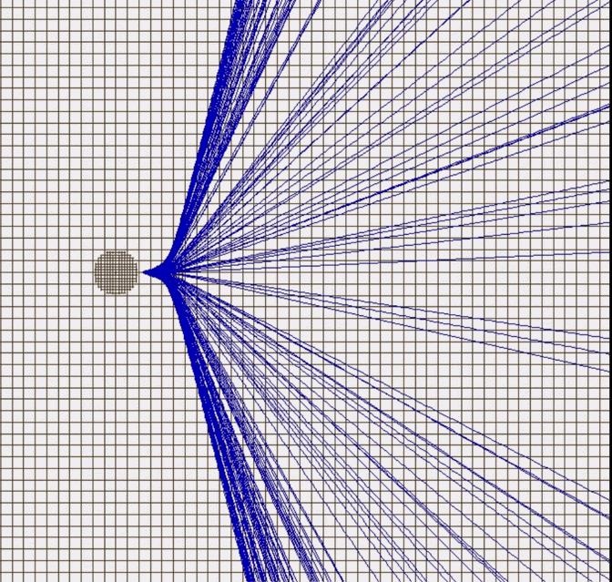
SIMION
Tracks particle trajectories
Servicer
Can model electron beam spread
Analyzes impacts and recollection
Target

Slide 12
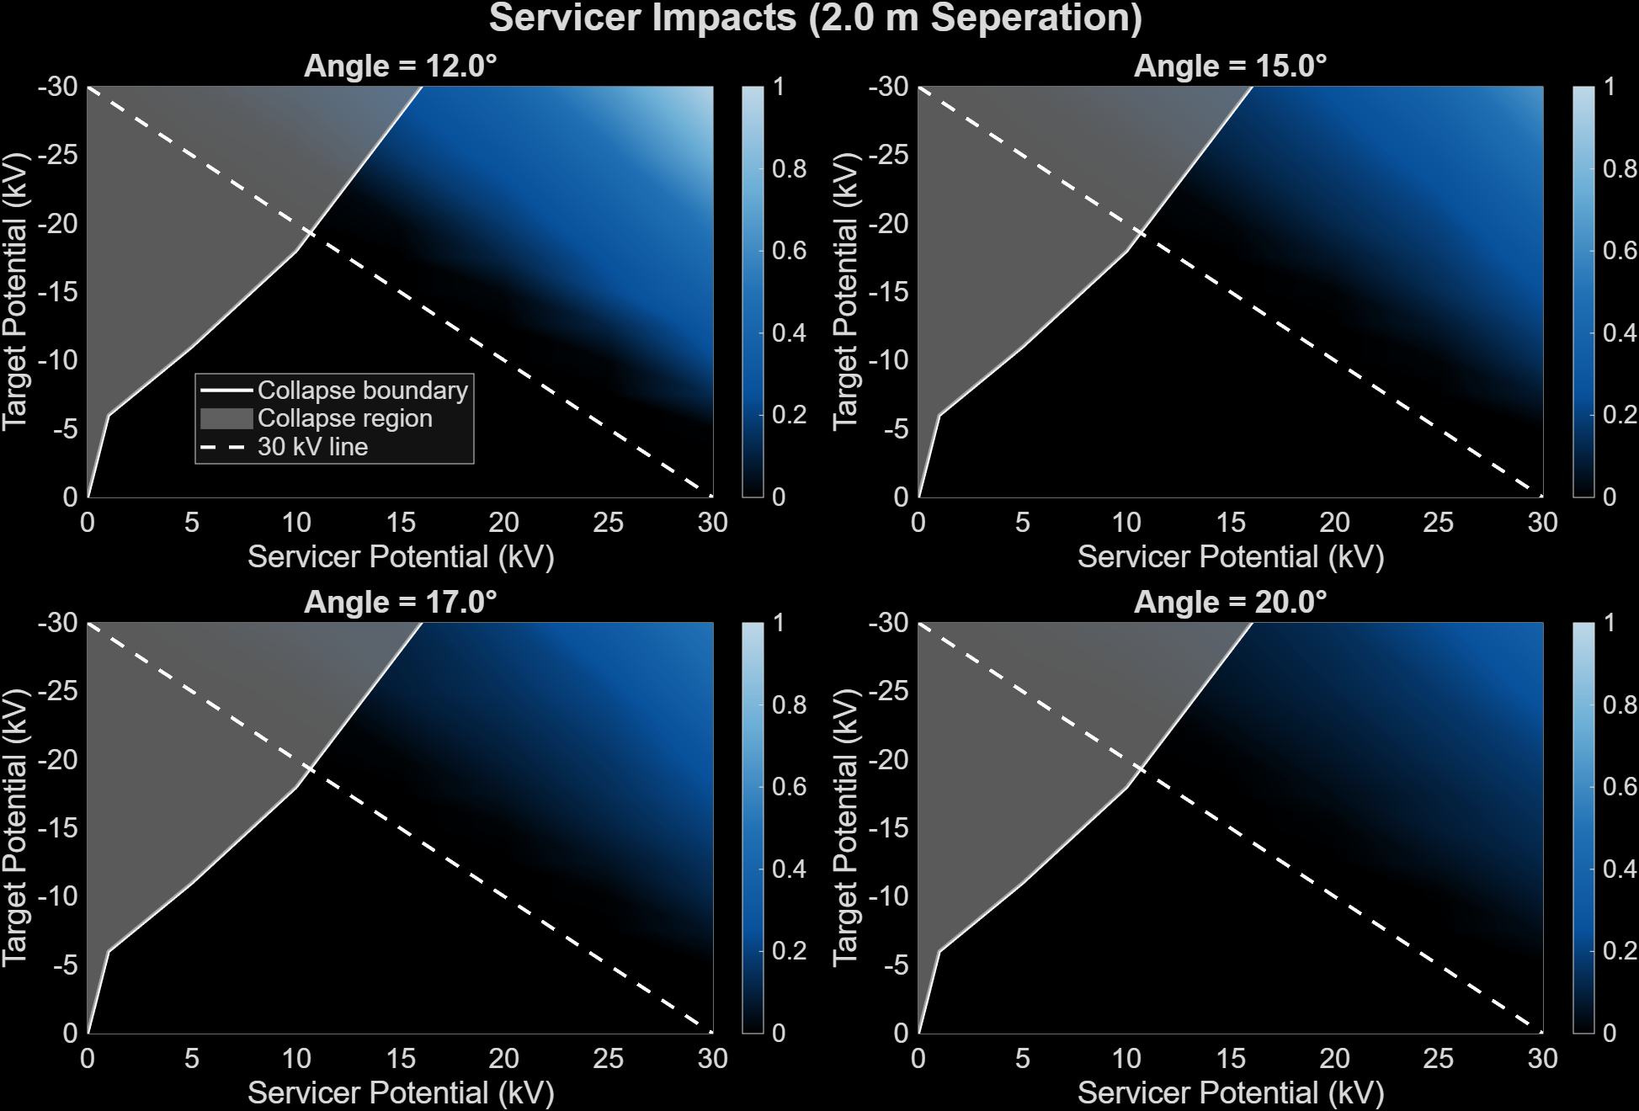
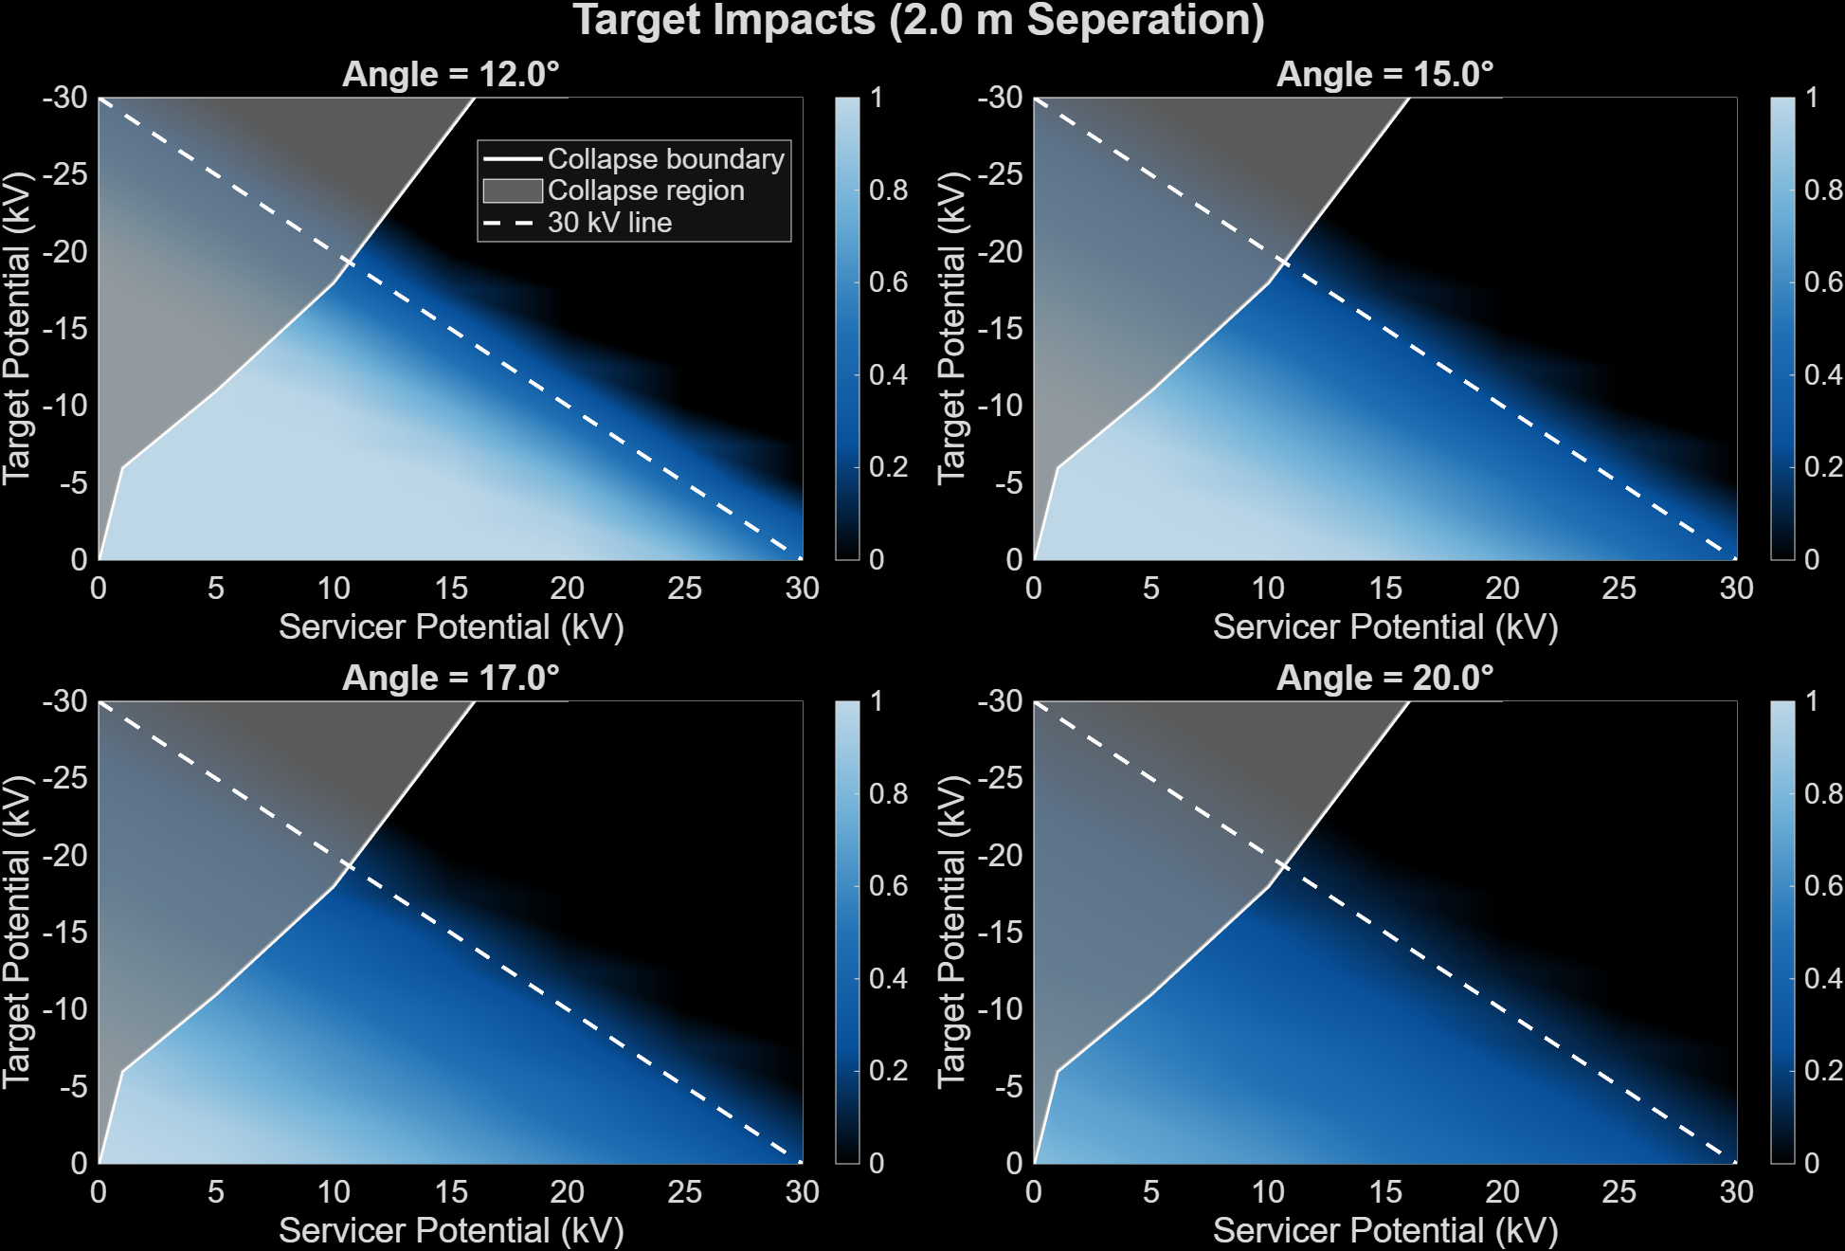
SIMION Results
Looking for balance between electron impacts and recollection

Slide 13
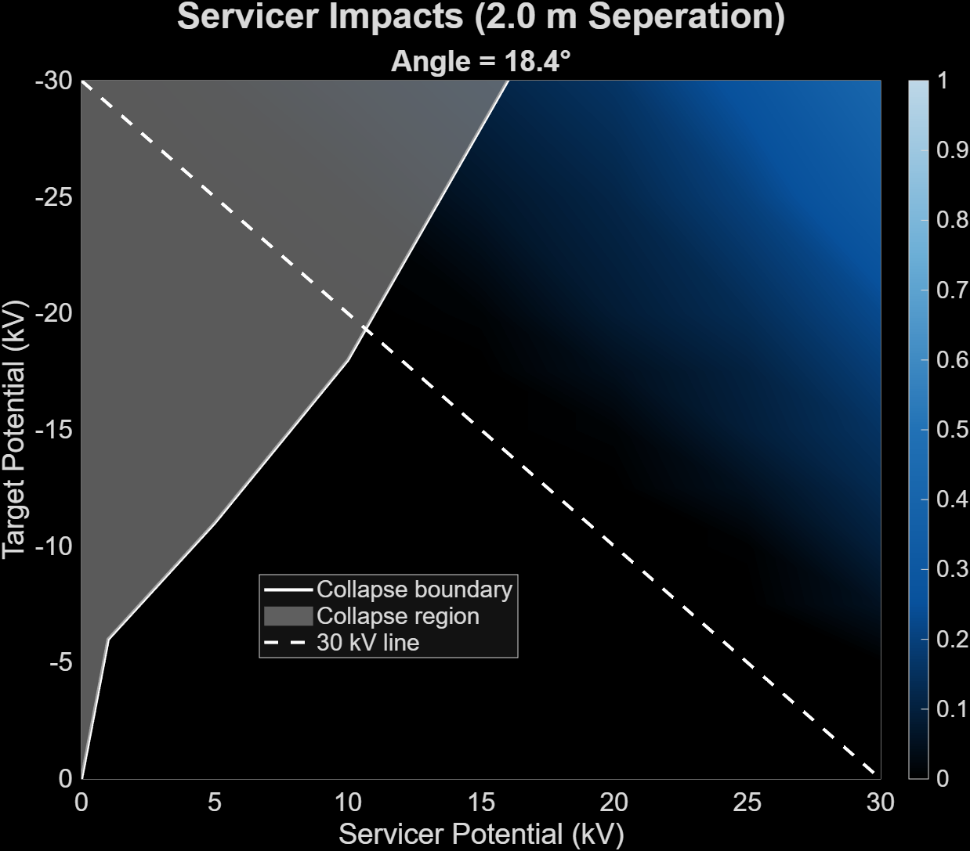
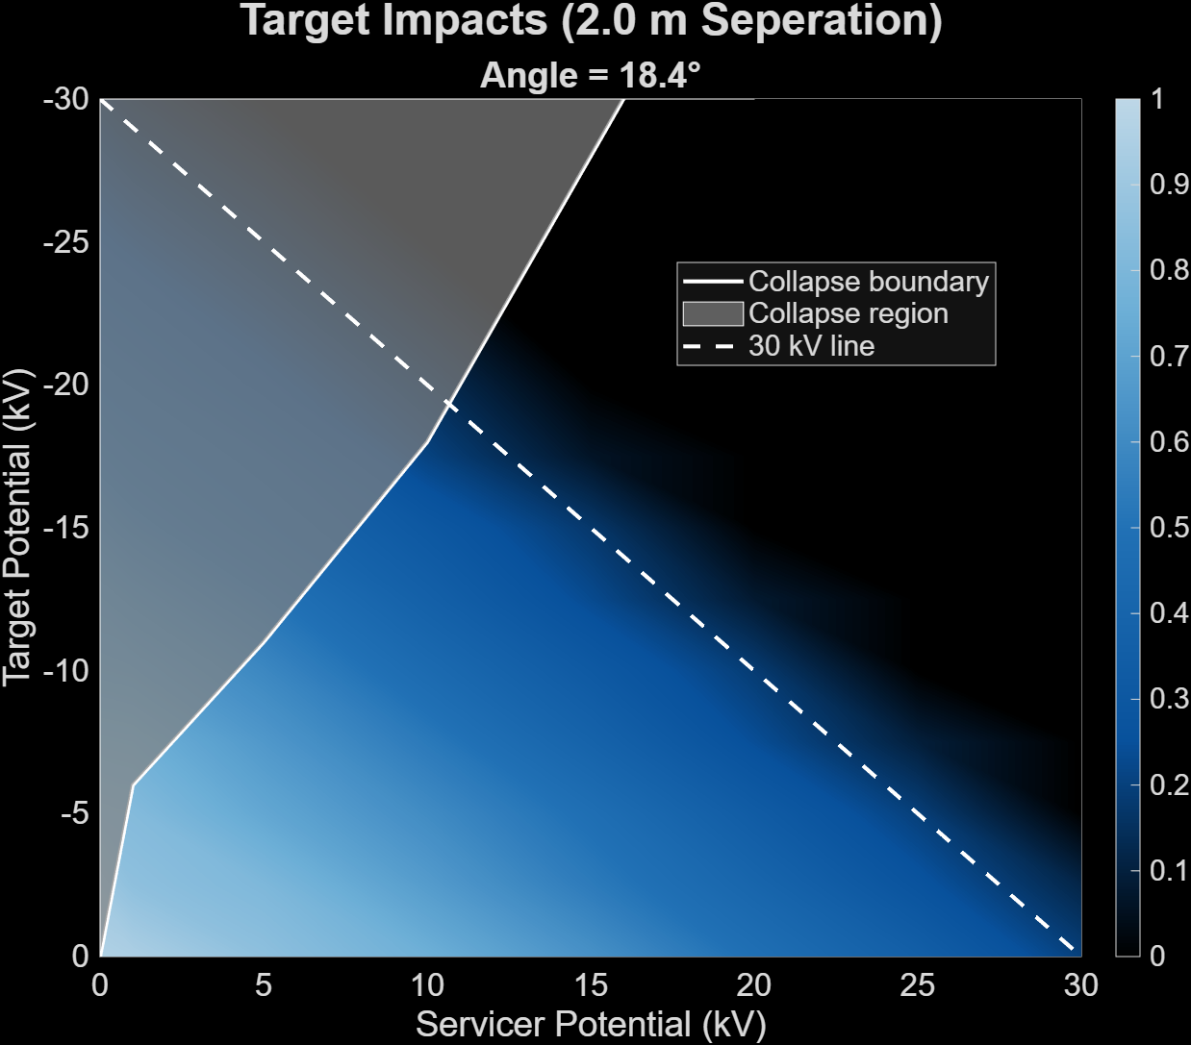
Proposed Beam Width
18.4°
Half Angle

Slide 14
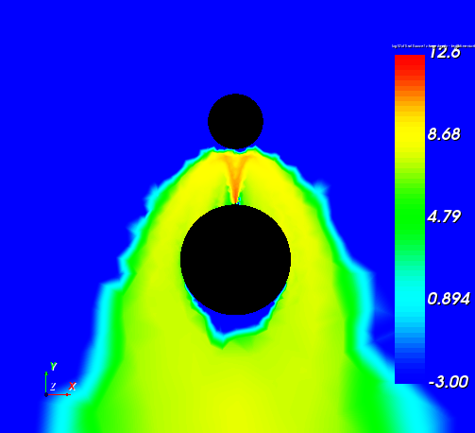
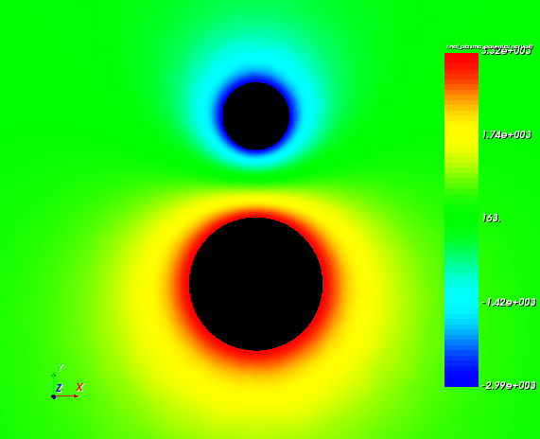
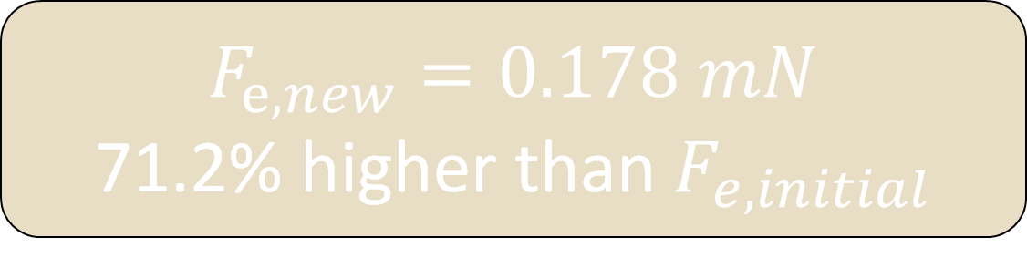
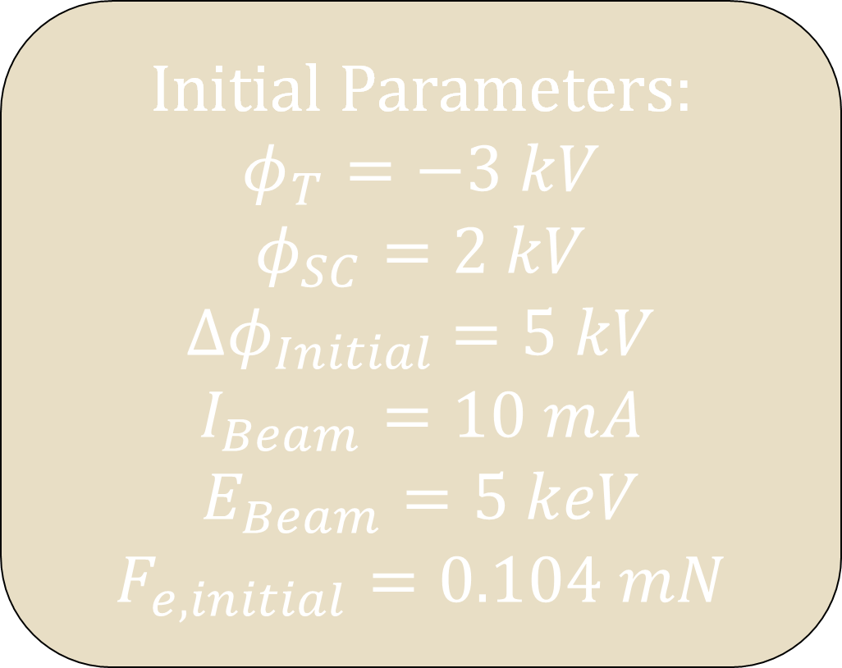

Supercharging Validation
To verify supercharging in a plasma environment, we start with a potential difference equal to the beam energy
-3 kV
Initial Parameters:
$φ_{T}=−3 kV$
$$φ_{SC}=2 kV$$
$${∆φ}_{Initial} =5 kV$$
$$I_{Beam}=10 mA$$
$E_{Beam}=5 keV$
$$F_{e,initial}=0.104 mN$$
3.32 kV
Servicer does not recollect all the emitted electrons
$${∆φ}_{Final/Initial} =+ 1.32 kV$$
$$F_{e, new}=0.178 mN$$
71.2% higher than $F_{e,initial}$

Slide 15
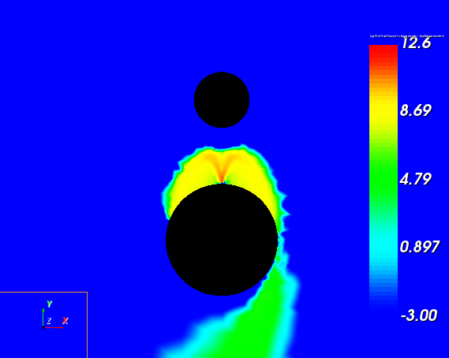
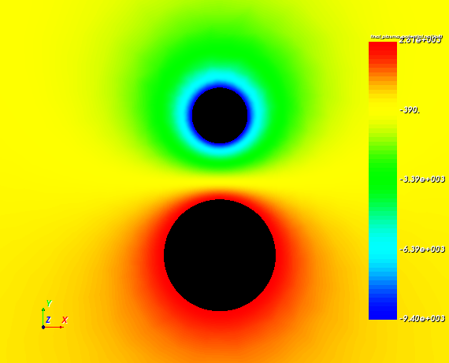
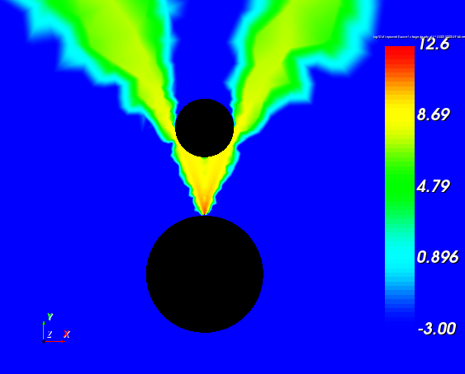
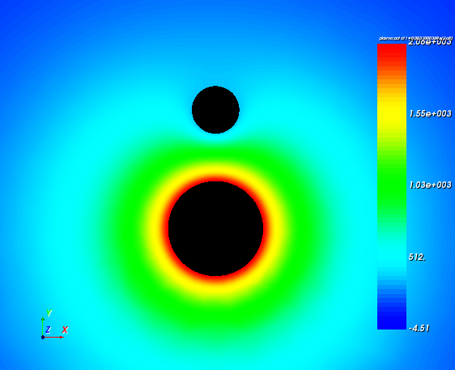
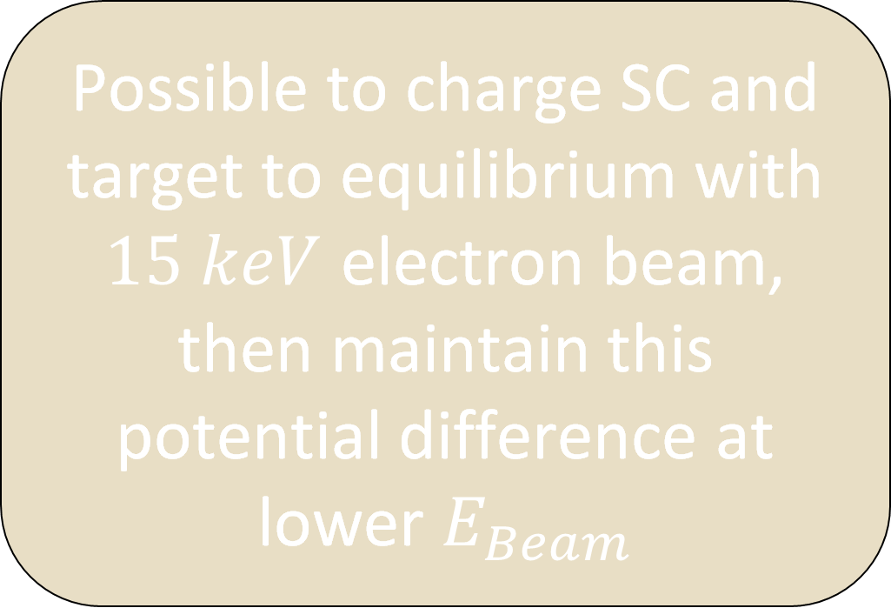
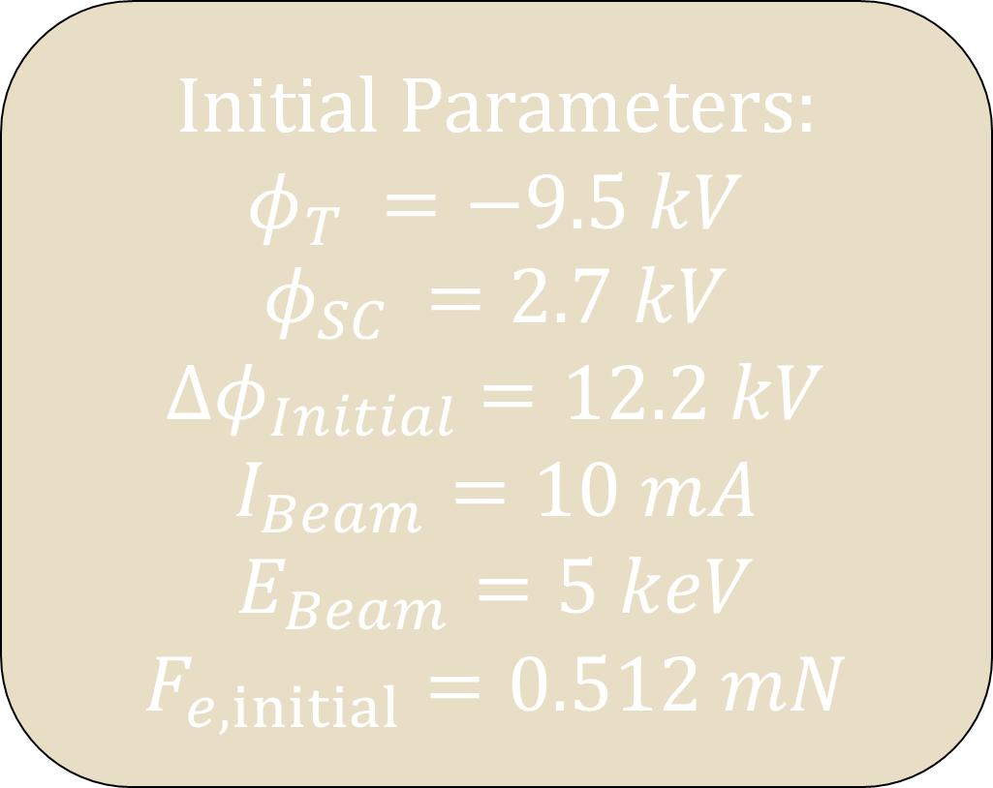
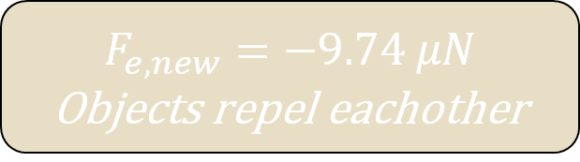
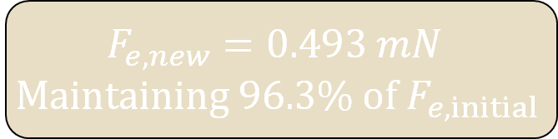
Applied Supercharging
Possible to charge SC and target to equilibrium with $15 keV$ electron beam, then maintain this potential difference at lower $E_{Beam}$
-9.4 kV
In wake
2.61 kV
$${∆φ}_{Final} =12.01 kV$$
Initial Parameters:
$$φ_{T }=−9.5 kV$$
$$φ_{SC }=2.7 kV$$
$${∆φ}_{Initial} =12.2 kV$$
$$I_{Beam}=10 mA$$
$$E_{Beam}=5 keV$$
$F_{e,initial}=0.512 mN$
$$F_{e,new}=0.493 mN$$
$$Maintaining 96.3\% of{ F}_{e,initial}$$
358 V
Not in wake
2.06 kV
$$F_{e,new}=−9.74 μN$$
Objects repel eachother
$${∆φ}_{Final} =1.7 kV$$

Slide 16
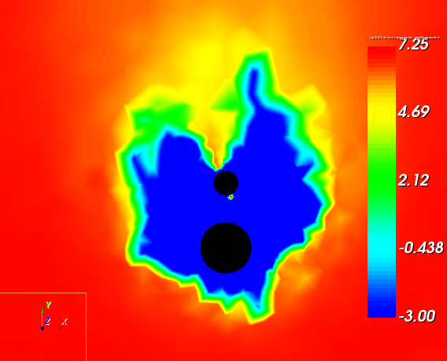
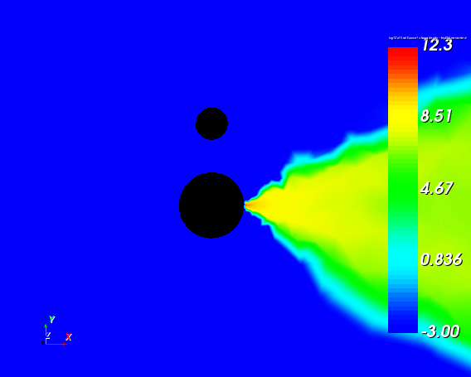
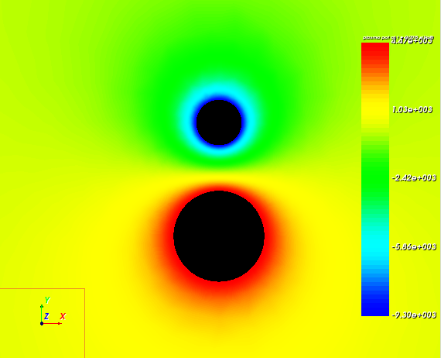
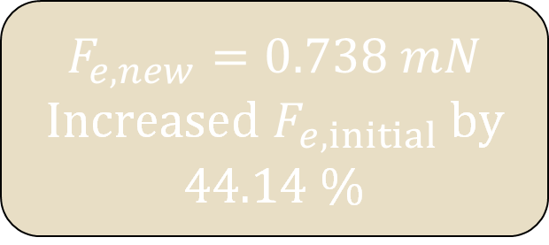
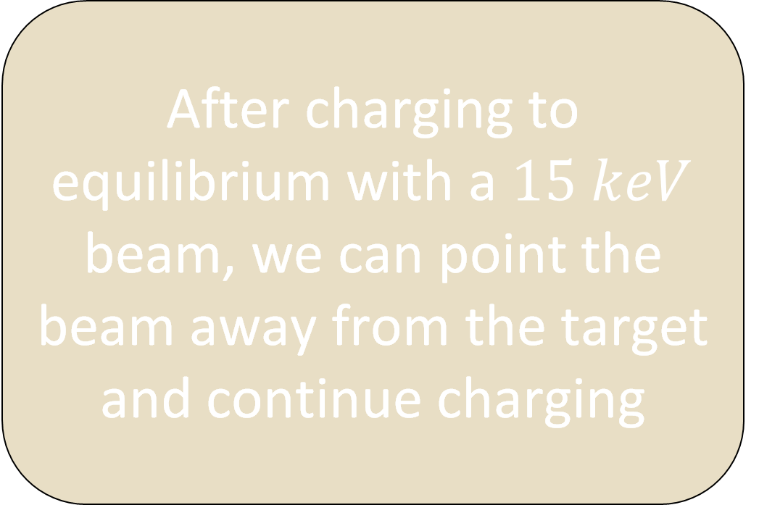
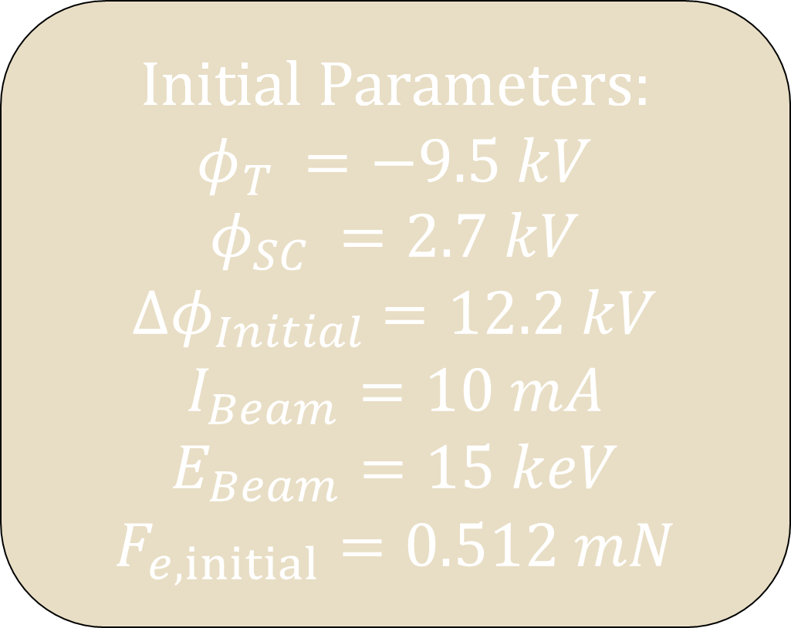
Additional Charging Application
After charging to equilibrium with a $15 keV$ beam, we can point the beam away from the target and continue charging
Wake has not collapsed
Beam emitted away from the target
Initial Parameters:
$$φ_{T }=−9.5 kV$$
$$φ_{SC }=2.7 kV$$
$${∆φ}_{Initial} =12.2 kV$$
$$I_{Beam}=10 mA$$
$$E_{Beam}=15 keV$$
$F_{e,initial}=0.512 mN$
-9.3 kV
4.47 kV
$$F_{e,new}=0.738 mN$$
Increased $F_{e,initial}$by 44.14 %
$${∆φ}_{Final} =13.77 kV$$

Slide 17
Summary
1. Supercharging must occur inside of a plasma wake
2. A wider beam width, to an extent, provides better supercharging
3. It is possible to maintain a significantly higher potential difference than the energy of the beam if the target stays in the wake
4. It is possible to continue charging passed equilibrium by pointing the beam away from the target

Slide 18
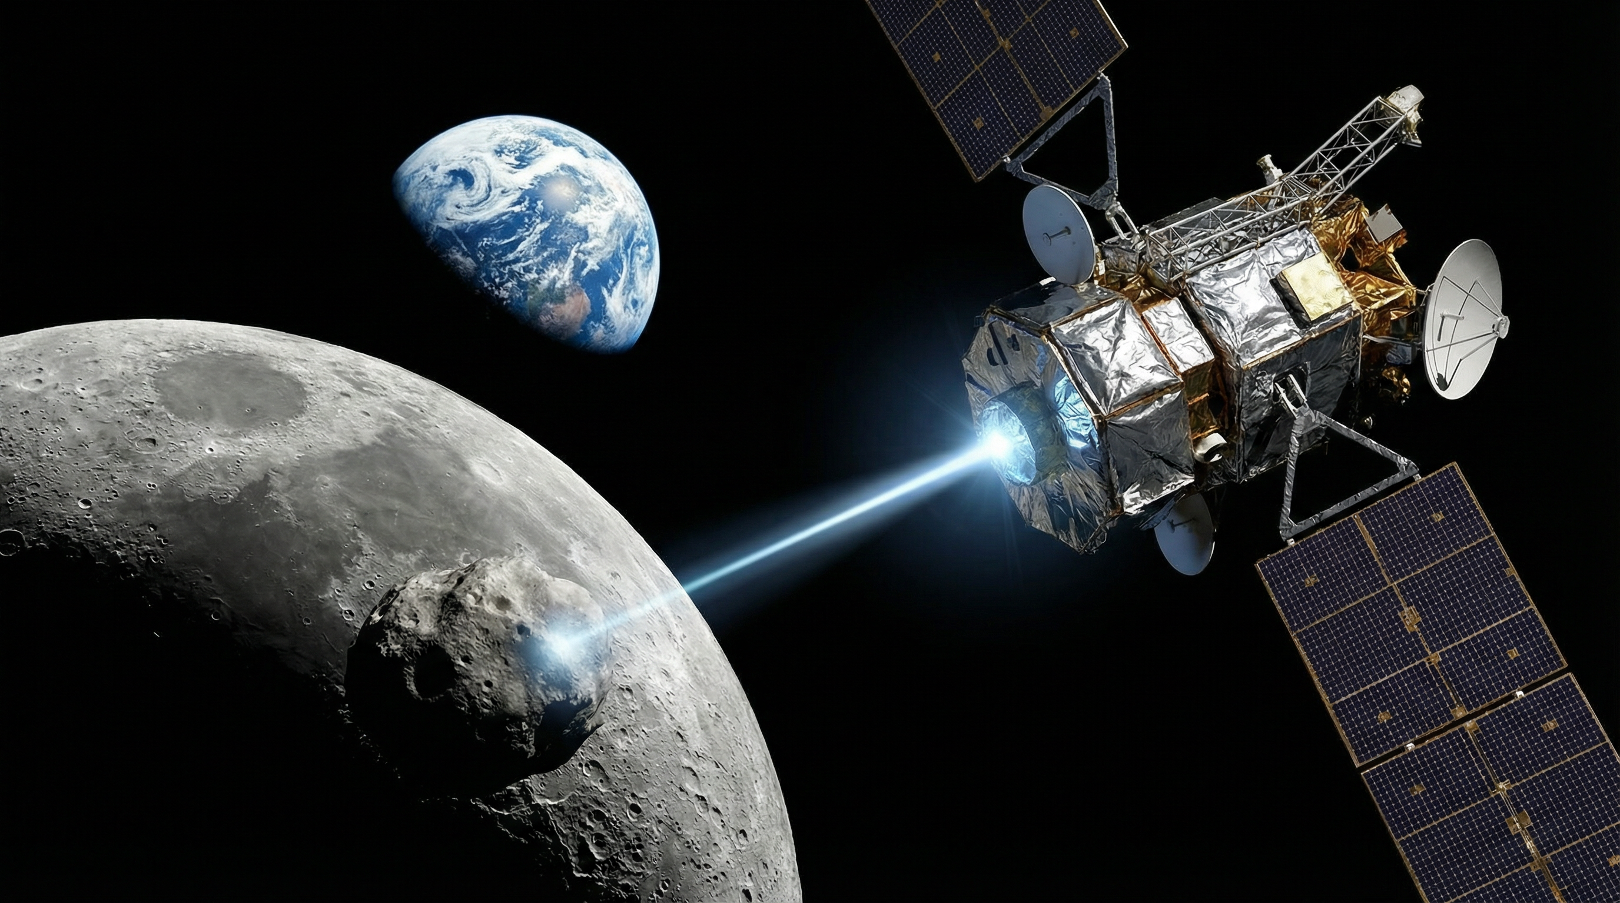
Next Steps
Explore supercharging in additional mesothermal regions (Cislunar, LEO)
Apply supercharging concepts to more realistic geometries
Optimize beam width, separation distance and beam energy and current
Explore uses in active charge or attitude control

Slide 19

References
Acknowledgements
[1] Strain, Daniel. “Space tractor beams may not be the stuff of sci-fi for long.” Phys.org, June 1, 2023. https://phys.org/news/2023-06-space-tractor-sci-fi.html
[2] European Space Agency. “Space debris - evolution in pictures.” ESA. https://www.esa.int/About_Us/ESOC/Space_debris_-_evolution_in_pictures
[3] Case, Nathan A. Solar Wind-Magnetosphere Interactions: A Statistical Analysis of Spacecraft Measurements. PhD thesis, Lancaster University, April 2014. https://doi.org/10.13140/2.1.2588.8321
Kaylee Champion, Graduate Student, University of Colorado Boulder
Hanspeter Schaub, Faculty Advisor, University of Colorado Boulder
Discovery Learning Apprenticeship, University of Colorado Boulder
Sharon Anderson, University of Colorado Boulder
U.S. Air Force Office of Scientific Research (AFOSR) under grant FA9550-23-S-0570

Slide 20
Questions?

