Slide 1
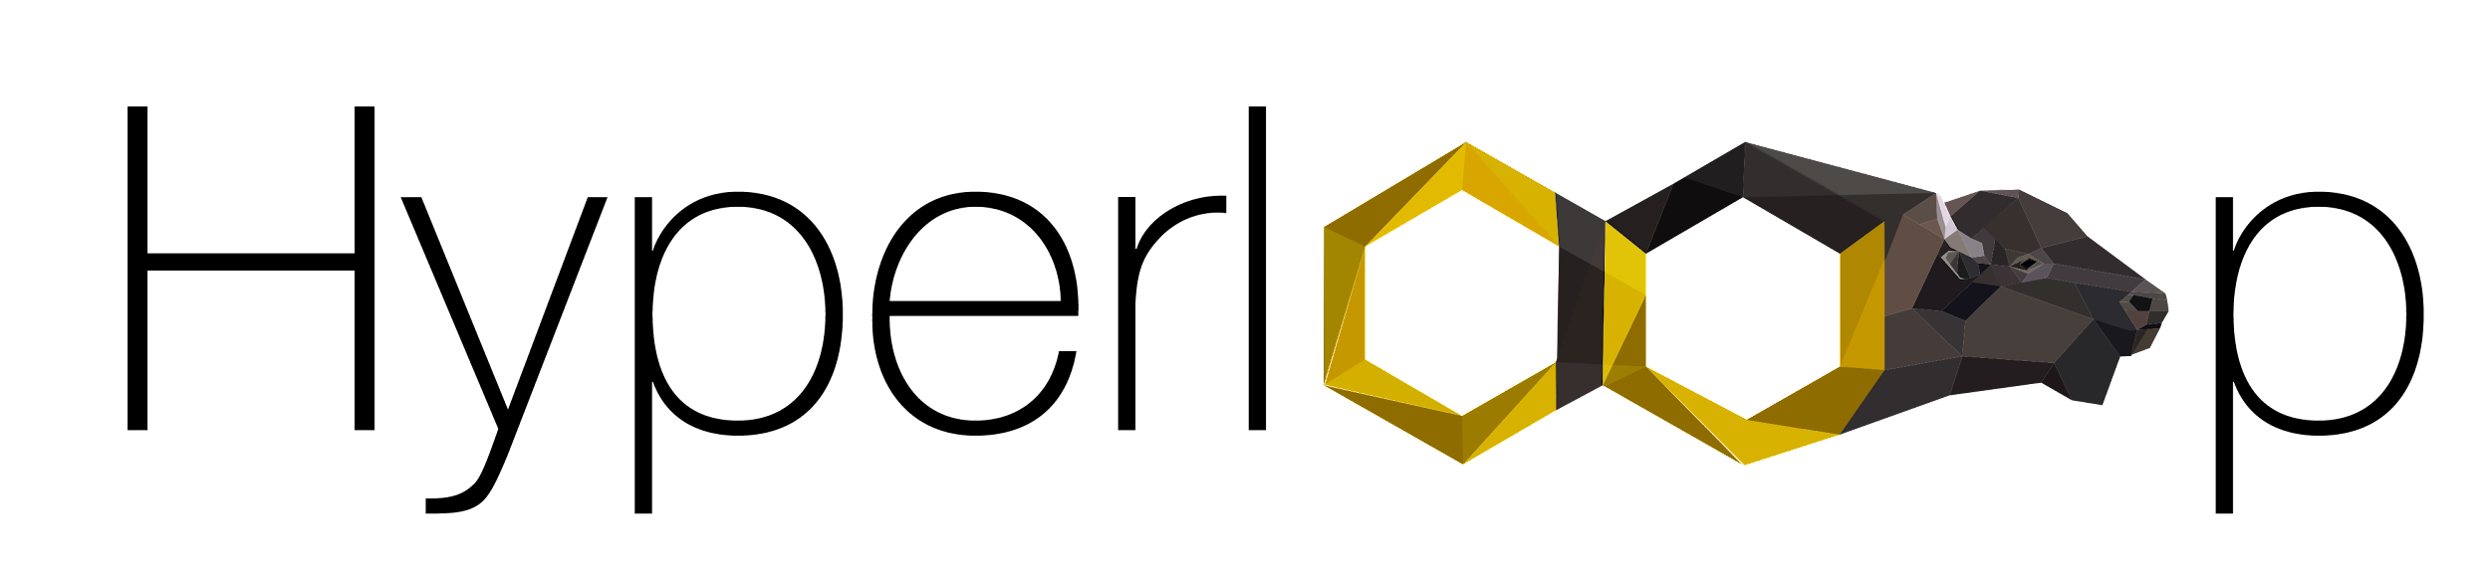
Propulsion
Design Review

Slide 2
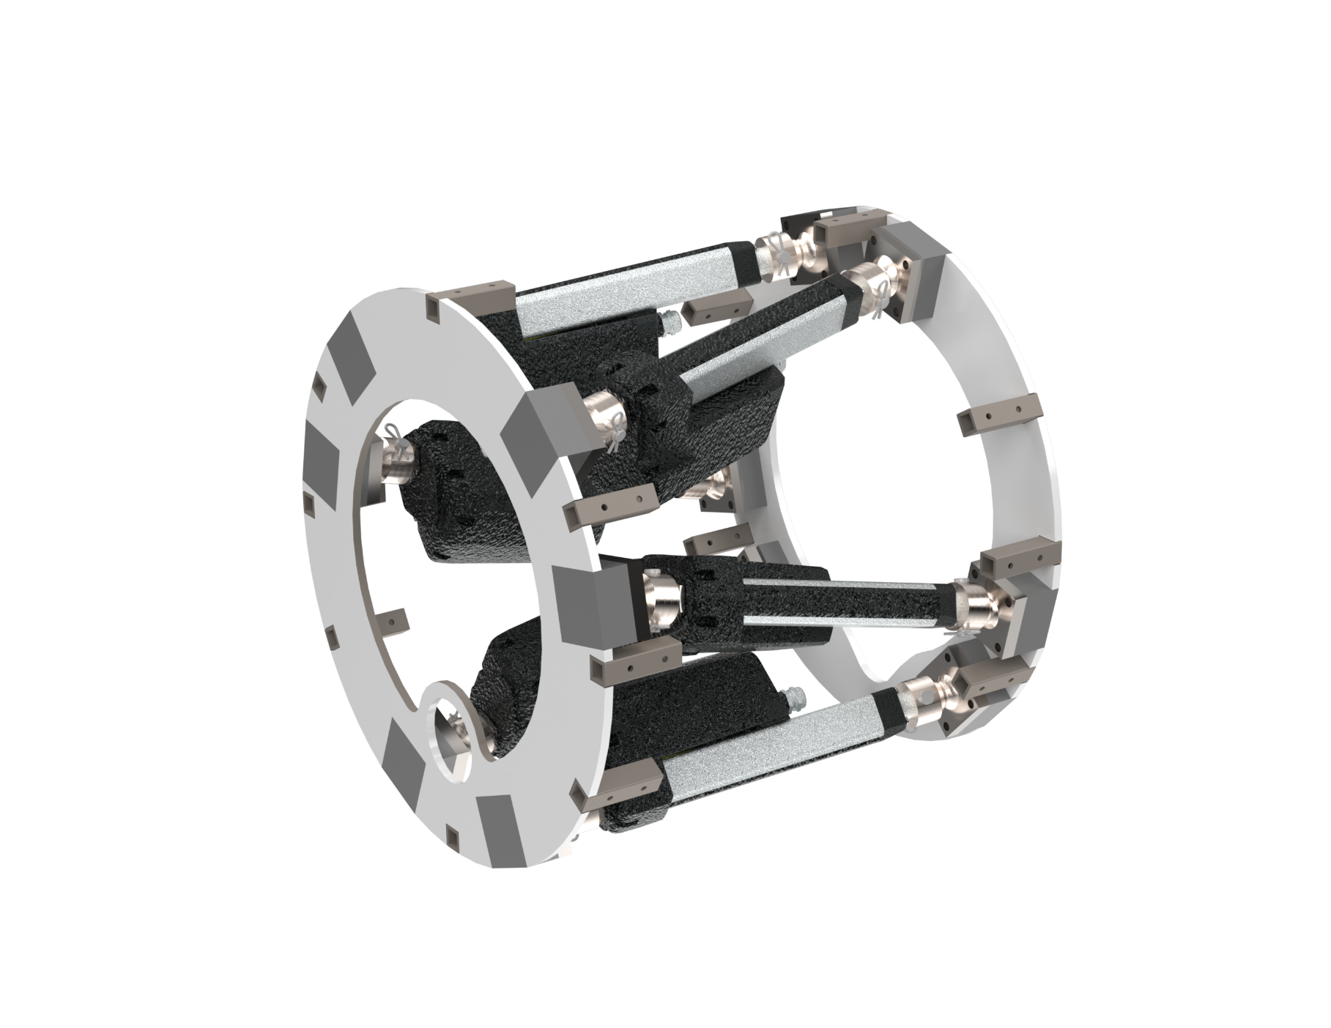
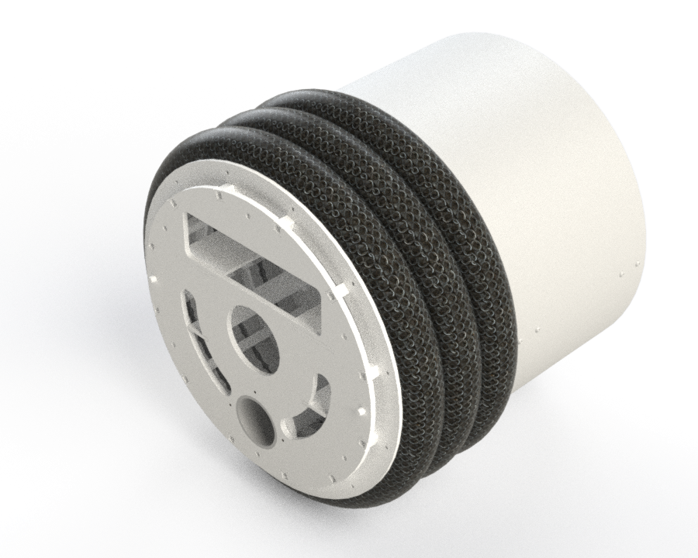
Overview
TBM moves forwards using Grippers and a Hexapod
Active/Pushing
Pulling
Grippers:
Grippers will be made from bicycle tire inner tubes covered by a puncture resistant material.
The inner tubes expand into the walls of the tunnel providing a frictional force to resist the thrust force needed to dig.
            With a compressor on the surface, inflatable grippers help us save valuable space onboard the machine
            Inflatable grippers are intrinsically resistant to soil ingress
            Inflatable grippers help us distribute forces on soil better/more evenly
            Grippers surrounded by Grade 80 chain to transfer load into structure
Hexapod:
6 axis Stewart platform provides dig force as well as steering control
                Encoders in each actuator to give a precise length measurement of each actuator for forward kinematics
            Angles between actuator joints are non-symmetrical to allow for better organization of internal components
            Base/Platform plates are cut with a waterjet to ease assembly and increase accuracy of angles

Slide 3



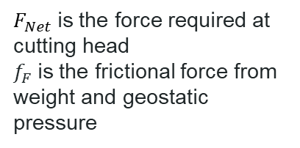



Hexapod
Thrust Force Analysis – How much force do we need from the hexapod
$F_{Net}$is the force required at cutting head
$f_{F}$is the frictional force from weight and geostatic pressure
$$F_{Net}$$
$$F_{req}$$
$$f_{F}$$
At Max Depth:
Hand calcs:
$f_{F}=18.4kN$
$$F_{Net}=21.1kN$$
$$F_{req} =f_{F}+F_{Net}$$
= $39.5kN$ Required

Slide 4











Hexapod - Geometry
Hexapod geometry – Want to distribute even pressure on the front section/cutting head, but also reduce slope from last year
  Decrease angles on the back plate
$$θ$$
$$F_{thrust}=F_{A} cos(θ)$$
$$θ_{1}=14.1deg$$
$$θ_{2}=11.8deg$$
$$F_{A}=10000 N$$
$$F_{thrust}$$
$$F_{thrust,1}=9.70kN$$
$$F_{thrust,2}=9.79kN$$
$$F_{thrust,tot}=(1−μ)(4F_{thrust,1}+2F_{thrust,2})$$
Including potential losses from friction ~15% :
$$F_{thrust,tot}=49.0kN$$
$$F_{req}=39.5kN$$
$$Performance Factor=1.24$$

Slide 5
Hexapod Ball joints
Max Force:
Push:
FoS: 4.24
Pull:
FoS: 2.34

Slide 6
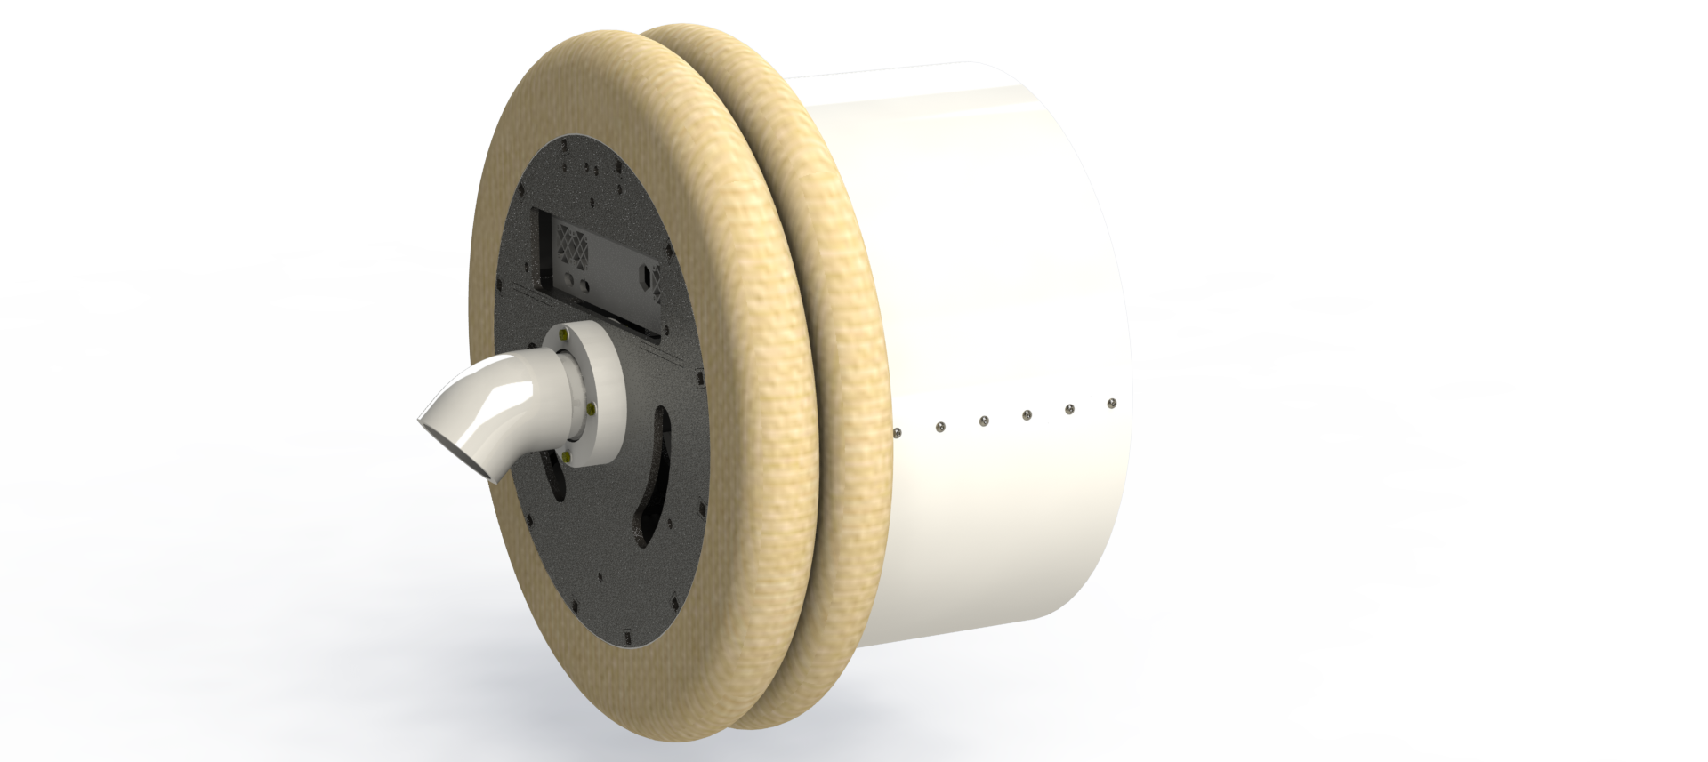




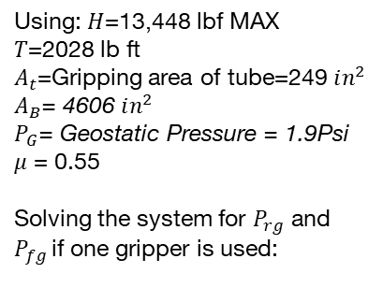








Grippers - Pressures
$f_{g}=$gripper friction (rotational/translational)
$H=$Hexapod Thrust Force
Using: $H$=13,448 lbf MAX
$T$=2028 lb ft
$A_{t}$=Gripping area of tube=249 $in^{2}$
$A_{B}$= 4606 $in^{2}$
$P_{G}$= Geostatic Pressure = 1.9Psi
$μ$ = 0.55
Solving the system for $P_{rg}$ and $P_{fg }$if one gripper is used:
$$H=f_{g,t}+f_{s,t}$$
$$T=r(f_{g,r}+f_{s,r})$$
$$F_{tot}=\sqrt{H^{2}+T^{2}}$$
$$f_{bs}=P_{g}∗A_{B}+μW_{b}$$
$f_{s}=$Shell friction (rotational/translational)
$T=$Cutting Head Torque
$$P_{rg}={(F}_{tot}−f_{bs})/μA_t$$
Using: H = $f_{s}+Max Thrust force=$8927.8
(Rear Gripper)
(Front Gripper)
$$P_{rg}=34.2psi$$
$$P_{rg}=15.13 psi$$
$$P_{fg}=73.59 psi$$
Rear gripper pressure is lower than front due to extra weight/surface area of back section

Slide 7
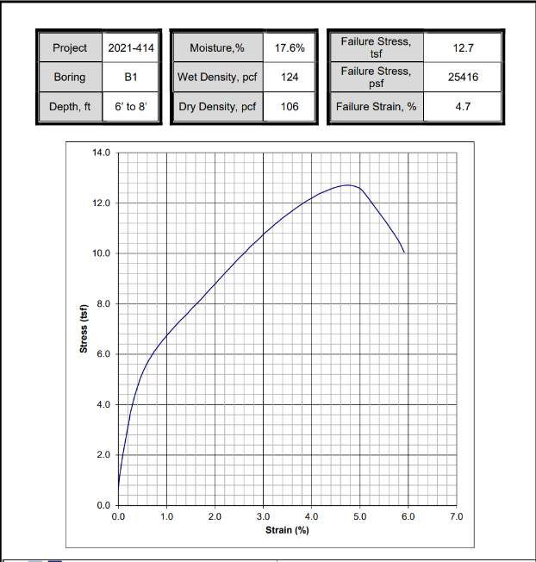
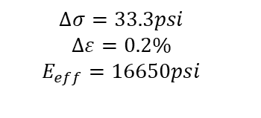
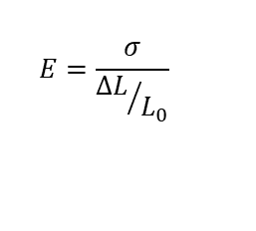




Grippers – Soil Deformation
Approximated from Geotechnical Report:
$$E=\frac{σ}{{∆L}/{L_{0}}}$$
$$∆L=\frac{σL_{0}}{E}$$
$$E=\frac{∆σ}{∆ε}$$
Using $σ=73psi$(inflation pressure)
$L_{0}=2ft$ (tunnel diameter)
$$∆σ=33.3psi$$
$$∆ε=0.2\%$$
$$E_{eff}=16650psi$$
$$∆L=0.27cm$$

Slide 8
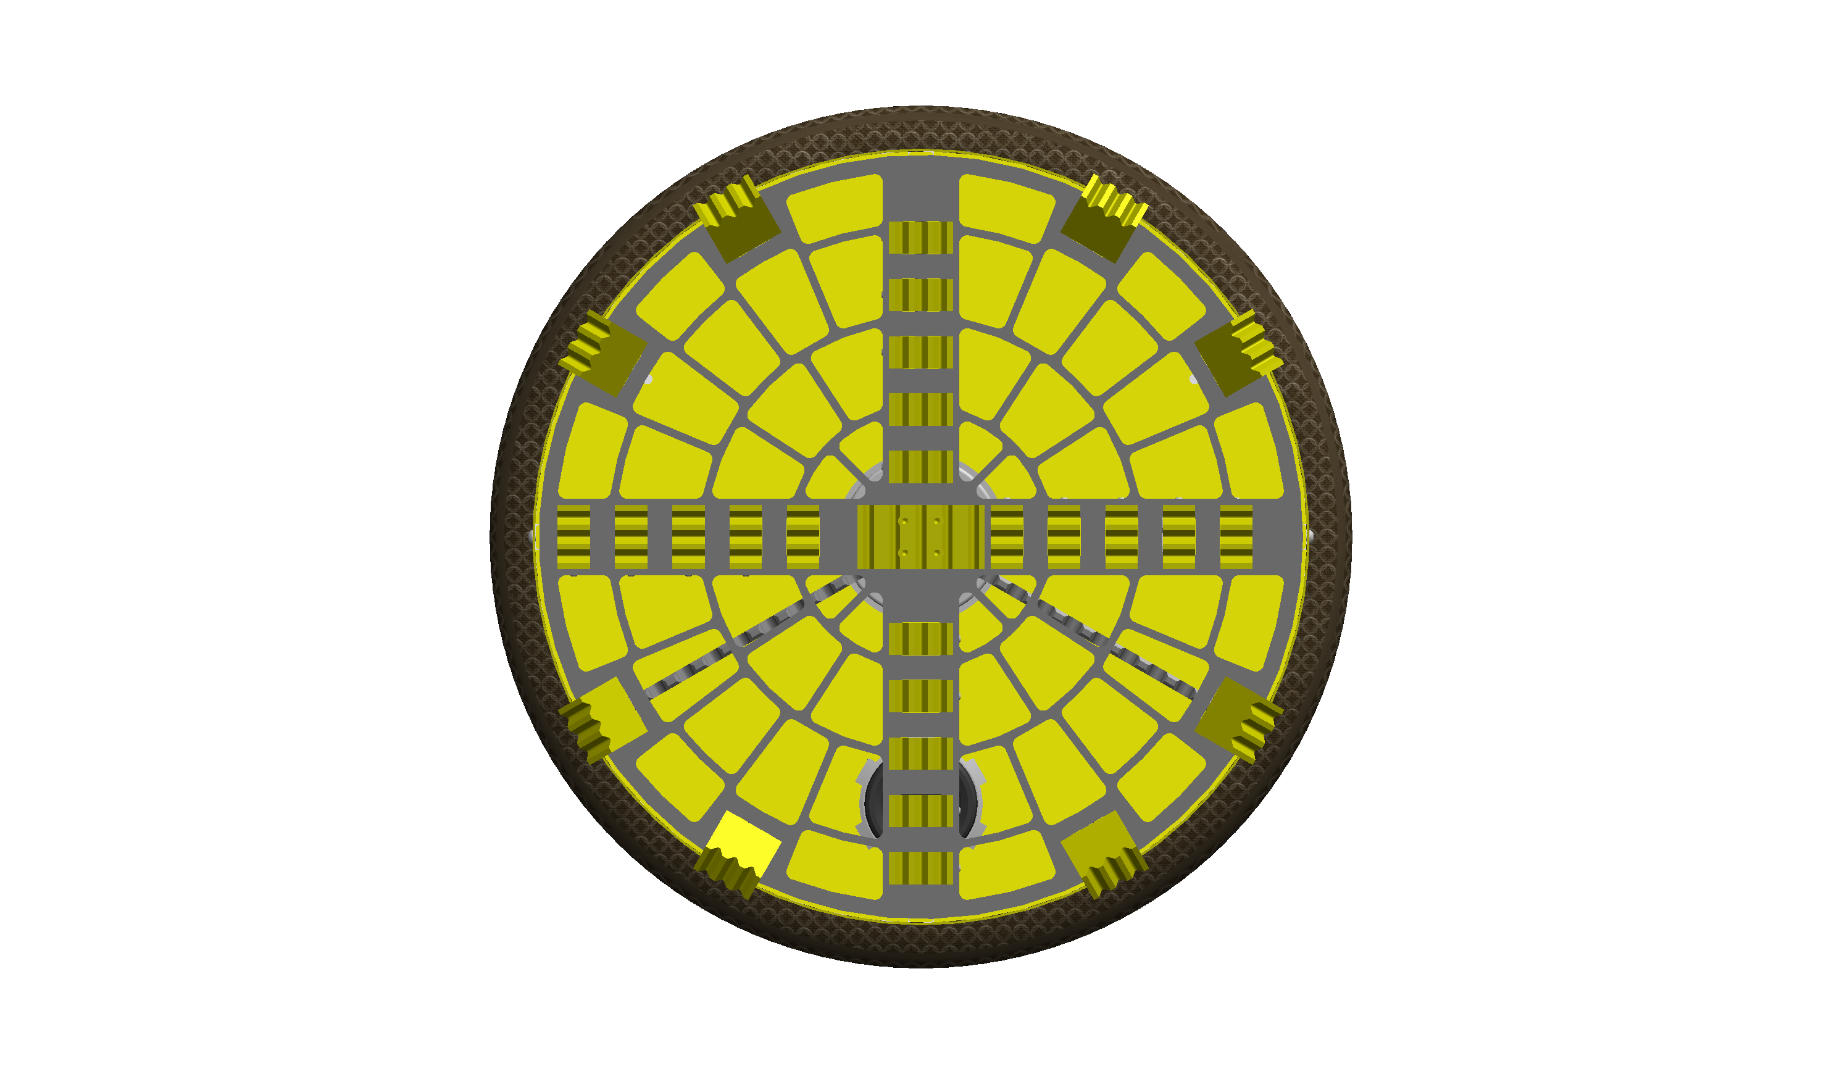

Grippers
Inflated
Deflated
Actuation Distance
Using a 3" inner tube with a gap of 1.41" gives:
3”-1.41” = 4.03cm of potential gripper actuation distance
Overcut
Effective actuation distance: potential – overcut =
4.03cm – 1.05cm = 2.98cm

Slide 9




Grippers - Shroud
Three Problems:
  Punctures
  Bulging
  Force Transfer

Slide 10
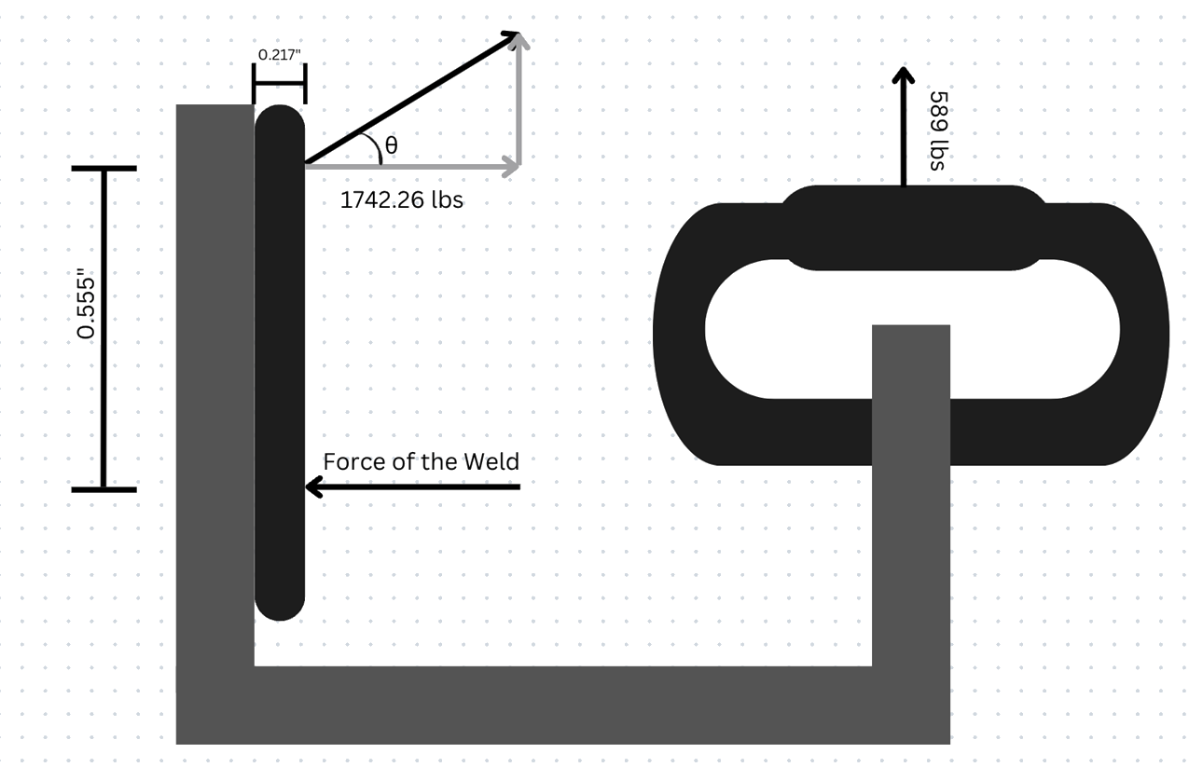
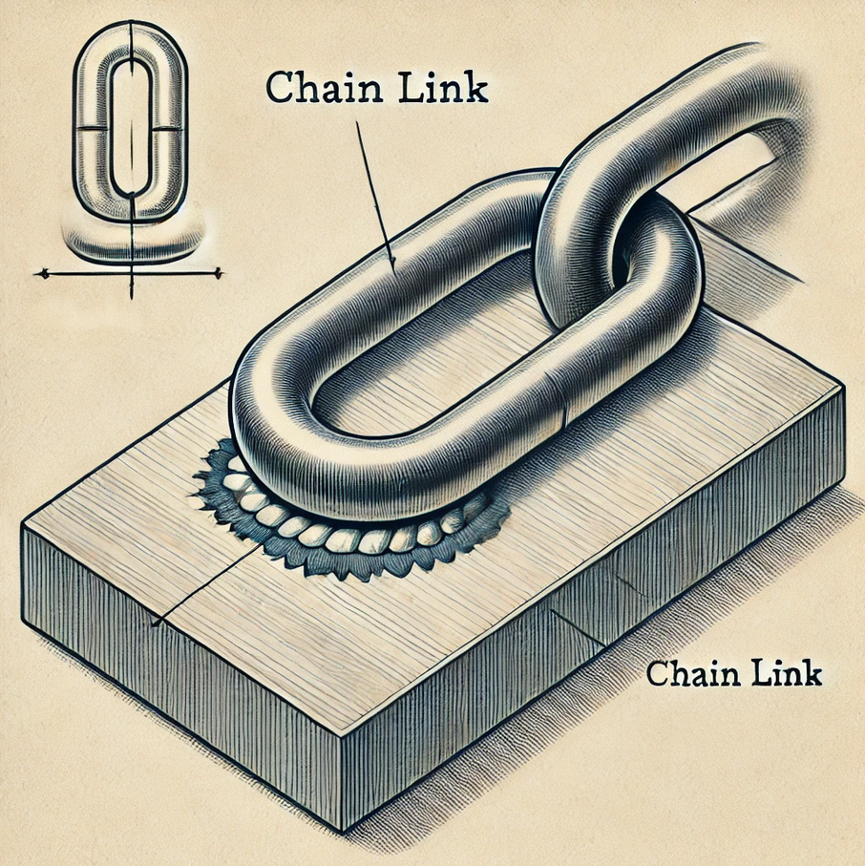
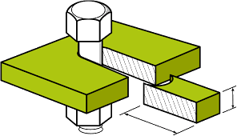
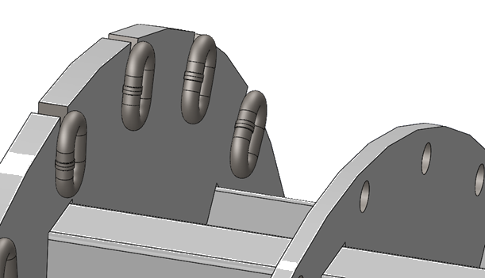
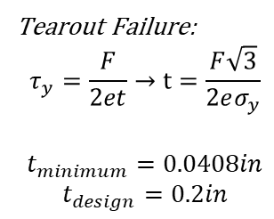

Grippers - Structural
Load capacity of 1,400 lbs
(Chain capacity 2100lbs)
e
t
Safety factor of the weld
Tearout Failure:
$$τ_{y}=\frac{F}{2et}→t=\frac{F\sqrt{3}}{2eσ_{y}}$$
$$t_{minimum}=0.0408in$$
$$t_{design}=0.2in$$
$$FS=\frac{flcos(45°)}{{\sqrt{3}β}_{w}Fcos(θ)}=47$$

Slide 11
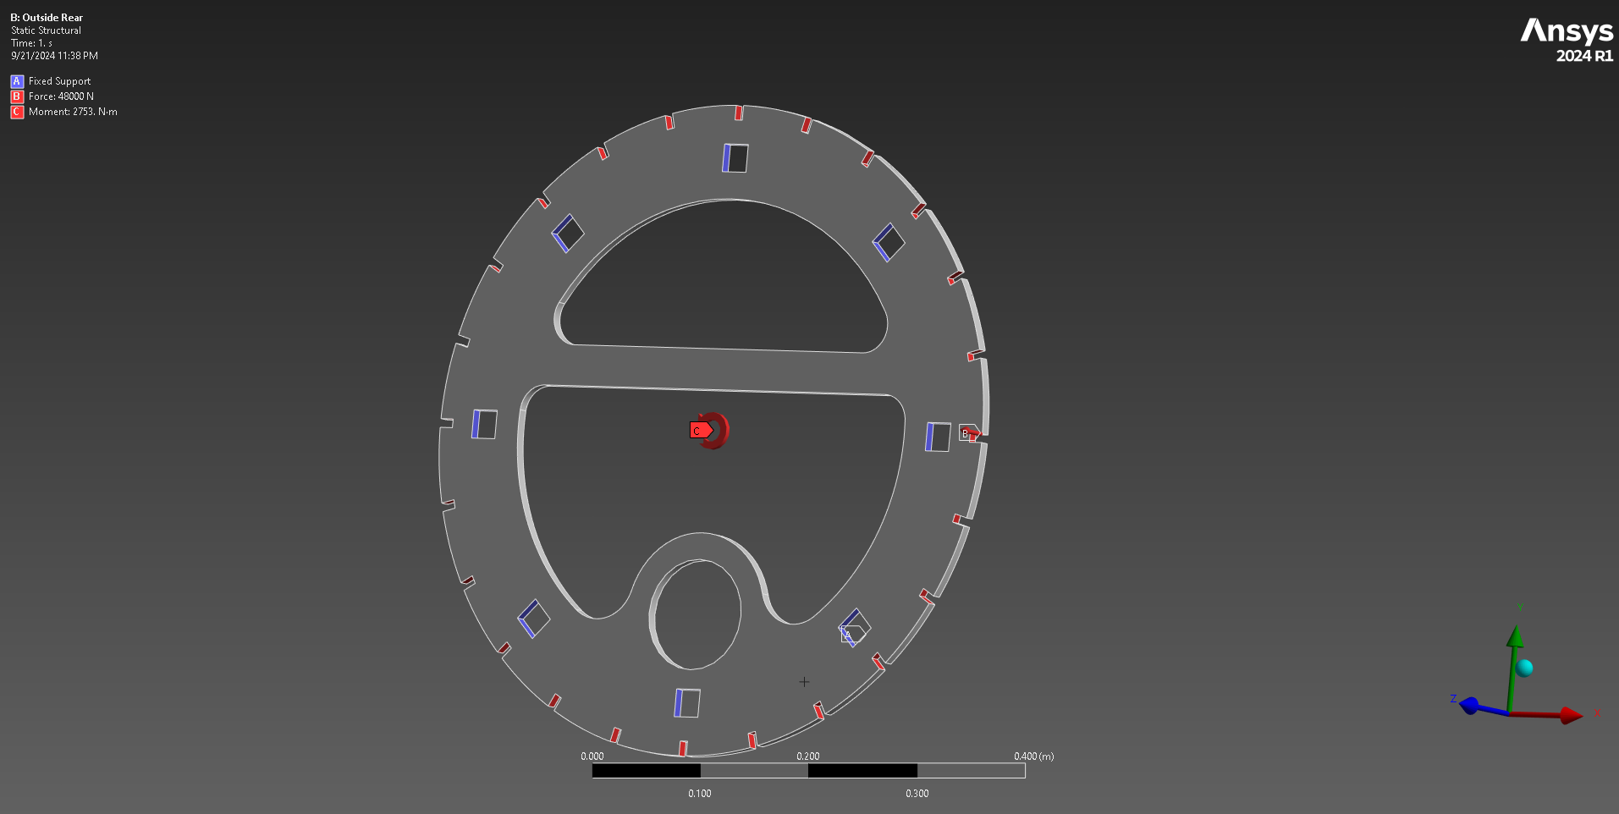
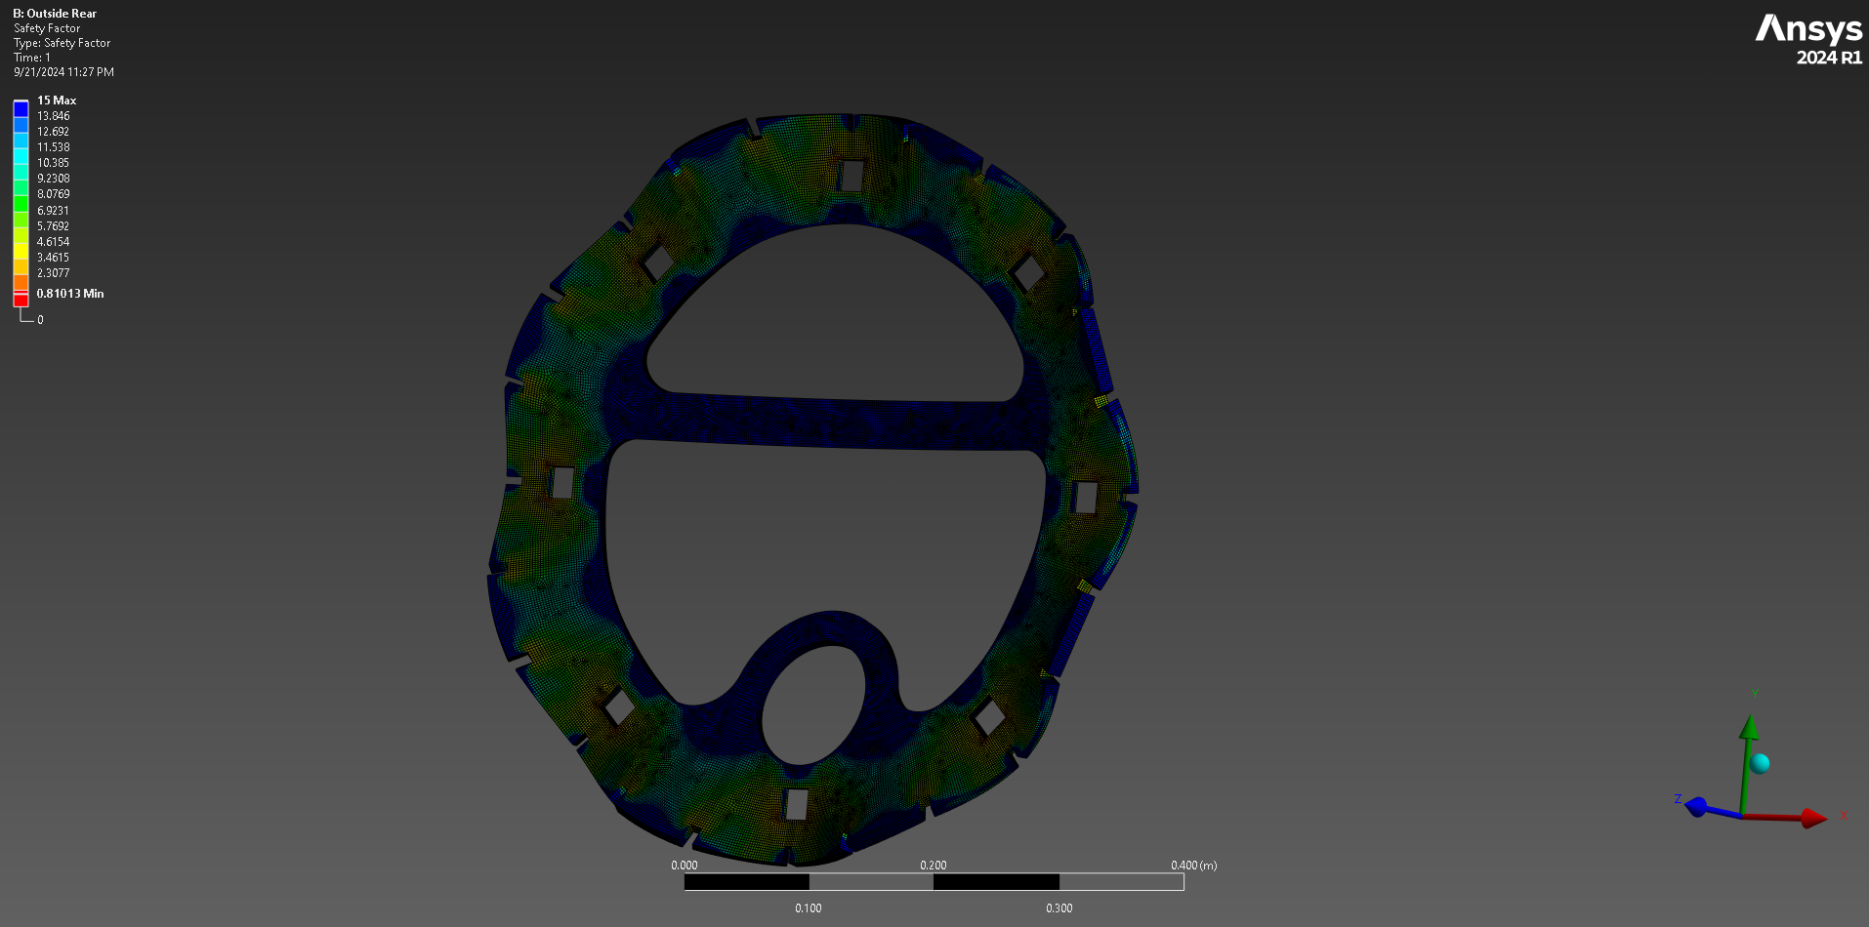
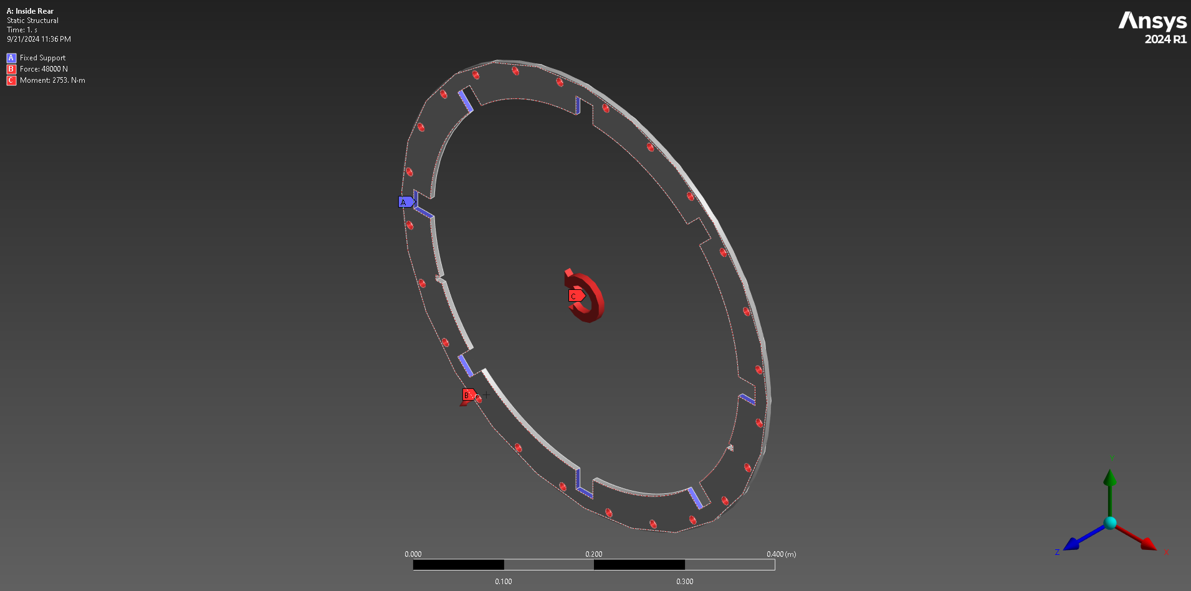
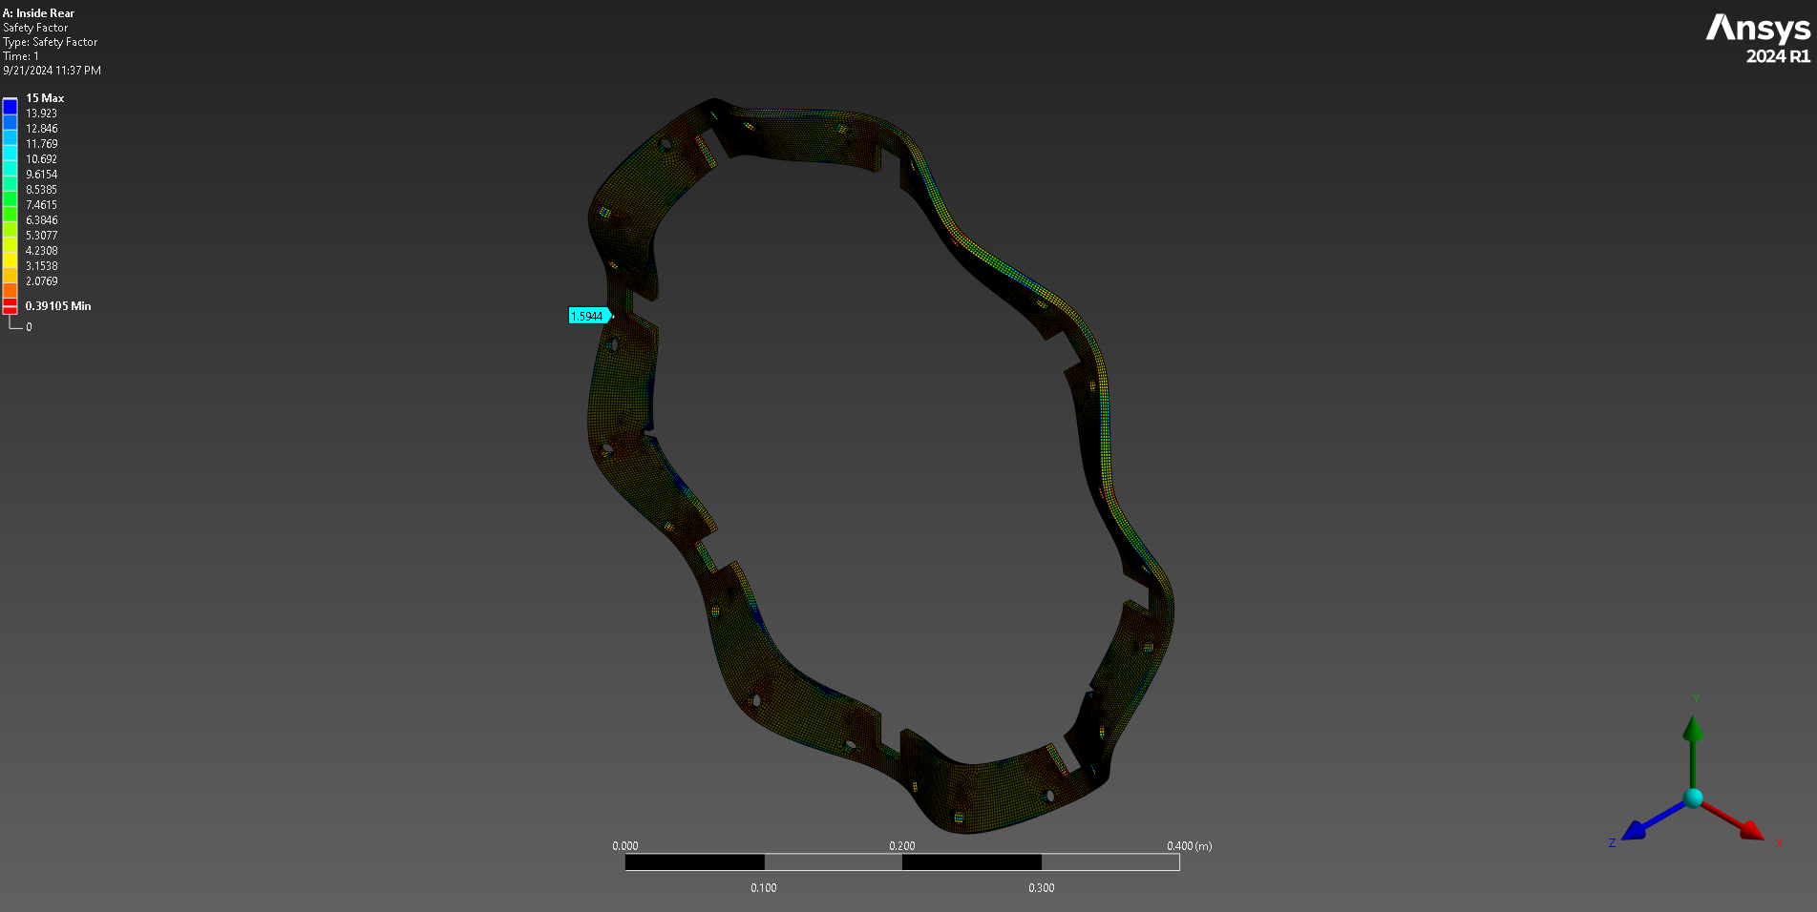
Gripper Analysis
Non-boundary FOS: 2.8
Non-boundary FOS: 2.7

Slide 12
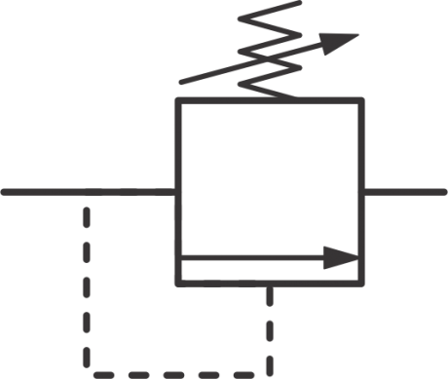
Grippers – Pneumatics
Single compressor feeding parallel circuits for front and rear grippers
  Compressor & valves on surface exterior to TBM, running 120 PSI line to valves
  Pressure transducers on board TBM to give most accurate pressure reading
Solenoid operated directional valve with piloting
Tubes have individual valves in case of puncture or control failure
  Normally closed.
Full State Table Below:
  Full Stroke Sequence: Dig Stroke, Transition, Return
FDV | RDV | Hexapod | Outcome
0 | 1 | Pushing front | Dig stroke
1 | 0 | Pulling back | Return
1 | 1 | 0 | Transition
0 | 0 | 0 | No motion
1 | 0 | Pushing front | Reverse stroke
0 | 1 | Pulling back | Reverse return
RDV
FDV
20psi
20psi
Compressor
120psi

Slide 14
OUTLINE
General overview:
system
Hexapod – mama & papa shell, model
Grippers – why inflatables
Hexapod:
Thrust force FBD/analysis
Geometry – reduce slop, even forwards pressure on cutting head
Hexapod forces – given geometry, FEM, friction (GREASE IN BALL JOINTS), DO SHEAR ANALYSIS ON PLATES/WELDS ON SOCKETS
Grippers:
Geometry analysis – overcut vs expansion, inner tube deflation, expected soil deformation: shroud length
f two tubes + compartmentalization
Thrust Force analysis – surface area assumptions, introduce bulging problem; shroud + testing results
Load path
Structural Force analysis – Worst case scenario calcs (bearing, tearout, bolt shear, gripper plate tearout) (FEM?)
Inflation time testing
Shroud retention – Testing + Spring calcs, worst case scenario (dragging)
Pneumatics – circuit with sensors and annotations, state table
f Pressure loss (minor losses)

