Slide 2
Current LDC projects
Data packet
DIMA API
PG DB
MET
Stream ingest
Main API
Data packet
Ingestion
NRI API

Slide 3
Postgres database current state
DB
schemas in current use:
  public_dev: used by client-side applications
    Intended for development
  gis: custom shapefiles and other layers
  postgis: postgis functions
  public_test: used by backend applications
    Intended for testing database operations: migrations, functions
    Main API
    Packet download service

Slide 4
Postgres database ideal state
DB
main schemas:
  Public: live data that is publicly accessible through API’s
  Data_portal_config: mirrors Public, configured for client-facing applications
  Public_dev: staging database that is only QC’d before going live
  Public_test: Used for internal development
  GIS: custom layers used by our applications
  postgis: postgis internal functions and types

Slide 5
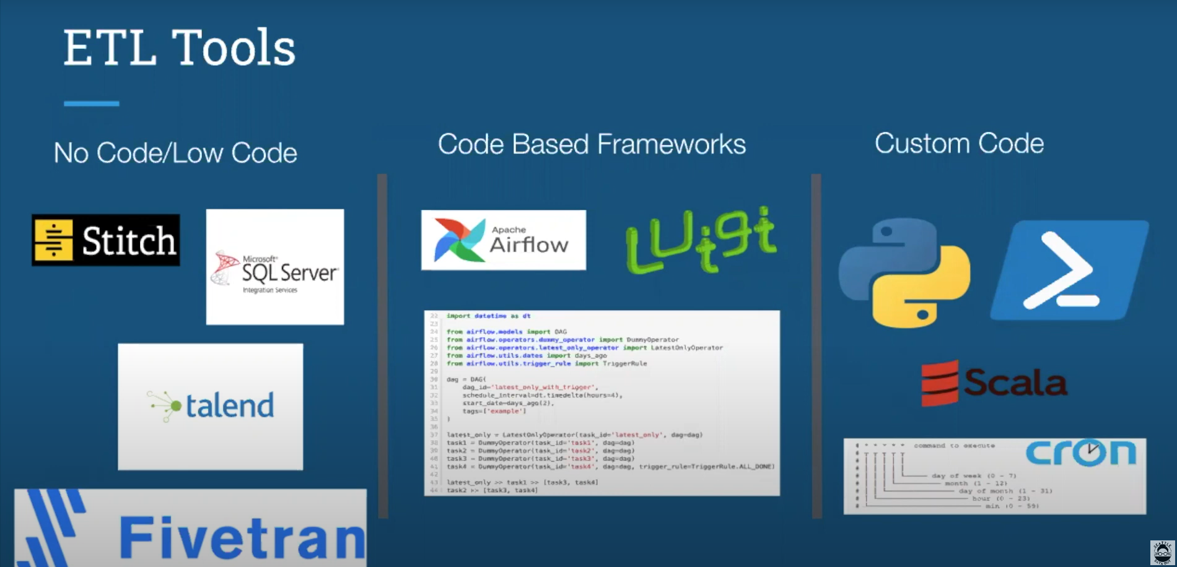
Ingestion current state
DB
Ingestion

Slide 6
Ingestion current state
1st step: DIMA ingestion
2nd step: Tall table ingestion
Access
DIMA PG DB
CSV’s
TALL PG DB
python
python
Extract tables from access db
Make composite tables for PK (plot + line + header etc.)
QC miscellaneous artifacts from join operations
Send to DIMA PG DB
Extract tables from CSV
Fix/transform some fields into PG compliant types
Enforce non-header tables match with header
Send to tall table PG DB

Slide 7
Ingestion ideal state
DB
Ingestion

Slide 8
Ingestion current state: challenges
DB
Ingestion
Dimas:
  Dima version specifications; exact changes per version
  Better logging
  No record of ingestion cycles
Tall tables
  Enforceable schemaTable/schemaPlan for each ingest cycle with types, type lengths, possible enums etc. for check constraints
  Better logging
  No record of ingestion cycles
Ingestion flow for new datasets

Slide 9
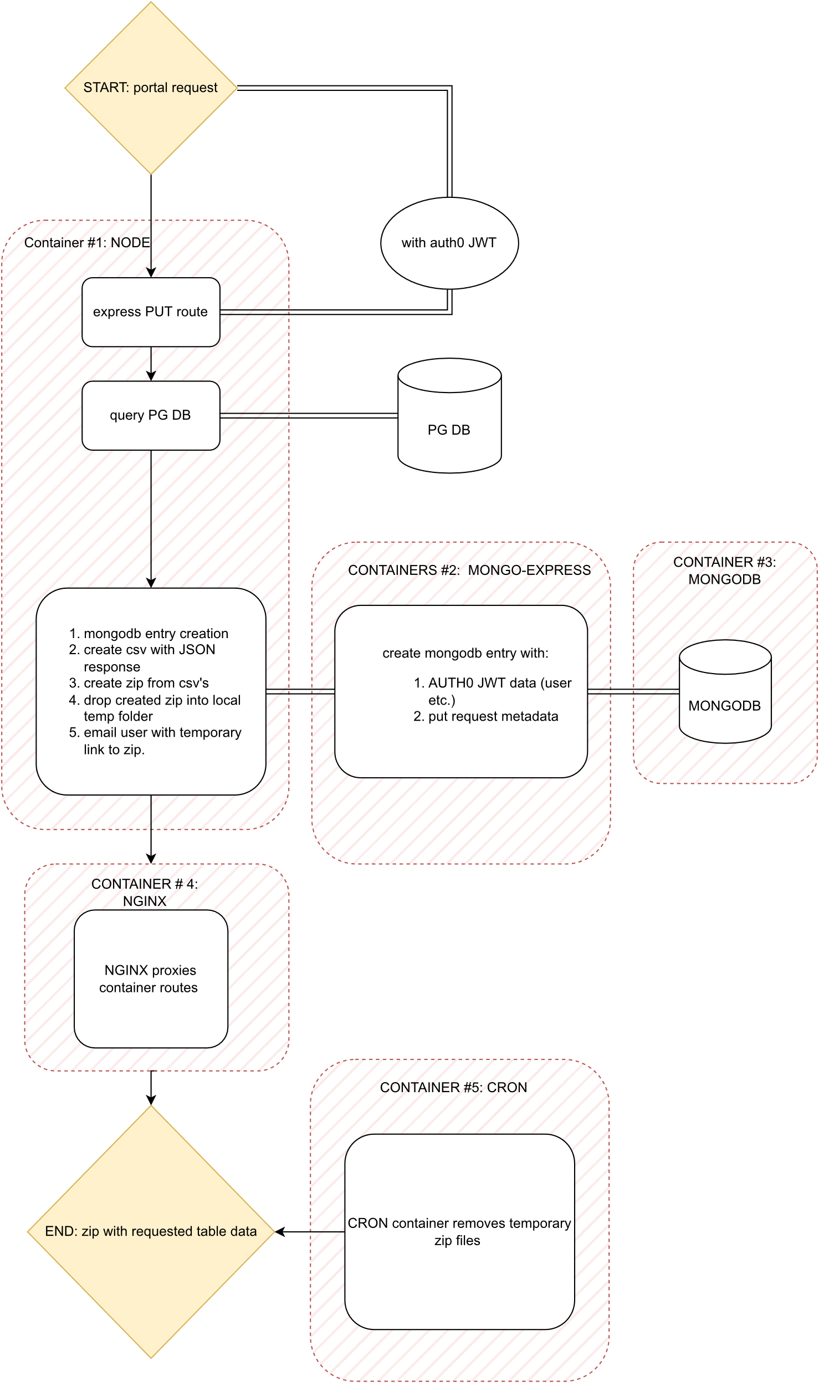
Data packet service current state
Data packet service
    5 container setup:
      Node application that serves the data
      Mongo express that enables mongo DB management
      Mongo DB that records each request
      NGINX to enable communication between each container
      Container with a cron-scheduled node function to delete expired requests (data packets)

Slide 10
Data packet service ideal state
Data packet service
    Refactored Node app to ease maintenance and improve scalability
    Migrate auth provider to AWS Cognito

Slide 11
Main API current state
Main API
Currently consists of:
  13 table routes, each with pagination
  Autogenerated documentation using SwaggerJS
  Uses NestJS typescript framework and PrismaJS as an ORM which creates the queries according to the typescript code
  No authentication/authorization flow yet

Slide 12
Main API ideal state
Main API
  Auth is implemented on each route
  Prisma client has access to PG users
Nest JS API
restricted
DB
Prisma client
Nest Routes
NWERN
Requests
NDOW
NRI
Security layer 1
Security layer 2

