Slide 1
Bacchus-Winery Case Study
Presentation by Lane Dorscher, Chelsea Mcelhiney, and Pedro Avila (Group A)
For CSD-310 Database Development and Use

Slide 2
Overview
Family-owned winery producing 4 key wines: Merlot, Cabernet, Chablis, and Chardonnay
Wanting better visibility into key areas of the business:
Inventory and Supply levels
Supplier delivery performance
Wine distribution and sales
Employee work hours
Proposed Solution:
Uses a normalized MySQL database to organize and connect related business data
Reports used the stored data to help management identify problems and support business decisions
Notes:
Bacchus Winery needed a better way to organize its operational data and turn it into useful information capable of guiding important business decisions.
Focused on the business’ proposed main areas: inventory and suppliers, supplier deliveries, wine distribution and sales, and employee hours.
The design aims to avoid unnecessary duplication and build reports to answer these questions.

Slide 3

Database Design
Designed in Third Normal Form (3NF) to reduce redundant data
Used primary and foreign keys to maintain relationships between business entities
Used junction tables for many-to-many relationships:
SUPPLIER_ITEM – items can be provided by multiple suppliers
DISTRIBUTOR_ITEM – wines can be carried by multiple distributors
Combined supplies and wines into a shared ITEM table, differentiated by CATEGORY:
SUPPLY – materials used by the winery, not for resale
PRODUCT – wines sold by the winery
Separated order headers, details, deliveries, and shipments to avoid repeated order-level information:
PURCHASE_ORDER – tracks supplies Bacchus Winery purchases for inventory
SALES_ORDER – tracks wine orders placed by distributors
Notes:
One of our main design goals was keeping the database normalized while still representing the business clearly. Instead of creating a separate wine table with many of the same attributes as an item, we categorized items as either supplies or products.
We also introduced junction tables because a supplier can provide multiple items, and an item can potentially be provided by multiple suppliers. The same applies to distributors and wines.
While Bacchus currently only has three suppliers and does not have multiple suppliers providing the same items, we designed the database to support that possibility in the future. This allows the database to accommodate additional suppliers without requiring changes to the schema.

Slide 4
Entity Relationship Diagram

Slide 5
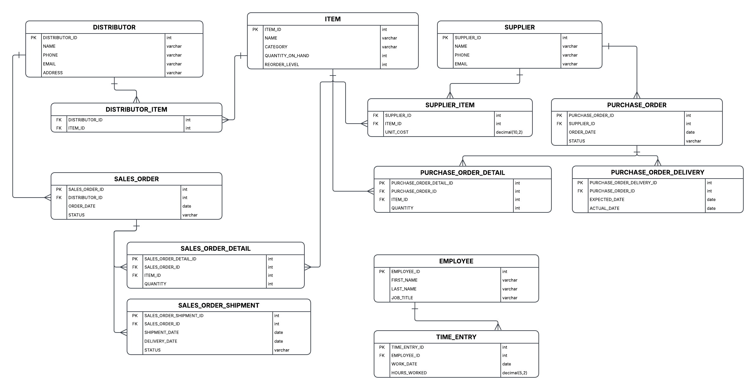
13 tables – Supports Inventory, Purchasing, distribution, sales, shipments, and employee time
Notes:
The database can be viewed in three main sections. Purchasing handles supplies coming into the winery, starting with suppliers and moving through purchase orders and deliveries. We separated the order details and deliveries so each part of the purchasing process can be tracked independently.
Sales and distribution handles products leaving the winery. Distributors are associated with the wines they carry, while sales orders, order details, and shipments track what was ordered and its delivery.
The ITEM table connects these two sides by storing both supplies we purchase and products we sell, differentiated by category.
Finally, employees and time entries are kept separate from those processes and allow us to track employee hours over time.

Slide 6

Reports

Slide 7
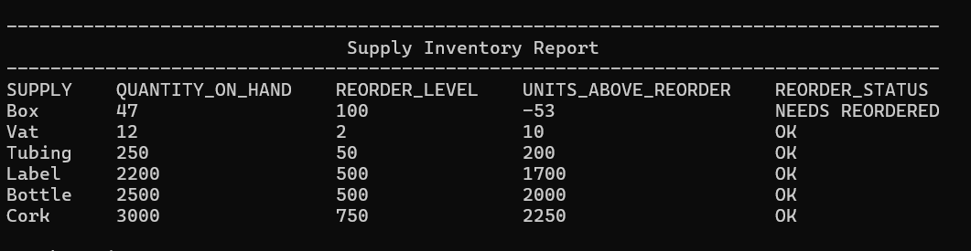
Supply Inventory Report
Bacchus Winery questions:
Which Supplies are approaching or have reached the point when they need reordered?
Report Provides:
Current Quantity On Hand
Reorder level
Units Above OR below the reorder level
Clear STATUS flag identifying supplies that need reordered
This helps Bacchus Winery identify low inventory and take action before supplies affect wine production

Slide 8
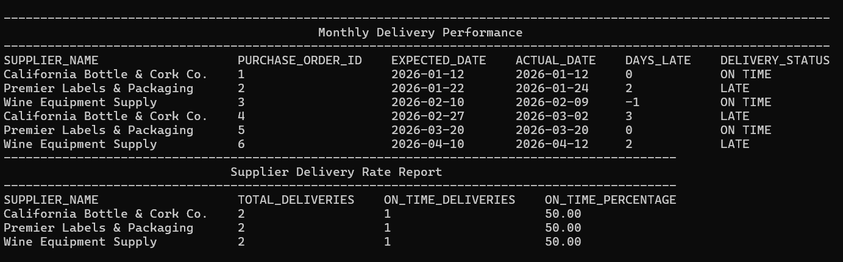
Supplier Delivery Performance Report
Bacchus Winery questions:
Are suppliers delivering on time, and how large is the gap between the expected and actual delivery dates?
Report Provides:
Supplier and purchase order
Expected vs actual delivery date
Number of days late
Delivery status: ON TIME, LATE, or NOT DELIVERED
This helps Bacchus Winery management idenfity suppliers with recurring delivery problems that could affect winery operations
Notes:
This report compares expected and actual delivery dates and calculates the number of days between them. The status makes late deliveries easy to identify, allowing management to evaluate supplier reliability and identify delays that could impact production.

Slide 9
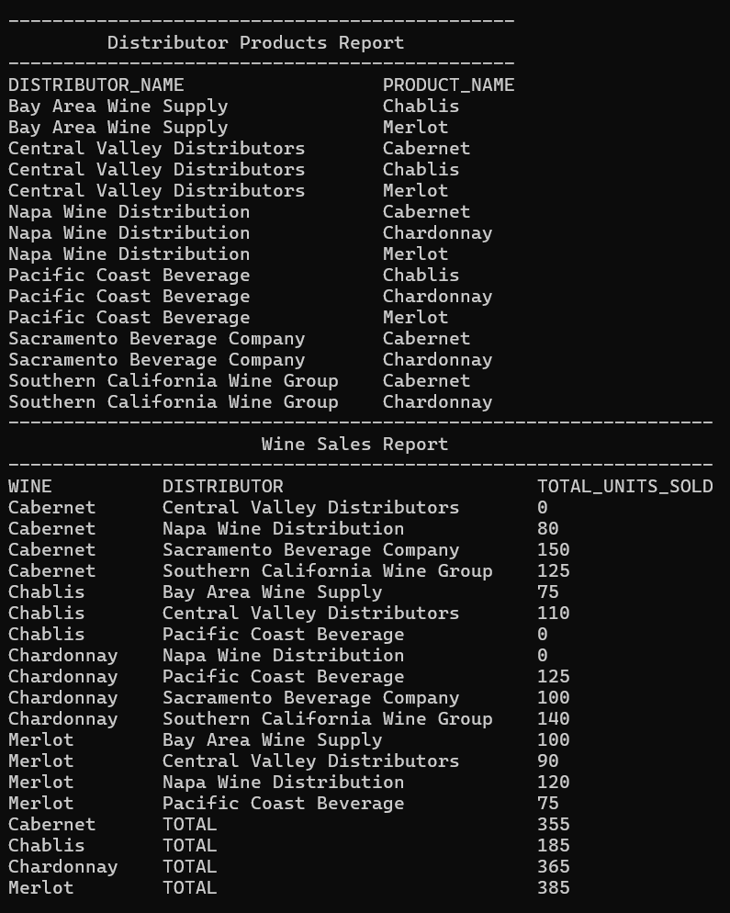
Wine distribution and Sales Report
Bacchus Winery questions:
Which distributors carry each wine? How are the wiens selling? Are any wines underperforming?
Report Provides:
Wine and distributor relationships
Units sold by each distributor for each wine
Zero-sale distributor/wine combinations
Total units sold for each wine
Helps management compare wine performance and identify products or distributor relationships that may need attention.
Notes:
This report combines distribution and sales information. It shows which wines each distributor carries and how many units they have sold. We also include zero-sale combinations and totals for each wine, making it easier to identify which wines are performing well and which may need additional attention.

Slide 10
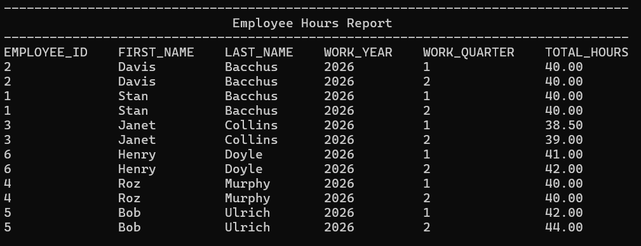
Employee Quarterly Hours Report
Bacchus Winery questions:
How many hours did each employee work during the previous four quarters?
Report Provides:
Employee name
Year and quarter
Total Hours Worked
Comparison of employee hours across quarters
Helps management identify labor trends and changes in employee workload over time.
Notes:
This report summarizes each employee's hours by quarter. Instead of reviewing individual time entries, management can compare employee hours across the previous four quarters and identify changes or trends in labor usage.

Slide 11
Assumptions & Design Decisions
Bacchus Winery may add additional suppliers or distributors in the future.
An item may eventually be available from more than one supplier.
Wines and supplies share enough common attributes to be represented in the ITEM table.
CATEGORY identifies whether an item is a SUPPLY or PRODUCT.
Reorder levels apply to supplies used in winery operations.
Sales performance is based on actual units sold because the case study did not provide expected sales targets.
Notes:
We made several assumptions where the case study did not provide specific details. Most importantly, we designed the relationships to support additional suppliers and distributors without changing the schema. We also combined supplies and wines into the ITEM table to reduce duplicate structures. Since no expected sales targets were provided, our sales report compares actual wine sales rather than measuring them against a forecast.

Slide 12
Summary
Created a normalized relational database supporting key winery operations
Connected purchasing, inventory, distribution, sales, and employee data
Developed reports focused on actionable business information
Reports help management:
Identify supplies that need reordered
Evaluate supplier delivery performance
Compare wine and distributor sales
Review employee labor trends
Designed the database to support future changes without restructuring the core schema
Notes:
Our goal was not only to organize Bacchus Winery's data, but to make that data useful. The final database supports the major business processes in the case study, while our reports turn the stored data into information management can use to identify problems and make decisions.

