Slide 1


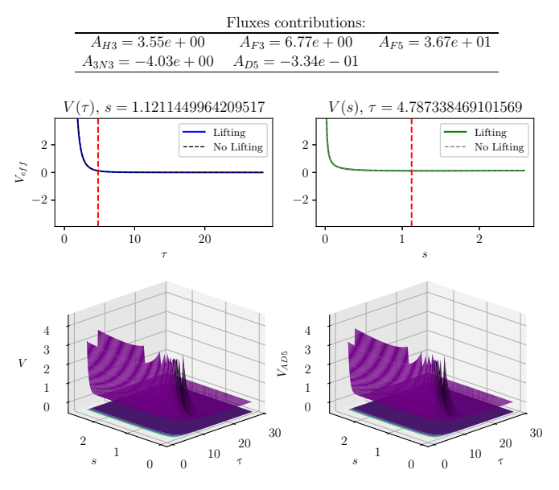
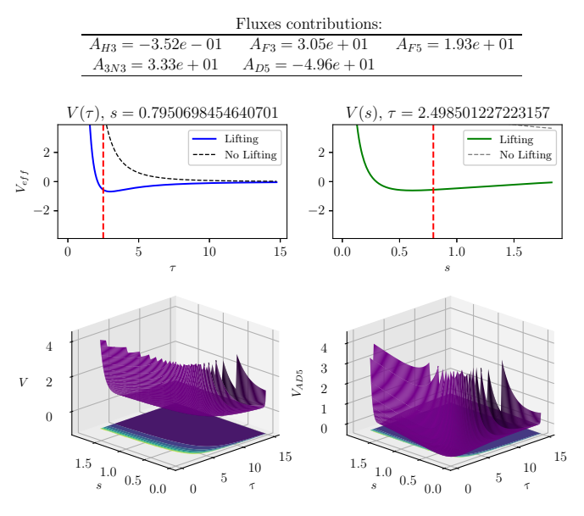
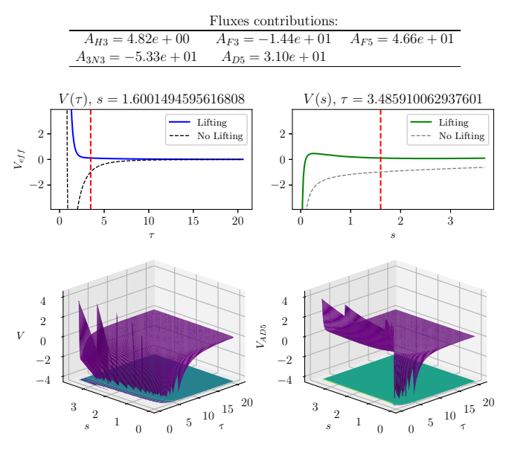
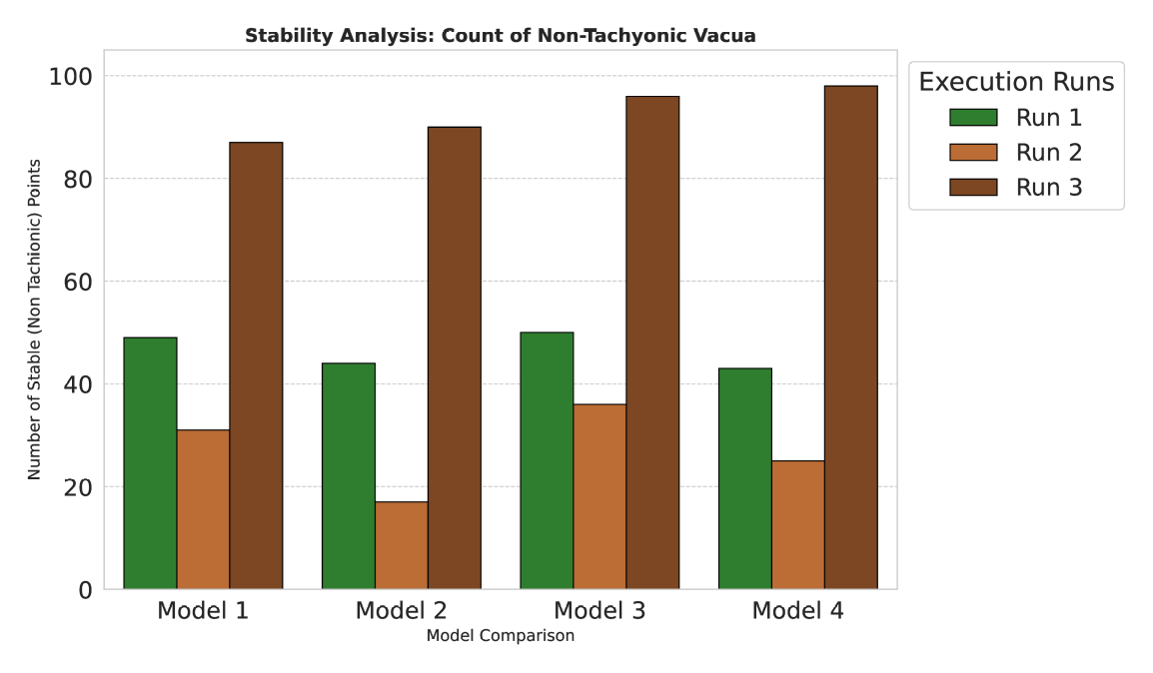
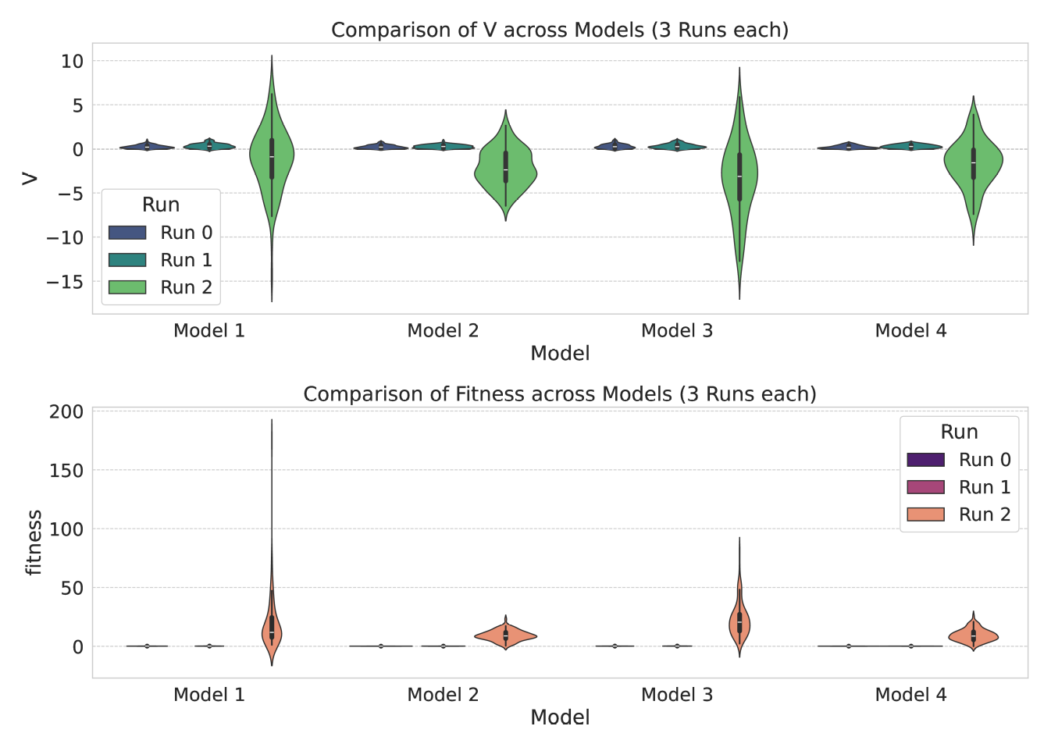
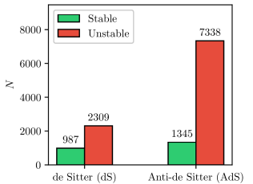
Genetic Algorithm Search for Stable Vacua in Type IIB String Theory: A Computational Approach
74
Brandon Marquez-Salazar¹ ┃ Cesar Damian¹ ┃ Angel Diaz-Pacheco¹
1. Universidad de Guanajuato
ABSTRACT
The exploration of high-dimensional, non-linear potential landscapes is a central computational challenge.
In string theory the search for stable vacua can be treated as an optimisation problem in order to include metaheuristic algorithms.
In this work, a simple Genetic Algorithm (GA) is tailored to the optimisation of a type IIB string theory potential with torsion, extending the analysis of a previous work.
OBJECTIVE
Extending previous work done in [1] using GA [2] instead of Simulate Annealing. This approach aims to use a poblation based algorithm instead of a single-point based like the original for further exploration and thus, further finding of stable configurations.
Some vacua were found to have interesting behaviours after lifting such as No visible change, Massive lowering, Only s affected.
INTRODUCTION
The application of computational intelligence to string theory has grown steadily over the past decade, with metaheuristics playing an increasingly central role in navigating the enormous space of possible vacuum configurations.
In previous works [3,4] GAs demonstrated being useful for vacua search in the field of string theory, searching configurations in less time and with less resources than using brute force and discovering new stable vacua configurations.
After the grid, it was found that, from 4 models, the best one was the one with 50 generations, 20 individuals, 0.5 of cross probability and 0.6 of mutation probability.
METHODOLOGY
This study implements 4 penalisation elements in a fitness function which is intended to be minimised.
The penalisation elements are descriptors from the potential effective function
The descriptors are
For a basic GA from MEALPY modulus and collect the results.
Finally, a grid search will be implemented to find a better model which is able to find higher amount of stable de Sitter vacua and the smallest fitness and potential effective values.
CONCLUSIONS
In this work 11 979 critical points were discovered, confirming stable de Sitter vacua. Systematic comparison of non‑lifted vs. lifted potentials revealed interesting behaviours. The coefficient A3N3 naturally converged to negative values, matching physical expectations. Some numerical instabilities remain though. Grid analysis shows GA tuning improves results. Future work will test other nature‑inspired algorithms.
RESULTS
REFERENCES
[1] Damian, C., Loaiza-Brito, O.: Metastable vacua from torsion and machine learning. The European Physical Journal C 82(12) (Dec 2022). DOI: 10.1140/epjc/s10052-022-11118-x
[2] Abel, S., Rizos, J.: Genetic algorithms and the search for viable string vacua. Journal of High Energy Physics 2014(8) (Aug 2014). DOI: 10.1007/JHEP08(2014)010
[3] Cole, A., Krippendorf, S., Schachner, A., Shiu, G.: Probing the structure of string theory vacua with genetic algorithms and reinforcement learning (2021)
[4] Eiben, A., Smith, J.: Introduction to Evolutionary Computing. Springer Berlin Heidelberg (2015). DOI: 10.1007/978-3-662-44874-8
Wolpert, D. H., & Macready, W. G. (1997). No free lunch theorems for optimization. IEEE Transactions on Evolutionary Computation, 1(1), 67–82. https://doi.org/10.1109/4235.585893
Holland, J. H. (1992). Adaptation in natural and artificial systems: An introductory analysis with applications to biology, control, and artificial intelligence (1st MIT Press ed.). MIT Press.
After the search, 11 979 vacua were found: 987 dS stables and 1 345 AdS stables.
The term A3N3 was found to be consistently definite negative even though the bounds were .

