Slide 1
SUBJECT
ACTION FOR ENDANGERED
SPECIES CONSERVATION
SEA TURTLES

Slide 2
MEMBERS
Trương Nguyễn Thùy Duyên
Đặng Thái Duy
Phan Trung Hiếu
Vũ Huy Quang
Nguyễn Trần Nhật Trinh
Trần Thị Trúc Vi
Trần Thị Bích Nhung
Dương Yến Nhi

Slide 3
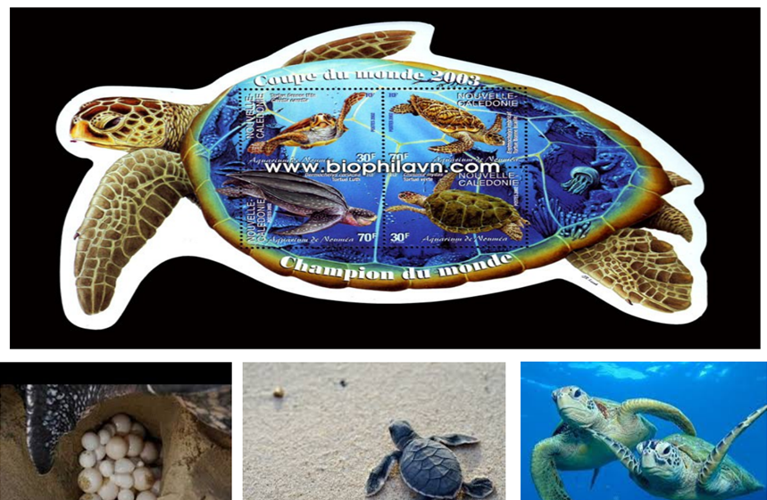

Slide 4
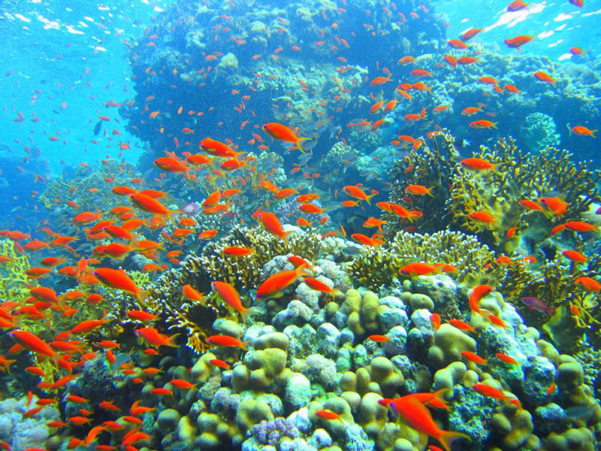
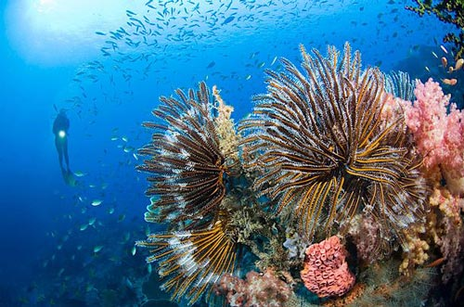
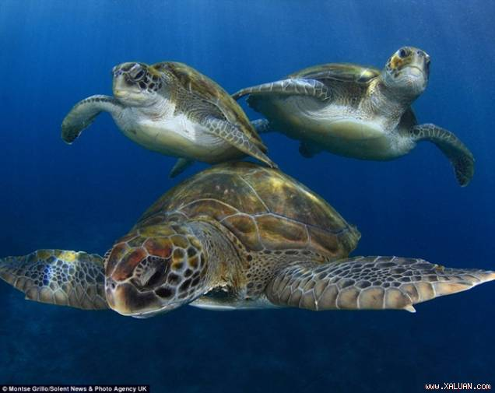
NATURAL SEA WORLD

Slide 5
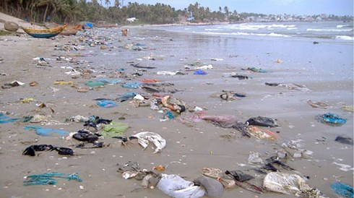
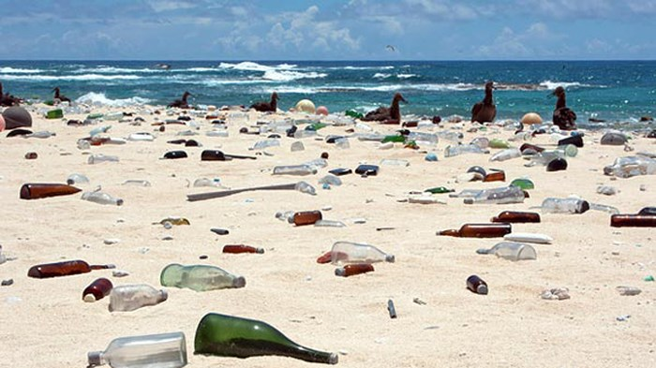
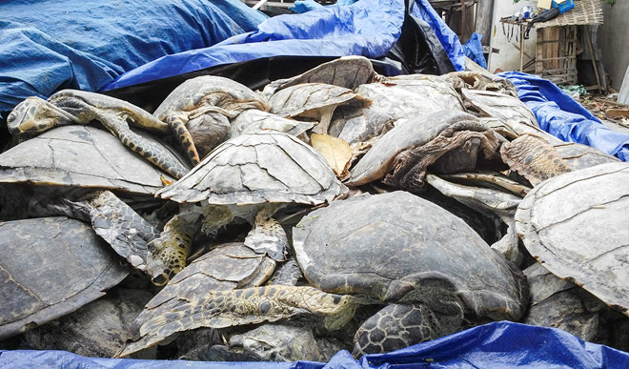
REAL SITUATION ABOUT
SEA TURTLES
Many rubbishes on the beach
Poaching and trading
sea turtles

Slide 6
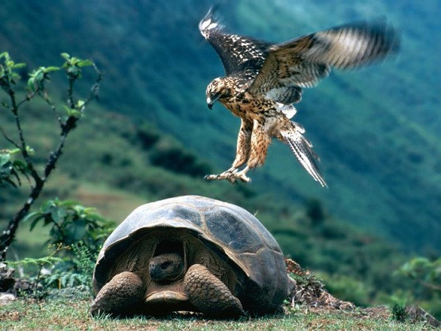
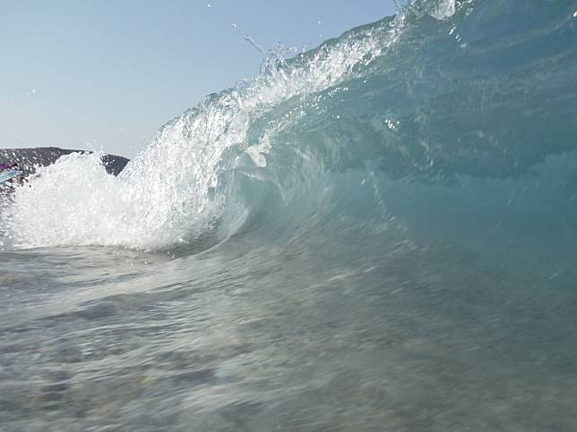
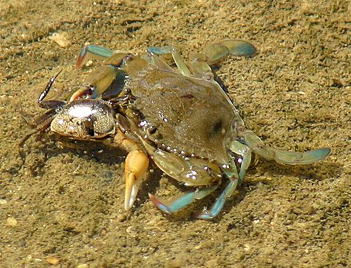
REASONS
OBJECTIVE
Natural predators:
birds, crabs, lizards, etc…
Natural disasters: tsunami,
Earthquake, drought, etc…

Slide 7
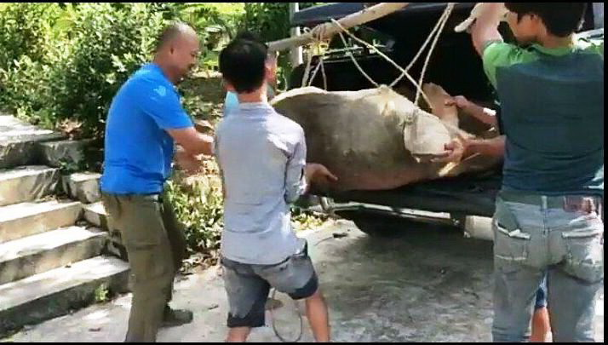
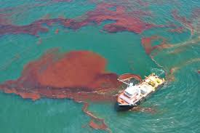
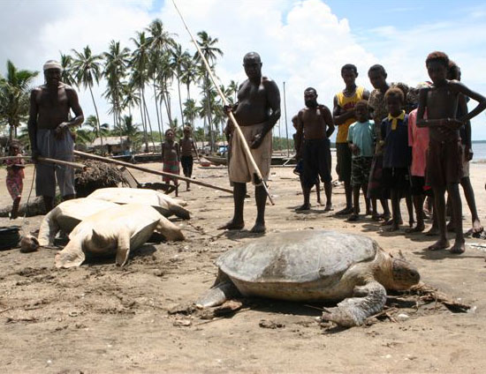
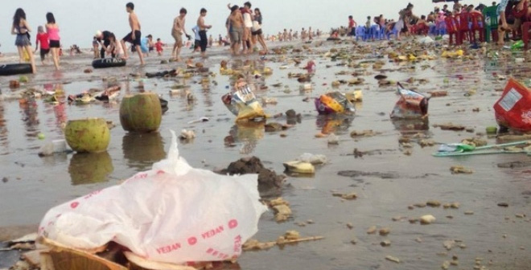
SUBJECTIVE
By human activities: hunting and poaching
Polluting the ocean:
release oil, litter,etc…

Slide 8
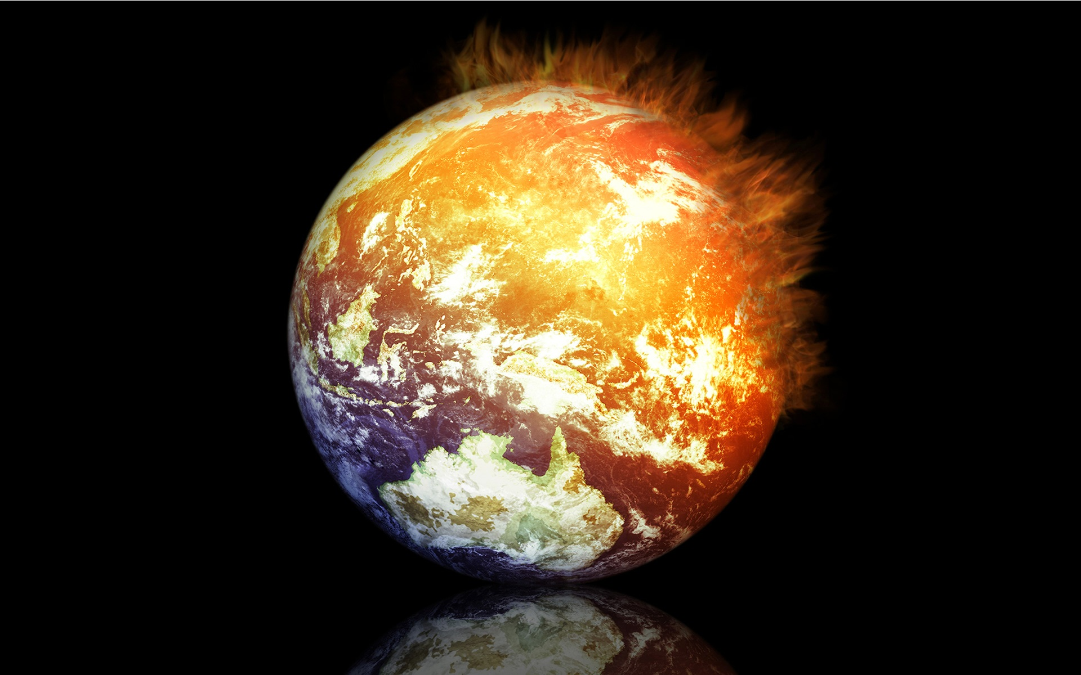
GLOBAL WARMING

Slide 9
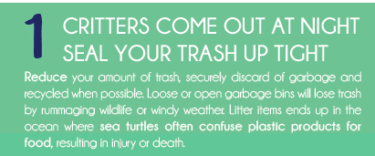
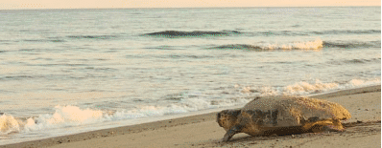
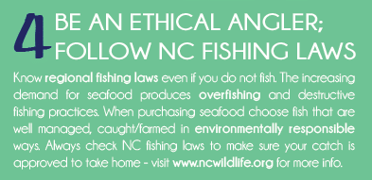

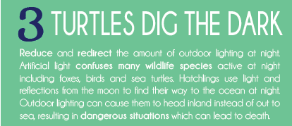
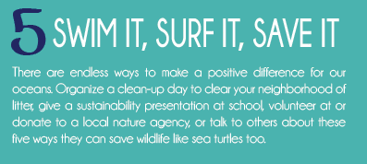
SOLUTION

Slide 10
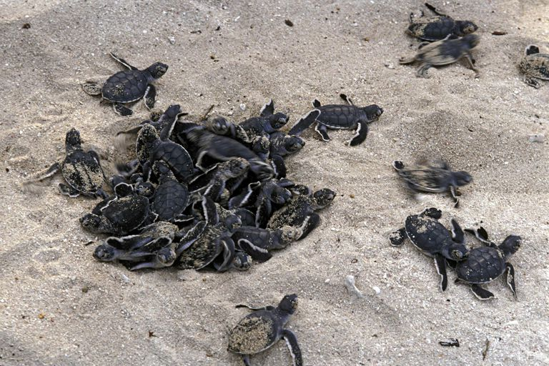
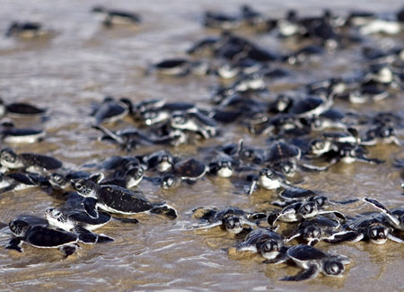
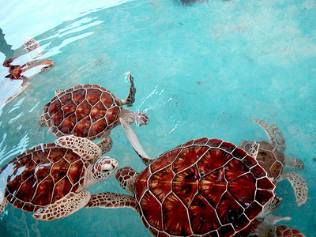
THE BEST FUTURE FOR
SEA TURTLES

Slide 11
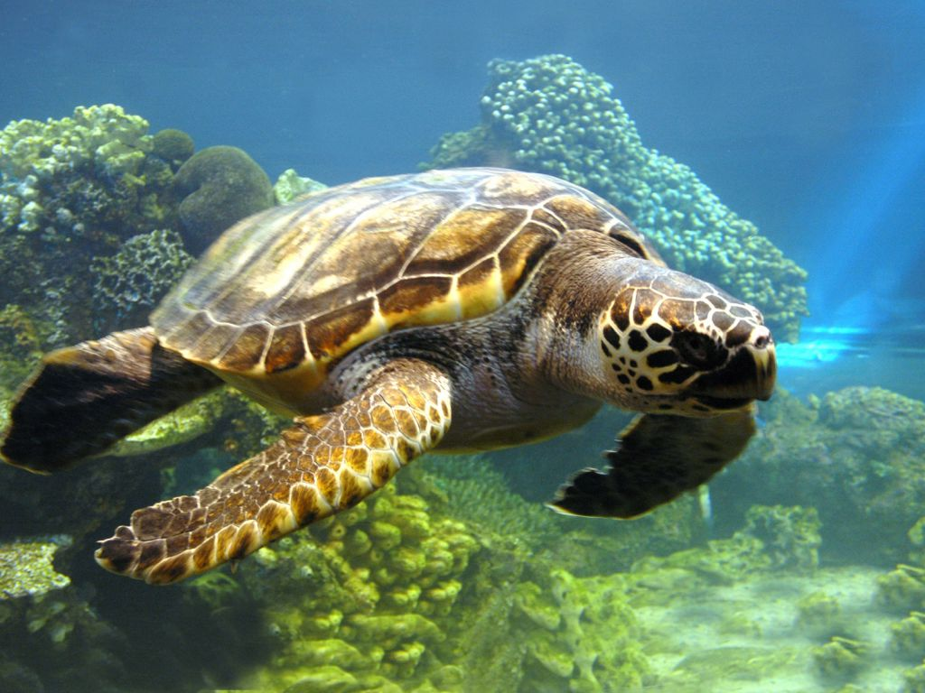
THANKS FOR YOUR LISTENING

