Slide 1
Prescient AI Tech Assessment Project
By David Lang

Slide 2
Overview
Objective: Review the accuracy of OpenWeather’s API Forecast endpoint output, by comparing it with their Current endpoint output.
Tool Stack: Python, PyCharm, PostgreSQL, pgAdmin, and Z-Cron
High Level Architecture: I designed the database in a Data Lake style. Where there is a minimalistic “data dump” (the “weather” table), then all analysis is extracted with views layered on top of the Data Lake.

Slide 3
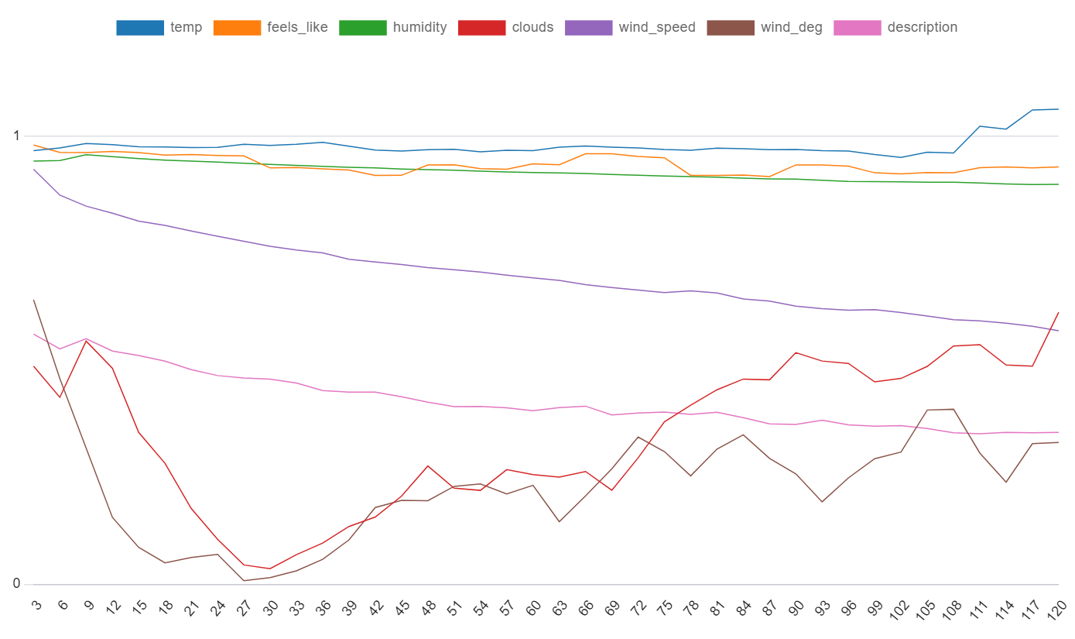
Findings
X: forecast hours Y: accuracy (perc)

Slide 4
Job Facts
jobs run per day: 8
avg job duration: 3m 16.4s
rows imported per job: 5,453
rows imported per day: 43,624
rows imported total: 370,804
latitude/longitude combinations: 133 (different points on the globe data is collected for)

Slide 5
Import Architecture
FILE / DIRECTORY | DESCRIPTION
sql (dir) | The CREATE TABLE/VIEW sql files.
import_weather.py | Main Python script that performs the ETL.
util.py | Utilities Python module. Collection of generally helpful tools.
api.py | API Python module. Contains the functionality for “extracting” data from the OpenWeatherApi.
db.py | Database Python module. Contains the functionality for “loading” data into the Postgres database.
test.py | Unit test script.

Slide 6
Database Architecture
TABLE / VIEW | DEPENDENCIES | DESCRIPTION
logs (table) | None | Logs.
test (table) | None | For unit tests.
weather (table) | None | Primary data load table (the “Lake”).
current_weather (view) | weather | Helper view for data analysis view.
forecast_weather (view) | weather | Helper view for data analysis view.
forecast_accuracy (view) | current_weather, forecast_weather | Primary data analysis view.
forecast_accuracy_full_agg (view) | forecast_accuracy | The pipeline endpoint.

Slide 7
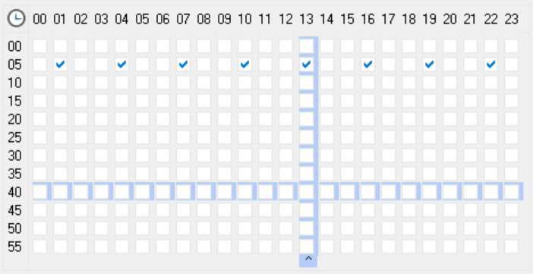
Job Scheduler
The hour pattern of “every 3 hours” was chosen to mirror the Forecast endpoints data return pattern.
The hour pattern starting with 01, was chosen to account for the local/UTC difference.
The minute pattern of 05 was chosen somewhat for safety to ensure there are no issues with < vs <= or > vs >= regarding the statefulness of the endpoints.

Slide 8
faq
Why do you not have a traditional ERD? ERDs are primarily used for understanding the relationships between tables, in large part the PK/FK relationships. Considering that I only have one single table, there are no “table relationships”. My database “structure” is made up primarily of views. And views in an ERD can make it extremely convoluted. So, to “understand the relationships between tables one table and many views”, 1 made a quick “dependency chart” and organized the CREATE VIEW queries as files for easy viewing.
Why no unit testing on the API module? This is very open for discussion. But my experience in my previous role, had us not testing API interactions at all because what it accomplishes is questionable. Mainly because what you’re testing is external, therefore entirely unpredictable. Why run a test on a function that is itself 100% mocked? You’re not testing anything, you’re only testing the mock. There is far more to this discussion, and I’m very open to it. But I will say that the focus, instead of being on unit testing, is more emphasized on the handling of requests and their responses. The specifics of an API client’s get function really is the meat n’ potatoes of a pipeline.

