Slide 1
W
hat is
,
W
oT
JSON Schema
Notes:
In this video, we will briefly explain Schema Languages and then move to the JSON Schema since it is the one that describes and validates JSON, which is important in the scope of Web of Things.

Slide 2
What is a Schema?
Notes:
Let us explain what is a schema.

Slide 3
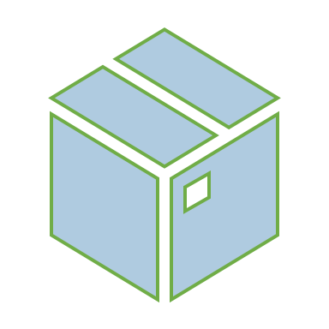
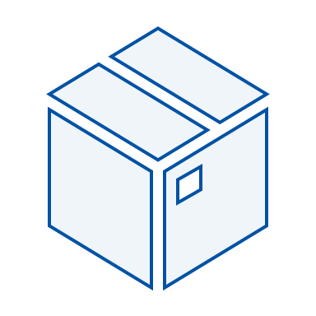
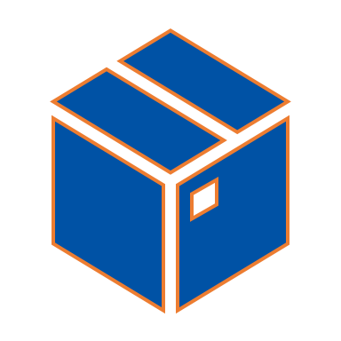
Notes:
Many payload formats offer a way to describe what a payload instance should look like. Generally, these are called Schema Languages. For example, JSON Schema, XML Schema, GraphQL Schema Definition Language.

Slide 4
JSON Schema
XML Schema
GraphQL SDL
Schema Languages
Describe
Notes:
Many payload formats offer a way to describe what a payload instance should look like. Generally, these are called Schema Languages. For example, JSON Schema, XML Schema, GraphQL Schema Definition Language.

Slide 5
WHAT
What is JSON Schema?
Notes:
Now let's take JSON Schema.

Slide 6

JSON Schema
=
Describe
+
Validate
Notes:
JSON Schema is a JSON document used to describe and validate how JSON payload instance should look like.

Slide 7




JSON Schema
Validation
{
}
{
}
{
}
Sender
Reciever
Notes:
The main idea is to enable senders such as clients to understand how the request should be and for the receiver to automatically validate the payloads.

Slide 8
JSON Schema
{
}
JSON
Metadata
Notes:
Although it is also a JSON, it is metadata and not part of the payloads.

Slide 9
{"type": "number"}
{"type": "object"}
{"type": "array"}
{"type": "null"}
{"type": "integer"}
Notes:
We can see some basic JSON Schema examples here. “type”: “array” tells that the schema accepts JSON documents that are arrays. This can be defined for other types in JSON as well, such as, string, number, boolean, and null.

Slide 10
Validation Object
JSON Schema
JSON
bool isValid = MyValidator.validate(schema, payload)
Validation Function
Notes:
Thus, in the receiver end, you can do this validation process to validate. This is an example how it could look like in JavaScript.

Slide 11
Python
Java
validate(instance={"name" : "Eggs", "price" : 34.99}, schema=schema)
Set<ValidationMessage> errors = schema.validate(node);
Notes:
It can look different in other programming languages. For instance, Python, Java and C++

Slide 12
C++
Python
Java
jsonschema::json_validator<json> validator(sch);
// Will call reporter for each schema violation
validator.validate(data, reporter);
validate(instance={"name" : "Eggs", "price" : 34.99}, schema=schema)
Set<ValidationMessage> errors = schema.validate(node);
Notes:
It can look different in other programming languages. For instance, Python, Java and C++

Slide 13
C++
Java
jsonschema::json_validator<json> validator(sch);
// Will call reporter for each schema violation
validator.validate(data, reporter);
Set<ValidationMessage> errors = schema.validate(node);
Notes:
It can look different in other programming languages. For instance, Python, Java and C++

Slide 14
Further Validation Possibilities with JSON Schema
Notes:
Of course, way more advanced validations are possible with JSON Schema such as:

Slide 15
Further Validation Possibilities with JSON Schema
Regular Expressions
URIs
Length of a string
Notes:
Regular expressions, URIs, length of a string

Slide 16
Further Validation Possibilities with JSON Schema
Regular Expressions
Max/min for Numbers
URIs
IP Addresses
How many items
In Array
Allowed Types
Length of a string
Email Addresses
Notes:
Max/min for numbers, IP addresses, email addresses

Slide 17
Further Validation Possibilities with JSON Schema
Max/min for Numbers
IP Addresses
How many items
Required Properties
In Array
In Object
Allowed Types
Amount of Properties
Email Addresses
Notes:
Or you can specify amount of the items and allowed types in an array

Slide 18
Further Validation Possibilities with JSON Schema
How many items
Required Properties
In Array
In Object
Allowed Types
Amount of Properties
Notes:
as well as required properties and amount of properties in an object.

Slide 19


JSON
in
Practice
JSON
Schema
NEXT VIDEO
JSON
Schema
in Practice
JSON
Schema
in Practice -2
Notes:
In the next video, we will go into further details of JSON Schema.

Slide 21
Subscribe to our Channel
Playlist
Next Video

