Slide 1
W
hat is
,
W
oT
Architecture Patterns
Notes:
In this video, we will explain architecture patterns, and how devices/ things interact with controllers, agents, and servers.

Slide 2


Notes:
Previously we have explained the server and client models and describe how this architecture works

Slide 3
Notes:
Previously we have explained the server and client models and described how this architecture works.

Slide 4
Notes:
Previously we have explained the server and client models and described how this architecture works.

Slide 5
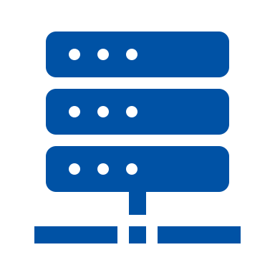
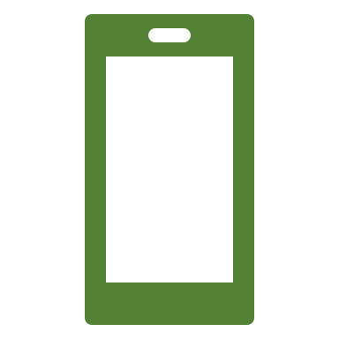

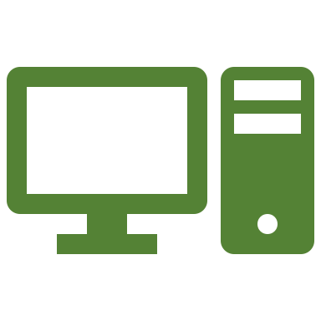
Server Client Model
Notes:
Previously we have explained the server and client models and described how this architecture works.

Slide 6
How in WoT?
Notes:
Now we will show how they are used in the WoT architectures.

Slide 7
Device Controllers
Digital Twins
Thing-to-Thing
Cross-domain Collaboration
Gateways
System Integration
Notes:
We will introduce 6 archtecture patterns in this video.

Slide 8
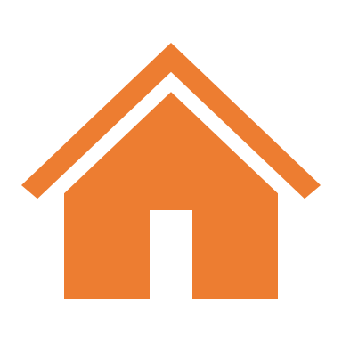

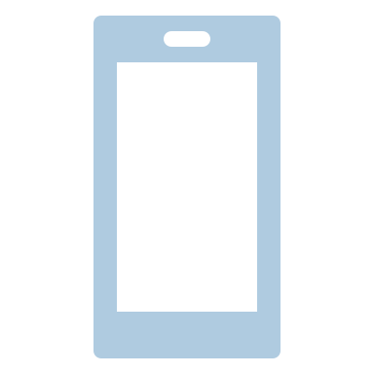

Notes:
So, first, let’s start with the device controllers. A common deployment pattern is a local device controlled by a user-operated remote controller. Let’s remember the smart house example from the previous video.

Slide 9
Remote Access
Electronic appliances
Local Home Network
Notes:
A remote controller can access the electronic appliance through the local home network. In this pattern at least <one device> (electronic appliance) has a server role that can accept a request and respond. Another device (remote controller) has a client role that can send a message with a request like to read a sensor value or to turn on the device.

Slide 10
Request
Client role
Server role
Local Home Network
Notes:
A remote controller can access the electronic appliance through the local home network. In this pattern at least <one device> (electronic appliance) has a server role that can accept a request and respond. Another device (remote controller) has a client role that can send a message with a request like to read a sensor value or to turn on the device.

Slide 11
Request
Client role
Server role
Local Home Network
Notes:
A remote controller can access the electronic appliance through the local home network. In this pattern at least <one device> (electronic appliance) has a server role that can accept a request and respond. Another device (remote controller) has a client role that can send a message with a request like to read a sensor value or to turn on the device.

Slide 12
Request
Client role
Server role
Local Home Network
Notes:
A remote controller can access the electronic appliance through the local home network. In this pattern at least <one device> (electronic appliance) has a server role that can accept a request and respond. Another device (remote controller) has a client role that can send a message with a request like to read a sensor value or to turn on the device.

Slide 13
Request
Client role
Server role
Local Home Network
Notes:
A remote controller can access the electronic appliance through the local home network. In this pattern at least <one device> (electronic appliance) has a server role that can accept a request and respond. Another device (remote controller) has a client role that can send a message with a request like to read a sensor value or to turn on the device.

Slide 14
Response
Client role
Server role
Local Home Network
Notes:
A remote controller can access the electronic appliance through the local home network. In this pattern at least <one device> (electronic appliance) has a server role that can accept a request and respond. Another device (remote controller) has a client role that can send a message with a request like to read a sensor value or to turn on the device.

Slide 15
Response
Client role
Server role
Local Home Network
Notes:
A remote controller can access the electronic appliance through the local home network. In this pattern at least <one device> (electronic appliance) has a server role that can accept a request and respond. Another device (remote controller) has a client role that can send a message with a request like to read a sensor value or to turn on the device.

Slide 16
Response
Client role
Server role
Local Home Network
Notes:
A remote controller can access to the electronic appliance through the local home network. In this pattern at least <one device> (electronic appliance) has a server role that can accept a request and respond. Another device (remote controller) has a client role that can send a message with a request like to read a sensor value or to turn on the device.

Slide 17
Response
Client role
Server role
Local Home Network
Notes:
A remote controller can access to the electronic appliance through the local home network. In this pattern at least <one device> (electronic appliance) has a server role that can accept a request and respond. Another device (remote controller) has a client role that can send a message with a request like to read a sensor value or to turn on the device.

Slide 18
Notes:
Let’s move to the second architecture pattern, Thing-to-Thing. In this scenario we have an electronic appliance let's say a heater and a temperature sensor.

Slide 19
A thermometer and a control agent
Notes:
When a sensor detects a change in room condition such as temperature drops below the threshold, it issues a control message “turn on” to the electronic appliance to power on the heater.

Slide 20
A thermometer and a control agent
Notes:
When a sensor detects a change in room condition such as temperature drops below the threshold, it issues a control message “turn on” to the electronic appliance to power on the heater.

Slide 21
Turn on
A thermometer and a control agent
Notes:
When a sensor detects a change in room condition such as temperature drops below the threshold, it issues a control message “turn on” to the electronic appliance to power on the heater.

Slide 22
Turn on
A thermometer and a control agent
Notes:
When a sensor detects a change in room condition such as temperature drops below the threshold, it issues a control message “turn on” to the electronic appliance to power on the heater.

Slide 23
Gateways
Notes:
Third architecture that we will intorduce is Gateways.

Slide 24
Servers
Remote Access
Notes:
Smart home gateways pattern is achieved by placing a gateway between a home network and the Internet to manage electronic appliances inside the house. It can also receive commands from a remote controller over the Internet.

Slide 25
Both server and client roles
Notes:
In this pattern, the home gateway has both client and server roles.

Slide 26
Servers
Server for Smartphone
Client for Security Camera
Remote Access
Notes:
For instance, when the remote controller in this case a smartphone, activates the electronic appliance let's say security camera in the client role and the smartphone in the server role.

Slide 27
Servers
Client for Smartphone
Server for Security Camera
Remote Access
Notes:
On the other way around, when the security camera sends a message to the smartphone, the gateway acts as a server role for the security camera and it acts as a client for the smartphone. If the camera is in a client role, it can pass the firewalls easily.

Slide 28
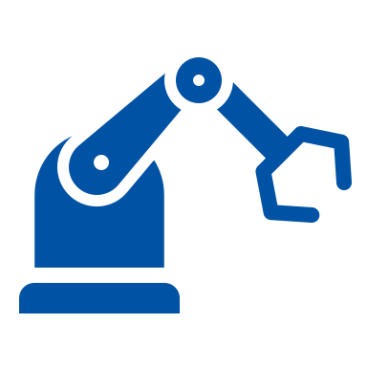


00101001010100100011
010101110101100010101
010101011000111010101
1010101010111000110000101
1010100111000111101010100
01010001010100100101001
Notes:
The next one is Digital twins. Digital Twin is a model of a device or a group of devices that resides on a cloud server or edge devices. It is useful to represent real-world devices that may not be continuously online or to test simulations and services before they are deployed to real devices.

Slide 29

00101001010100100011
010101110101100010101
010101011000111010101
1010101010111000110000101
1010100111000111101010100
01010001010100100101001
Device
Digital Twin
Notes:
The next one is Digital twins. Digital Twin is a model of a device or a group of devices that resides on a cloud server or edge devices. It is useful to represent real-world devices that may not be continuously online or to test simulations and services before they are deployed to real devices.

Slide 30
00101001010100100011
010101110101100010101
010101011000111010101
1010101010111000110000101
1010100111000111101010100
01010001010100100101001
Remote Access
Notes:
The next one is Digital twins. Digital Twin is a model of a device or a group of devices that resides on a cloud server or edge devices. It is useful to represent real-world devices that may not be continuously online or to test simulations and services before they are deployed to real devices.

Slide 31
00101001010100100011
010101110101100010101
010101011000111010101
1010101010111000110000101
1010100111000111101010100
01010001010100100101001
Remote Access
Notes:
It can model one or more devices. Digital Twins can be categorized in different ways depending on weather a device is connected to the cloud or gateway.

Slide 32
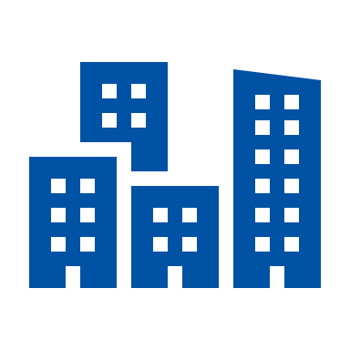

Smart Cities
Industial
Applications
Smart Homes
Notes:
Lastly, we will move to cross-domain collaboration. In cross-domain collaborations, each system involves other systems in other domains. For example, Smart Factory with Smart City, Smart City with Smart Home.

Slide 33
Notes:
In those models, you can exchange information directly with each other in a peer-to-peer manner or indirectly via some collaboration platform.

Slide 34
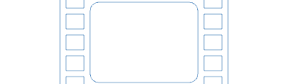

Application
Domains
Architecture
Patterns
NEXT VIDEO
Building
Blocks
Thing
Description

Slide 35
Application
Domains
Architecture
Patterns
Building
Blocks
NEXT VIDEO
Thing
Description
Notes:
In the next video, we will explain Building Blocks in WoT.

