Slide 1
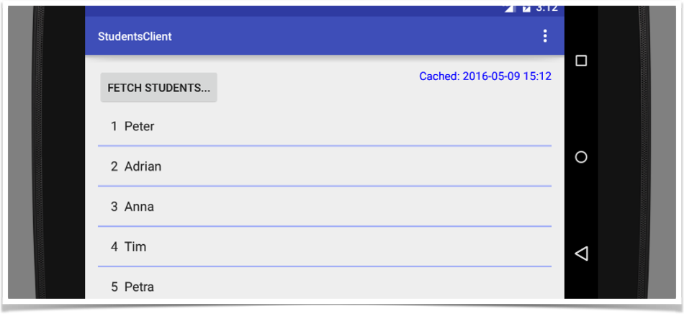
StudentService
THE CLIENT

Slide 2
Features…
Tried to separate the Controller from the View as much as possible
shared ‘commons’-package with Server
preference-activity / user settings
difficult Exception-handling

Slide 3
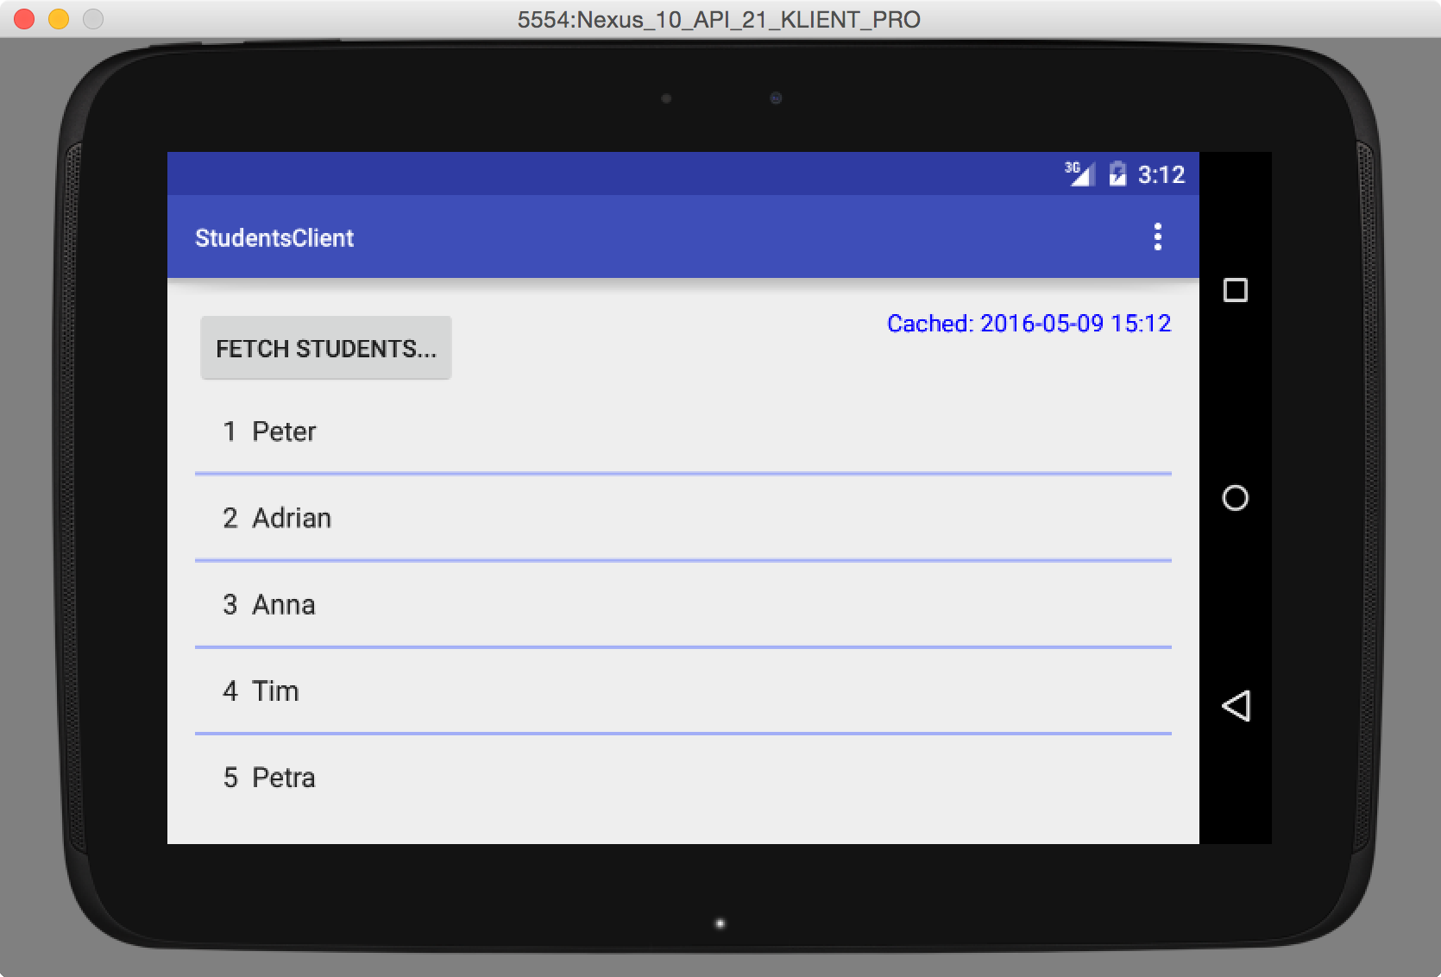
ACTIVITIES

Slide 4

S
<<Singleton>>
DataManager
ACTIVITIES
User Action

Slide 5
S
<<Singleton>>
DataManager
ACTIVITIES
User Action
Get students from cache
SQLite_DB
S
DBHandler

Slide 6
Send data back to client-
A secret for now…!
DataManager
User Action
Cache data
fetch data
SQLite_DB
DBHandler
shadow = on background thread

Slide 7
Fetch updated data from a service
DataManager
NetworkManager
User Action
AsyncTask
Cache data
fetch data
SQLite_DB
DBHandler
shadow = on background thread

Slide 8

Fetch updated data from a service
HttpGetService
fetch content
DataManager
ACTIVITIES
NetworkManager
User Action
AsyncTask
Cache data
fetch data
SQLite_DB
DBHandler
shadow = on background thread

Slide 9
Fetch updated data from a service
HttpGetService
fetch content
DataManager
ACTIVITIES
NetworkManager
User Action
AsyncTask
F
IServiceProvider
Cache data
fetch data
SQLite_DB
-file system?
DBHandler
-data base?
- …
shadow = on background thread

Slide 10
Fetch updated data from a service
HttpGetService
fetch content
DataManager
ACTIVITIES
NetworkManager
User Action
AsyncTask
translate content
Cache data
fetch data
SQLite_DB
DBHandler
JsonReader
shadow = on background thread

Slide 11
Fetch updated data from a service
HttpGetService
fetch content
DataManager
ACTIVITIES
NetworkManager
User Action
AsyncTask
F
translate content
Cache data
fetch data
SQLite_DB
Factory - global format setting
DBHandler
IContentReader
JsonReader
shadow = on background thread

Slide 12
HttpGetService
Callback to client
fetch content
DataManager
ACTIVITIES
NetworkManager
User Action
AsyncTask
Result Callback
translate content
Cache data
fetch data
SQLite_DB
DBHandler
JsonReader
shadow = on background thread

Slide 13
CallbackEventBus
S
HttpGetService
registers &
listens
Callback to client
fetch content
DataManager
ACTIVITIES
NetworkManager
User Action
AsyncTask
Result Callback
translate content
Cache data
fetch data
SQLite_DB
DBHandler
JsonReader
shadow = on background thread

Slide 14
CallbackEventBus
HttpGetService
listens -
onEvent()
broadcast
Callback to client
fetch content
DataManager
ACTIVITIES
NetworkManager
User Action
AsyncTask
Result Callback
translate content
Cache data
fetch data
SQLite_DB
DBHandler
JsonReader
shadow = on background thread

Slide 15
CallbackEventBus
HttpGetService
registers &
listens
broadcast
fetch content
DataManager
ACTIVITIES
NetworkManager
User Action
AsyncTask
Result Callback
translate content
Cache data
fetch data
SQLite_DB
DBHandler
JsonReader
shadow = on background thread

Slide 16
To improve…
Toast error-messages shows to long, other form of feedback?
Why so difficult exception-handling if only simple messages are shown?!
clean up commons-package (global specifications)
split up constants to shared preferences (user settings), property file in commons (global settings for developers) and local private constants (real hidden constants)
A simpler design better (no different services, transport formats, or strict separation of view/controller needed)

Slide 17
Thanks

