Slide 1

A Sentiment-Analysis-Based Social QA Chatbot System
Group 15
Taibo Zeng(2230026201) Hailang Hu(2230026050)
Zherui Zhang(2230026218) Jian Xiong(2230026180)
Jiatong Lin(2230026094) Manxi Tao(2230026145)

Slide 2
Outline
1
Background & Datasets
2
Social Sentiment/Emotion Analysis Model and Evaluation
3
Chatbot System Based on Sentiment Analysis Model and Evaluation
4
Emoji Innovation
5
Demo & Conclusion

Slide 3
Background
With the booming development of social media, users have higher requirements for the emotional understanding and response capabilities of intelligent chatbots
Enhanced User Experience
Improved Problem Solving
Natural Conversations
Emotion analysis allows chatbots to provide more empathetic and tailored responses.
Understanding user emotions helps chatbots address issues more effectively.
Emotion-aware chatbots can maintain more human-like, fluid dialogues.

Slide 4
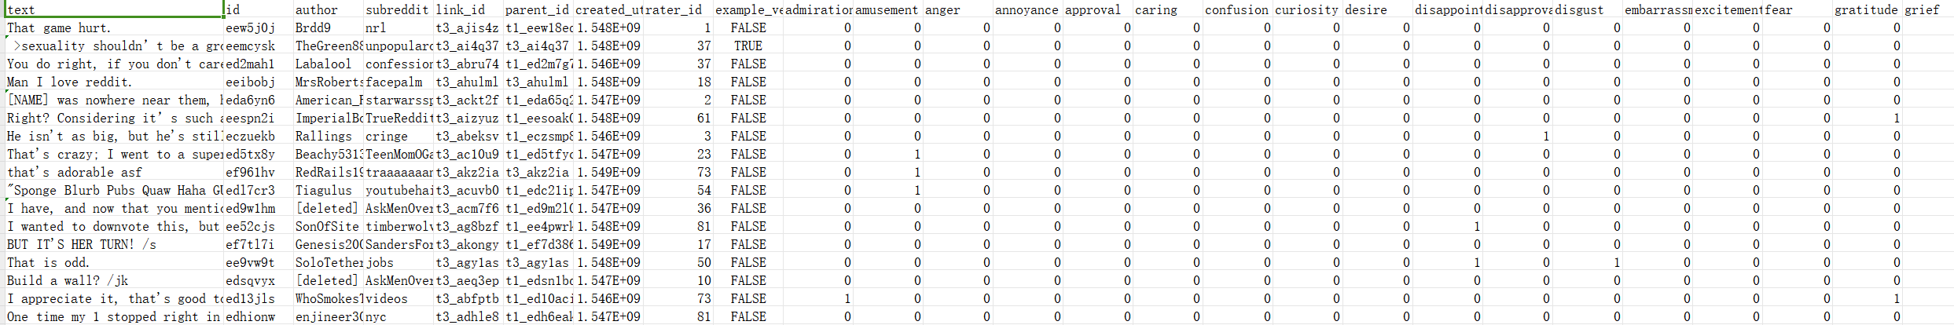
Datasets
Our datasets comes from social media platform (Twitter and Google)
We have crawled approximately 30000 comments and text on these two socail media, each text has their corresponding sentiment.
We have defined 28 different kinds of sentiments/emotions
('admiration', 'amusement', 'anger', 'annoyance', 'approval', 'caring', 'confusion', 'curiosity', 'desire', 'disappointment', 'disapproval', 'disgust', 'embarrassment', 'excitement', 'fear', 'gratitude', 'grief', 'joy', 'love', 'nervousness', 'optimism', 'pride', 'realization', 'relief', 'remorse', 'sadness', 'surprise', 'neutral'])

Slide 5
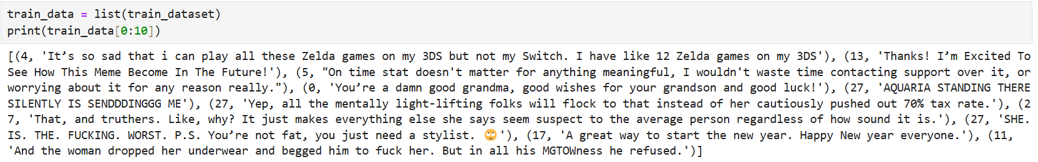
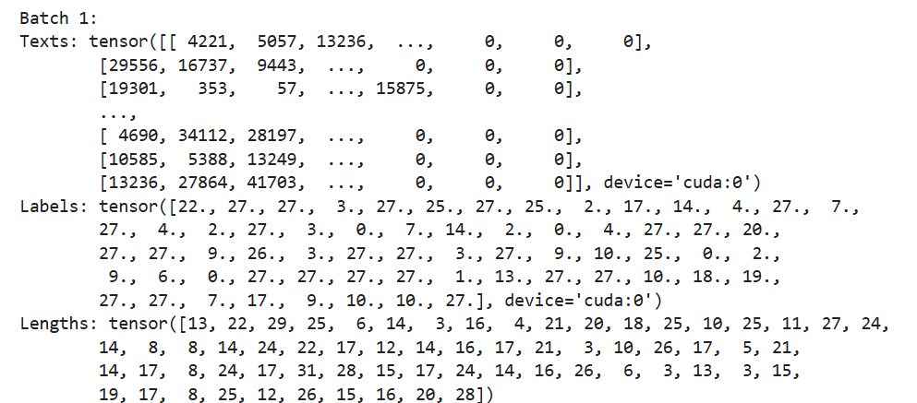
Dataset Preprocessing
Give each text corresponding label that indicates which emotion that the text belongs to
Delete some row of data that the text do not have the sentiment, and append all the data to training list and test data list repectively, as following: (Each tuple has the text and corresponding emotion label)
Create the tensor for each text and label so that can be applied to our sentiment analysis model

Slide 6





Emotion Analysis Model Approach
Embedding Layer:
To convert discrete tokens into continuous vector representations.
In practice, we compute embeddings for a set of tokens simultaneously
, packing them into a matrix X, and then multiplying by an embedding
matrix E to get the output embeddings:
Embedding(X) = XE
Bi-directional LSTM
Bidirectional LSTM (BiLSTM) to capture context from both past and future input sequences.
BiLSTM(X) = concat(LSTMforward(X), LSTMbackward(X))
Since we have 28 emotions and only need the emotion that has the highest socre

Slide 7
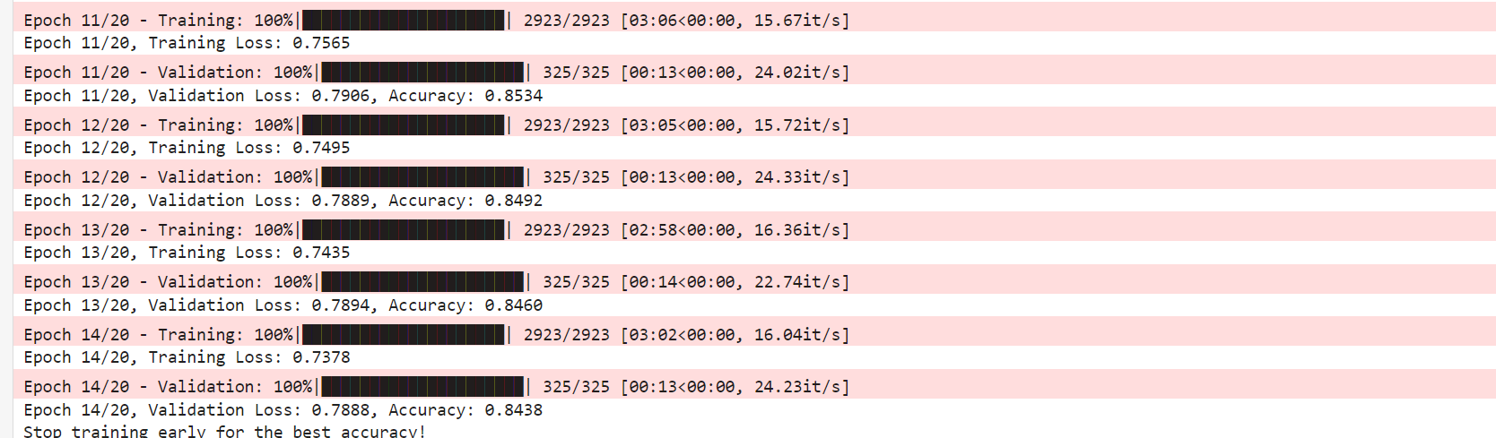
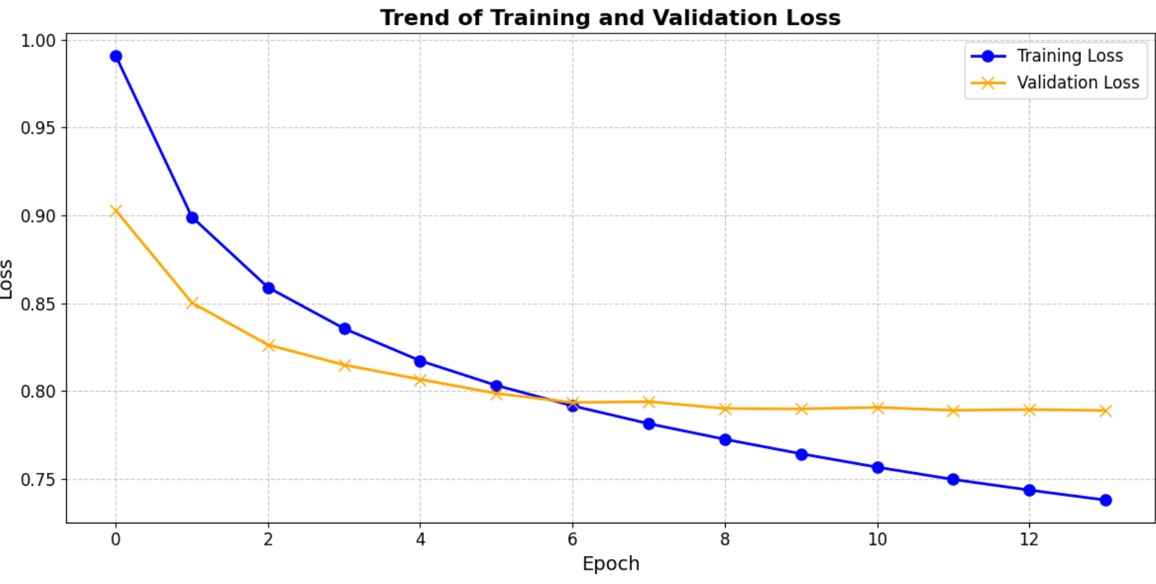
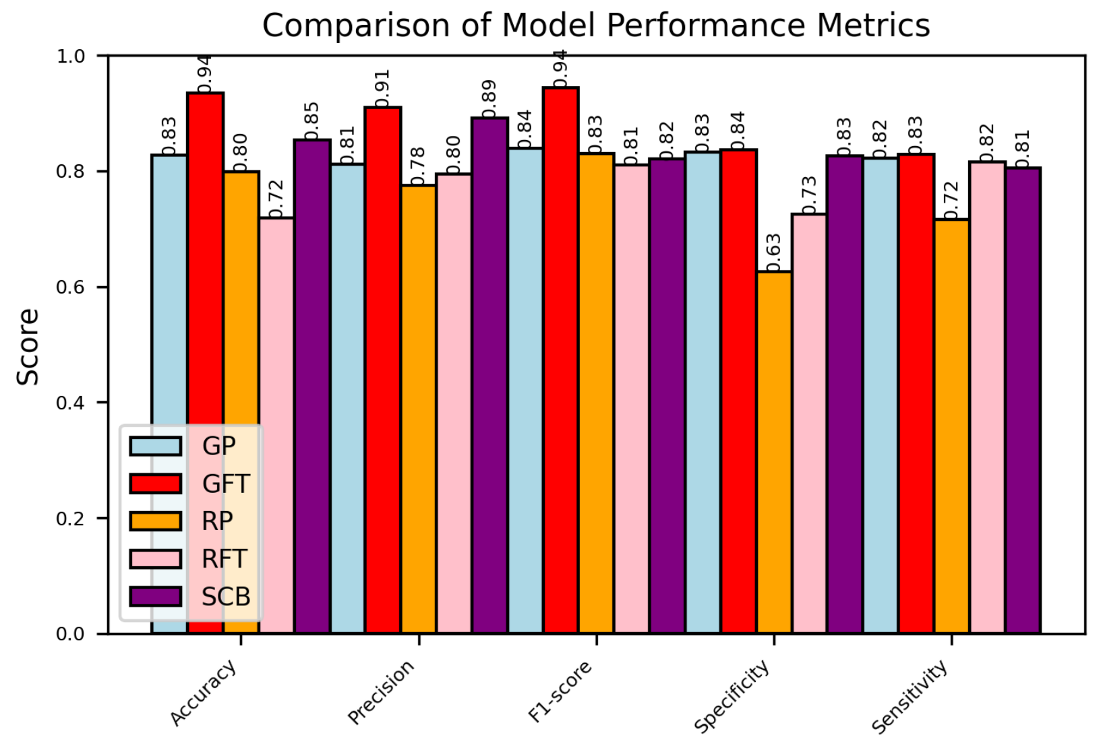
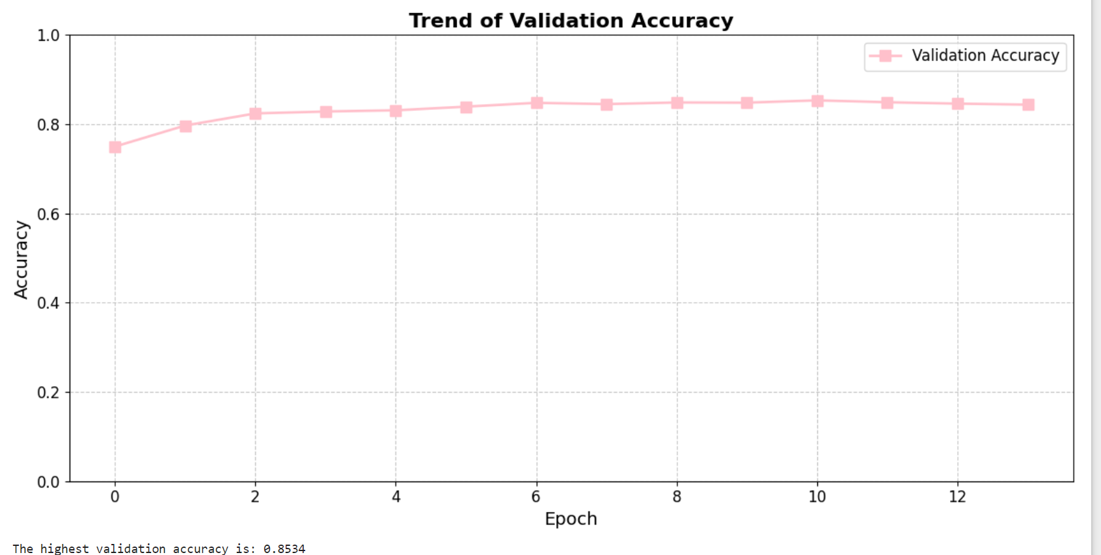
Evaluation of Social Sentiment Analysis
Accuracy of our model: 84.38%
Good performancec in accuracy and spcificity
training loss
Comparison with other existing methods

Slide 8
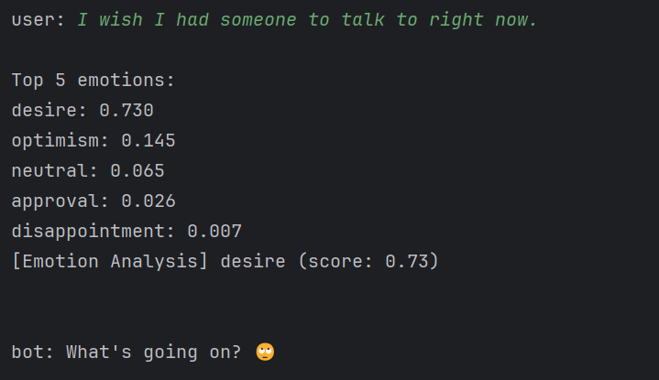
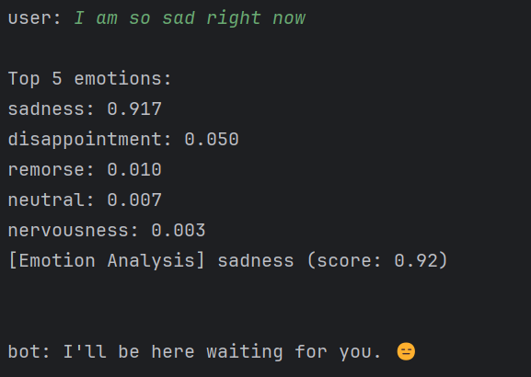
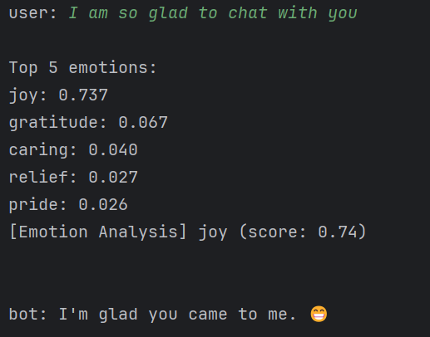
Chatbot construction
1
Use as runable program
-contains sentimental analysis and emoji.
2
Fine-tune GPT-2 to generate output flow:
-reason: easy implement and free, but friendly use
-operation: feed enough data and add prompts
3
Generate emotion classification
-output the emotional score(this part shows our
sentimental analysis only)
4
Final response with humanization
-some examples shows on the right

Slide 9
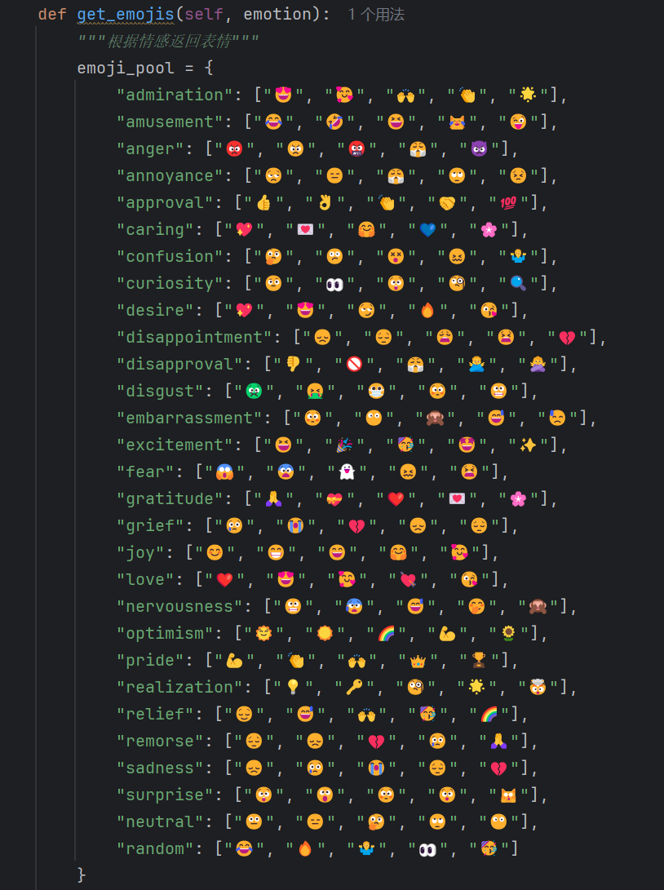
Emoji
1
Emoji mapping and selection
-create a mapping table
2
Introducing randomness
-randomly pick one fitable emoji
3
Intensity threshold
-calculate the threshold to judge if it need to use emoji
4
Emotion insertion and sentence reconstruction
-final step to reconstruct the sentence

Slide 10
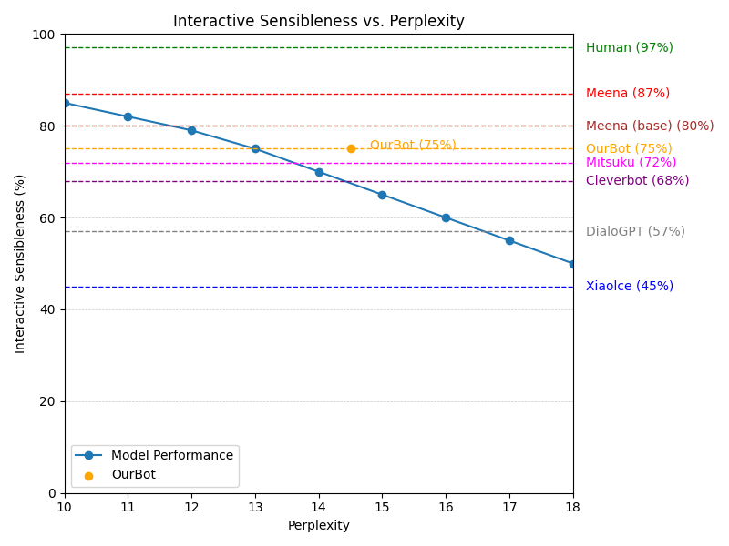
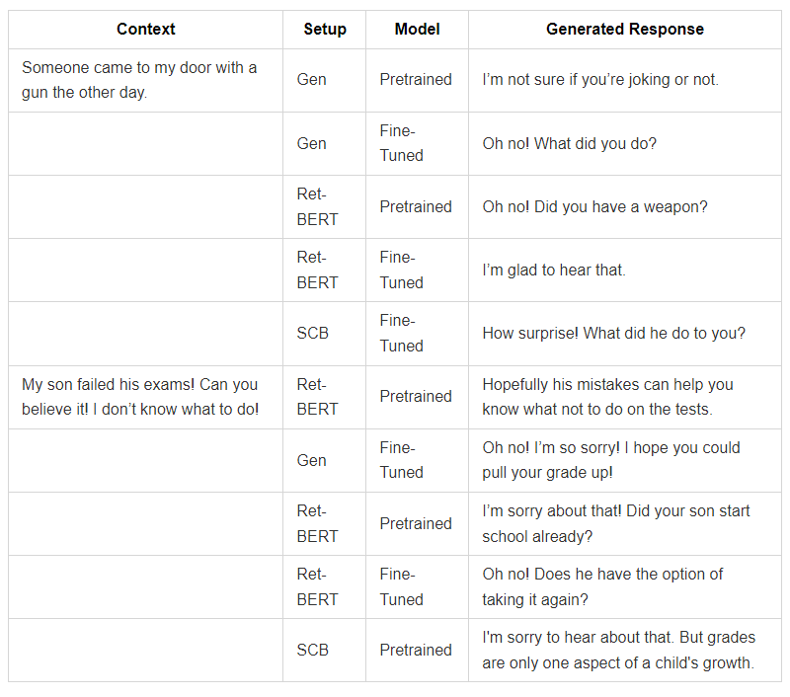
Evaluation and Output of Chat Bot System
SAA vs PPL
response & comparison

Slide 11
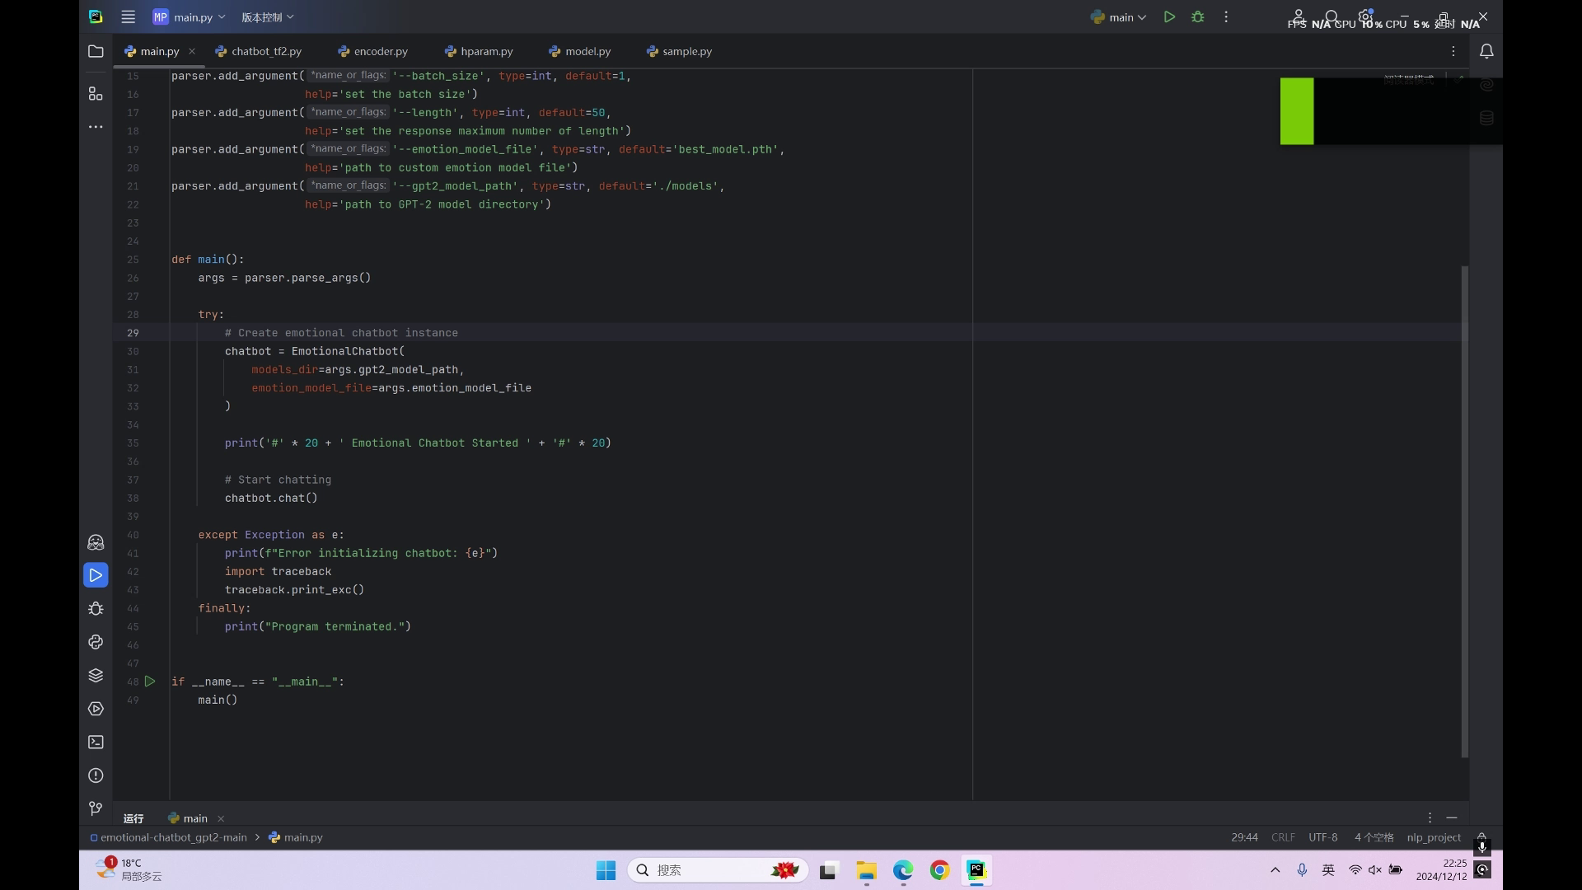
Briefly Demo

