Slide 1
06/07/22
FEL-1 Techno-Economic Assessment of a New Technology Route for Production of Propylene by Bromination of Propane
Michael Xing, Yunus Ross, Selina Liu

Slide 2
Process Design Overview
Objective:
New chemical routes to produce propylene from bromination of propane
Produce 100 kta of 99.5% purity Propylene
Background:
Current global propylene
market value: $3.7 billion
$5.7 billion by 2030 with a 4.5% compound annual growth rate
Chemical Species | Price
Polymer-Grade Propylene (C3H6) | $900/MT
Pure Propane (C3H8) | $200/MT
Pure Hydrogen (H2) | $1400/MT
Bromine (Br2) | $3000/MT
CO2 Charge | $75/MT
Fuel | $4.25 /GJ

Slide 3
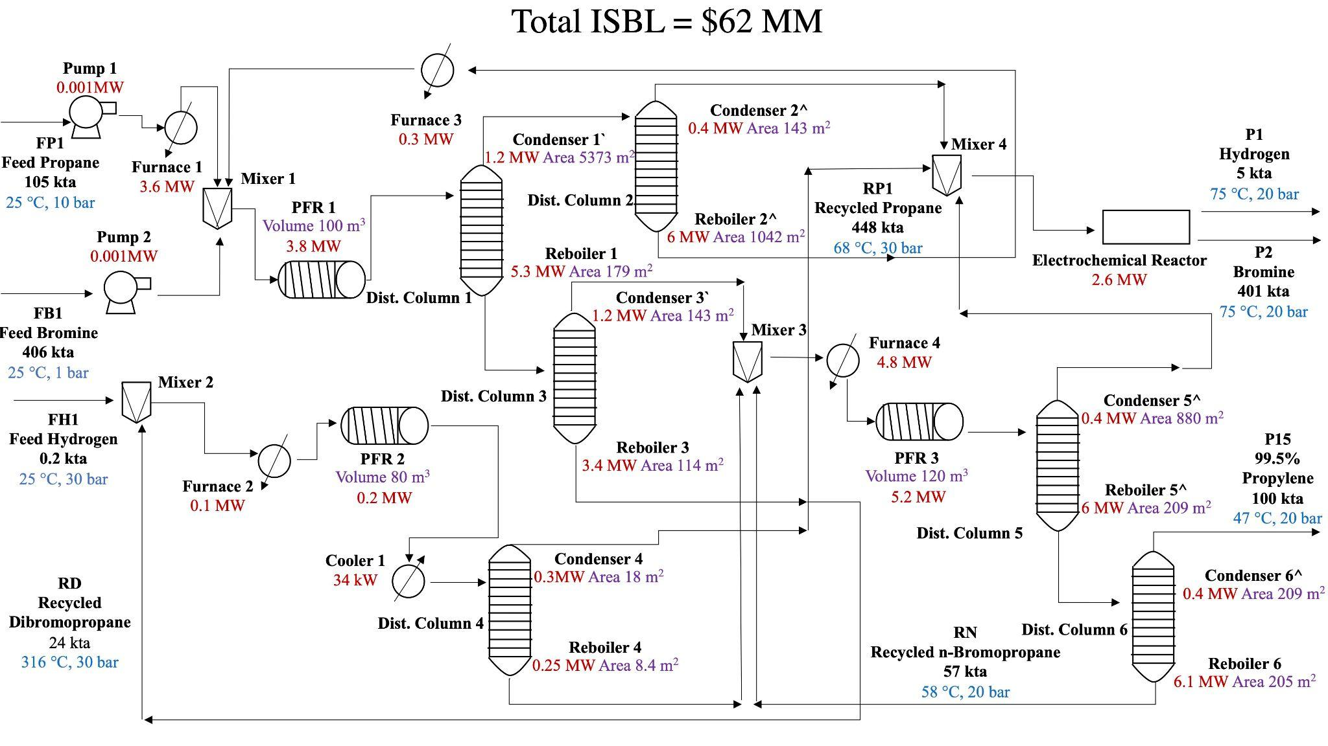
Simplified Process Flow Diagram (Without Heat Exchangers)
Sub Plant 3
Sub Plant 1
NPV: $18 MM; Total Capital Cost: $169 MM; Total Operating Cost: $31 MM/yr
Sub Plant 2

Slide 4
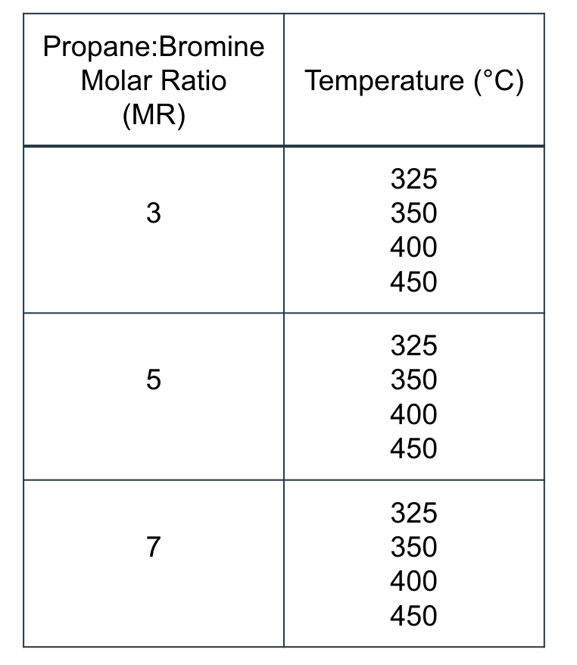
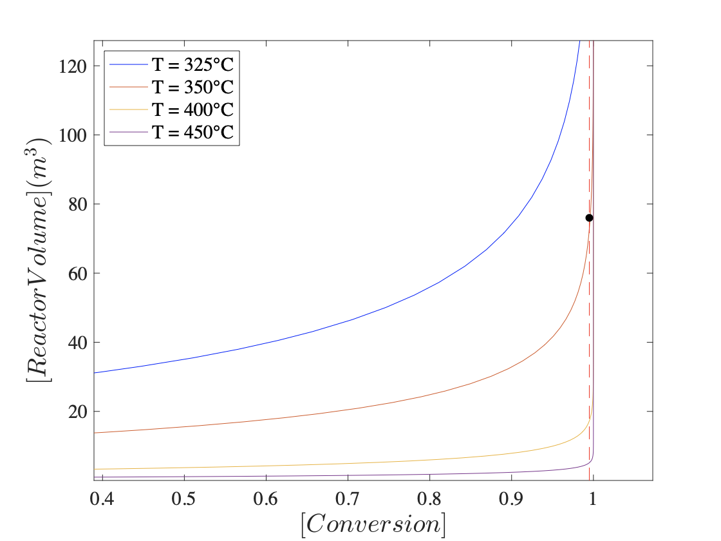
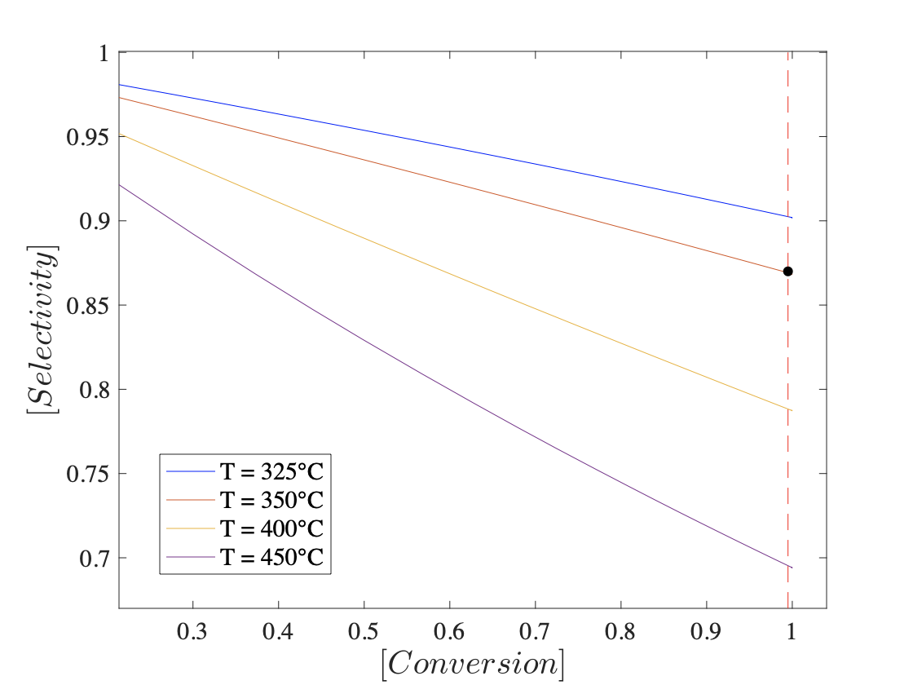
PFR Reactor Variables Determination
Sub-plant 1, first reactor: Propane:Bromine = 3:1, Reactor Temperature = 350°C
Reactor Volume Vs. Conversion
Selectivity Vs. Conversion
Sub-plant 1, second reactor: Hydrogen:Dibromopropane = 3:1, Conversion = 0.92
Sub-plant 2 reactor: N-bromopropane conversion = 0.88

Slide 5
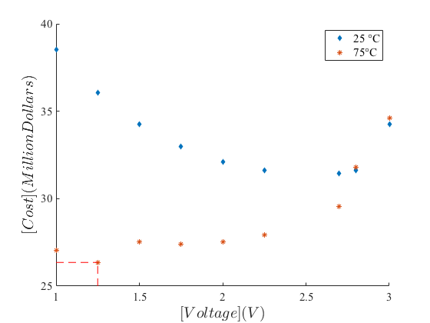
Electrochemical Plant Design
To recycle the waste HBr back to Br₂ and H₂ , an electrochemical plant was designed.
In designing electrochemical plant, the primary design variables were the voltage of the reactor and the operating temperature.
Reactor Capital Cost Vs Voltage
Final Operating Conditions :
Temperature: 75 °C
Voltage: 1.25 V
Power Usage: 2.6 MW
Operating Cost: $8 MM/yr
Capital Cost: $26 MM
$26 MM
1.25V

Slide 6
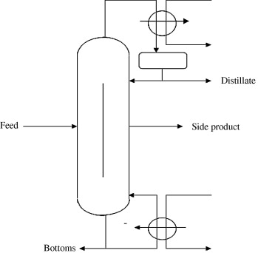
Heat System Design
This design requires high temperature for reactions and separations, so the process will be heat intensive
To get the best possible ratio on capital cost to operating cost, the heat exchangers and reboilers of the distillation column were also integrated in to overall heat exchanger system
Final Heating Table:
Final Heating Values:
Total Power Exchanged: 32 MW
Energy Consumption: 32.8 MJ/kg of propylene product produced
Total Carbon footprint: 1.4 CO₂ kta of per kta of propylene.
System Type | dT (°C) | dH (MW)
Heating | 381 | 67
Cooling | -374 | -61
Image Source: sciencedirect.com

Slide 7
Economic Analysis Model
Assumption: 2-year Construction, 13-year Plant Life
Start-Up Cost = 10% FCI, Working Capital = 10% FCI, Salvage = 5% FCI
Tax Rate =27%
Annual Interest Rate = 10%
Depreciation: 10-year linear schedule
Category | Value
Total Capital Cost, TCI | $169MM
Revenue, R | $65 MM/yr
Operating Cost, OpX | $31MM/yr
HYSYS ISBL ~ $62 MM
Including: 3 PFR Reactor
1 Electrochemical Reactor
6 Distillation Column
4 Furnace
3 Heater
1 Cooler

Slide 8
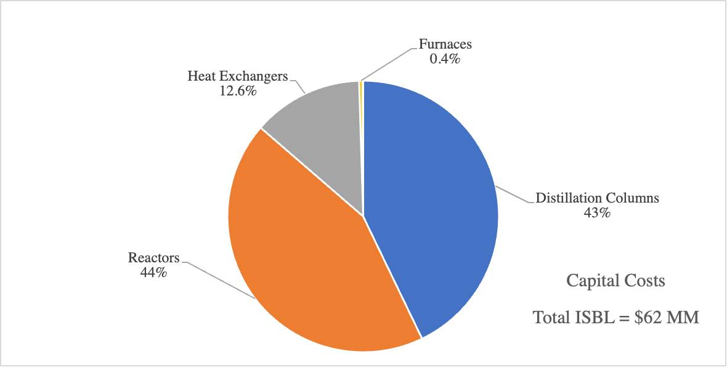
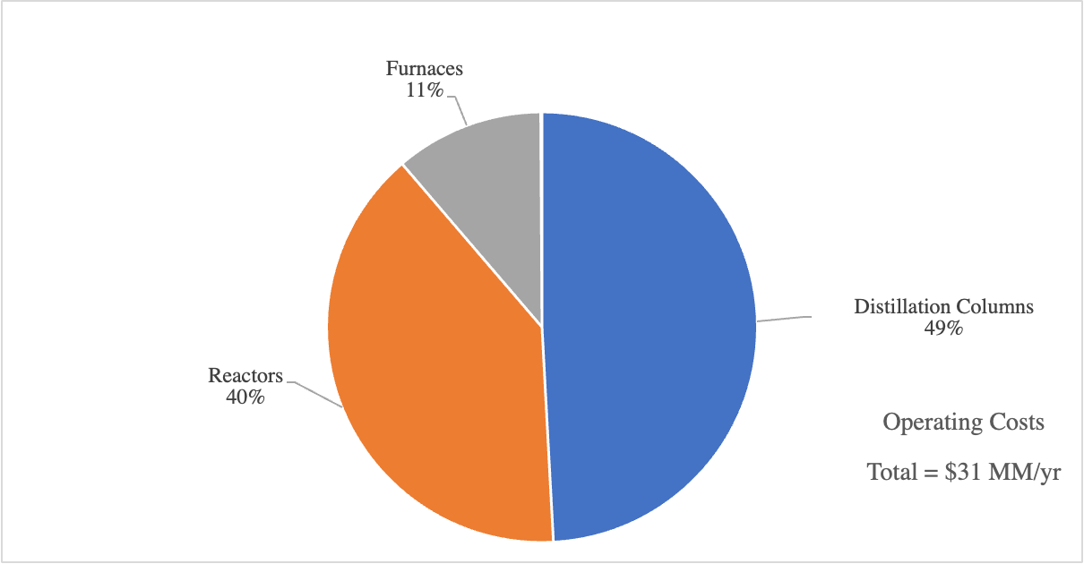
Capital Cost And Operating Cost Attribution
Distillation Column | Pressure (bar) | No. Stages & Feed Stage | Height (m) | Reboiler Duty (MW) | Condenser Duty (MW) | Reflux Ratio | Material
1 | 30 | 20 & 4 | 14 | 5.3 | 1.2 | 2 | Solid Titanium*
2 | 30 | 55 & 19 | 34 | 6 | 0.4 | 8.7 | Solid Titanium*
3 | 30 | 52 & 20 | 31 | 3.4 | 1.2 | 2.3 | Solid Titanium*
4 | 30 | 30 & 10 | 20 | 0.25 | 0.3 | 5 | Solid Titanium*
5 | 20 | 40 & 19 | 26 | 6 | 0.4 | 21 | Solid Titanium*
6 | 20 | 60 & 22 | 37 | 6.1 | 0.4 | 3.2 | Solid Titanium*
Distillation columns and reactors each takes ~44% of total CapX
Electrochemical reactor takes 41% total CapX ～$26MM
Distillation columns has the largest operating cost ~ 49%

Slide 9
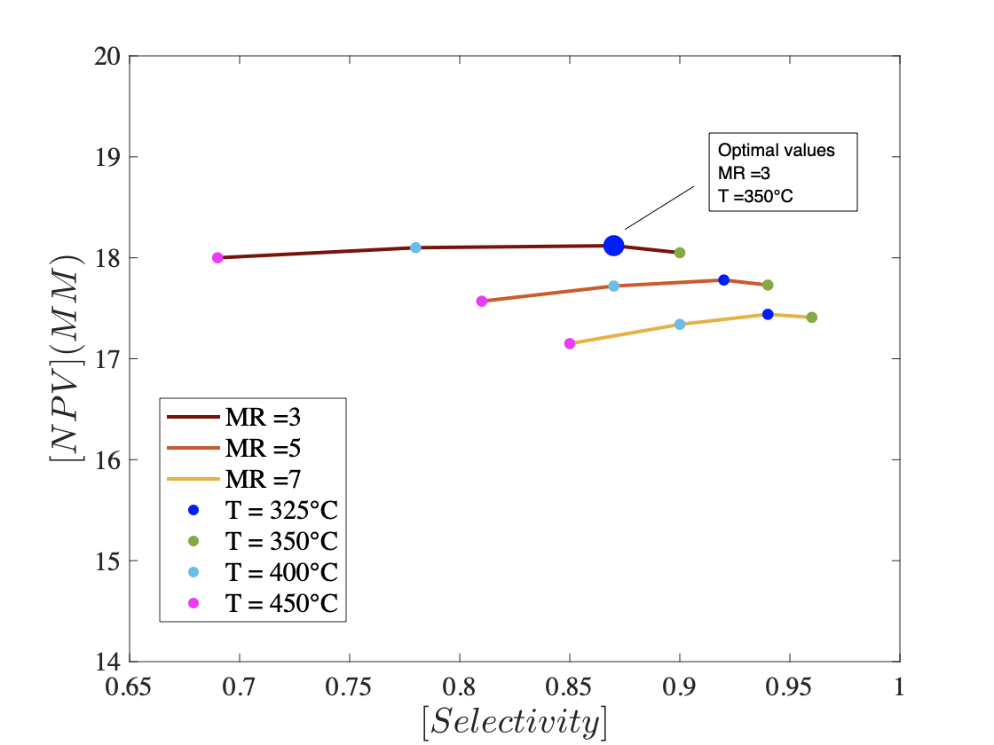
NPV Optimization
Profitability Metric | Value
Net Present Value, NPV | $18MM
NPV% | 0.69%
IRR | 12.04%
* Optimal Values for Design Variables: s = 0.87 (at MR =3, T = 350°C)

Slide 10
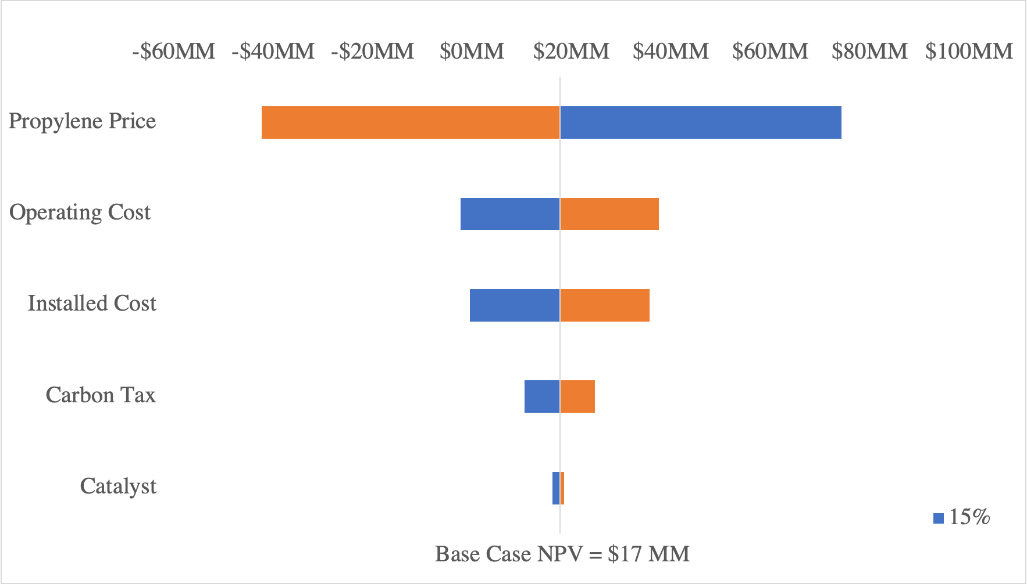
Sensitivity Analysis
Analysis based on ±15% price variation
Fluctuation in propylene selling price has the greatest impact on profitability

Slide 11
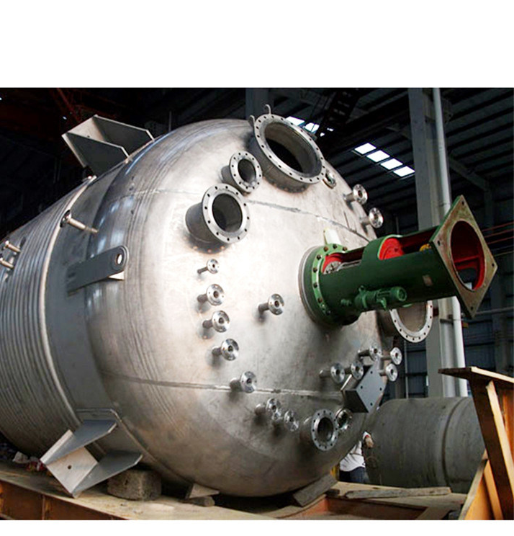
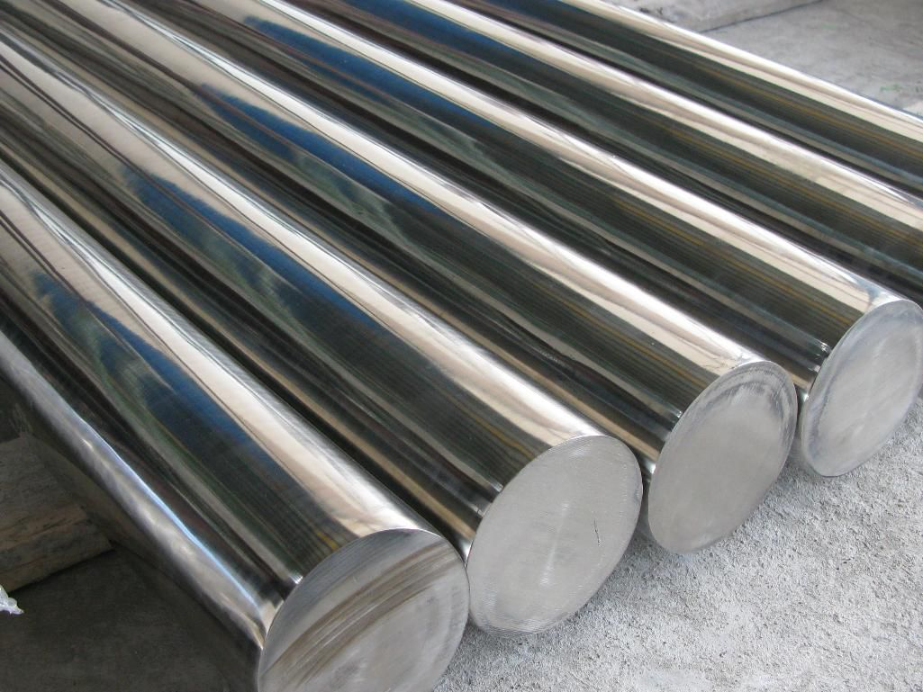
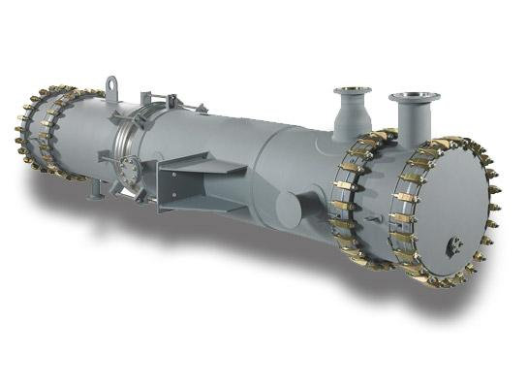
Process Safety
Due to the existence of different corrosive materials such as Br₂, HBr and H₂ non conventional building materials may be needed
Monel
Stainless Steel
Tantalum
Br₂ H₂
Br₂ HBr
High T (?)
However Tantalum is 20x the price of Titanium
For this process to be successful, a more detailed materials safety analysis is required
Image Sources in order Left:thoughtco.com, Middle: made-in-china.com, Right:tantec-group.com

Slide 12
Summary
Results
TCI: $169MM, NPV: $18MM, NPV%: 0.69%, IRR: 12.04%
The energy consumed by the process: 32.8MJ/kg propylene
The CO2 produced by the process: 1.4kg CO2/kg propylene
Distillation columns attributes the most to CapX and OpX; electrochemical reactor following in the second place has CapX of $26MM
Conclusion
The design will make profits, but the amount may be negligible; whether the design is worth operating is still debatable and will depend on the future work conducted
Future Work
A more detailed material safety analysis is required
More analysis for the viability of the electrochemical reactor is suggested

Slide 13
Thank You!

Slide 14
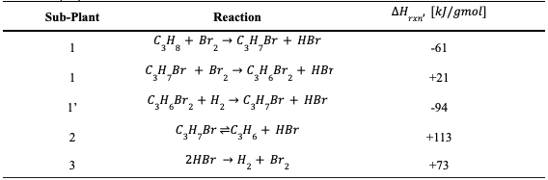
Reaction Chemistry
Reaction | Standard Potential (V)
Br2+2e- ⇌ 2Br- | 1.087
2H-+2e- ⇌ H2 | 0
Catalyst | Price ($/kg) | Diameter (mm) | Length (mm) | Surface Area (m2/gram) | Particle Density (kg/liter) | Void Fraction (%)
Hydrogenation | 140 | 10 | 20 | 100 | 0.88 | 50
Dehydrobromination | 10 | 15 | 25 | 100 | 0.5 | 50

Slide 15
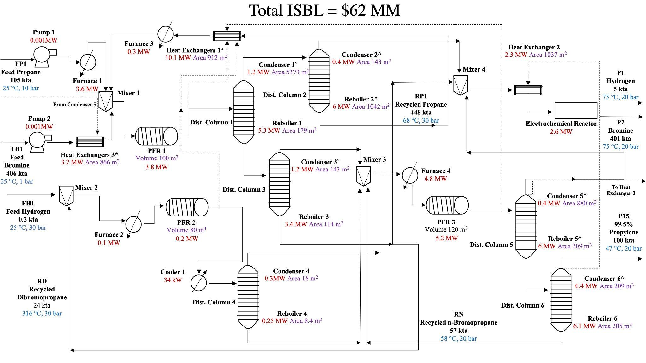
Detailed Process Flow Diagram (Including Heat Exchangers)

Slide 16
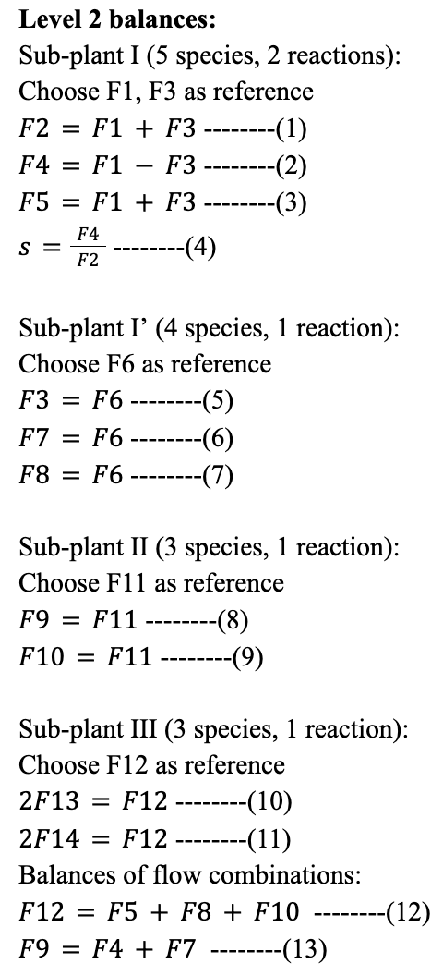
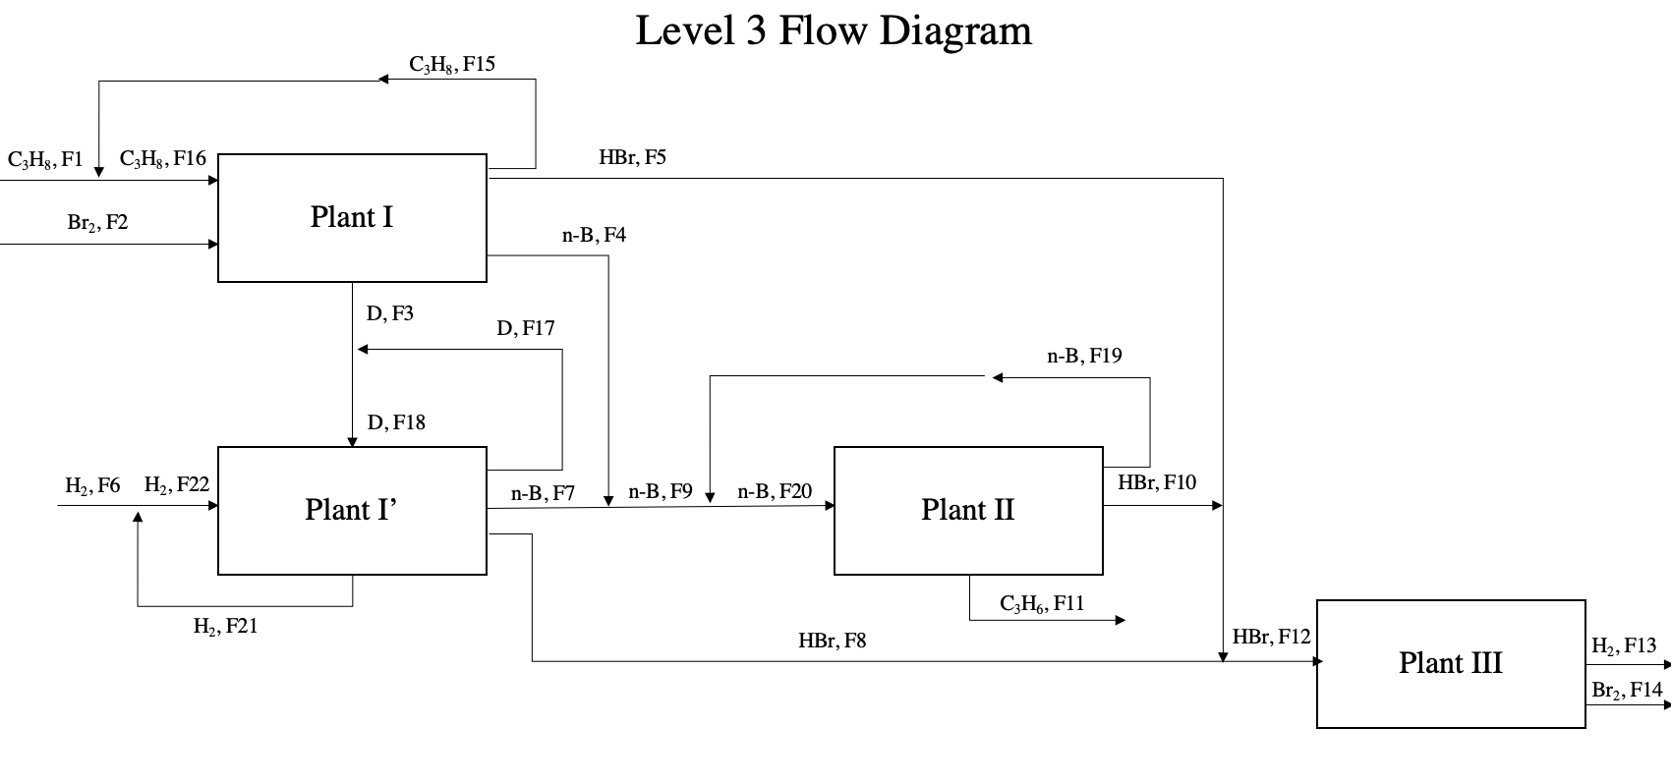
Level 2&3 Flow Diagram and Balances

Slide 17
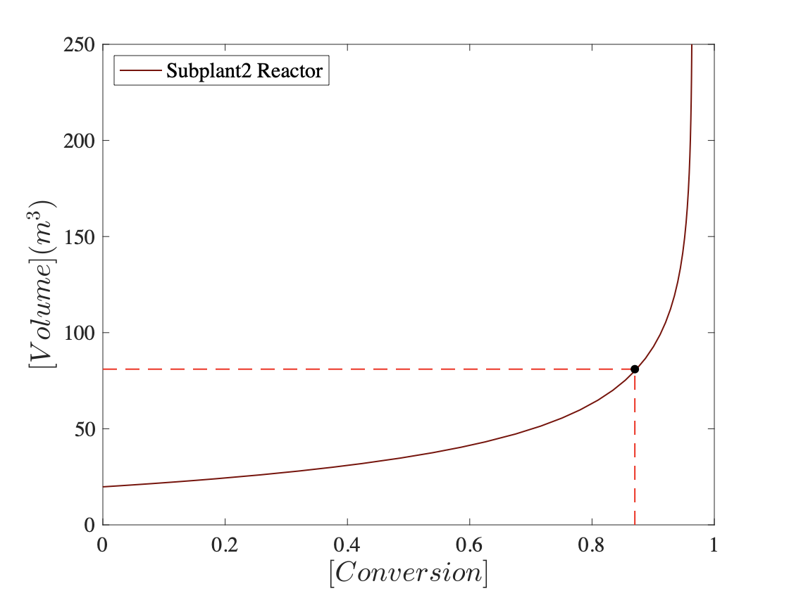
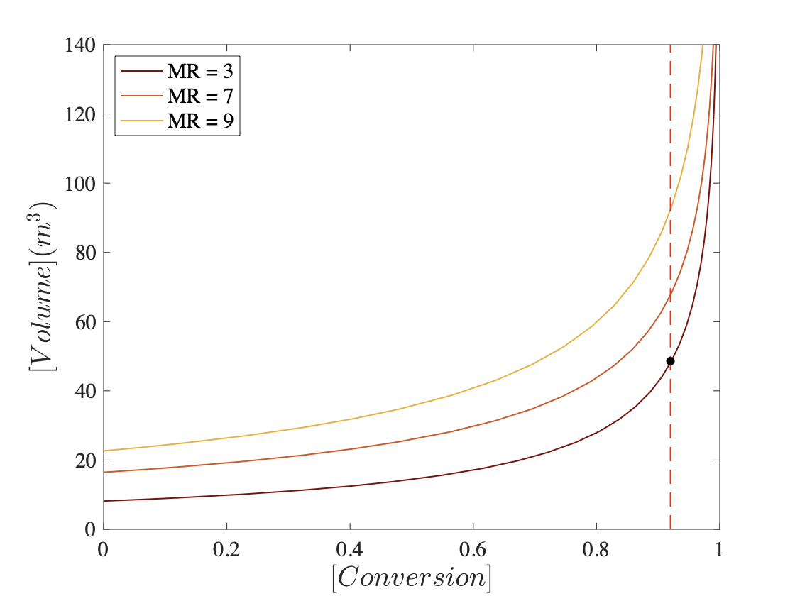
Sub-plant 1 & 2 Variable Values Determination

Slide 18
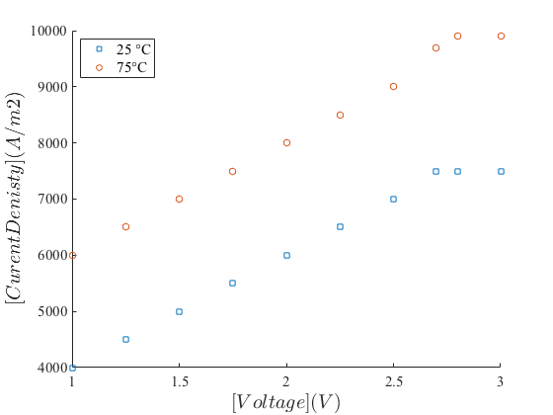
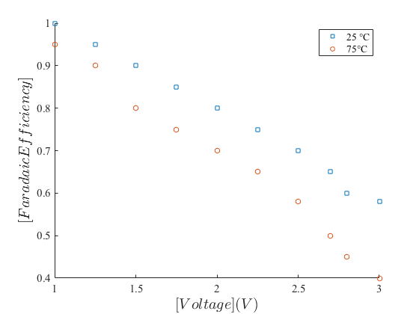
Electrochemical Plant Calculations
CapX=I/(A[V]*e[V])*10000
OpX=I*V*Cost of Energy
Where I is the current, A is the current density, and e is the faradaic efficiency.
Experimental Data:
The plant separates water using dehumidifying salts such as sodium sulfate

Slide 19
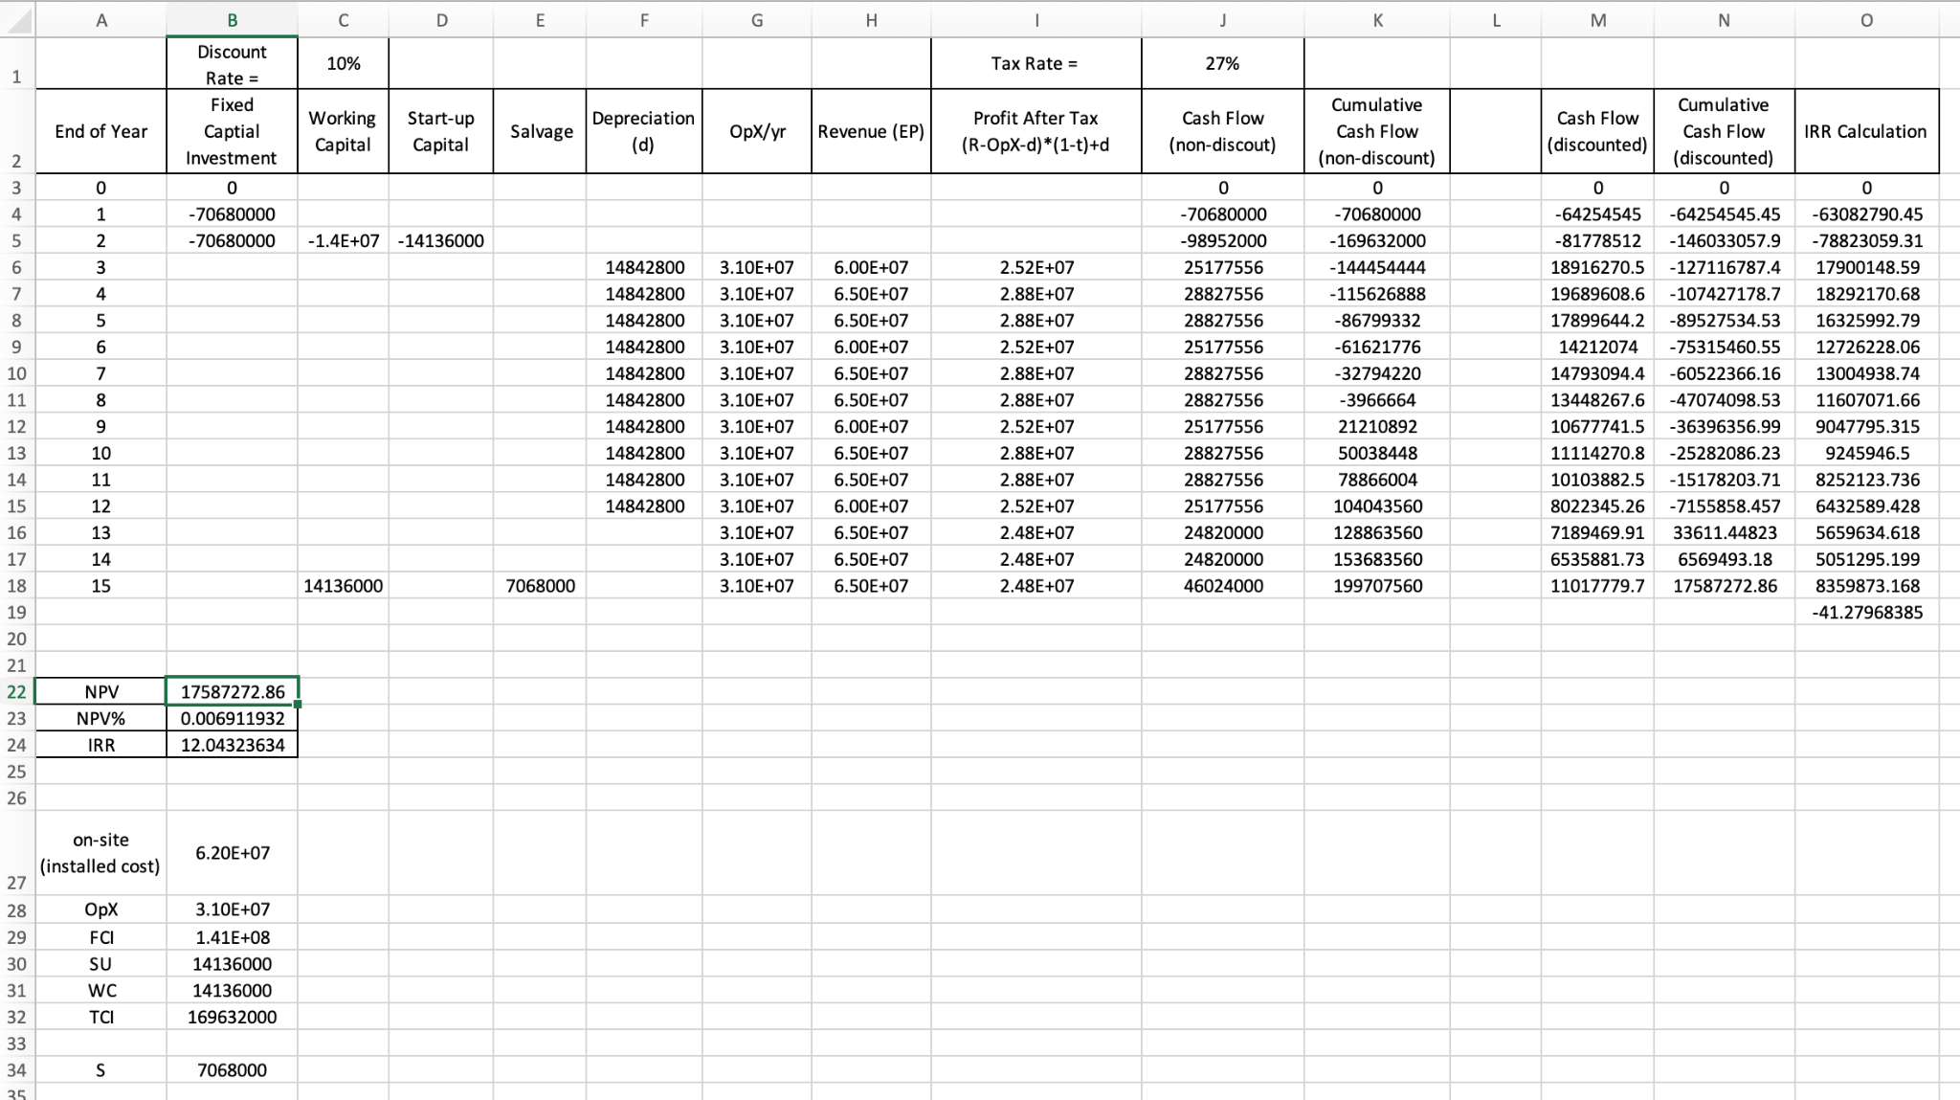
CFA Spreadsheet

Slide 20
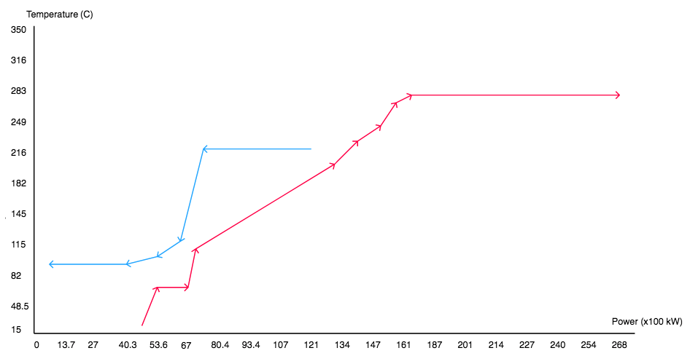
Heat Trim
HeatX | dH | dT | A (m2) | A (ft2) | Price | Water Cos/ Heat Transfer Fluid Cost | Total Cost
1 | 5,000 | 120 | 278 | 2,990 | $2,645,886 | N/A | N/A
2 | 5,450 | 80 | 454 | 4,889 | $3,642,149 | N/A | N/A
3 | 1,354 | 100 | 90 | 971 | $1,273,962 | N/A | N/A
4 | 1,354 | 100 | 90 | 971 | $1,273,962 | N/A | N/A
5* | 12,090 | 15 | 5,373 | 57,838 | $18,147,893 | N/A | N/A
6 | 3,407 | 120 | 189 | 2,037 | $2,061,971 | N/A | N/A
7 | 2,334 | 15 | 1,037 | 11,166 | $6,230,382 | N/A | N/A
8 | 3,246 | 25 | 866 | 9,317 | $5,538,906 | N/A | N/A

