Slide 1

Sharing the Australian Slang Survey Data collection
Rosanna Smith
Simon Musgrave
Notes:
This material was presented to the 8th Forum on Englishes in Australia, Melbourne 7/11/2025.

Slide 2
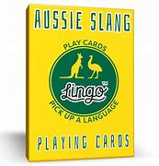
The project
The data was collected as part of the project 'Metaphors and Identities in the Australian Vernacular' supported by the Australian Research Council (SR200200350).
The Chief Investigators for the project were:
Professor Kate Burridge
Dr Howard Manns
Dr Simon Musgrave
Emeritus Professor Keith Allen
Research Associate: Dr Isabelle Burke
PhD Student: Dylan Hughes
All attached to Monash University.
Notes:
The title of the project includes the phrase ‘Australian Vernacular’. For many people, this phrase makes sense intuitively but for our purposes we needed to unpack its meaning, particularly in relation to the idea of ‘Australian Slang’. Slang is a part of language use in any community, deployed to indicate membership of specific groups and to exclude people from some communication. This kind of slang is typically short-lived. As Dylan and Howie have pointed out in recent work, the move from ‘cool’ to ‘cringe’ can happen very quickly [link]. But there is also a repertoire of expressions which have lasted longer and which are taken by many people to be part of an Australian identity; this is a much more reified idea of ‘Australian Slang’, the kind of language which is the subject of humorous websites intended to help new chums (see what I did there?).

Slide 3
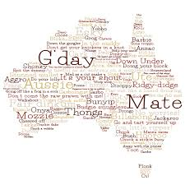
The survey
Aimed to access knowledge:
Of users of Australian English
About Australian slang
Collected basic demographic information:
Gender
Age (in brackets)
Place of residence
Childhood location (if different from current place of residence)
Body of survey is responses to a series of prompts
Survey delivered via Qualtrics
Responses collected July and August 2021
More than 4000 people visited the survey
Almost 3000 contributed responses
Notes:
As part of our project, we wanted to find out how people who use Australian English think about this version of ‘Australian Slang’. It seemed unlikely that collecting spontaneous language use data would address this question - and that would have been very expensive and time-consuming. (This is not to say that looking at records of language use is irrelevant - see the post on this blog [link] about Simon Musgrave’s work on slang as part of an Australian literary tradition where corpus data inform the argument.) We decided that collecting data about metalinguistic knowledge of Australian Slang, what users of the language can reflectively say about Slang, would be a substantial resource for our research and we therefore designed and implemented a survey to collect such data.
Two members of our team (Kate and Howie) regularly appear on various ABC Radio stations and this meant that we were able to publicise the survey very widely. As a result, we were fortunate to acquire a very substantial body of data.

Slide 4
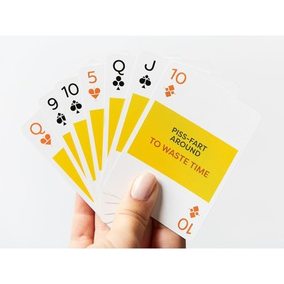
Prompts
Participants were asked to provide information in response to 13 prompts
Response categories:
Word or expression:
Meaning of word/expression:
Example of word/expression in use:
When and where have you heard this word/expression used?
Any further comments:
Notes:
We mentioned above that the information we were hoping to receive was metalinguistic and this is reflected in the structure of the survey questions. We did not ask participants about expressions which they did or might use - of course self-report data is notoriously unreliable. Instead, we asked about expressions which they thought of as typically Australian, and allowing them the opportunity to give information about the potential usage of an expression. Answering the question ‘When and where have you heard this expression used?’ allowed respondents to say that they used an expression, but many of the responses here were of the kind: “Not since the 80s.” (in relation to grouse). Many of the further comments responses were along similar lines, for example, ‘It's not that common anymore. A working class or rural expression’ as a comment about beauty. These examples suggest that responses to the survey were of the kind we had hoped to receive: accounts of the consciously accessible knowledge people had about Australian Slang as a language register.

Slide 5
Prompts
Something very good?
Something very bad?
Someone who is stupid?
An attractive person of any gender?
An attractive female?
An attractive male?
An unattractive person?
Someone who is arrogant?
Nonsense?
Alcohol?
Being intoxicated?
Someone who does not do their fair share?
Any part of the body?
Open question: Lastly, what other words or expressions do you think of as being characteristically Australian?
Notes:
The thirteen prompts mainly cover meanings with an affective component. Some of these prompts could be seen as referring to things or ideas which are seen as stereotypically Australian (e.g. the two alcohol-related items). This was a deliberate choice as we might expect that a strong association with Australianness might correlate with language which is also seen as distinctively Australian. As noted previously, prompt 13 and the final open question included an additional response category for the meaning of the expression. The responses for prompt 13 are of course much less cohesive than responses for the other prompts, but in the survey design process we were unable to decide on one specific body part which we thought would elicit characteristically Australian expressions (and we didn’t want to be indelicate!).

Slide 6
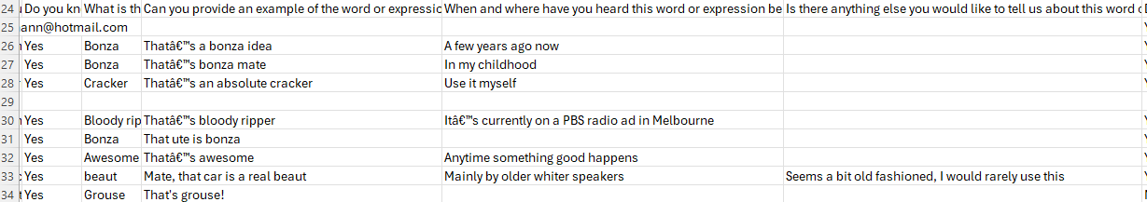
What the responses look like
Notes:
The upper screen shot shows the first part of some rows on the response table. The initial columns are all Qualtrics-generated metadata; responses to questions we asked begin in the column headed ‘Is your age….’. The full question was “Is you age over 15?” and it was included because we wanted to include at least some school age participants but to make ethics clearance possible we had to specify a minimum age. If a participant answered ‘No’ to this question, the survey automatically closed. The lower screen shot shows some responses to one prompt (something very good).
The screen shots show several problems which needed to be addressed before the data could usefully be shared:
Potentially identifying information (precise location when survey was accessed, email provided if willing to answer follow-up questions)
Blank responses
Encoding issues (here partly due to the idiosyncrasies of Excel)

Slide 7
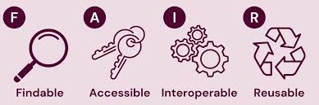
Sharing the data - FAIRification
Previous slide already shows some problems for sharing this data
Potentially identifying information (location when responding, email in some cases)
Encoding problems (‘Often used with â€˜bloodyâ€™ before it (bloody ripper)’)
Unwieldy data structure - we showed responses to one prompt, all responses for a participant (up to 14) are a single row in the table
Notes:
Our aim was to make this dataset FAIR compliant. Findability is the last step in the process: when the data is tidied and formatted as an RO-Crate, it can be published in the LDaCA data portal where it is now discoverable and has a DOI. Our aim was to have a dataset which could be freely shared and this required the removal of the potentially identifying information mentioned on the previous slide. Contact emails were provided by some respondents in response to a question asking if they were willing to be contacted for follow-up questions. This information could only be shared beyond the project team if explicit permission was sought from each respondent and this is not practically possible.
We improved the interoperability and reusabilty of the data in several ways. The download from Qualtrics has all responses from one a participant as a single row with over 100 cells. We created a separate table for responses to each prompt to make the data more manageable. Within each of those tables, we removed blank responses, i.e. if a participant provided no responses to a particular prompt, that participant would not appear in the relevant table but might appear in other tables (unless they provided no responses at all). We also normalised encoding of e.g. quotation marks to improve interoperability. Spelling variations (e.g. bonza/bonzer) were left untouched as we believe that they may provide valuable information; for example, spelling variation may be regionally conditioned..

Slide 8
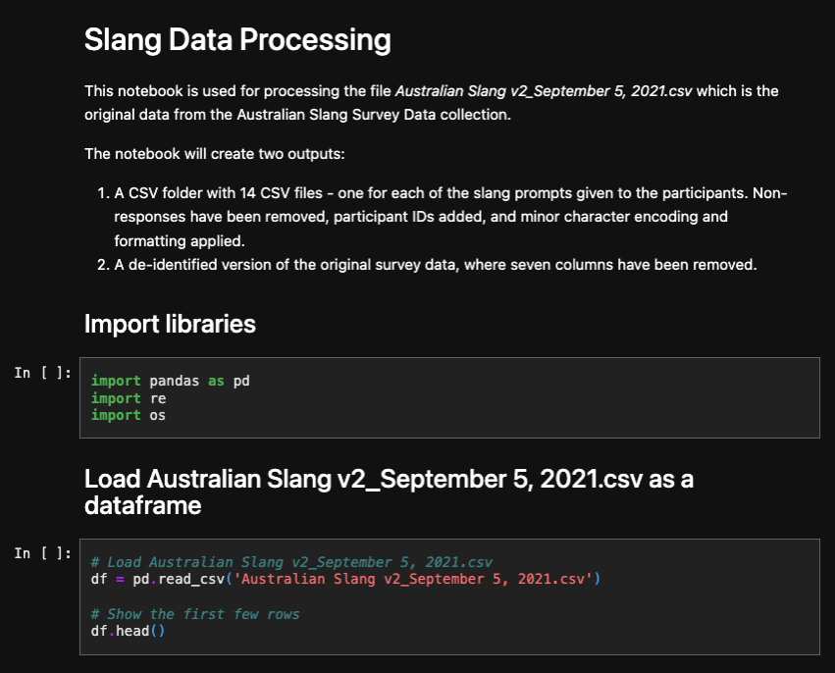
Data transformation using Jupyter Notebooks
Input: Original survey data consisting of 121 columns
Required outputs:
14 CSV files per prompt
De-identified version of the original data
Slang_Data_Processing.ipynb
Notes:
As Simon has mentioned, the original format of the data was unwieldy, with all the responses from a single participant in one row.
We needed to convert the 100+ columns in the original data to separate rows per prompt, and from these generate 14 CSV files for each of those prompts.
We also needed a de-identified version of the original data without any further transformation.
To do this, we used Jupyter Notebooks, which allow you to load the collection data and transform its contents in a repeatable way.
This reproducibility also means others can run the same steps and identify areas where further data wrangling is needed, and I’ll take you through some of these now.

Slide 9
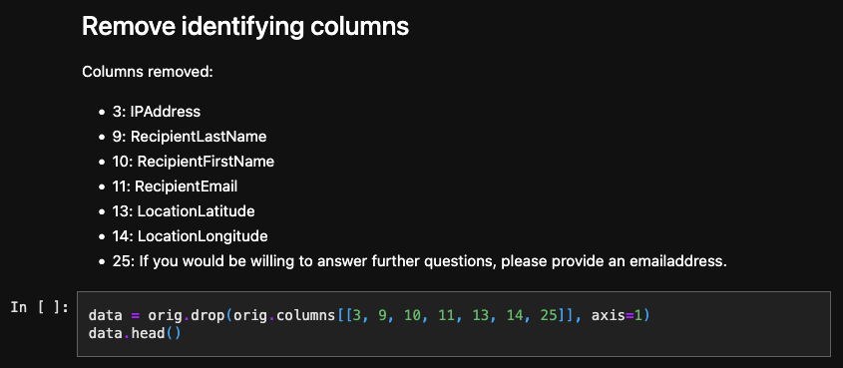
Identifying information
Columns removed:
IPAddress
RecipientLastName
RecipientFirstName
RecipientEmail
LocationLatitude
LocationLongitude
If you would be willing to answer further questions, please provide an emailaddress.
Notes:
For the de-identified version of the original survey, we removed 7 columns that contained personal identification data.
This was then exported to a CSV with no further changes, preserving the original structure of the survey within the collection.

Slide 10
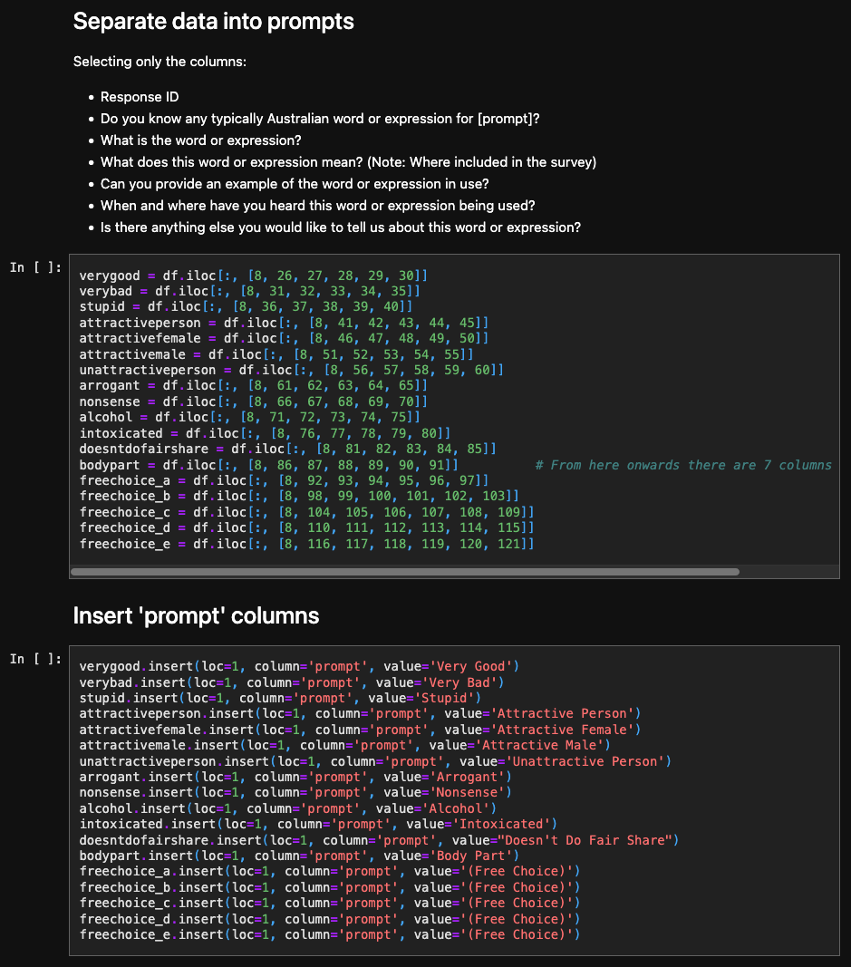
Prompt separation
Dataframe split according to each prompt
Columns kept for CSVs:
Response ID
Do you know any typically Australian word or expression for [prompt]?
What is the word or expression?
What does this word or expression mean? (Note: Where included in the survey)
Can you provide an example of the word or expression in use?
When and where have you heard this word or expression being used?
Is there anything else you would like to tell us about this word or expression?
Prompt column added
Notes:
We then needed to generate the CSVs for the 14 prompts.
The first step here was to load the original data as a Pandas DataFrame and identify the columns related to each prompt.
We also kept the Response ID to map those responses to the participant metadata.
We then added a column with the prompt name, and this means we can recombine the data to run further processing, but it’s easy to split these out again for the separate CSVs.

Slide 11
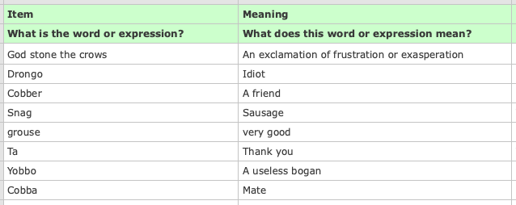
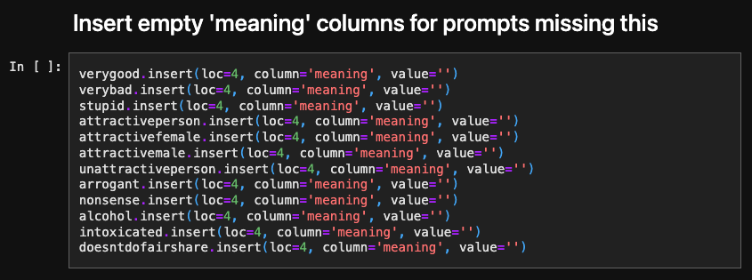
Handling prompts 13 and 14
Prompts for Body Part and (Free Choice) had an additional column ‘meaning’ for participants to describe the word or expression.
Additional blank ‘meaning’ column added to other prompts so data is structured identically.
Notes:
Unlike the rest of the prompts, those for Body Part and Free Choice had an additional column where participants could explain the meaning of the slang term, and this created a mismatch when we were trying to recombine the data.
So for the 12 other prompts, we added a blank ‘meaning’ column to fix this and standardise the overall structure.

Slide 12
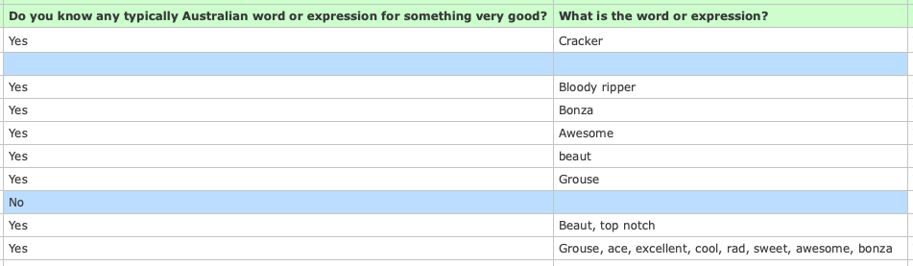
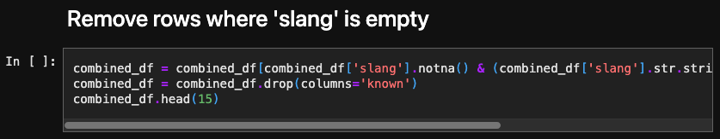
Non-responses
Blank prompt rows removed from data
Updated structure preserves the other responses provided by that participant
Notes:
Throughout the data, there were also sections where participants didn’t have responses to a particular prompt, and these weren’t useful to keep for this collection.
Removing these would have caused a problem in the original format, but now that the data was divided according to prompt, we could remove these non-responses without deleting the whole row of a participant where they’d provided responses to other prompts.

Slide 13
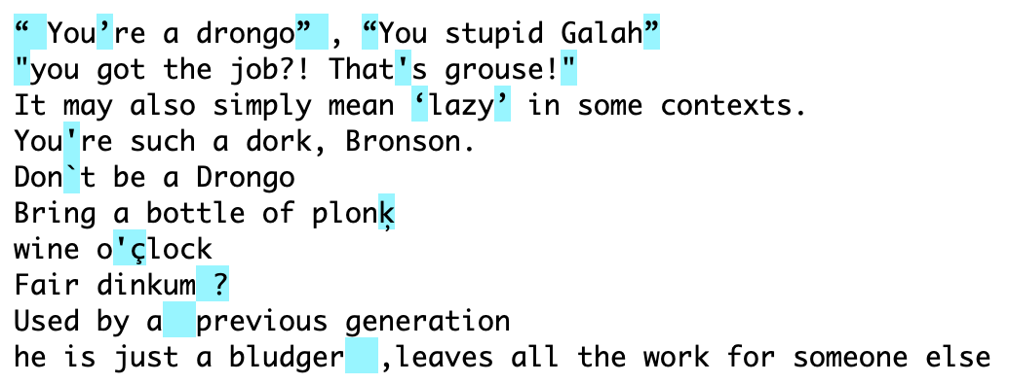
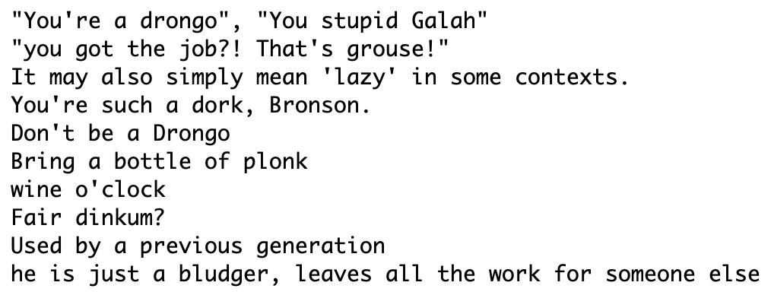
Formatting and character encoding
Leading and trailing spaces removed
Quotation mark standardisation
Minor character encoding and formatting corrections
Notes:
Another important part of the slang data processing was standardising some of the formatting and character encoding, to improve the searchability of the collection overall.
This included removing leading and trailing spaces, fixing double spaces and minor errors in punctuation position.
We also standardised quotation marks and removed some diacritic typos.
The examples here show the highlighted items that were identified in the first box, and the reformatted version in the second.

Slide 14
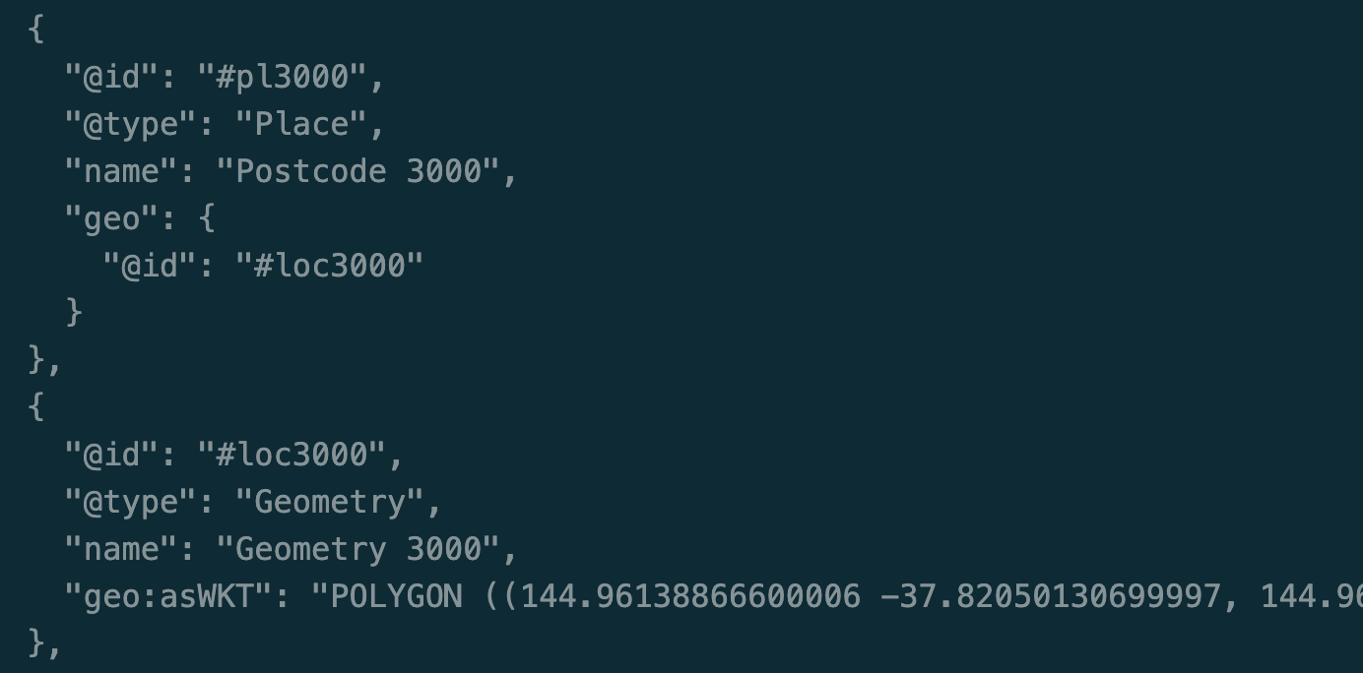
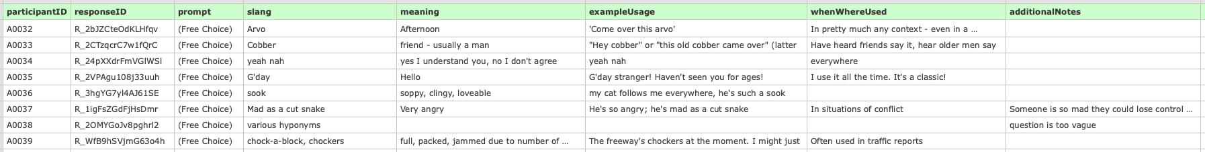
Mapping the participant metadata
Participant ID maps the responses to the participant metadata
Prompt data exported to 14 CSVs
Geomapping data for postal areas added to participant metadata based on their postcodes provided
Melbourne Postcode Polygon Metadata
Notes:
So with all these updates applied, we mapped the participant ID to the responses, and each prompt was exported to a separate CSV file, like the example shown here.
With the participant ID, we could also map each response to the postcodes provided by the participants, and then use geomapping data from the Australian Bureau of Statistics to turn these postcodes into polygons in the collection metadata.

Slide 15
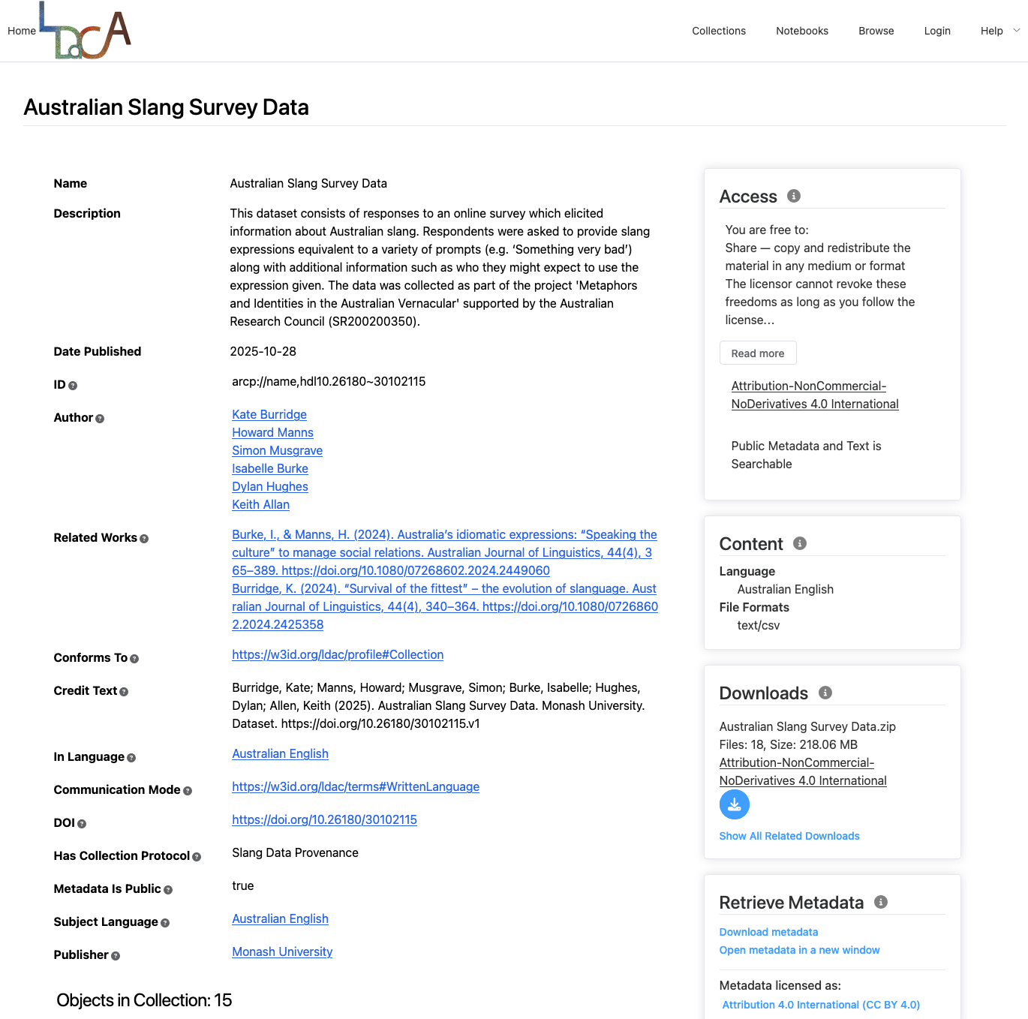
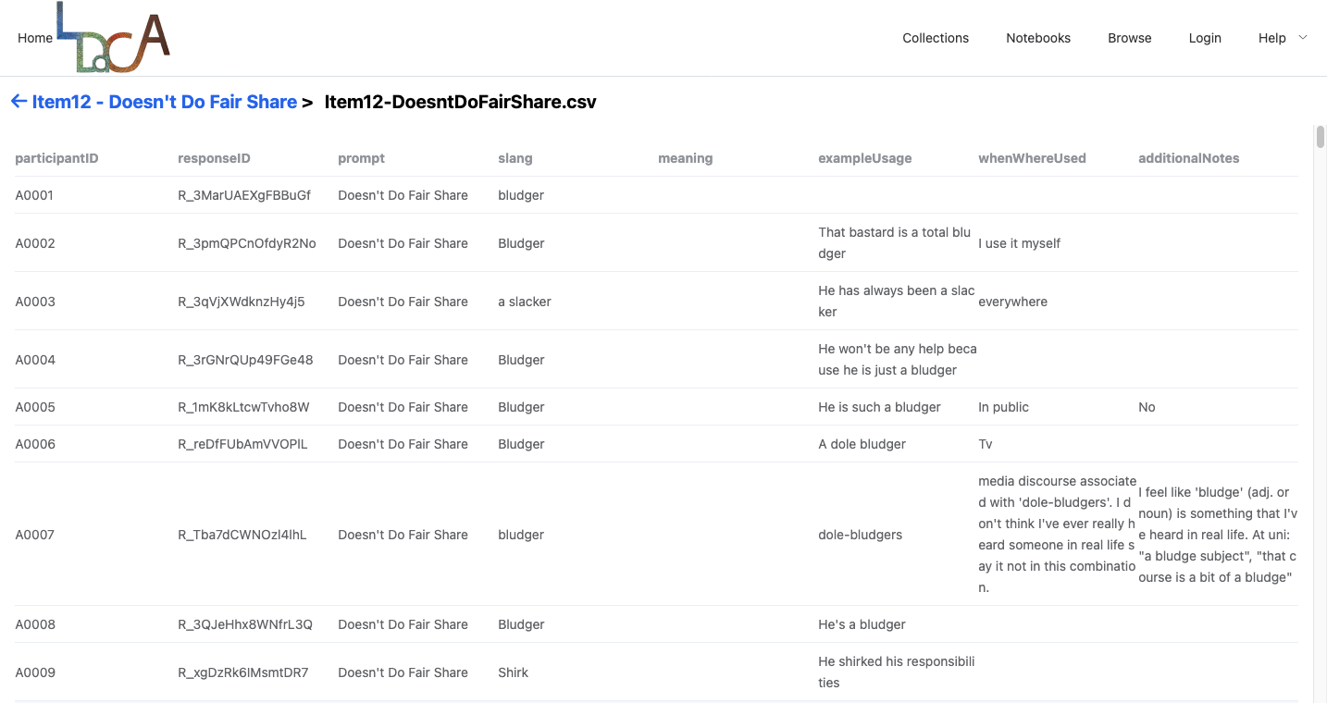
Data in LDaCA Portal
data.ldaca.edu.au
Notes:
The transformed collection is now stored in the LDaCA Portal as an RO-Crate or Research Object Crate.
This is a way of packaging research data that stores the data together with its associated metadata and other component files, such as the data license.
The screenshot on the right shows the collection in the portal, listing some of its main details, access permissions and downloads.
The screenshot on the left is an example of one of the transformed CSV files within the collection, that can be viewed in the portal.

Slide 16
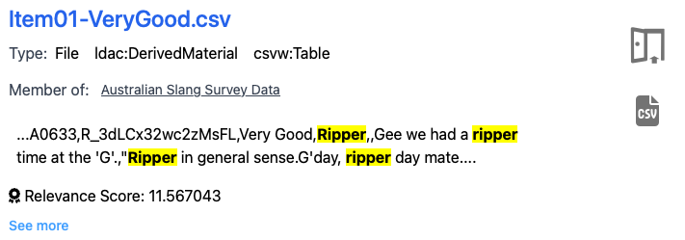
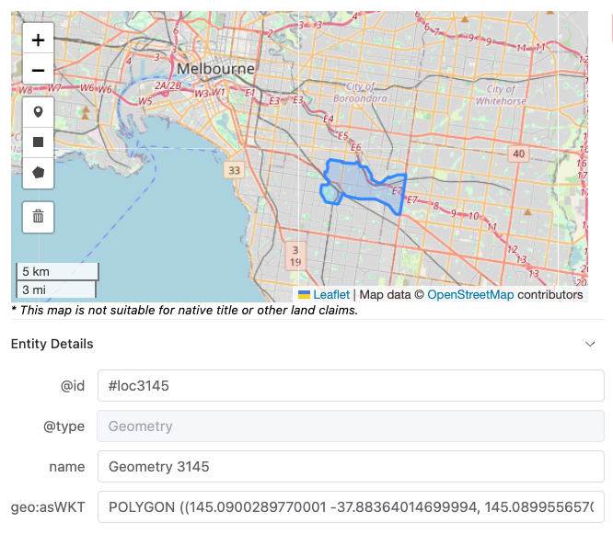
Future work
Improve search capabilities and display in the LDaCA portal.
Add an additional download for a combined prompts CSV.
Create a Jupyter Notebook that allows users to explore the collection:
Filter by a word or expression and view its related demographics
View most common responses to a prompt and any associated geographical patterns
Geomapping a given word or expression using the postcode data provided by the participants
Notes:
Now that the data is available in the portal, we’re looking at next steps for the slang data.
One of these is improving how results from searching the collection are displayed. As you can see from the top screenshot, a query currently returns the full line from the CSV file rather than just the cells where the search term occurs.
Another is adding a download combining all the prompts in a single CSV, which in some cases is preferable to work with than the split CSVs.
We’ll also be developing a Jupyter Notebook linked from the portal, that allows users to explore the collection in more detail.
This would include the ability to filter by word or expression, demographics including age range and gender, as well as viewing the most common responses for a given prompt.
We can also map the postcodes provided by the participants using the geomapping data, and through this view any geographical patterns associated with the slang terms.

Slide 17

Notes:
Finally, if you’re interested in hearing more about this and other collections we’re working on at LDaCA, you can subscribe to our newsletter with the QR code.

