Slide 1
Five ways RO-Crate data packages are important for repositories
Peter Sefton*, Stian Soiland-Reyes**
*University of Queensland, Australia; **The University of Manchester, UK
Notes:
Time: 05/June/2024: 11:00 - 12:30 · Location: Drottningporten 1
Peter Sefton*, Stian Soiland-Reyes**
*University of Queensland, Australia; **The University of Manchester, UK
Research Object Crate is a linked data metadata packaging standard which has been widely adopted in research contexts. In this presentation we will briefly explain what RO-Crate is, how it is being adopted worldwide, then go on to list ways that RO-Crate is growing in importance in the repository world:
- Uploading of complex multi-file objects means RO-Crate is compatible with any general purpose repository that can accept a zip file (with some coding, repository services can do more with RO-Crates)
- Download for well-described data objects complete with metadata from a repository rather than just a zip or file with no metadata
- Using RO-Crate metadata reduces the amount of customisation that is required in repository software, as ALL the metadata is described using the same simple, self-documenting linked-data structures, so generic display templates
- Sufficiently well-described RO-Crates can be used to make data FAIR compliant, aiding in Findability, Accessibility, Interoperability and Reusability thanks to standardised metadata and mature tooling
- And if you’re looking for a sustainable repository solution, there are tools which can run a repository from a set of static files on a storage service, in line with the ideas put forward by Suleman in the closing keynote for OR2023

Slide 2
Uploading of complex multi-file objects …
Notes:
RO-Crate [1], [2] is a data packaging format and can be used to put multiple data files together with their metadata into a package such as a zip, tar or disk image file. This means that as long as your repository can handle a zip file it can take RO-Crates.
RO-Crates enable data to travel with metadata.
Beyond simply allowing upload of opaque RO-Crates there are opportunities for repository software to recognize metadata in an uploaded package and to pre-populate built-in metadata forms and/or datastores. This is not a pattern the authors have seen widely implemented in comprehensive institutionally focussed repositories, although at the time of writing it is being explored in Dataverse and InvenioRDM/Zenodo. We would encourage repository developers to explore this further, particularly those working with research data. RO-Crate support is increasing in research-domain repositories; eg RO-Crate upload with metadata extract is supported by WorkflowHub and ROHub).

Slide 3
… is already supported even if the repo does not speak RO-Crate

Slide 4
RO-Crate Metadata Document
{
"@id": "2021-04-08 07.58.17.jpg",
"@type": "File",
"contentSize": 3271409,
"dateModified": "2021-04-08T07:58:17+10:00",
"description": "",
"encodingFormat": [
{
"@id": "https://www.nationalarchives.gov.uk/PRONOM/x-fmt/391"
},
"image/jpeg"
],
"name": "Cute puppy"
},
|
|- ro-crate-metadata.json
|-- Folder1/
| |-- file1.this
| |-- file2.that
|-- Folder2/
| -- file1.this
| |-- file2.that
|-2021-04-08 07.58.17.jpg
📂

Slide 5
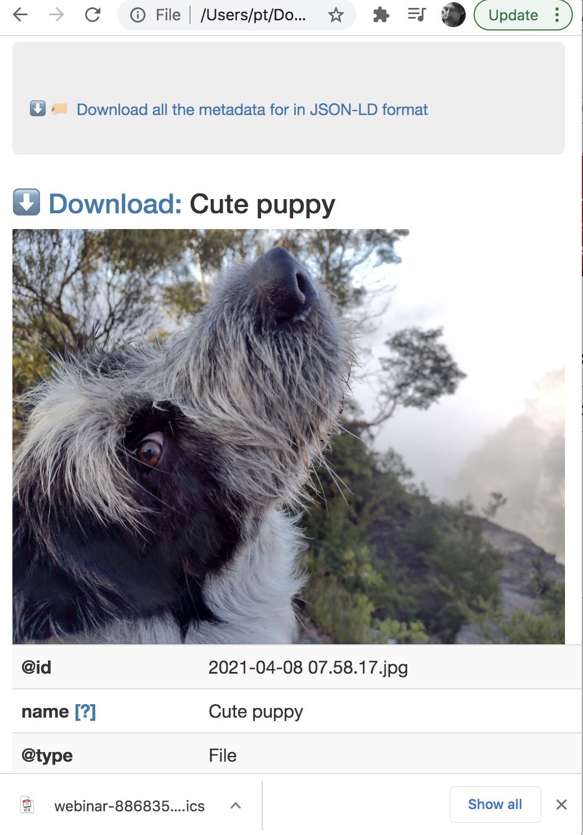
|-- Folder1/
| |-- file1.this
| |-- file2.that
|-- Folder2/
| |-- file1.this
| |-- file2.that
|-2021-04-08 07.58.17.jpg
📂

Slide 6
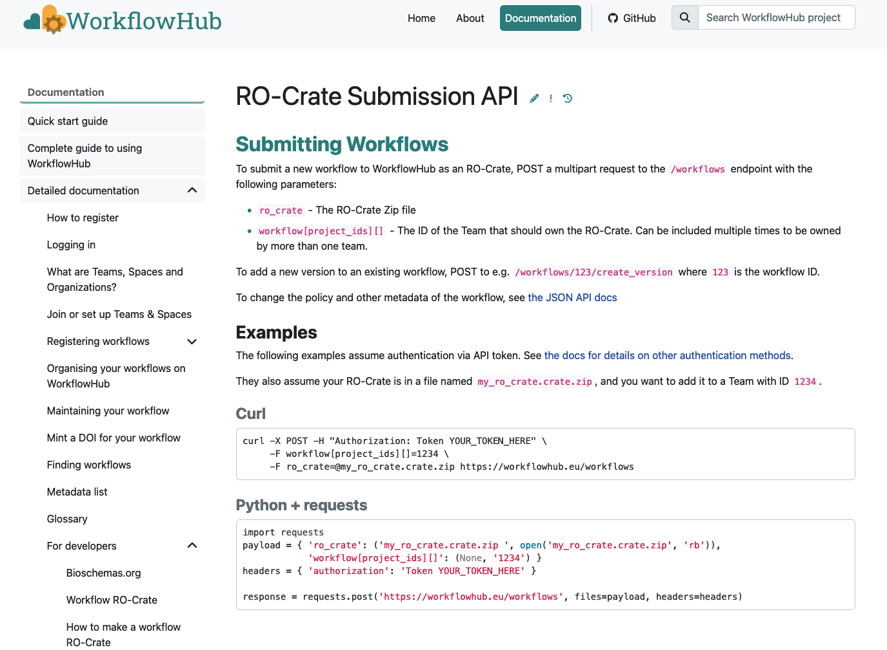

Slide 7
2. RO-Crate is a packaging format suitable for downloads
2.

Slide 8
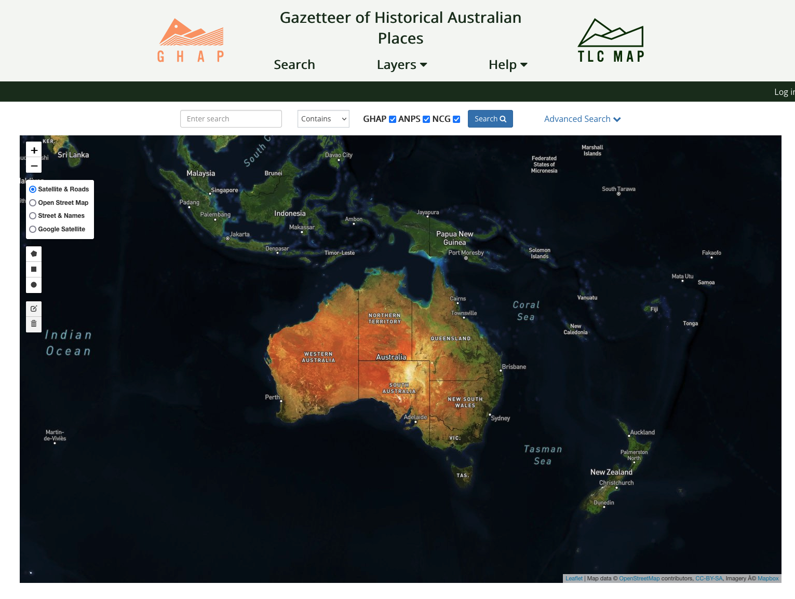

Slide 9
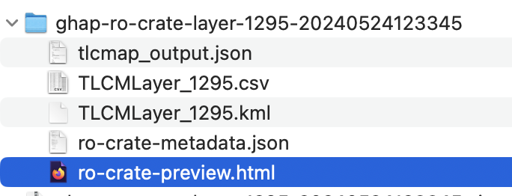
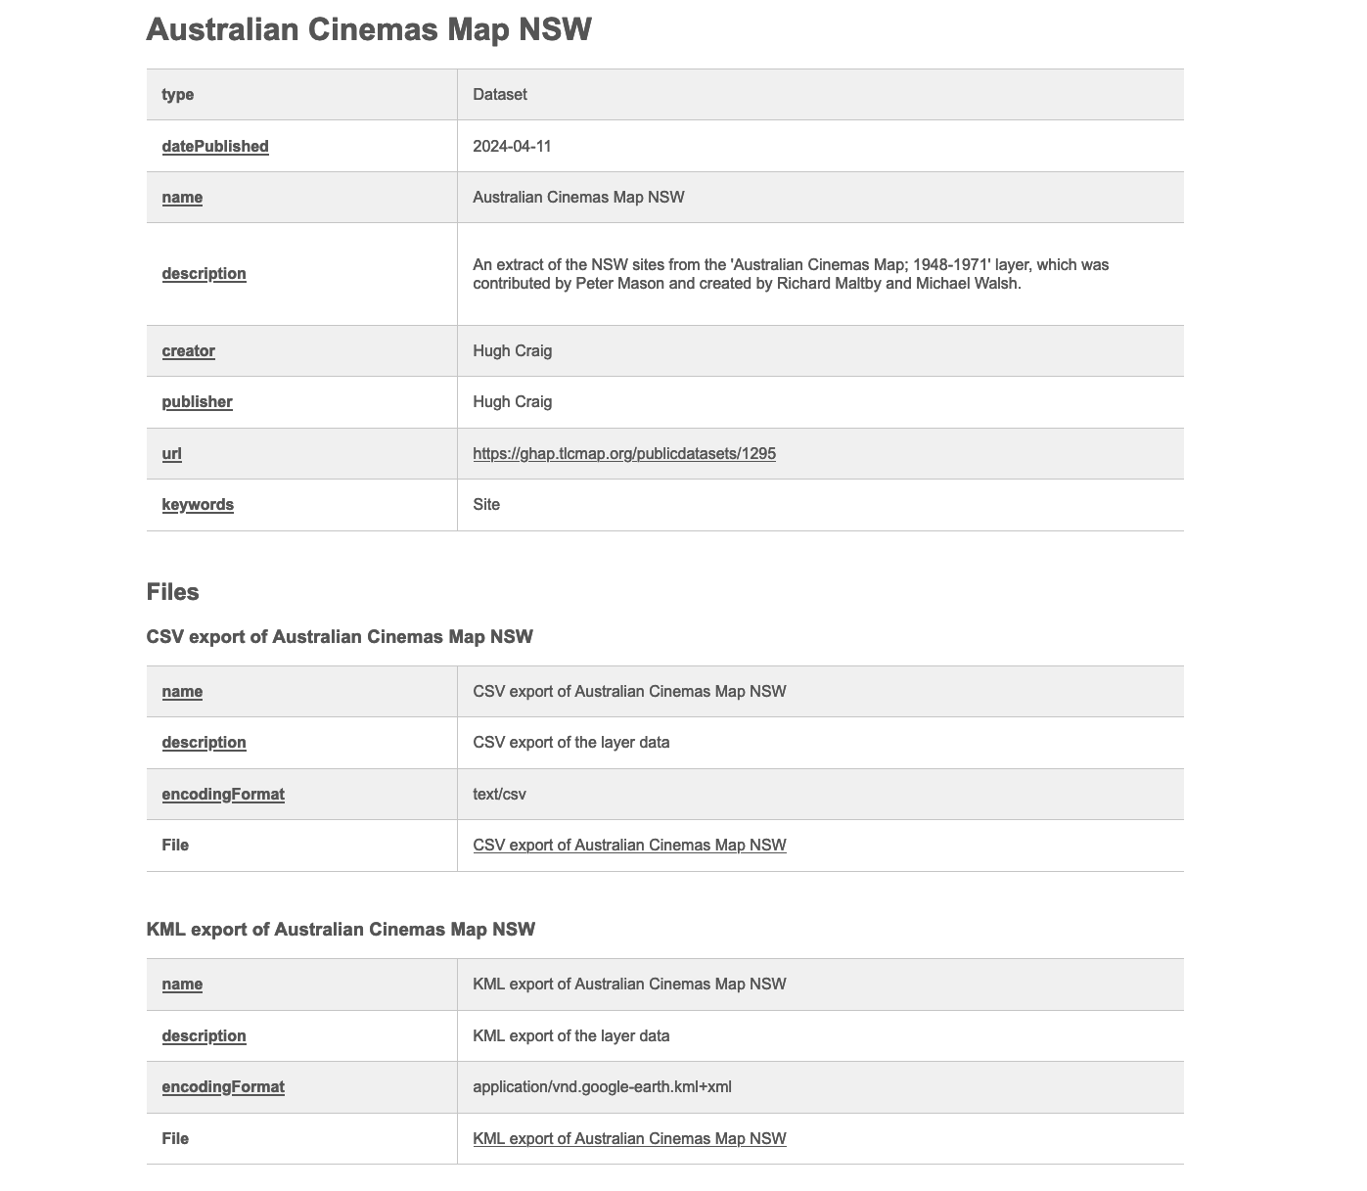
HTML Preview Describes the files

Slide 10
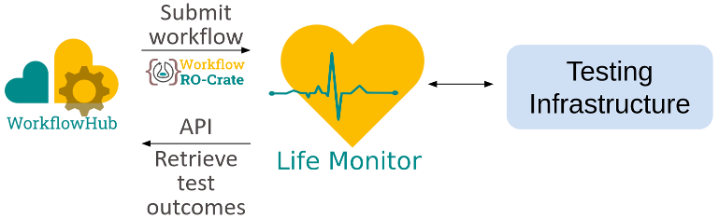

Enable programmatic downloads – include the metadata and its extensions
signposting.org

Slide 11
3. Less user interface customisation will be needed for different types of metadata

Slide 12
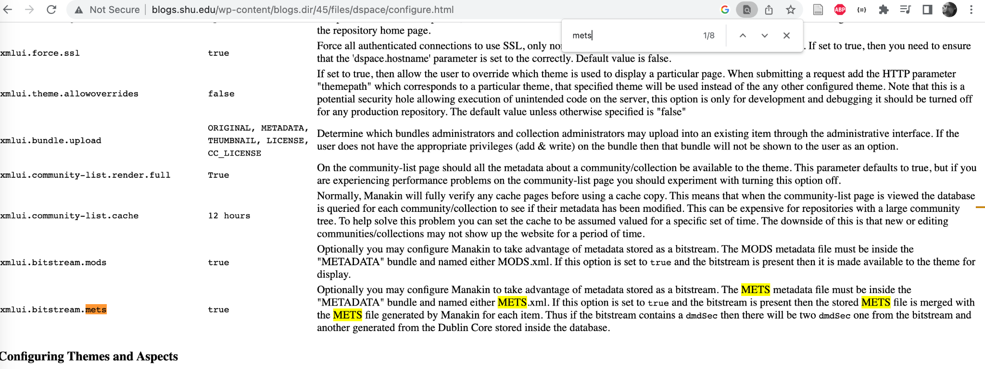
Here the mechanism is to use the ‘magic’ name METS.xml to store some extra metadata – with a fully linked-data system this kind of thing is not needed

Slide 13
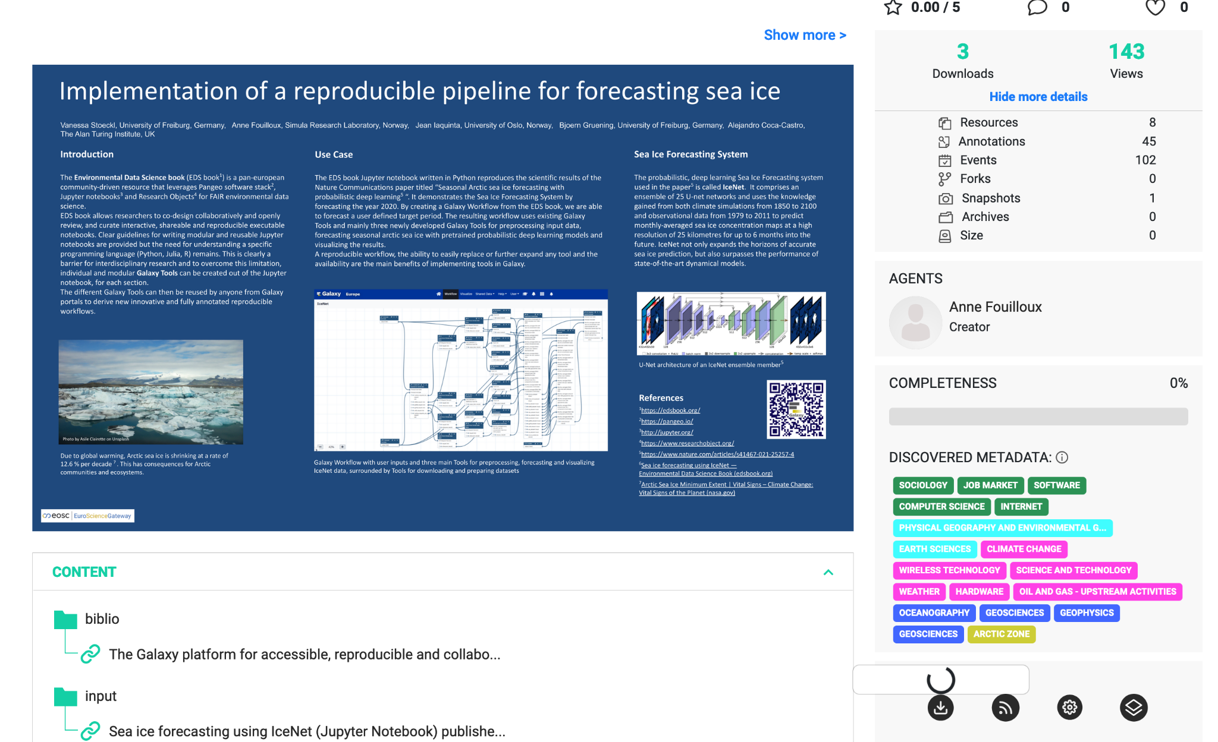
Notes:
This is an example of a data object in RO-Hub, which has a variety of files described in the object.
This site does not need to have multiple plugins for different kinds of data, as RO-Crate has a generic structure. We saw another example of how the generic structure can be rendered in the opening example with a picture of a dog.

Slide 14
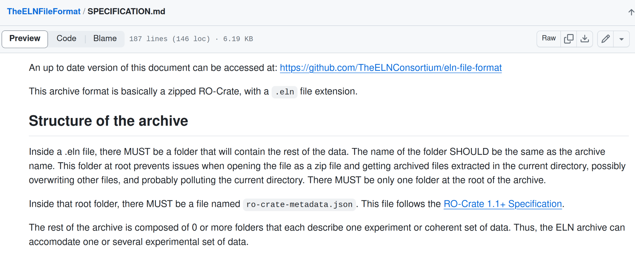
No need to invent (completely) new file formats anymore!

Slide 15
4. The availability of RO-Crate editing tools opens the way for repository software to focus on access and discoverability

Slide 16
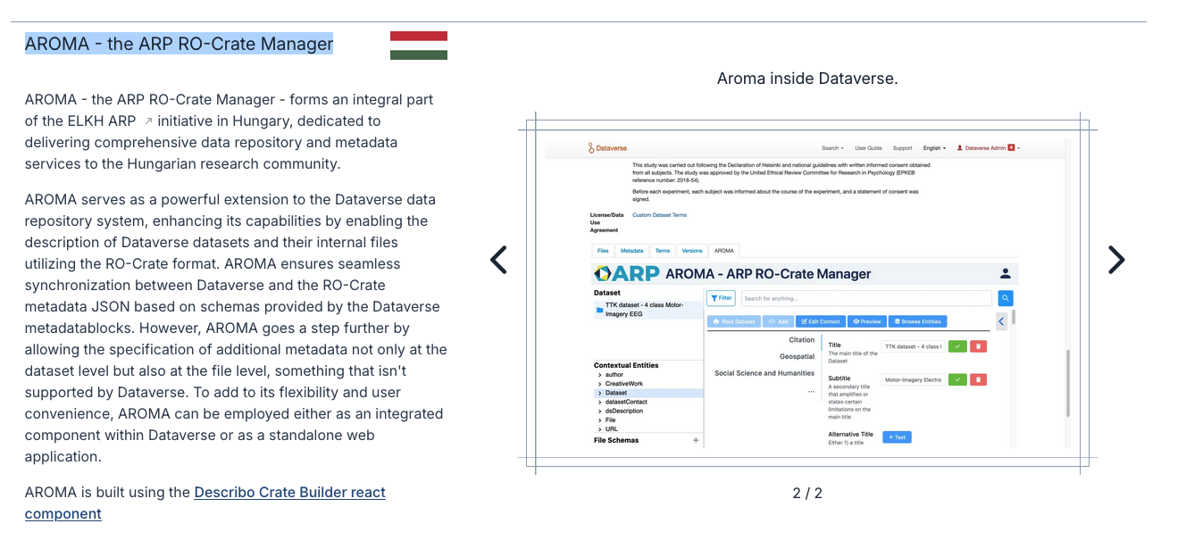

Slide 17
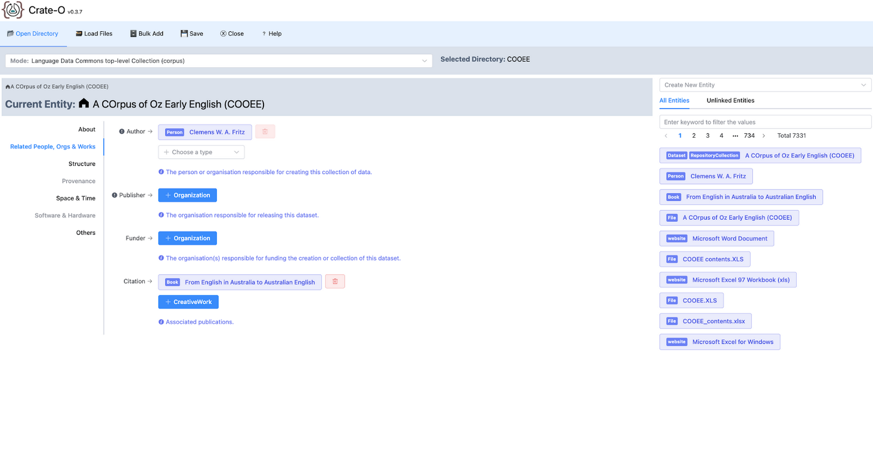
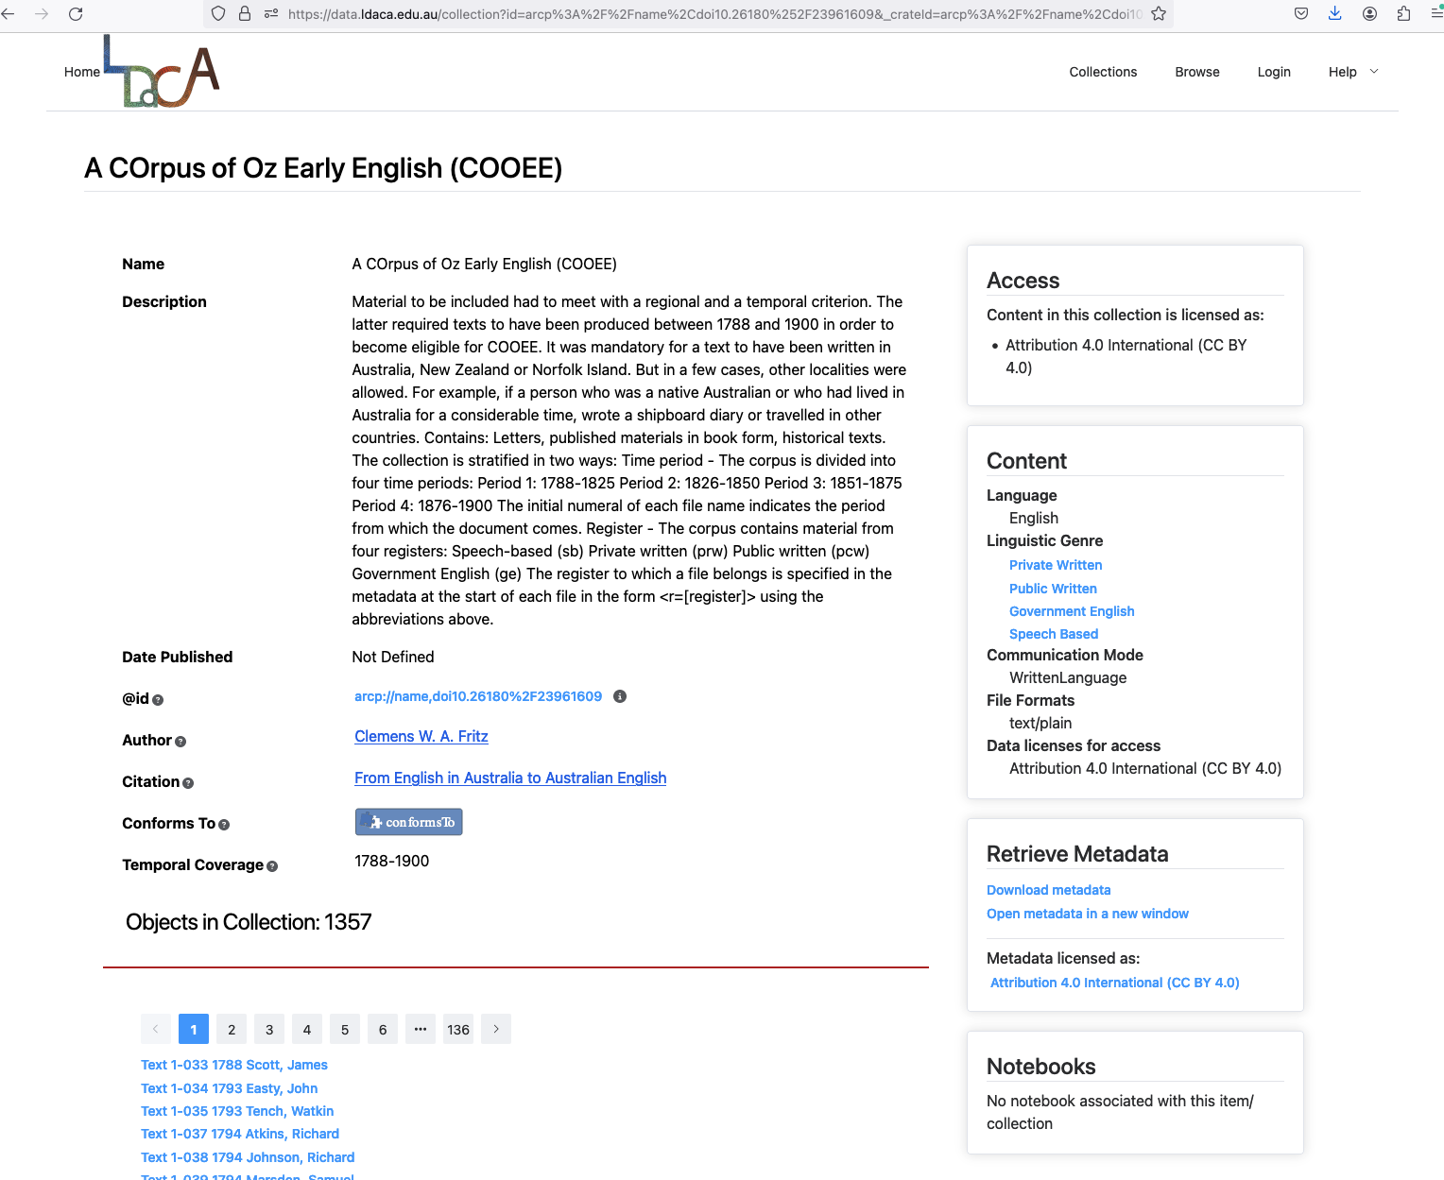
RO-Crate editing
Data Portal

Slide 18
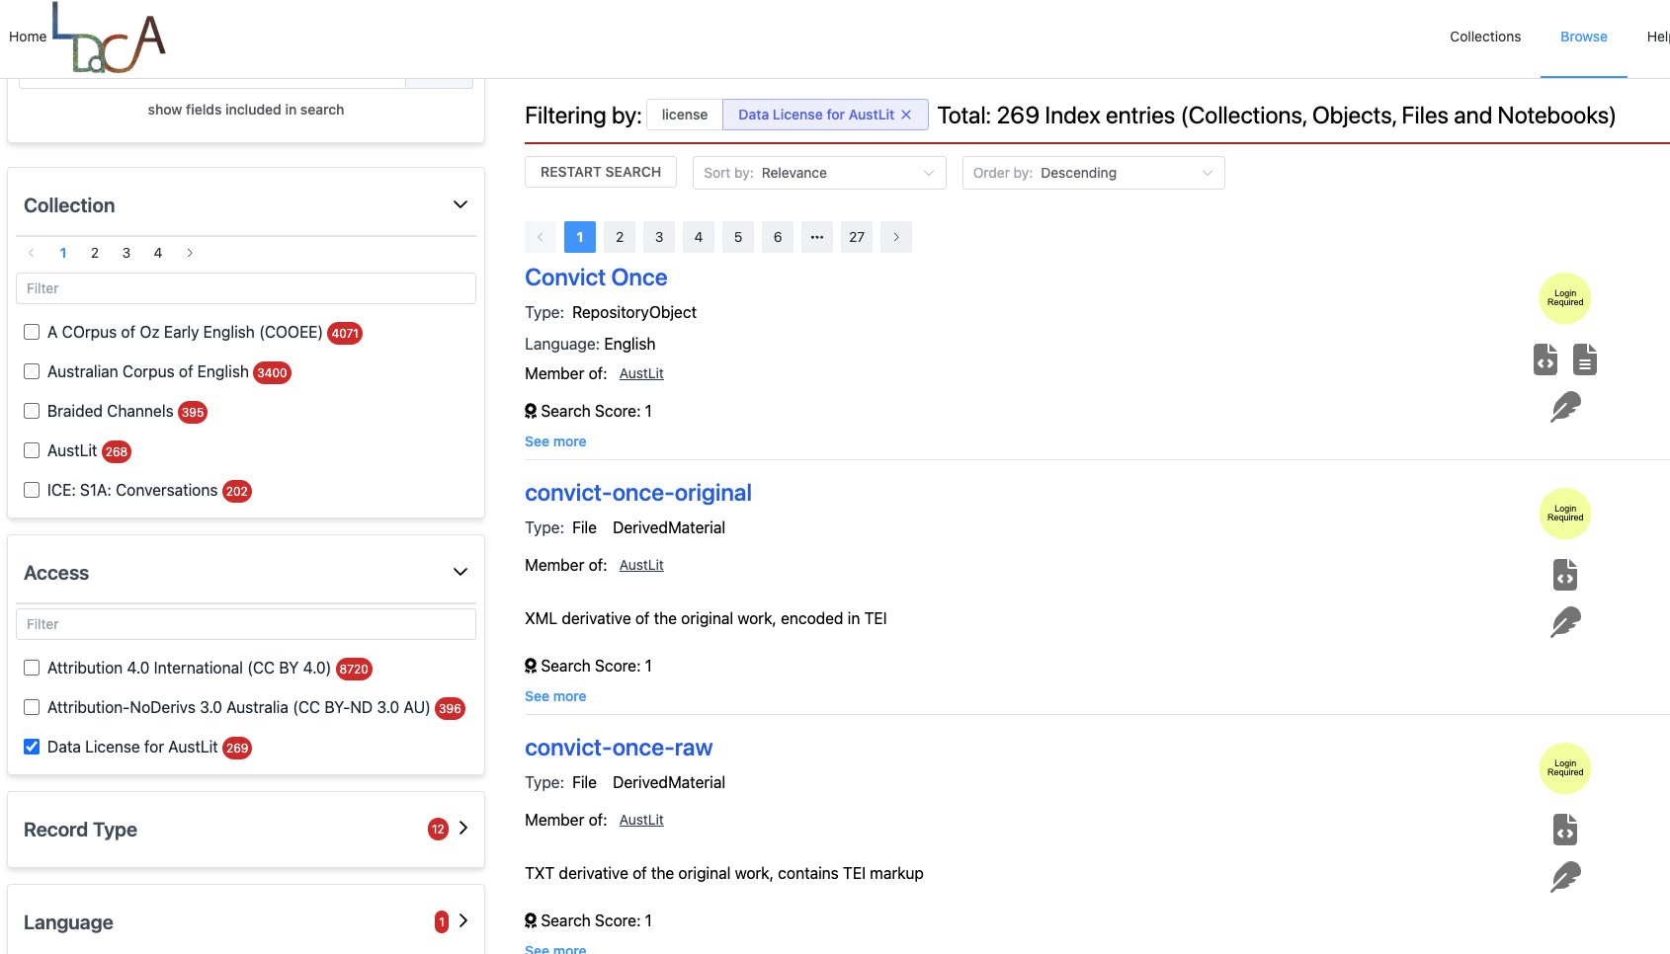
Portal shows that accessing this data requires authorization. First step: Log in.

Slide 19
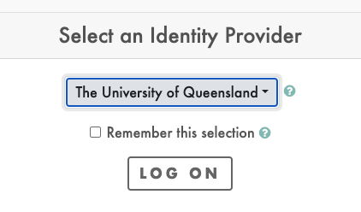
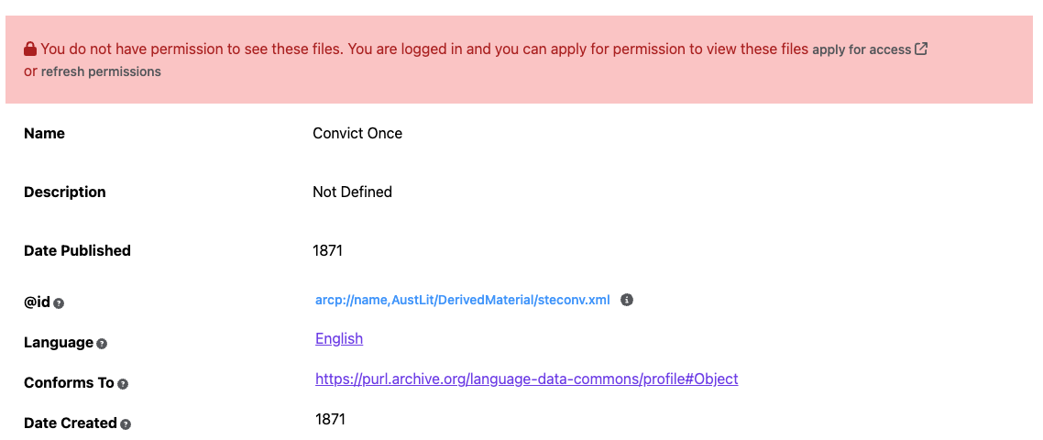

Slide 20
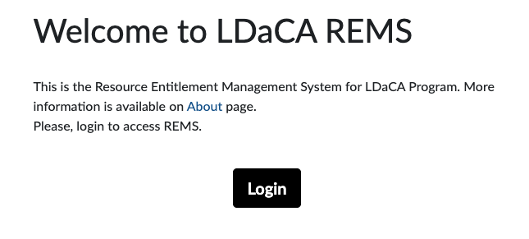
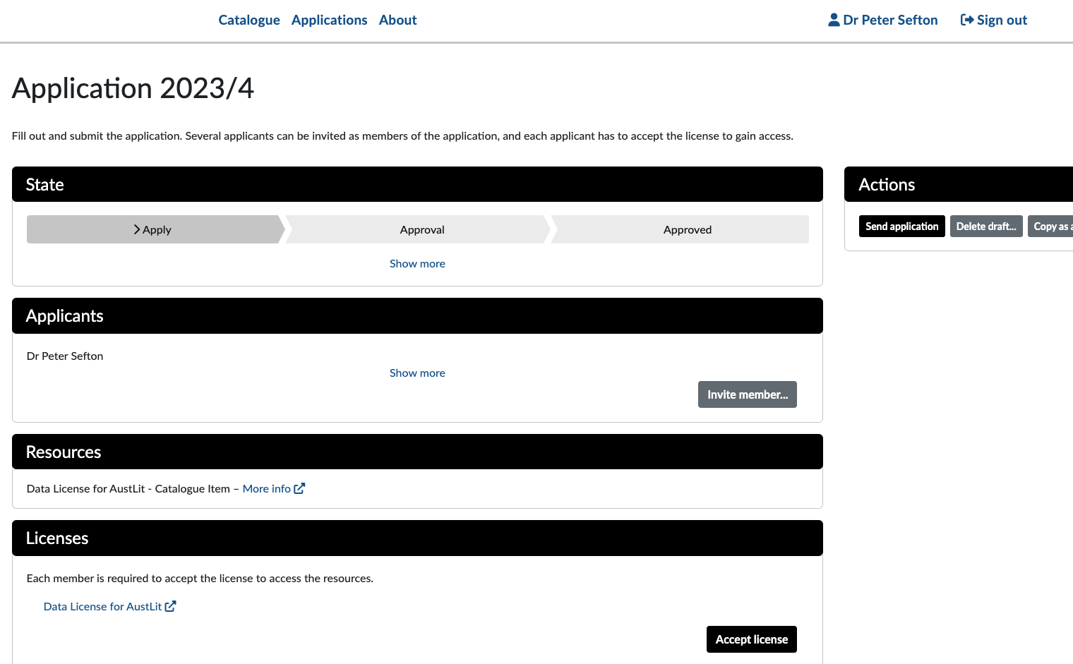


Slide 21
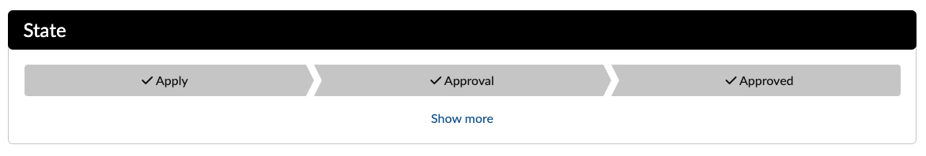
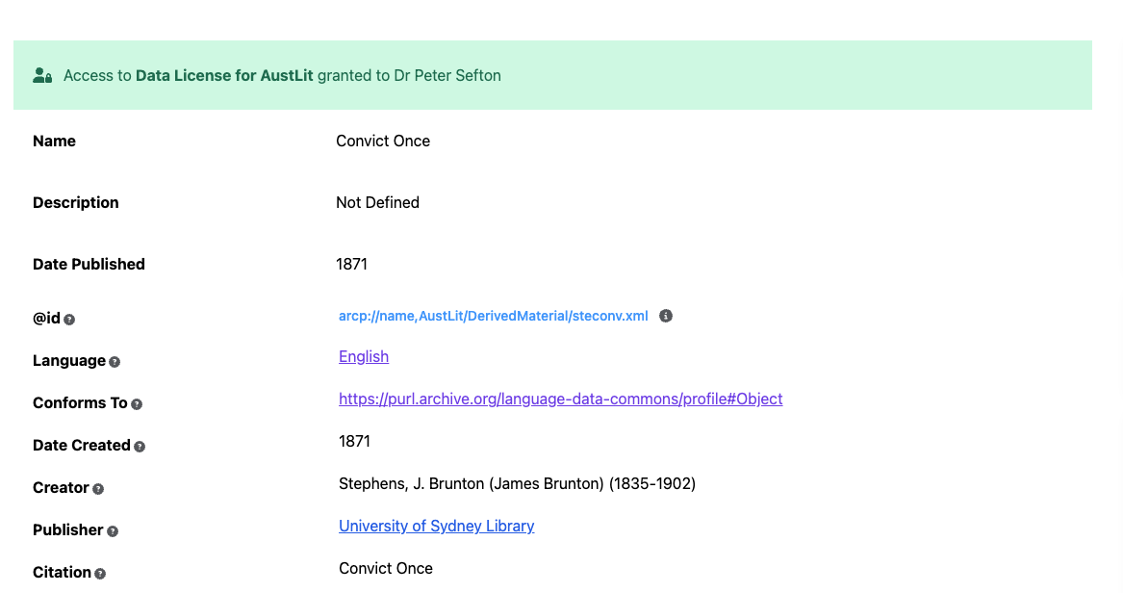

Slide 22
5. With a repository to keep data safe and serve it using persistent Identifiers, RO-Crates help make data FAIR

Slide 23
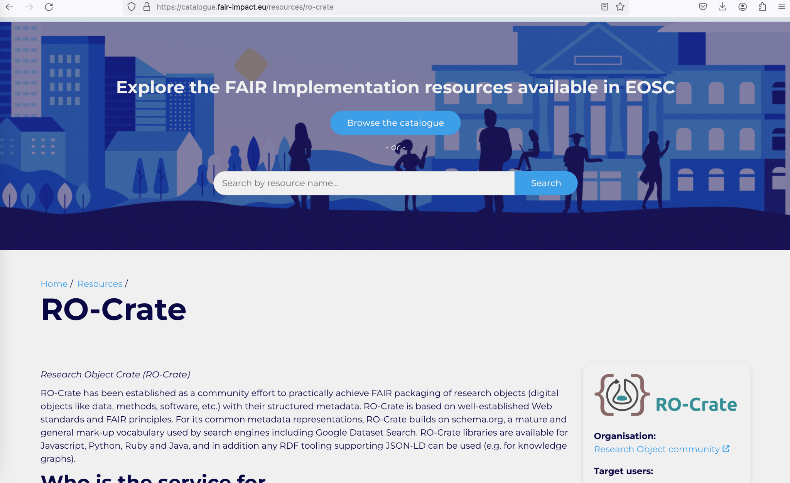

Slide 24
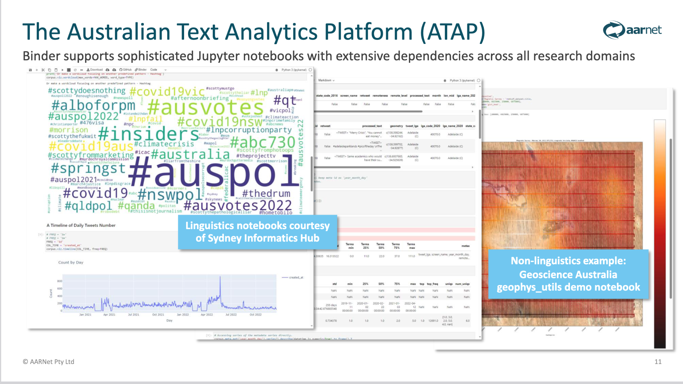
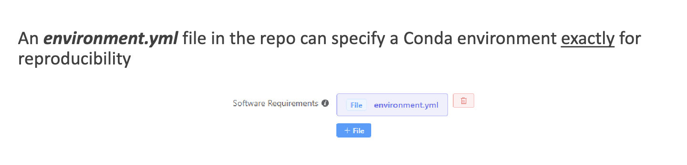

Slide 25
6. (bonus point) There are tools which can run a repository from a set of static files on a storage service, in line with the ideas put forward by Prof Suleman at OR 2023

Slide 26
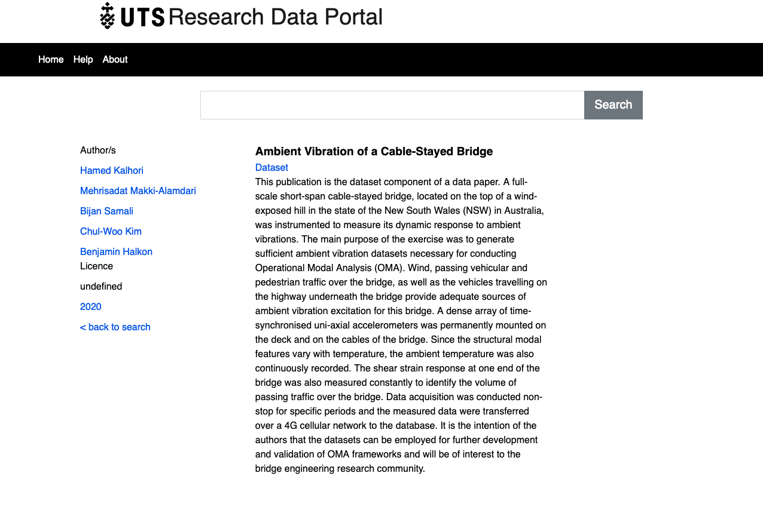
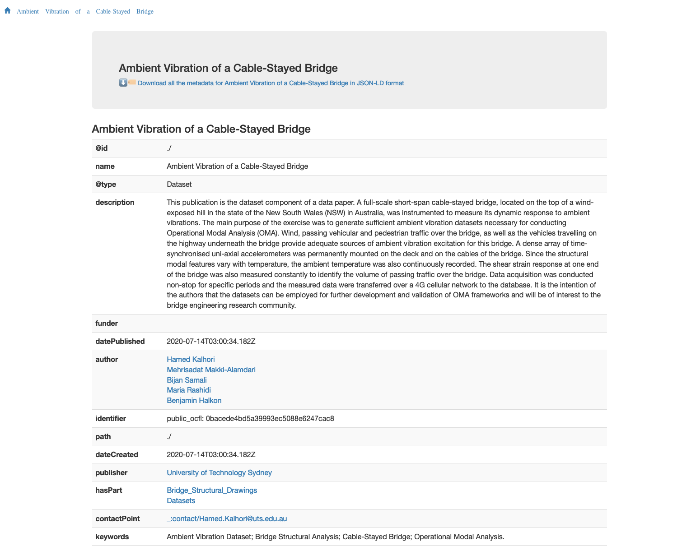

Slide 27


The Language Data Commons of Australia Data Partnerships (LDaCA-DP), Language Data Commons of Australia Research Data Commons (LDaCA-RDC), and Australian Text Analytics Platform (ATAP) projects received investment
(https://doi.org/10.47486/DP768, https://doi.org/10.47486/HIR001, & https://doi.org/10.47486/PL074)
from the Australian Research Data Commons (ARDC).
The ARDC is funded by the National Collaborative Research Infrastructure Strategy (NCRIS).

Slide 28

A web version of this presentation with notes can be found at:
https://www.ldaca.edu.au/news/posts/open-repositories-2024-ro-crate

