Slide 1
A comprehensive, open and sustainable set of principles protocols and tools for low (and high) resource archival-repositories
Peter Sefton, Robert McLellan, Michael Lynch**, Moises Sacal Bonequi*, Nick Thieberger***

Slide 2
LDaCA Execution Strategy Overview (Draft 2024-05-17)
Strengthen the data management
skills of language worker communities
Develop shared tools, standards and technical infrastructure to help data stewards care for data for
the long term
Build data portals with useful search functions and lightweight technical structures
Create guidance for data stewards to document and grant access and reuse rights
Support language communities to gain greater control over their language data
Develop tools for data and metadata processing, analysis, annotation, visualisation, and enrichment
Develop and guide the implementation
of policy and governance toolkit
Provide examples and training for
research at scale
Starting state (2021)
Activities
Desired state (2028)
collect &
organise
Language data is rarely organised or described in reusable ways, if it's described at all
Standards and tools are available and being applied by data stewards
care for
A lot of language data is at risk of being lost forever
Good governance and standardised, distributed storage of data helps
preserve data
find
It’s difficult to know what language data exists and where to find it
Discovering and locating language data is easy via linked portals
access
Processes for granting permissions and getting access to data are either absent or aren’t easy to understand or apply
Access controls are in place and easy to use, so that data access can be given to the right people
analyse
Ad hoc tools, analysis and annotation methods are used, lacking reproducibility
Shared tools and technologies can be used to analyse, reuse, annotate and enhance data at scale
guide
Guidance and training for collecting, handling, using and analysing data are scattered and hard to find
Best practice advice and training for working with language data is available from a single source which is easy to find

Slide 3
LDaCA Execution Strategy Overview (Draft 2024-05-17)
Strengthen the data management
skills of language worker communities
Develop shared tools, standards and technical infrastructure to help data stewards care for data for
the long term
Build data portals with useful search functions and lightweight technical structures
Create guidance for data stewards to document and grant access and reuse rights
Support language communities to gain greater control over their language data
Develop tools for data and metadata processing, analysis, annotation, visualisation, and enrichment
Develop and guide the implementation
of policy and governance toolkit
Provide examples and training for
research at scale
Starting state (2021)
Activities
Desired state (2028)
collect &
organise
Language data is rarely organised or described in reusable ways, if it's described at all
Standards and tools are available and being applied by data stewards
care for
A lot of language data is at risk of being lost forever
Good governance and standardised, distributed storage of data helps
preserve data
find
It’s difficult to know what language data exists and where to find it
Discovering and locating language data is easy via linked portals
access
Processes for granting permissions and getting access to data are either absent or aren’t easy to understand or apply
Access controls are in place and easy to use, so that data access can be given to the right people
analyse
Ad hoc tools, analysis and annotation methods are used, lacking reproducibility
Shared tools and technologies can be used to analyse, reuse, annotate and enhance data at scale
guide
Guidance and training for collecting, handling, using and analysing data are scattered and hard to find
Best practice advice and training for working with language data is available from a single source which is easy to find

Slide 4
“Archival Repository”

Slide 5
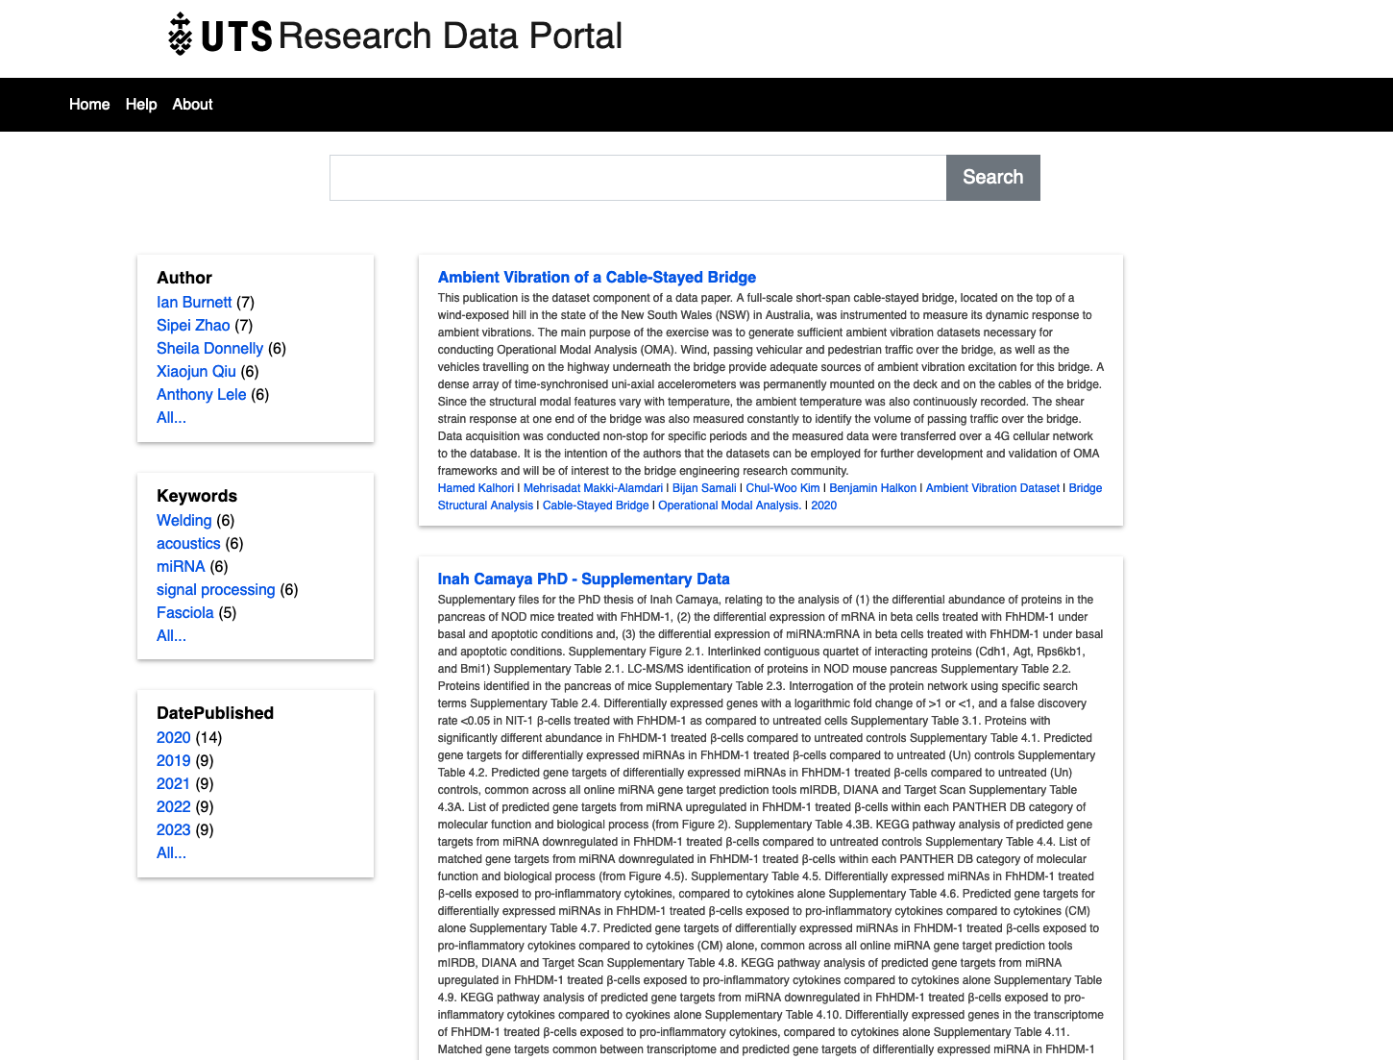

Slide 6
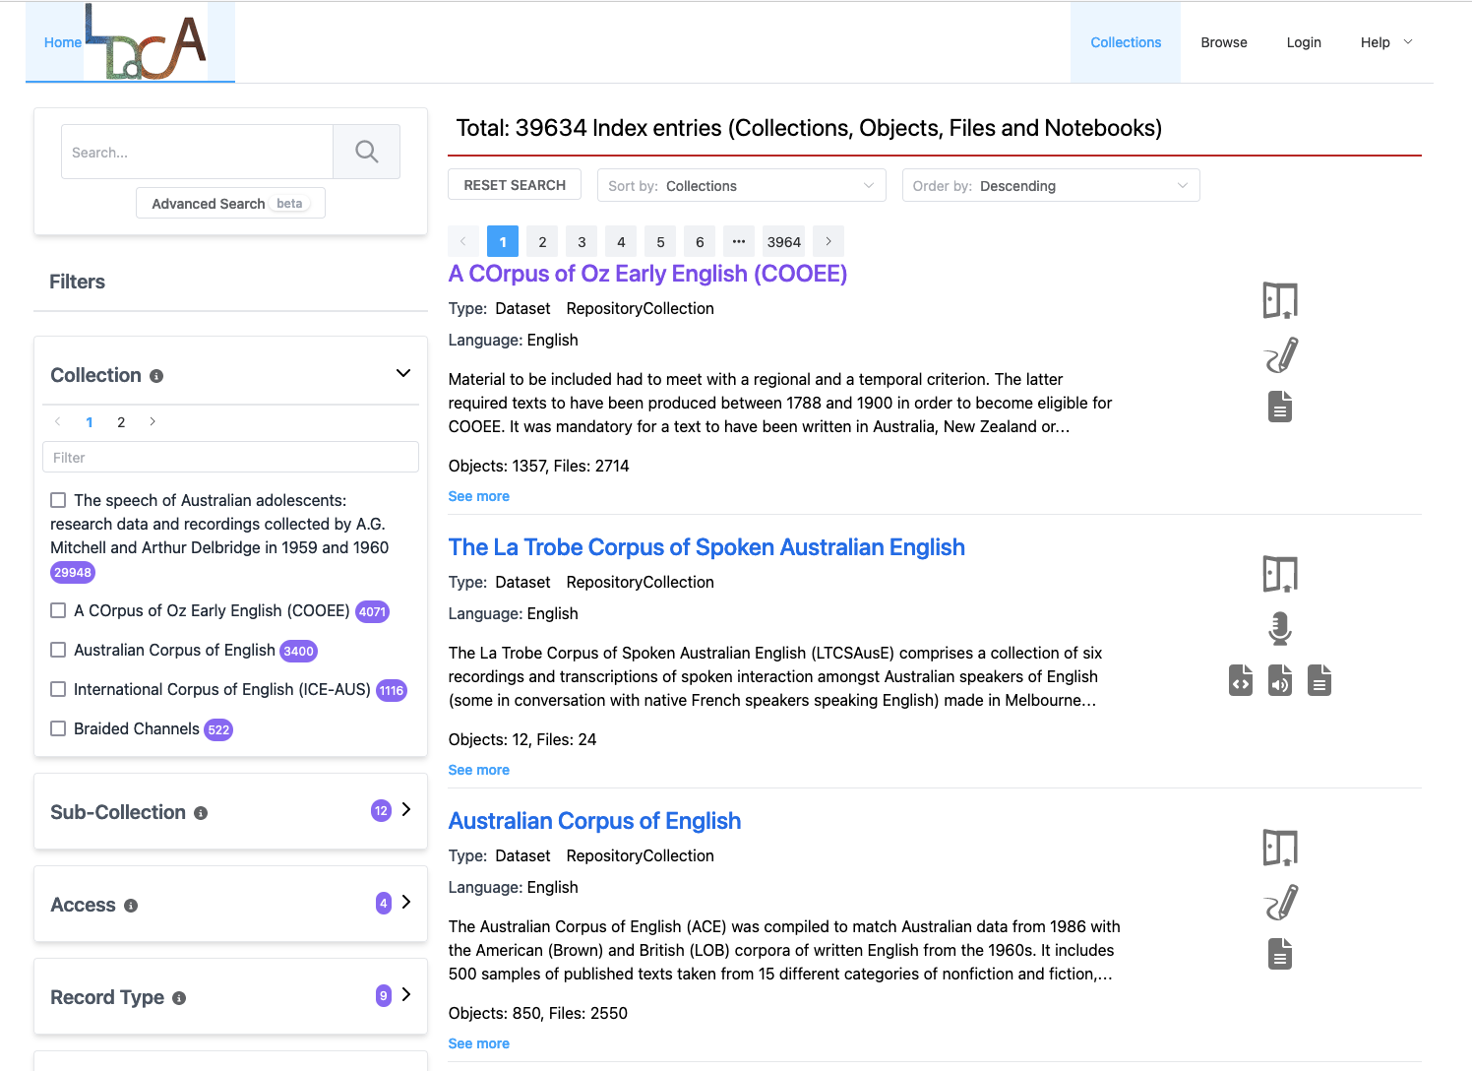

Slide 7
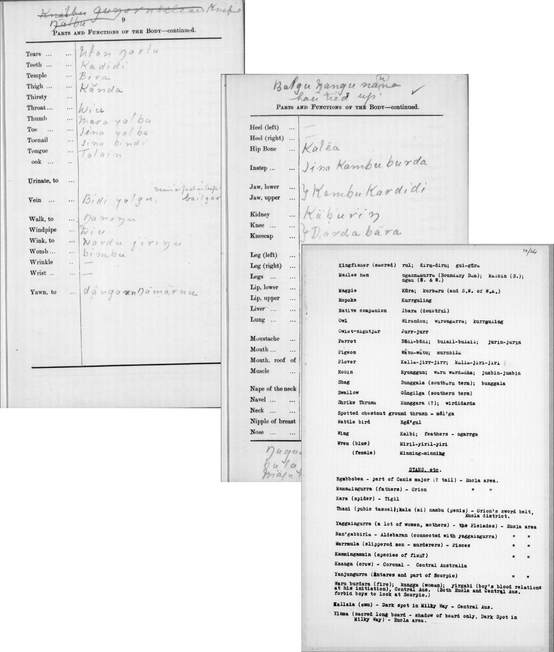
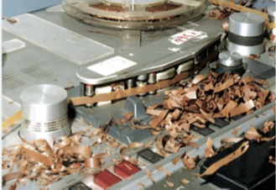
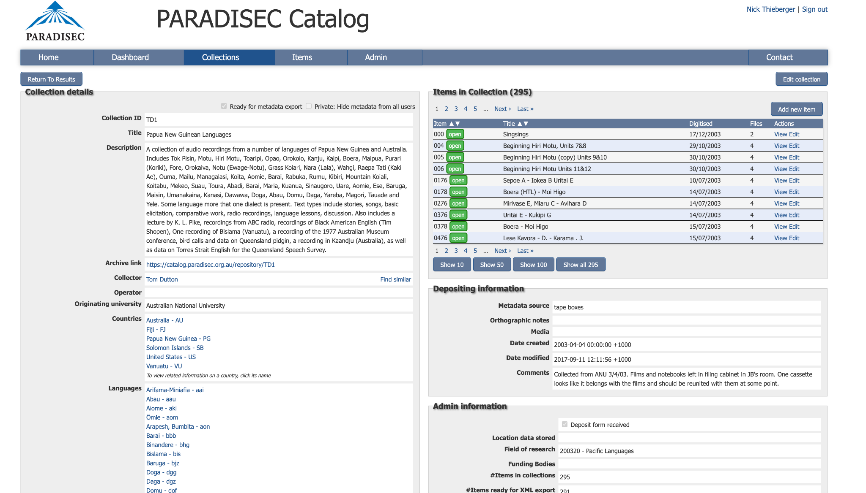
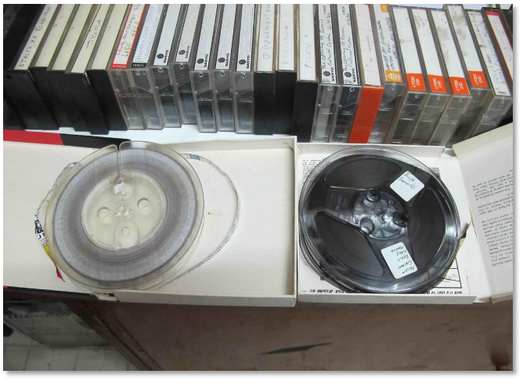
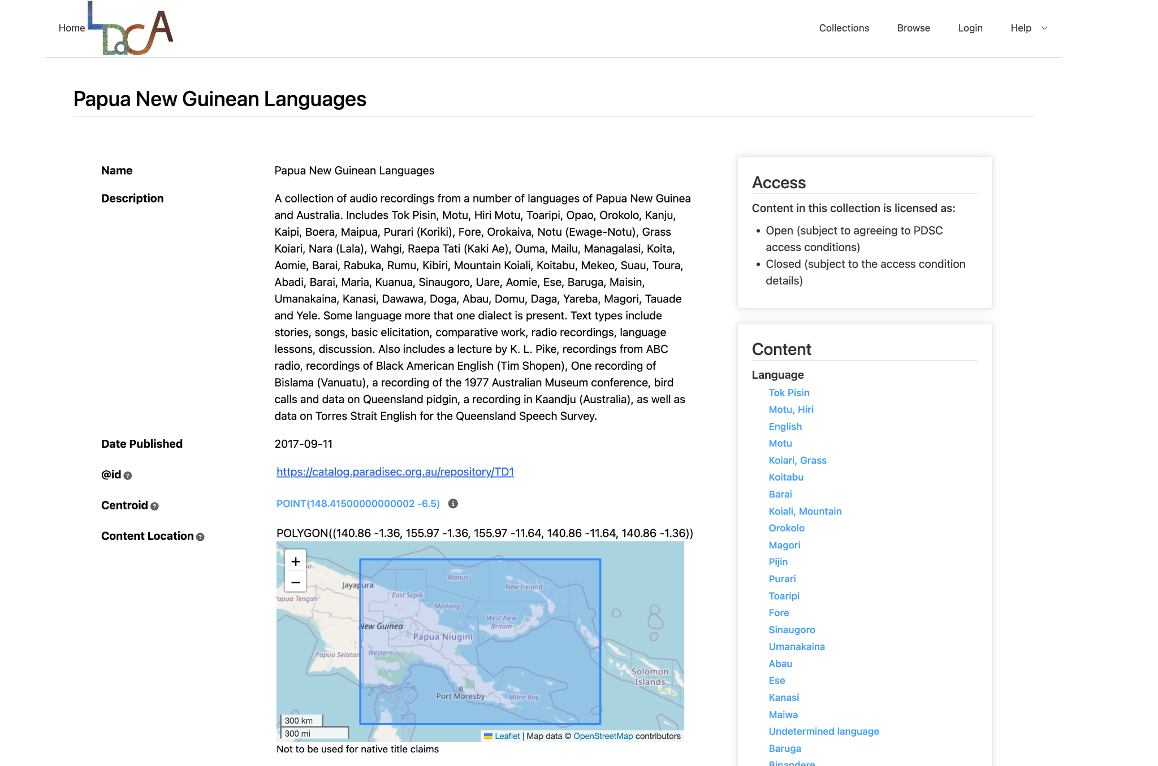
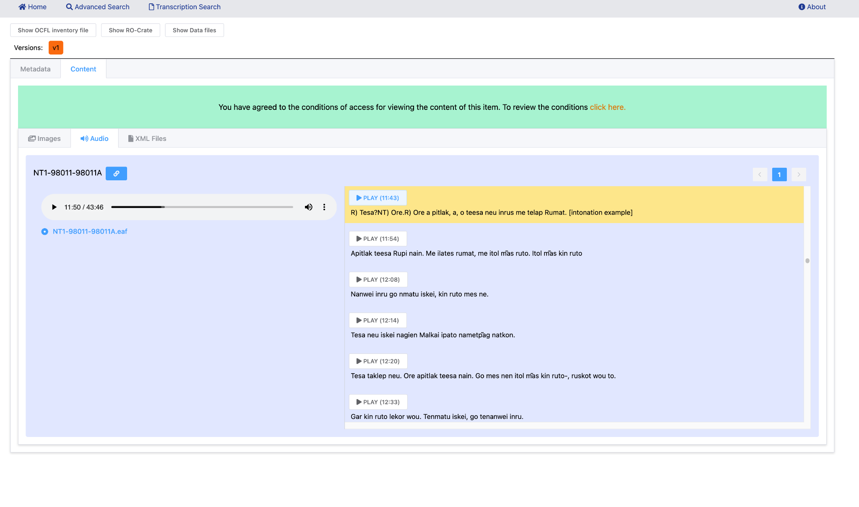
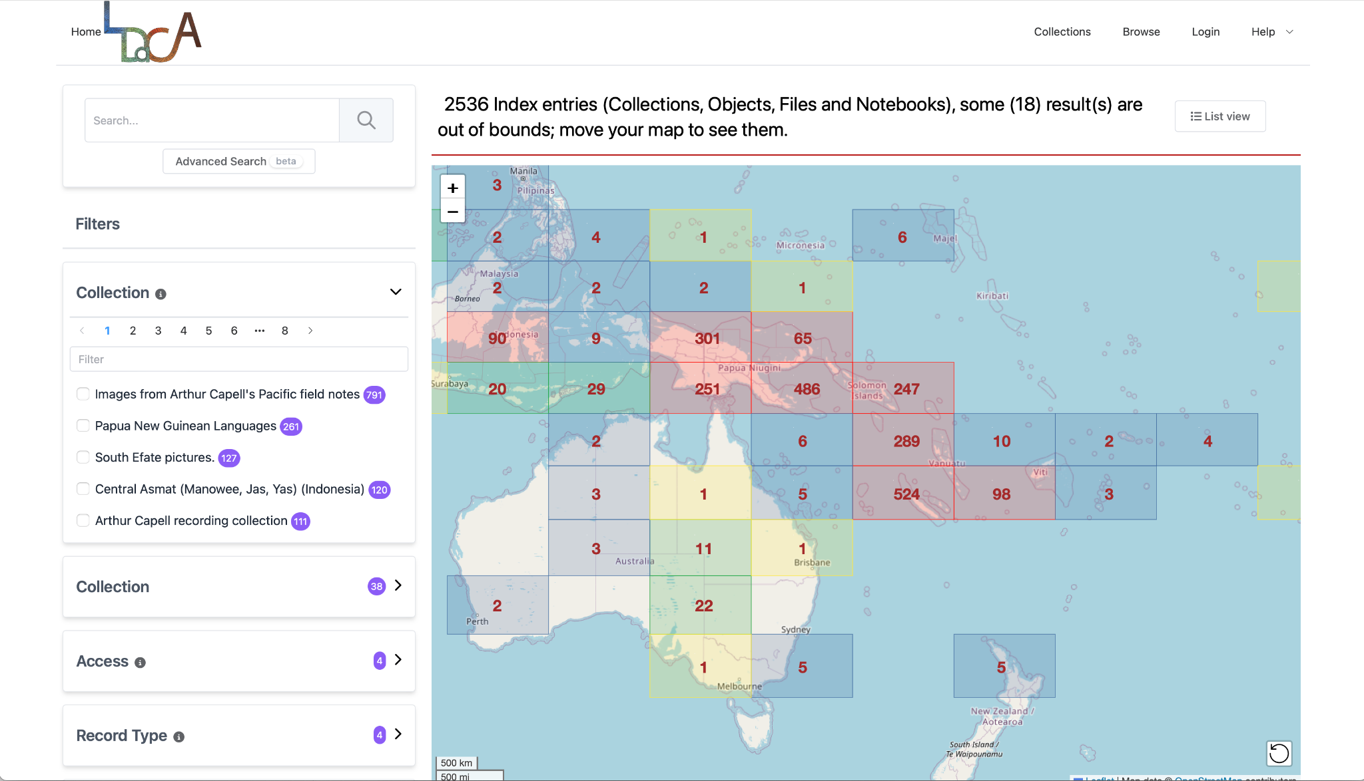
LDACA PARADISEC INDEX SCREENSHOT

Slide 8
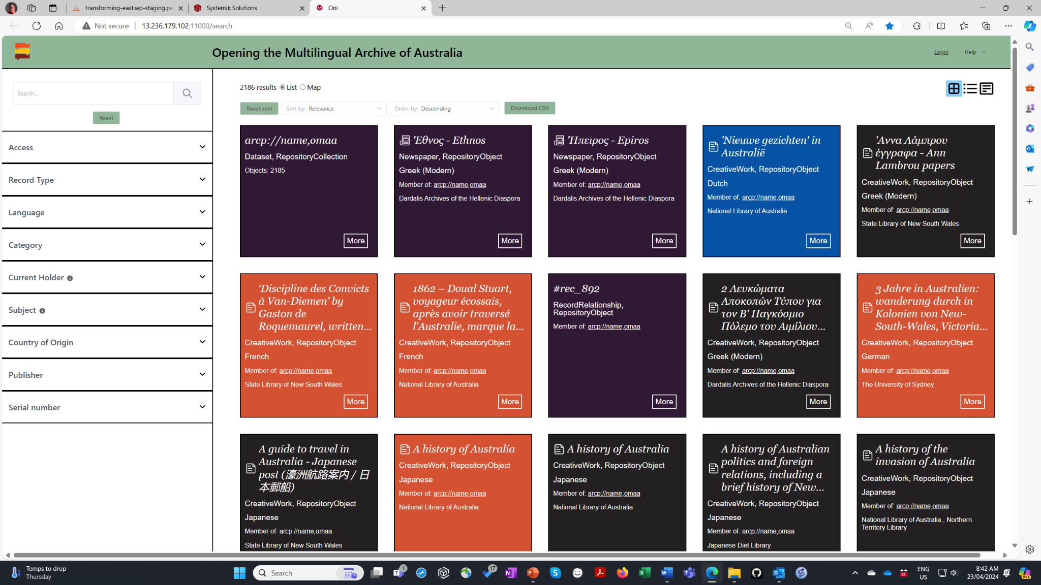
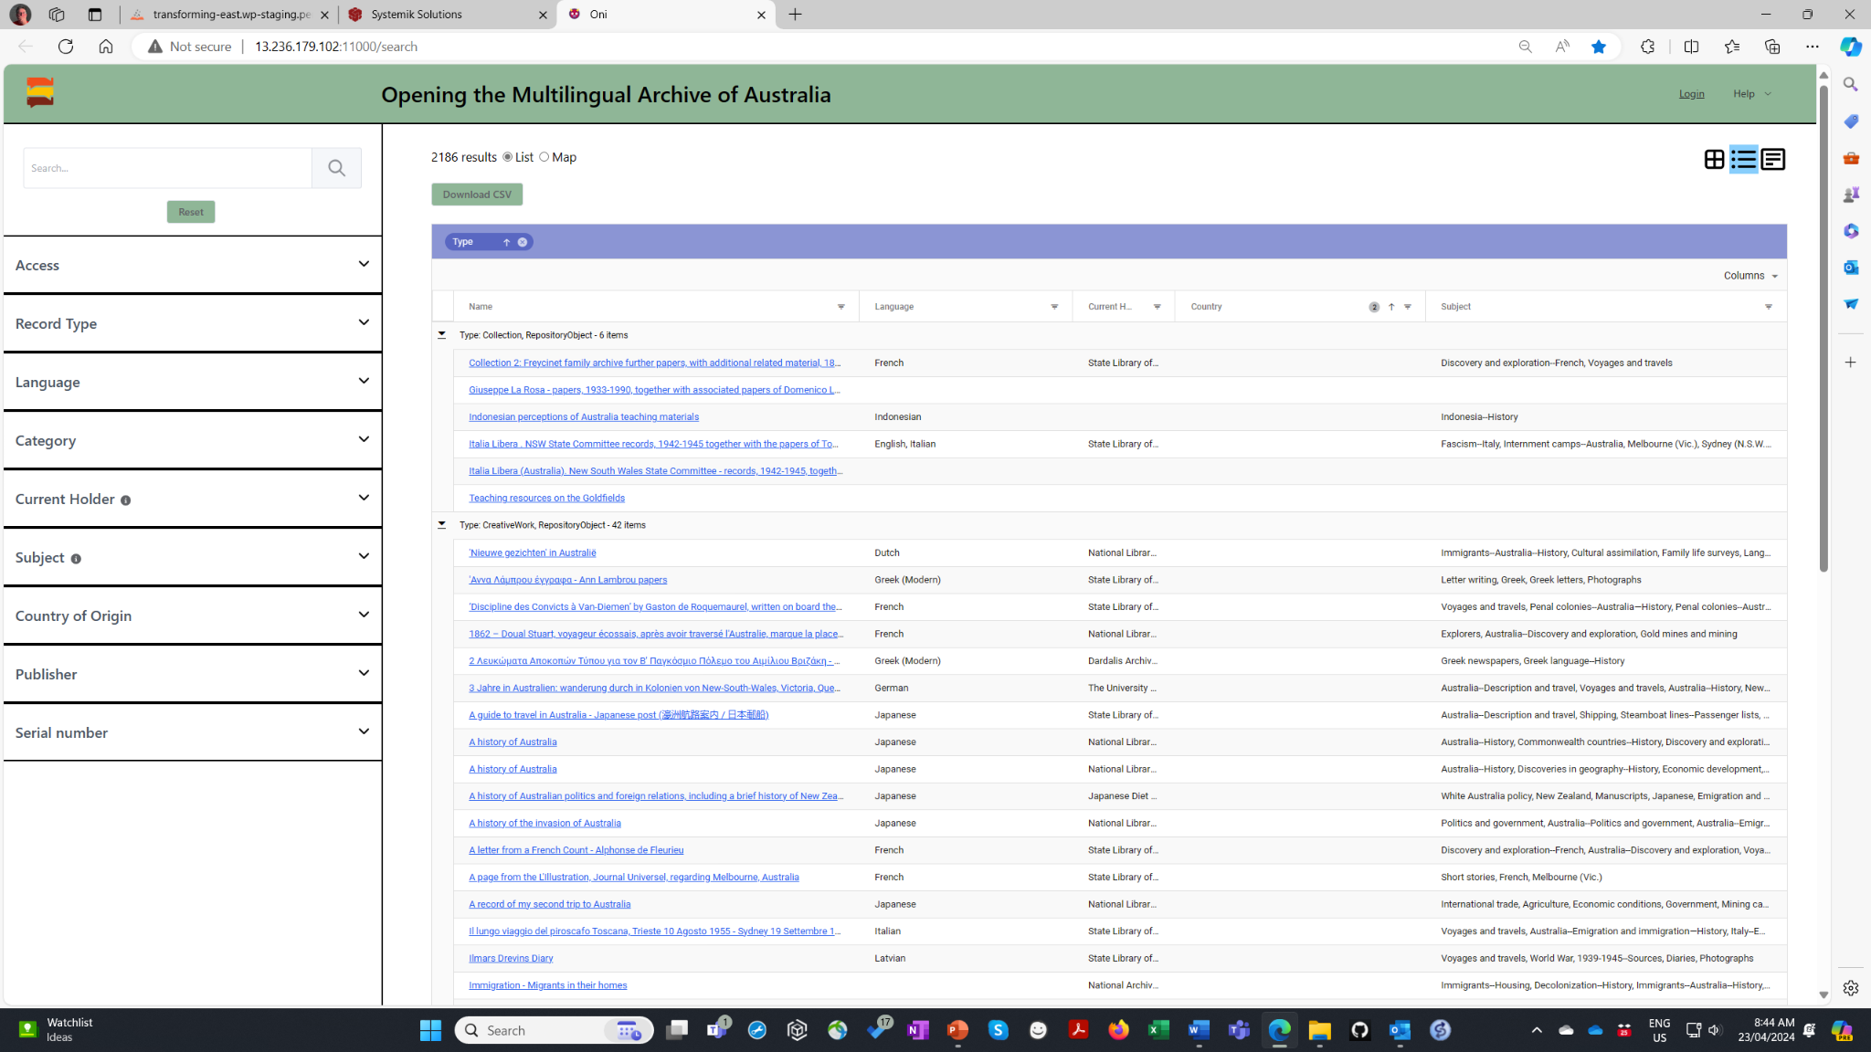
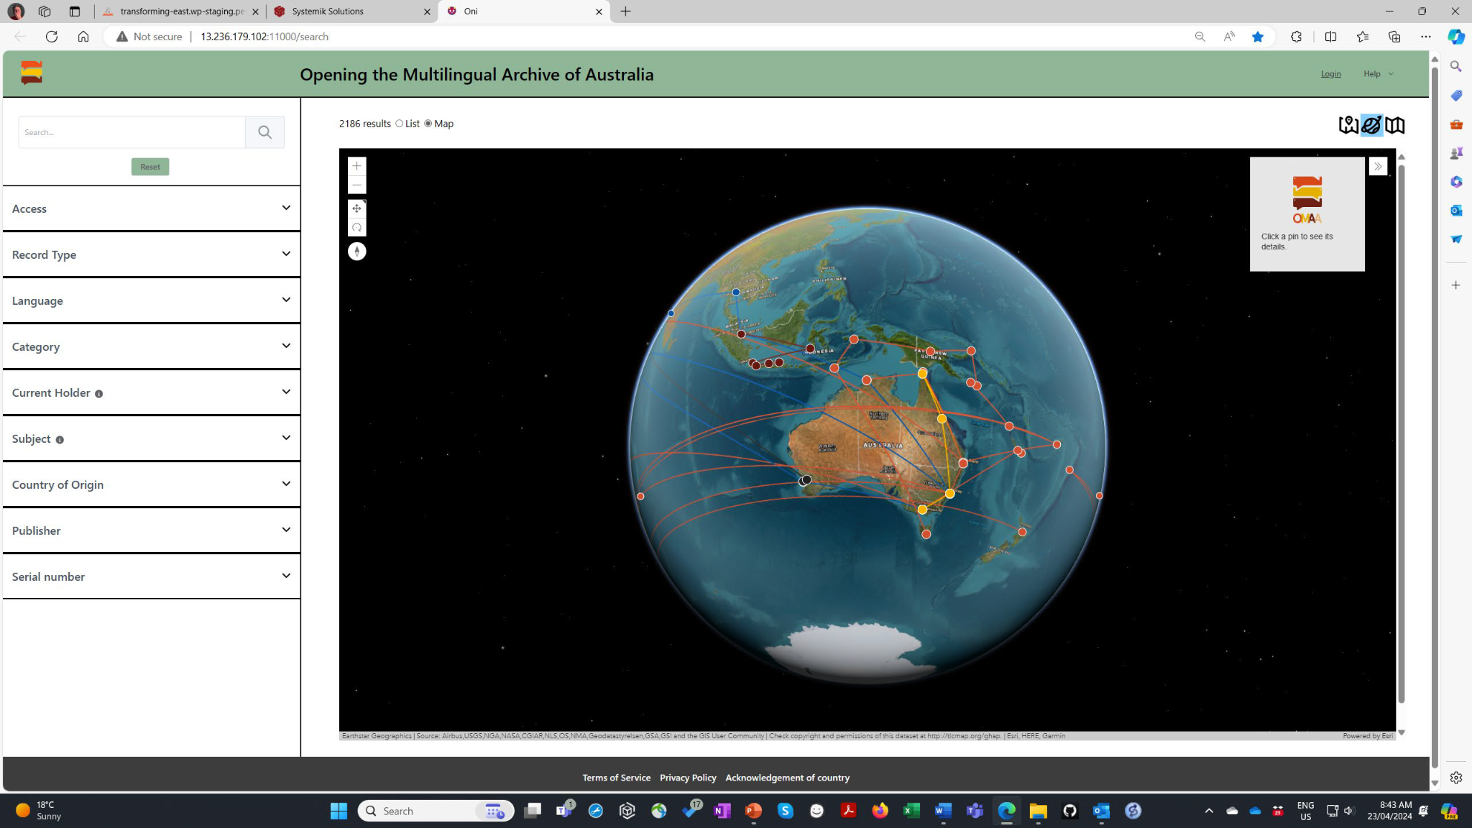

Slide 9
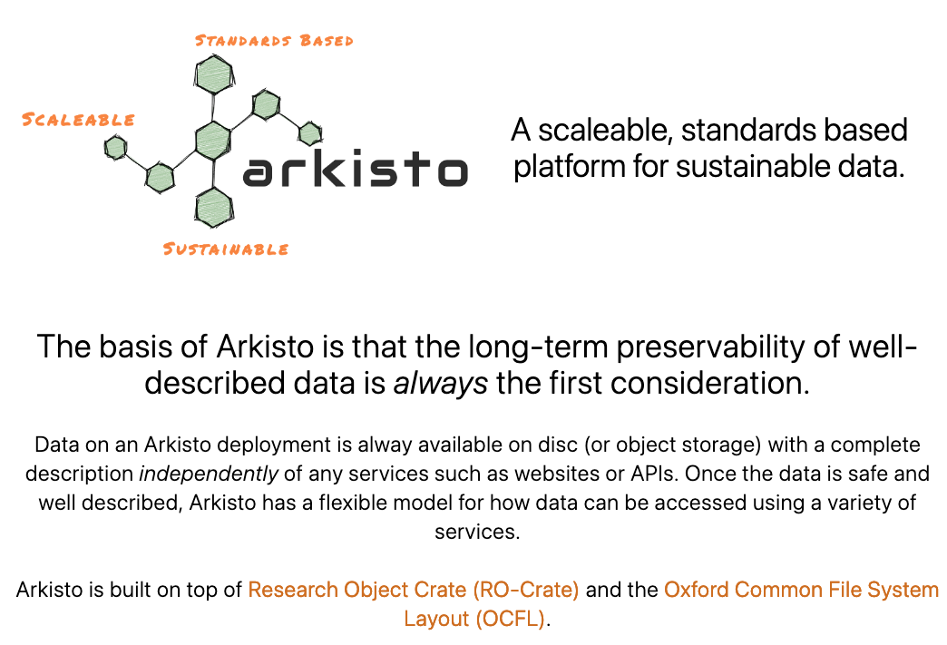
Context and history

Slide 10
Not really a platform, the core idea was a set of principles
THIS BIT IS WHAT WE *REALLY* MEANT TO SAY
These are two important specifications but we should not have tied Arkisto to just these two

Slide 11
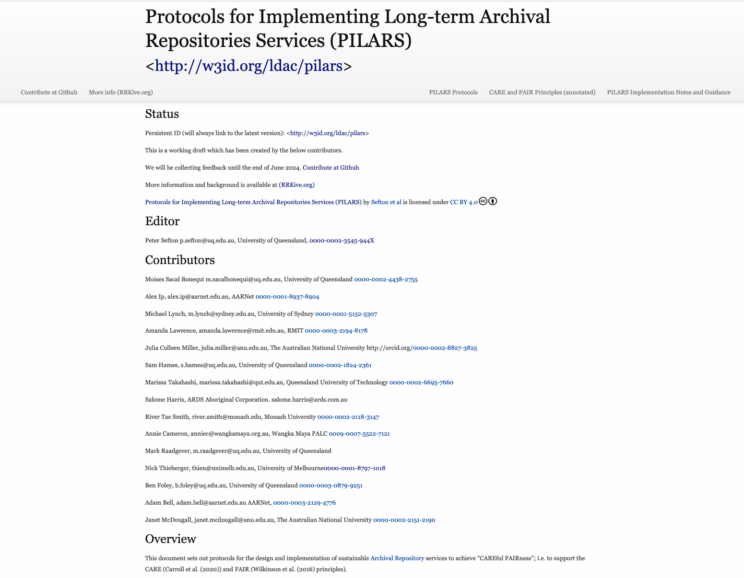

Slide 12
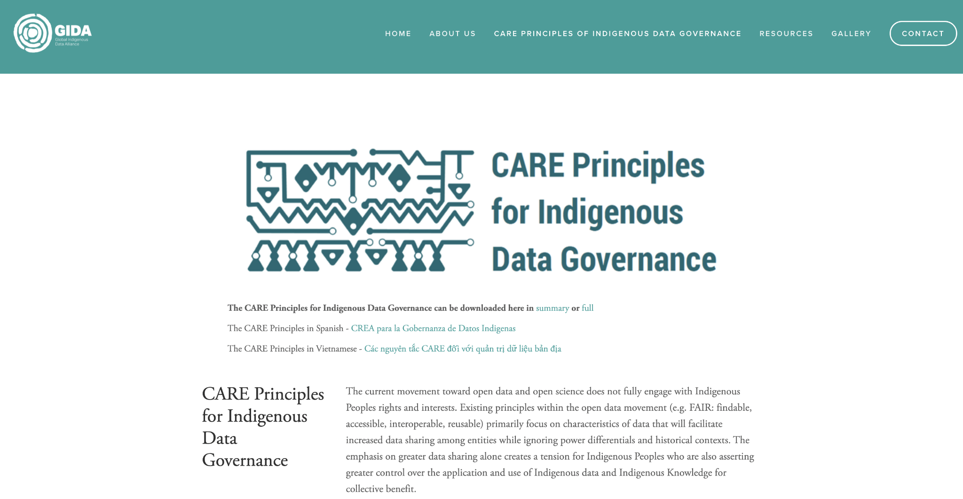
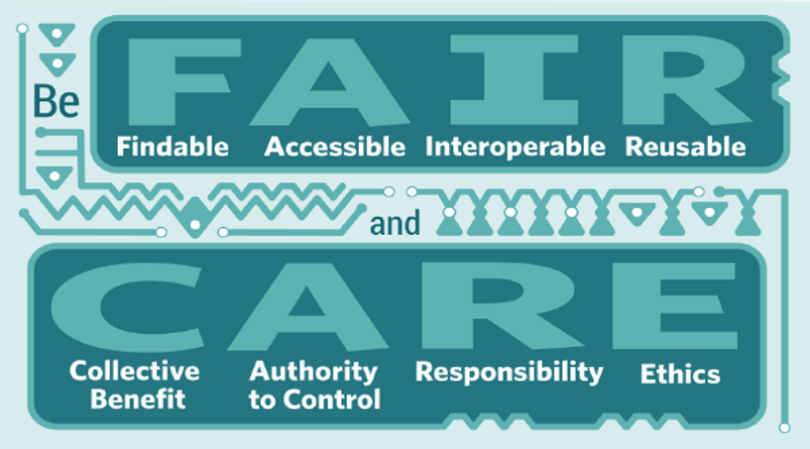

Slide 13
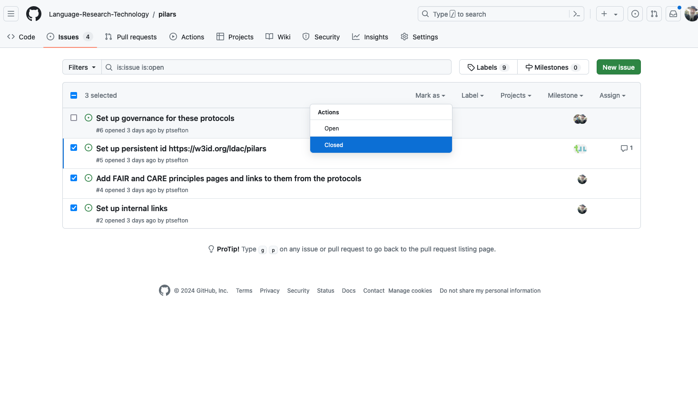

Slide 14
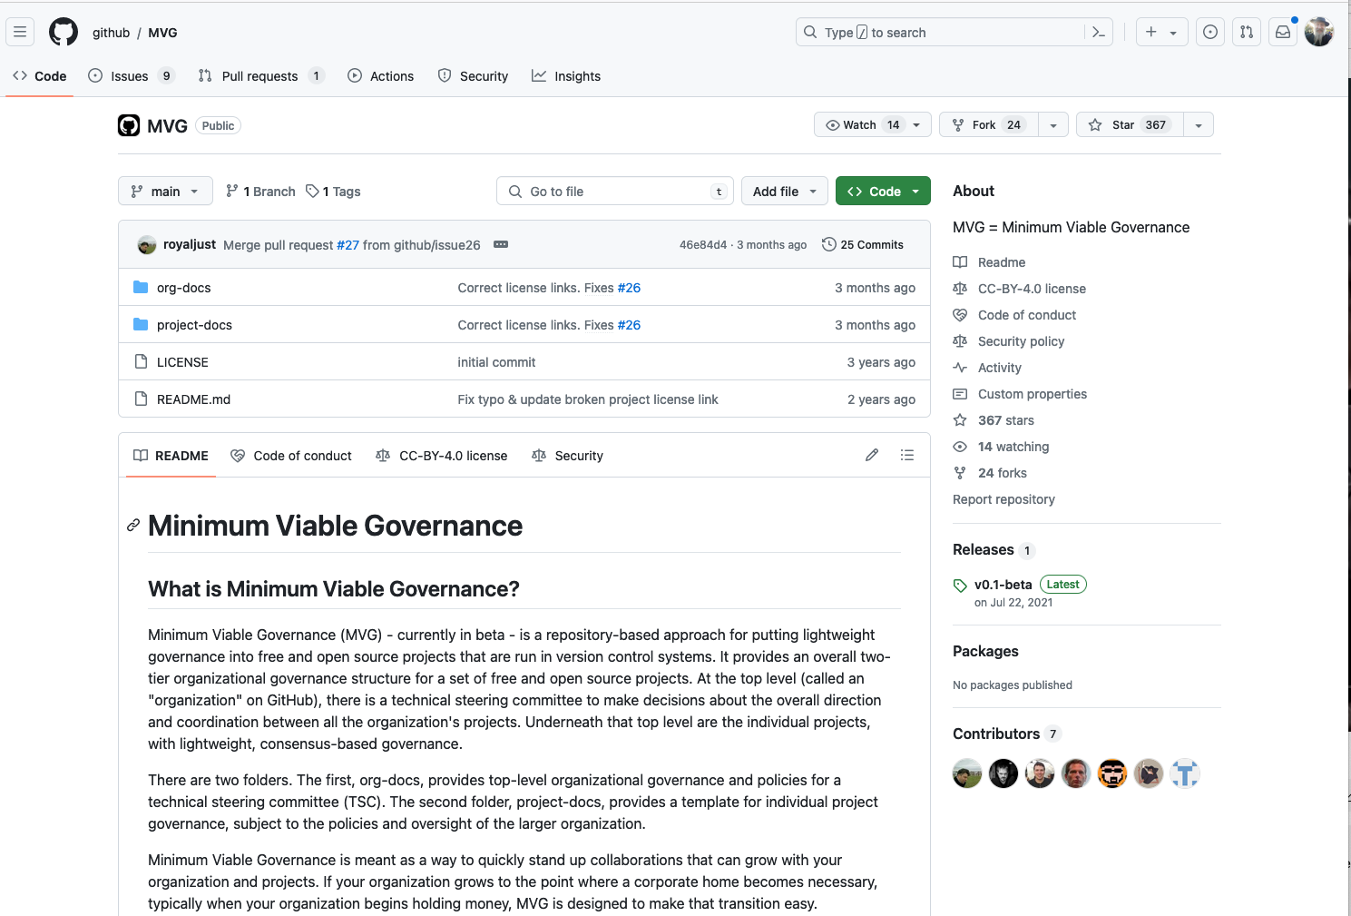

Slide 15
1 Data is Portable: assets are not locked-in to a particular mode of storage, interface or service
(TLDR; Use OCFL)

Slide 16
2 Data is Annotated: contents, structure, provenance and access and reuse permissions are comprehensively described with metadata and licenses
(TLDR; Use RO-Crate)

Slide 17
3 Governance
(No shortcuts here – this is the hard part)

Slide 18
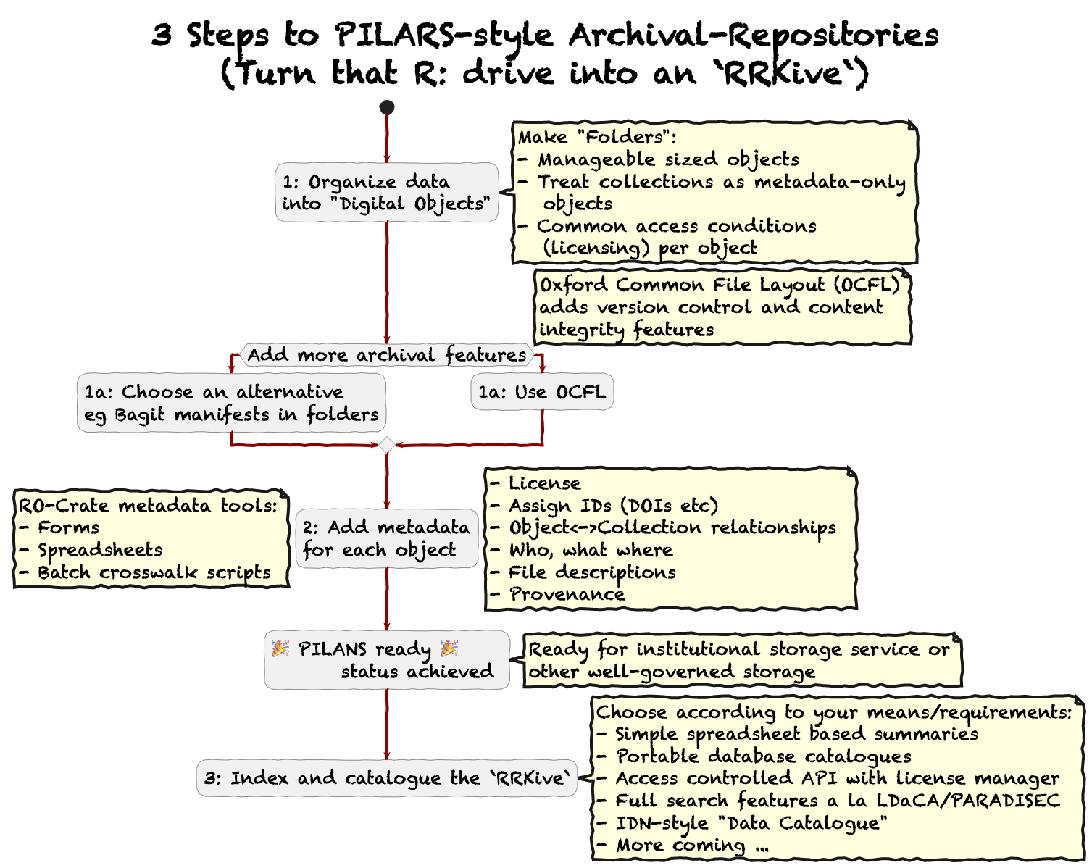

Slide 19
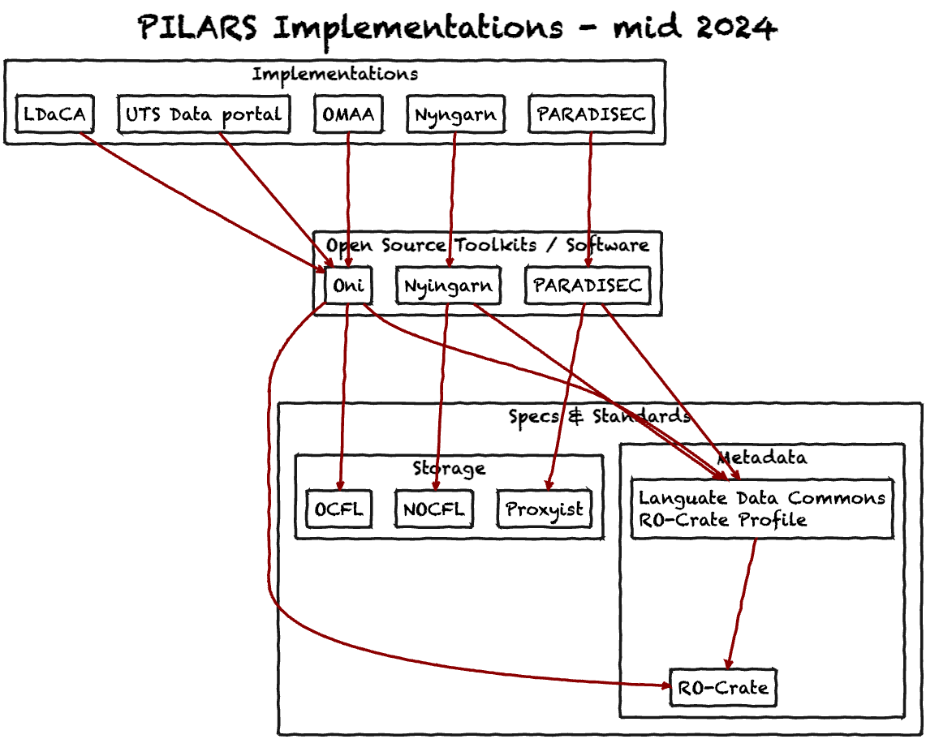

Slide 20
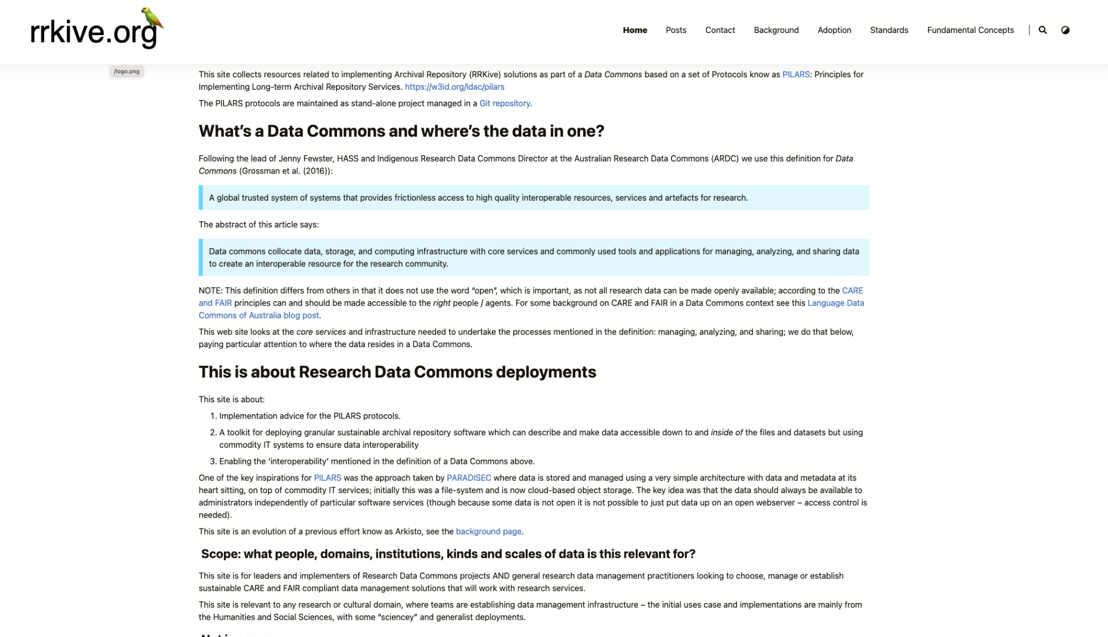

Slide 21
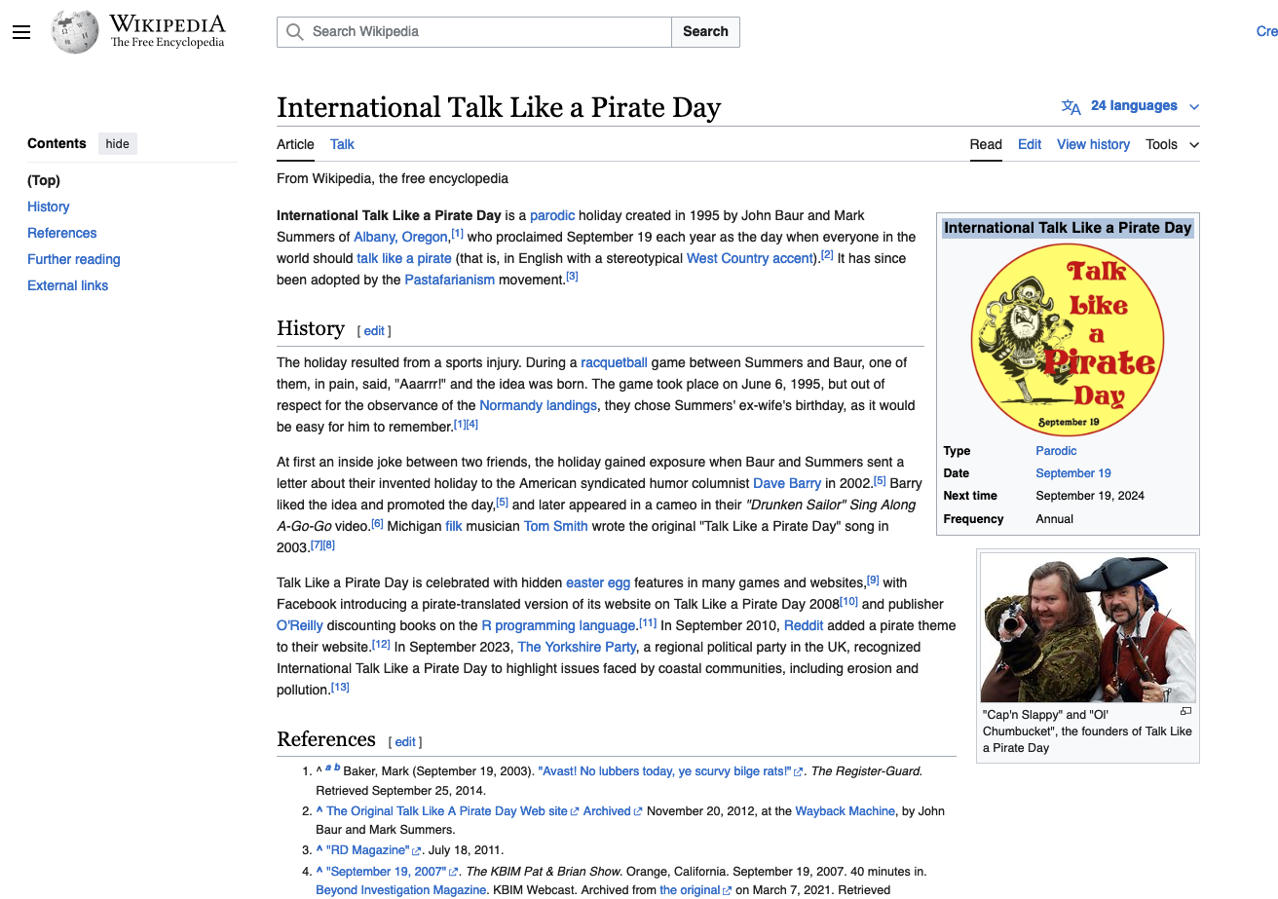
Pronunciation guide – talk like it’s the 19th of September

Slide 22
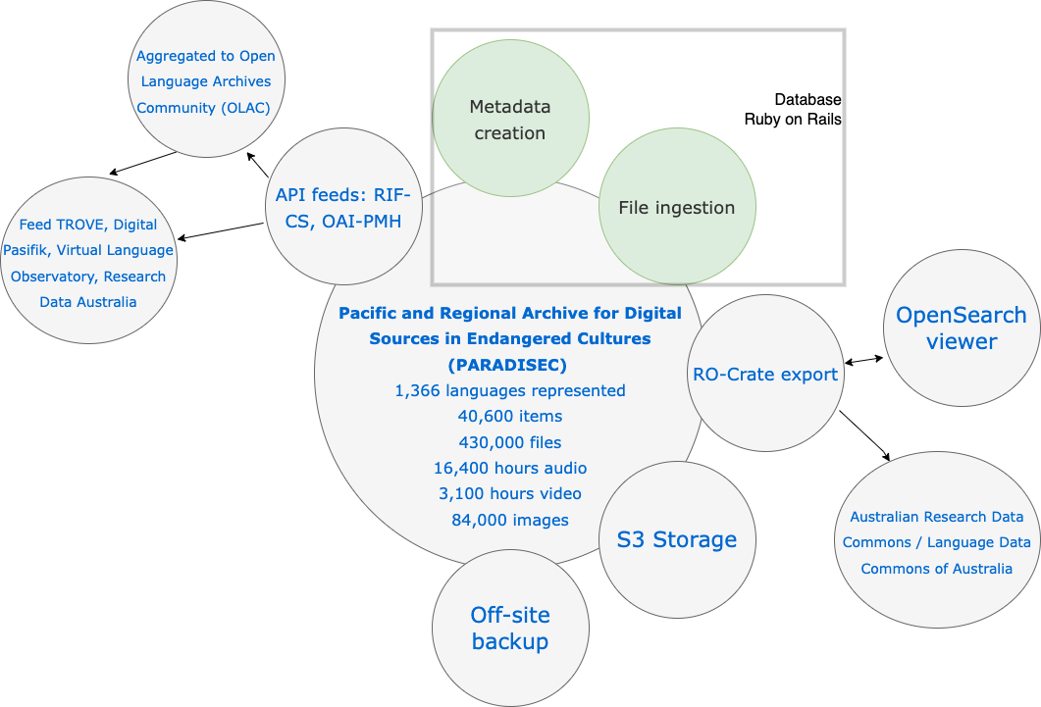

Slide 23
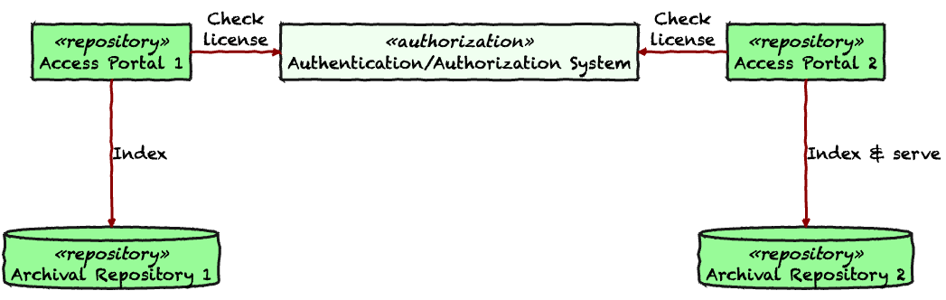
_ something about licensing
A summary of the LDaCA architecture vs

Slide 24
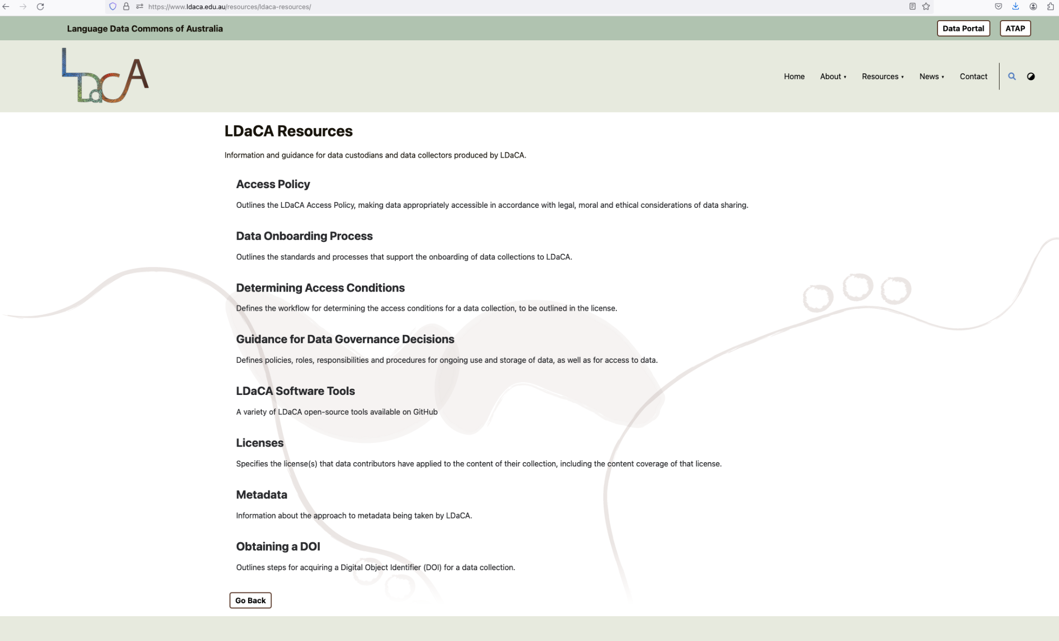

Slide 25

A web version of this presentation with notes can be found at:
https://www.ldaca.edu.au/news/posts/open-repositories-2024-pilars/

