Slide 1
Cyber Security Incident Analysis
Identifying High-Risk Accounts, Anomaly Patterns & MITRE ATT&CK Behaviors
By: Lani Nguyen

Slide 2
Project Overview
This project analyzes 3 months of Microsoft security logs to identify:
High-risk user activity
Off-hours anomalies
Repeated high-severity alerts
MITRE ATT&CK techniques
Organizational exposure and control gaps
Goal: Detect potential threats and provide audit-focused recommendations.

Slide 3
Dataset & Tools
Dataset: Microsoft Security Incident Prediction (Kaggle)
Tools Used:
SQL (BigQuery syntax): Data cleaning, filtering, incident queries
Excel: Initial validation
Tableau: Dashboard design & analysis
PowerPoint: Reporting insights

Slide 4
Methodology
Cleaned data
Analyzed patterns
Mapped incidents to MITRE ATT&CK techniques
Visualized findings in Tableau
Documented recommendations for IT audit teams
Imported raw logs

Slide 5
Key Questions
Which user accounts have triggered more than 3 high-severity incidents in a single week?
What is the average time between an alert being generated and the next alert for the same user account, and does that interval decrease during known attack periods?
Which departments or business units generate the highest volume of unresolved medium-to-high alerts, and what controls can be strengthened there?
How many incidents involve access attempts outside normal working hours (6PM-6AM), and how often do those lead to escalation?
What was the trend in failed login attempts over the last 30 days, and were there any spikes on specific dates?

Slide 6
Dashboard 1
Highlights:
Top high-risk accounts
Unresolved alerts
Off-hours spikes
Average seconds between alerts

Slide 7
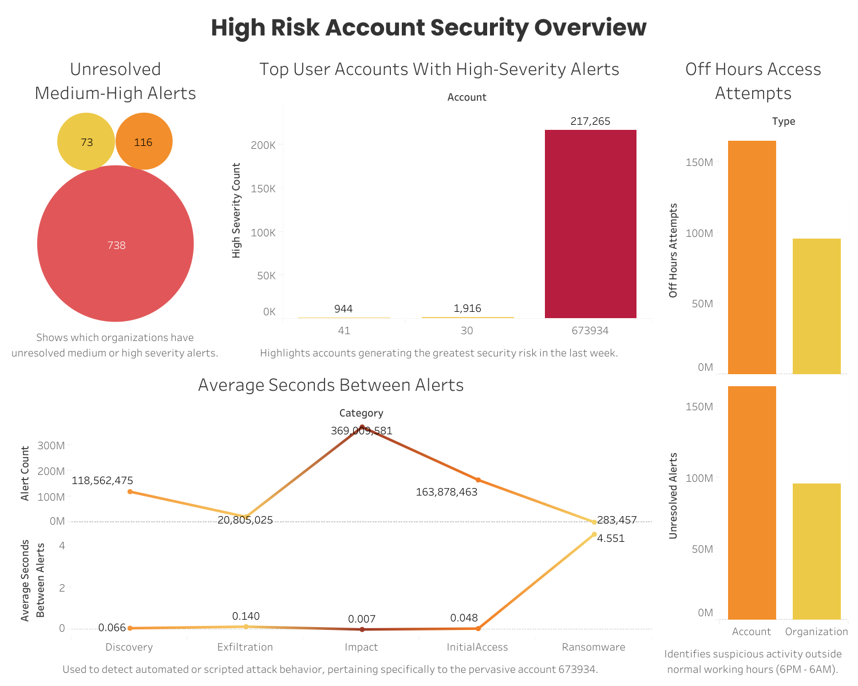

Slide 8
Dashboard 1 Findings
Account 673934 triggered unusually high volumes of high-severity alerts
Organizations 738, 73, and 116 showed the largest clusters of unresolved incidents
Off-hours access patterns indicate potential automation or malware beaconing
One account generated alerts seconds apart, suggesting scripted behavior

Slide 9
Dashboard 2
Highlights:
MITRE technique frequency
Categories by severity
Technique-to-account mapping
Organization exposure

Slide 10
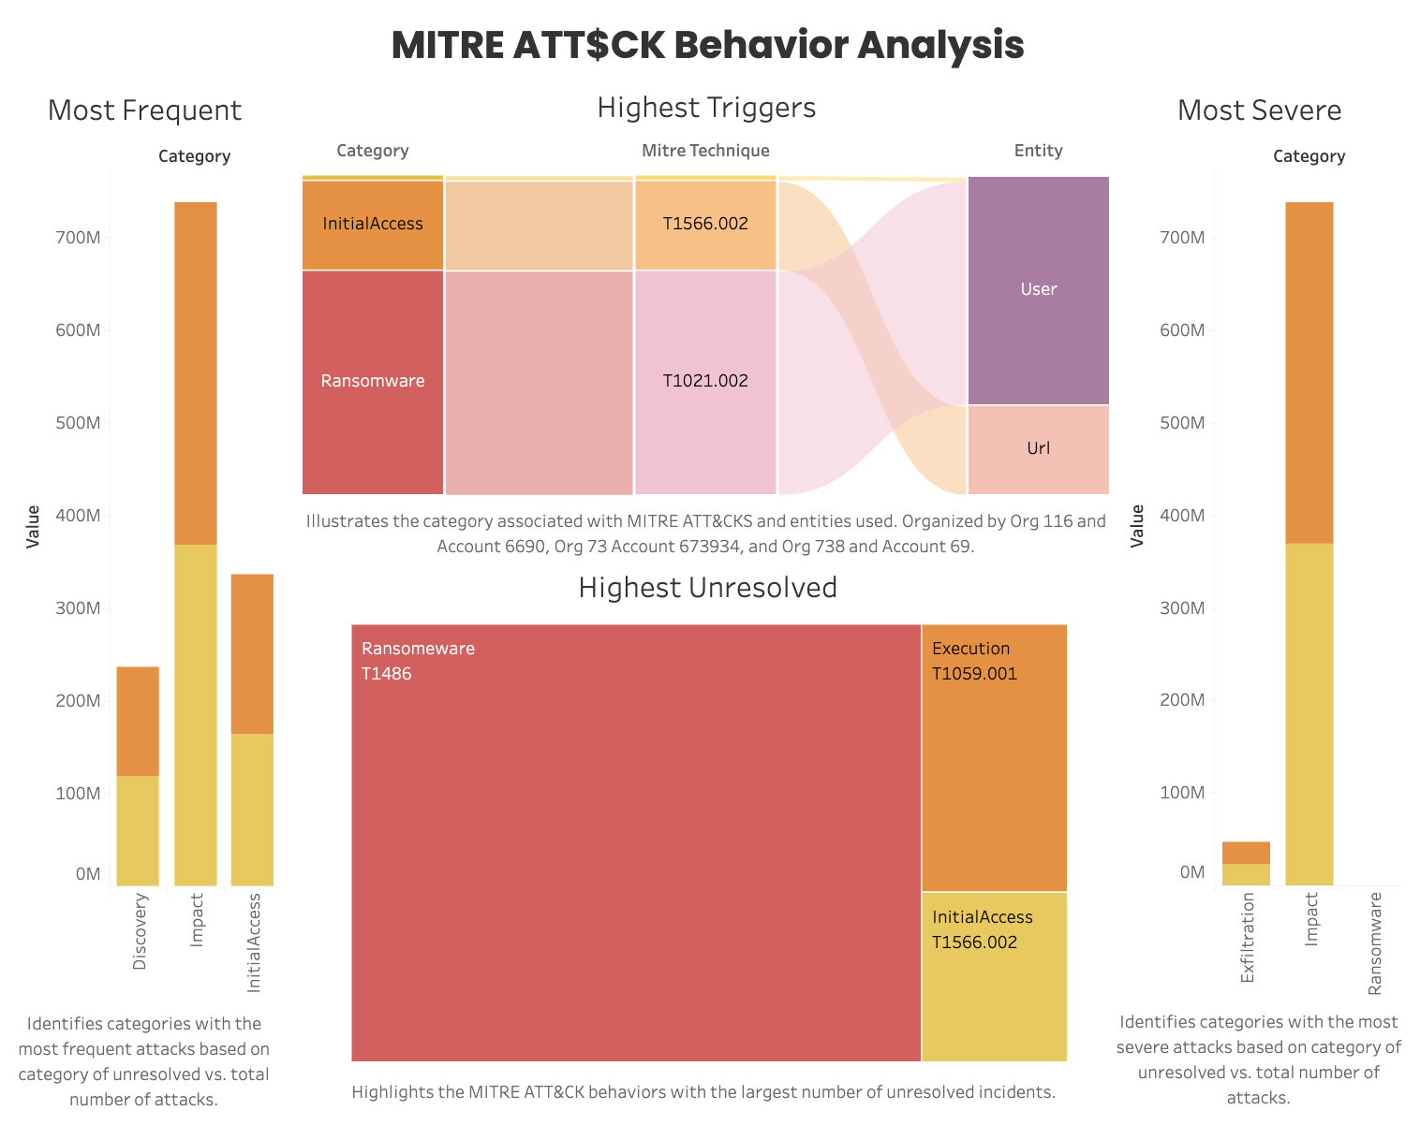

Slide 11
Dashboard 2 Findings
Frequent techniques include T1486 (Ransomware), T1566.002 (Phishing), and T1059.001 (PowerShell)
Some organizations showed repeated occurrence of the same technique
Multiple high-severity alerts mapped to execution and ransomware categories
Patterns suggest targeted or automated attempts

Slide 12
Risk & Audit Observations
High-risk accounts triggered 3+ high-severity alerts per week, indicating potential security threats
Clusters of unresolved alerts in organizations 738, 73, and 116 reveal gaps in incident response controls
Off-hours access spikes suggest possible automated attacks or unusual insider activity
Frequent MITRE ATT&CK techniques (T1486, T1566.002, T1059.001) highlight repeated attack patterns
Near-instant alert occurrences indicate scripted or automated attack behavior

Slide 13
Recommendations
Implement stricter controls and continuous monitoring for accounts generating repeated high-severity alerts
Enhance incident triage to reduce unresolved alerts and strengthen response processes
Increase off-hours monitoring to detect automated attacks or suspicious insider behavior
Map alerts to MITRE ATT&CK techniques for proactive threat detection and compliance alignment
Conduct follow-up investigations on flagged accounts to remediate potential security risks
Strengthen internal logging, alert correlation, and reporting to improve auditability and risk mitigation

Slide 14
Conclusion
This project demonstrates:
Threat behavior analysis
Pattern detection
MITRE ATT&CK skill
Dashboard design
Audit-style reporting
Real-world security thinking

Slide 15
Links
Kaggle Data Source:
https://www.kaggle.com/datasets/Microsoft/microsoft-security-incident-prediction
GitHub Repository:
https://github.com/LaniNguyen1/cybersecurity-incident-analysis
Tableau Dashboards:
https://public.tableau.com/app/profile/lani.nguyen7732/viz/AnalyzingSecurityIncidentLogstoDetectPotentialCyberThreats/Dashboard4#1

Slide 16
Cyber Security Incident Analysis
Identifying High-Risk Accounts, Anomaly Patterns & MITRE ATT&CK Behaviors
By: Lani Nguyen

